Slide 1
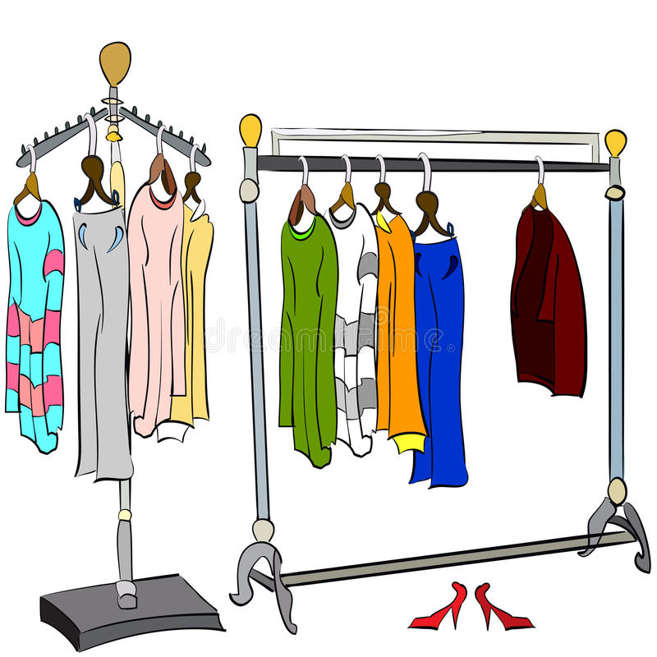
The 22nd of April.
Class work
theme: Clothes

Slide 2
On / Off
Put on your … - Надень …
Take off your … - Сними …

Slide 3
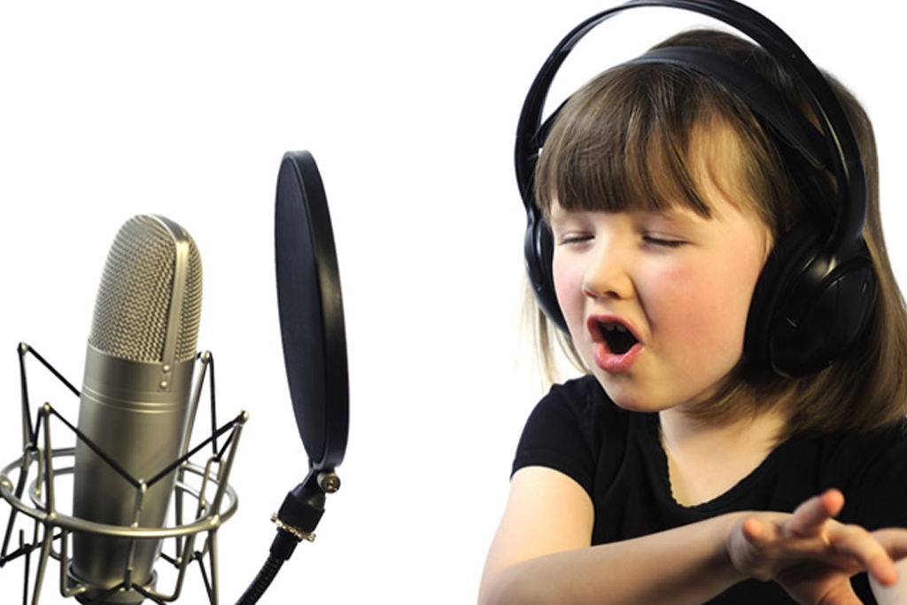
https://supersimple.com/song/put-on-your-shoes/

Slide 4

What are you wearing?

Slide 5

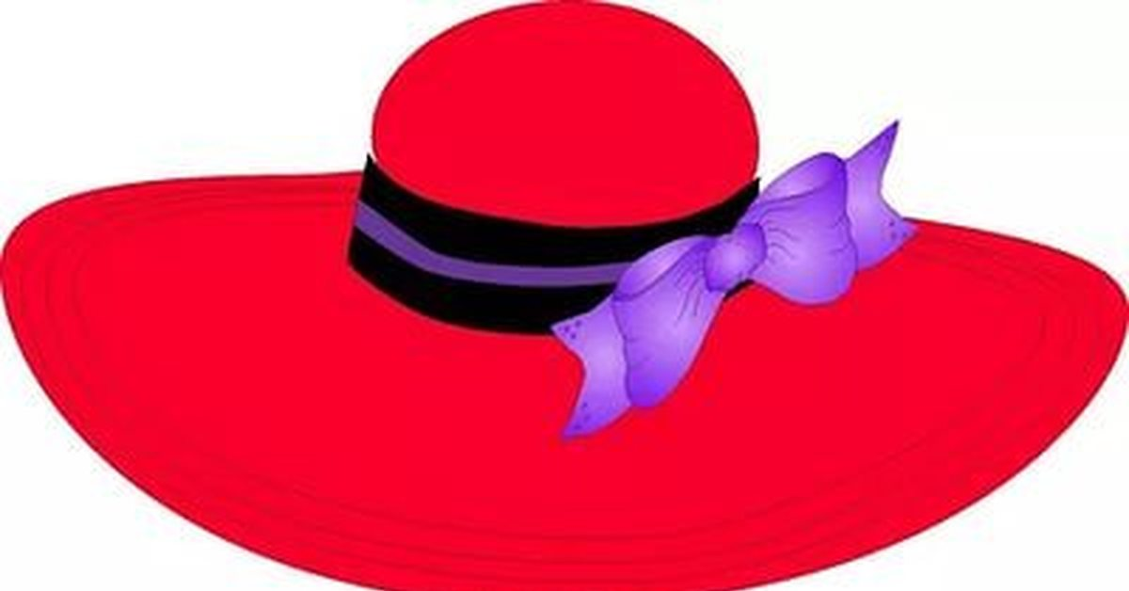
a hat

Slide 6

a cap

Slide 7
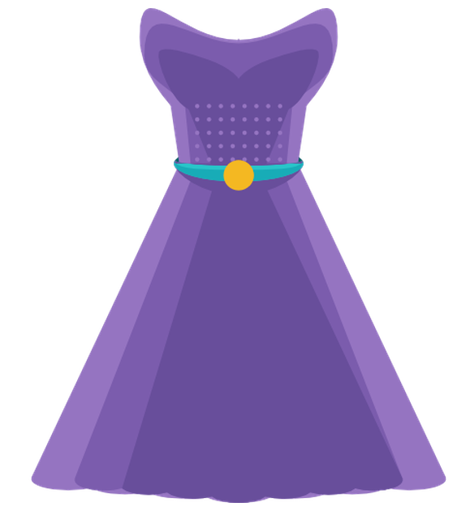
a dress

Slide 8
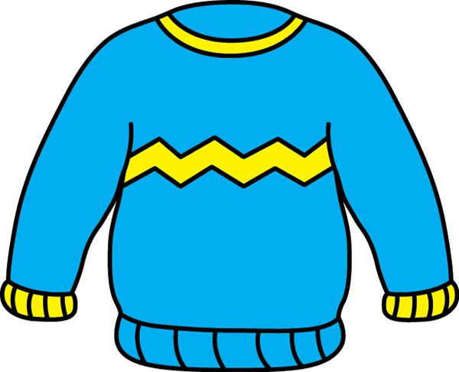
a jumper

Slide 9
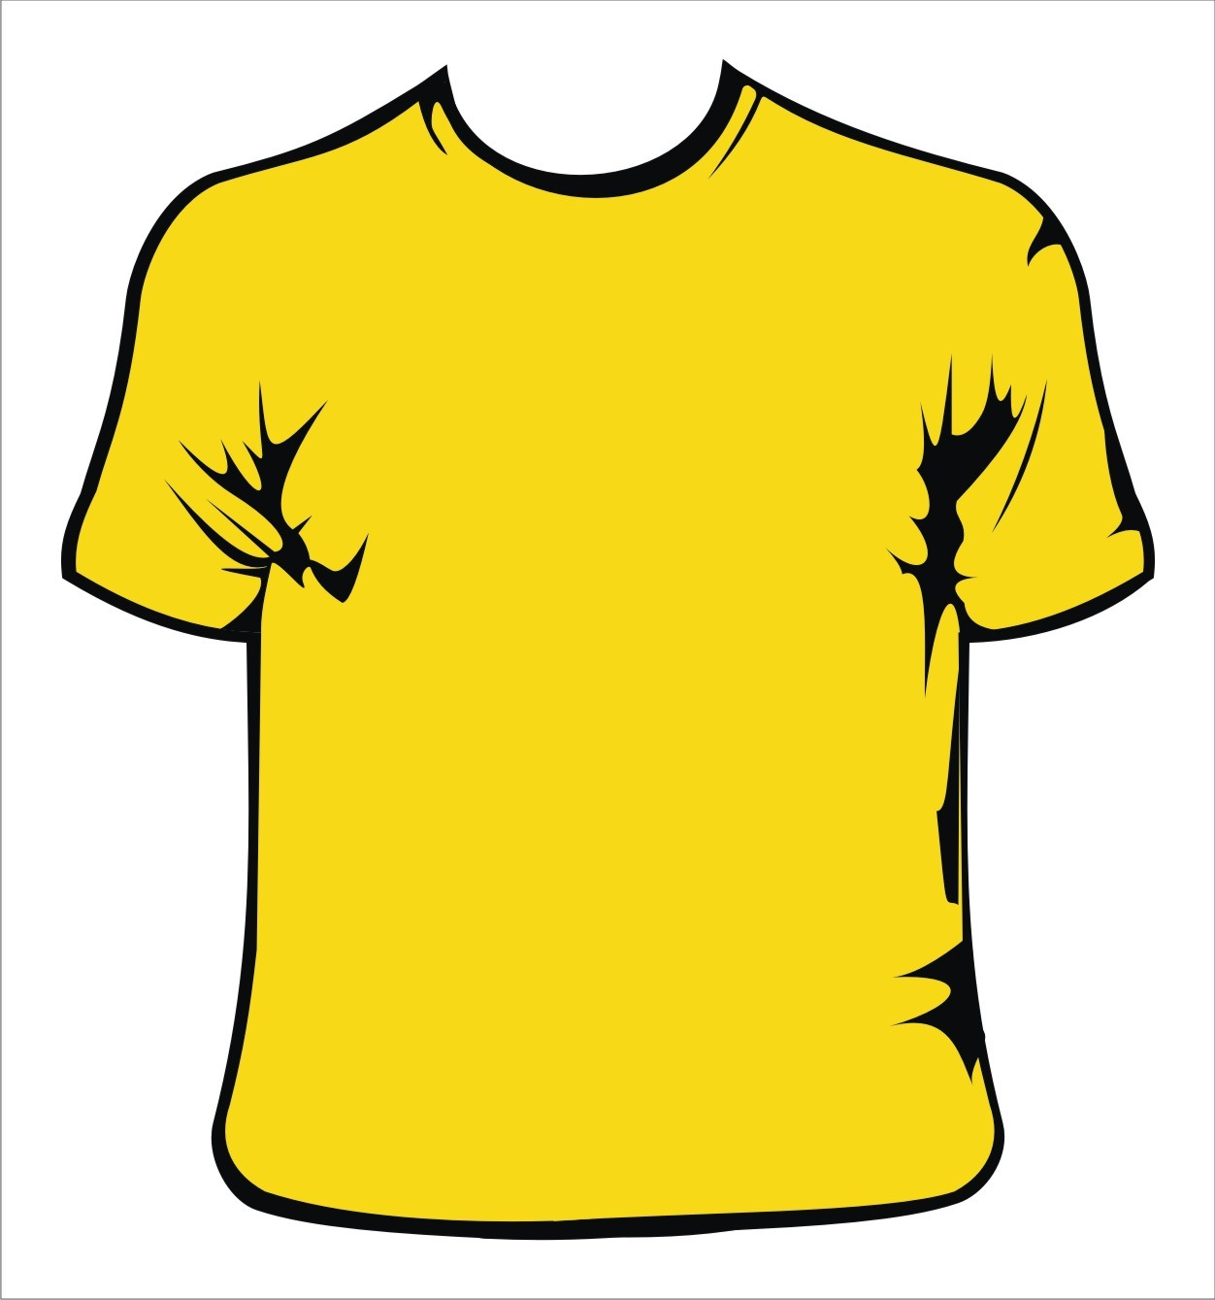
a T-shirt

Slide 10
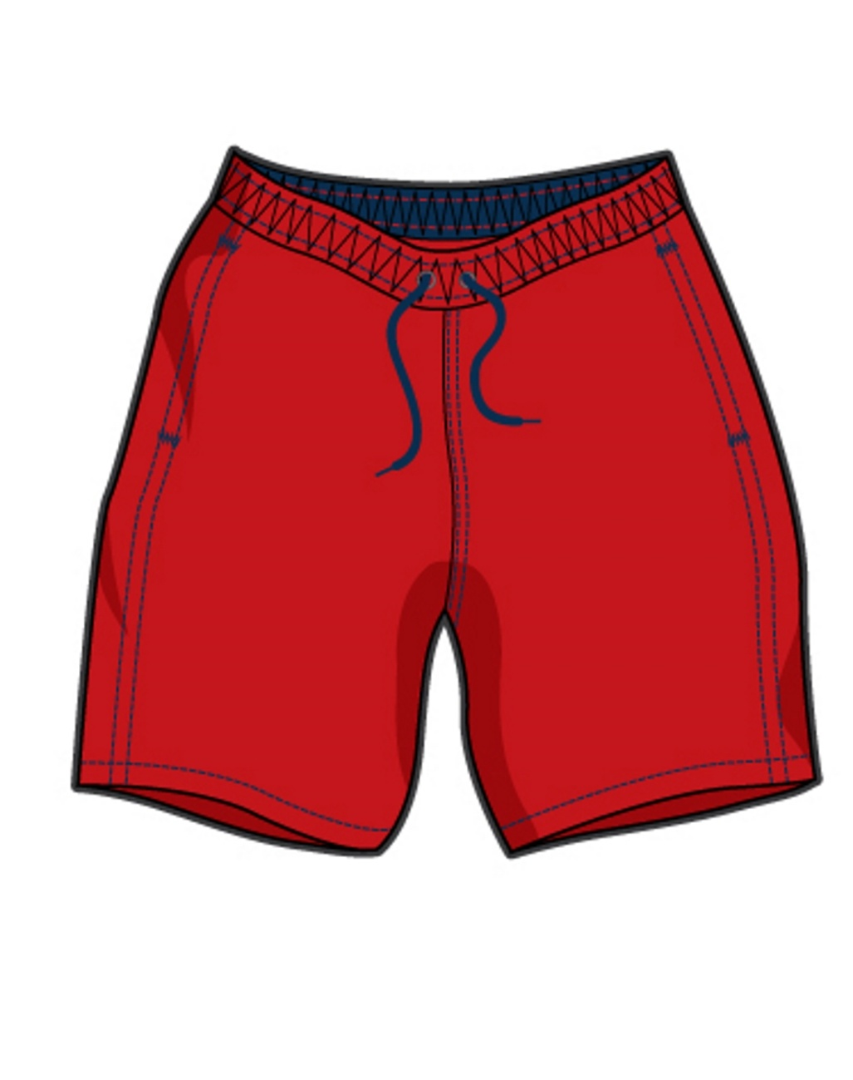
shorts

Slide 11
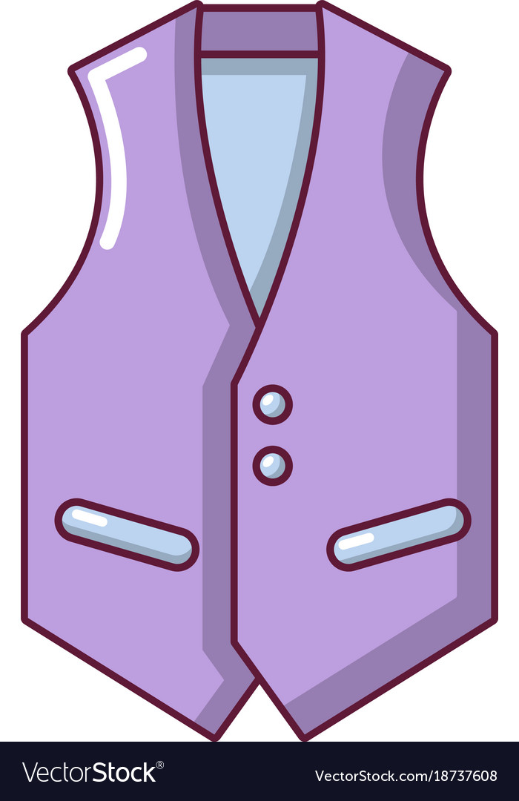
a vest

Slide 12
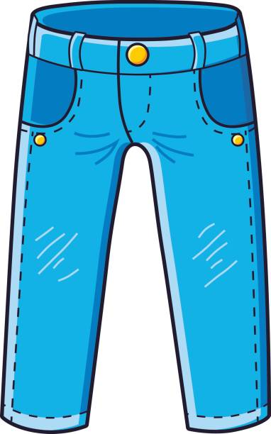
jeans

Slide 13
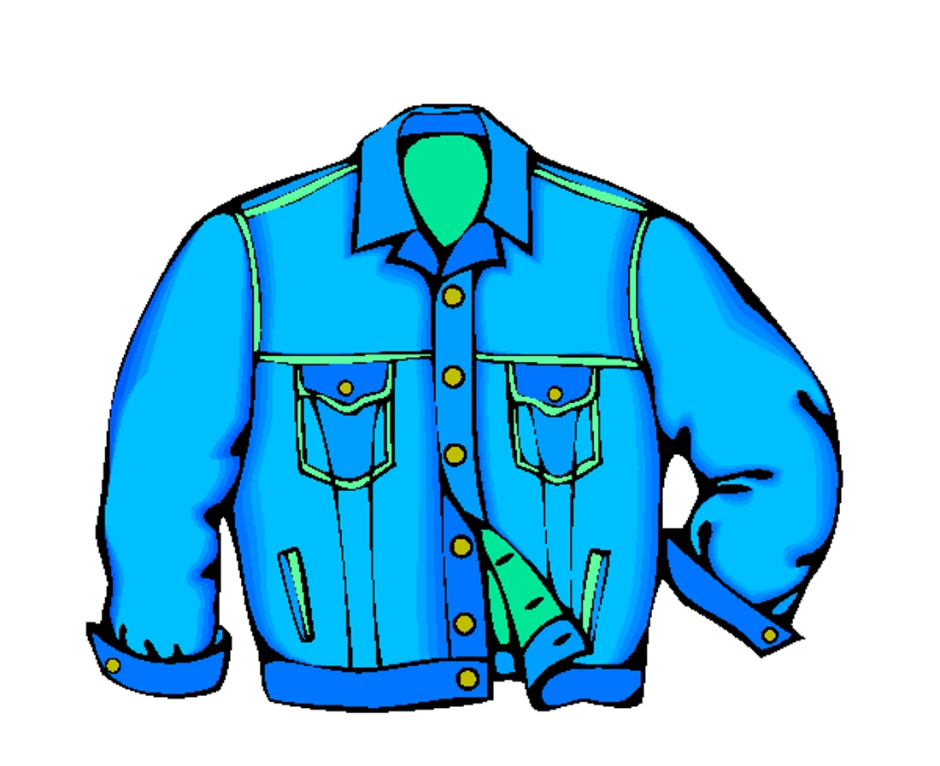
a jacket

Slide 14
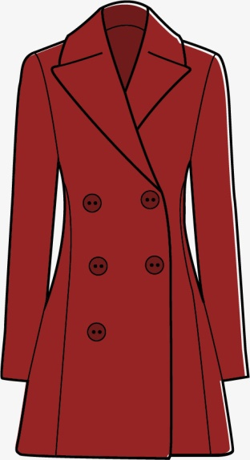
a coat

Slide 15
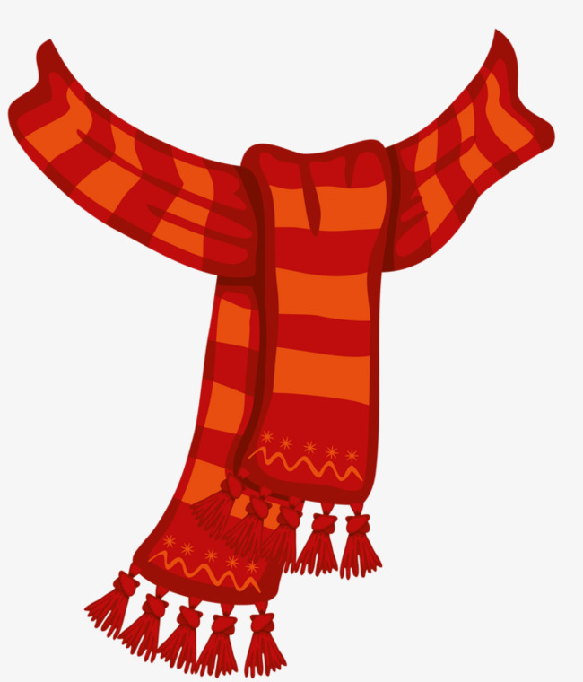
a scarf

Slide 16
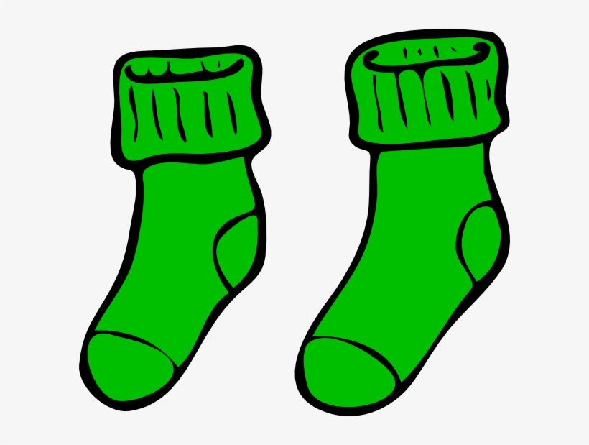
socks

Slide 17

boots

Slide 18
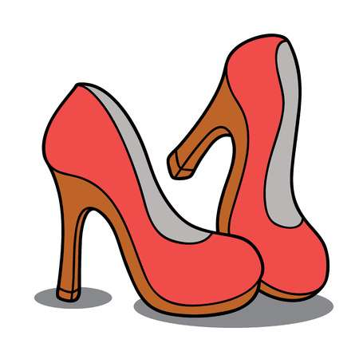
shoes

Slide 19
I’m wearing … На мне надето …
She’s wearing … На ней надето …
He’s wearing … На нем надето …

Slide 20


Slide 21
Выбери предмет одежды на экране https://en.islcollective.com/video-lessons/clothes-despicable-me-2 https://en.islcollective.com/video-lessons/what-she-he-wearing-today

