Slide 1
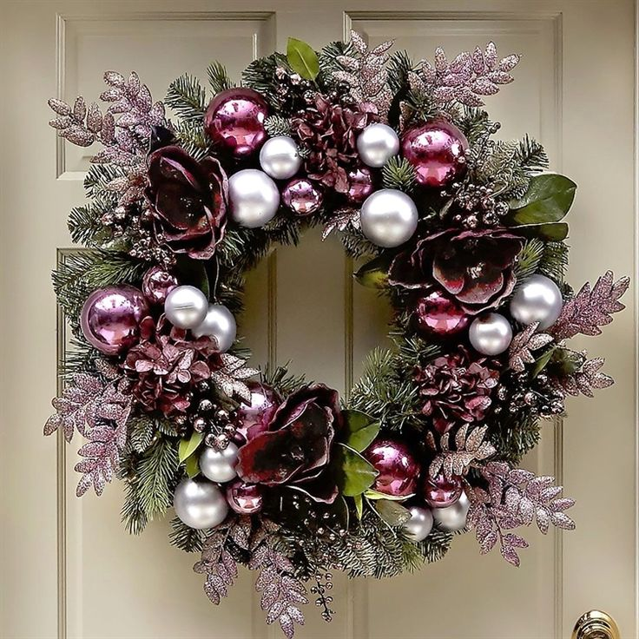
What do you know about Christmas?

Slide 2
When is Christmas celebrated in Europe?
- on the 7th of January
- on the 25th of December
- on the 31st of December

Slide 3
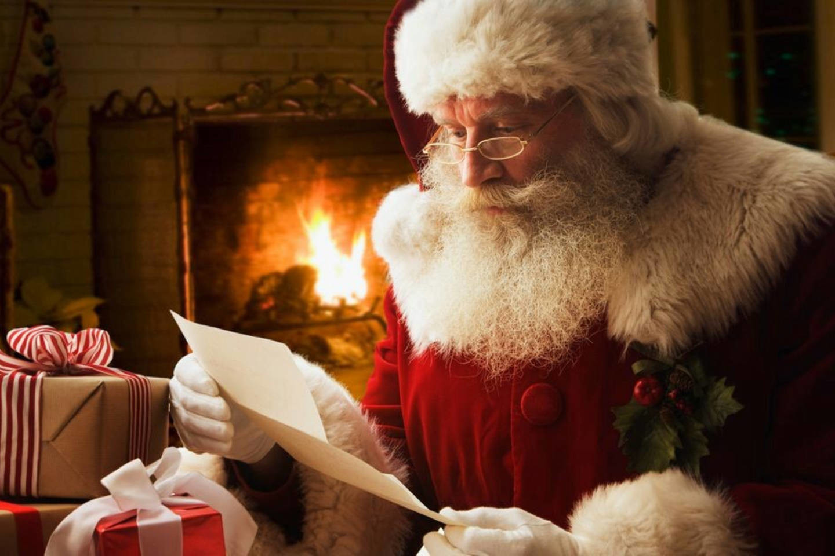
Whose birthday is celebrated on Christmas?
- Queen Victoria
- Jesus Christ
- Santa Claus

Slide 4
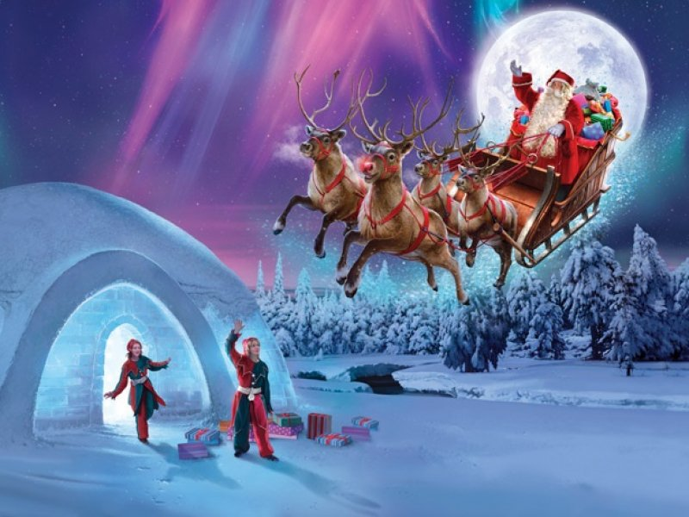
When was Santa Claus created?
- about 150 years ago
- about 2000 years ago
- about 300 years ago

Slide 5
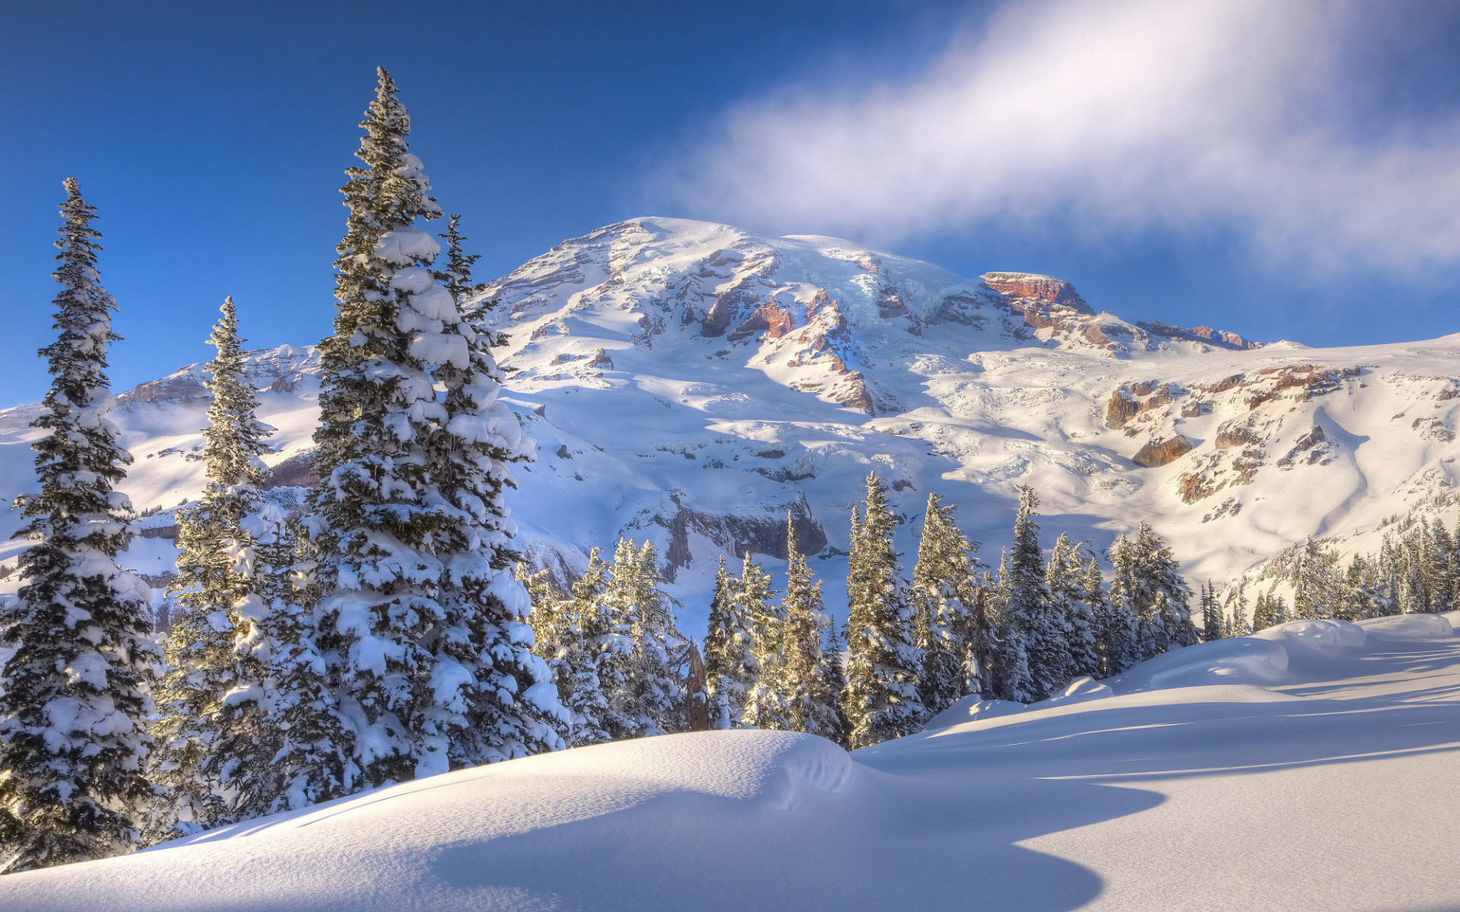
What country gave us the tradition to decorate the Christmas tree?
- Norway
- Italy
- Germany

Slide 6
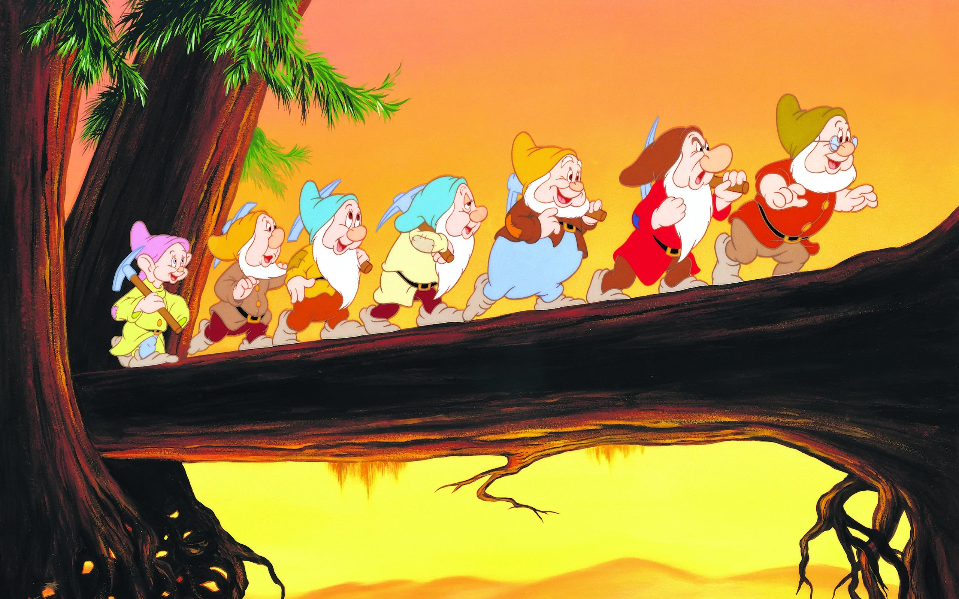
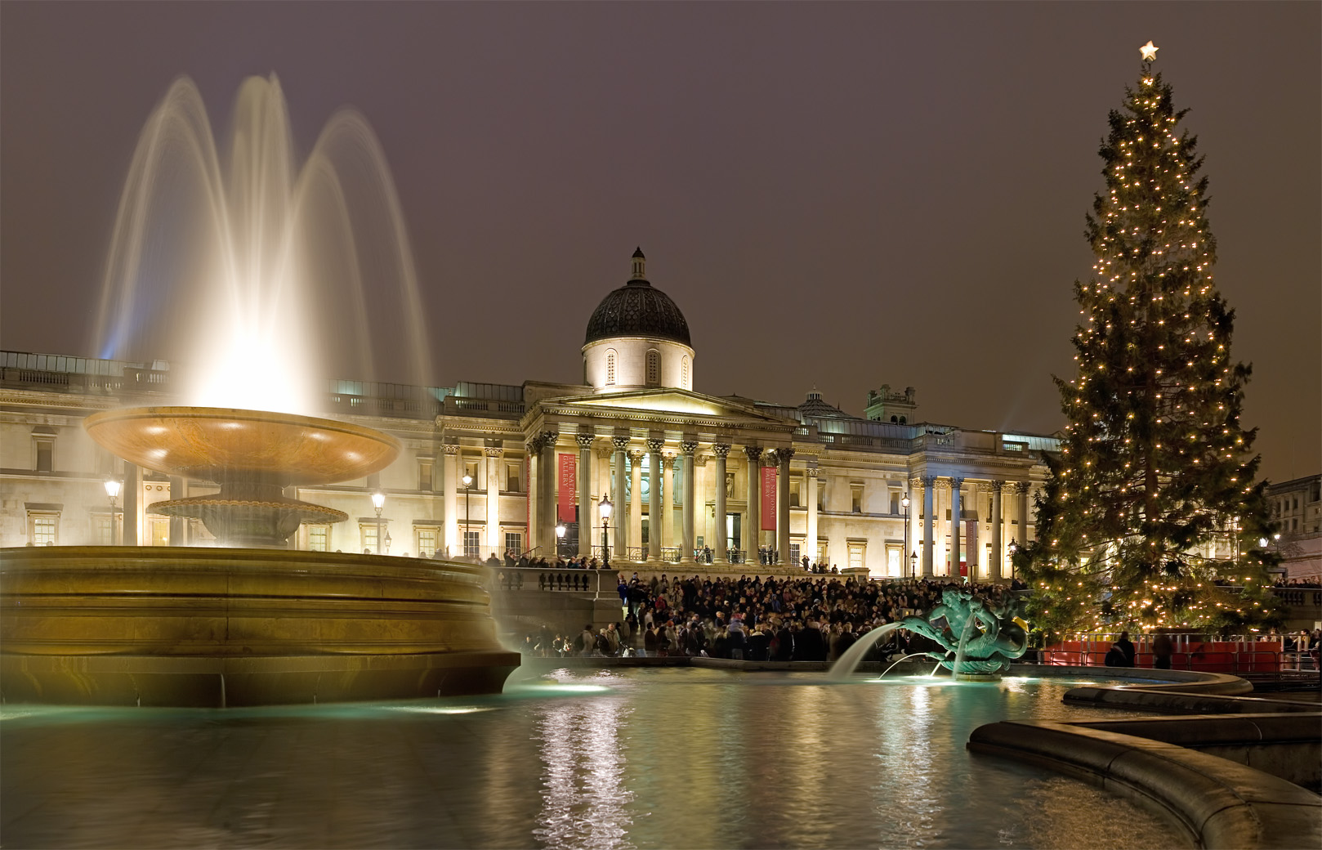
Where does the most famous Christmas tree stand in London?
- in front of Buckingham
Palace
- in Trafalgar Square
- in Piccadilly Circus

Slide 7
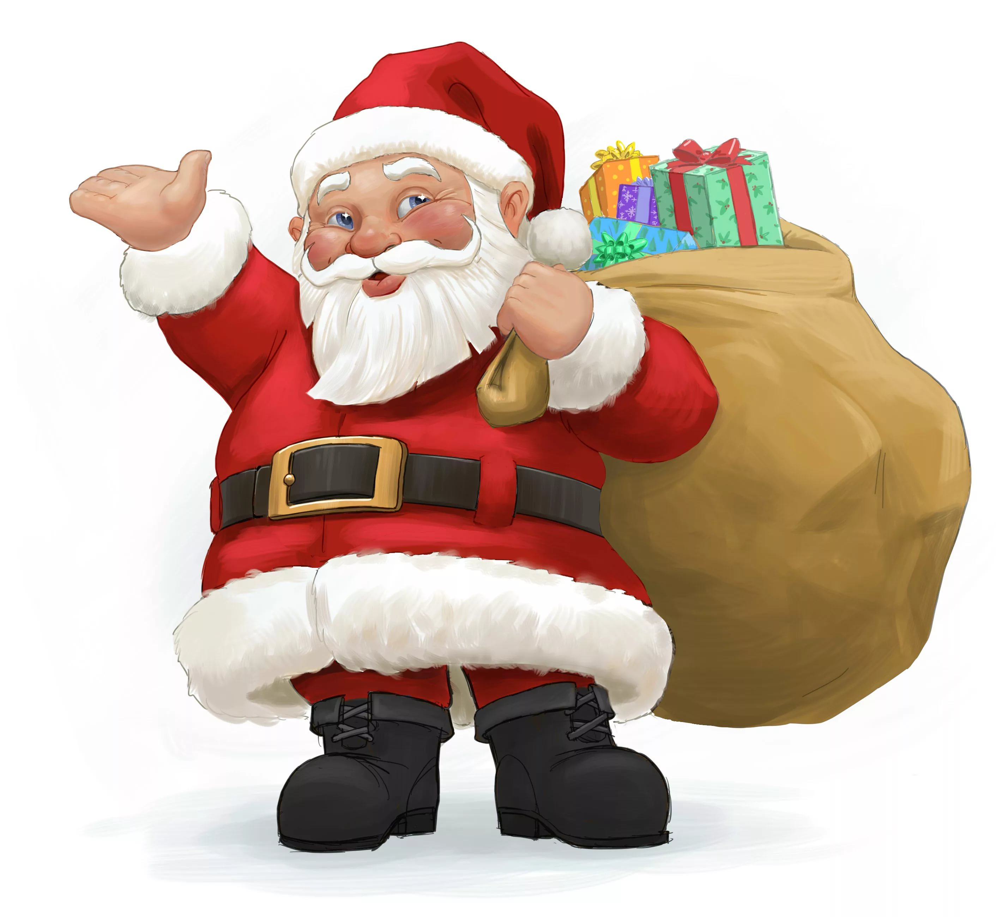
What do people call Father Frost in the west?
- Santa Claus
- Frost - Red Nose
- Grandfather Frost

Slide 8
What does Santa Claus look like?
- is dressed in white
- fat and merry
- thin and unhappy

Slide 9
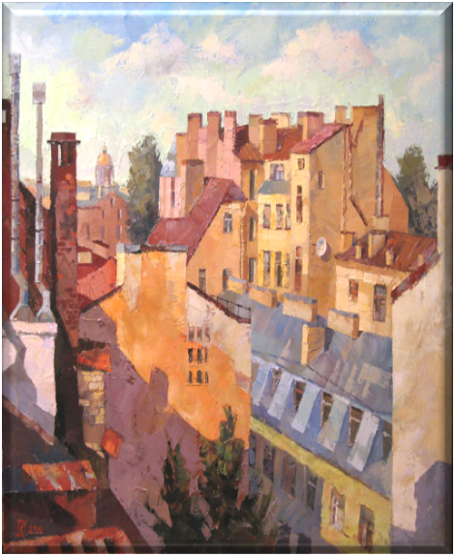
How does Santa Claus enter the houses to give children Christmas presents??
- through the window
- knock at the door
- climb down the chimney

Slide 10
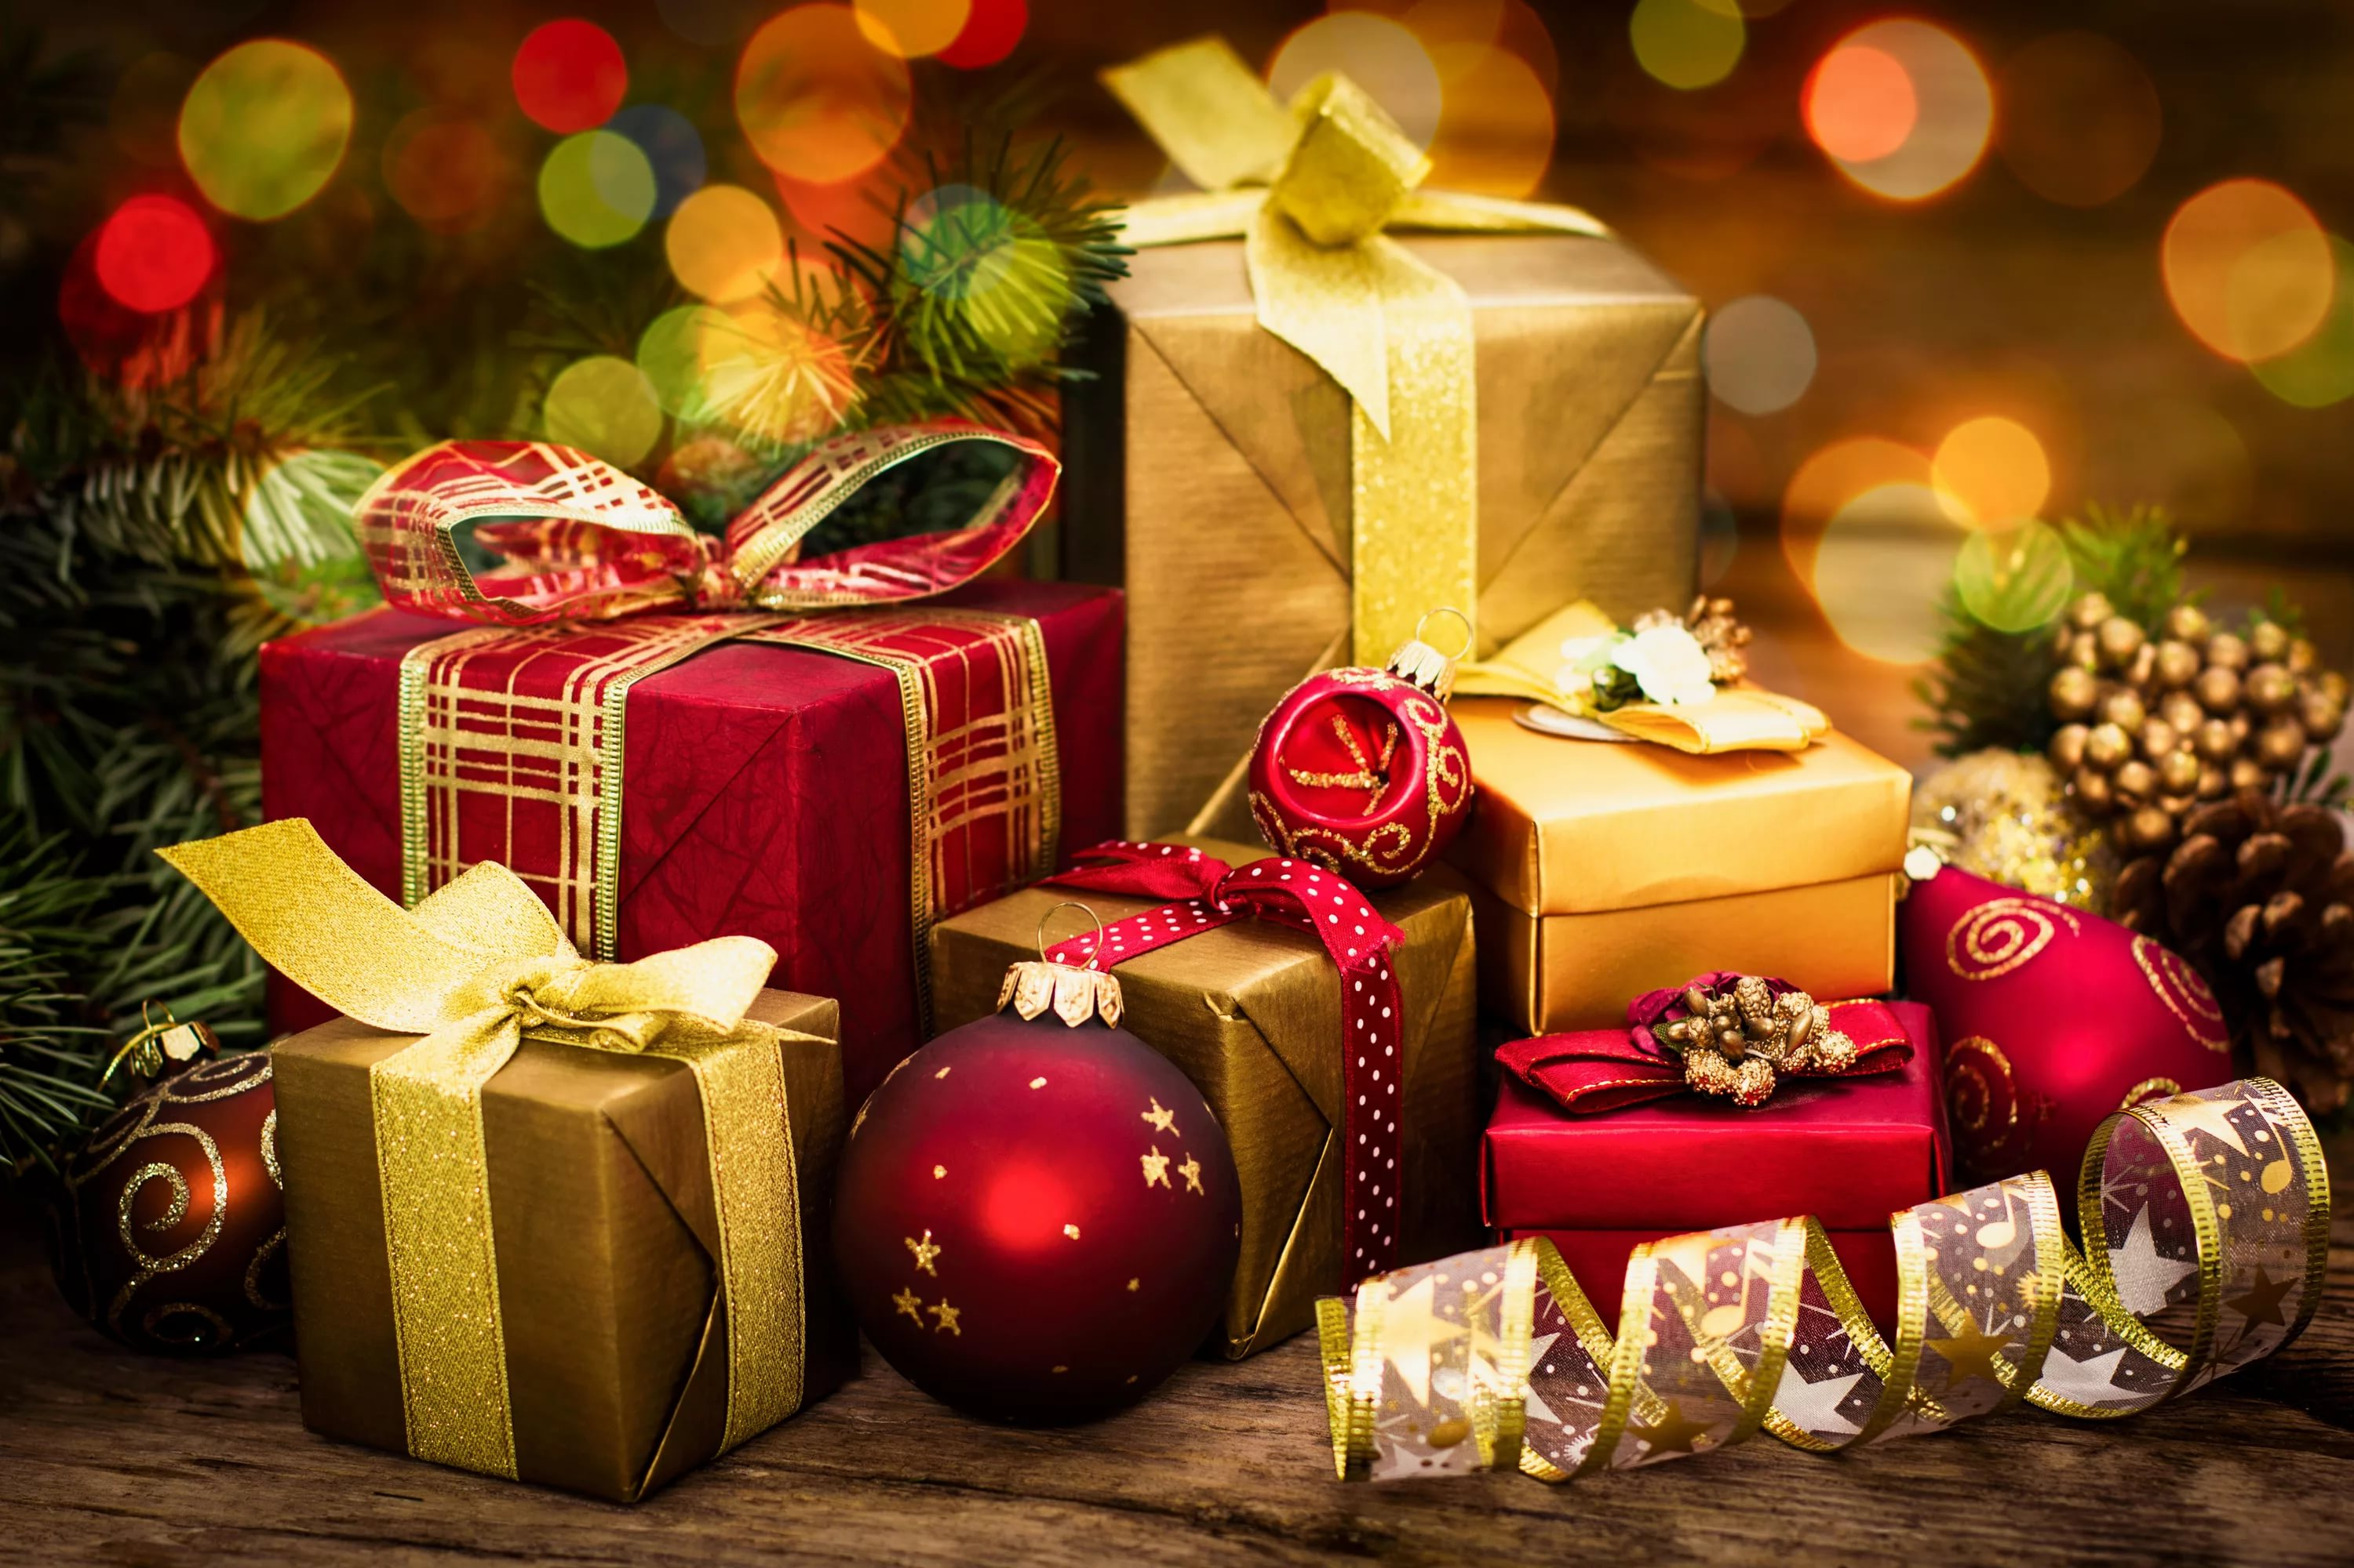
Where does Santa Claus put Christmas presents?
- under the Christmas
tree
- in long socks called
“Christmas stockings”
- in colourful boxes

Slide 11
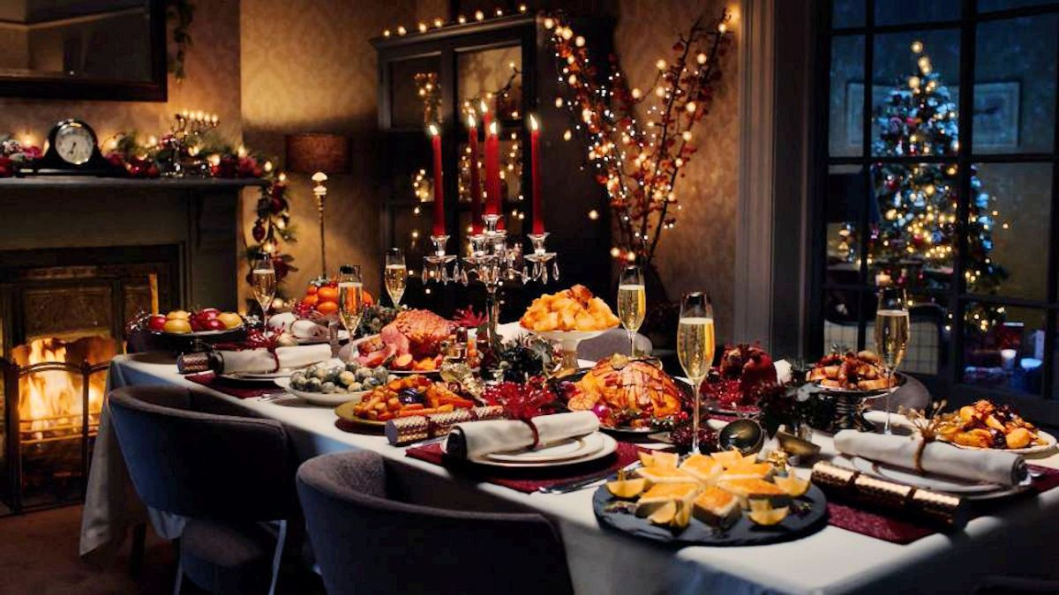
What is the traditional Christmas food?
- a roast chicken
- some vegetables
- a roast turkey and Christmas
pudding

Slide 12
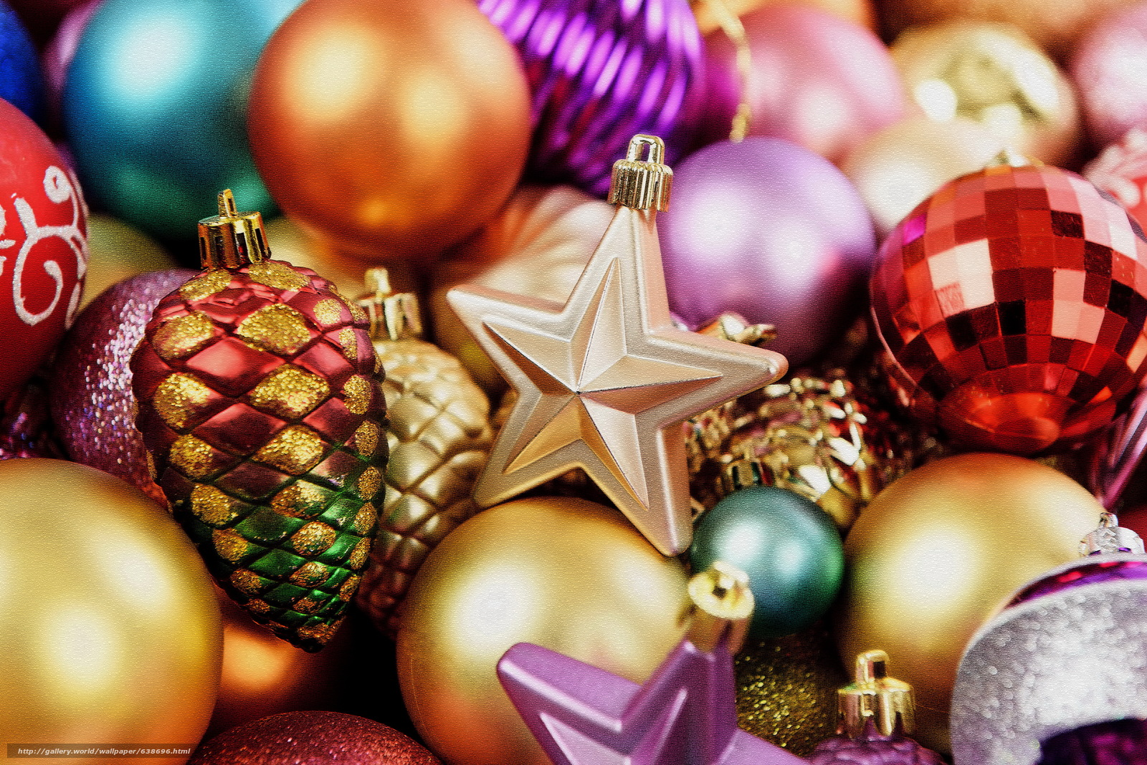
How do British people decorate their houses at Christmas?
- with tinsel and candles
- with angels and stars
with such plants as holly,
mistletoe and ivy

Slide 13
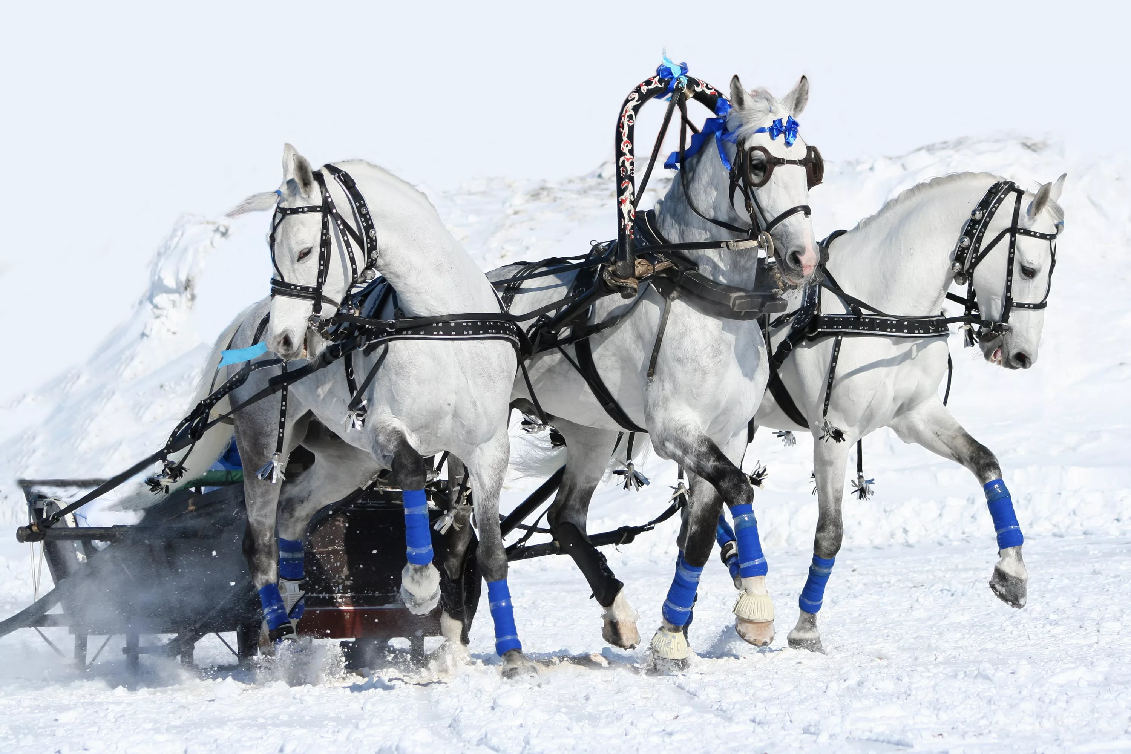
How does Santa Claus travel?
- by horses
- on a sleigh pulled by reindeer
- on foot

Slide 14
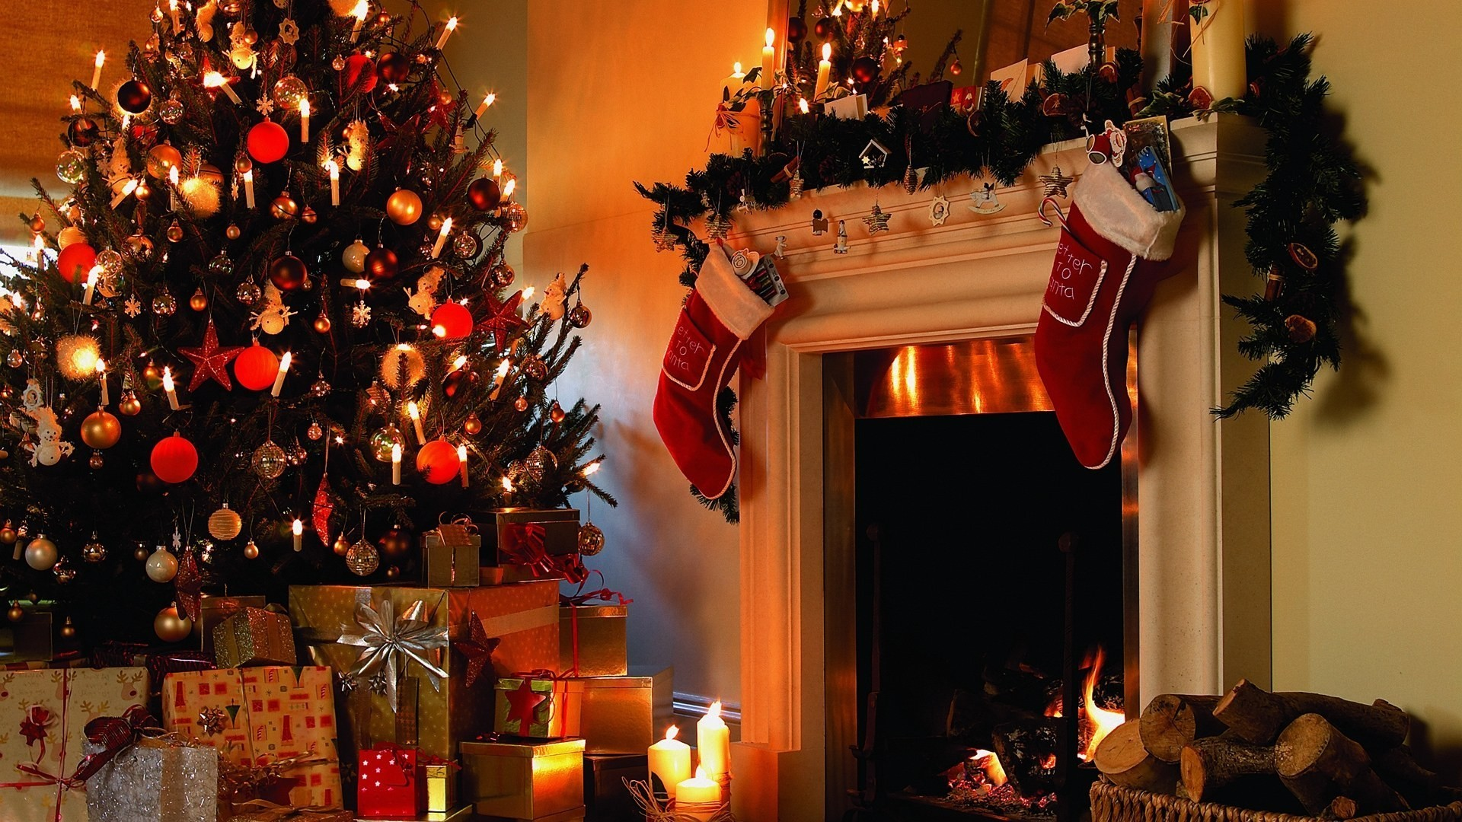
What do British people put on the top of the fur tree?
- an angel
- a star
- a figure of Santa Claus

Slide 15
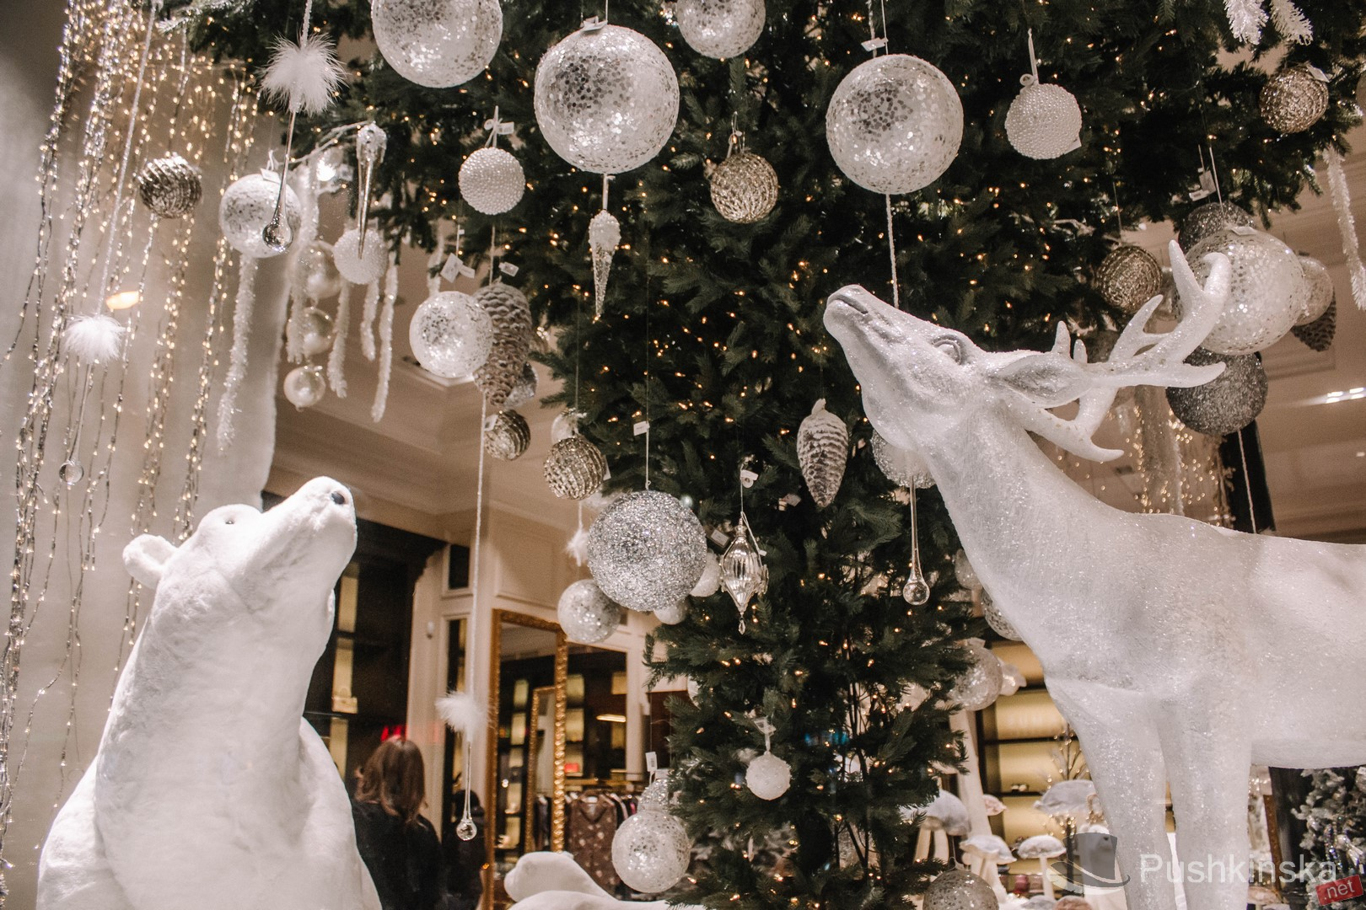
What do British people traditionally do at the start of Christmas meal??
- give presents to each other
- set off crackers
- sing carols

Slide 16
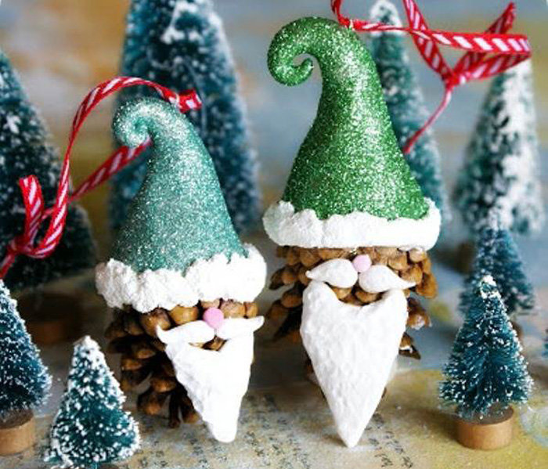
How does Santa Claus spend most of the year??
- in his workshop making toys
- in his Ice Palace reading children’s
letters
- in his sleigh visiting a lot of shops

Slide 17
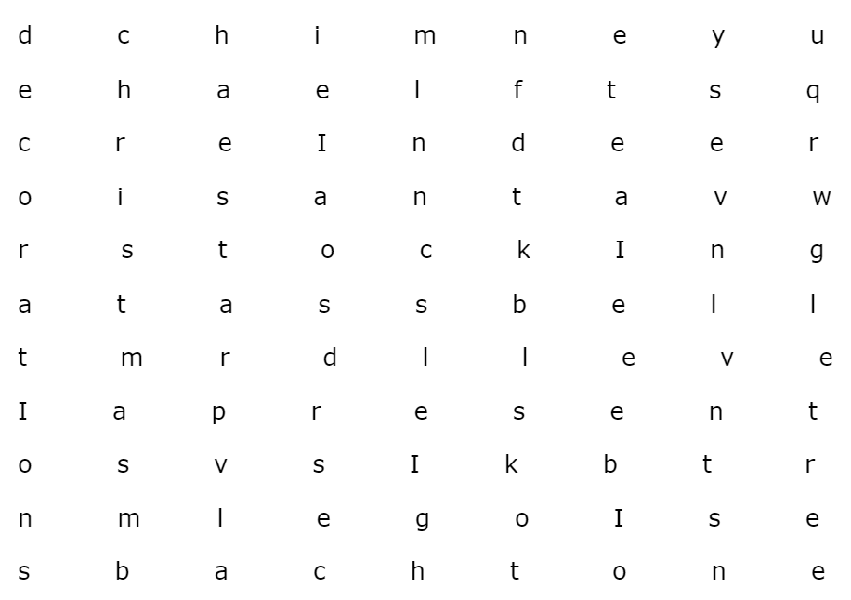
Find 10 Christmas words and write them down

Slide 18
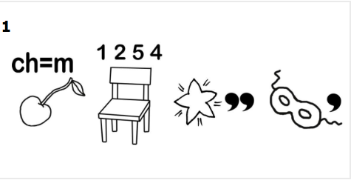

Slide 19
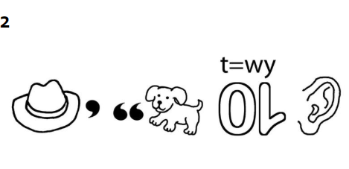

Slide 20
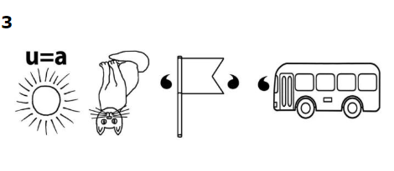

Slide 21
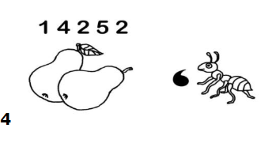

Slide 22
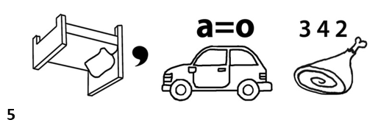

Slide 23
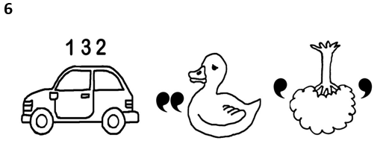

Slide 24
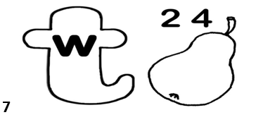

Slide 25
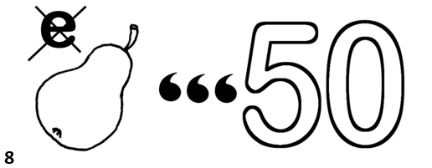

Slide 26
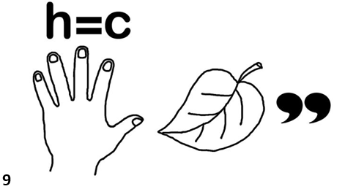

Slide 27
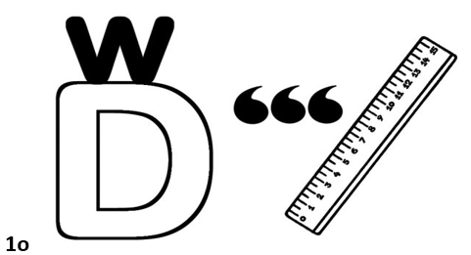

Slide 28
the keys
1. On the 25th of December 12. on a sleigh pulled by reindeer
2. Jesus Christ 13. an angel
3. About 150 years ago 14. set off crackers
4. Germany 15. in his workshop making toys
5. In Trafalgar Square
6. Santa Claus
7. Fat and merry
8. Climb down the chimney
9. In long socks called “Christmas stockings”
10. A roast turkey and Christmas pudding
11. With such plants as holly, mistletoe and ivy

Slide 29
the keys
1. Chimney 1. Merry Christmas
2. Reindeer 2. Happy New year
3. Stocking 3. Santa Claus
4. Bell 4. present
5. Present 5. decorate
6. Decoration 6. cracker
7. Christmas 7. winter
8. Sleigh 8. party
9. Star 9. candle
10. Tree 11. wonder

