Slide 1
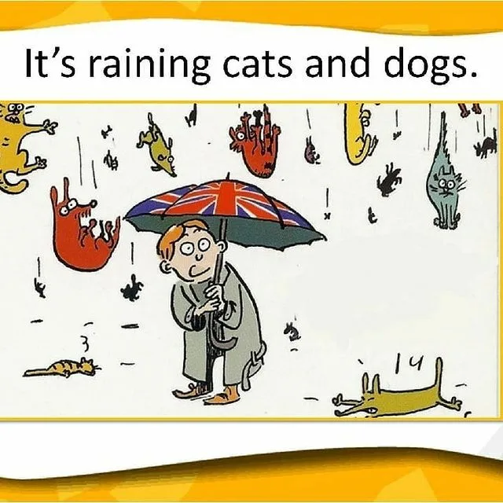
Typical Weather in britain
Земченкова Татьяна Владимировна,
учитель английского языка
ВКК СК им. Ф.Ф.Слипченко, Волгоград, 2021г.

Slide 2
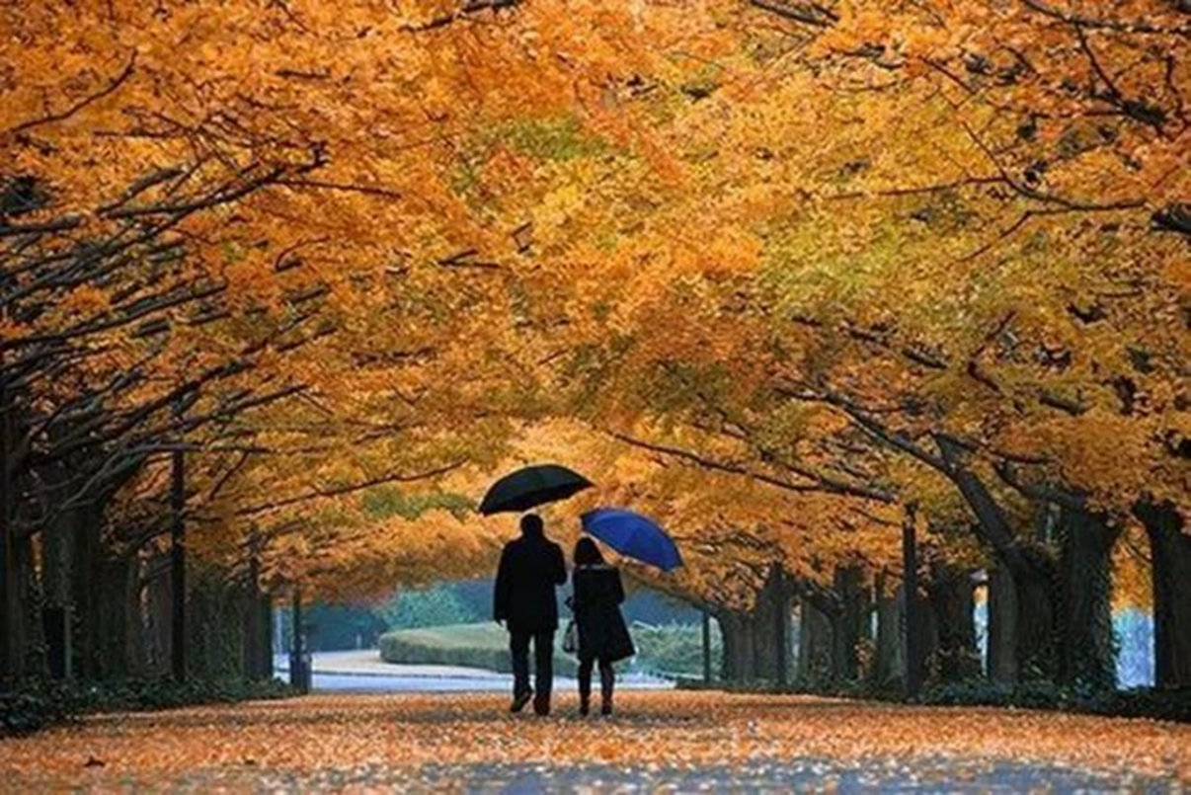
It’s a nice day today, isn’t it?
Warm up
What’s the weather like today?
Is it a typical weather for this season?
Do you like the weather today?
homework
Ex. 2 p. 47
Ex.16 p. 8

Slide 3
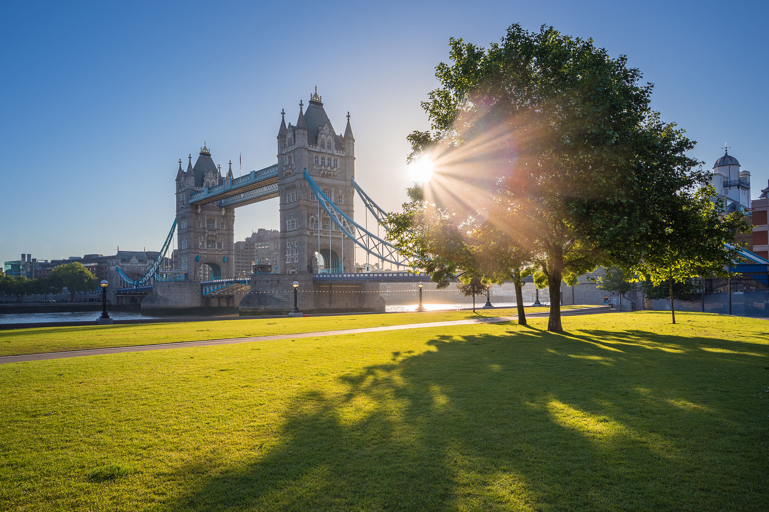


Reading skills
Pre-reading
What do you know about British weather?
Let’s read more about it!
Reading
Student’s book p.9 ex. 17. Read the text
What new words and phrases can you see in the text?

Slide 4
Give English equivalents
pass without snow
quite comfortable
rains very heavily
change very quickly
a good way
changeable weather
проходить без снега
вполне комфортная
идет сильный дождь
меняться быстро
хороший способ
изменчивая погода

Slide 5
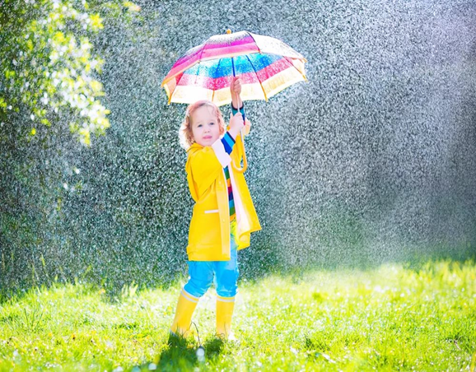
Reading skills
Student’s book p.9 ex. 18.
Mark the sentences True, False, Not Stated.
How many paragraphs are there in the text?
Give each paragraph a title and make a plan for retelling the text

Slide 6
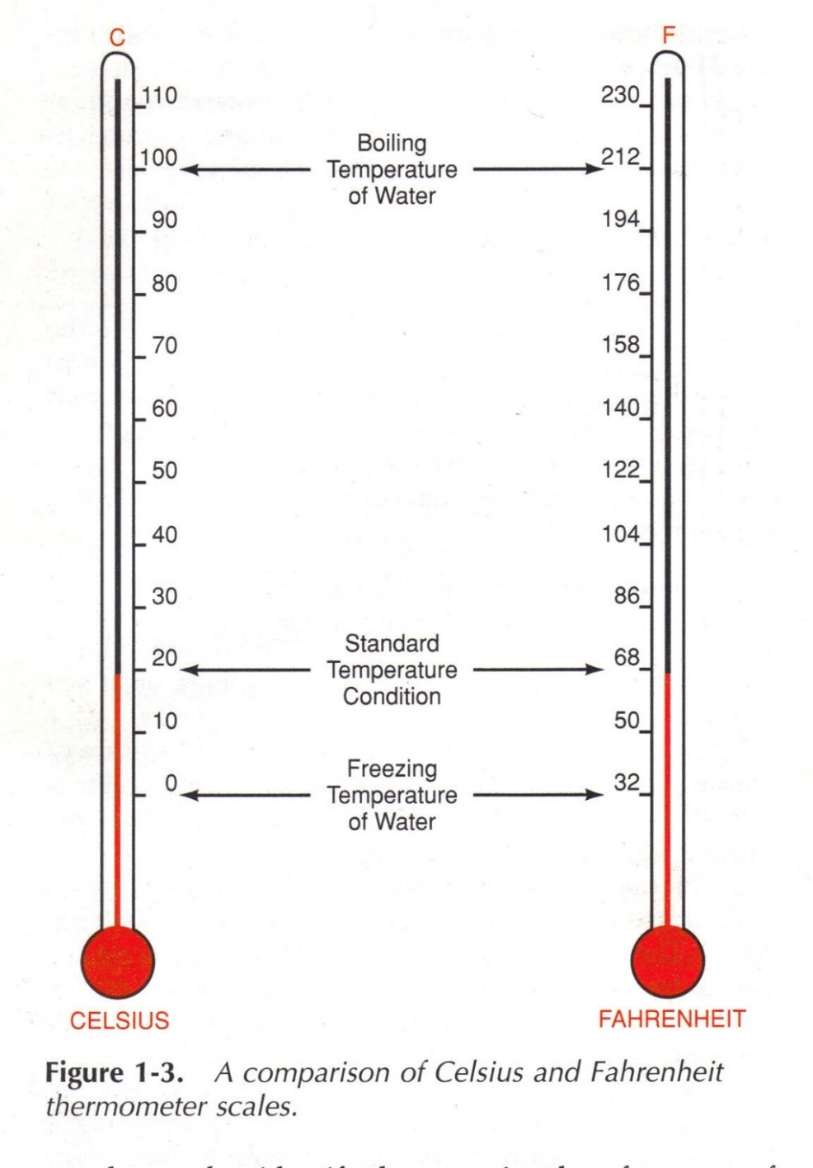
Scales of temperature
Celsius or Fahrenheit?
Student’s book ex. 19 p.9
  Listen and repeat
*Temperature
*Scale
*Degrees
*Minus
*Plus
Can you see the difference?

Slide 7
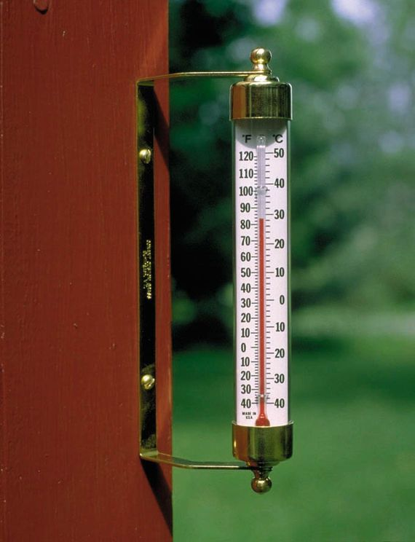
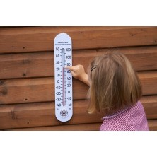
British people have special thermometer
It’s interesting…

Slide 8
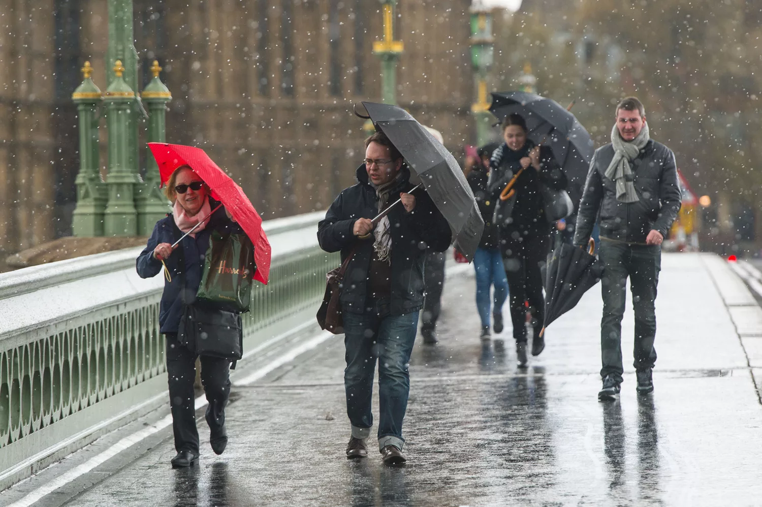
reflexion:
Can you speak about British weather now?
What new have you learnt today?
Hometask:
p. 47 ex. 3 (письменно),
p. 9 ex.17 (устное сообщение по плану)

