Slide 1
“A Long Hard Journey to Somewhere”
Урок английского языка по формированию читательской грамотности
Учитель: Солодовникова Наталья Николаевна

Slide 2

Speak about yourself (“Five Fingers”)
Do you like to travel?
Where did you travel last?
Whom do you usually travel with?
What transport do you usually use while travelling?
Do you feel sick while travelling?

Slide 3
Read the text “A Long Hard Journey to Somewhere”
“Does anybody have grandparents who live in Siberia during the Great Patriotic War?” asked my history teacher.
“Yes, I have”, I said.
“Well, Zanda, could you write an essay about it? Write about what they went through at that time.”
“Er… I will try.” I went home and found Granny was knitting socks. She is 73 years old. In 1943 when she was eight, she was exiled with her parents to Siberia. I asked her to tell me something about it.
“Oh, dear. That was a long time ago. I wonder what I can tell you.”
She thought a while and then she started the story. “It was 64 years ago, a cold winter. We were sitting at home, but suddenly soldiers with weapons came into our home. They ordered us to take only necessary things and follow them. Then soldiers packed us in freight trains, in freezing train cars. And so began a long hard journey to … somewhere, we didn’t know where. Everybody was starving. Many people died. Soldiers just threw them out on the tracks. Then somebody told us that we were being exiled to Siberia,” said Granny.
She continued, “We arrived in Siberia. It was cold and snowing too! We were tired and almost dead from starvation. We had nowhere to go, no houses, no food, no heavy clothes for this cold. We were sent to some families. We approached the houses, and knocked on the doors, but the doors and windows were closed to us. At first, nobody wanted to open their doors to us.”
“Finally, we were sheltered by a kind Siberian woman. Thanks to her, we survived. She said, “Before your arrival, somebody said that you were cannibals!” When my Granny remembered this, her face became sad and her eyes filled with tears.
In 1956, my Granny and her family were allowed to return to Kalmykia. She still remembers that wonderfully kind Siberian woman who did not see us different.

Slide 4
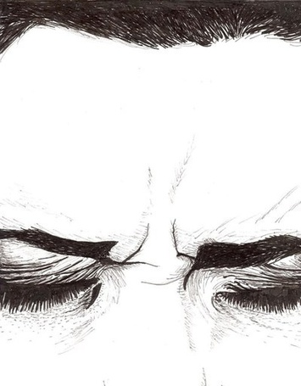
Close your eyes for a moment and try to imagine the story

Slide 5
1. Understanding the Story
What is the main idea of the story? (What is the story about? Who are the main characters of the story? When did the action take place)

Slide 6
2.1 Explain the words in bold or translate them
What does it mean to be exiled?
What is freight?
What do you do when you feel like you are freezing?
When do you need shelter?
What do you do when a stranger approaches you?
Why were the people able to survive?

Slide 7
Check yourself
To be exiled – быть отправленным в ссылку
Freight – грузовой
Freezing – замерзающий, промерзший
Shelter – убежище, приют
To approach - обращаться
To survive – выживать

Slide 8
2.2 Match the words that are opposites
Freezing
Enemies
Dead
Punished
Allowed
Friends
Prevented
Rewarded
Burning
Alive

Slide 9
Check your partner
Freezing
Enemies
Dead
Punished
Allowed
Burning
Friends
Alive
Rewarded
Prevented

Slide 10
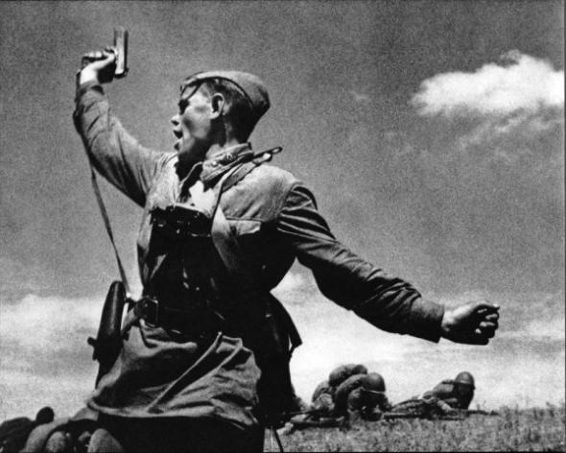
3. Share whatever you know about the Great Patriotic War (1941-1945)

Slide 11
4. Role Play
Young Granny and two soldiers: she asks to stay at home (1)
Young Granny and the mother in the train: the young girl wants food (2)
The young girl and a Siberian woman: the woman offers shelter (3)

Slide 12
5. Homework
Write a summary of the story (15 sentences)

