Slide 1
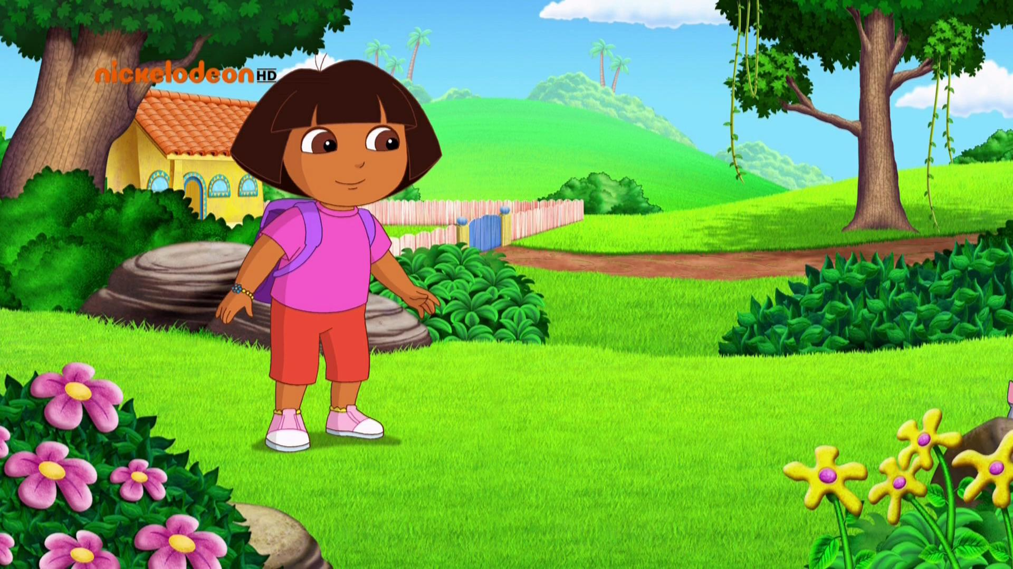
Someone stole Boots!

Slide 2

Now the Map will help us.
Let’s go!

Slide 3
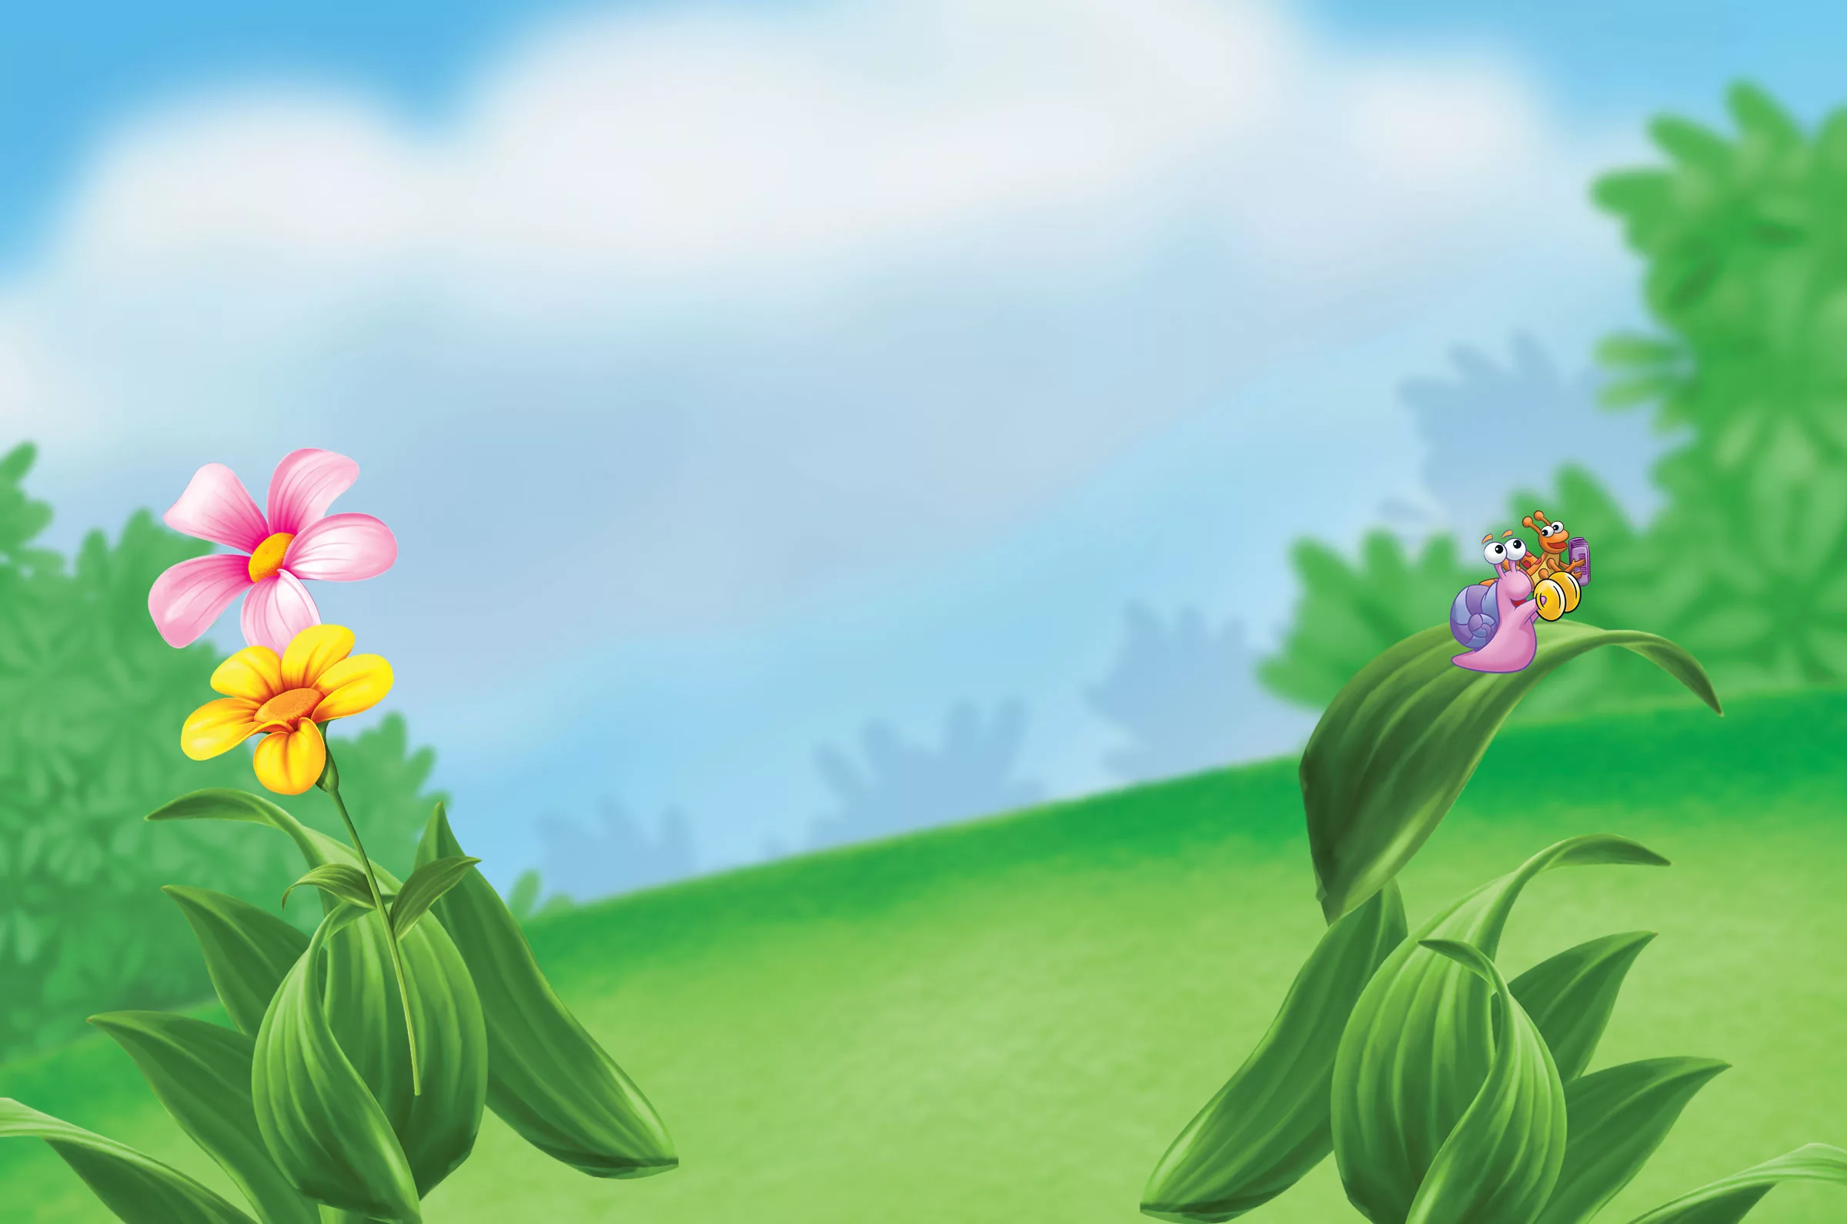
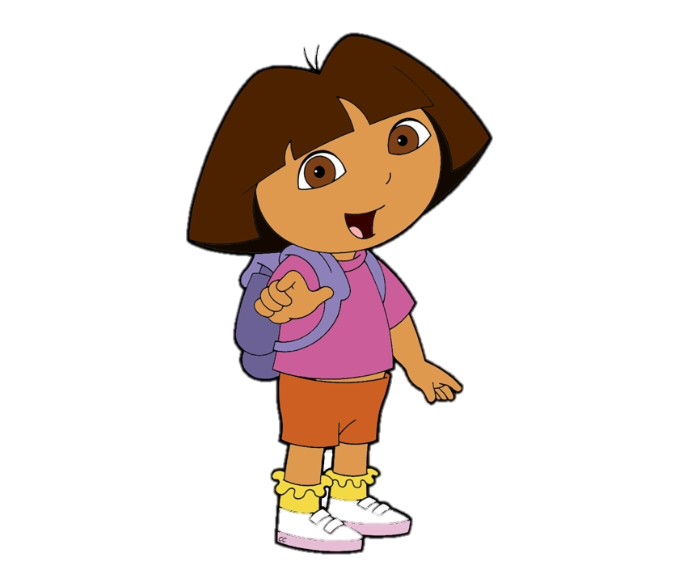
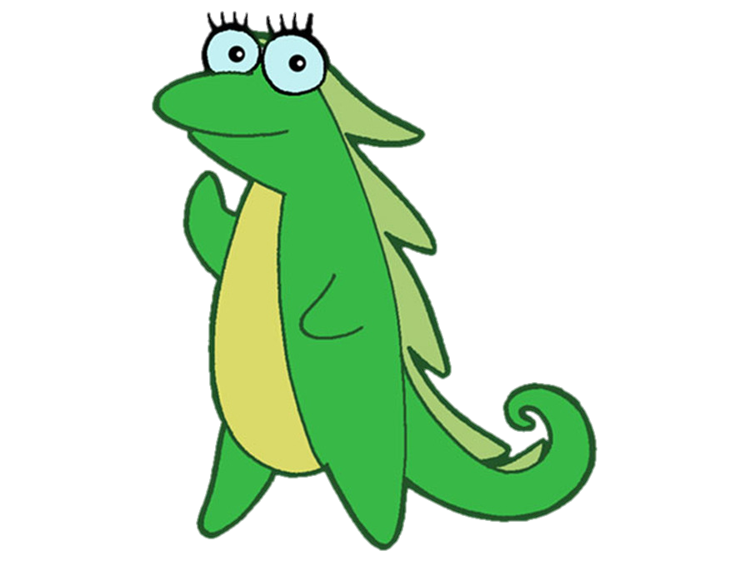
What happened Isa?
I don`t know who I want to be.

Slide 4
Will we help Isa?

Slide 5
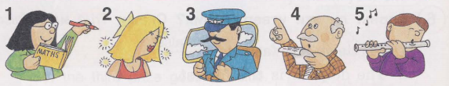
Nice work!
Film star
Musician
Politician
Teacher
Pilot
We need to match the pictures with words.

Slide 6
Let’s go!

Slide 7
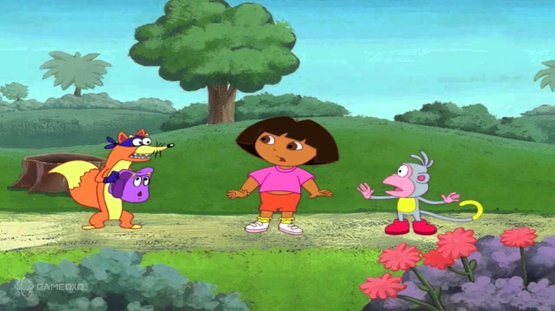
Oh, no! This is Swiper !

Slide 8
He stole my Backpack!

Slide 9
Complete the sentences.
He will be a pilot.
He will be drive a tractor.
He will be a teacher.
He will fly a plain.
He will be a farmer.
He will be teach children.

Slide 10
We found a Backpack!
Let’s go!

Slide 11
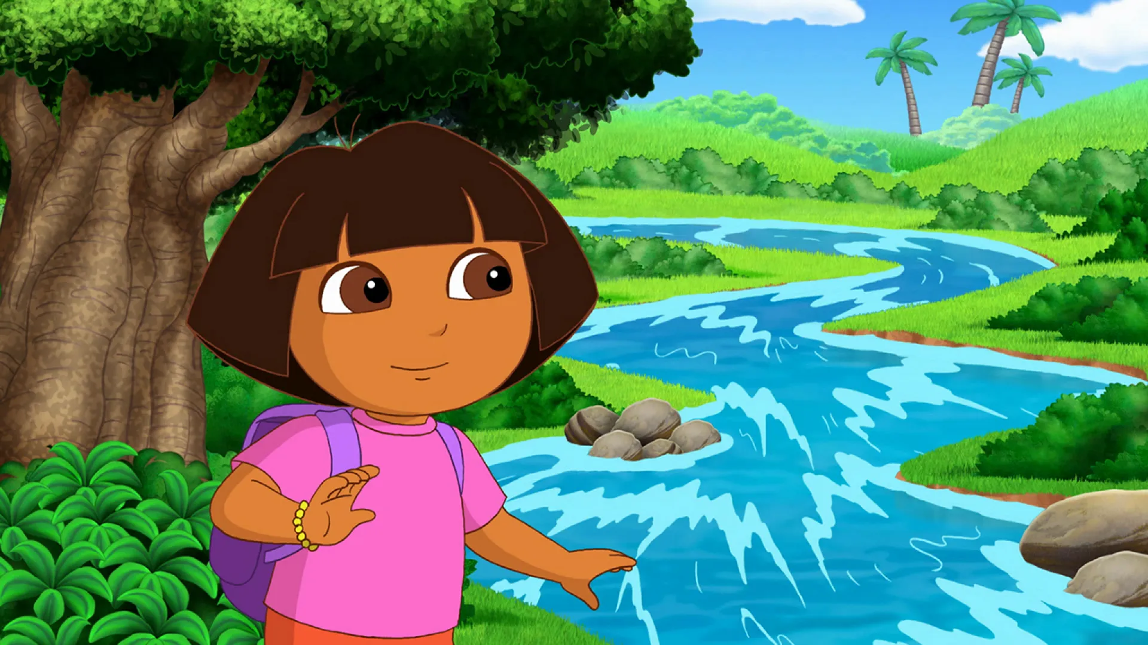
We came to the waterfall.

Slide 12
But we need to get over to the other side.

Slide 13
Complete the sentences.
will be
1. This year I am eight. Next year I … nine.
2. Today it is Friday. Tomorrow it… Saturday.
3. Alice …… win. She fell and won’t be able to catch up with the rest.
will be
won’t

Slide 14
We almost came to the witch`s house.
Let’s go!

Slide 15
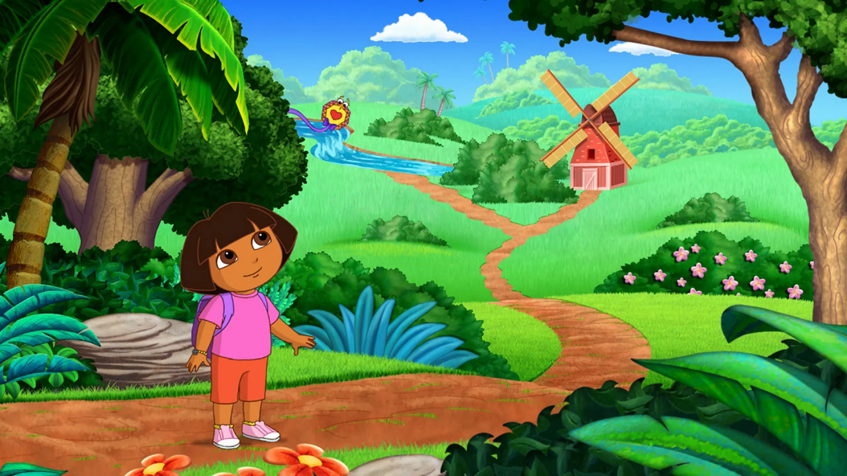
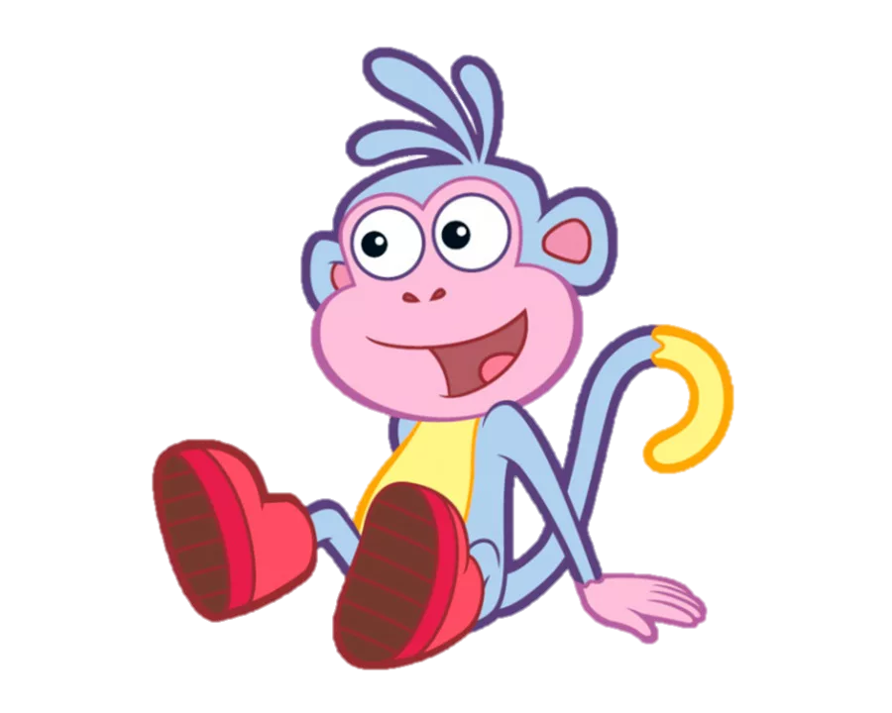
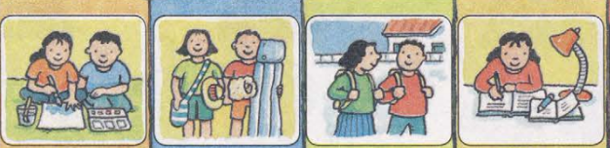
We need to find door which referred to in the sentence
“She will do her homework tomorrow”

Slide 16

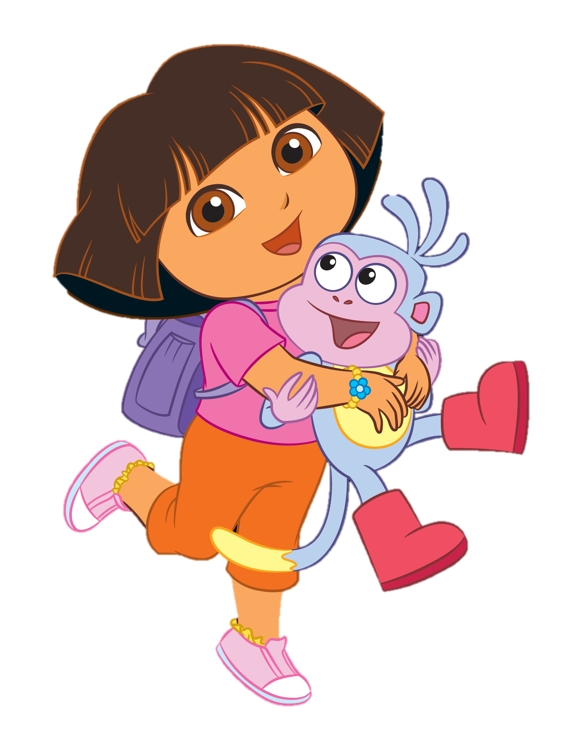
We helped Dora find Boots!

