Slide 1
Презентация к уроку по учебному предмету «Английский язык» в 7 классе на тему: «How to become famous?»
Родионова Ирина Петровна, учитель английского языка
МБОУ СШ 9 г.Выкса

Slide 2
Lesson of developing critical thinking include stages: evocation, realization of meaning.
1 stage Evocation:
actualization of previous knowledge;
provokes interest to get new information;
students state their own goals and purposes.
Possible ways and techniques:
predictive narration using key words;
graphic systematization of material(clusters).
Teacher’s activity
A teacher should find out what students know about the topic, encourage students’ activity, increase their motivation for further work.
Students activity
Students “recall” what they know, make predictions, systematize information before learning new material, ask questions.

Slide 3
2 stage Realization of meaning:
getting new information;
correction of purposes of the lesson.
Possible ways and techniques:
Method of active reading( on this stage students work with new information).
Teacher’s activity
A teacher tries to keep students’ interest for the topic while working with new information.
Students activity
Students read or listen texts using active methods of operating information, making notes while realizing new information.

Slide 4
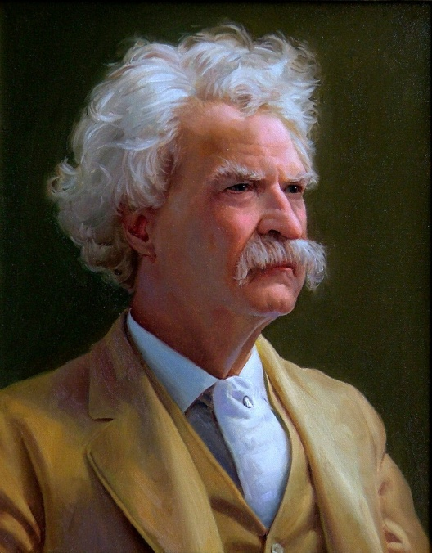
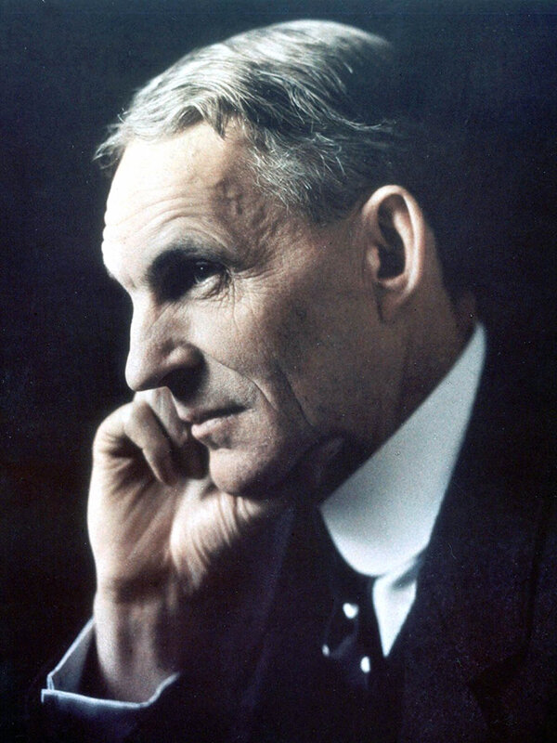
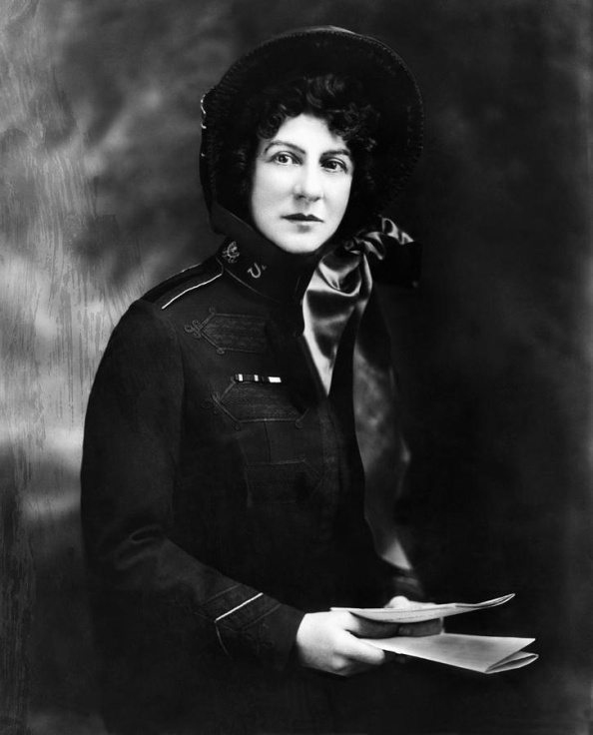
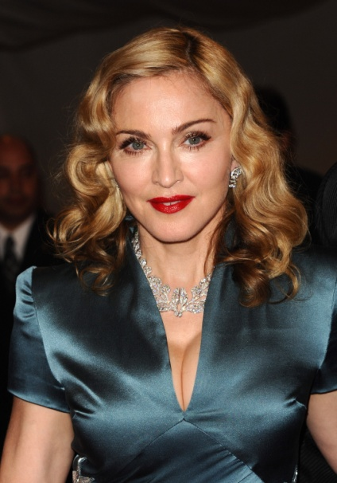
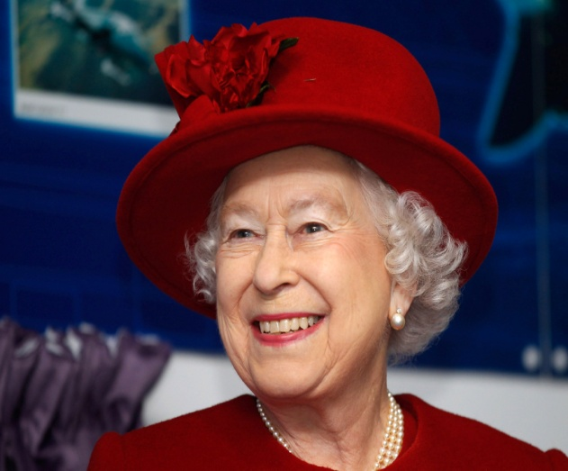
Do you know these people?
They all have one trait in common: they are famous!

Slide 5

Is it easy to be famous?
To answer this question you have to discuss in groups, what does it mean to be famous? Advantages and disadvantages of being famous. You have to suggest so many ideas as possible!

Slide 6
Advantages
Disadvantages
What does it mean to be famous?
Write down your ideas in a cluster, please!

Slide 7

Becoming a famous person is not really easy.
Do you agree with this statement? Why? Why not?

Slide 8

Famous people came to their fame in different ways. Do you know this person?
Now let’s check your suppositions. Let’s read a text about the Mark Twain and decide, whether we are right.

Slide 9

Mark Twain
Mark Twain was a talented writer and wrote some of the funniest stories in the world. His real name was Samuel Clemens. He was born in 1835. When Sam was twelve his father died. Sam began to write funny stories and took the name Mark Twain. His experience and talent helped him to write his funny stories.

Slide 10
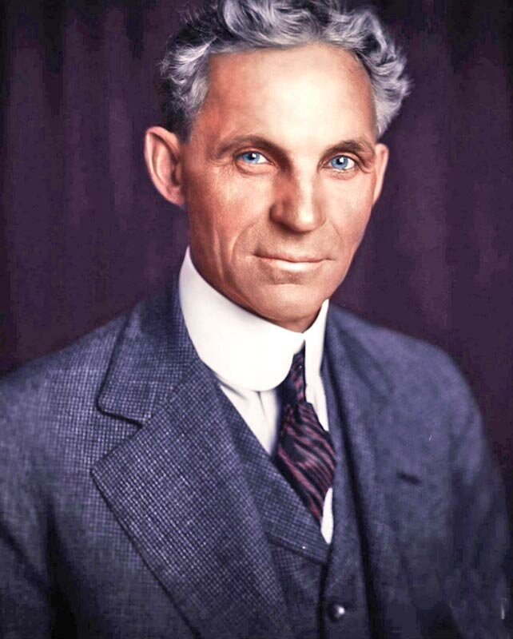
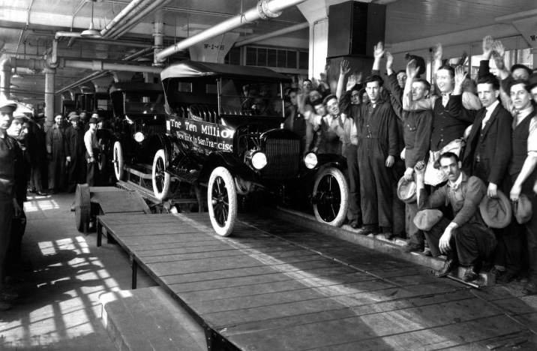
Henry Ford
Henry Ford was born in 1863 on a farm near Detroit, USA. When he was 16, he went to Detroit to work in a workshop. In 1896 he built his first car. He was the first to use an assembly line and in 1908 the company made a car that many people could buy.

Slide 11

Evangeline Booth
Evangeline Booth was born in London on Christmas Day in 1865. People called her the «White Angel». She raised money for poor people, supported needy people. She became the world leader of the Salvation Army. President Woodrow Wilson gave her a medal for her work.

Slide 12

Discuss in groups what helped Mark Twain, Henry Ford and Evangeline Booth to become famous.

Slide 13

Come out with your statements. Agree or partly agree with your group mates.

Slide 14

What have you done well? What was difficult for you?

Slide 15
Write down the home task: p.137 ex.1(1)
The lesson is over. Goodbye. Have a nice day, children!

