Slide 1
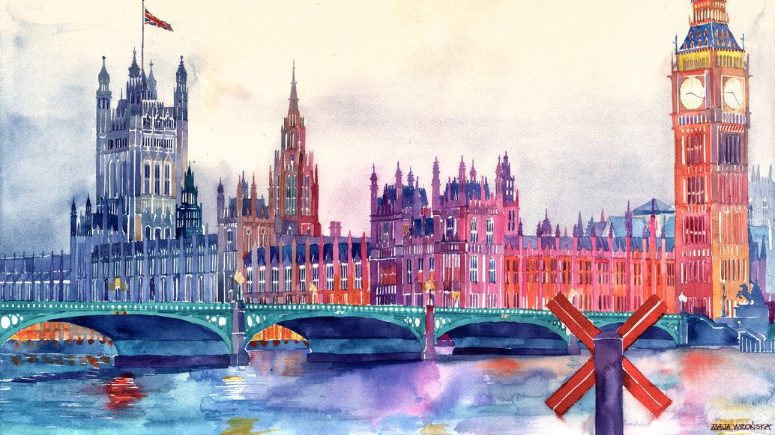
Paddington's cookery book
презентацию подготовила учитель английского языка ГБОУ школы №83 с углубленным изучением японского и английского языков г. Санкт-Петербург Заварзина А.М.
Кулинарная книга медвежонка Паддингтона

Slide 2

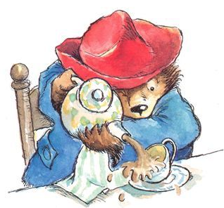
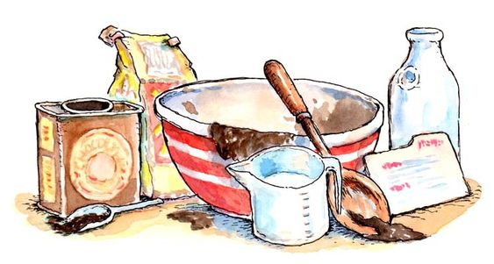

Данная презентация предназначена для закрепления и отработки лексики по теме «Еда и приготовление пищи» на занятиях по внеурочной деятельности. С её помощью учащиеся могут не только повторить изученное, но и познакомиться с британской кухней и узнать больше о стране изучаемого языка. Перед просмотром предлагается выполнить упражнение на установление соответствий (слайд 5), а в конце устно ответить на вопросы по содержанию презентации. Кроме того, предлагается попробовать свои силы в приготовлении знаменитого английского десерта «Apple crumble» по рецепту.

Slide 3
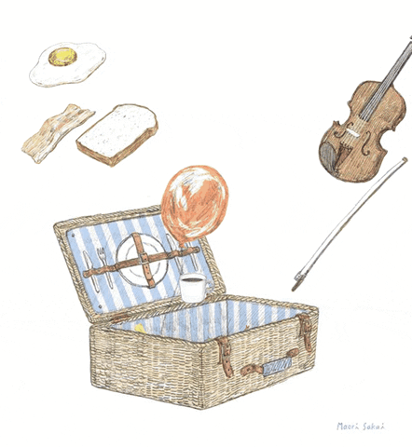
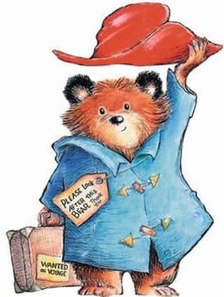
Hello, friends! My name’s Paddington. I’ve come to London from hot and sunny Peru, and I must say the local food is indeed surprising! I used to eat only toasts with marmalade and all sorts of fruit back home, but British cuisine is so strange and unusual I can’t wait to find out more about it!

Slide 4
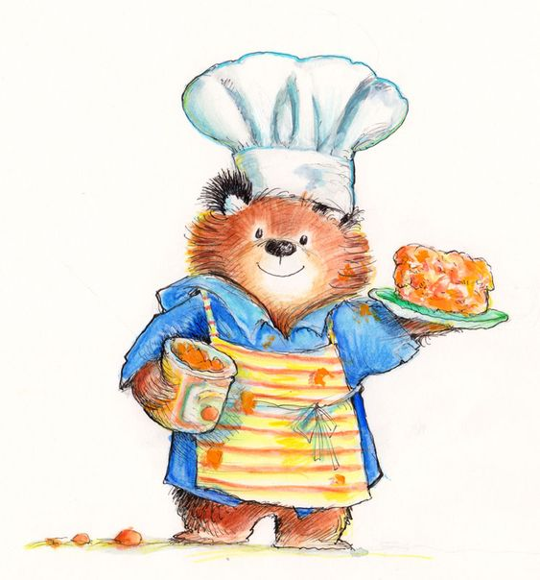



Here’s my book of recipes. Make use of these buttons for navigation.
forward вперед
back назад
return to the map вернуться к карте
reference ссылки
final tasks заключительные задания

Slide 5
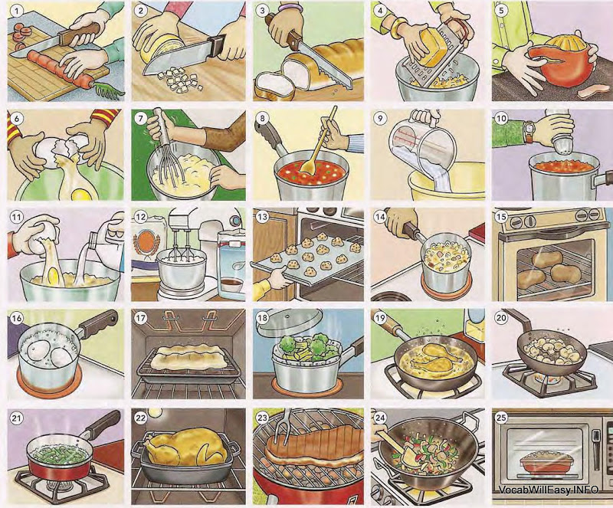
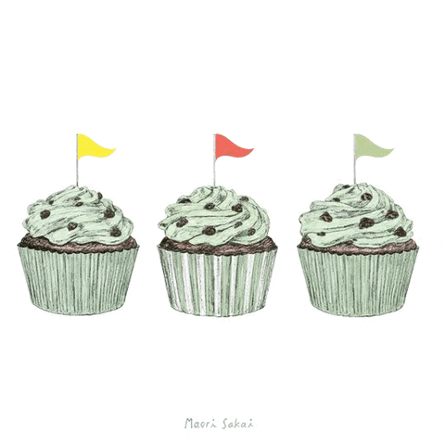
Match the pictures with the verbs.
1 cut (up)
2 chop (up)
3 slice
4 grate
5 peel
6 break
7 beat
8 stir
9 pour
10 add
11 combine__and
12 mix_and_
13 put_in_
14 cook
15 bake
16 boil
17 broil
18 steam
19 fry
20 saute
21 simmer
22 roast
23 barbecue/grill
24 stir-fry
25 microwave

Slide 6
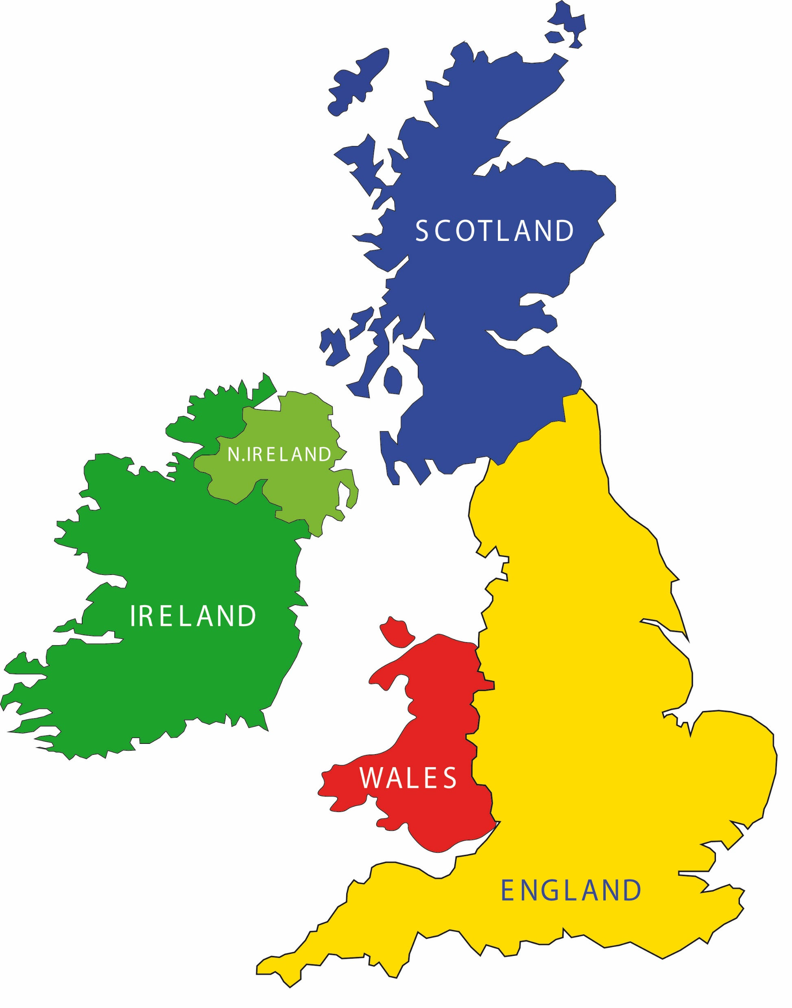
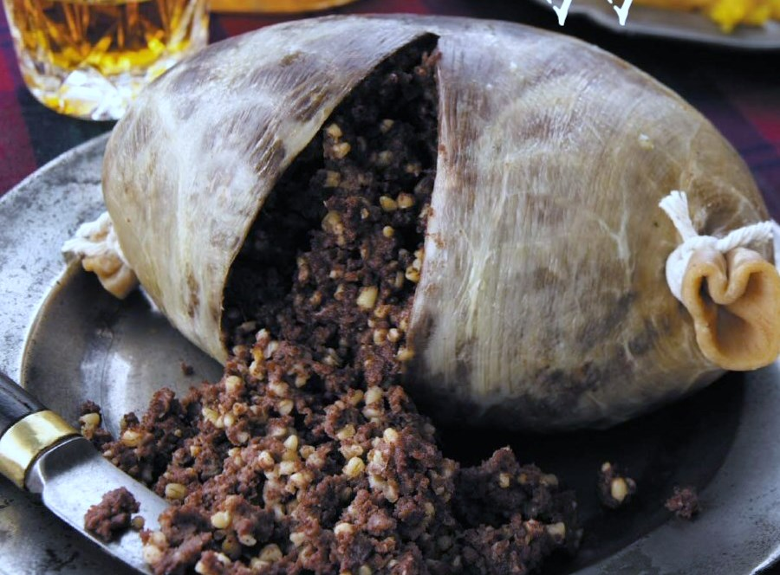
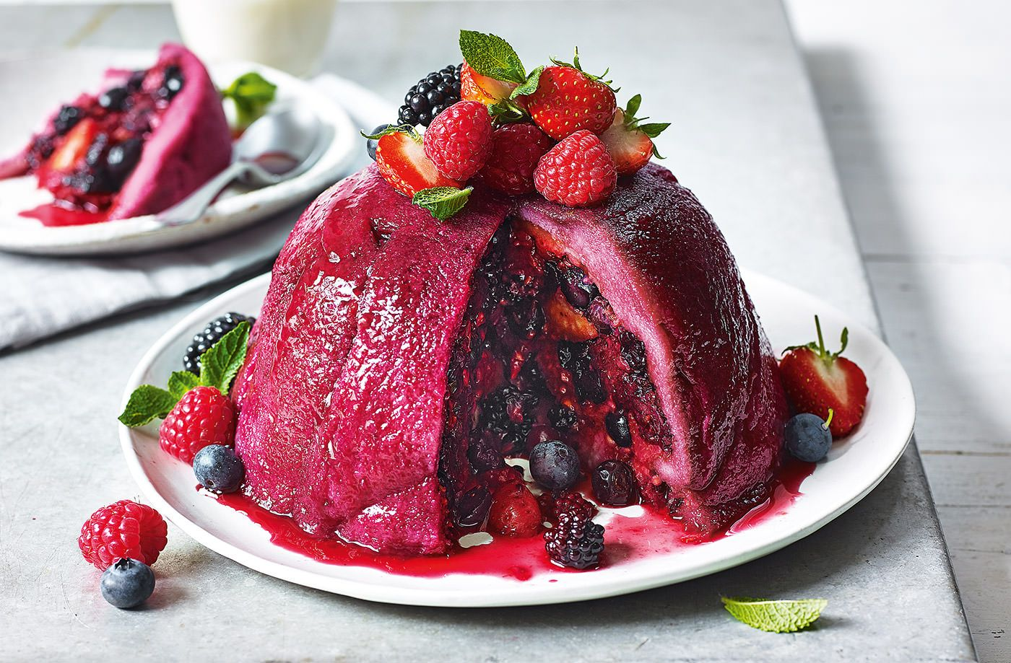
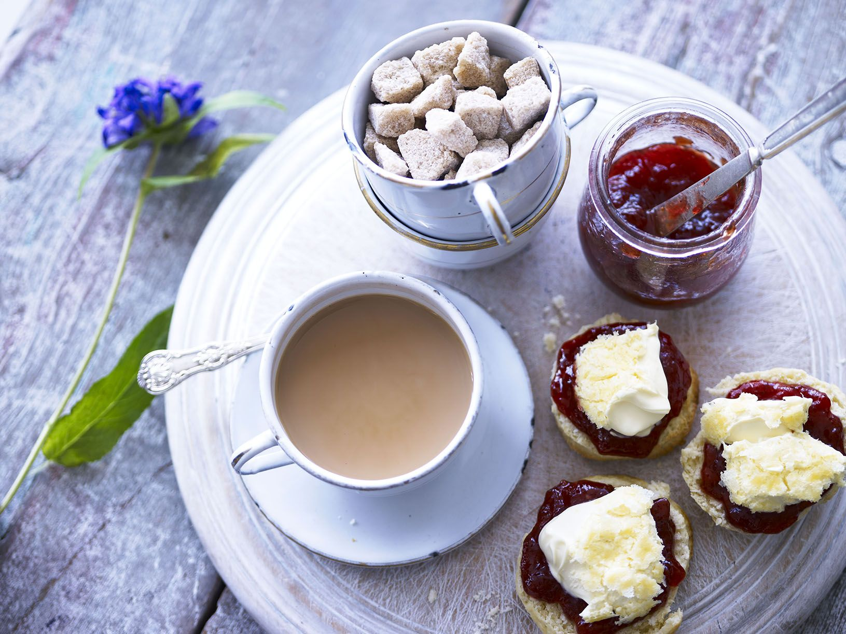
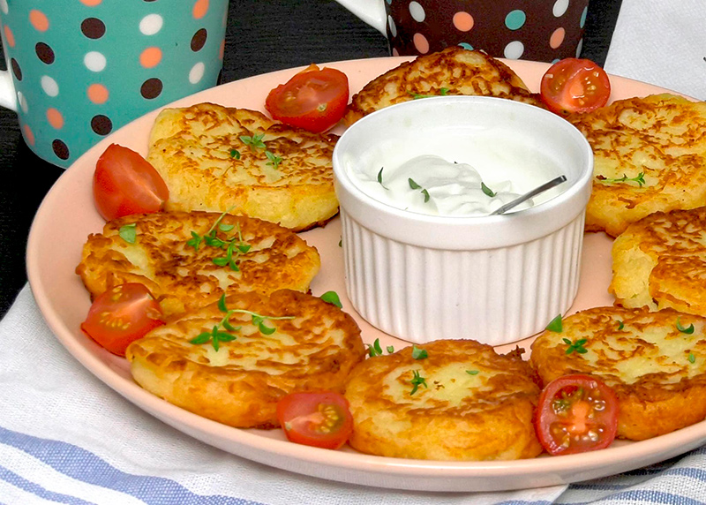
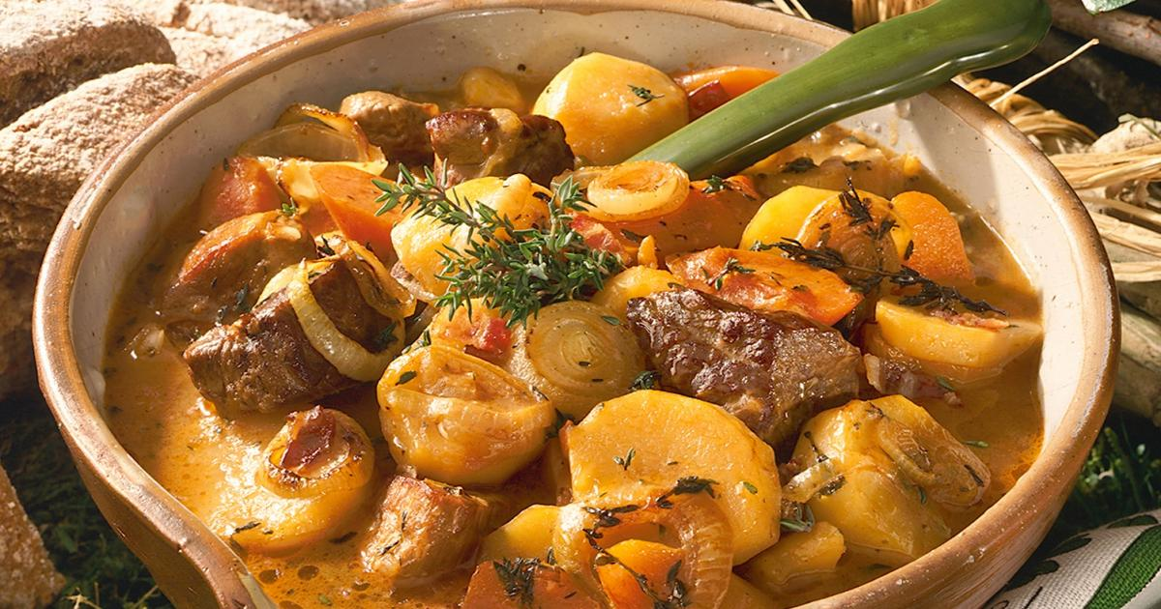
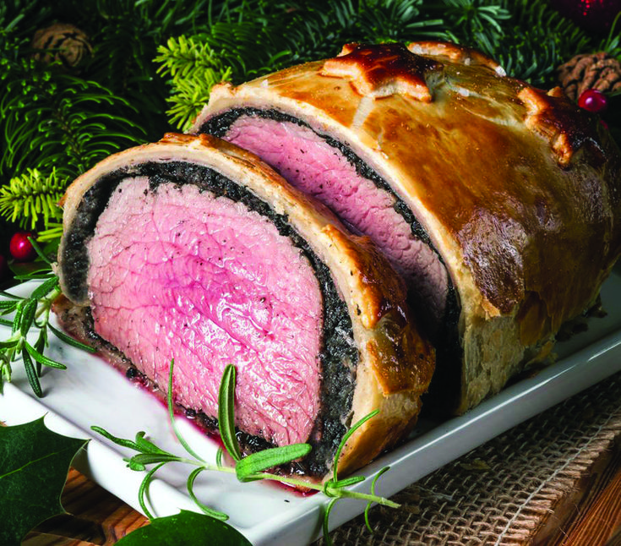
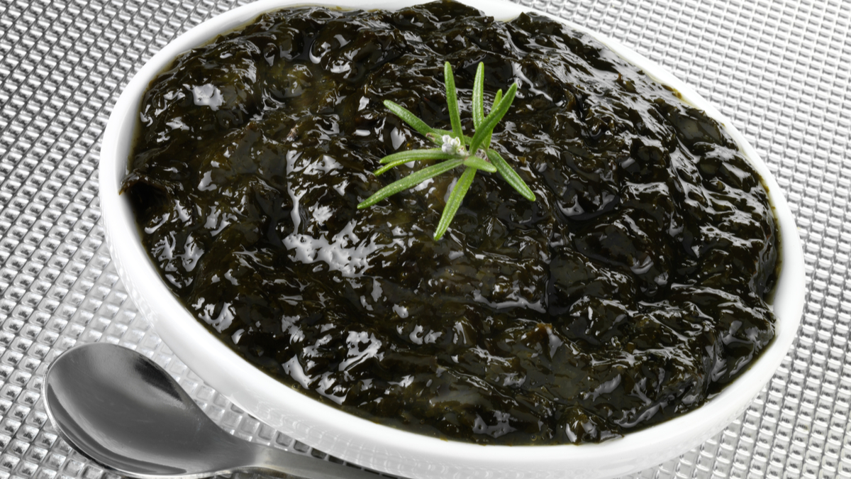
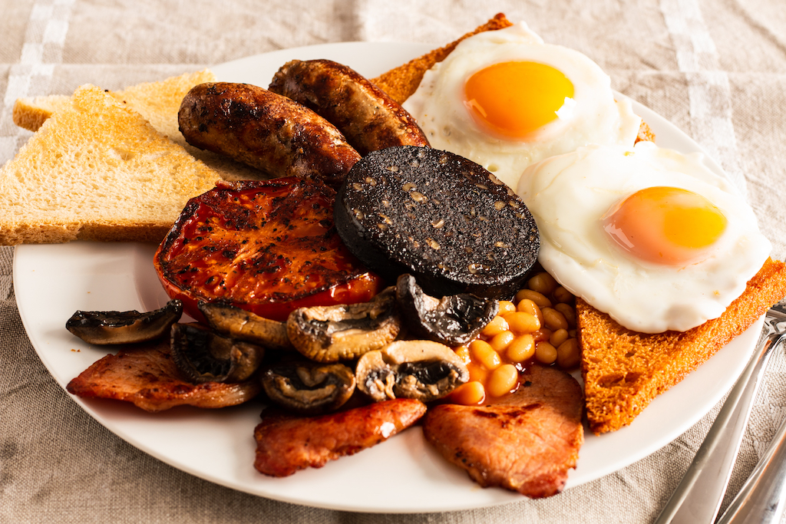
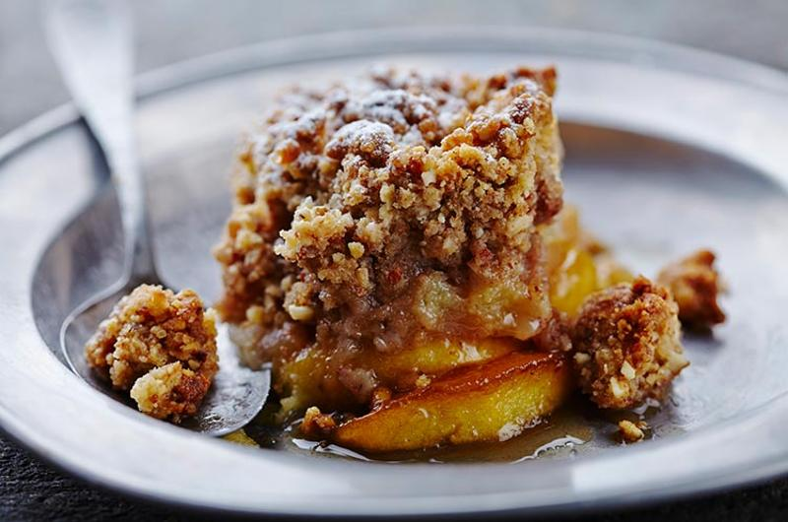
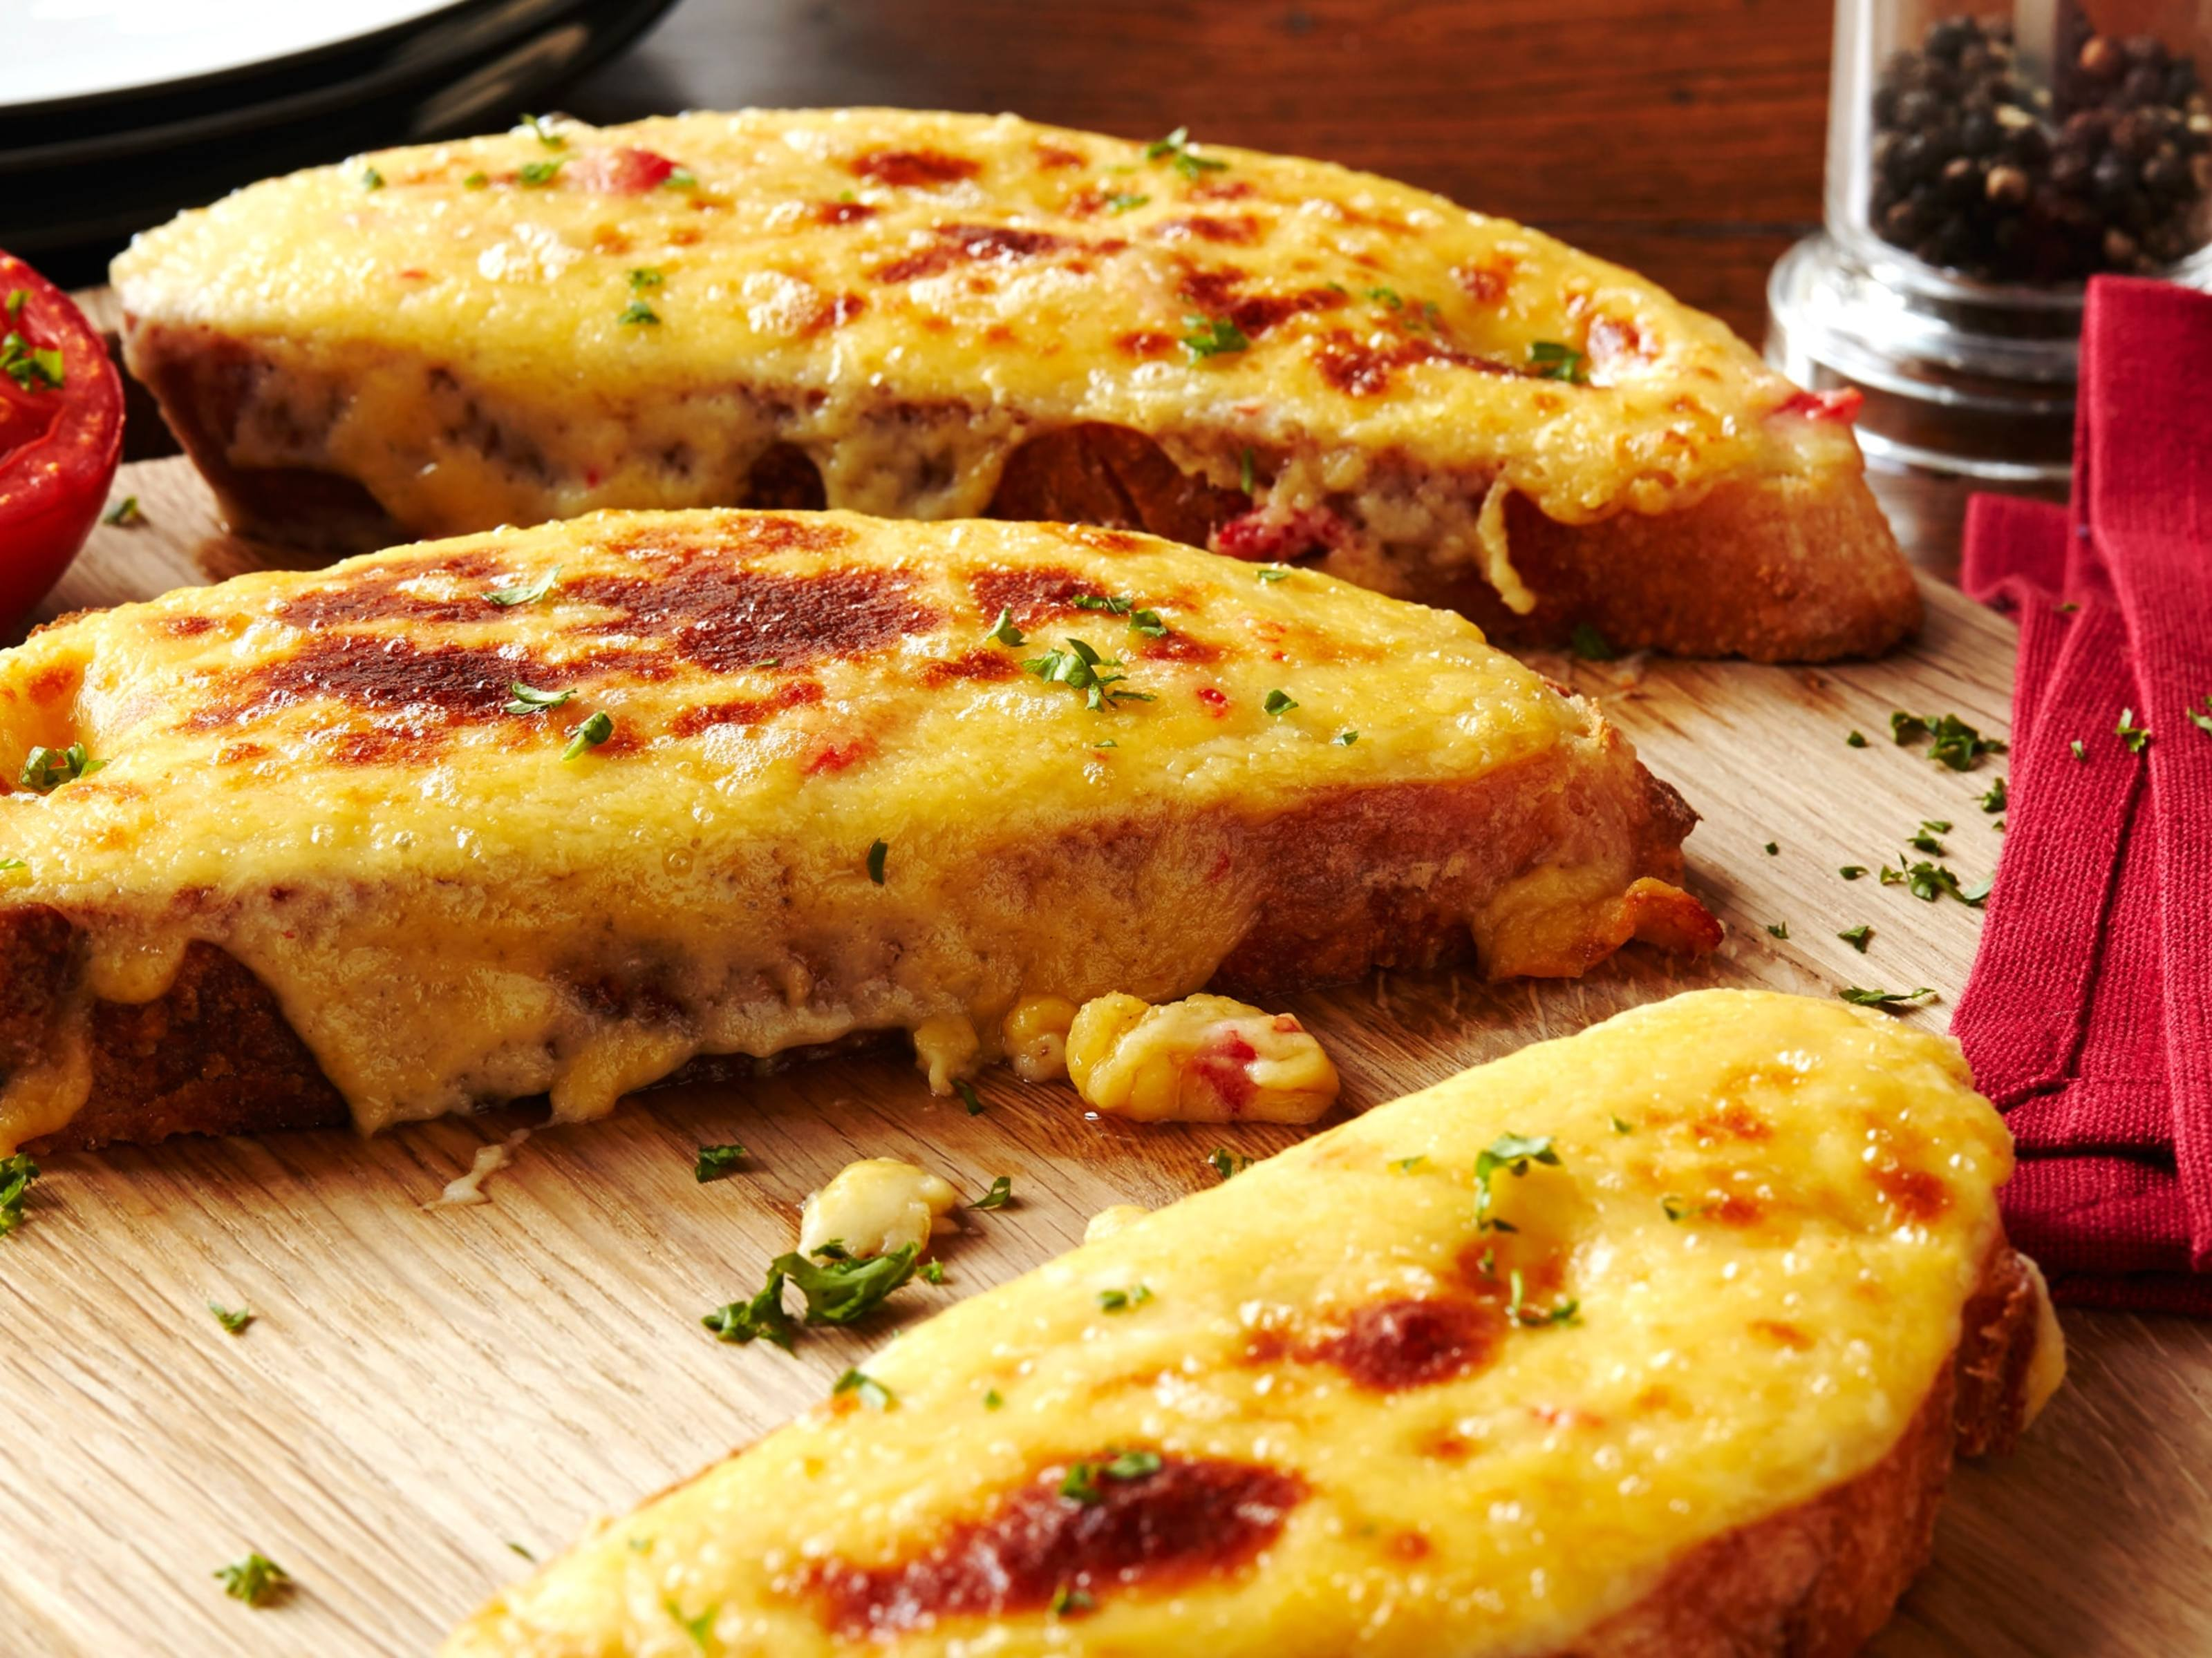
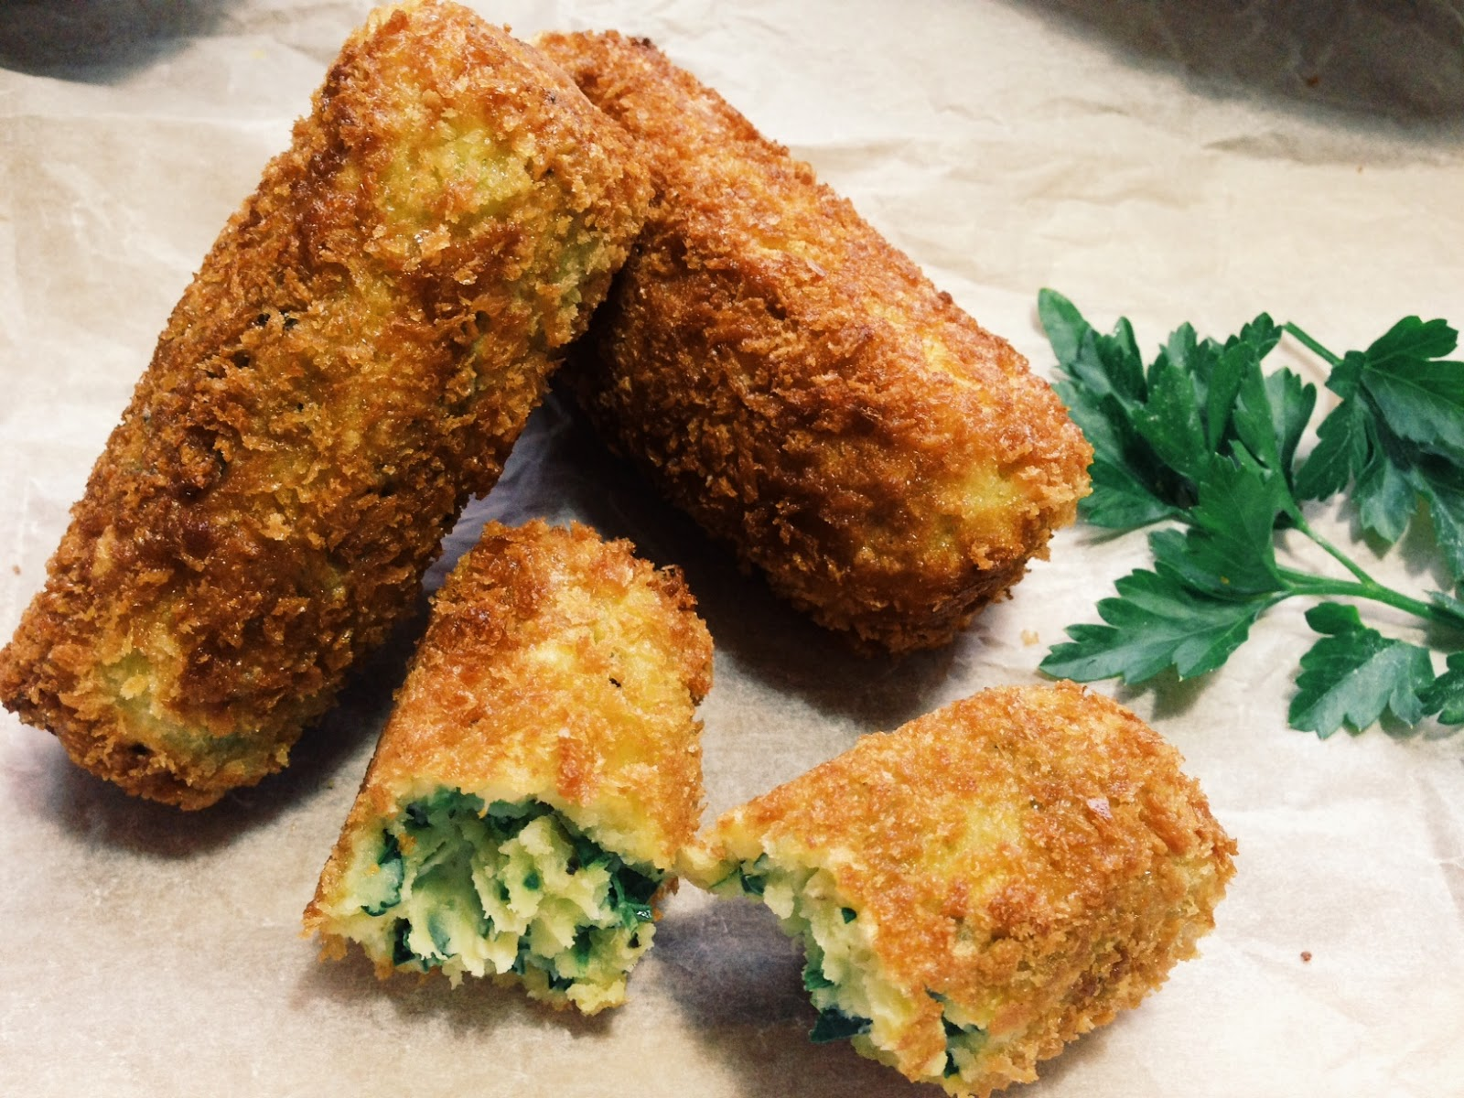
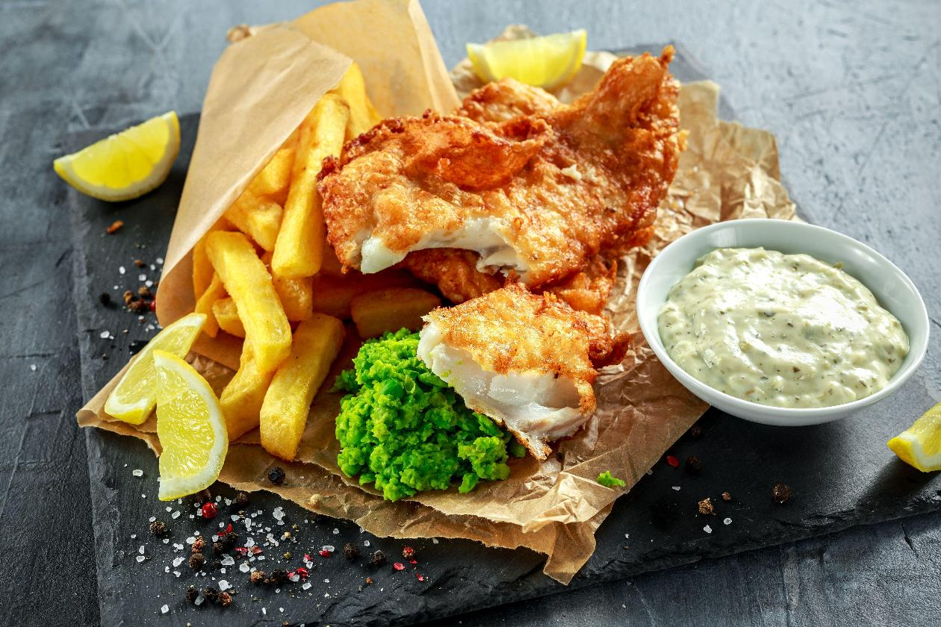

Slide 7
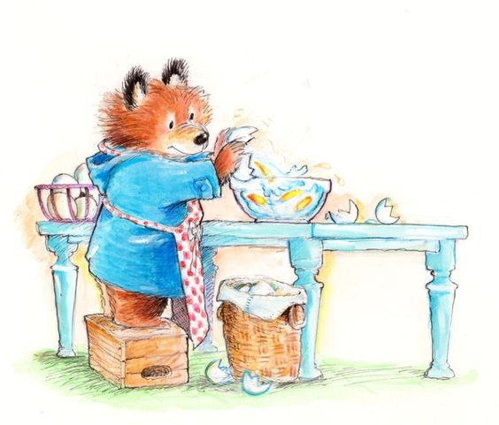
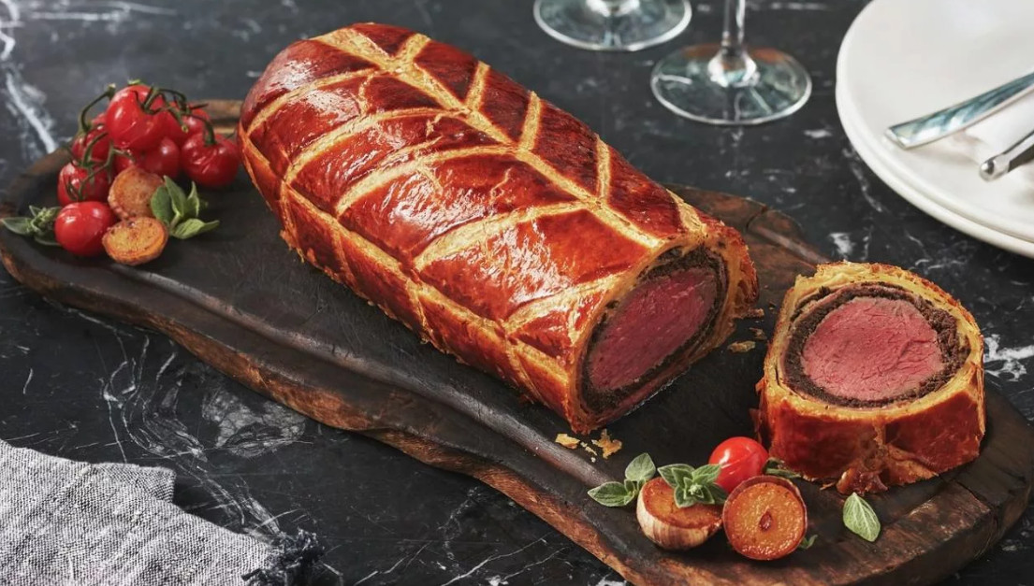
Beef Wellington
Beef Wellington is a beef dish that dates back to 1815. It is often served at expensive restaurants and can only be ordered for two people because of its size. It takes time to be cooked, so it must be ordered 24 hours in advance.

Slide 8
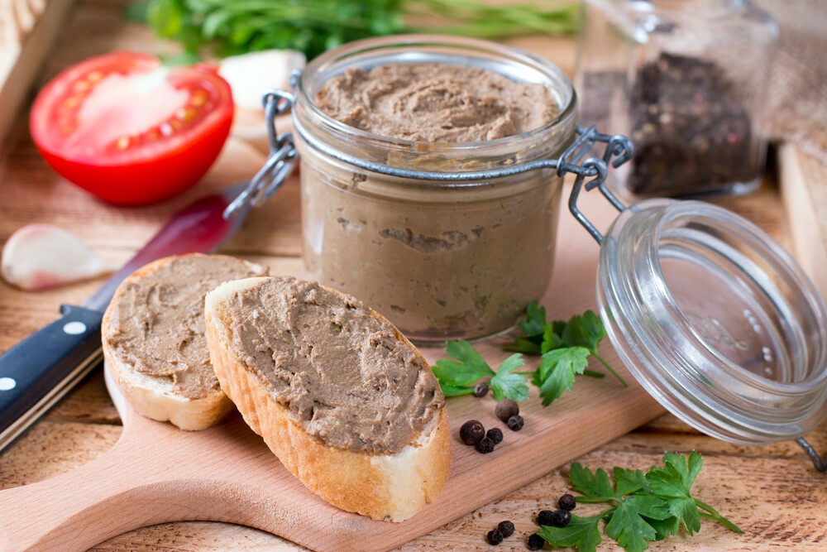
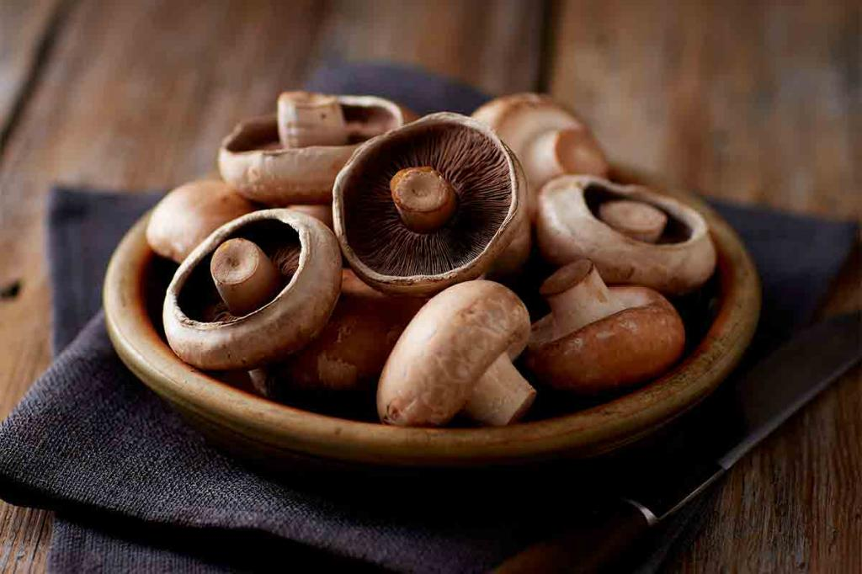
Beef Wellington starts with a piece of raw beef. It is then coated with pate, a mixture of minced mushrooms and onions mixed with herbs and spices. The beef roast is then traditionally wrapped in a large sheet of dough.

Slide 9

The are a lot of stories of how Beef Wellington got its name. The most popular tale of its origins claims the dish was named after Arthur Wellesley, 1st Duke of Wellington, whose favourite food were beef, mushrooms, wine and pate.
Yummy!

Slide 10
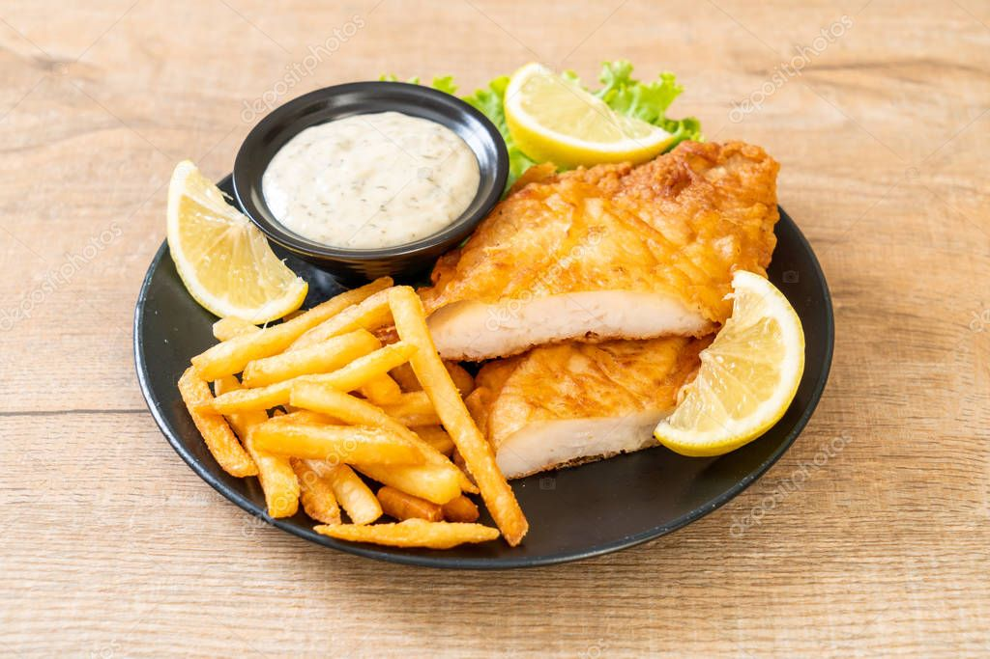
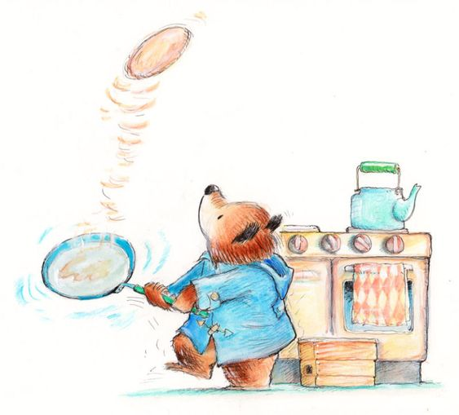
Fish and chips
Brits have been eating fish and chips since the 19th century. This beloved British street food is traditionally served wrapped in a piece of white paper or newspaper. Most people enjoy eating it with their fingers.

Slide 11
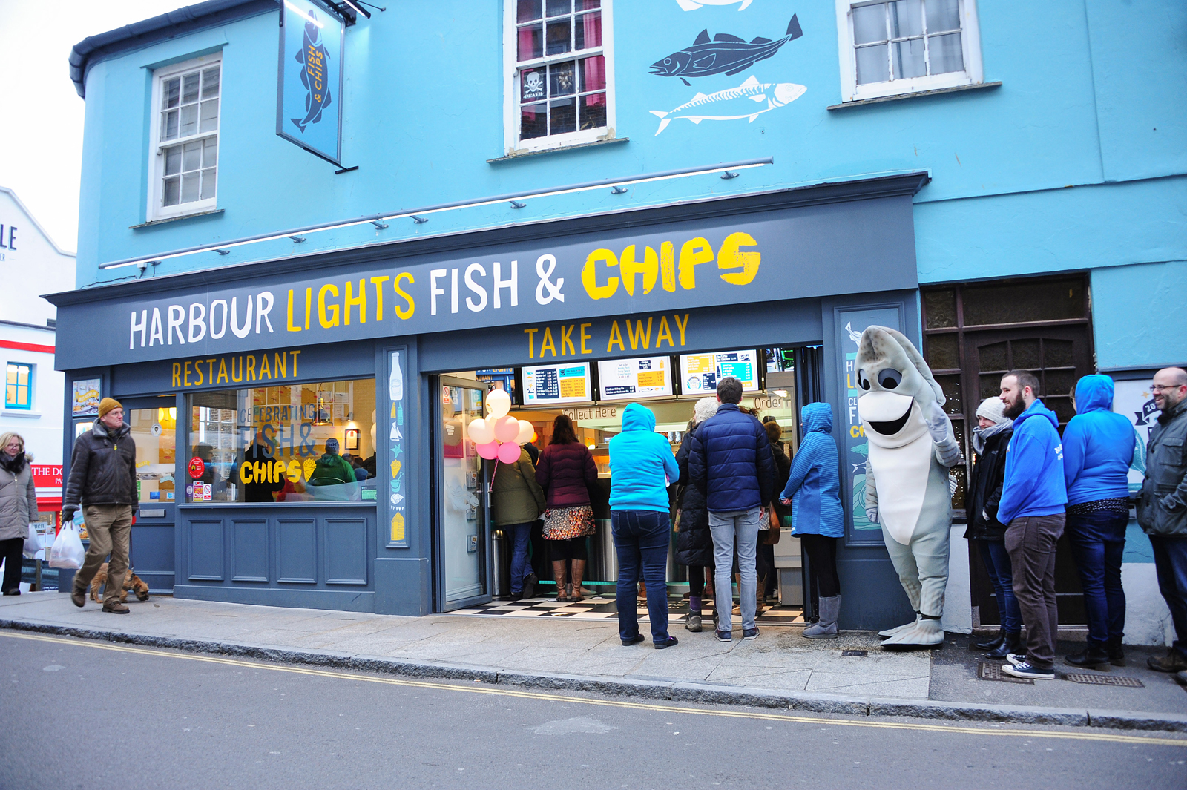
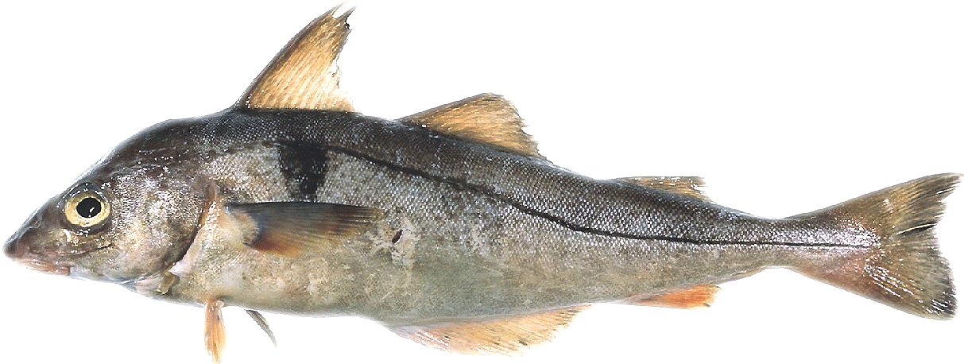
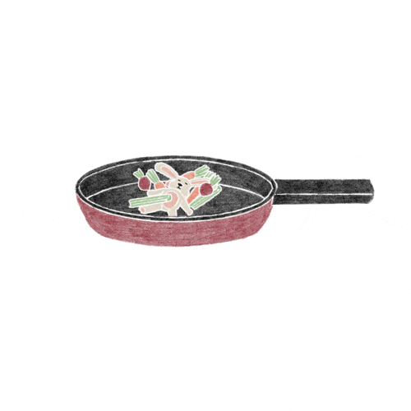
The fish, which is usually cod, haddock, or plaice, is dipped in batter and deep-fried. Similarly, the chips are cut thicker than French fries and deep-fried twice.

Slide 12
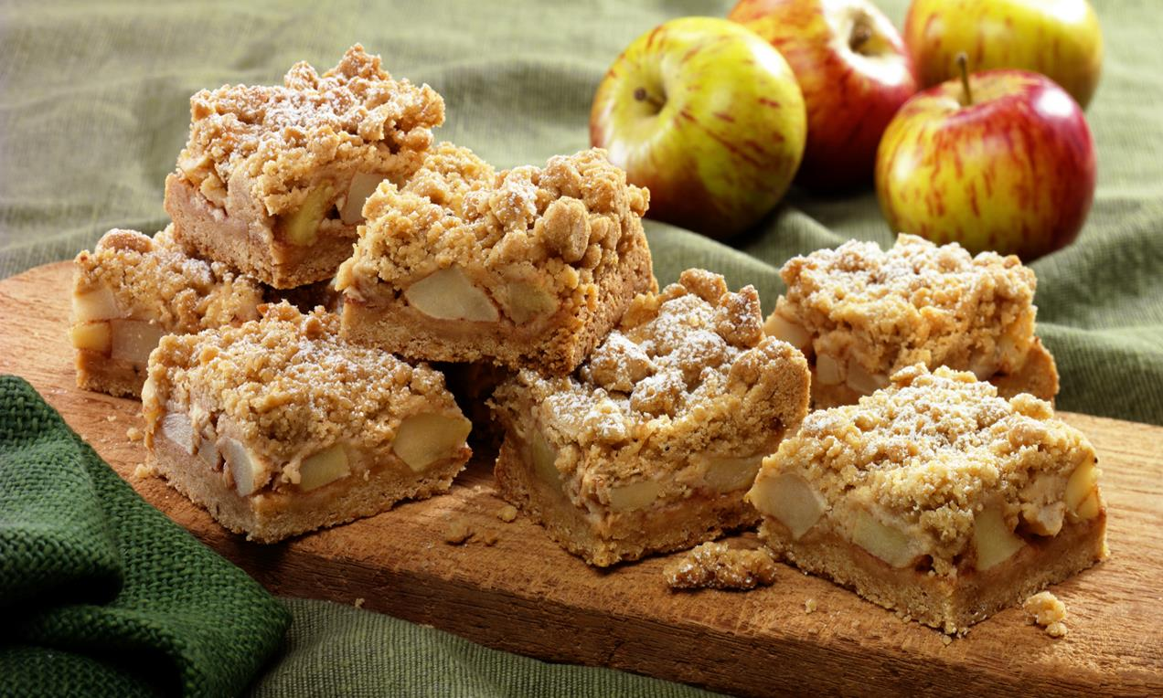
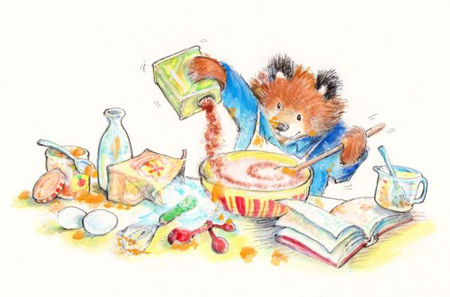
Apple Crumble
The Brits love their sweet after-dinner treats, and the most popular of these is arguably apple crumble. This consists of peeled, cored, and sliced apples covered with a mixture made from flour, sugar, and butter.

Slide 13
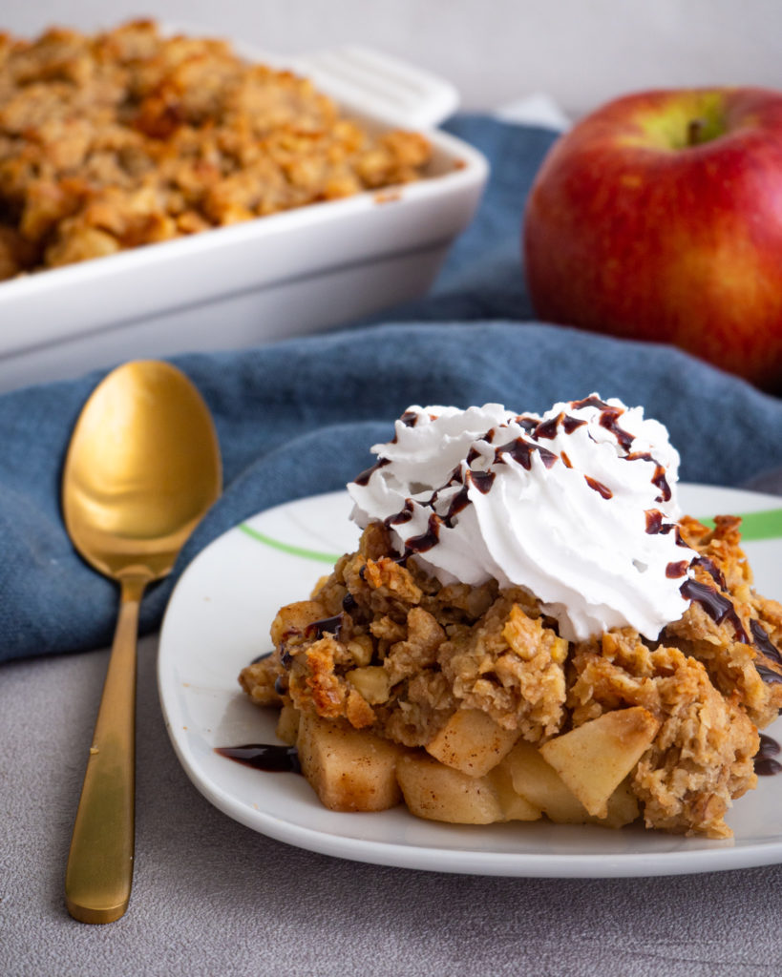
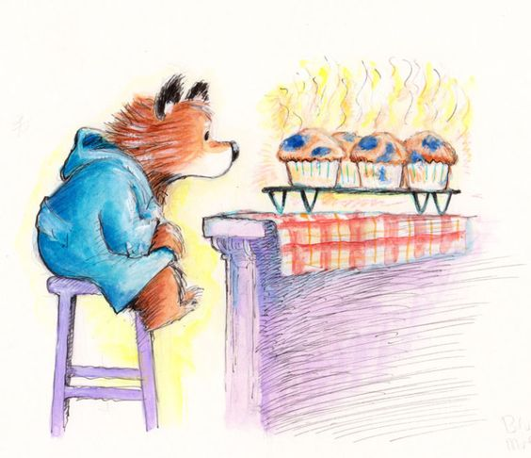
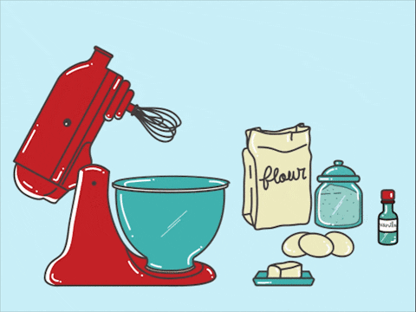
This delightful dessert is baked in the oven until the crumble turns a golden brown and the apples are soft. The dessert is often served with vanilla ice-cream or custard made from eggs, milk, and vanilla. Other popular fruits that are often used in crumble include blackberry, peach and plum. The topping may also include oats, almonds, or other nuts.

Slide 14
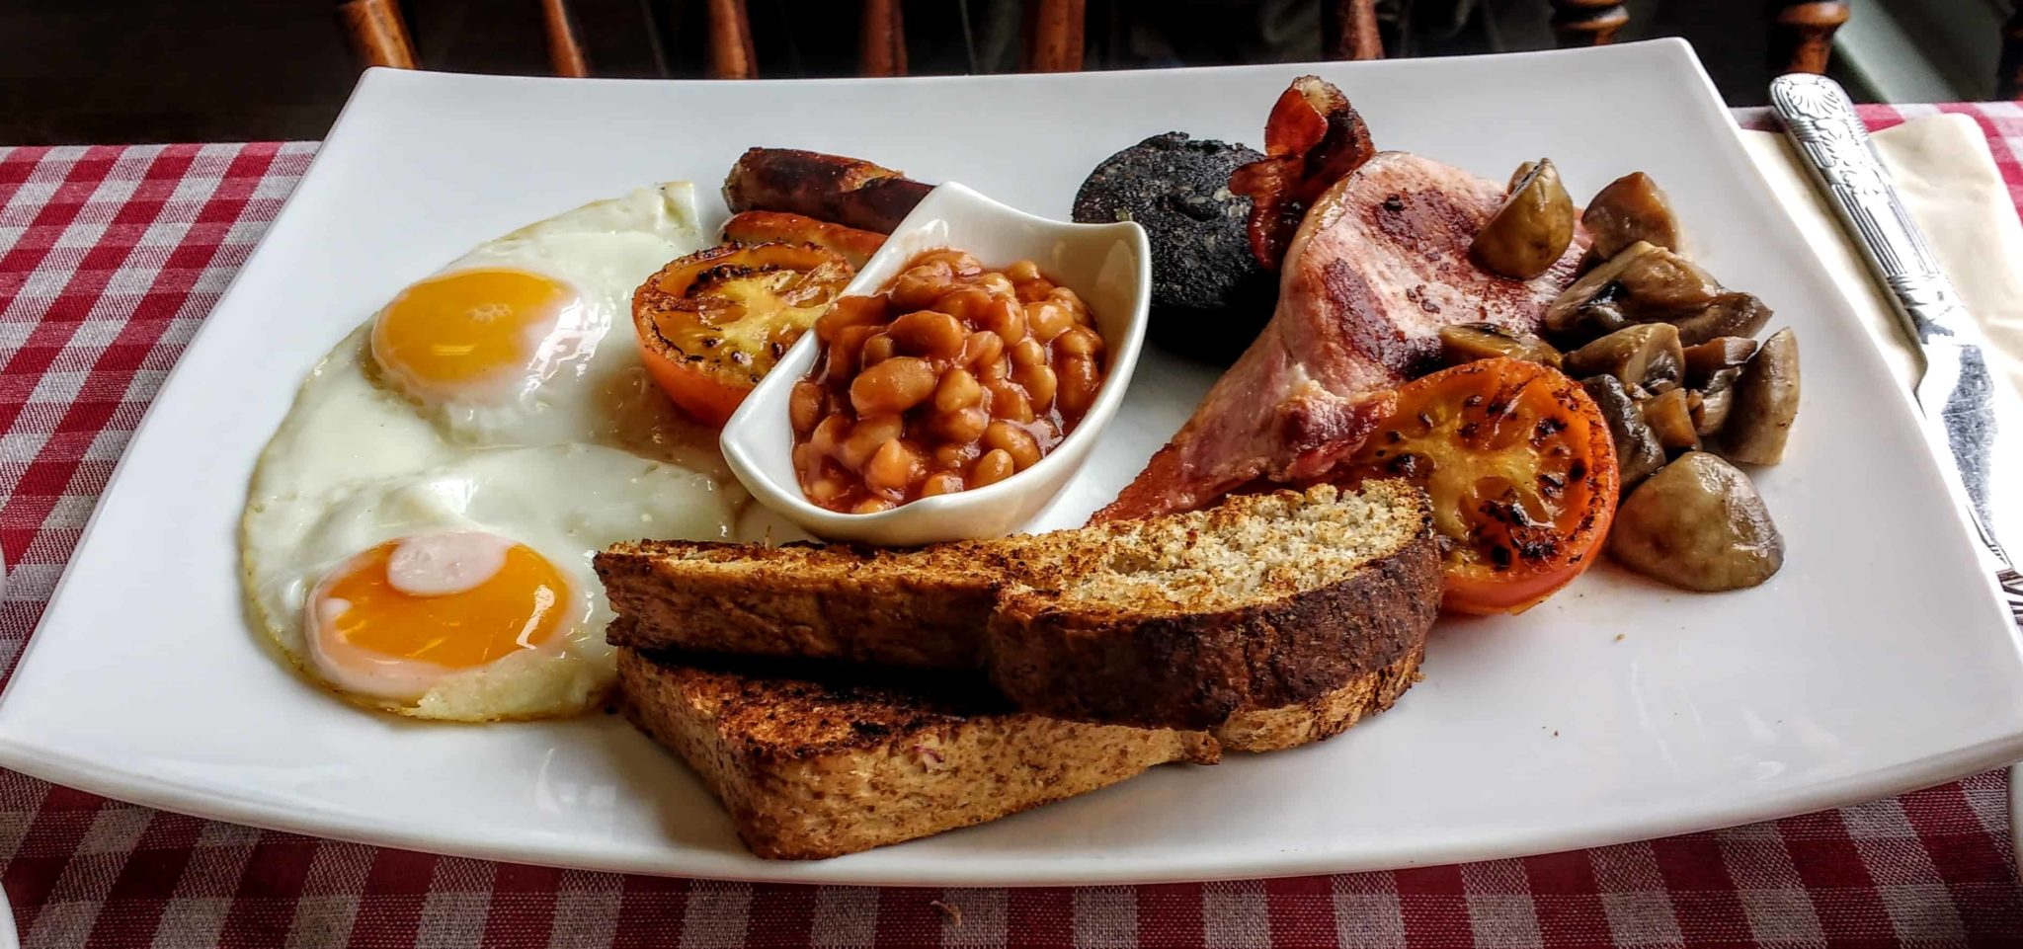
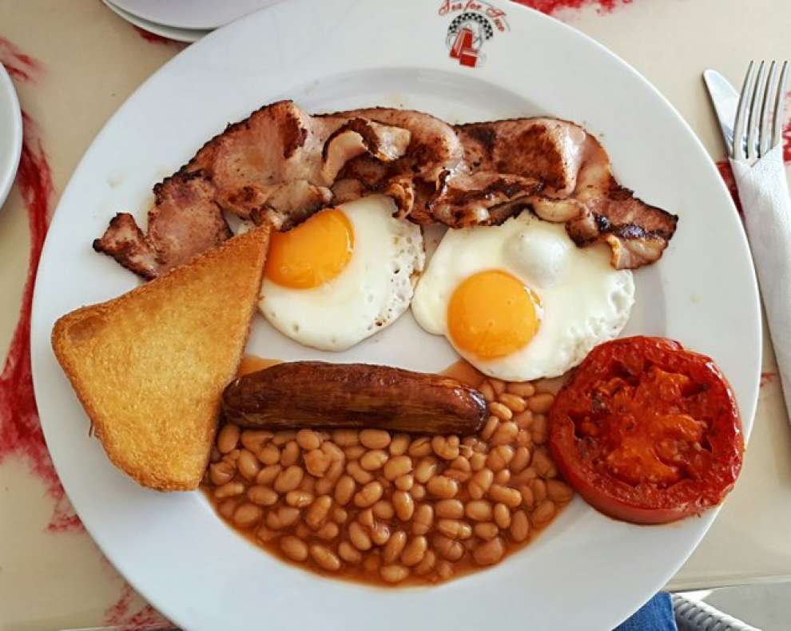
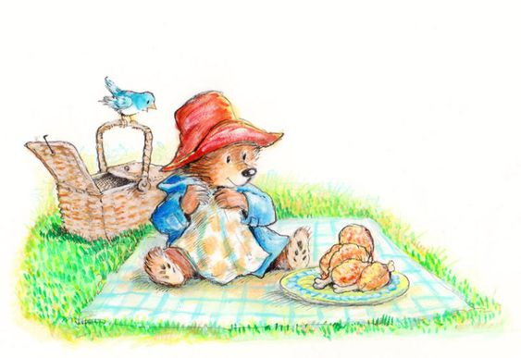
Ulster Fry
The Ulster fry breakfast consists of sausages, bacon, bread and eggs. Some people also cook tomatoes with it.
It is so popular in Britain and Ireland that many cafes and pubs offer the meal at any time of day as an "all-day breakfast".

Slide 15
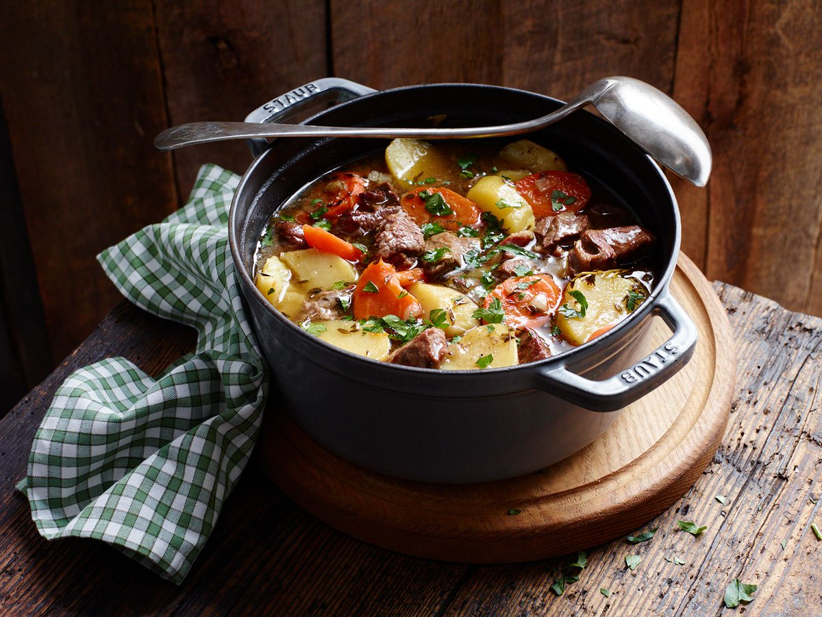
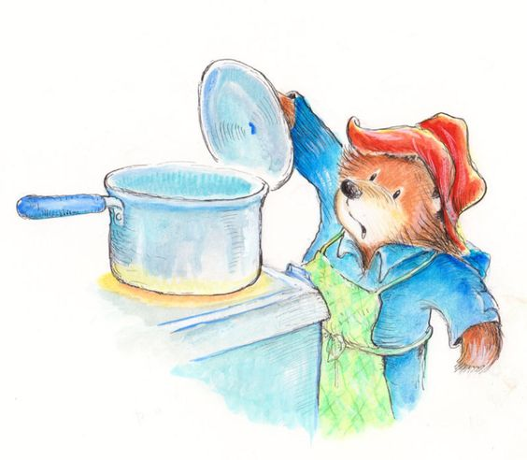
Irish stew is a lamb or mutton and root vegetable stew native to Ireland. Basic ingredients include lamb, or mutton as well as potatoes, onions, and parsley. It may sometimes also include carrots.
Irish stew

Slide 16

Boxty
Boxty is a traditional Irish potato pancake. The dish is mostly associated with the north midlands, north Connacht and southern Ulster. There are many recipes, but all contain grated, raw potatoes and all are served fried.
The most popular version of the dish consists of grated raw potato and mashed potato with flour, baking soda, buttermilk, and sometimes egg. The mixture is fried on a pan for a few minutes on each side, like a normal pancake.

Slide 17
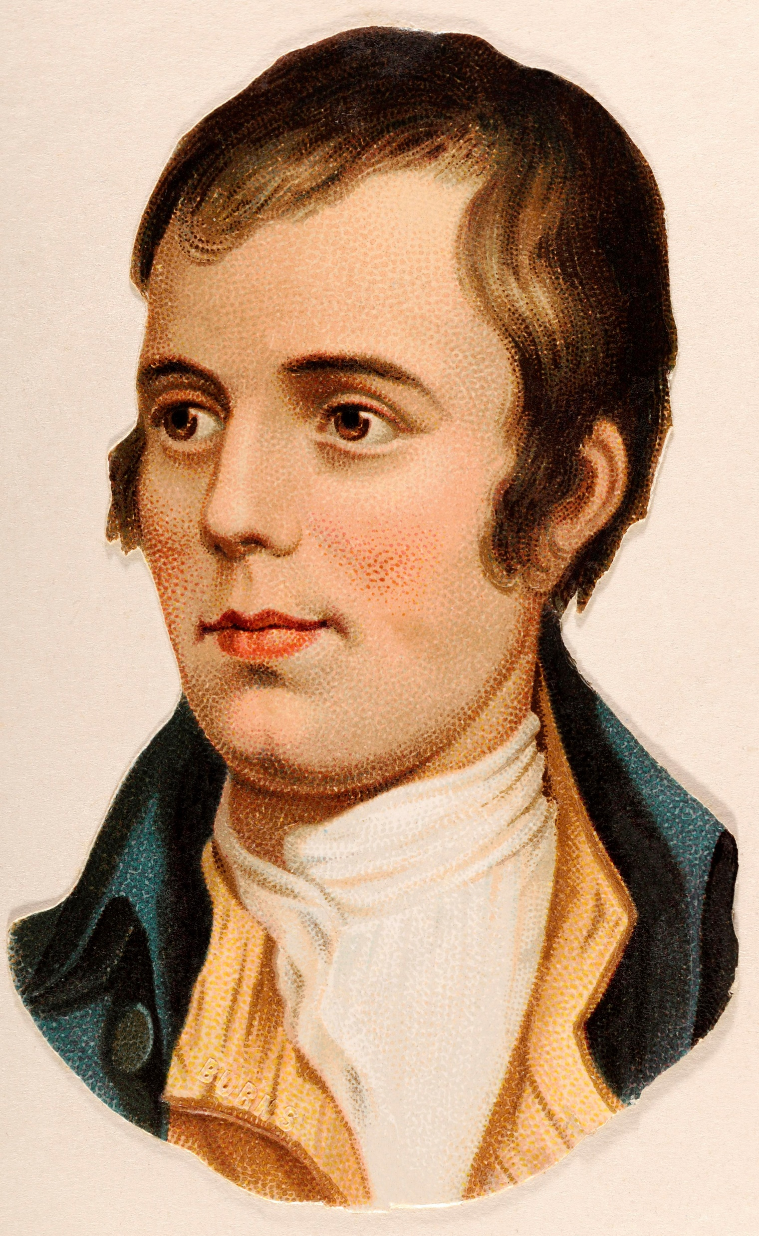
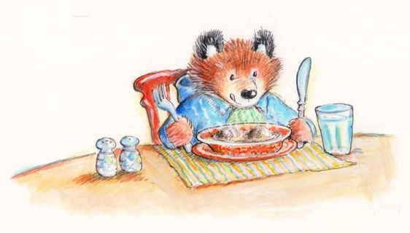
Haggis
Scotland’s national dish, haggis, is certainly not for the faint-hearted. It is the stomach of a sheep stuffed with a mixture of chopped sheep’s heart, liver and lungs, oatmeal, onions and seasoning. It is common to eat it with mashed potato. People traditionally eat haggis on Burns Night, on January 25. This is the birthday of Scotland’s national poet Robert Burns. While it might not sound very appealing, haggis is actually a very popular British food. You can buy it in almost any supermarket in Scotland, and fast-food chains sometimes serve it in the form of a large, deep-fried sausage.

Slide 18
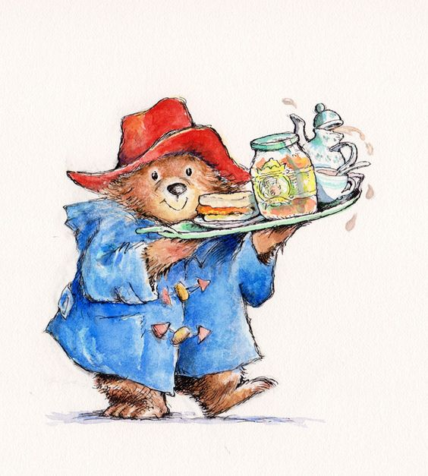
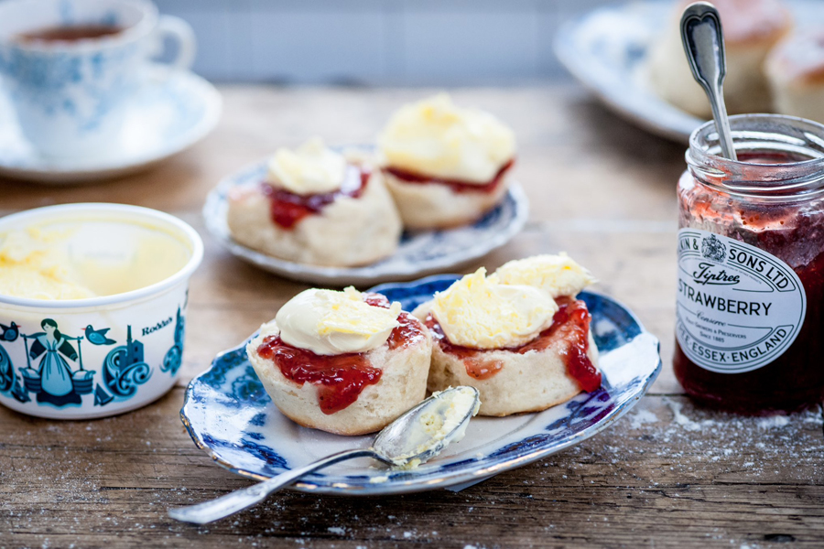
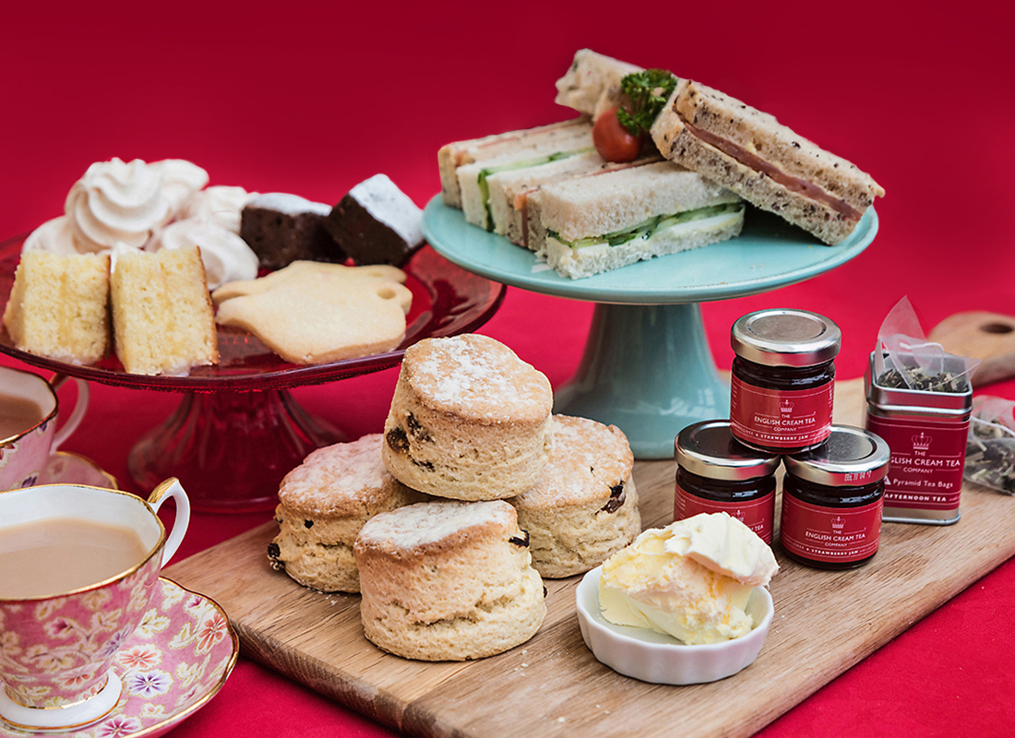
Cream tea
The British ‘afternoon tea’ wouldn’t be complete without tea and scones. This teatime treat consists of a pot of tea – preferably Earl Grey – with either lemon or a dash of milk; plus scones. These are dense, bread-like cakes made from flour, butter, and milk. They traditionally come with strawberry or raspberry jam and clotted cream; a rich yellow cream with a crusty top. You simply cut the scone in half, spread it with jam and cream, and enjoy. This iconic British food is associated with the South West of England and Scotland where you will find it in numerous cafés and tearooms.

Slide 19
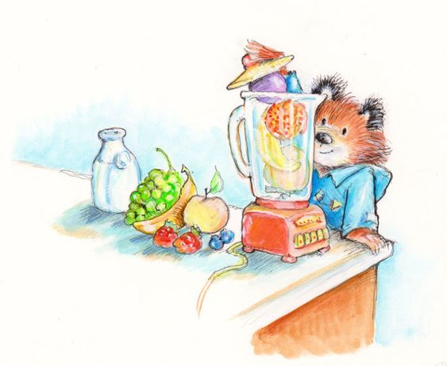
Fruit Pudding
Fruit pudding is a British dessert made of white bread, layered in a deep bowl with fruit and fruit juice. It is left to soak overnight and turned out onto a plate. Making summer pudding is much easier if the bread is somewhat stale. This helps the fruit juices soak through the bread, which makes the pudding more pleasant. Summer pudding can be served with cream.
The fruits typically used in summer pudding are raspberries, strawberries, black currants, red currants, white currants, and blackberries.
It looks delicious!

Slide 20
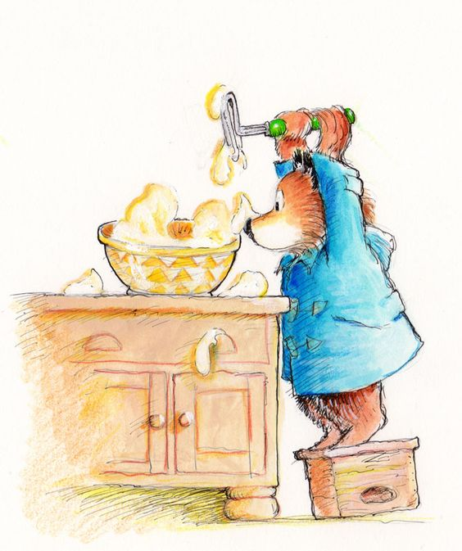
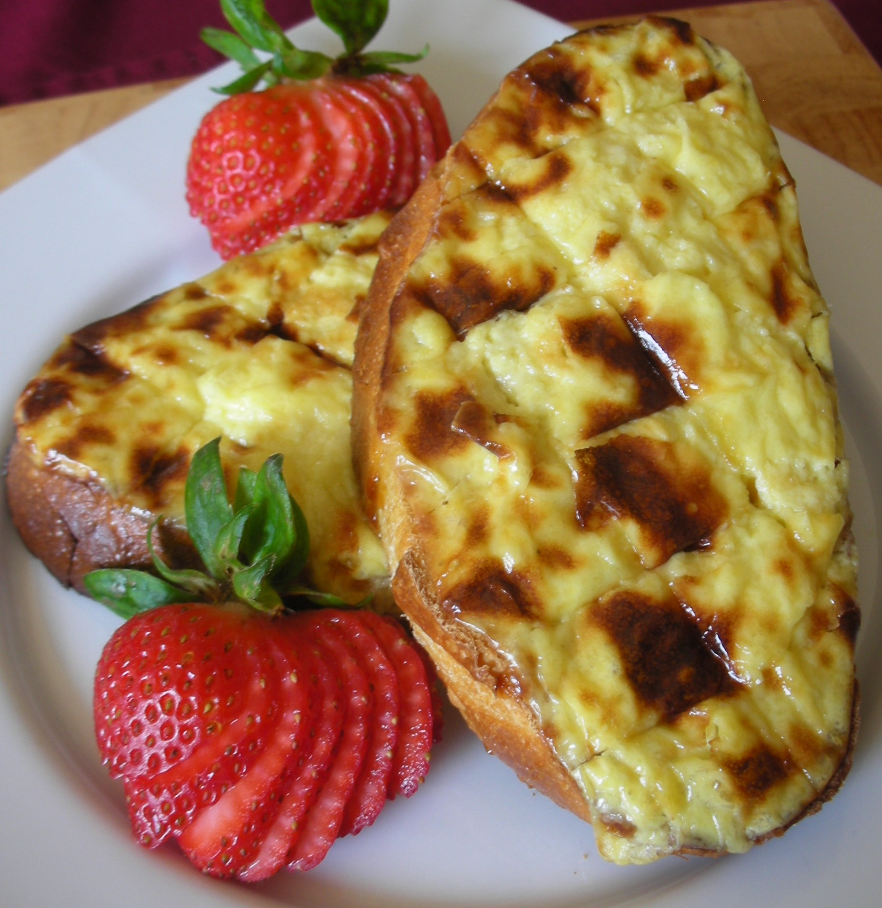
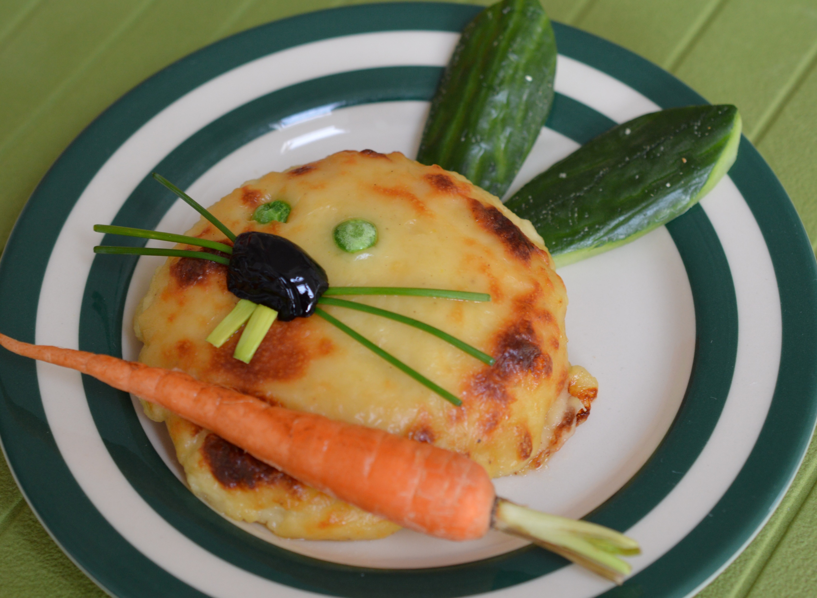
Welsh rarebit or “Welsh rabbit”
Welsh rarebit or “Welsh rabbit” as the local people joke, is a traditional Welsh dish made with a sauce of melted cheese and served hot, after being poured over slices of toasted bread or served in a dish like a fondue. The dish contains no rabbit meat.

Slide 21
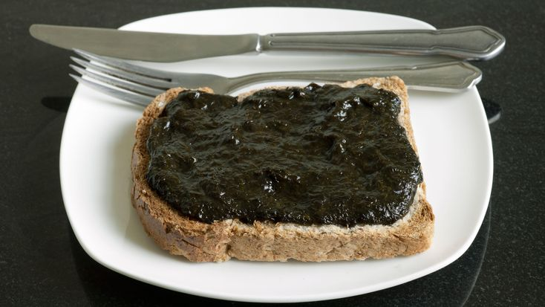

Laverbread
Laverbread is a food product, made from an edible seaweed, consumed mainly in Wales as part of local traditional cuisine. The seaweed is commonly found around the west coast of Great Britain and east coast of Ireland along the Irish Sea, where it is known as slake. It is prepared by washing repeatedly and then boiled until it becomes a soft mush when it is known as laverbread. The gelatinous paste that can then be sold as it is. Laverbread is traditionally eaten with bacon and bread as part of a Welsh breakfast.

Slide 22


Glamorgan sausage
Glamorgan sausage is a traditional Welsh vegetarian sausage for which the main ingredients are cheese, leeks and breadcrumbs. It is named after the historic county of Glamorgan in Wales. This dish became popular during the Second World War when meat was harder to come by.

Slide 23
Questions for discussion:
Apple crumble recipe.
Preheat oven to 180C.
Peel apples, then chop them into cubes.
Put apple in a bowl. Sprinkle with flour, sugar and cinnamon, then pour over lemon juice. Mix, then spread out in a baking dish.
Place Topping ingredients in a bowl. Mix until clumps form, like wet sand (watch video). Spread over the apples, crumbling with fingers if required to get that crumbly topping.
Bake for 30 to 40 minutes or until golden brown. Remove, cover loosely with foil to keep warm and let stand for 10 minutes before serving (let the apple filling come together).
Serve warm with vanilla ice cream!
https://www.recipetineats.com/apple-crumble/
What dish do you find the most surprising?
Which one would you like to try most? Why?
What other unusual foreign dishes do you know?
What dishes can you cook? How do you do it?
Watch this video and make some apple crumble – here is my recipe!

Slide 24


Thank you for your attention!
https://www.expatica.com/
https://en.wikipedia.org
https://kidspicturedictionary.com/

