Slide 1

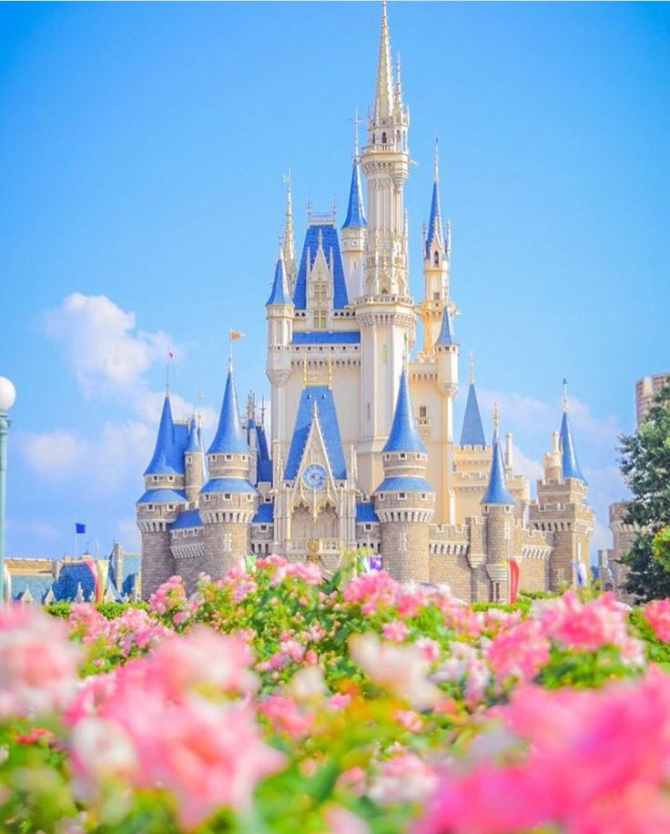

THE FUN STARTS HERE

Slide 2

Watch the video and predict the topic of our lesson
I think that the topic of our lesson is……

Slide 3
The aims of our lesson:
Learn new words
Read the texts about the most famous theme parks in the world
Create adverts

Slide 4

Let’s practice English sounds
[ aı ] ride, tiny, pirate, sight
[ æ ] andmark, candy, character
[ i: ] trapeze, wheel, meal
[ ɵ ] theme, thanks, thin
[ k ] cartoon, clown, character, candy
[əu ] ghost, home, rollercoaster, models
[ ɔ: ] explore, haunted, journey, floss

Slide 5
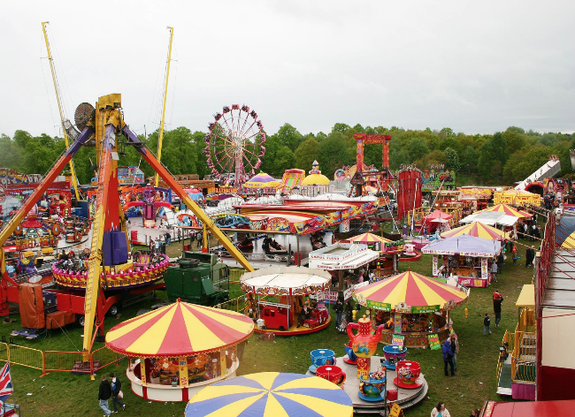

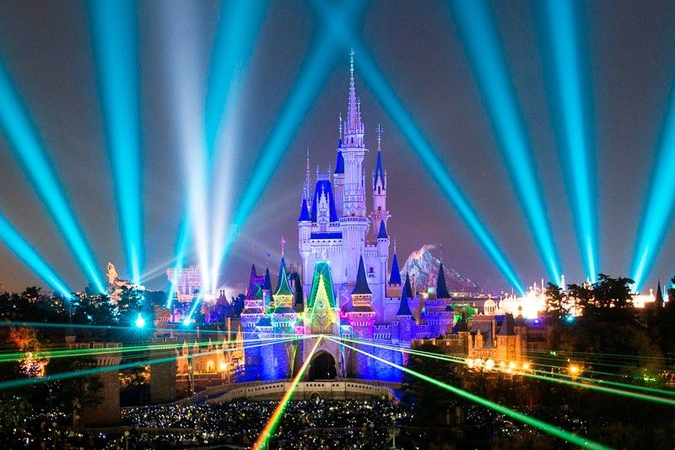
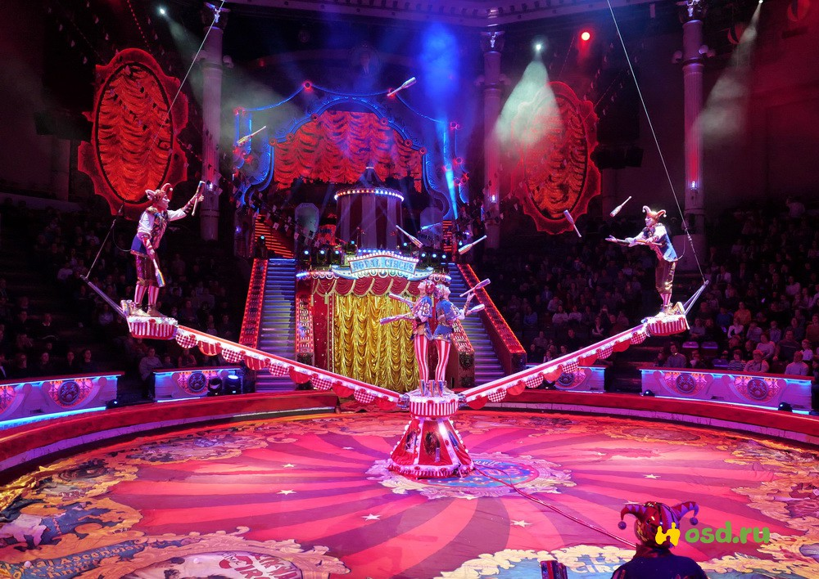
Where do you prefer to go?
Have you ever been in a circus?
What did you like? Have you ever dreamt of visiting the Disney Land?

Slide 6
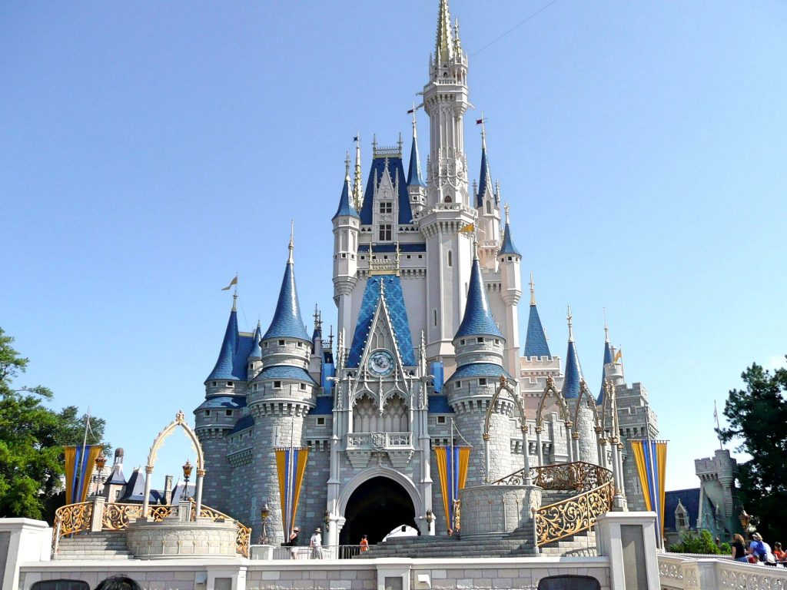
Disneyland - Tokyo

Slide 7
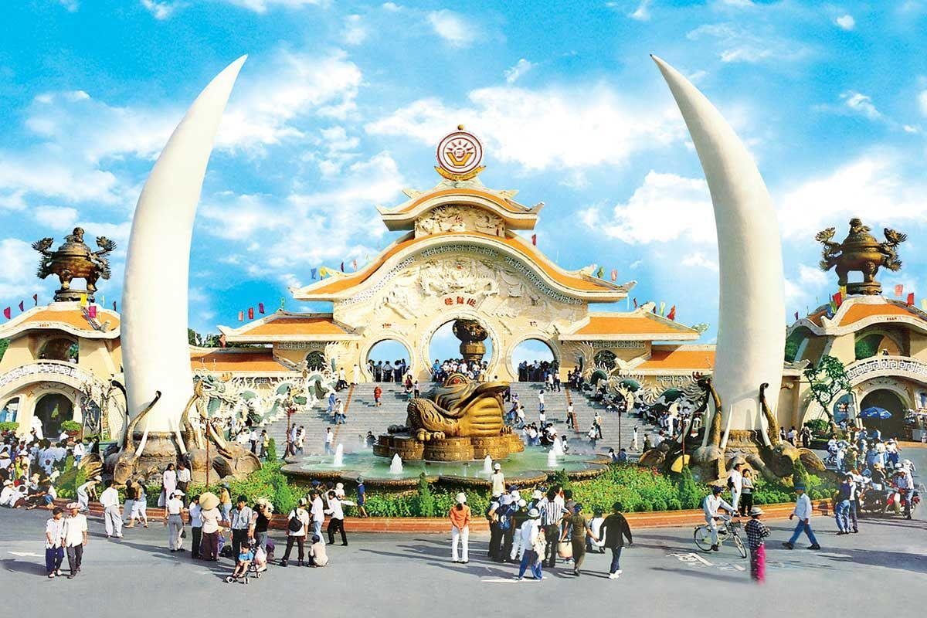
Suoi Tien Cultural Amusement Park – Vietnam

Slide 8
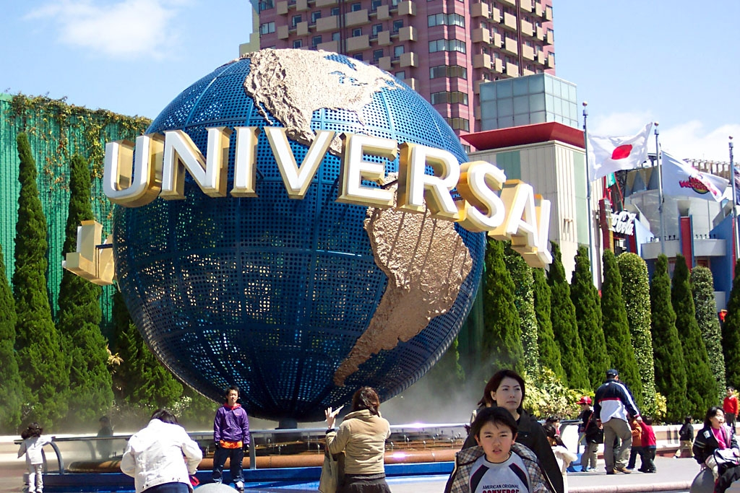
Universal Studios Japan Osaka Japan

Slide 9
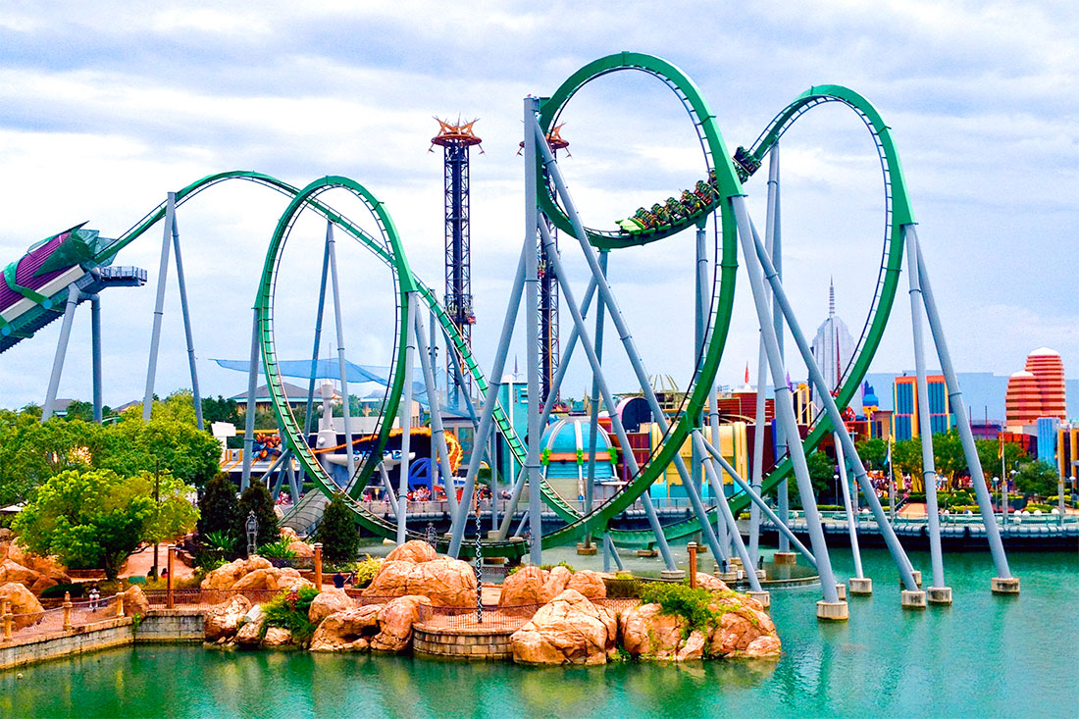
Islands of Adventure – Florida, US

Slide 10

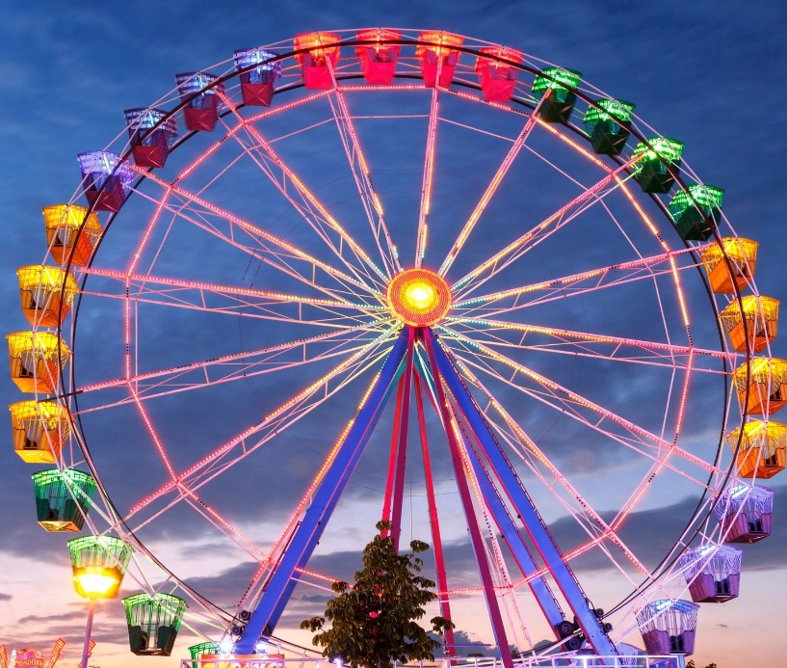
fly in a pirate ship
Two teams
1
2
ride on the big wheel

Slide 11
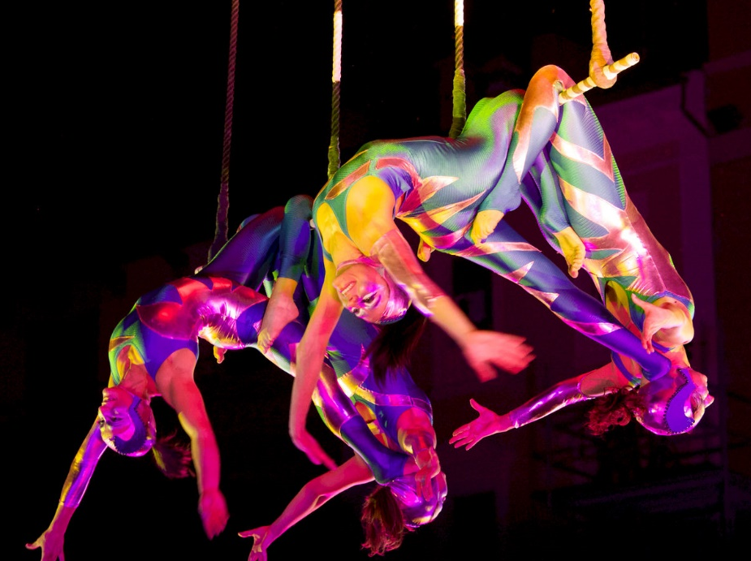
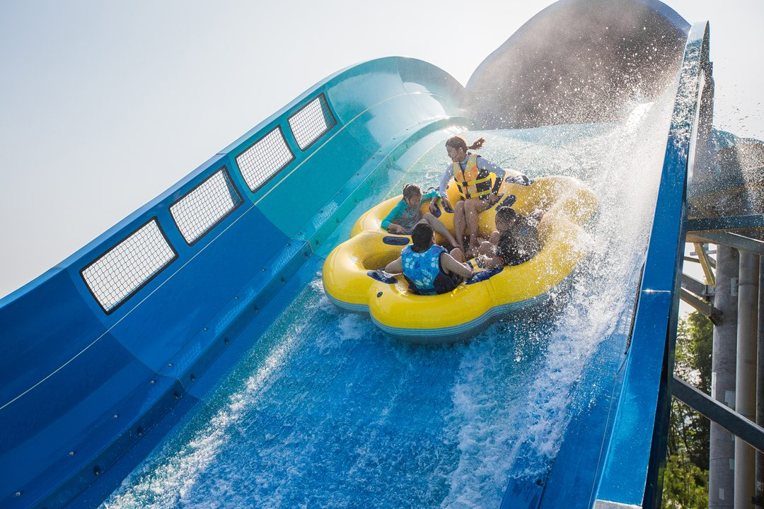
see trapeze artists
1
2
go on water ride

Slide 12
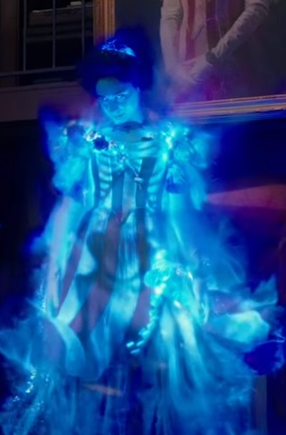
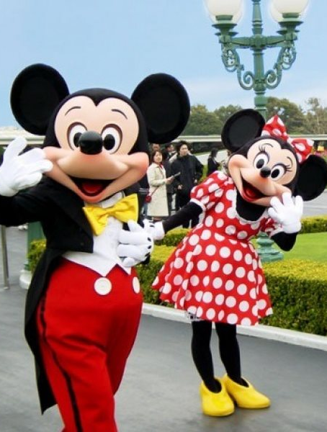
shake hands with cartoon characters
meet a ghost
2
1

Slide 13
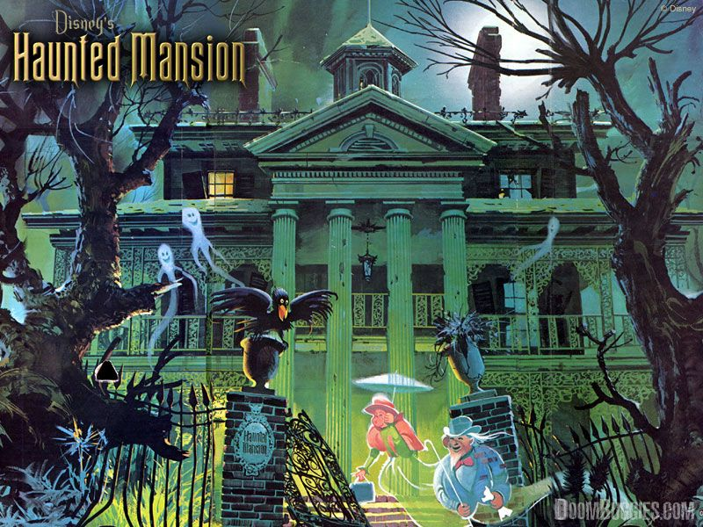
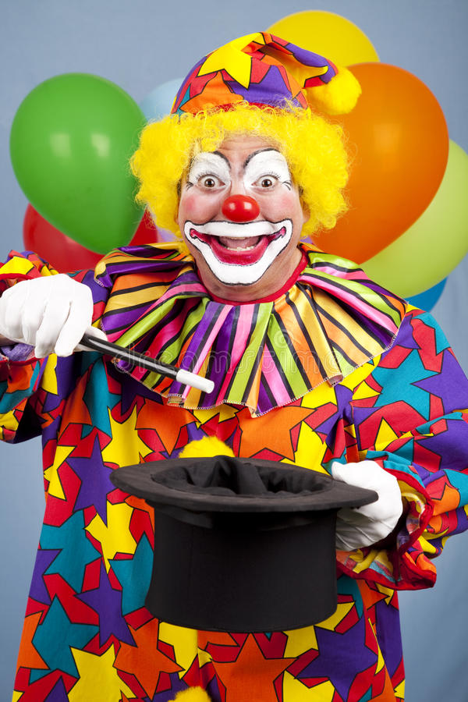
explore a haunted mansion
1
2
see clowns performing tricks

Slide 14
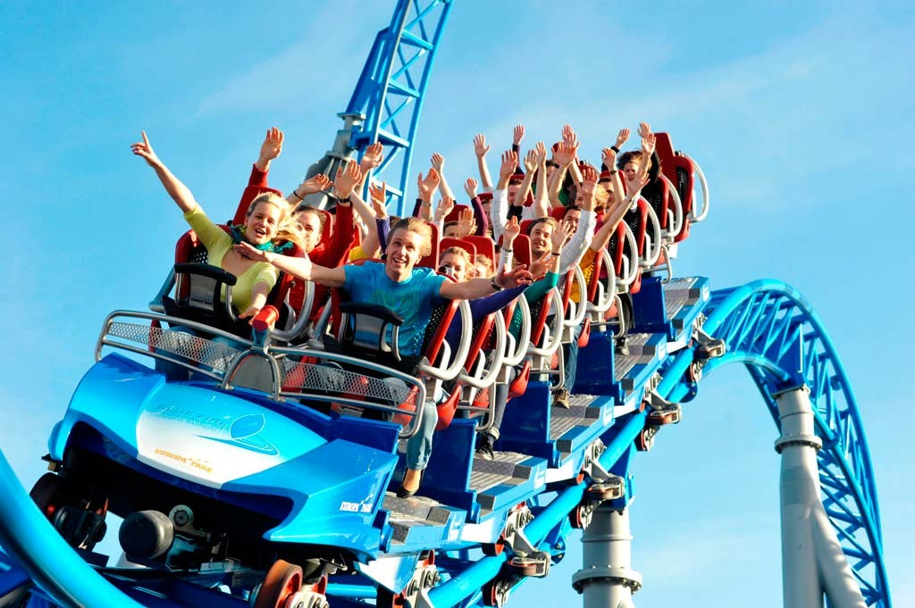
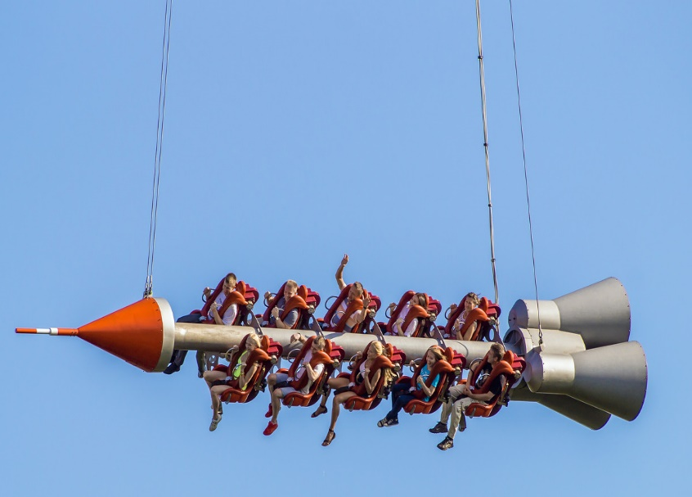
ride on a rollercoaster
1
2
go on a rocket journey

Slide 15
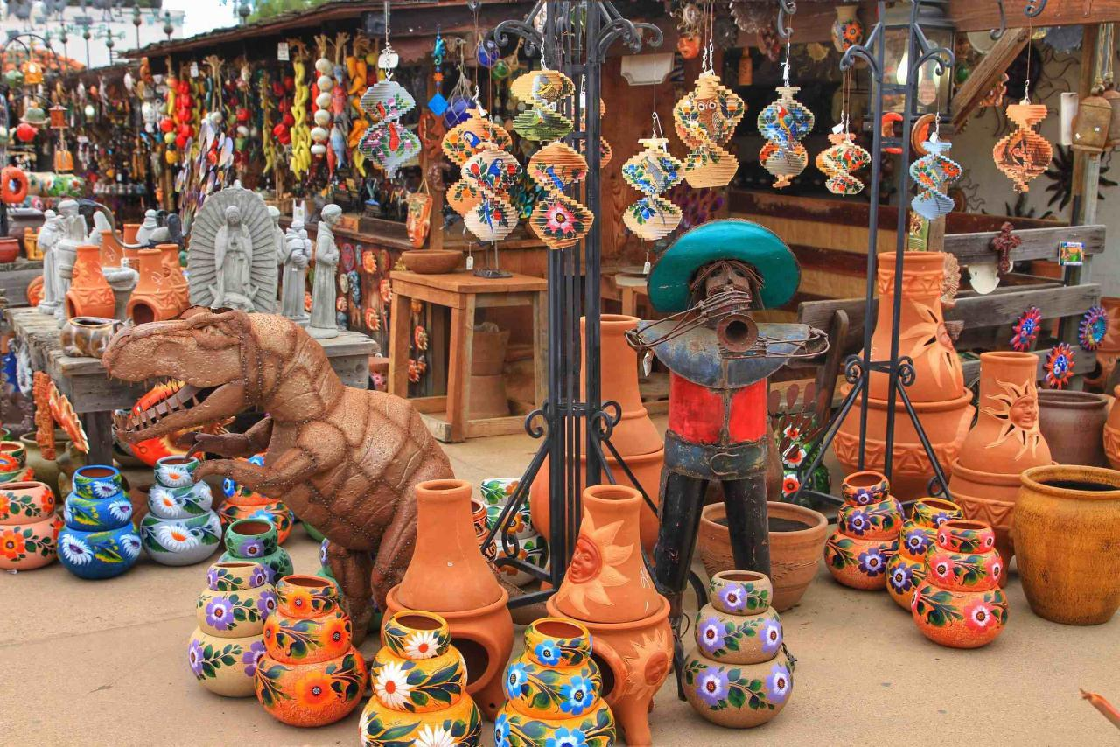
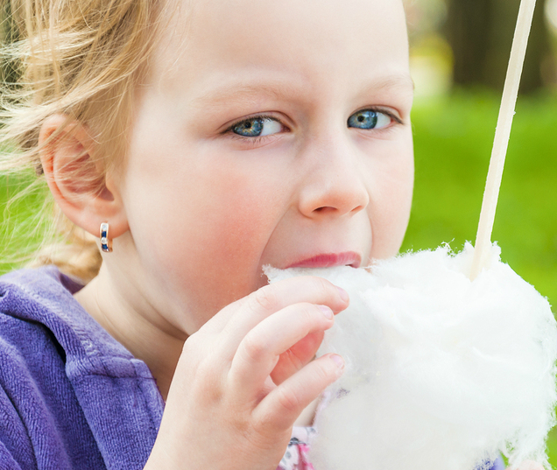
eat candy floss
2
go souvenier shopping
1

Slide 16

See
a pirate ship
trapeze artists
water ride
famous landmarks
a ghost
a rocket journey
souvenier shopping
clowns performing tricks
2

Slide 17
souvenier shopping
water ride
famous landmarks
a pirate ship
the big wheel
haunted mansion
rollercoaster
rocket journey
Ride on
1

Slide 18
Go on
souvenier shopping
trapeze artists
a rocket journey
water ride
a rollercoaster
a ghost
the big wheel
a haunted mansion
famous landmarks
2

Slide 19
Fly in
trapeze artists
souvenier shopping
water ride
a pirate ship
a ghost
the big wheel
a haunted mansion
clowns performing tricks
1

Slide 20
Explore
cartoon characters
a rocket journey
famous landmarks
the big wheel
a haunted mansion
clowns performing tricks
2

Slide 21
Shake hands with
trapeze artists
cartoon characters
a ghost
clowns performing tricks
1

Slide 22

How many activities have you tried?

Slide 23
New words
Explore (v) - to go around a place where you have never been in order to find out what is there
tiny (adj): very small
home-cooked (adj): cooked in the home, not store-bought
ghosts (n): phantoms
stroll (n): leisurely walk
get tired (v): feeling that you want to rest or sleep
Исследовать
Крошечный
Домашняя еда
Приведения
Прогуливаться
Устать

Slide 24
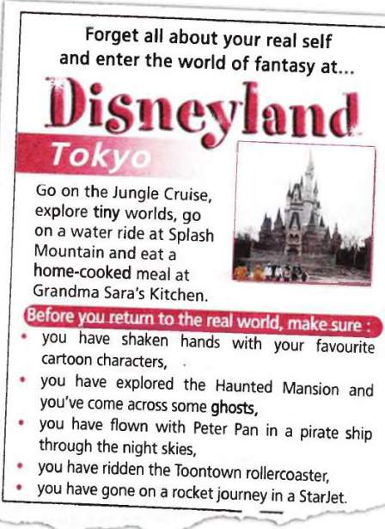
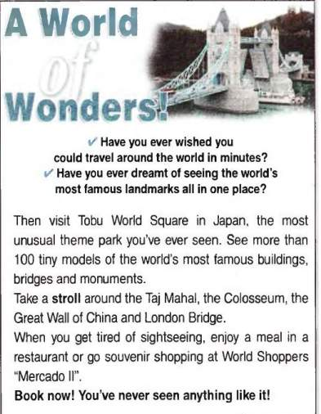

Slide 25
YOUR Advertisement
An original name of your park where it is situated what materials it’s made of describe the attractions in your theme park what’s the age of people you would recommend to visit it explain why a visit to your park will be unforgettable (незабываемый)

Slide 26
KWL
KNOW I know that…. | LEARNT I have learnt that… | WANT TO LEARN I want to learn about ….

Slide 27
What have you learnt?
What did you like?
Homework
WB: p.35, № 1-3
Thanks! See you soon!

