Slide 1
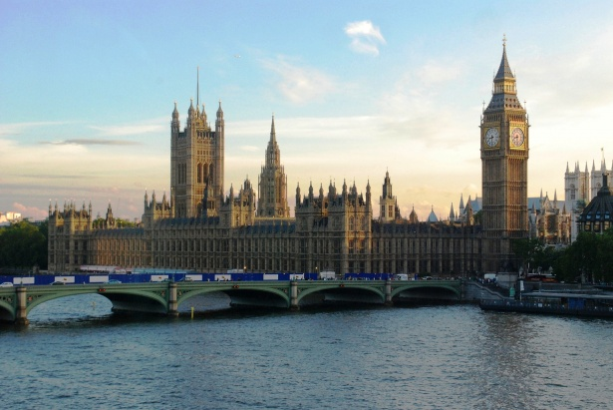
АВТОР: АНДРЕЕВА ТАТЬЯНА ПАВЛОВНА
УЧИТЕЛЬ АНГЛИЙСКОГО ЯЗЫКА
ГБОУ ГИМНАЗИЯ 399 САНКТ-ПЕТЕРБУРГ
ПРЕЗЕНТАЦИЯ К УРОКУ-ВИКТОРИНЕ ПО УЧЕБНОМУ ПРЕДМЕТУ «АНГЛИЙСКИЙ ЯЗЫК» В 6 КЛАССЕ НА ТЕМУ «ВЕЛИКОБРИТАНИЯ»

Slide 2
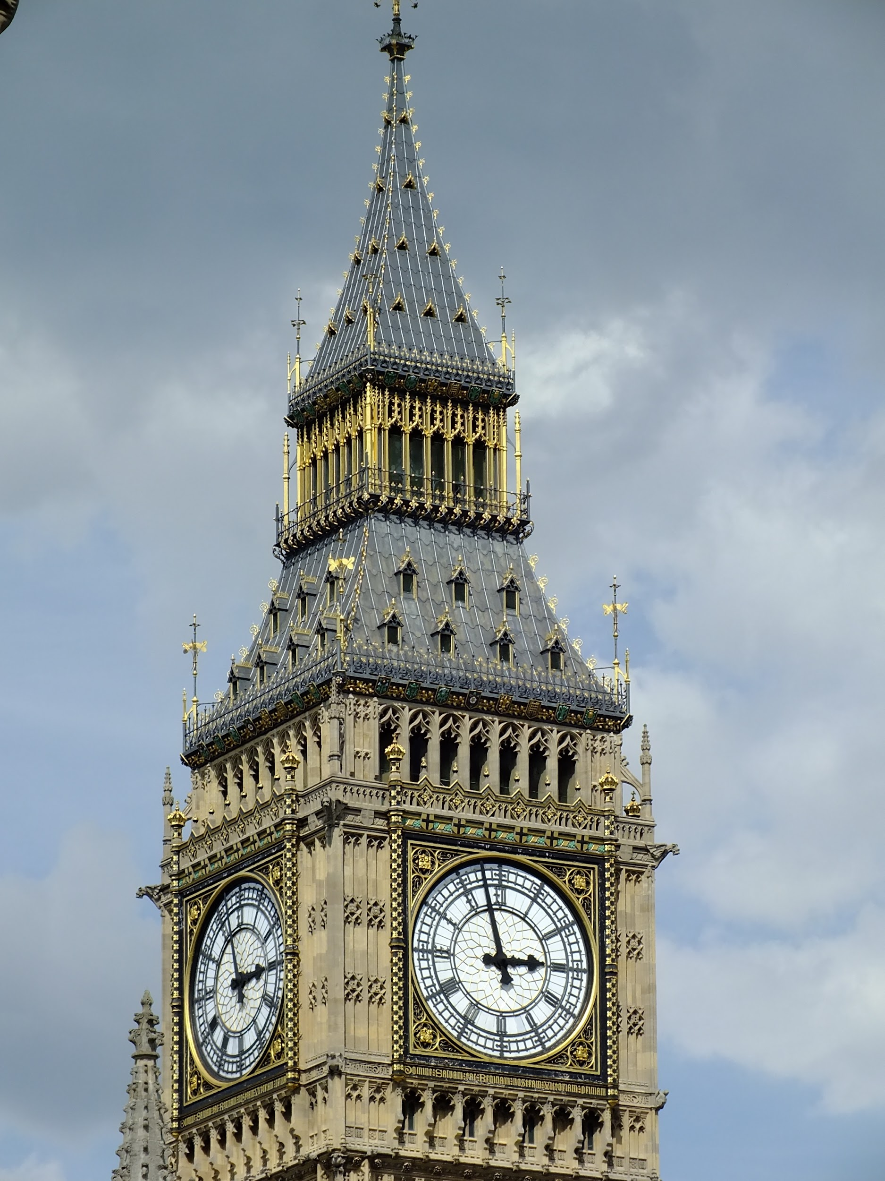
How many countries does Great Britain consist of?
What is the official name of Great Britain?

Slide 3
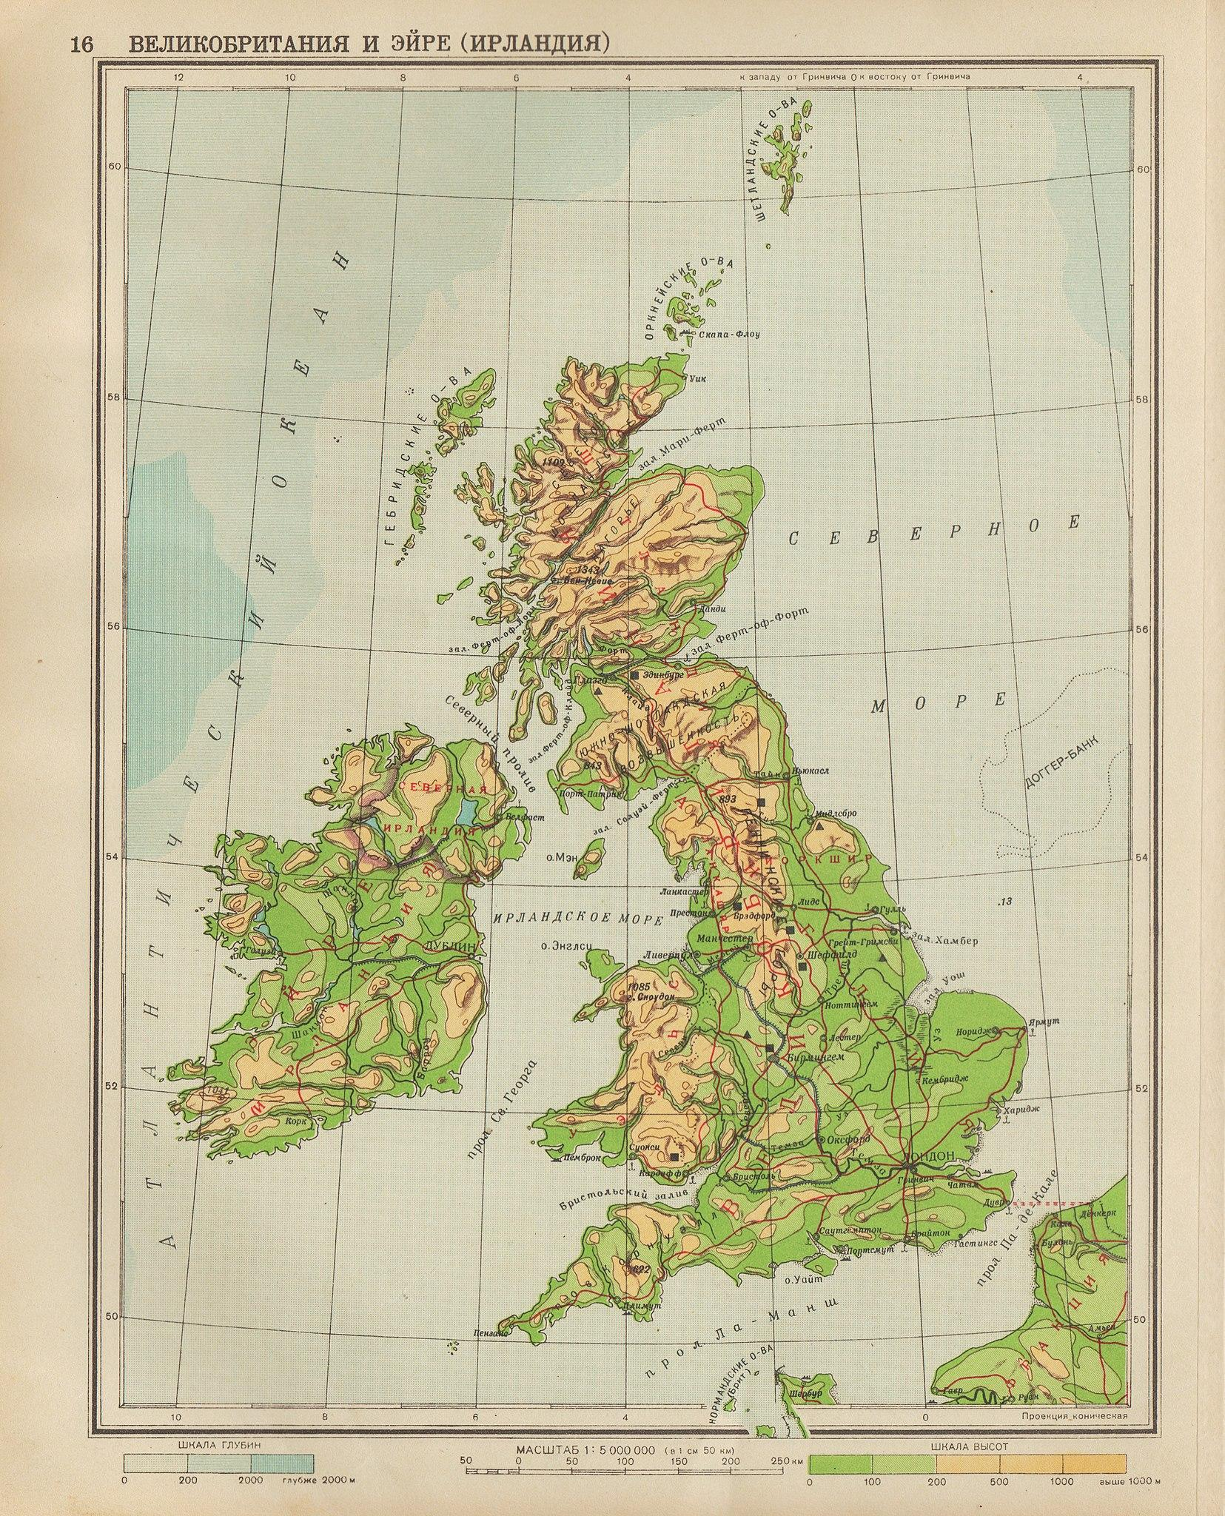
Which is the biggest island out of 5000 islands in the UK?
(Great Britain, Wales, Northern Ireland, Scotland)?

Slide 4
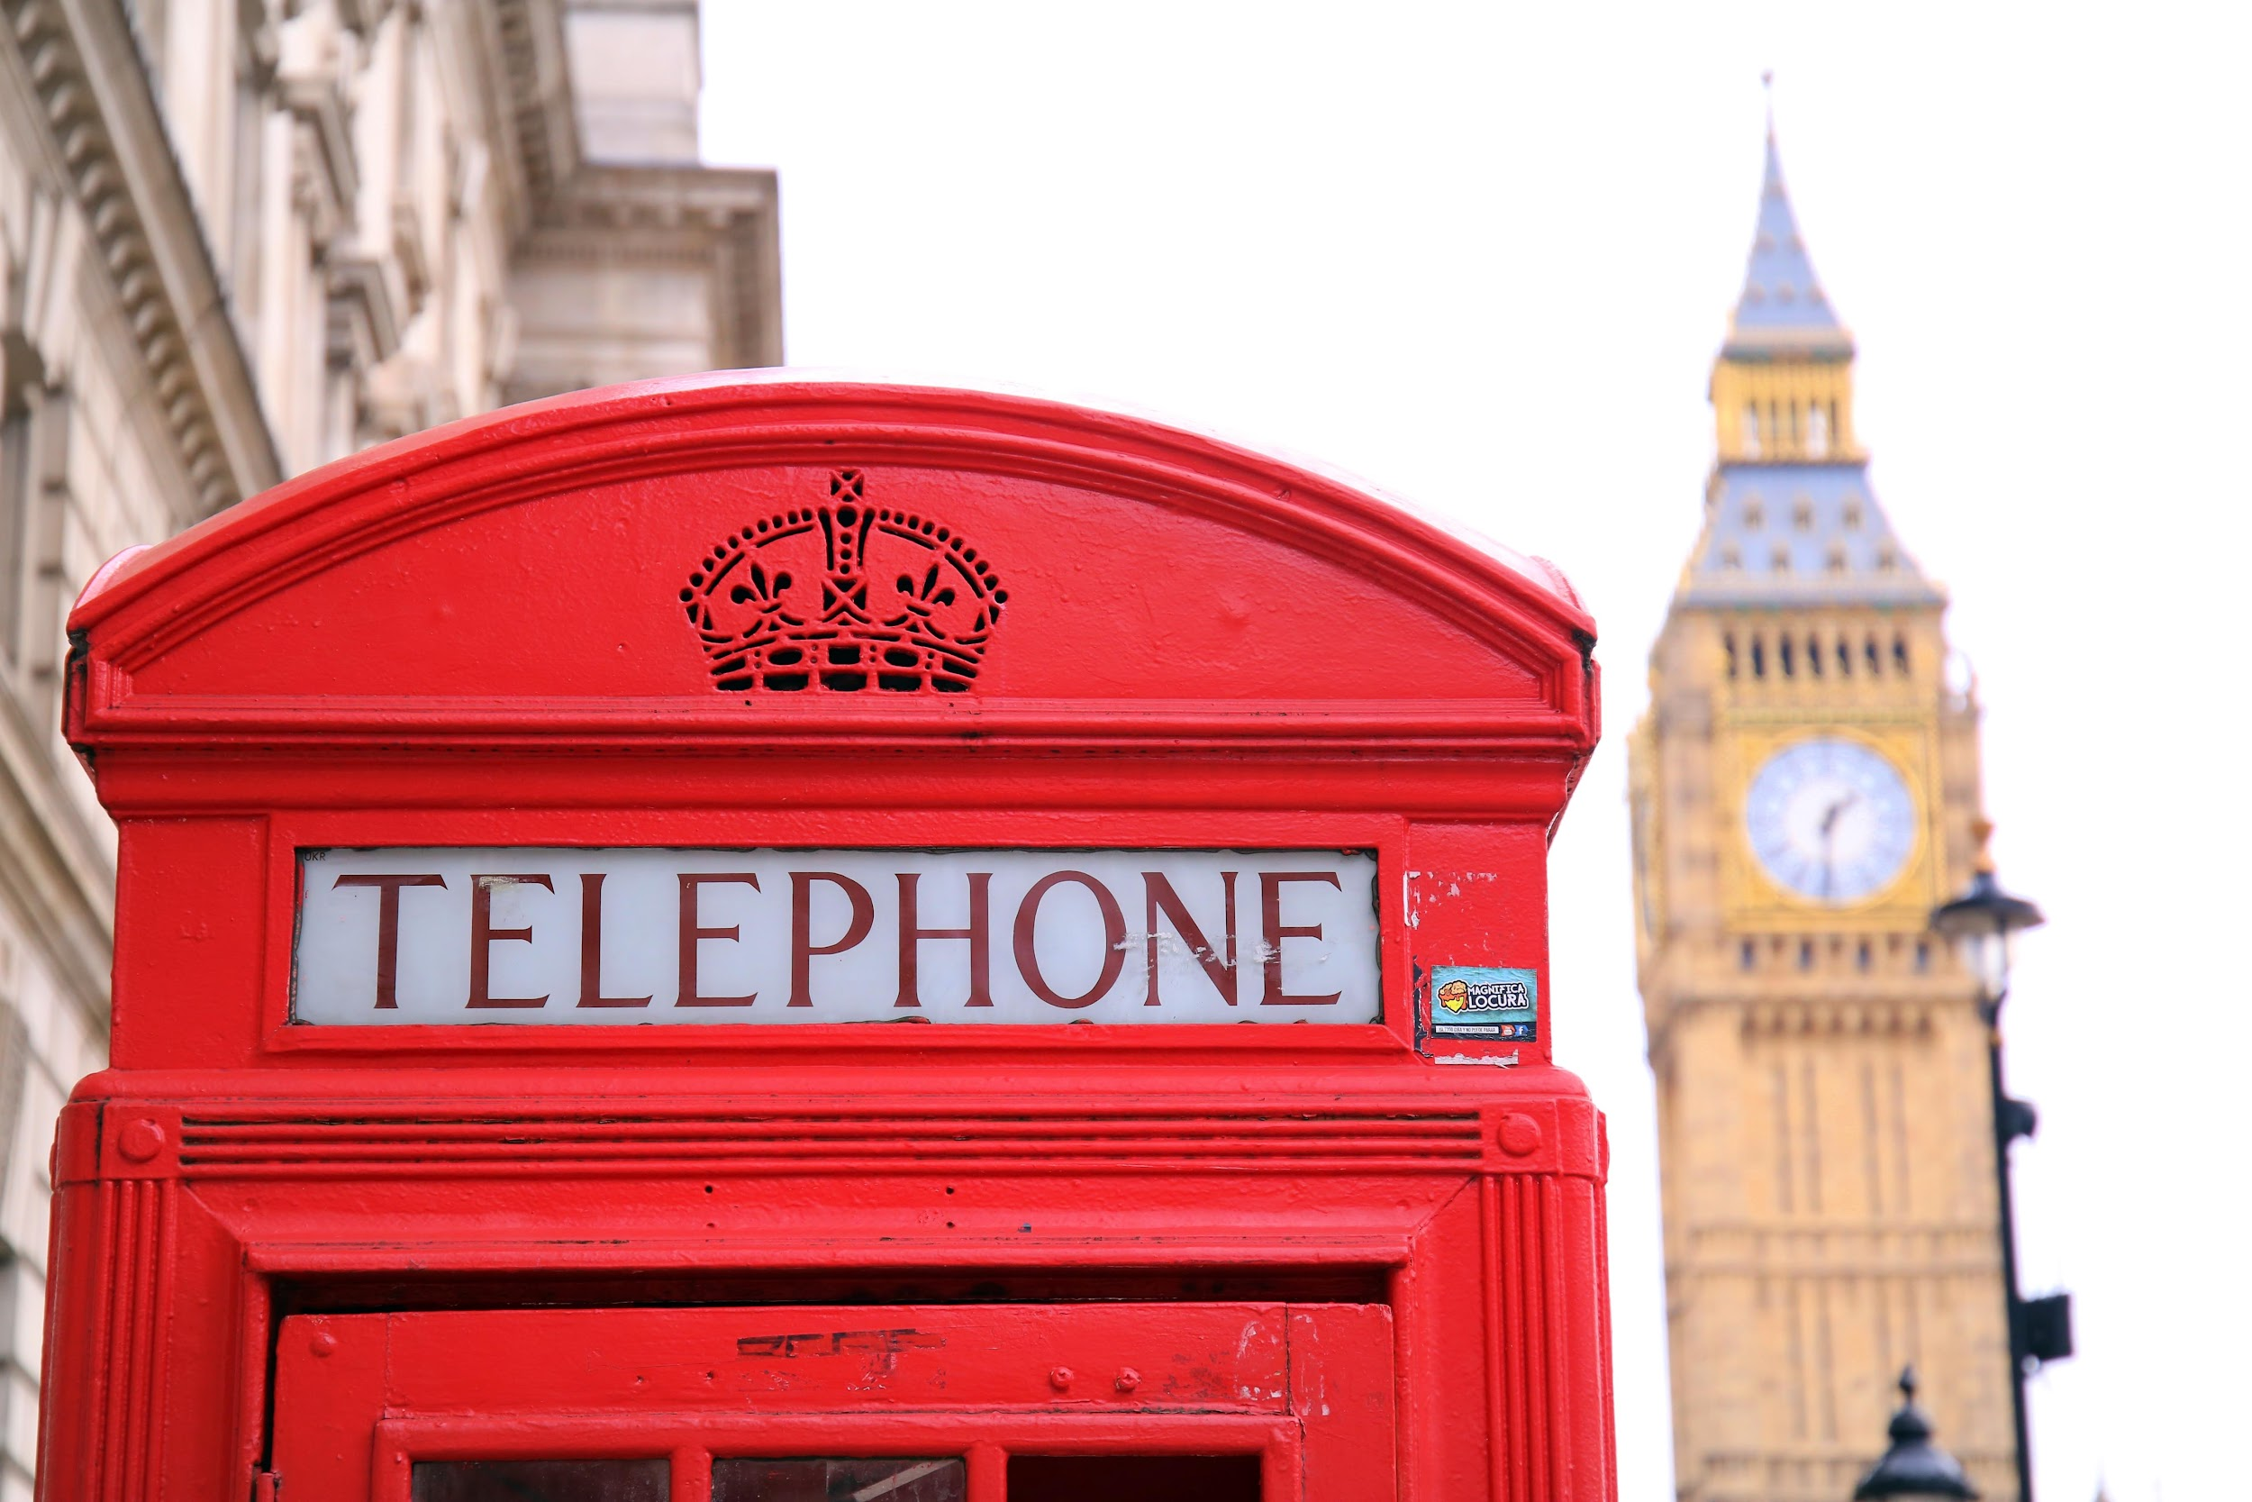
Match the countries to the capitals:
England
Scotland
Wales
Northern Ireland
Belfast
Cardiff
London
Edinburgh

Slide 5
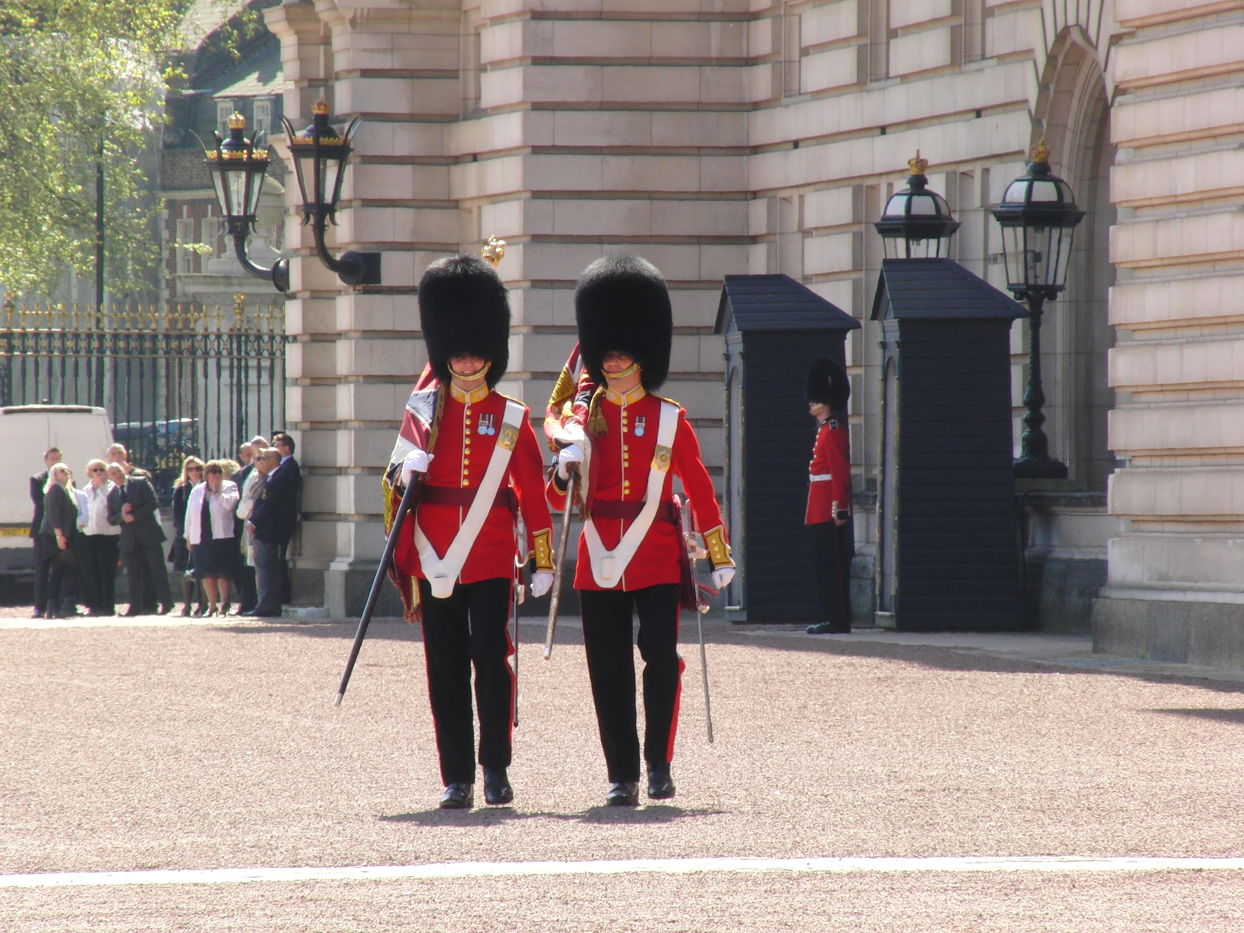
What is the population of Great Britain?
23 mln
67 mln
32 mln

Slide 6
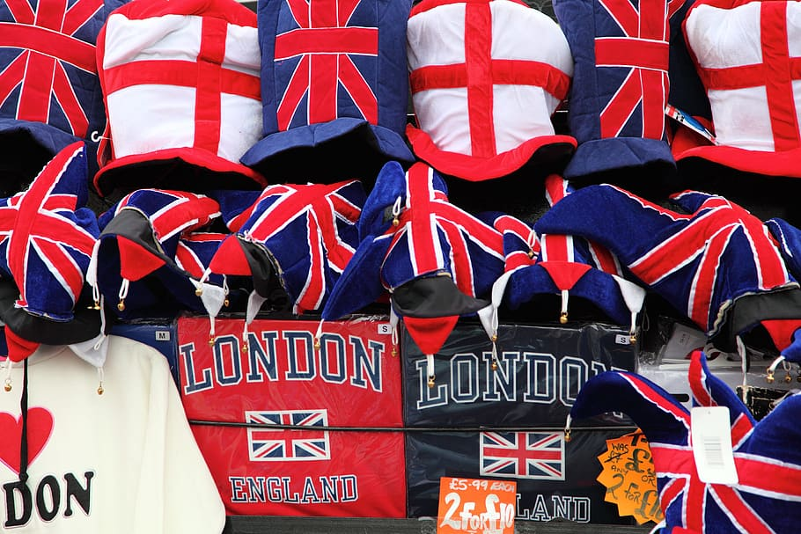
What is the Union Jack?

Slide 7

Which kind of sport was born in the UK?
football skiing
surfing cricket

Slide 8
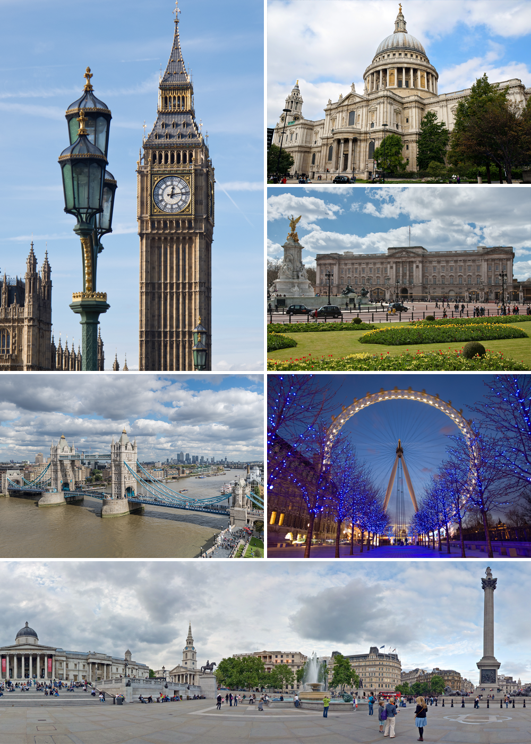
Name as many places of interest (sights) in London as you can.

Slide 9
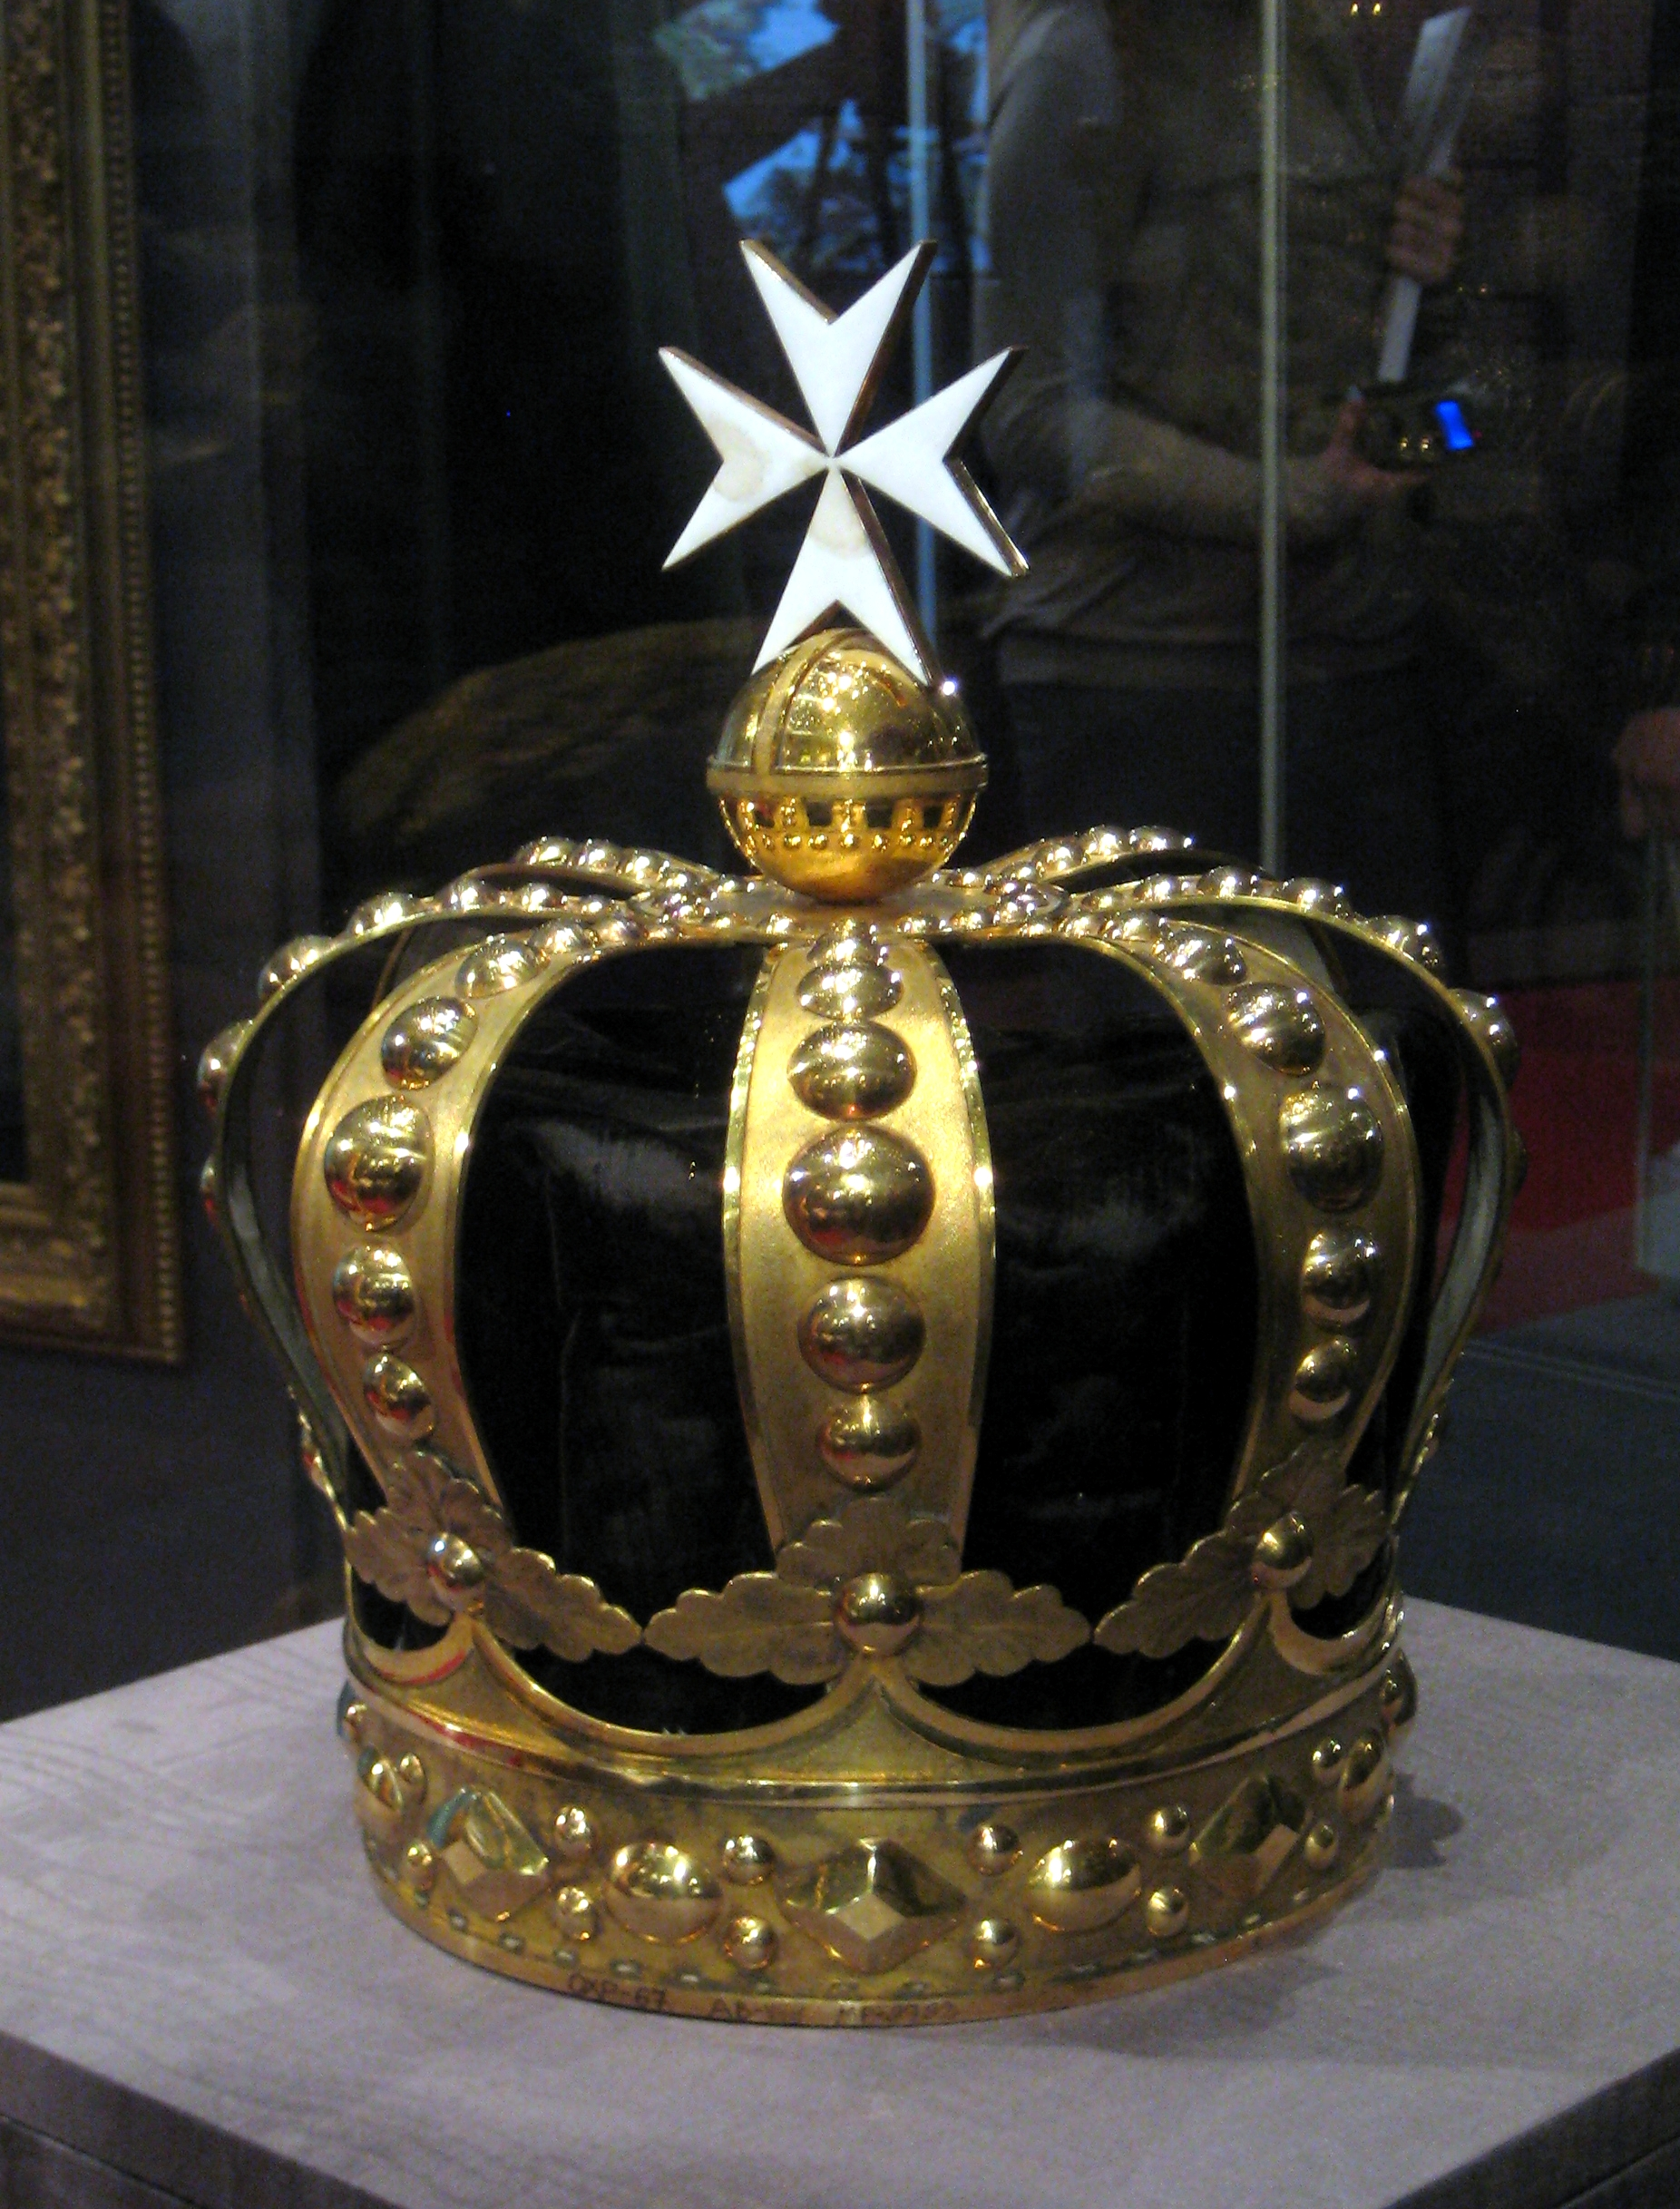
Who rules Great Britain?

Slide 10
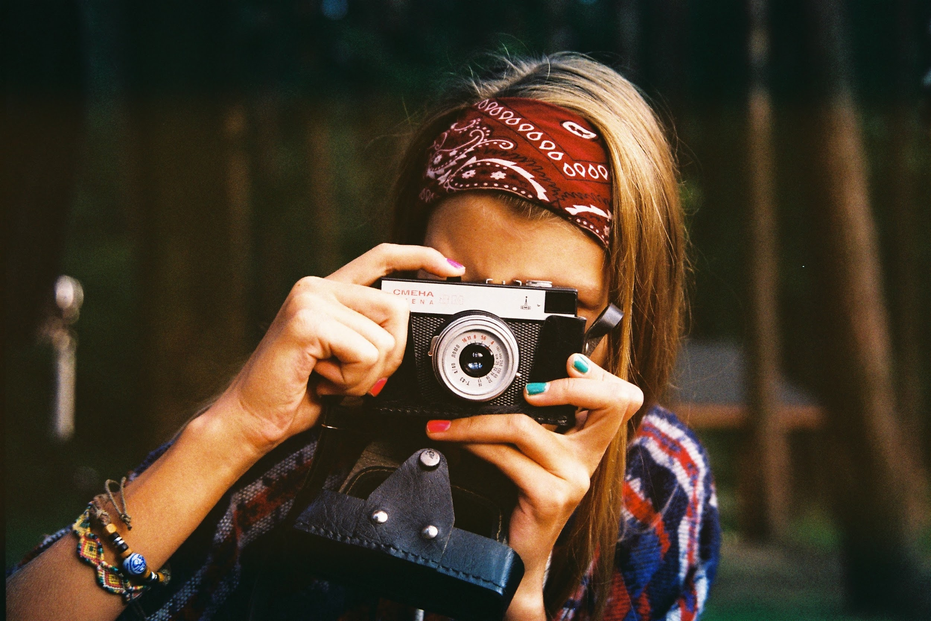
What are the most popular English hobbies?

Slide 11
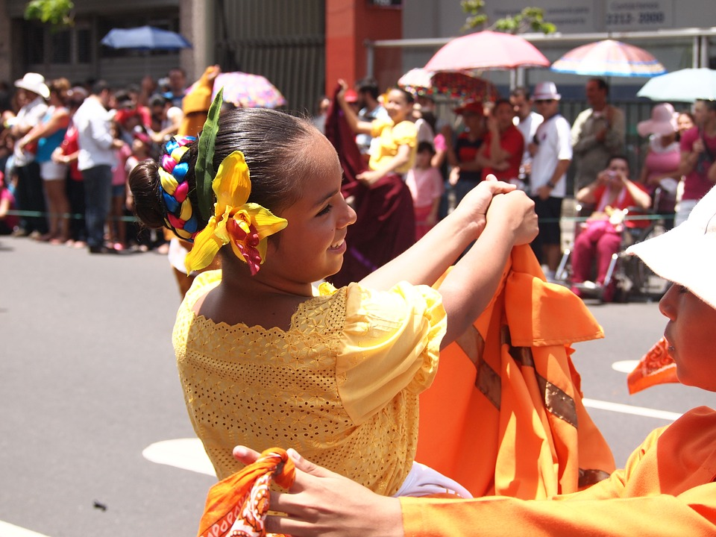
Which holidays do British people celebrate with the rest of Europe?
-Christmas
-Pancake Day
-New Year
-Guy Fawkes* Night

Slide 12
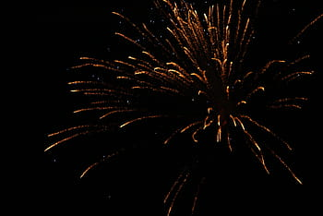
When is Guy Fawkes* Night celebrated in Britain?
November,5
-October, 31
-February, 14
-July, 4

Slide 13
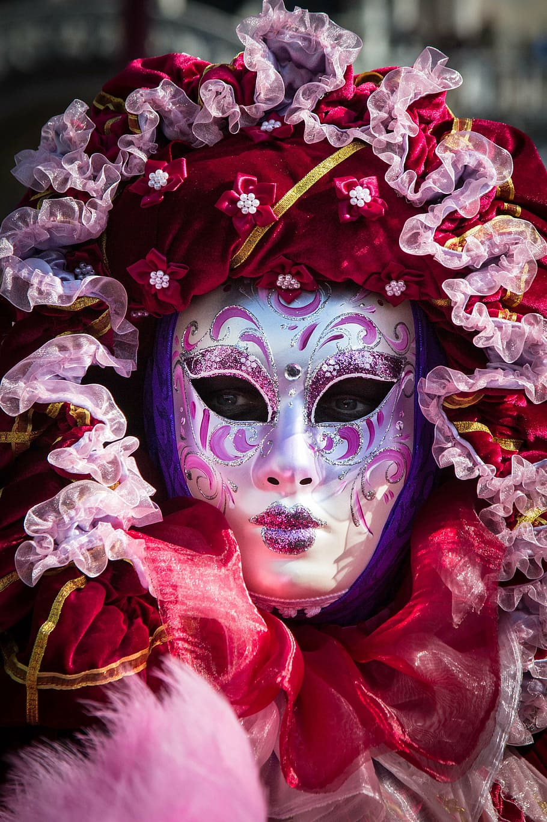
What do people usually do at Guy Fawkes* Night?
burn a model of Guy Fawkes
-have lots of fireworks
-make models of "Guys"
- all these things

Slide 14
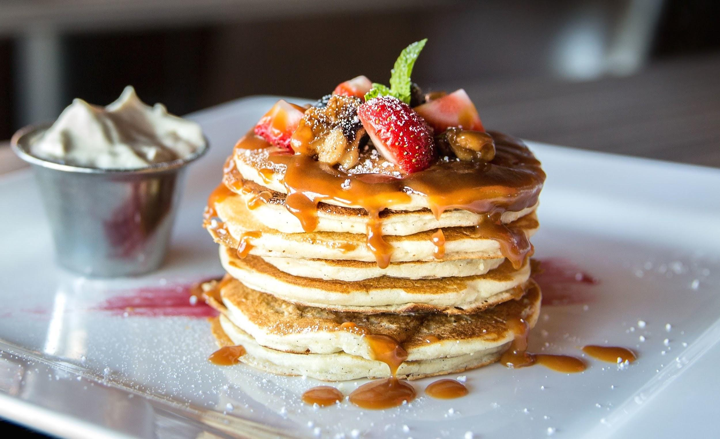
What is Pancake Day? When is it celebrated?
in May
-in February
-in March
What races do British people have on this day?

Slide 15

What is St. Valentine*s Day? When do people celebrate it? What do they send to the people they are in love with?

Slide 16
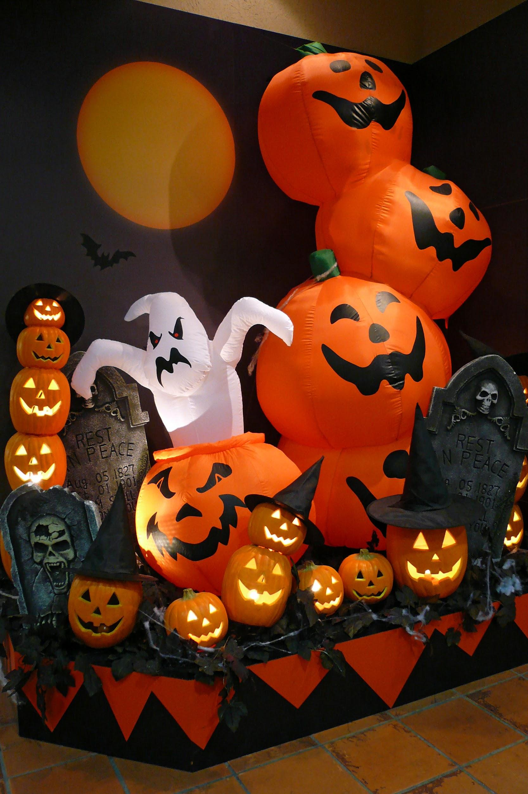
- What kind of holiday is Halloween? When is it celebrated? What do people do?
-give presents
-have parties
-dress as witches and ghosts

Slide 17
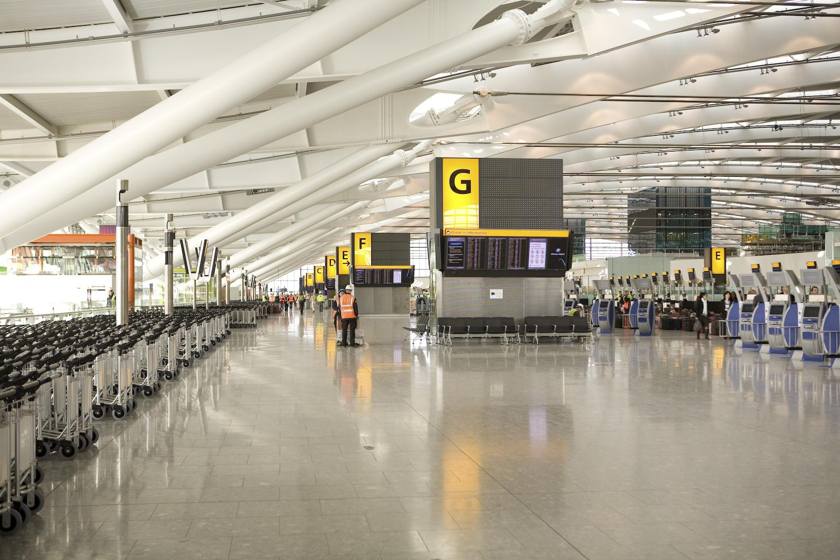
What is the famous airport in London?

Slide 18
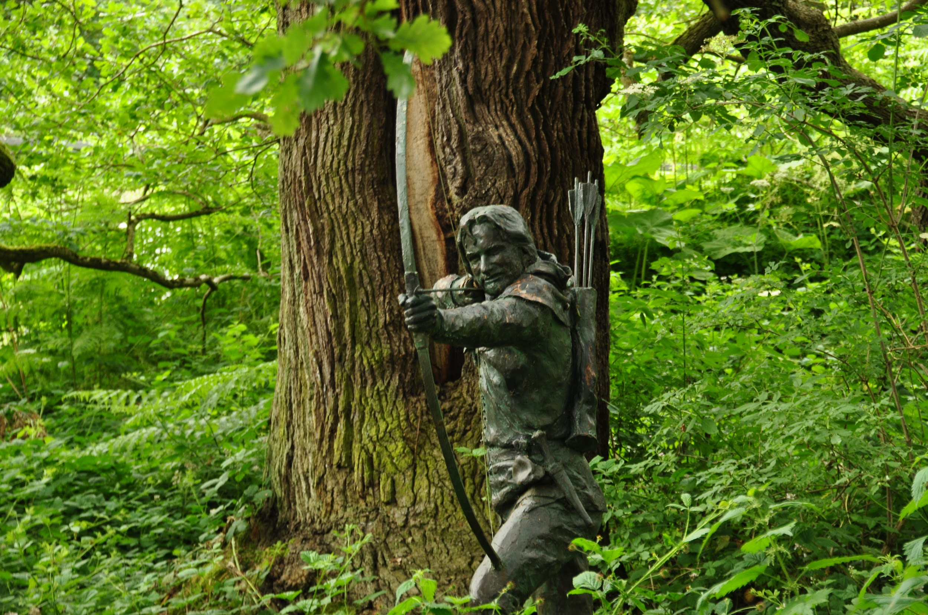
Who lived in Sherwood forest?

Slide 19
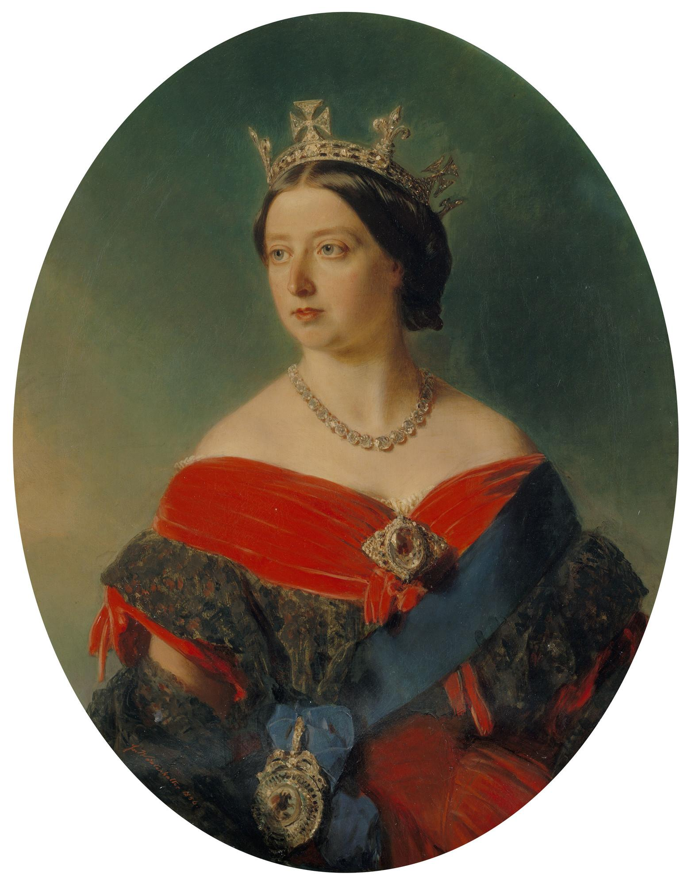
This monarch ruled for the longest period in the English history? (64 years)

Slide 20
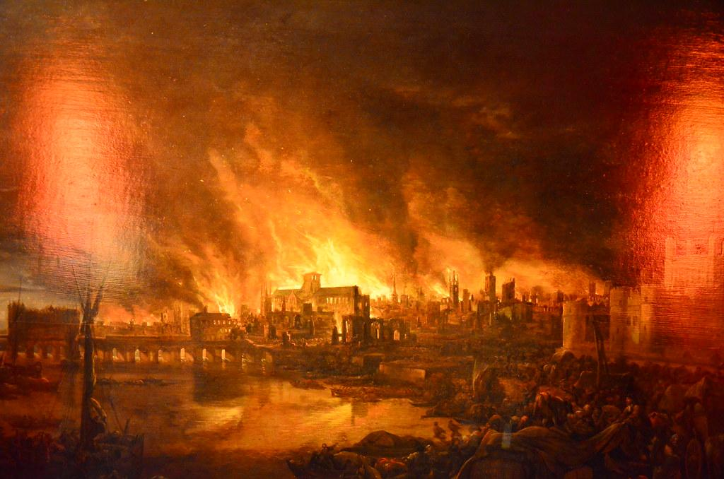
When did the Great Fire of London take place?

Slide 21
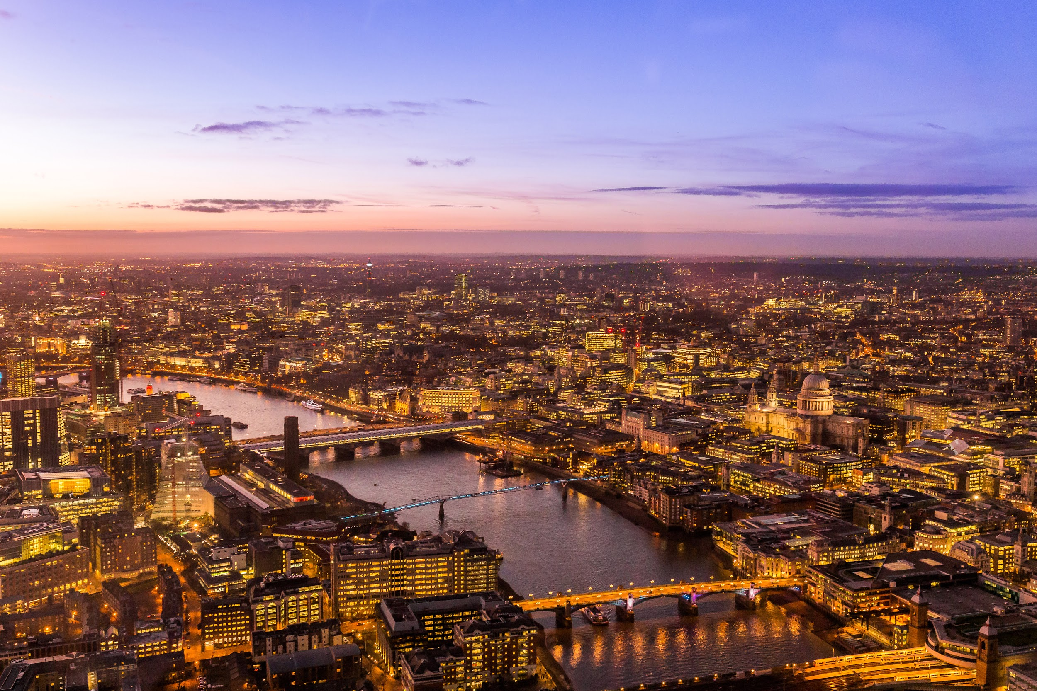
It is the historical centre of London and one of the biggest financial centres of the world.

Slide 22
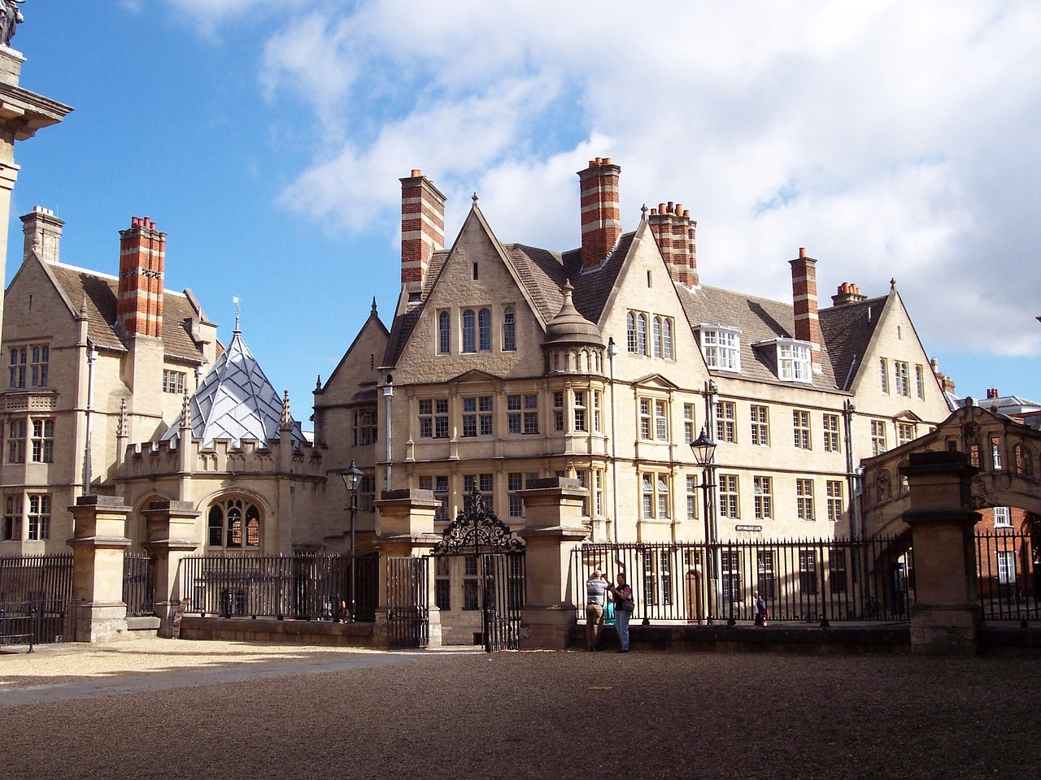
It is the second largest university in Britain

Slide 23

What languages are spoken in Wales?

Slide 24
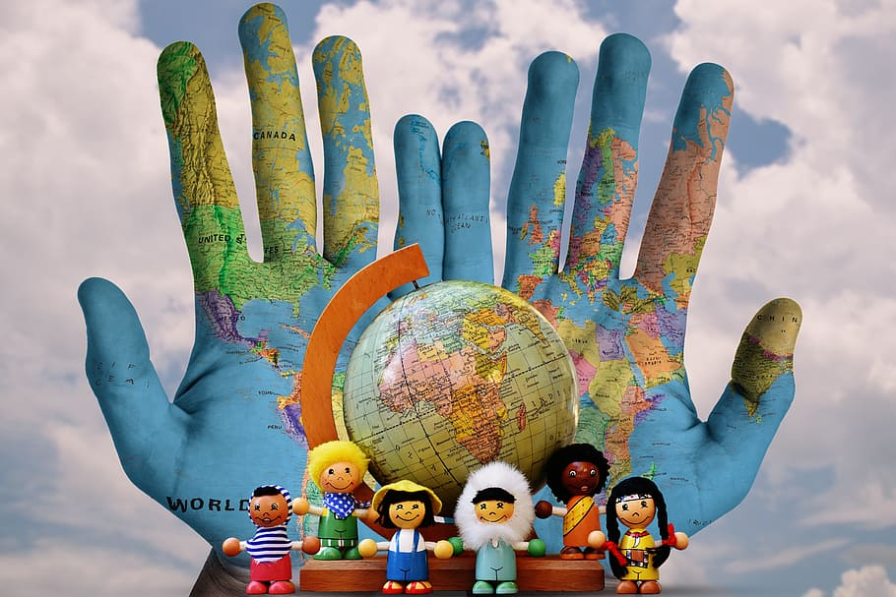
What is the nationality of people who were born in Nortern Ireland?

Slide 25
THANK YOU FOR YOUR ATTENTION!

