Slide 1

Мешалкина Снежана Валерьевна учитель английского языка
МБОУ «СОШ№8 г.Горно-Алтайска»
Презентация к уроку по учебному предмету «Английский язык» в 4 классе
к УМК Rainbow English 4 Unit 7 Step 1 на тему
«В выходные. Правильные глаголы и глагол to be в прошедшем времени.»

Slide 2

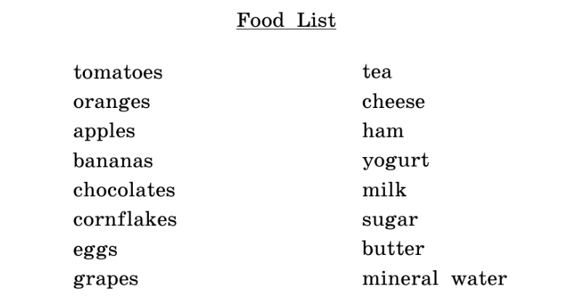
Послушай и скажи, какие из этих продуктов были, а каких не было в магазине
Образец:
There were some tomatoes in the shop.
There were no grapes there.

Slide 3
Образец:
There were some tomatoes in the shop.
There were no grapes there.
There were some tomatoes, bananas, apples in the shop.
There were no oranges, cornflakes, chocolates, eggs there.
There was some ham, tea, sugar, milk and mineral water.
There was no yogurt, butter, cheese in the shop.

Slide 4
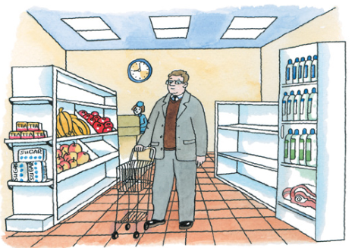
Поработайте в парах. Глядя на картинку, задайте несколько вопросов о том, что было вчера на полках в магазине.
Образец:
Was there any sugar in the shop?
Yes, there was.
Were there any grapes in the shop?
No, there weren’t.

Slide 5
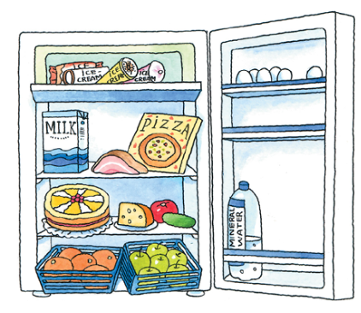
Посмотри на картинку и скажи, что было и чего не было в холодильнике у госпожи Браун (Mrs. Brown) вчера утром.
There was a pizza in the fridge.
There was a ... in the fridge.
There was a ... .
There was a ... .
cucumber
tomato in the fridge
cake in the fridge

Slide 6
There was some bacon in the fridge.
There was some ... in the fridge.
There was some ... .
There was some ... .
milk
cheese in the fridge
mineral water in the fridge

Slide 7
There were some ice creams in the fridge. There were some ... in the fridge.
There were some ... .
There were some ... .
apples
oranges in the fridge
eggs in the fridge

Slide 8
ham
There was no ... in the fridge.
There was no ... in the fridge.
There were no ... .
There were no ... .
yogurt
grapes in the fridge
bananas in the fridge

Slide 9
Выбери правильную форму глагола, чтобы закончить эти предложения.
ед.ч.
мн.ч.
1)Yesterday it (was/were) rainy and cold. There (was/were) no children in the parks.
2)Last year there (was/were) two cinemas and one hotel in Apple Street. There (is/are) one cinema and two hotels there now.
3)What (was/were) there in the middle of the room? There (was/were) a table and four chairs there.
4) There (was/were) four desks and a teacher’s table in the classroom.
5)There (was/were) some juice and some vegetables on the kitchen table.
6) There (was/were) some vegetables and some juice on the kitchen table.
7) There (was/were) a bus stop and a pet shop in front of John’s house.
8) There (was/were) a lot of new toys in the toy shop yesterday.
мн.ч.
ед.ч.
ед.ч.
мн.ч.
неис.сущ.
мн.ч.
ед.ч.
мн.ч.

Slide 10

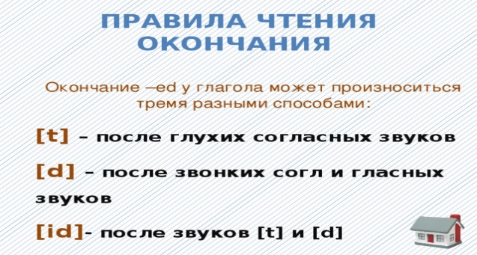
Past Simple простое прошедшее время
ed
open - открывает
opened - открыл

Slide 11
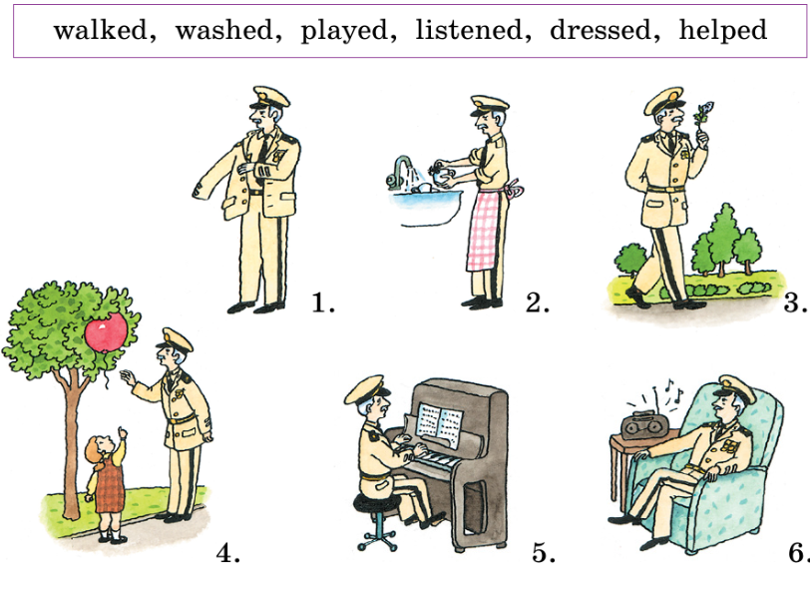
Last weekend general Green….

