Slide 1
Презентация к уроку по учебному предмету
«Английский язык» в 5 классе
на тему «Школьные предметы»
Абрамова Анастасия Александровна
Учитель английского языка
ГБОУ СОШ №1798 г.Москва

Slide 2
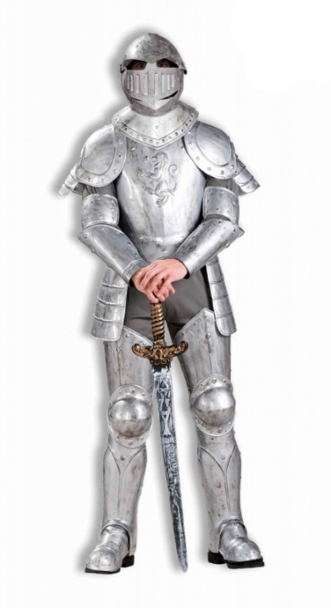
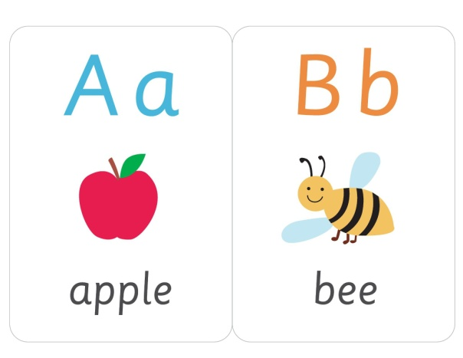

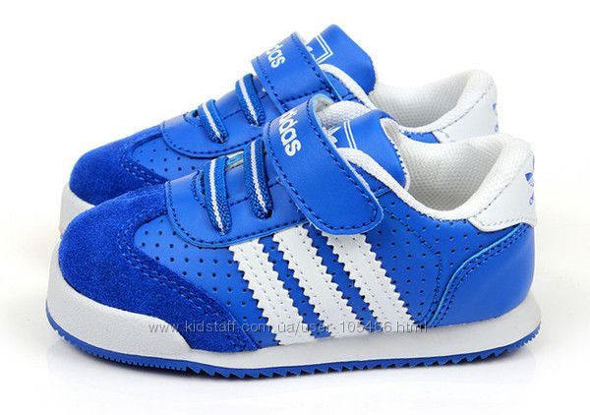








Read and match
Russian
Literature
English
Maths
History
Technology
Geography
Music
PE
IT
Art
Biology

Slide 3

What is the missing letter?
R _ ssian
Lite _ ature
Engli _ h
Mat _ s
Histor _
Tec _ nology
Geogra _ hy
Musi _
_ rt
B _ ology

Slide 4

What is the word?
Smtah
Cmsui
Obyogli
Nsrasui
Sgehinl
Aogyprhge
Oshytir
Aeietrtlru
Oncylhgoet

Slide 5
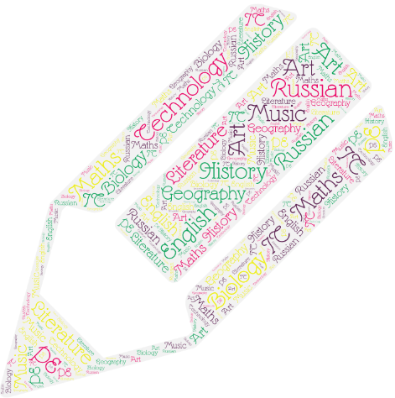
Dictation

Slide 6
Английский язык

Slide 7
История

Slide 8
Технология

Slide 9
Русский язык

Slide 10
Информатика

Slide 11
Музыка

Slide 12
Физкультура

Slide 13
Литература

Slide 14
География

Slide 15
Биология

Slide 16
Математика

Slide 17
Рисование

Slide 18

What is your favourite subject?
 | Tanya | Lena | Slava | Misha
Russian
Literature
English
Maths
History

Slide 19
Read the text and answer the questions
Look at Dima’s dairy. He is good at English.
He’s goot at Maths, IT and PE. But he’s not good at
Geography and Biology.
What are Dima’s favourite subjects?
English – 5
History – 4
Music – 3
Russian – 4
Maths – 5
Geography – 2
Biology – 3
PE – 5
IT - 5
What subject are you good at?

Slide 20
Have got – Has got
We ___ History today.
I ___ Maths at school.
He ___ English at school.
She ___ Russian every day.
The boy ___ PE every day.
We ___ Geography.
My sister ___ not got Art today.
___ you got Biology today?
The girl ___ Literature today.
Our brother ___ Technology at school.

Slide 21
Во многих словах греческого происхождения звук [f] передаётся буквосочетанием ph. Эти слова относятся к группе интернациональных слов. Их значение легко понять.
Telephone
Photo
Geography
Alphabet
Physical
Dolphin
ph
[ f ]

Slide 22
Найди слова греческого происхождения
Telephone, favourite, photography, fact,
paragraph, phrase, fiction, philosophy,
family, physics, factory, alphabet

Slide 23
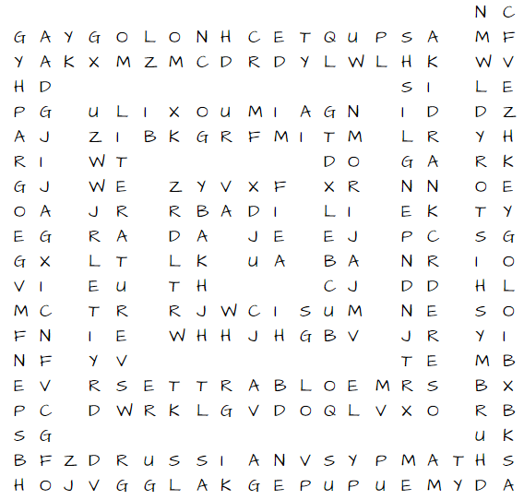
Wordsearch
12 school subjects

