Slide 1
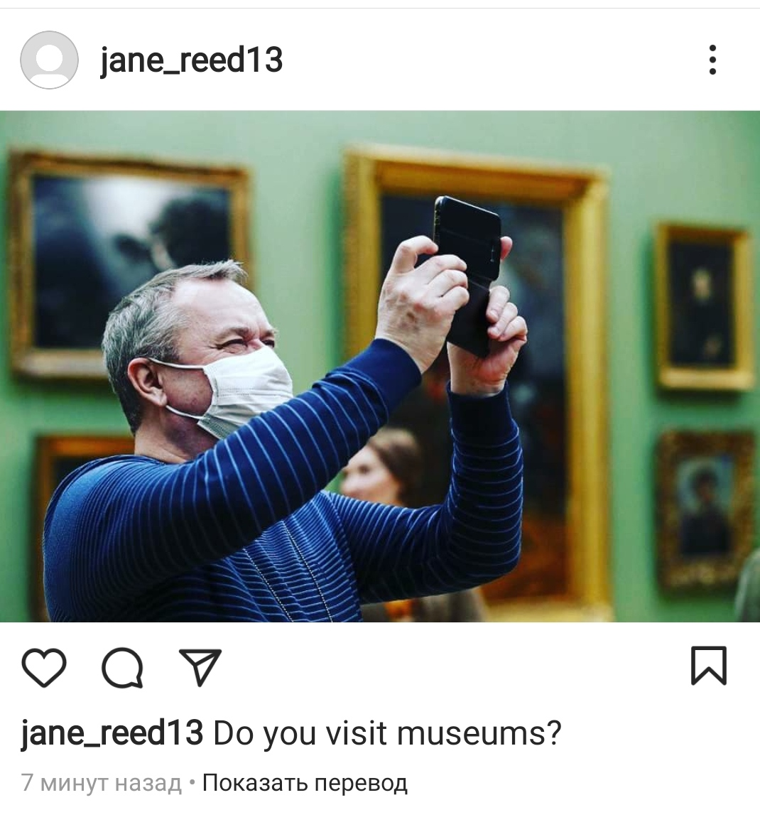

Slide 2


Slide 3
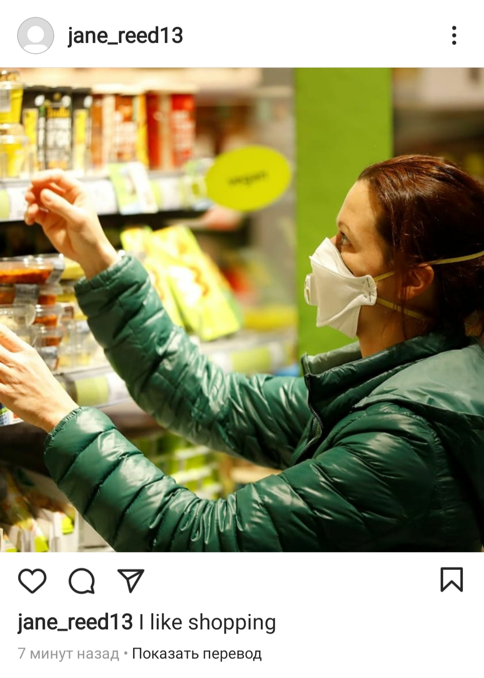

Slide 4


Slide 5
Modal Verbs

Slide 6
Modal verbs
never change
before another verb
without to
-s, -ed, -ing

Slide 7
But:
have to
ought to
be able to

Slide 8
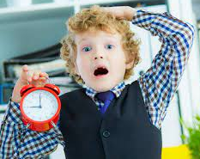
You have to get up earlier.

Slide 9

Possibility
May
Might

Slide 10


Possibility
This ___ hurt you.
I haven’t decided yet.
I _____ go to Ireland.
may
might
may
might

Slide 11
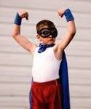
Ability
can
could
be able to

Slide 12
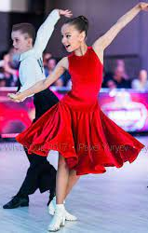
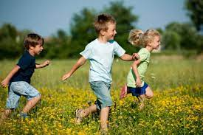
Ability
Sarah ____ dance well.
David _____run faster
when he was young.
can
сould
can
could

Slide 13
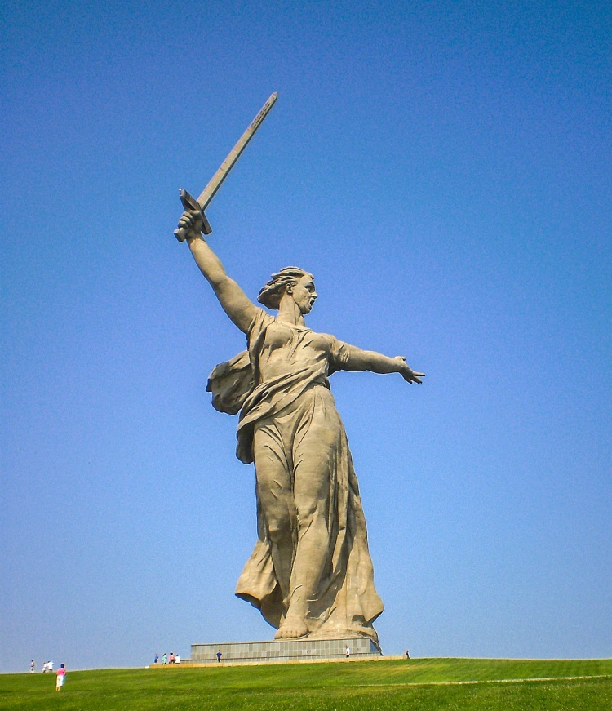
Obligation
Must
Have to
Should

Slide 14
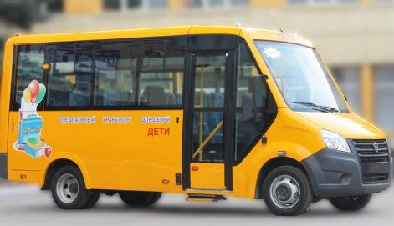
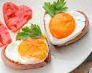
Obligation
Amy ____ go now, or
she will miss the bus.
I ______ cook breakfast in the morning. My mum is busy.
must
have to
must
have to

Slide 15

Prohibition
Mustn’t
Shouldn’t

Slide 16
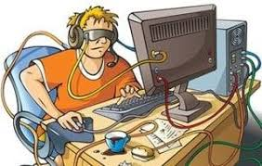
Prohibition
You _______eat any more chocolate.
You ________ play
computer games so much.
mustn’t
shouldn’t
mustn’t
shouldn’t

Slide 17


Slide 18
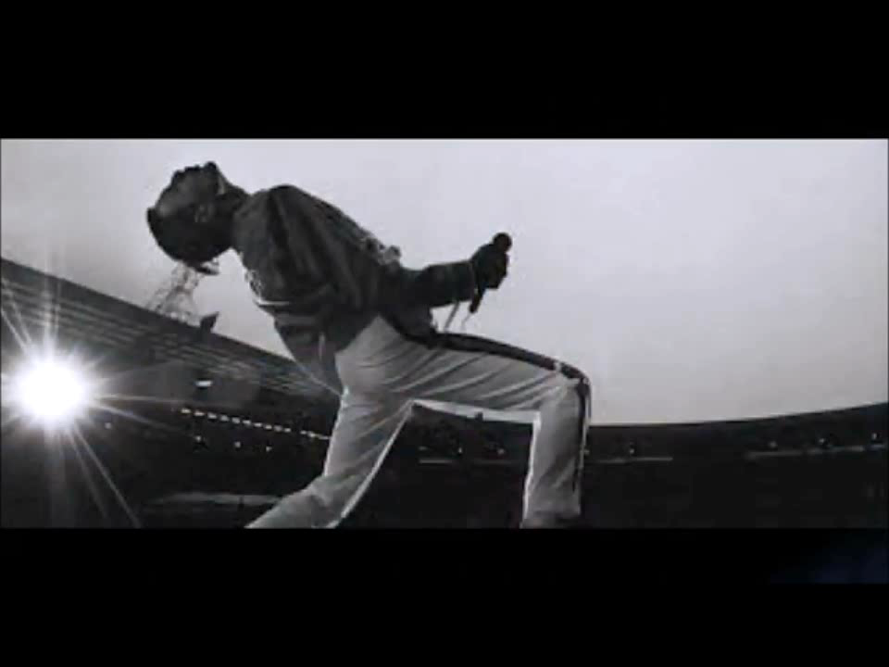

Slide 19
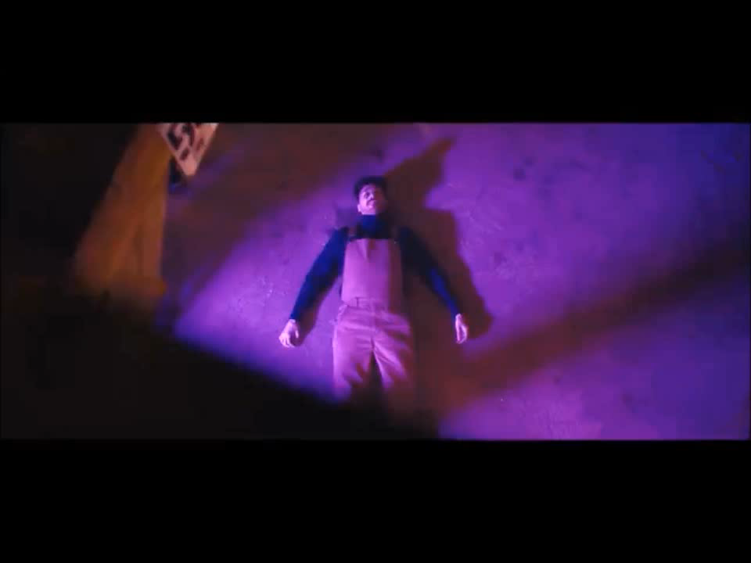

Slide 21
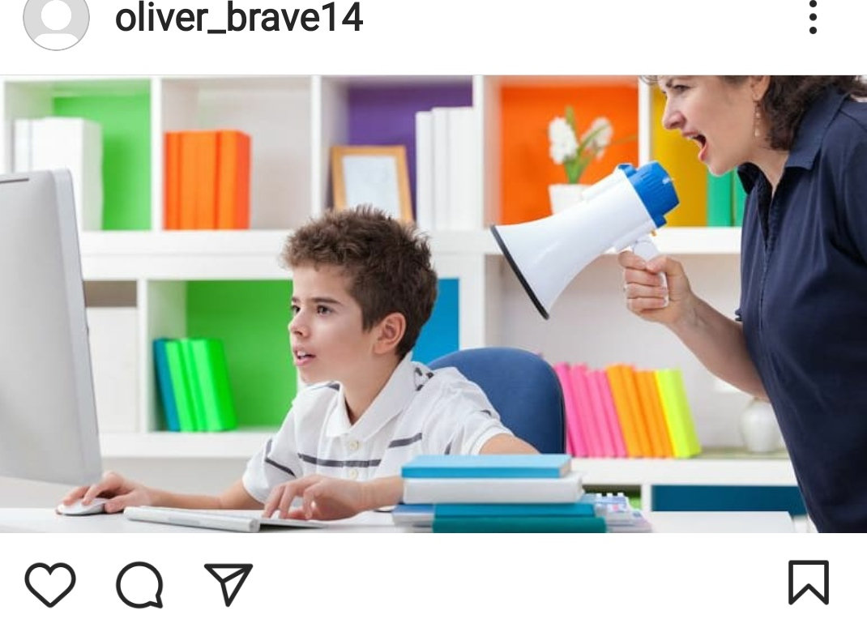
№1

Slide 22
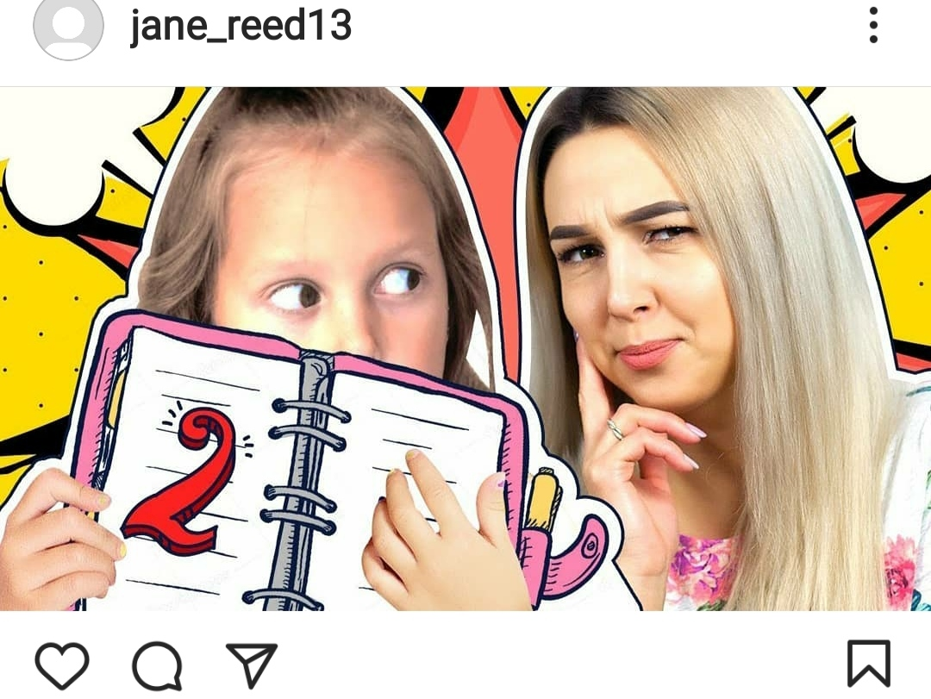
№2

Slide 23

№3

Slide 25

School of the Future

Slide 26


Slide 28
Tоday I …
Tоday it was interesting…
Tоday it was difficult …

Slide 29
Thank you!!!

