Slide 1
Презентация к уроку по учебному предмету «Английский язык» в 5-ом классе на тему: «English-speaking countries»
Разработчик презентации: Масюкова М. И.
Учитель английского языка
МАОУ СОШ №1
Сахалинская область, г. Холмск

Slide 2
English-speaking countries

Slide 3
General information
100
200
300
400
500
Animals
100
200
300
400
500
Food
100
200
300
400
500
Movies
100
200
300
400
500
Famous people
100
200
300
400
500

Slide 4
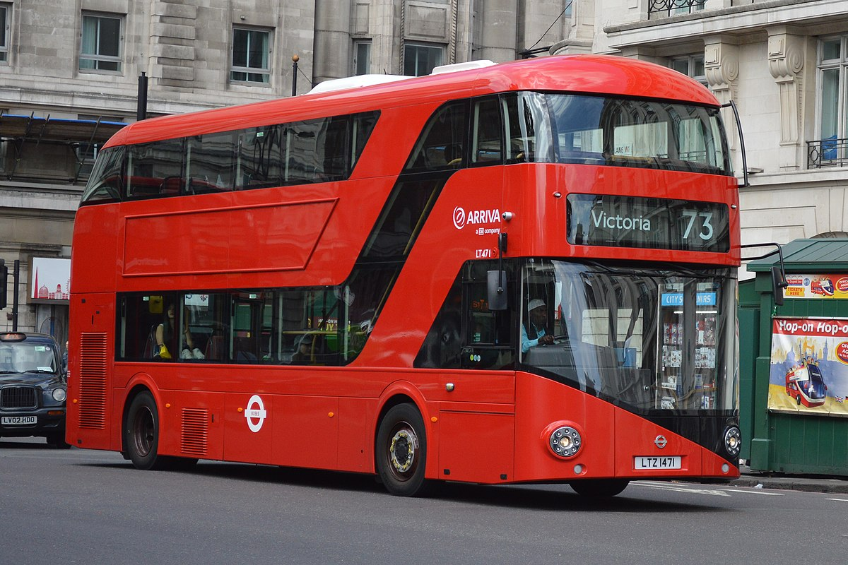
What colour are the British buses?
Red

Slide 5
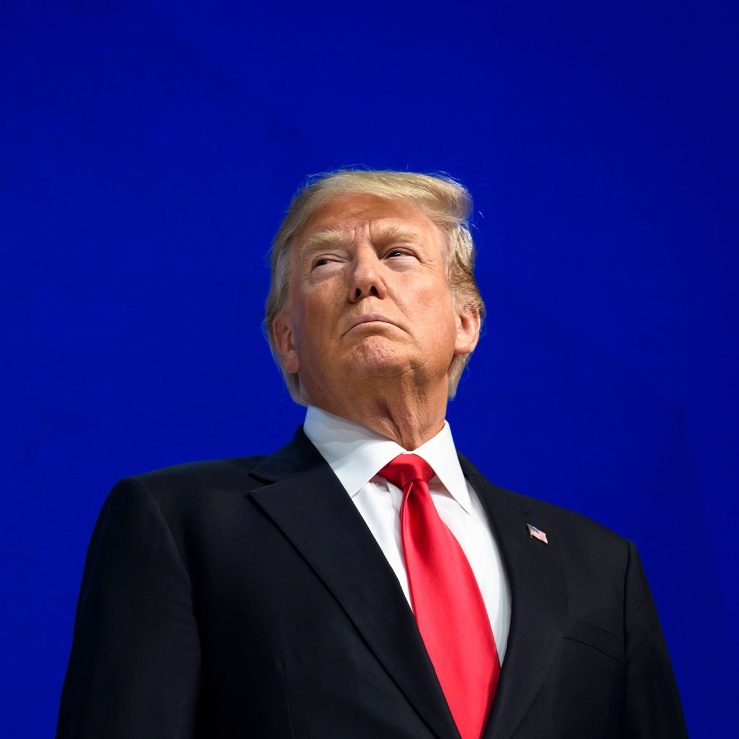
Who is the president of the USA?
Donald Trump

Slide 6
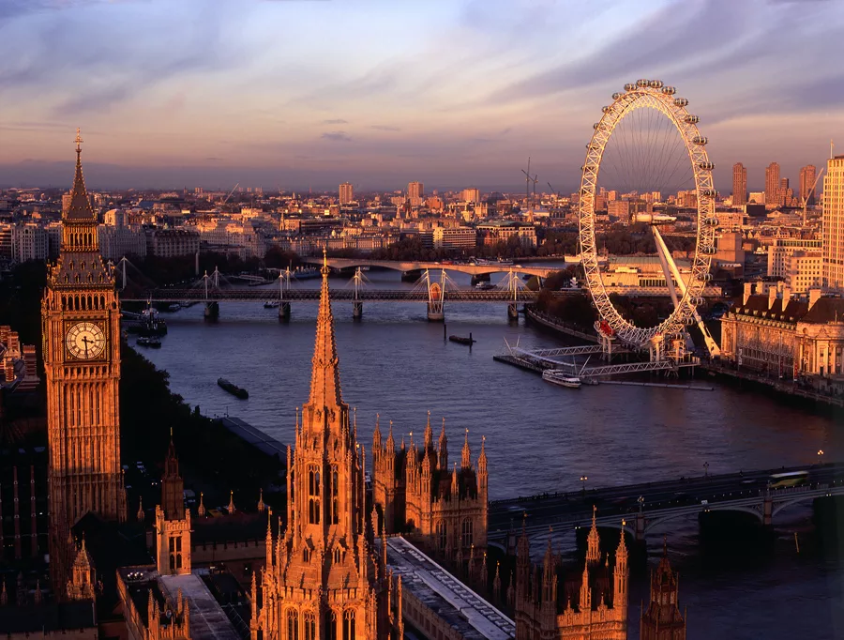
What city is the capital of Great Britain?
London

Slide 7
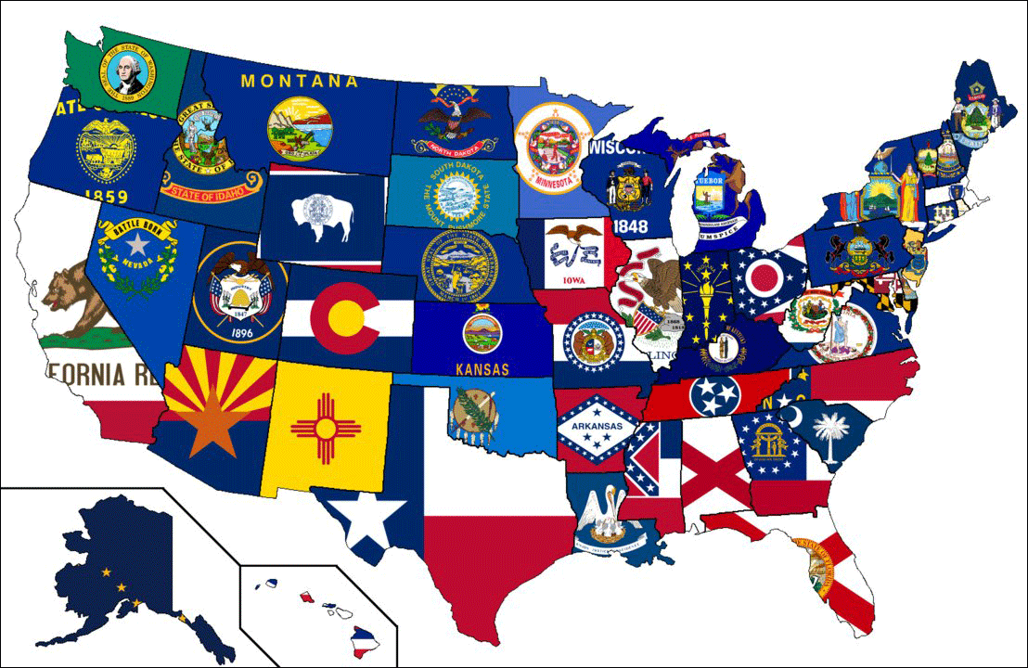
How many states are there in the USA?
50 states

Slide 8
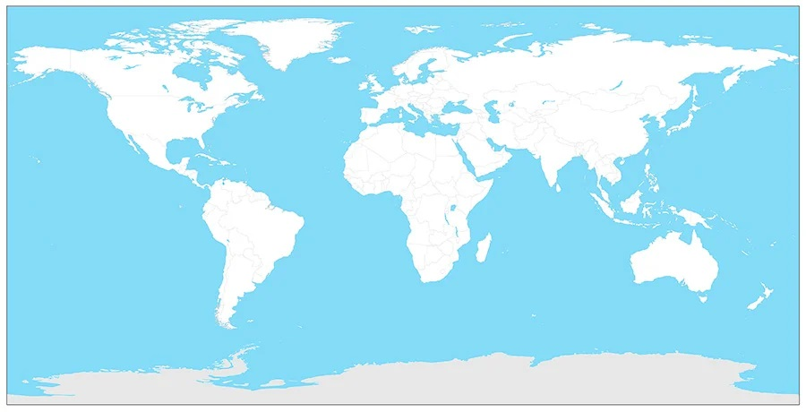
Where is Australia? Show on the map.

Slide 9
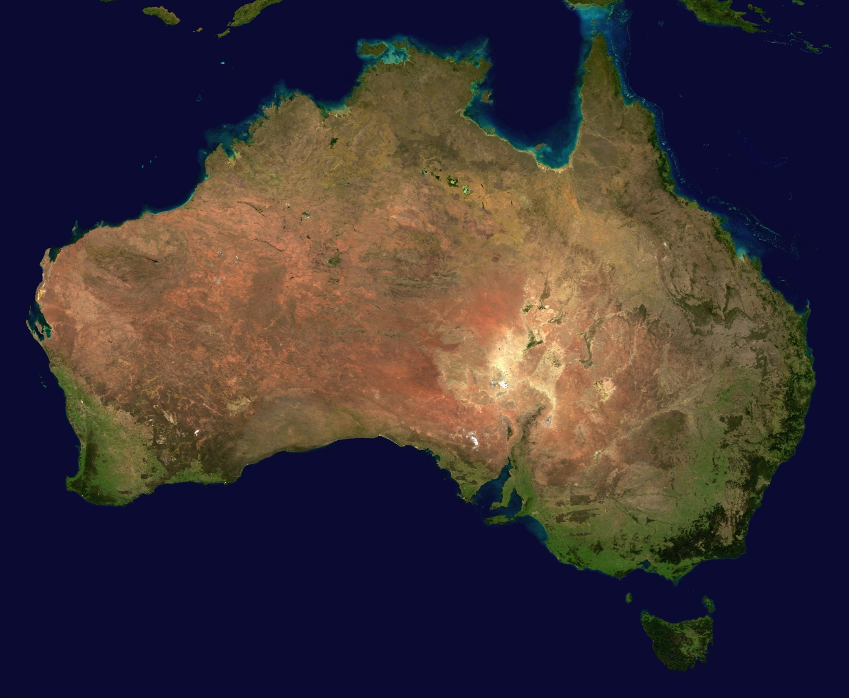
Where do kangaroos live?
Australia

Slide 10
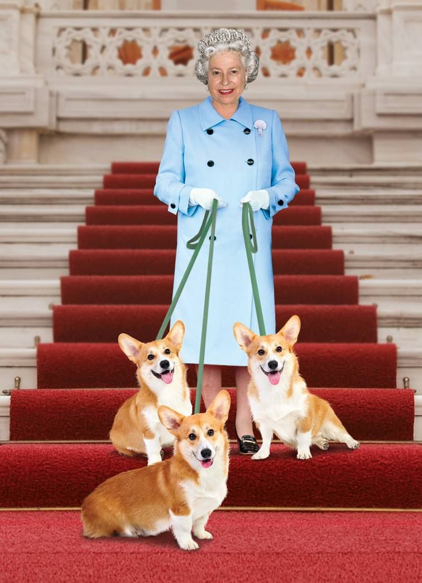
What animals does Elizabeth II have?
Dogs

Slide 11
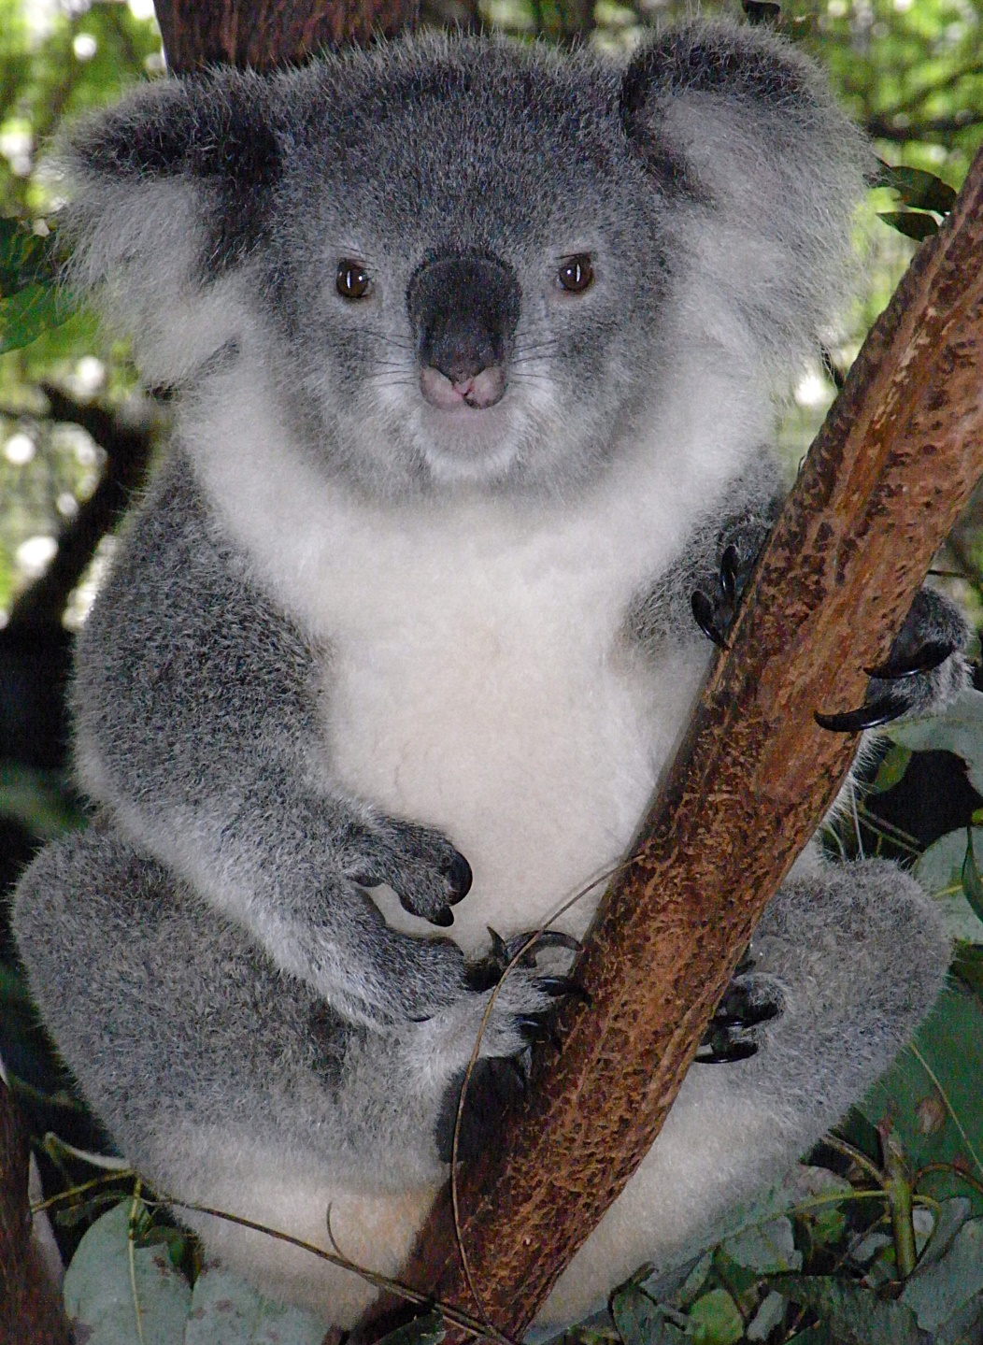
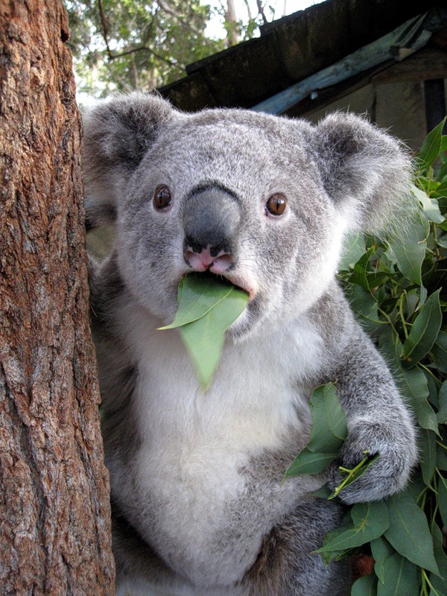
What do koalas eat?
Eucalyptus leaves

Slide 12
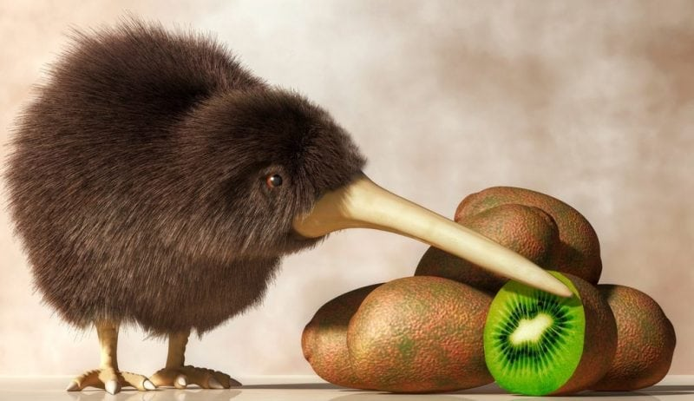
Which animal has the same name as a fruit?
Kiwi

Slide 13
What is the national animal of the USA?
Bald Eagle

Slide 14
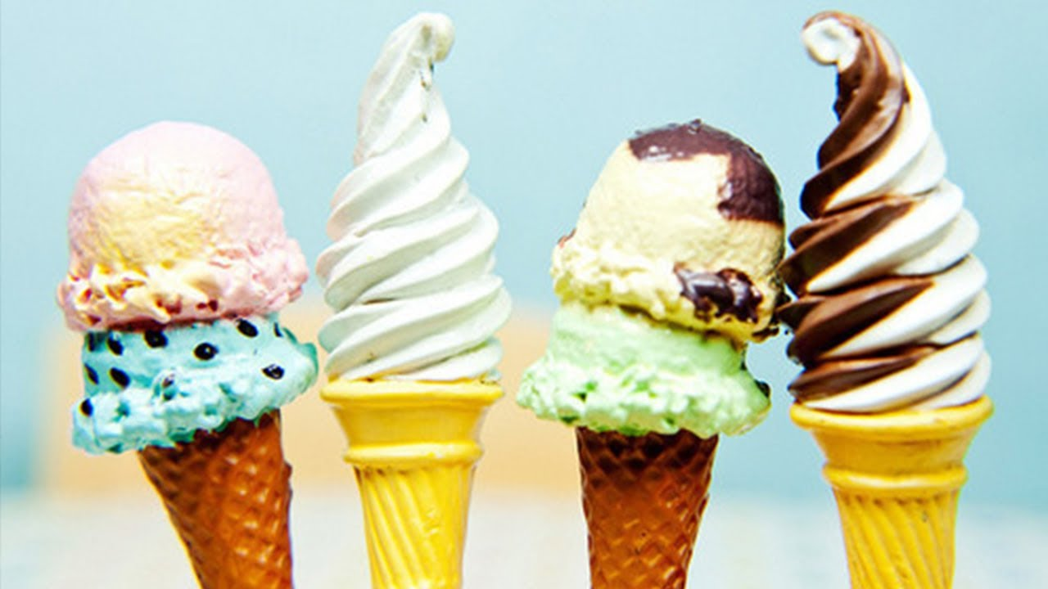
It is cold and sweet. Children like it.
Ice cream

Slide 15
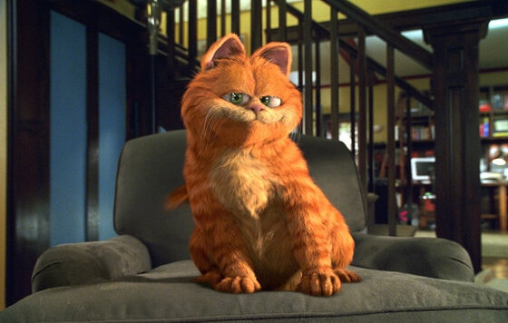
What was favourite food of Garfield?
Lasagna

Slide 16
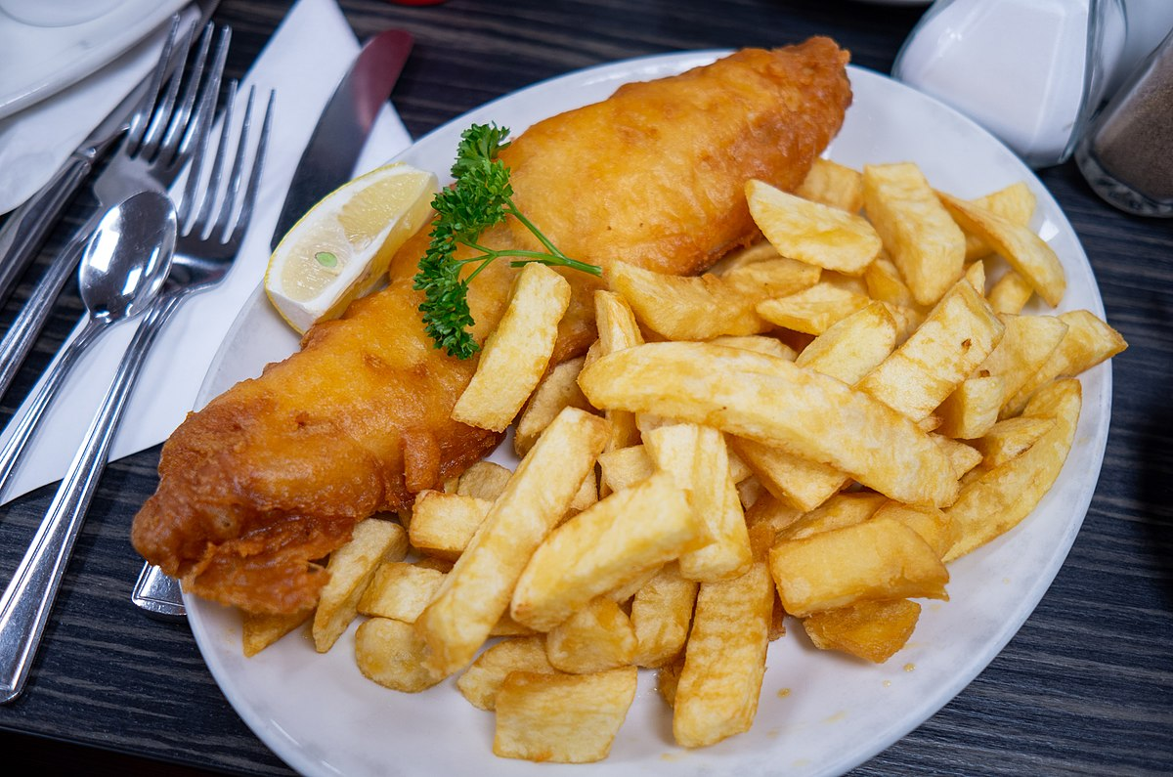
What’s traditional food in Britain?
Fish and chips

Slide 17
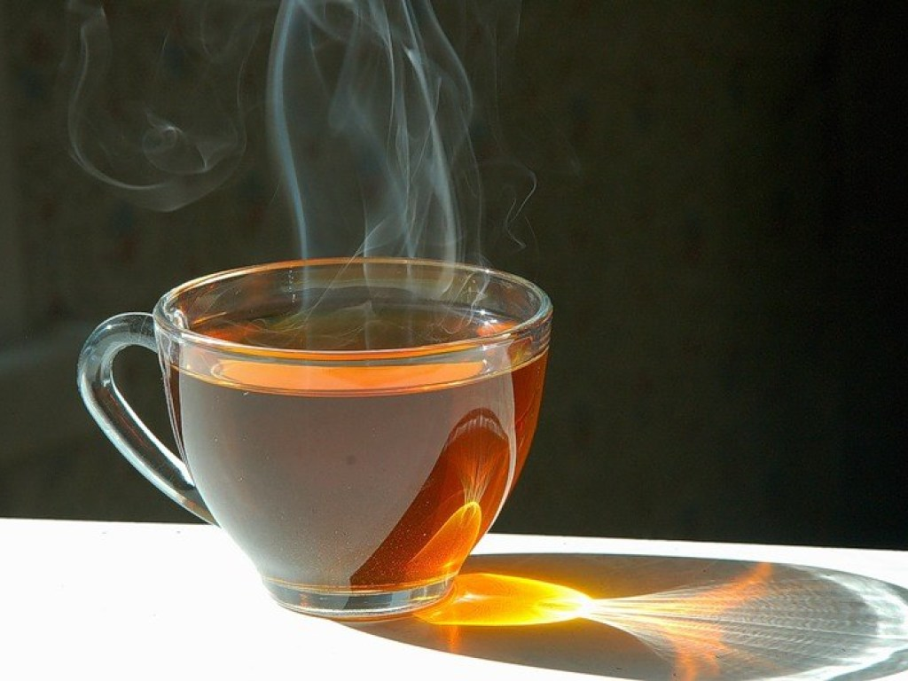
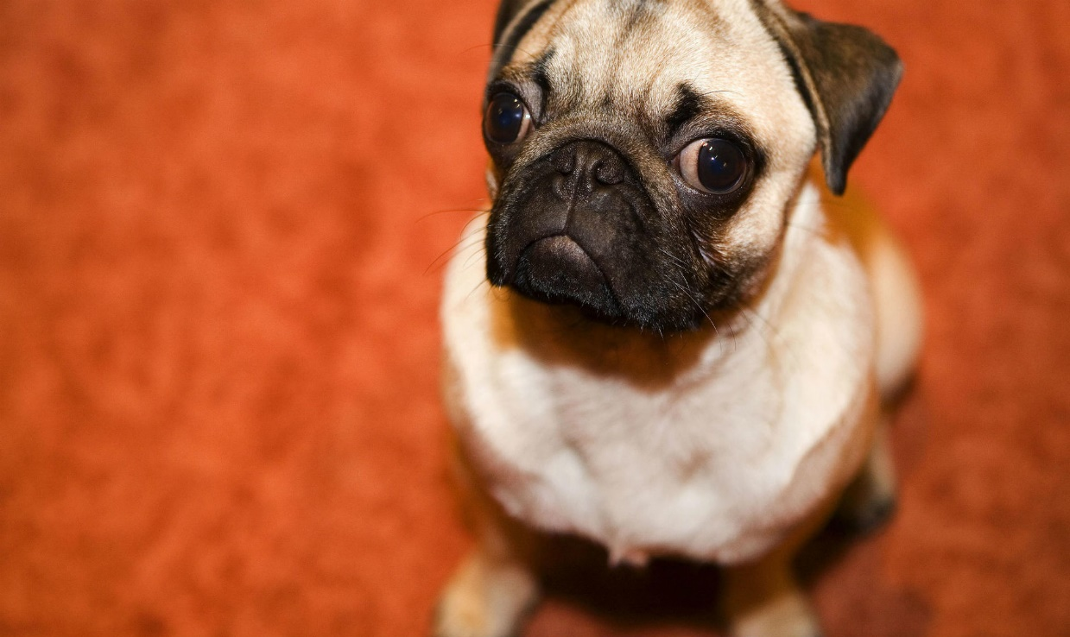
What is it?
Hot dog

Slide 18
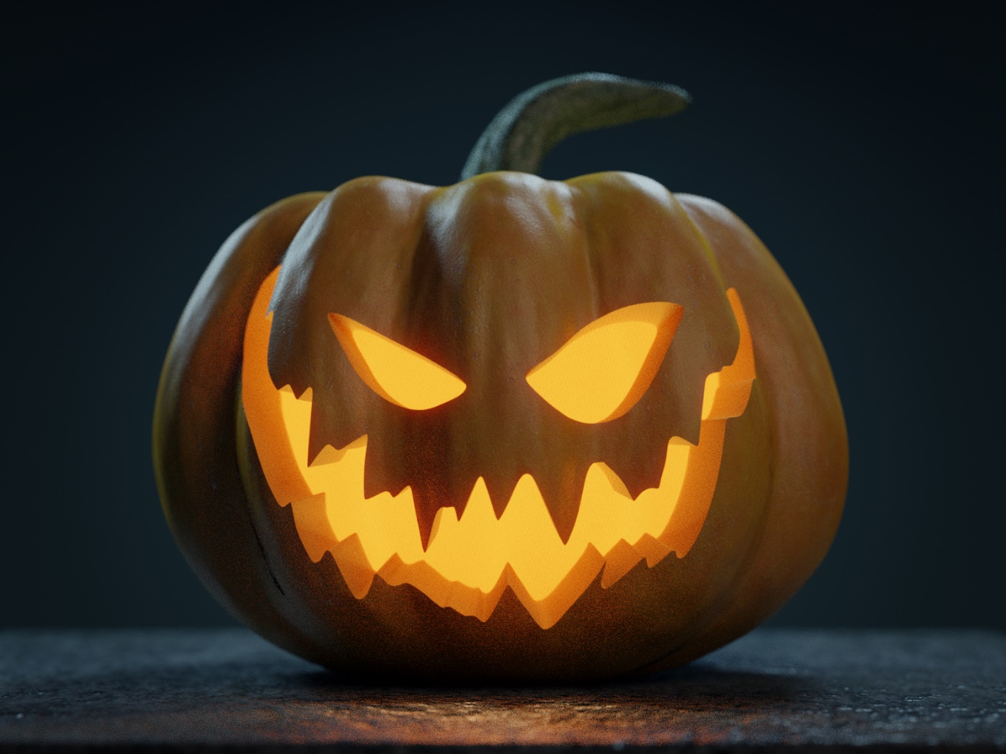
What vegetable do people use in Halloween?
Pumpkin

Slide 19
What’s the name of this film?
Harry Potter

Slide 20
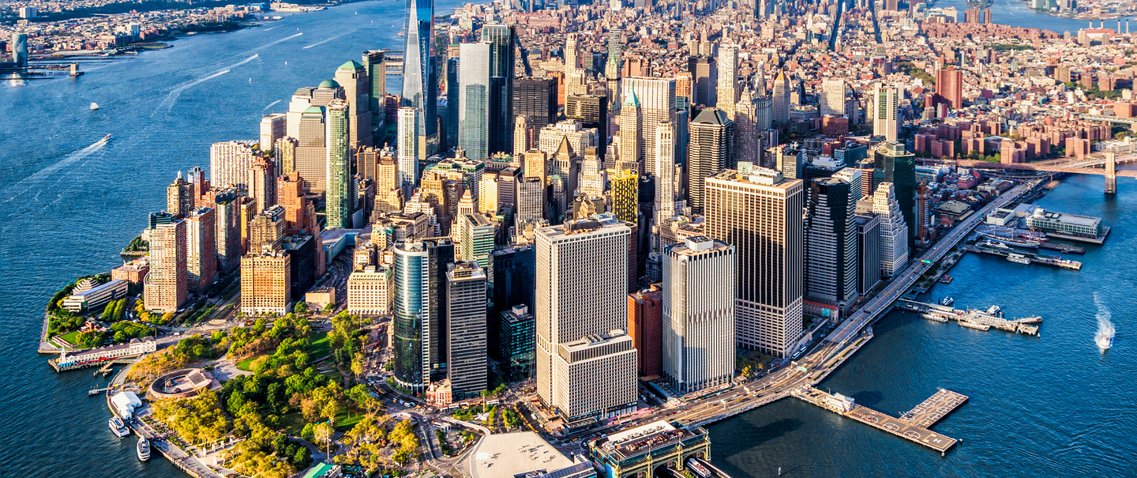
Where does Peter Parker live?
New York

Slide 21
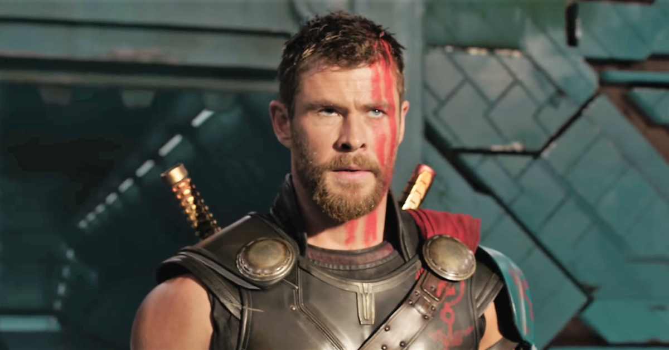
What’s the name of this character?
Thor

Slide 22
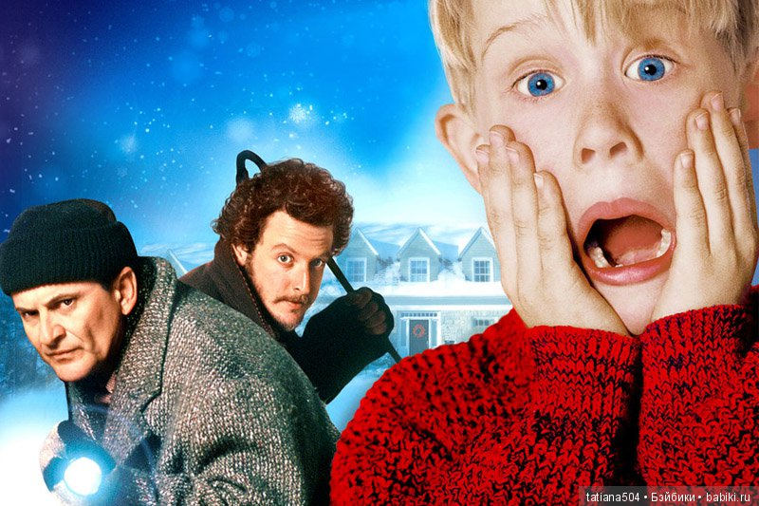
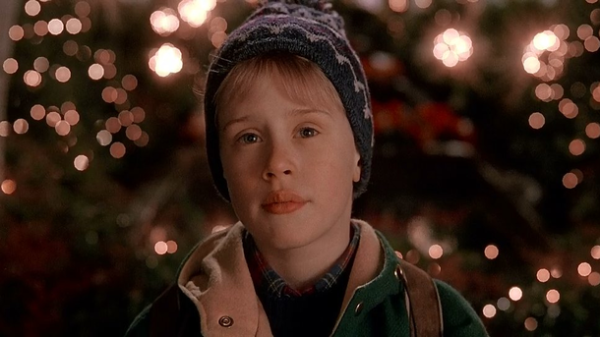
What’s his name?
Kevin

Slide 23
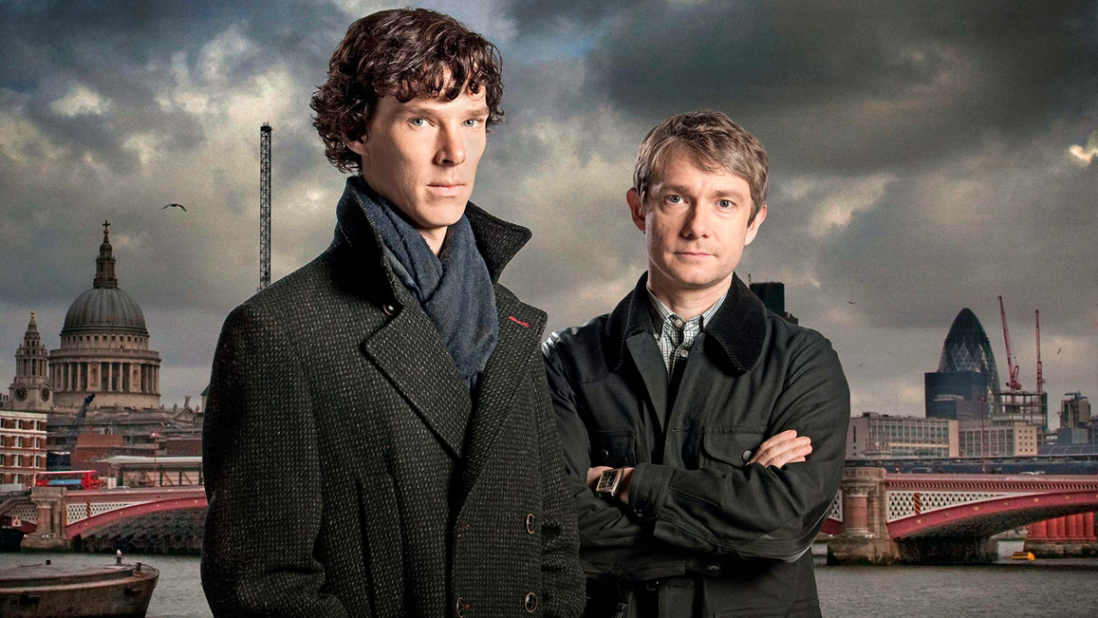
What is the name of the street where Sherlock Holmes lived?
Baker Street

Slide 24
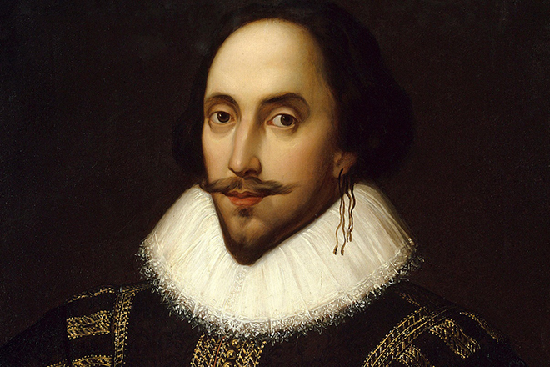
What’s his name?
William Shakespeare

Slide 25
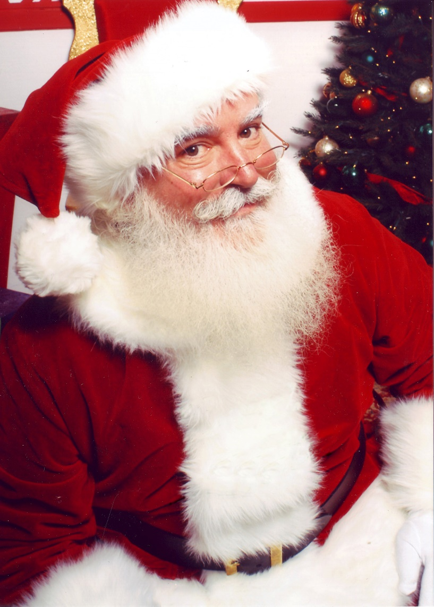
What’s the name of «Дед Мороз» in English-speaking countries?
Santa Claus

Slide 26
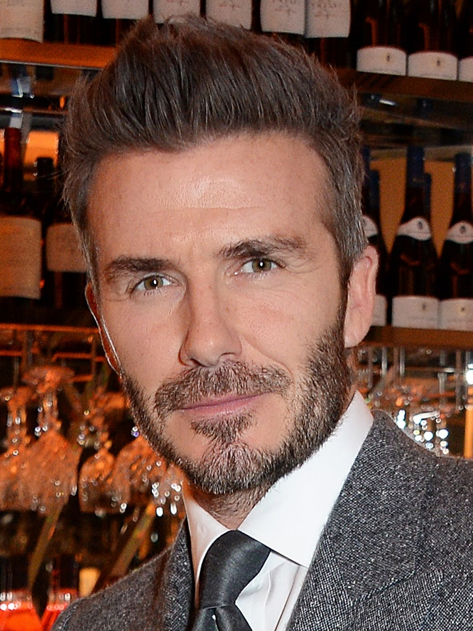
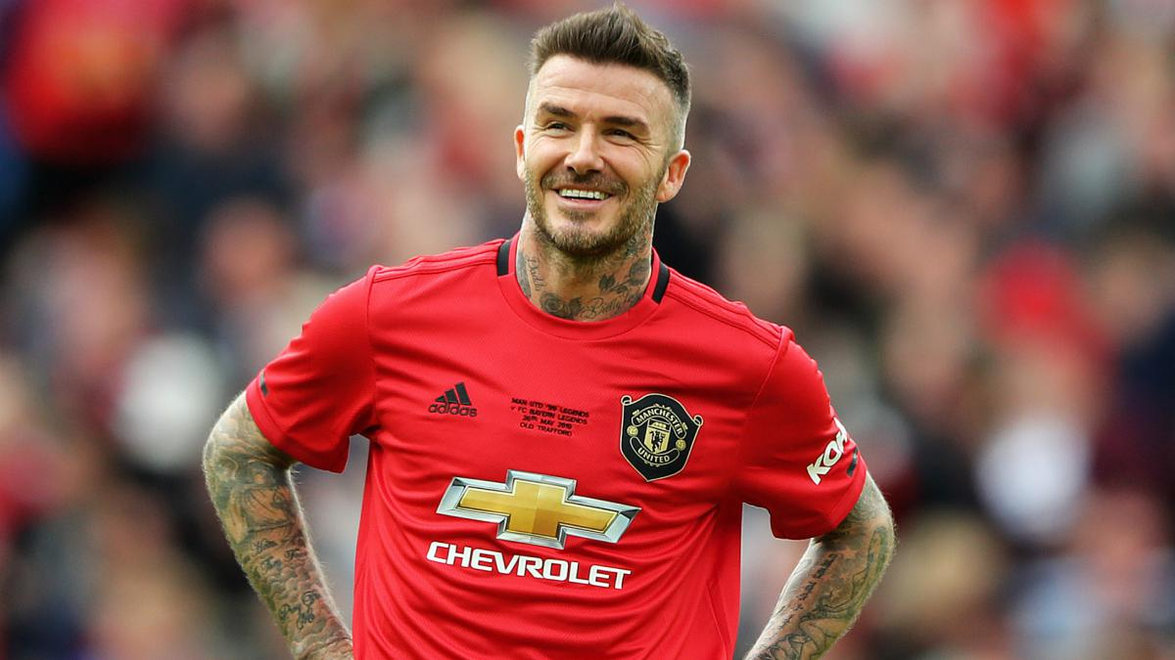
This is one of the most famous football players! What’s his name?
David Beckham

Slide 27
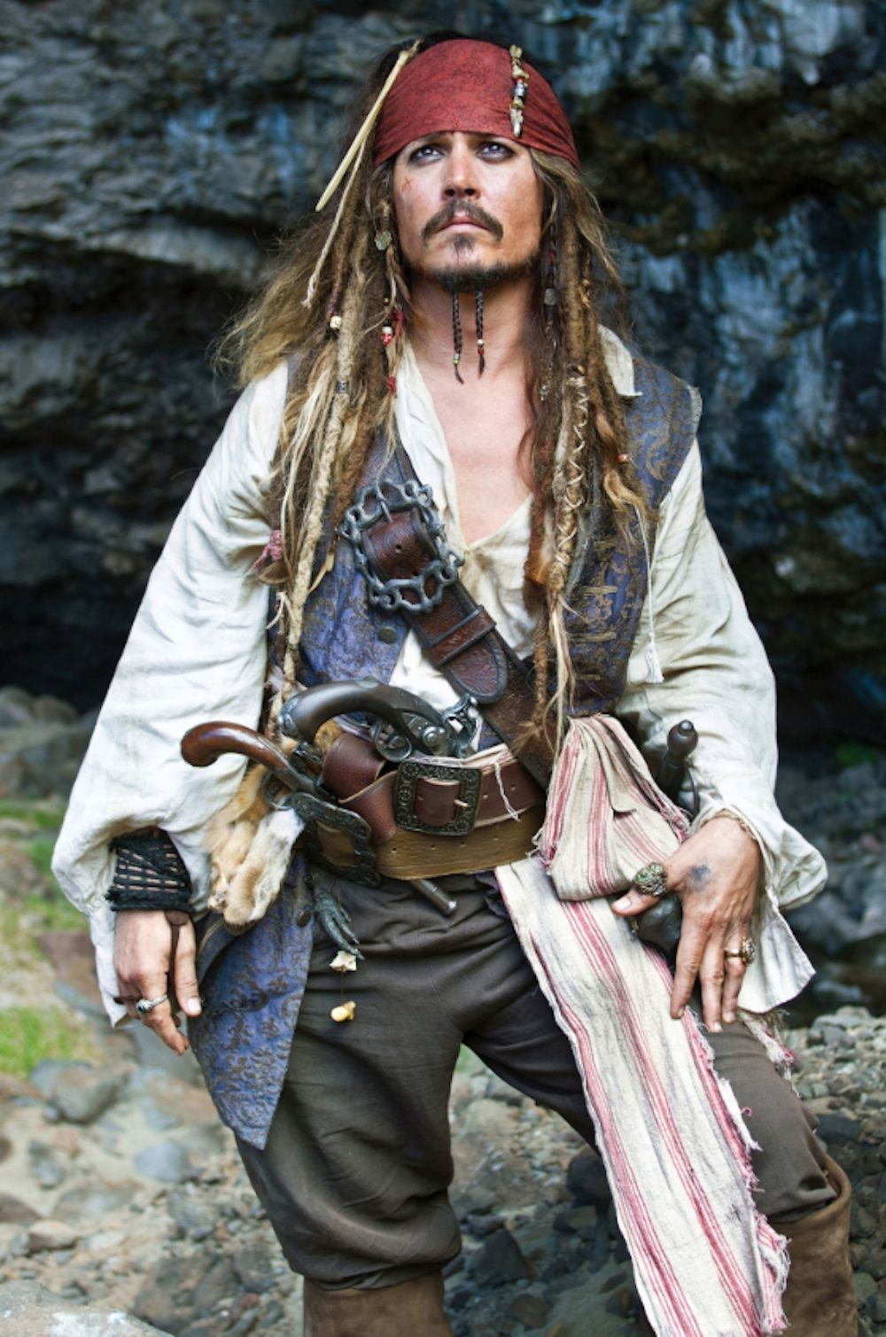
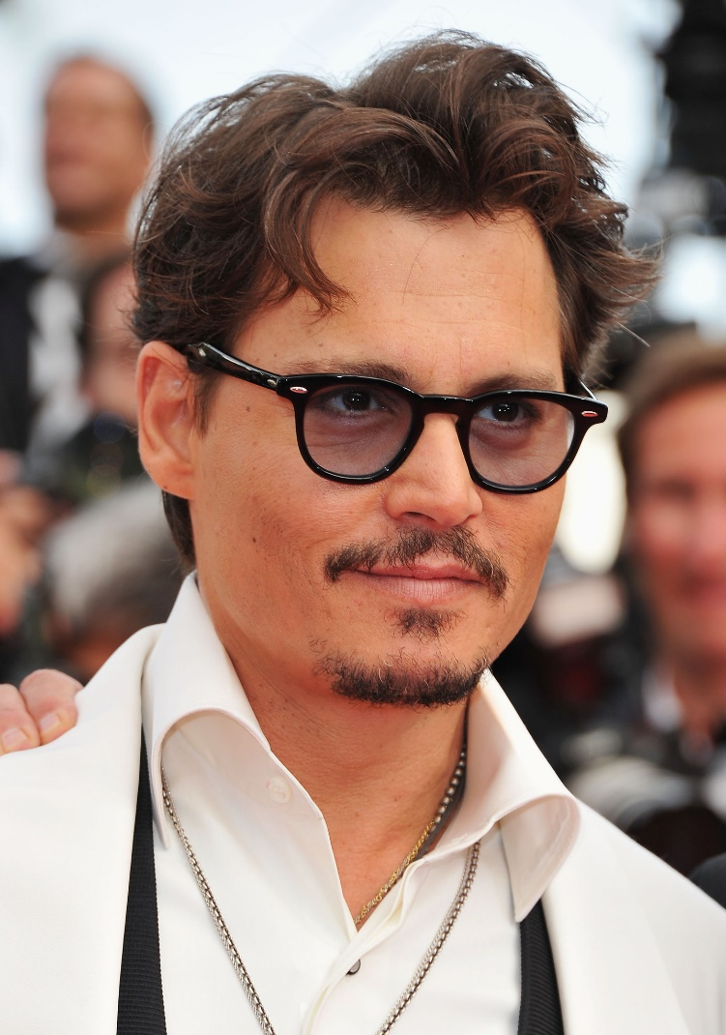
The most famous pirate in the world!
Johnny Depp

Slide 28
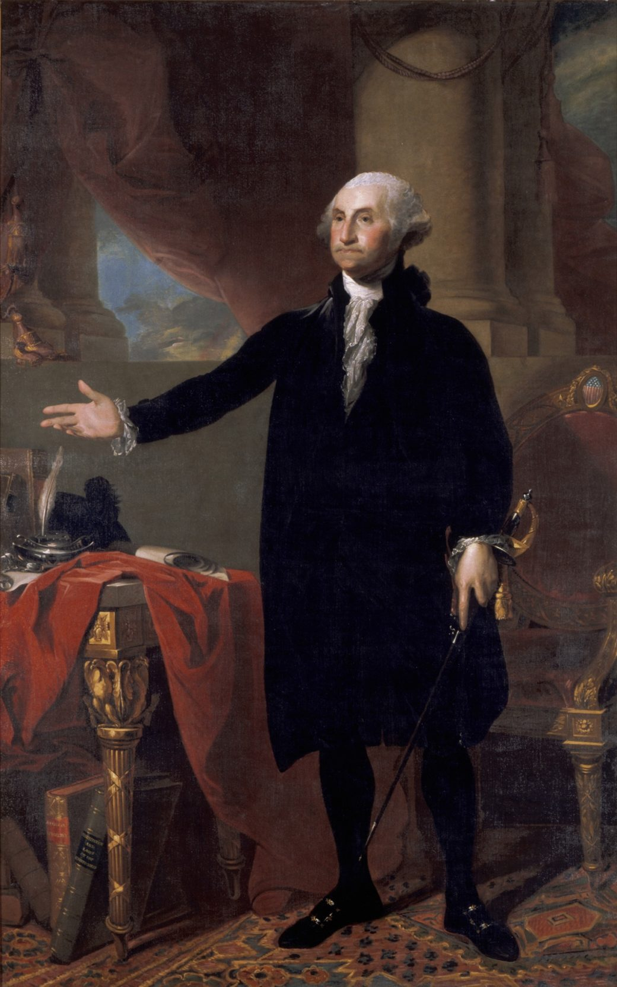
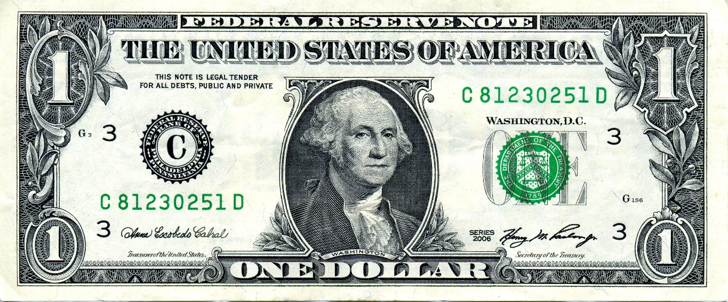
Who was the 1st President of the USA?
George Washington

