Slide 1

Better Safe Than Never
Пугачёва Ольга Анатольевна
МБОУ СОШ № 9 г. Татарска
Учитель английского языка

Slide 2
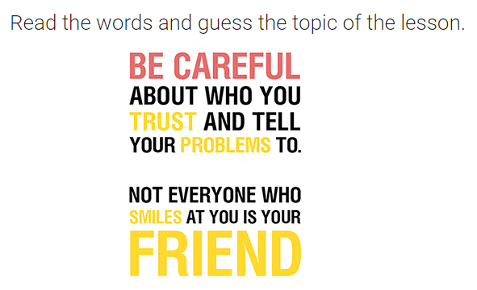

Slide 3
You will learn the names of different crimes
You will learn how to protect yourself in the city and in the country

Slide 4
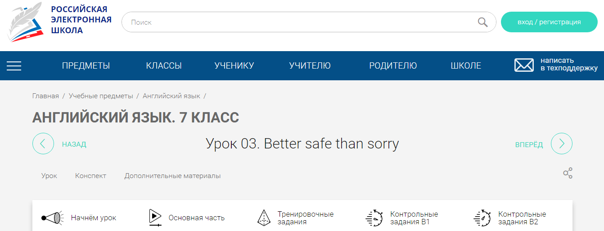
https://resh.edu.ru/subject/lesson/1567/conspect/

Slide 5
Match the words to their definition
a stranger
alarm system
ID
let him in
a burglar
peephole
1. allow him to come in
2. a small hole in the door
3. an unknown person
4. identification
5. a machine that signals danger
6. a criminal

Slide 6

Safety rules to protect yourself
look through the peephole

Slide 7
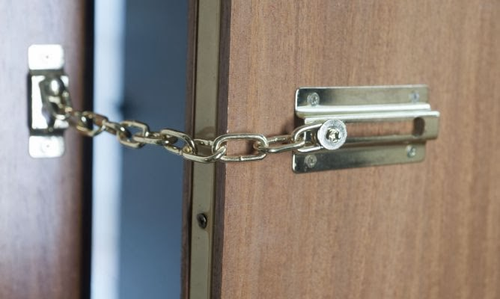
Safety rules to protect yourself
Put the door chain on the door before answering

Slide 8
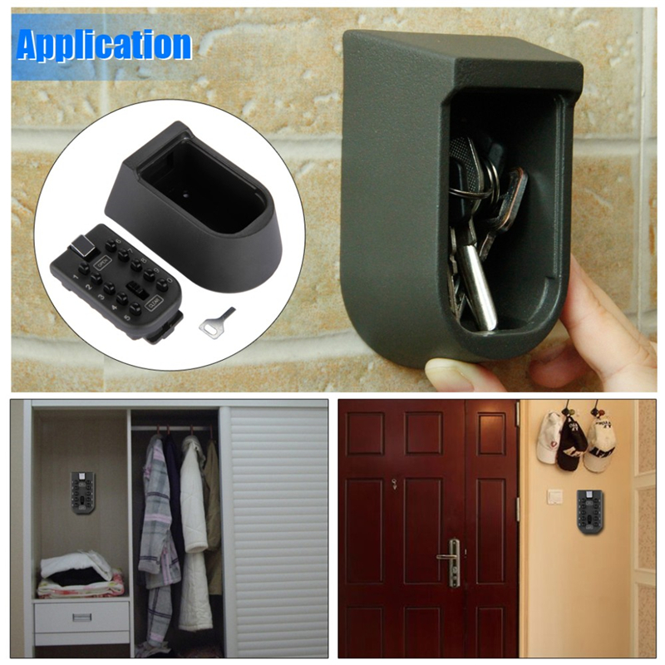
Safety rules to protect yourself
Don’t leave keys next to doors or windows

Slide 9

Safety rules to protect yourself
keep a mobile phone switched on beside your bed

Slide 10
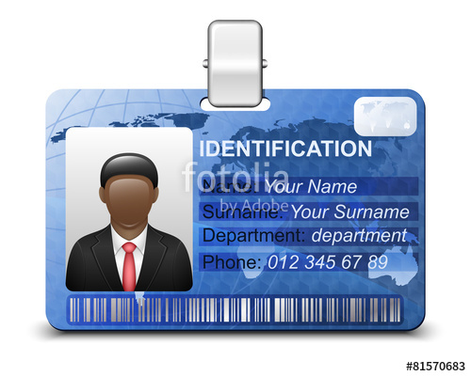
Safety rules to protect yourself
Check a stranger’s ID,
Don’t let him/her in.

Slide 11
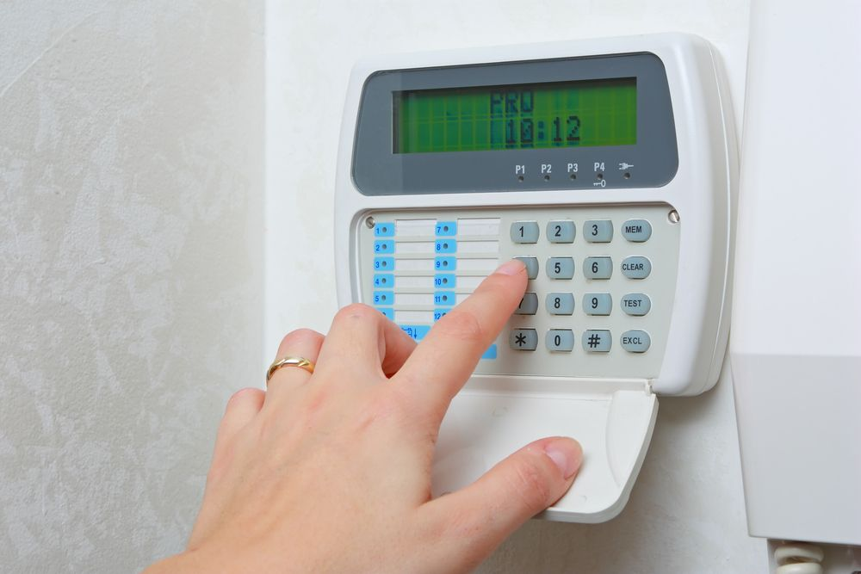
Safety rules to protect yourself
fit an alarm system

Slide 12

Safety rules to protect yourself
install dusk-to-dawn outside lights (2,5metres high) in the garden

Slide 13
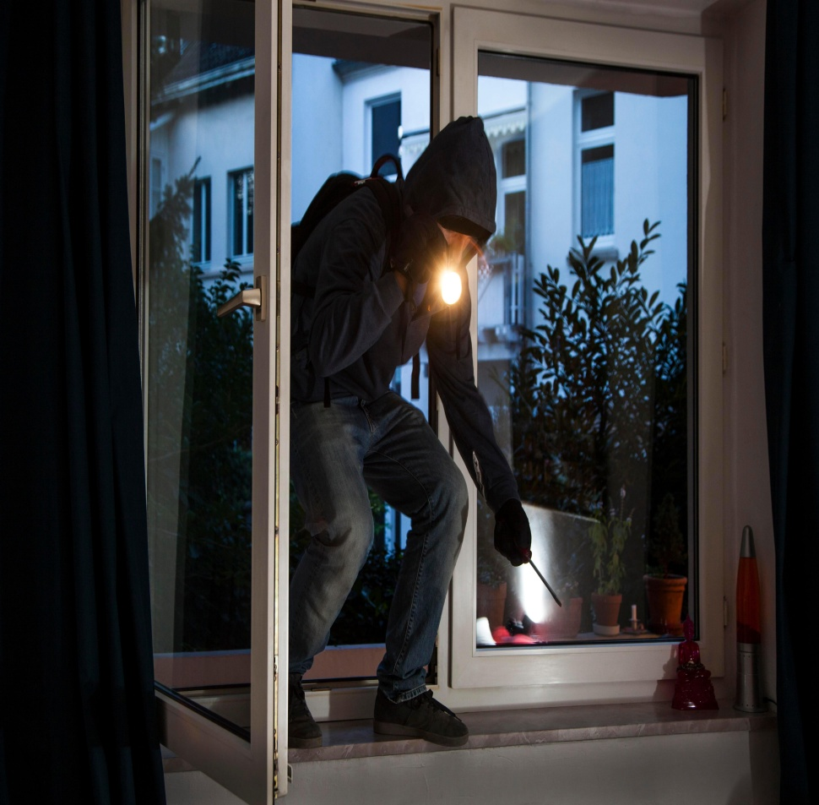
Safety rules to protect yourself
if a burglar breaks in
don’t put up a fight, hand over valuables
Call the police. Don’t run after the burglar.

Slide 14
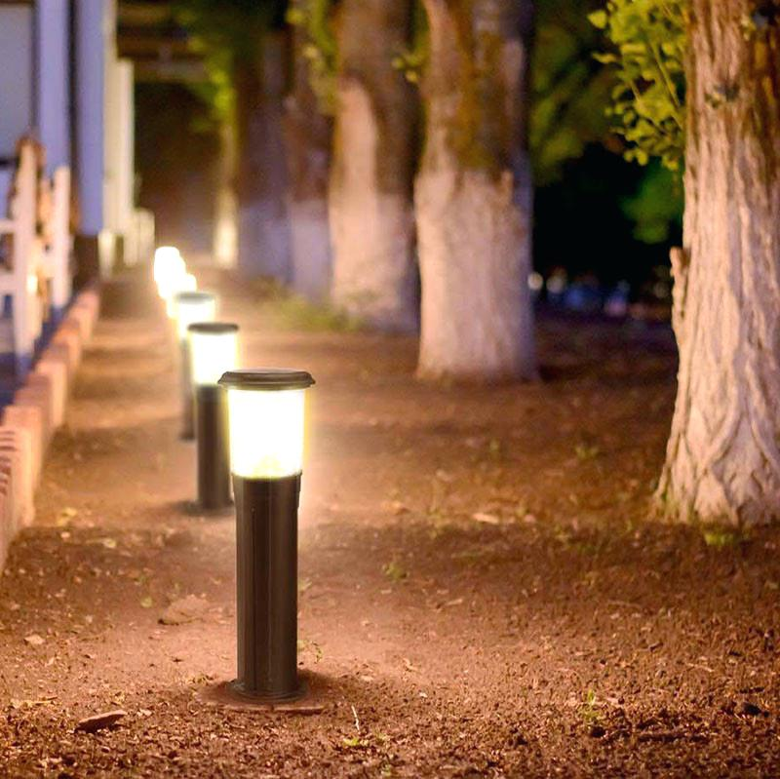
Safety rules to protect yourself
walk in well-lit sides of the streets

Slide 15
Read and translate the words
дверной глазок
peephole
switch on
ID
alarm system
install
hand over
strangers
burglar
включить
удостоверение личности
охранная сигнализация
устанавливать
отдать
незнакомцы
взломщик

Slide 16
Answer the questions and ask your friend the same
Have you got a peephole?
Where do you usually leave your keys?
Do you let strangers in?
Do you check a stranger’s ID?
Do you keep your mobile phone switched on beside your bed?
Have you installed an alarm system at home?
Have you got dusk-to-dawn outside lights?
Do you always walk in well-lit sides of the streets?

Slide 17
Complete the gaps
Don’t leave keys near doors or …
At night keep your … switched on beside your bed.
If a … comes to your door, always ask for …
Remember, if you don’t know a stranger, don’t … in.
Always look through your … before answering.
Fit an … to protect your home.
If a … breaks in, don’t put up a …
Never run after burglars. Call the …

Slide 18
Distribute the instructions into the table
Do | Don’t
let in strangers
keep your mobile switched on
look through the peephole
be vigilant
trust Internet acquaintances
put up a fight

