Slide 1
УМК. В.П.Кузовлев, Н.М.Лапа и др. Английский язык, 8 класс/ ” English-8”. Unit 2. “Is your country a land of traditions?” Lesson 7.
Тема: «Британские праздники и традиции».
Тип урока: изучения нового материала по теме
«Праздники и традиции».
Вид урока: практическая работа.
Формы организации познавательной деятельности: фронтальная, индивидуальная.
Средства обучения: компьютер, авторская презентация, проектор.

Slide 2
Цель урока: познакомить с реалиями культуры англоязычных стран (поздравительные открытки).
Задачи:
Научить писать короткие поздравления с днем рождения, другими праздниками и событиями, выражать пожелания.
Развить познавательный интерес к изучению английского языка.

Slide 3

As for me I associate a postcard with…
A postcard is associated with…
I also associate a postcard with such things as…
I also think of…

Slide 4
Here is wishing you all the joys of the season.
Wish you and your family a Merry Christmas!

Slide 5


Slide 6
Wishing you a very happy Easter!

Slide 7
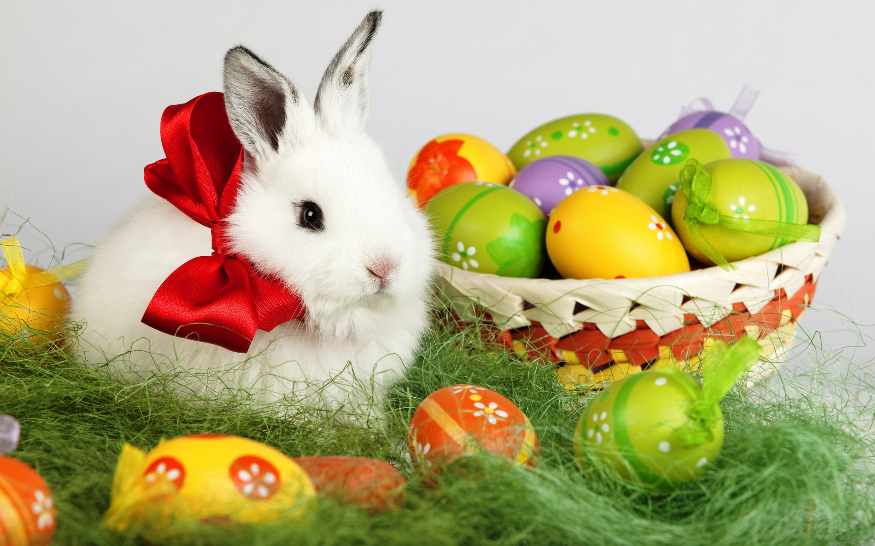

Slide 8
Wishing you a happy and prosperous Birthday and a sweet night of birthday dreams!

Slide 9
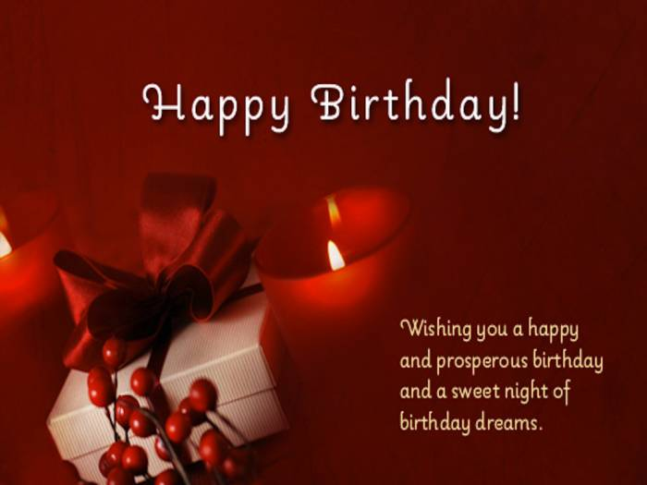

Slide 10
THE DIFFERENCE
WISH/ TO WISH FOR/ON | TO CONGRATULATE/ CONGRATULATIONS
FOR ANY OCCASIONS | FOR DIFFERENT ACHIEVEMENTS
HOLIDAYS | “BIG” BIRTHDAYS (18,21)
CELEBRATIONS | ANNIVERSARIES
Very best wishes for your birthday.
Congratulations on winning the competition in swimming.

Slide 11
Divide into 2 groups:
— Sorry you are sick. Hoping you will be well soon.
— With love on St Valentine’s Day and always.
— Best wishes on your birthday. Hope your birthday brings you all the things that make you happy.
— Congratulations on your new flat! What exciting news it is!
— With best wishes for your future.
— Wishing you every success!
— Wishing you every happiness in your new home! (on your birthday!)
— With warmest Christmas wishes!
— Thinking of you with warm wishes for a Very Merry Christmas and a Happy New Year!
— Many happy returns of the day.
— Happy Mother’s Day! Mothers are wonderful and you are one of the best!

Slide 12
Match the description and the name of celebration.
https://learningapps.org/display?v=pdx2yw4tt20

Slide 13
Make congratulations:
https://learningapps.org/watch?v=pfwd7aona20
https://learningapps.org/watch?v=p830g07sj20
https://learningapps.org/watch?v=p5nocewva20
https://learningapps.org/watch?v=p7qq2bz8320
https://learningapps.org/watch?v=p7w5upytt20
https://learningapps.org/watch?v=p0q0d3dsj20
https://learningapps.org/watch?v=pyh5xjc9a20
https://learningapps.org/watch?v=poyucsbn320
https://learningapps.org/watch?v=p1kkpwr3320

Slide 14
During today’s lesson I have a) found out…
b) learnt…
c) remembered…

