Slide 1
Разработчик презентации:
Чувашова Анна Александровна учитель английского языка
МБОУ СОШ №42 г. Ижевск
Презентация к уроку по учебному предмету «Английский язык» в 6-ом классе на тему «Highland games»
УМК «Spotlight 6»

Slide 2
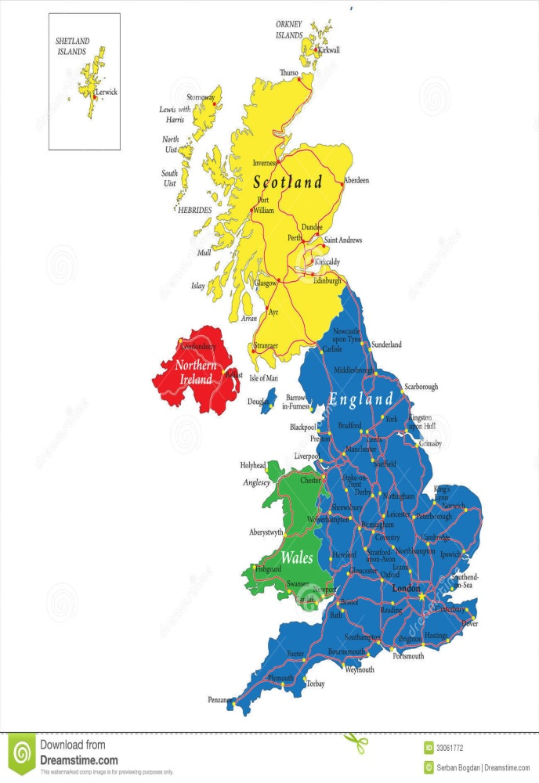
Организационный этап
Today we are going to travel from the south-east to the north-west. What country? Can you guess?

Slide 3
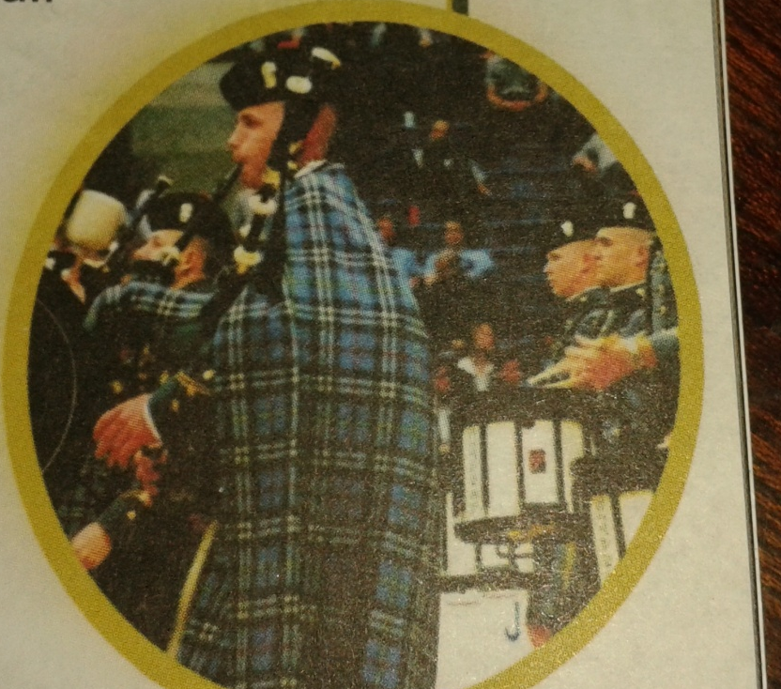
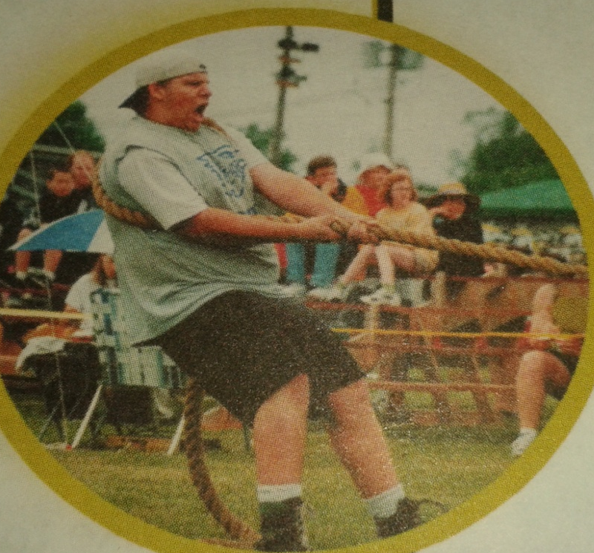
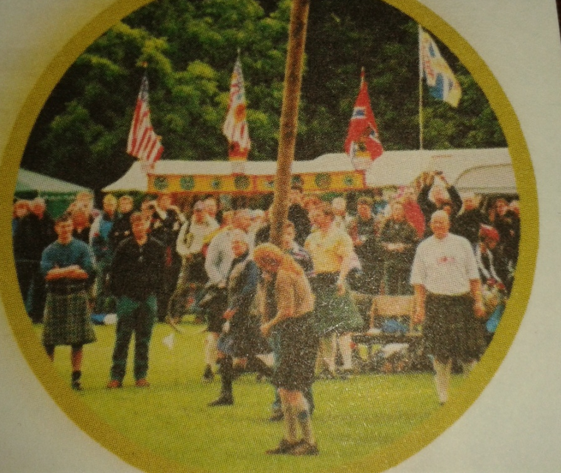
SCOTLAND- HIGHLAND
What are we going to talk about if we are in Scotland?
You will learn about a very important event in Scotland – Highland Games.

Slide 4
THE HIGHLAND GAMES

Slide 5
What is the aim of our lesson today?
To learn/to search/to know…

Slide 6
What are the tasks of the lesson?
To learn new words
To collect some information
To learn some information
To present some information to the class

Slide 7
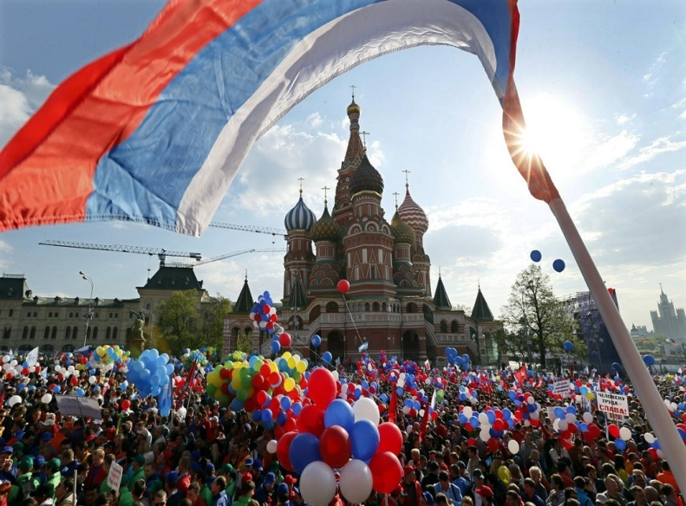
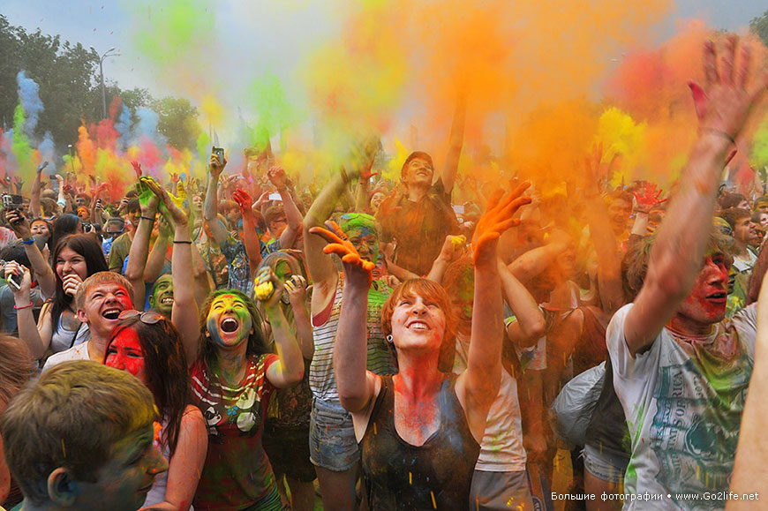
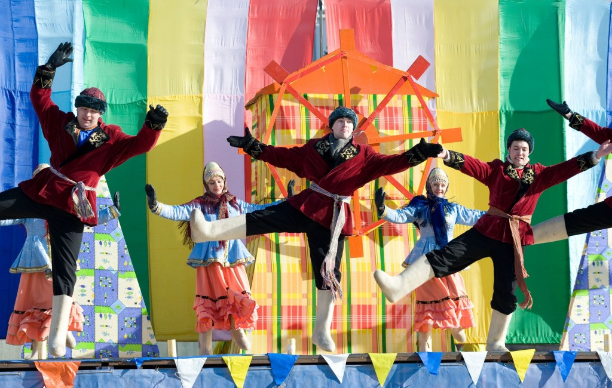
II. Основной этап
p.51, ex.2
Could you name the festivals in Russia like the Highland games?
What do people do on these days?

Slide 8
p.51
We are in Scotland now. But first we should do the exercise.
Look at the text. What are the people in the pictures doing? What is the text about?
Listen and read.
Work in pairs. Read the text again and translate

Slide 9
You’ve read that the Highland games take place every year. But what do you call an event that takes place every:
Hour- hourly
Day –
Week –
Month –
Year – Annual
What suffix do we use to form the words?
Which word forms in another way?

Slide 10
So, let’s pay attention on unknown words in this text.
The task is to match the words with their translation.
You should do this task in your workbooks

Slide 11
take part in meeting marching bands tree trunk sell out upright compete
участвовать
ствол дерева
марширующий оркестр
встреча
прямой
соревноваться
распродавать

Slide 12
In this text we’ve met different games. The task is to guess their translations. And then we'll compare your translation with the pictures
Hammer flow shot put tossing the caber tug of war hill run

Slide 13
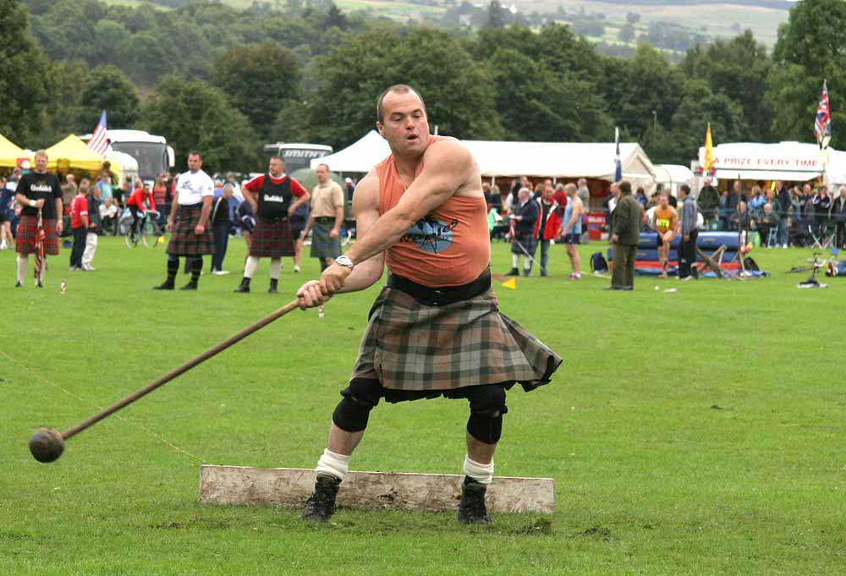
Hammer throw

Slide 14
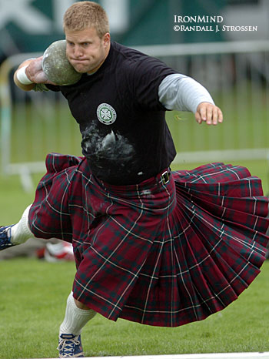
Shot put

Slide 15
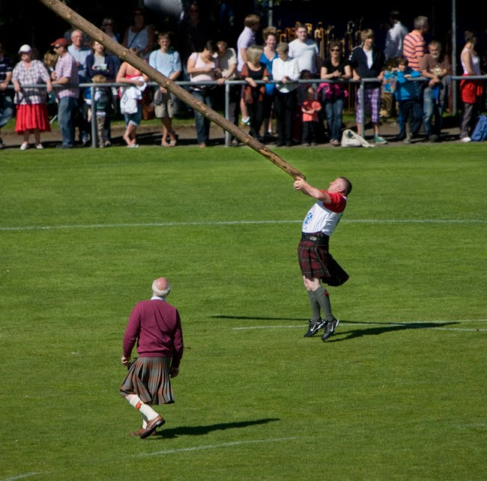
Tossing the caber

Slide 16
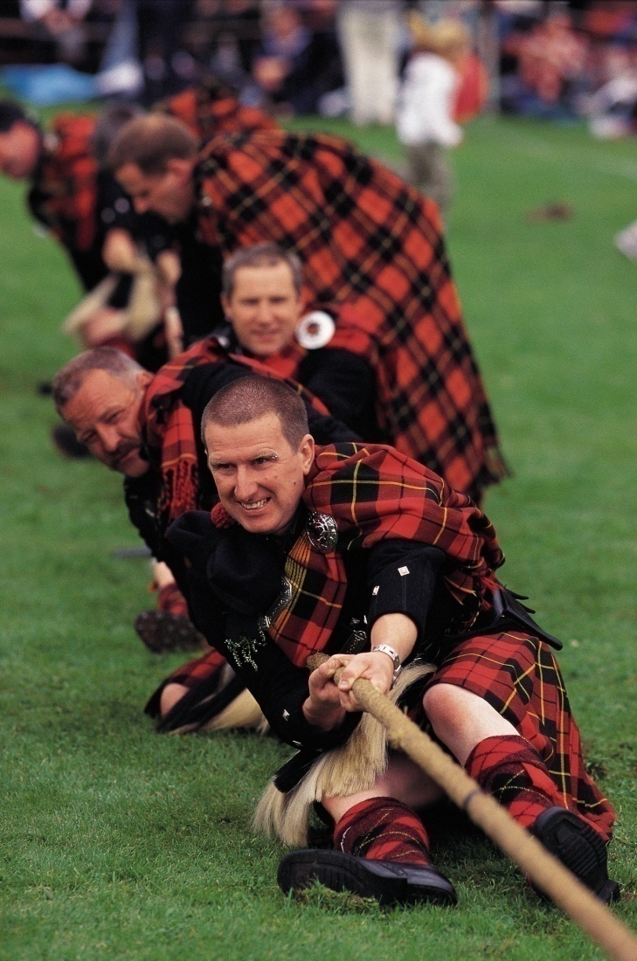
Tug of war

Slide 17
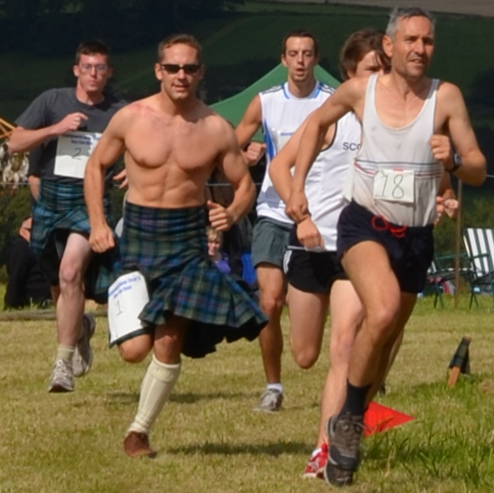
Hill run

Slide 18

Физкультминутка

Slide 19


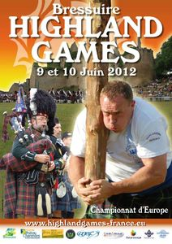
Imagine you are journalists now
Now you’ll work in groups. You are in Braemar. Choose only one game and write 1-2 sentences about these games for your own magazines. And then present it to the class.

Slide 20
III. Заключительный этап
Answer the questions
1. When do the games take place?
2. What events do the athletes compete in?
3. What is the “tug of war”?
4. Do people like this day?

Slide 21
Итог урока
What have we done at the lesson?
Was it interesting for you to learn about the Highland Games?
Which competition would you like to take part in?

Slide 22
Благодарю Вас за активность и инициативность на уроке. И в заключение хочу посвятить Вашей работе на уроке синквейн.
Pupils
Creative, talented
Spoke, wrote, listened
We had a good time together
Thank you!

Slide 23

Homework
You should make your own sinquain about these games

Slide 24
Thank you for your attention!

