Slide 1
Презентация к уроку по учебному предмету «Английский язык» в 10-ом классе на тему «Gerund/Infinitive/Bare Infinitive»
Злобич Татьяна Александровна
Учитель английского языка
ГБОУ лицей № 82 Петроградского района Санкт-Петербурга

Slide 2
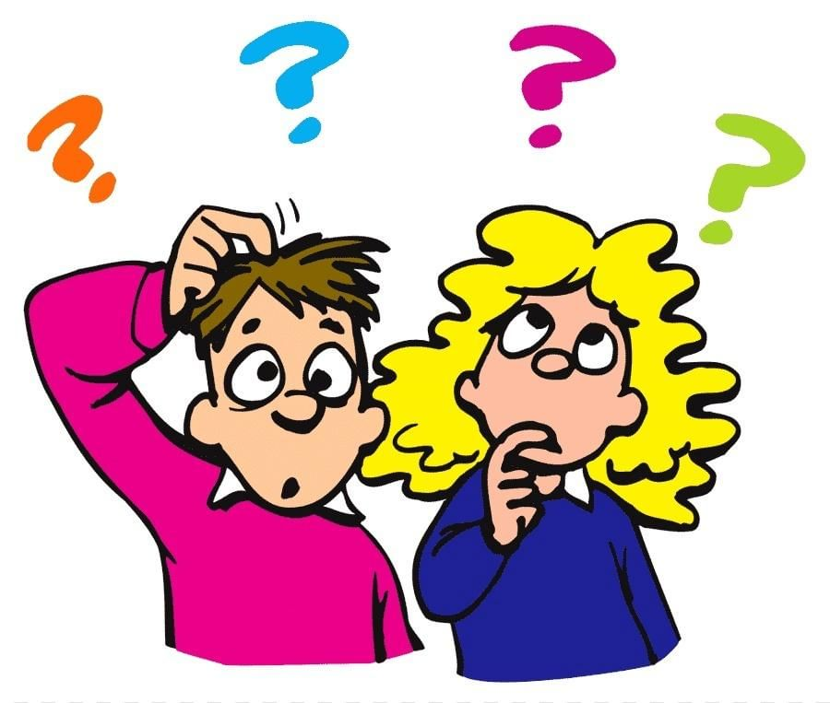
Gerund of infinitive?
What are “gerund” and “infinitive”?
When do we use gerund and infinitive?
Why do we need to know the rules on gerund and infinitive? How can we use them in real-life situations?
Do you mind watching TV?
I must finish this essay tonight.
Please let me go!
I’m keen on reading.
Would you like to go for a walk now?

Slide 3
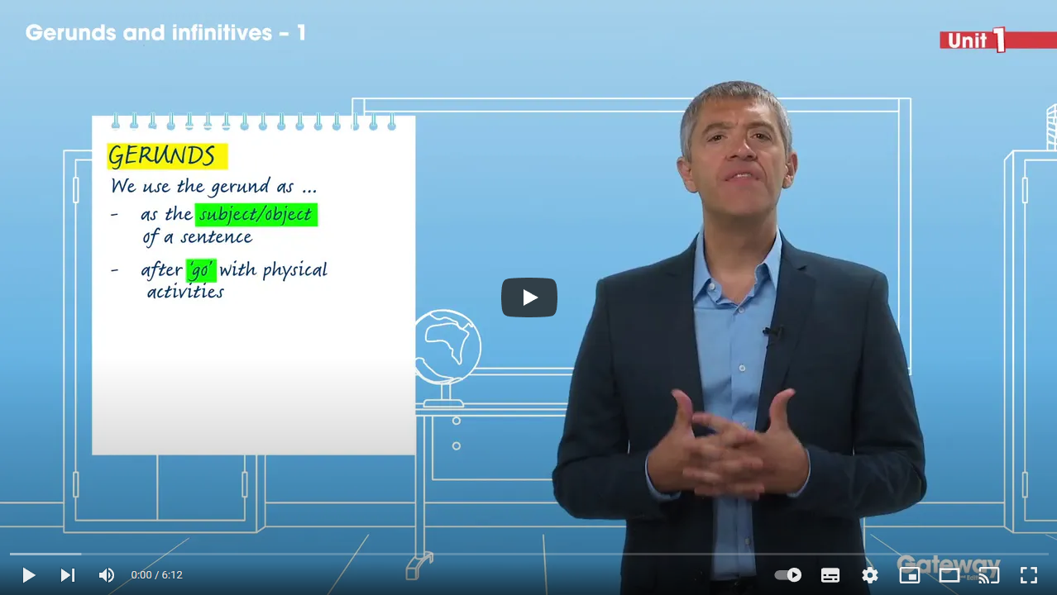
Presentation: Flipped Classroom
(revision for grade 9)
As home assignment for this lesson you had to
watch the video at home
make notes in your copybooks
on the rules about using gerund/infinitive/bare infinitive.
https://www.youtube.com/watch?v=pjzwzyxUOp8&ab_channel=L.Malda
GERUND | INFINITIVE | BARE INFINITIVE
-ing (e.g., reading) | to+verb (e.g., to read) | to verb (e.g., read)

Slide 4
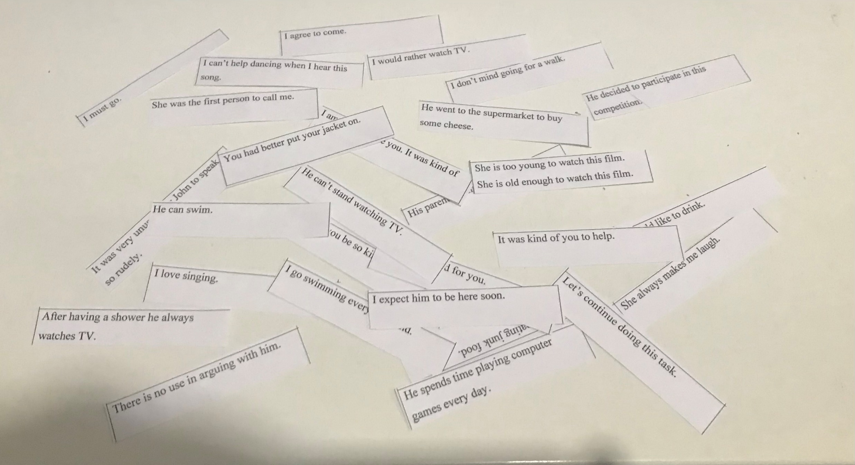
Presentation: Guided Discovery
Divide into 3 groups:
- “Gerund”,
- “Infinitive”,
“Bare Infinitive”
Each group gets the sentences illustrating the rules.
You need to choose the sentences according to the name of your group and match them to the rules you have in your copybooks.
Then we check it together.
You have 5-7 minutes to complete the task.

Slide 5
Let’s check!
GERUND | INFINITIVE | BARE INFINITIVE
-ing (e.g., reading) | to+verb (e.g., to read) | to verb (e.g., read)
1) As the subject/object of a sentence: Reading is good for you. | 1) To express purpose: He went to the supermarket to buy some cheese. | 1) After modal verbs: He can swim. I must go. * Pay attention to ‘have to’, ‘need to’
2) After the verb ‘go’ (with physical activities): I go swimming every weekend. | 2) After adjectives: I am happy to see you. It was kind of you to help. | 2) After the verbs of specific preference (would like, want, can’t wait): I would like to drink.
3) After prepositions: After having a shower he always watches TV. | 3) After too/enough: She is too young to watch this film. She is old enough to watch this film. | 3) After the verbs ‘let’, ‘make’: His parents let him come home late. She always makes me laugh.
4) After verbs of liking/disliking (love, like, hate, etc.): I love singing. | 4) After be+first/second/next/last: She was the first person to call me. | 4) After ‘had better’, ‘would rather’: You had better put your jacket on. I would rather watch TV.
 | 5) With it+be+adjective/noun; so+adjective+as; for+noun/pronoun: It was kind of you to help. Would you be so kind to help me? It was very unusual for John to speak so rudely.

Slide 6
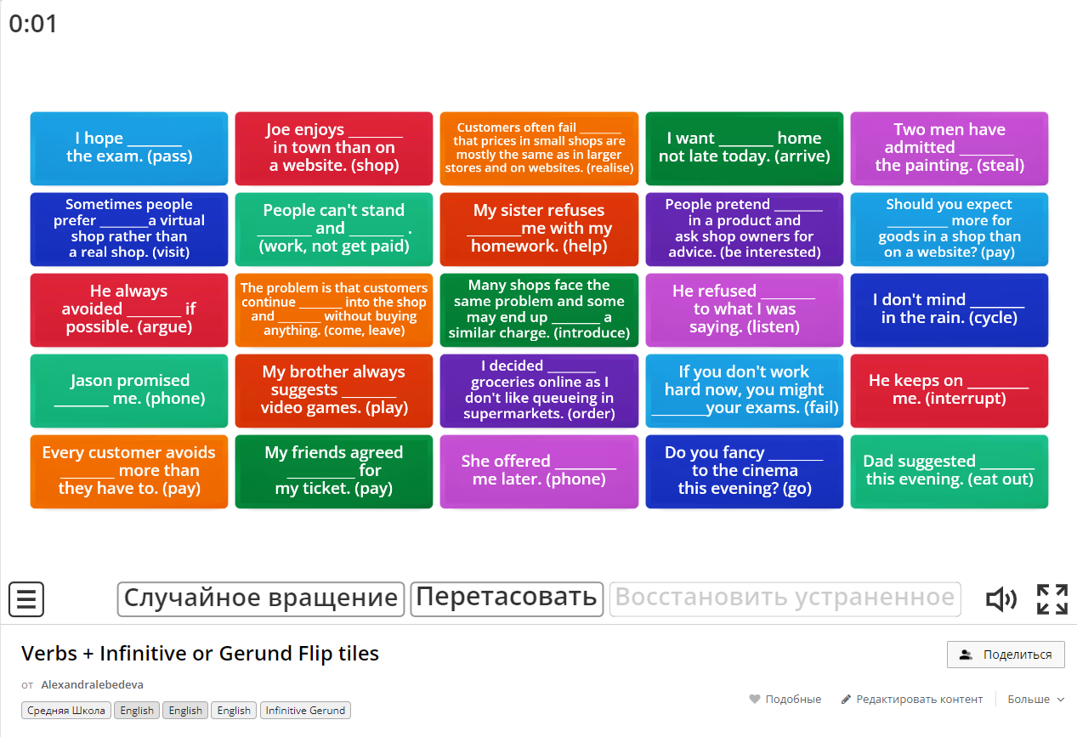
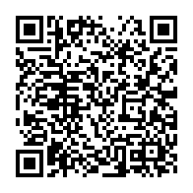
After certain verbs and phrases
INFINITIVE | GERUND
After the verbs agree, appear, ask, decide, expect, explain, find out, hope, learn, plan, promise, refuse: I agree to come. He decided to participate in this competition. I expect him to be here soon. | After the verbs admit, appreciate, avoid, consider, continue, deny, fancy, imagine, lose, mind, miss, practice, prevent, quit, save, spend, suggest, waste: She avoids eating junk food. Let’s continue doing this task. I don’t mind going for a walk. He spends time playing computer games every day.
 | After the expressions be busy, it’s no/what’s the use, it’s no good, it’s (not) worth, can’t help, can’t stand, have trouble: I can’t help dancing when I hear this song. There is no use in arguing with him. He can’t stand watching TV.
You get a list of ‘certain verbs and phases’. Using the rules from your Student’s book on pp.GR3-4 (Grammar Reference) try to put the following examples into an appropriate column.
You have 3-4 minutes to complete the task. Work in pars with a classmate you sit next to. Then we check it together.
Now let’s practice these verbs and phrases! Again you work in pars with a classmate you sit next to. Help each other! When you are ready show me your results!
Then we check it together.

Slide 7
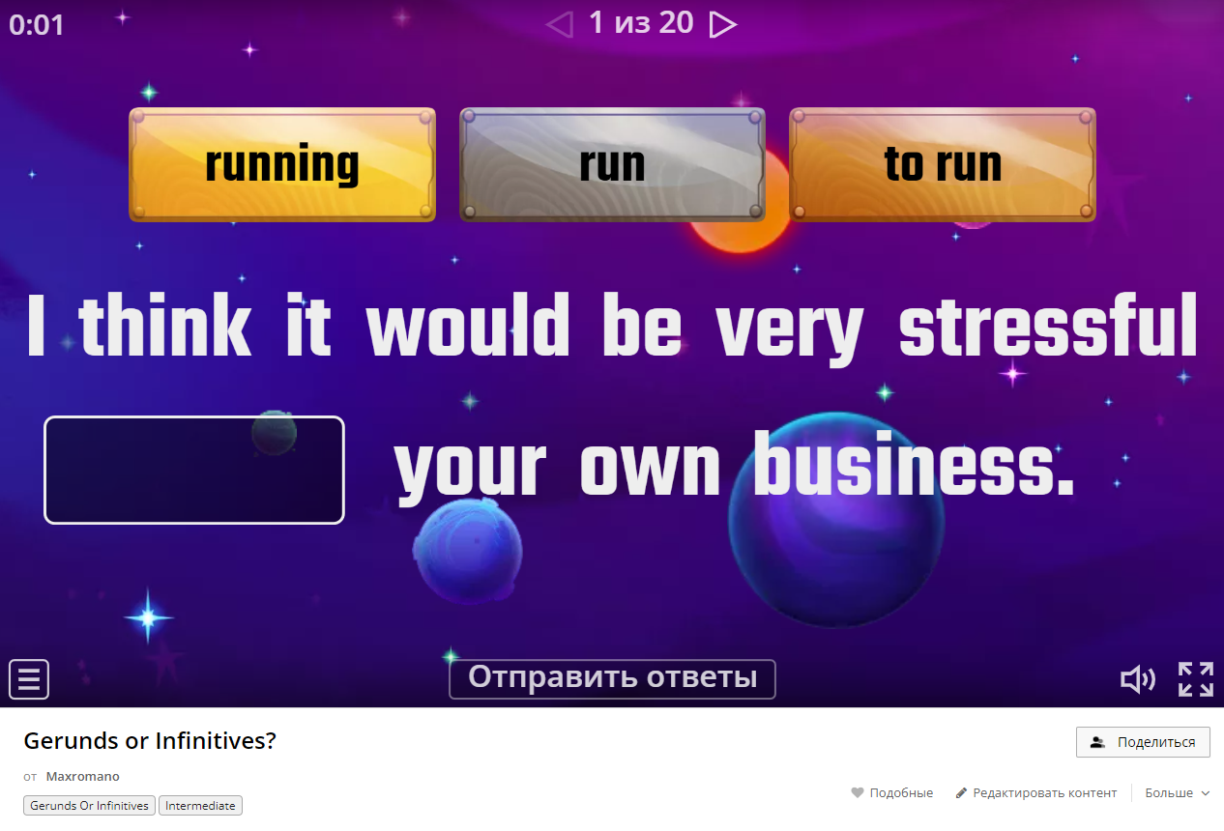
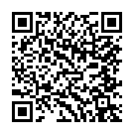
Let’s practice!
Using the notes in your copybook do the following exercise to practice the rules you have just learn. Work on your own. When you are ready share your results!

Slide 8
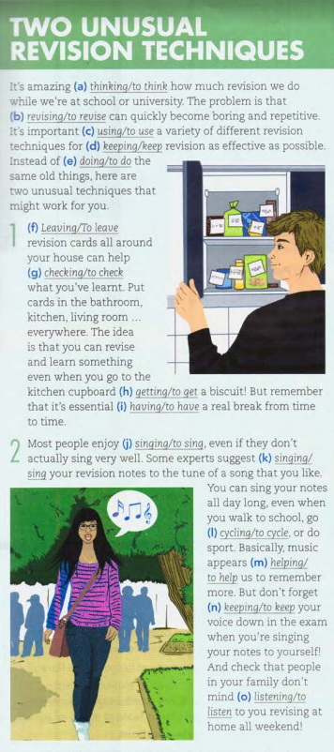

Let’s practice!
Read the text and choose the correct alternative. Explain your choice.
What is each paragraph about?
Would you use either of these techniques? Why/Why not?

Slide 9
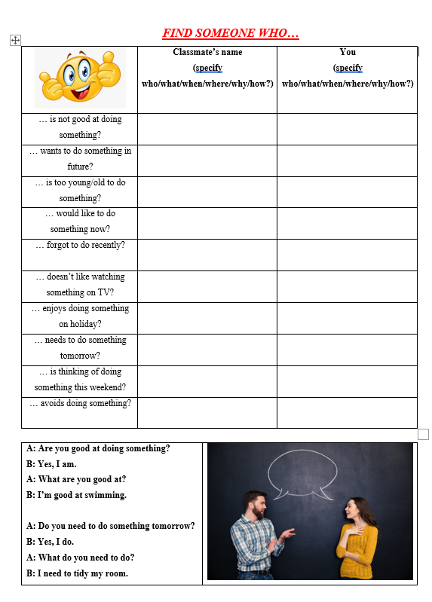

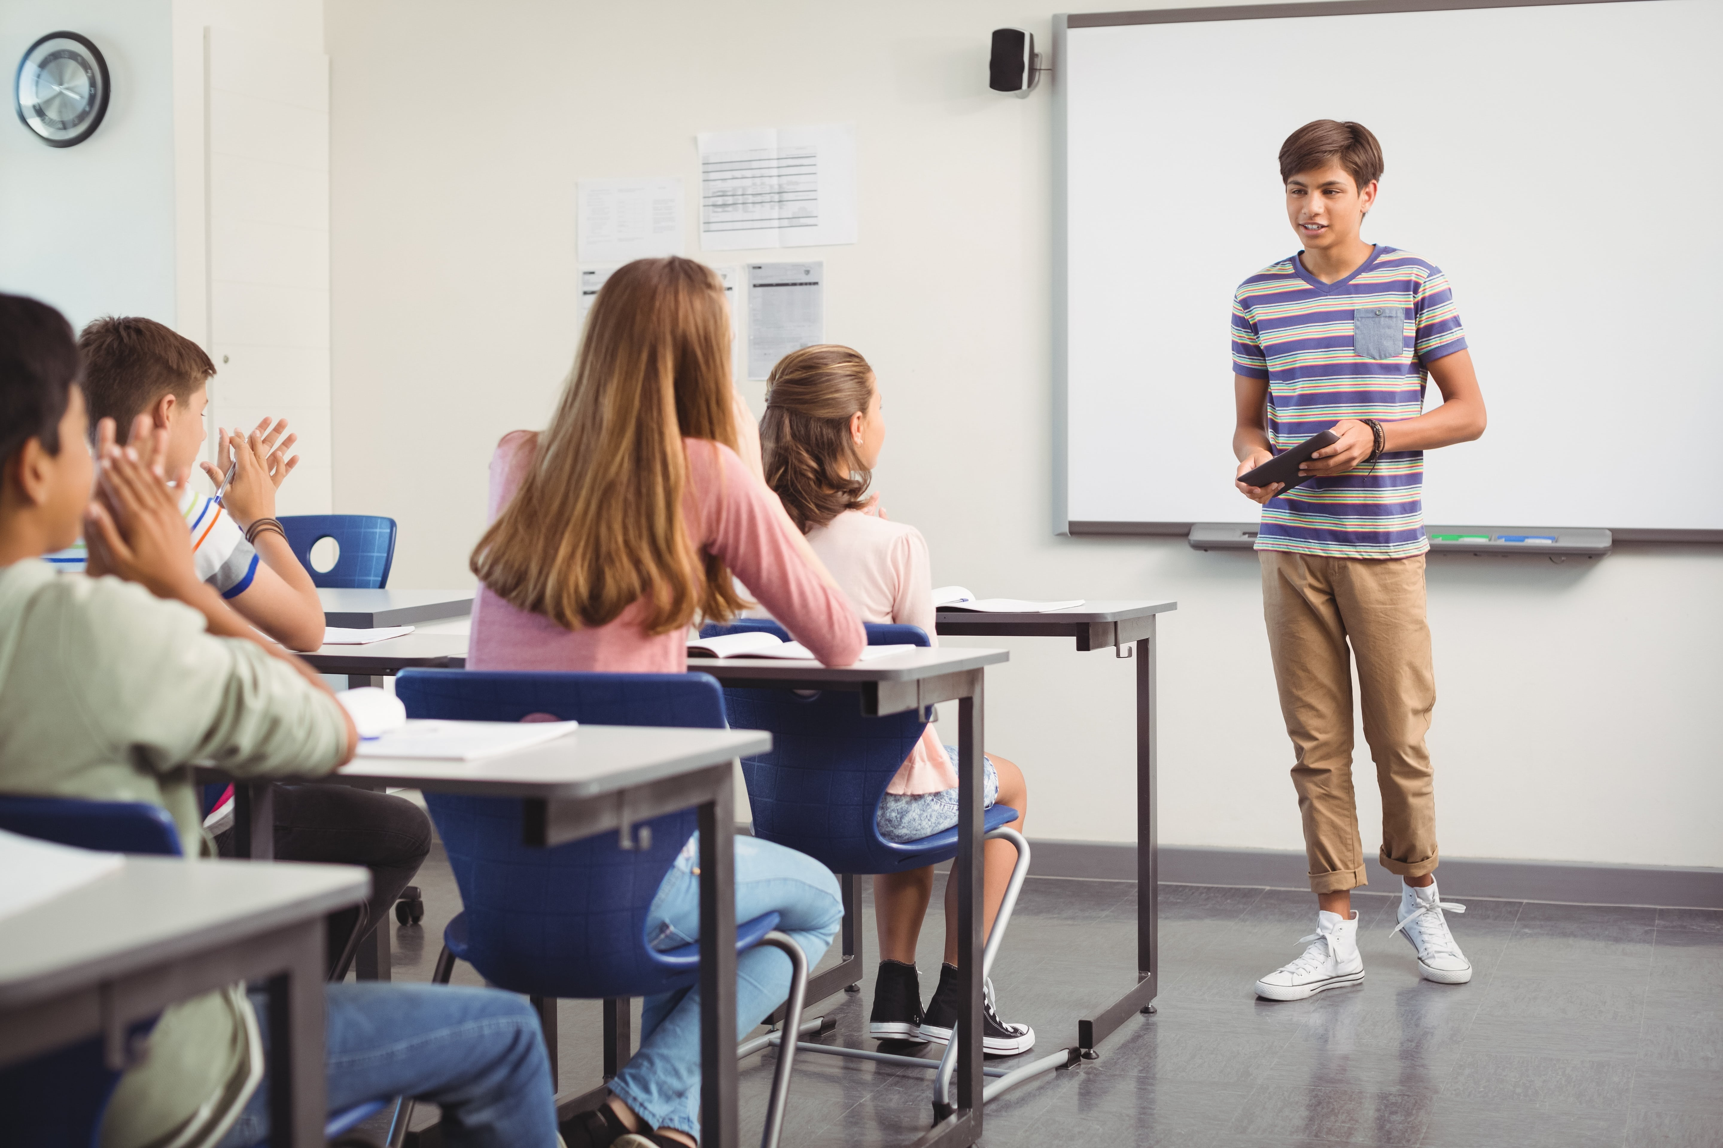
Find someone who…
Walk around the class and ask your classmates the following questions. Fill the chart about your classmates and you. Then be ready to talk about the information you have and compare.

Slide 10
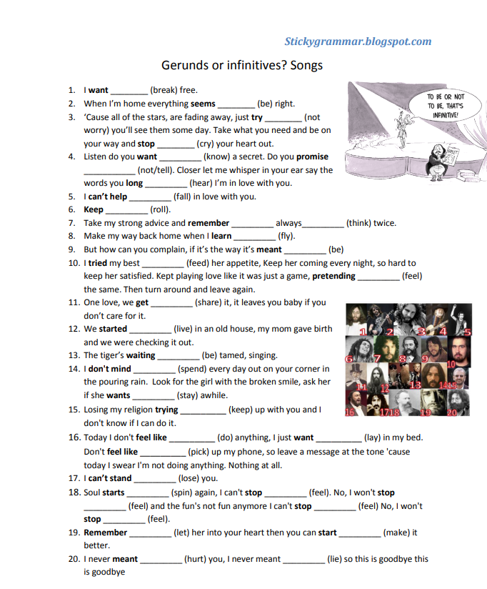

Home assignment
Watch the video and fill the gaps in your worksheets. Be ready to explain your choice (give the rule):
Gerund & Infinitive song – YouTube

Slide 11

Evaluate your work!
On this lesson I…
After the lesson I can talk about …
But I need to study/practice more about …
I need help with …
Choose how you feel:
Knew everything, haven’t learnt anything new. | Learnt something new. What was new for you? | Haven’t learnt anything as was lazy during the lesson.

Slide 12
Список использованных материалов:
1) «Английский в фокусе 10 класс» (Spotlight 10) / Афанасьева О.В., Дули Д., Михеева И. В. и др. – М.: Просвещение, 2012. – 245 c.
2) Gateway B2 / David Spencer. – Macmillan, 2017. – 158 c.
3) Gerund of Infinitive // URL: https://www.youtube.com/watch?v=pjzwzyxUOp8&ab_channel=L.Malda
4) Verbs + Infinitive or Gerund Flip tiles // URL: Verbs + Infinitive or Gerund Flip tiles - Перевернуть плитки (wordwall.net)
5) Gerunds or Infinitives? // URL: Gerunds or Infinitives? - Пропущенное слово (wordwall.net)
6) Gerund & Infinitive song // URL: Gerund & Infinitive song – YouTube
7) Gerunds or Infinitives? Songs // URL: http://www.vk.com/wall-20535929_59993?ysclid=lbtt1jak8y390820107

