Slide 1
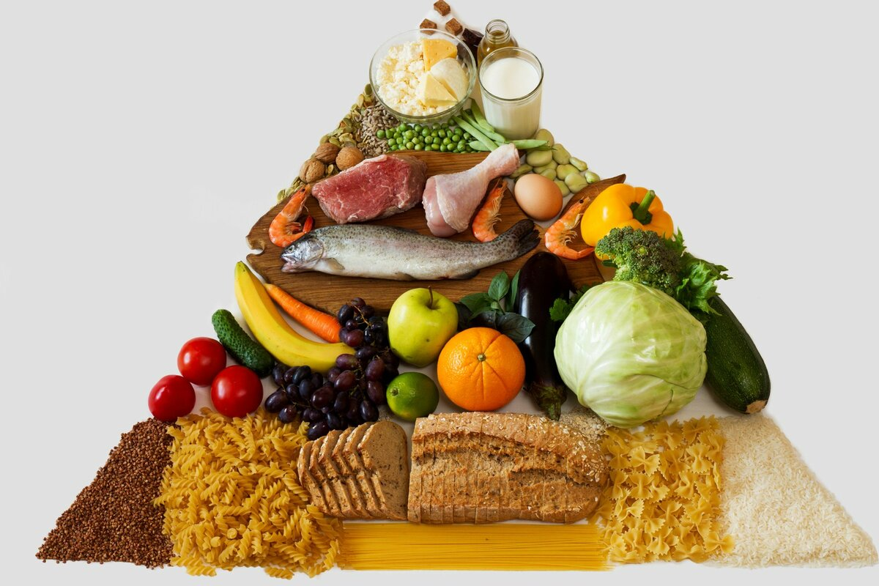
Тема урока: «Food»
Участник: Пак Анастасия Евгеньевна, учитель английского языка МАОУ СОШ 200, город Екатеринбург
На примере учебника: Spotlight 3 класс

Slide 2
Vocabulary:
meat | pasta
potatoes | carrots
biscuits | sausages
milk | rice
cake | popcorn
orange juice | Coke

Slide 3
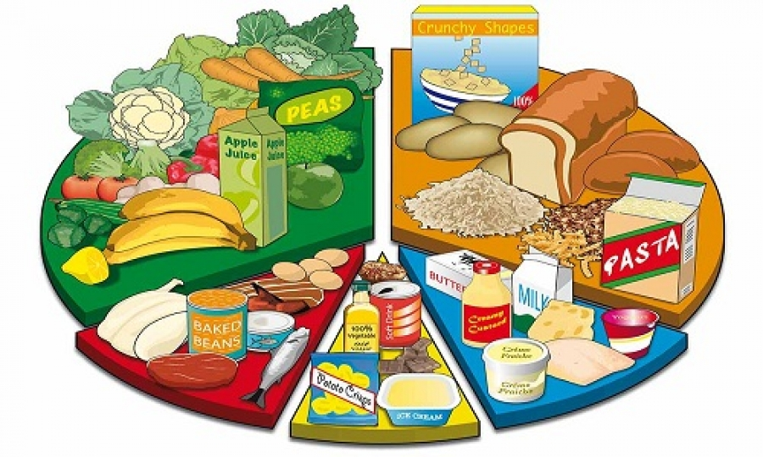
Ask and answers with your partner:
1) What do you like from this food and drink?
2) What is your favourite food?
3) What kind of food do you dislike?
4) Distribute food: what kind of food do you eat for breakfast, lunch and dinner?

Slide 4
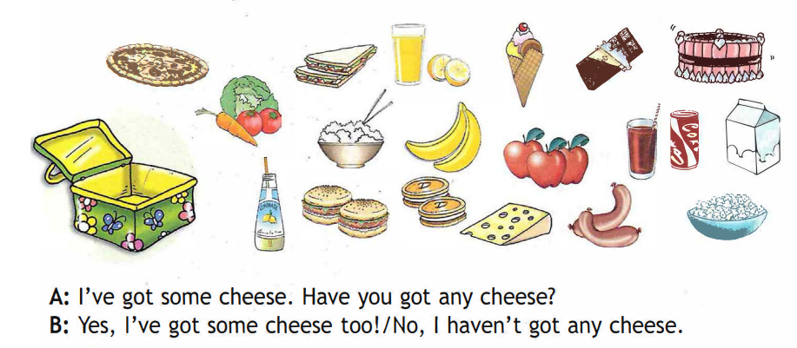
What's in your lunch bох? Choose 3 things and draw. Then talk with your friend

Slide 5
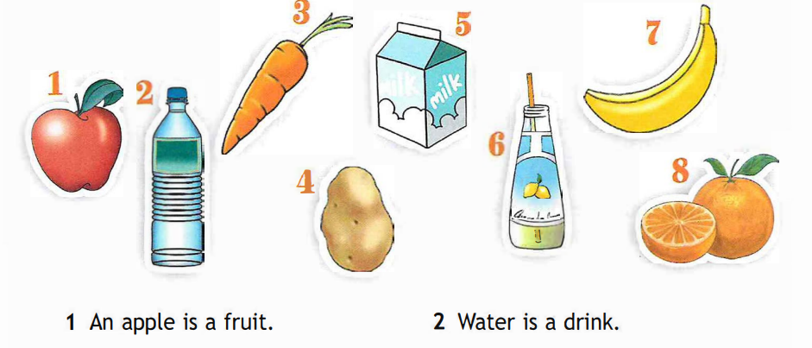
Fruit, vegetable or drink? Look and say

Slide 6
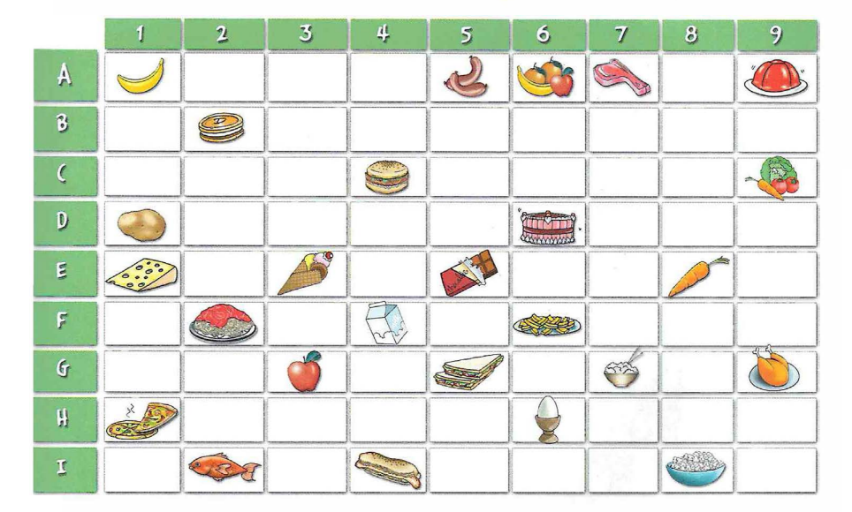
What's their favourite food? Read, look and find out!
• Edward tikes А5. • Lisa tikes D6.
• Penny tikes ЕЗ. • Darett tikes С4.
• Martin tikes Н1. • Jitty tikes F2.

Slide 7
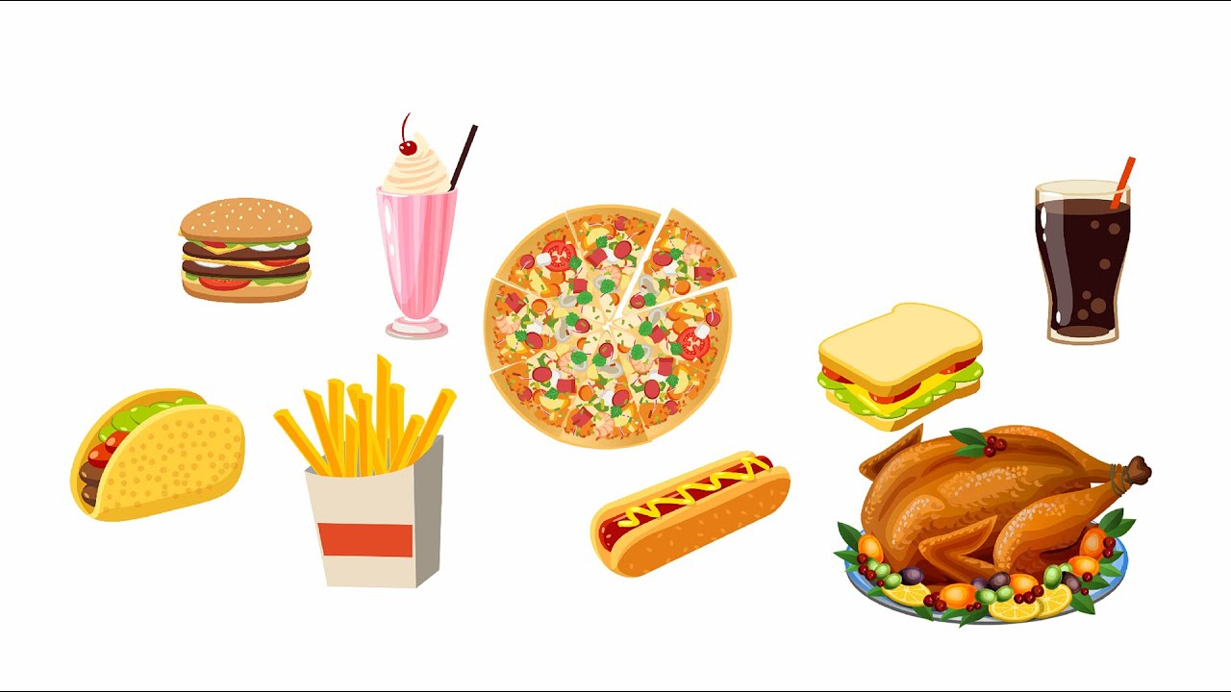
Now write in your notebooks about yourself and your family. Use the code!
I like... .
Му father likes ... .
Му mother likes ... .

Slide 8
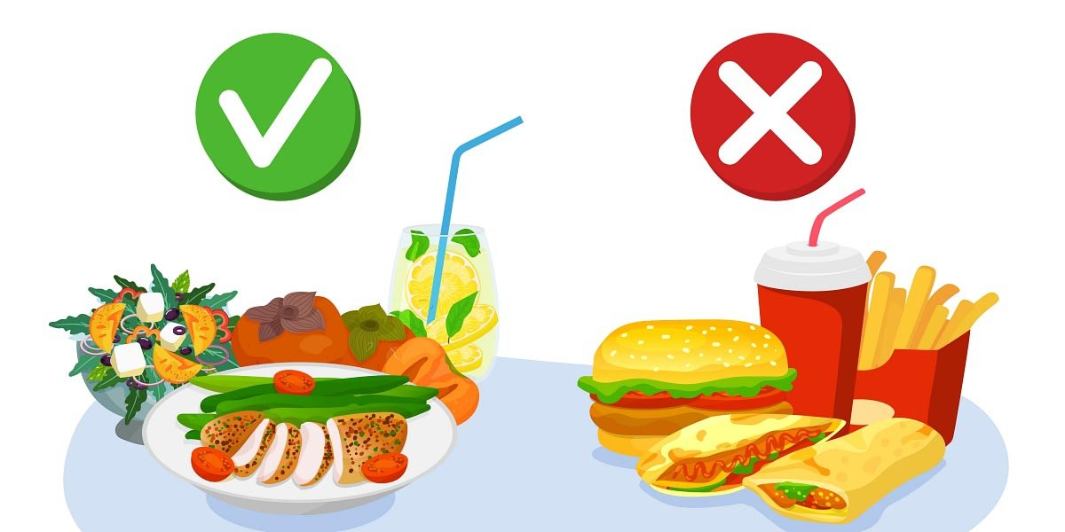
Useful or harmful?

Slide 9
Thank you!

