Slide 1



Разработчик презентации:
учитель английского языка ОУ “Лицей №3 г.Липецка им. К.А. Москаленко”
Богомолова Валерия Сергеевна
ПРЕЗЕНТАЦИЯ К УРОКУ ПО УЧЕБНОМУ ПРЕДМЕТУ «АНГЛИЙСКИЙ ЯЗЫК» В 3-М КЛАССЕ НА ТЕМУ
«МОЯ ШКОЛА (ШКОЛЬНЫЕ ПРИНАДЛЕЖНОСТИ)”
УМК: Spotlight 3

Slide 2


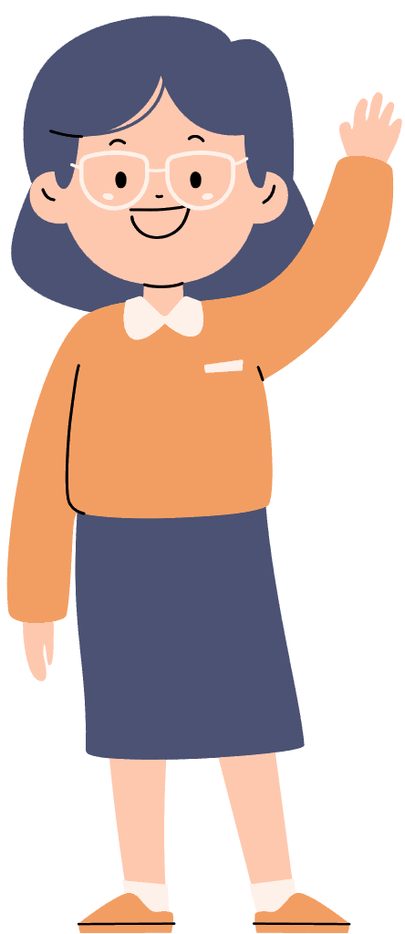
Hello, students!
How are you?
Who’s absent today?

Slide 3
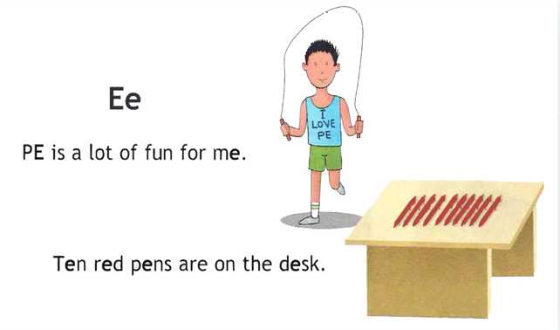



Let’s say our tongue-twist. Try as quick as you can!

Slide 4
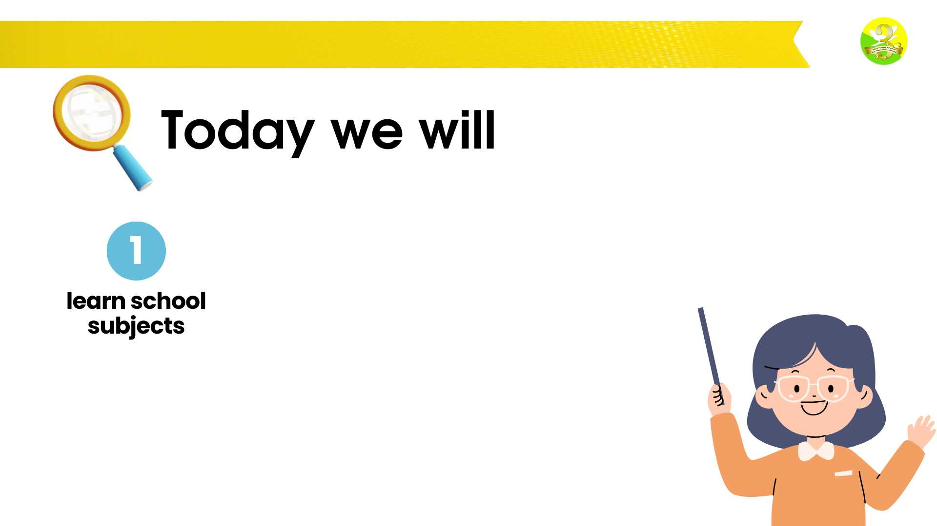
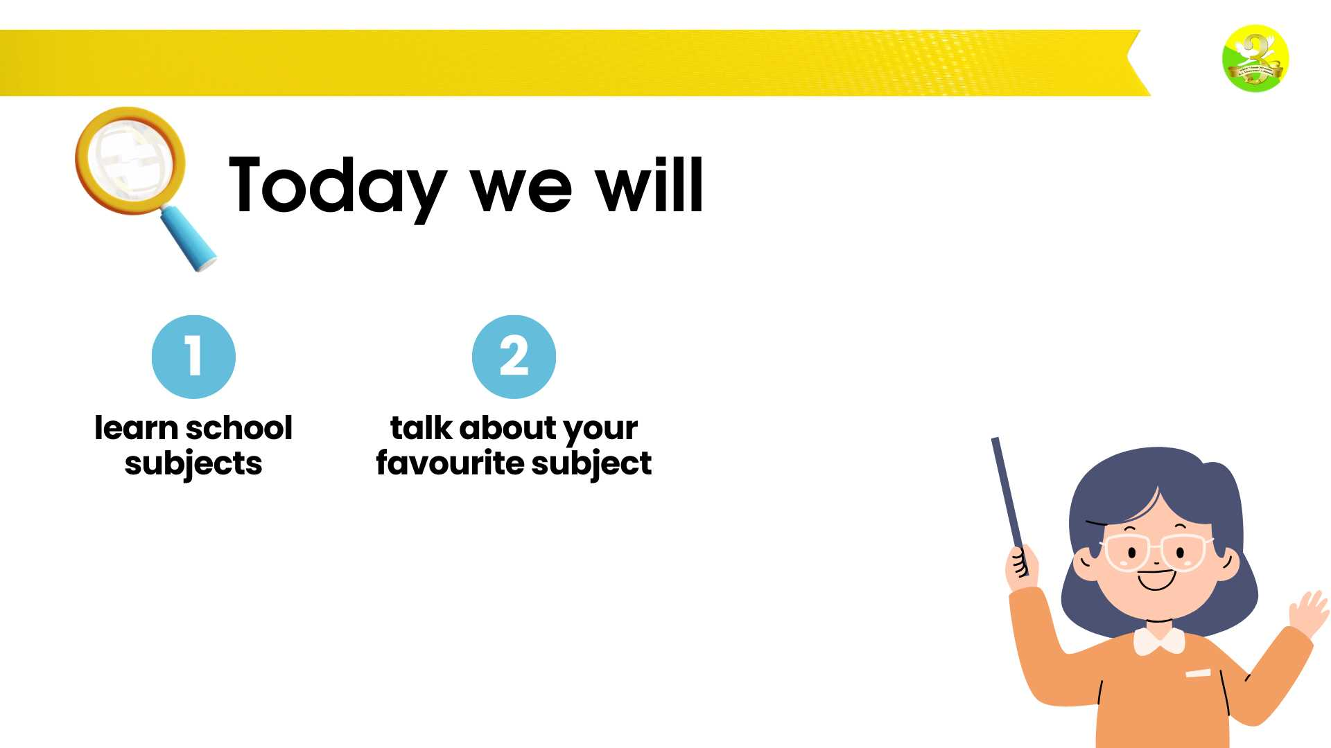
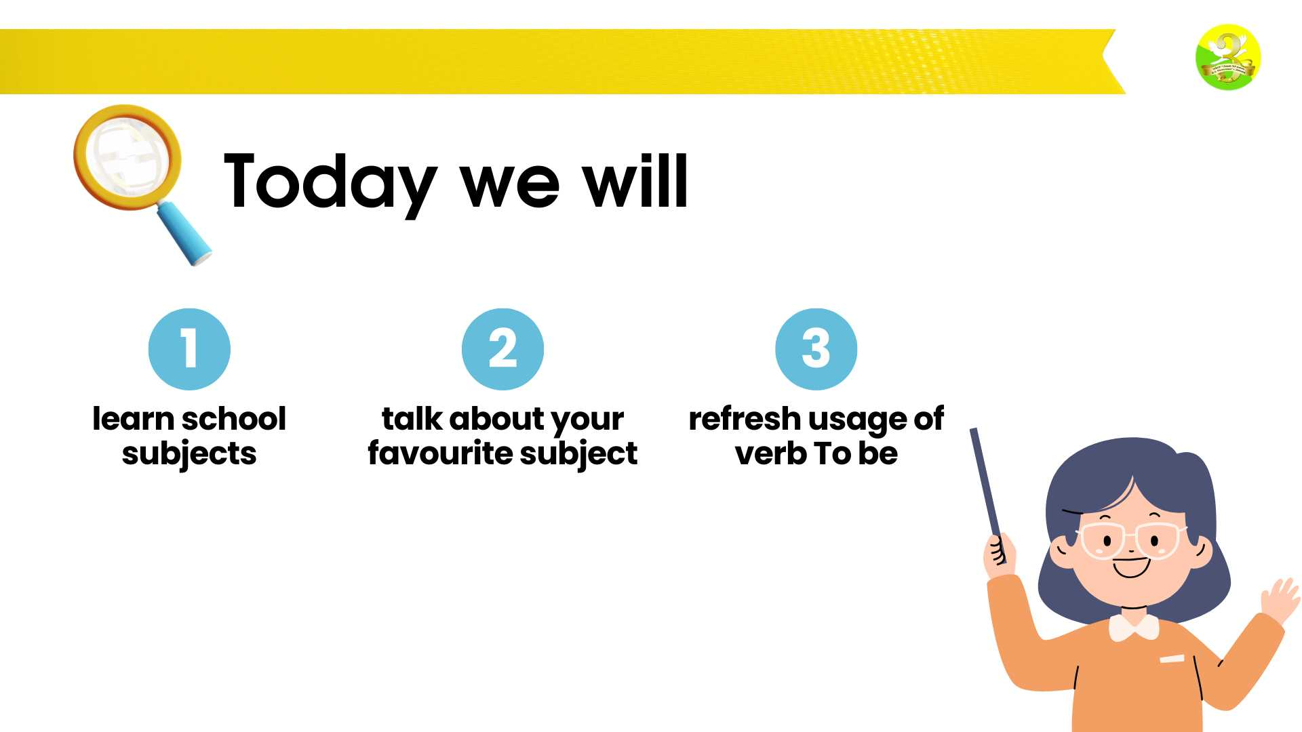


Today we will

Slide 5
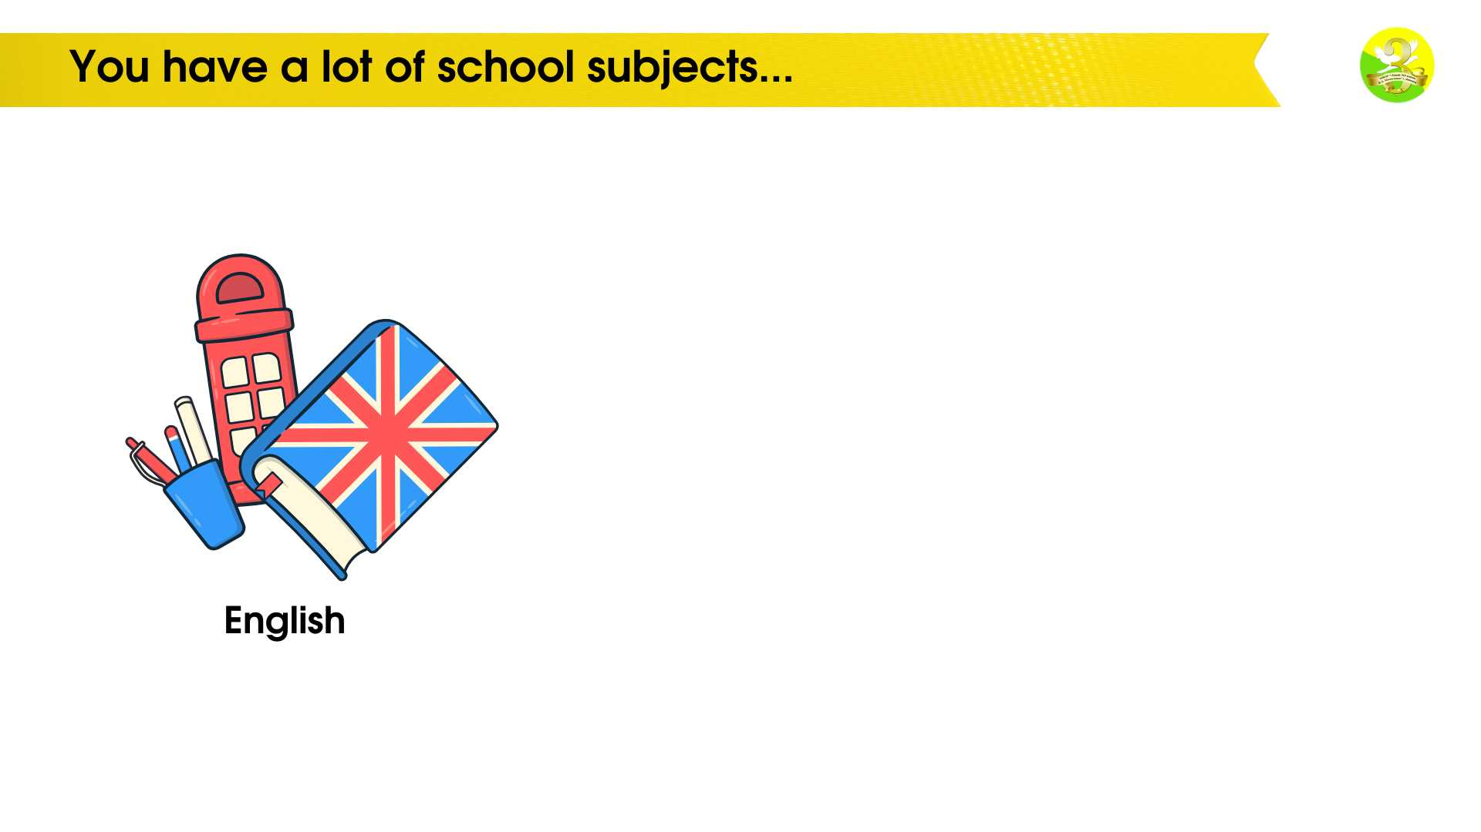
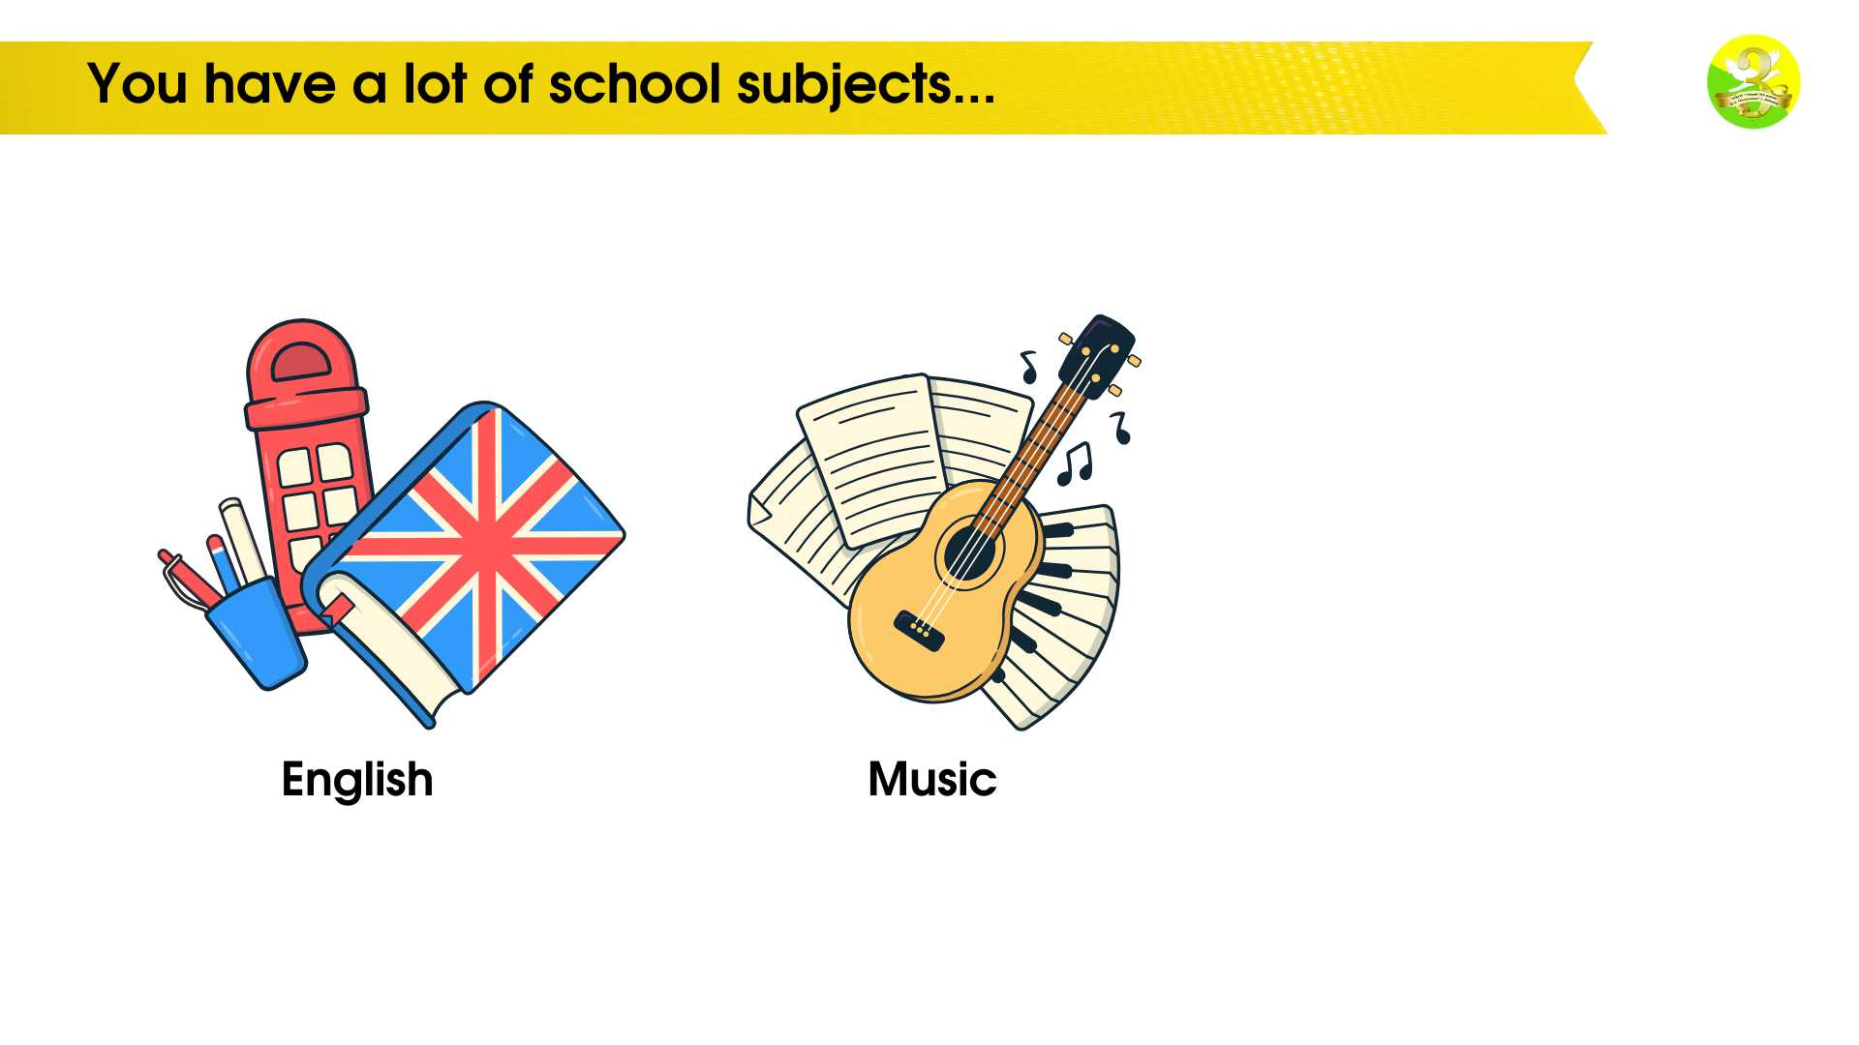
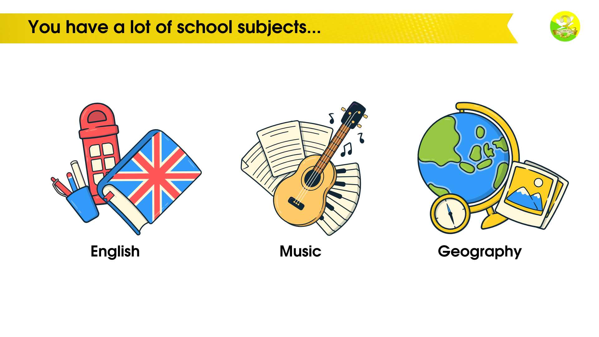
You have a lot of school subjects...

Slide 6
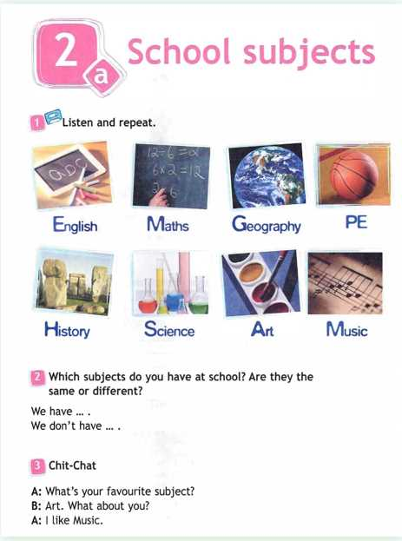
OPEN YOU SB AT PAGE 14. EX. 1. LISTEN TO ME AND REPEAT

Slide 7
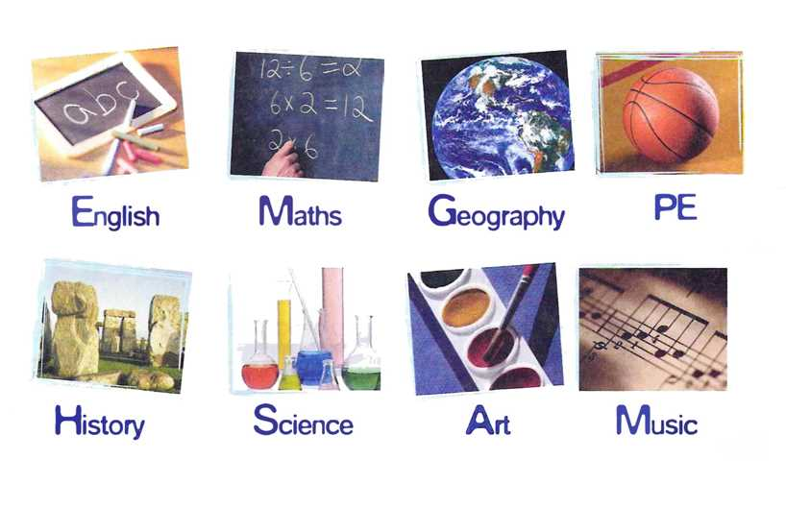
LOOK AT THE PICTURES AGAIN AND REPEAT

Slide 8
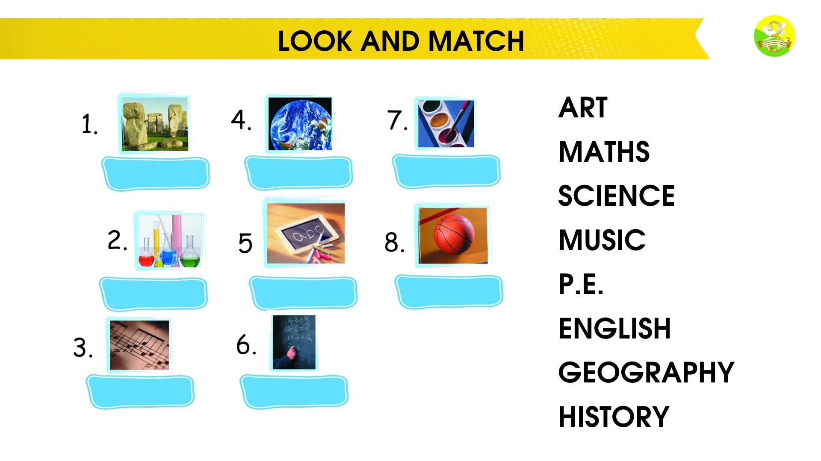
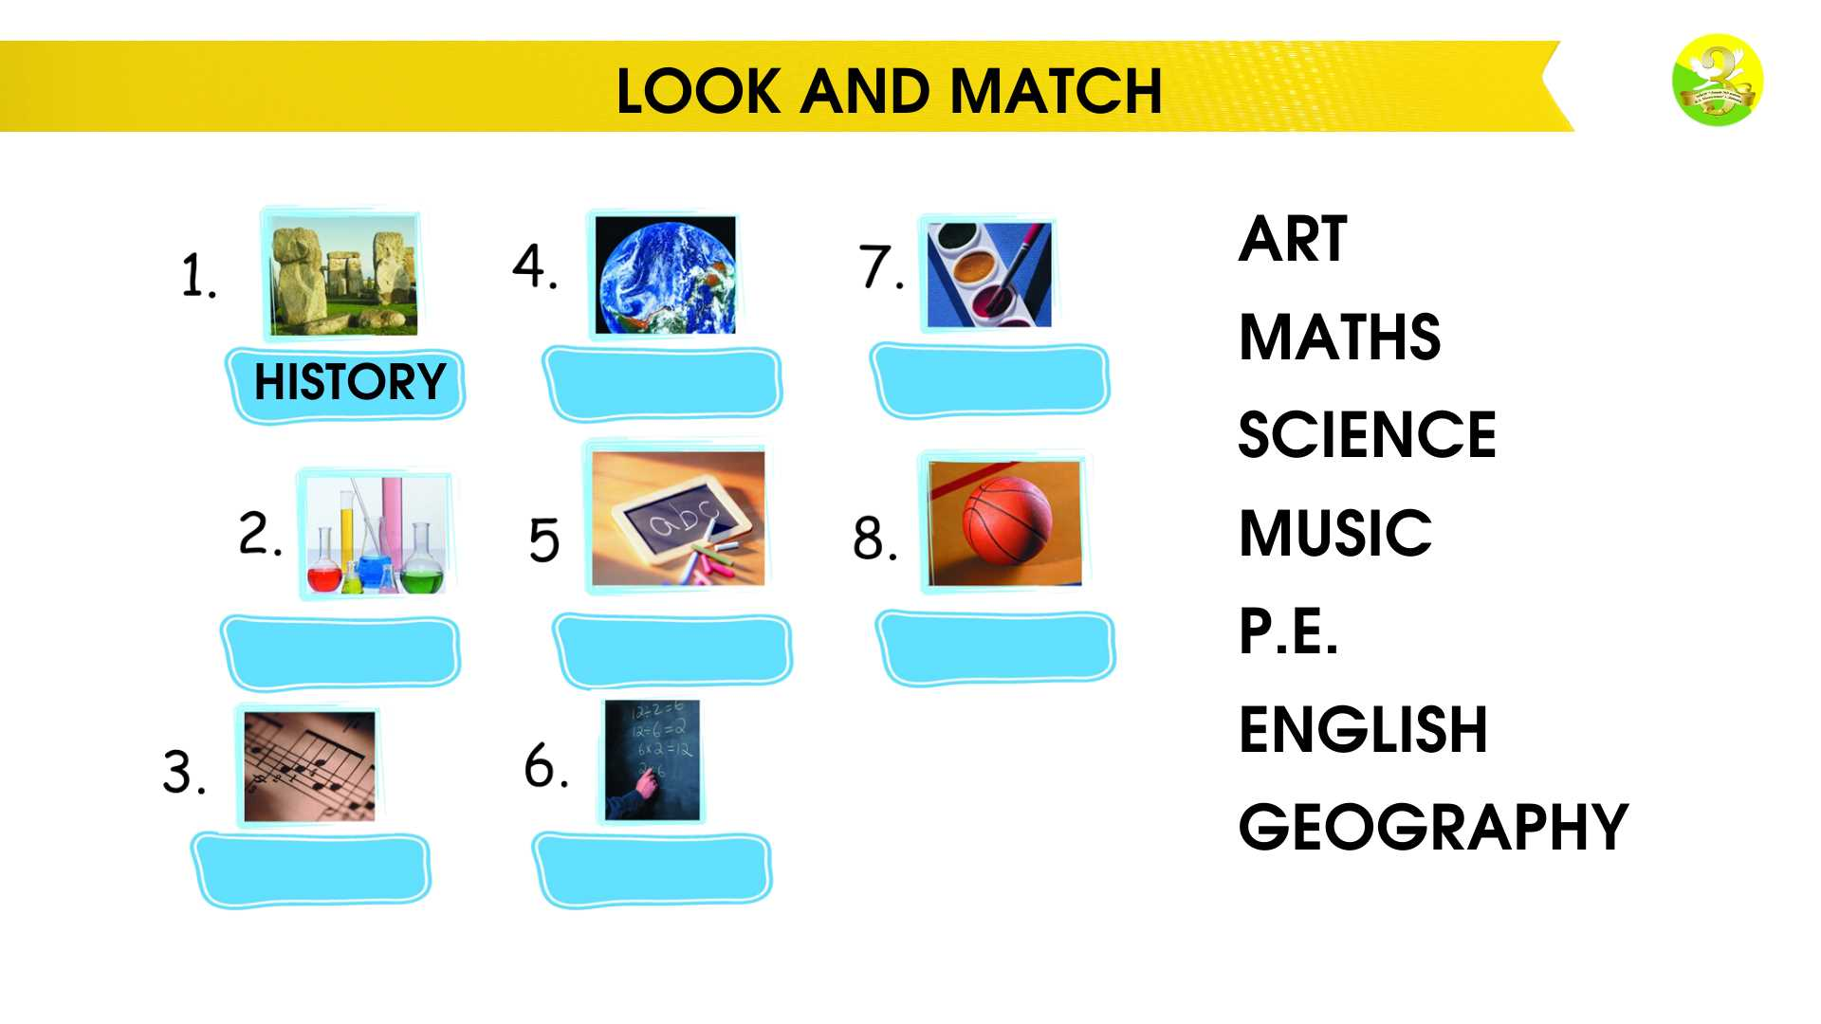
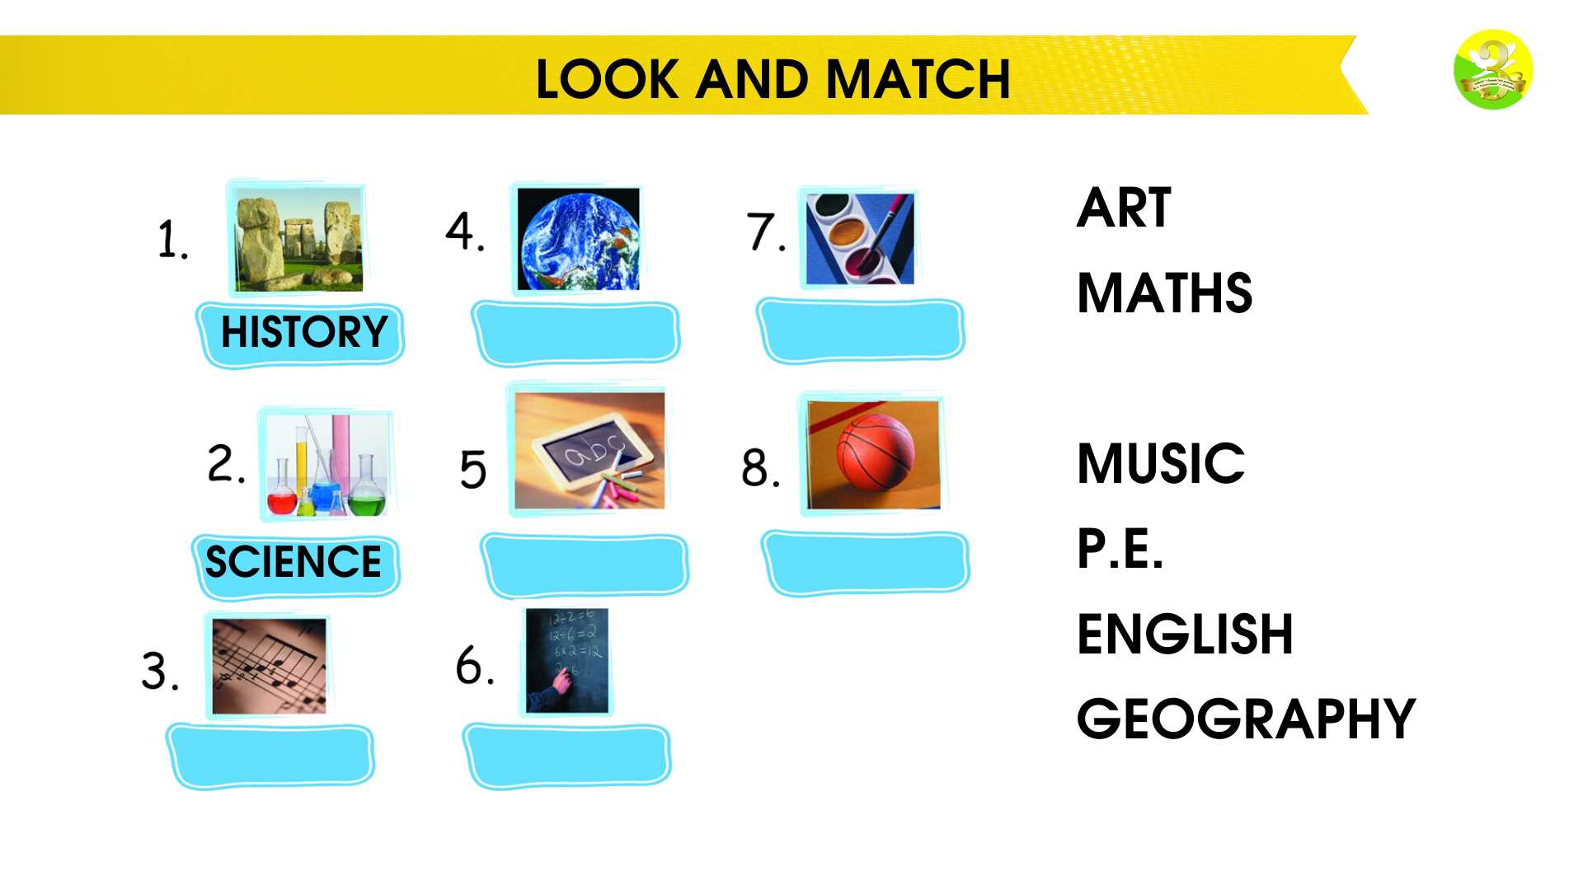
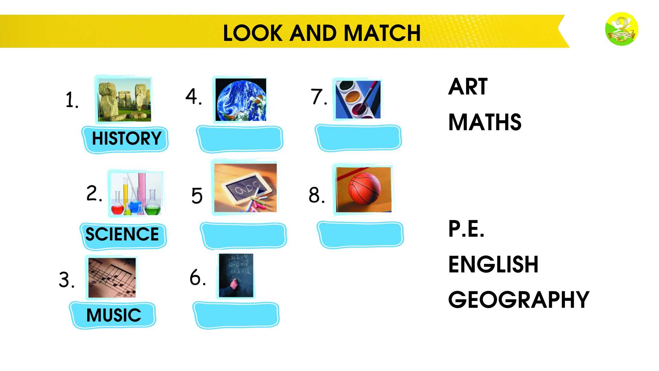
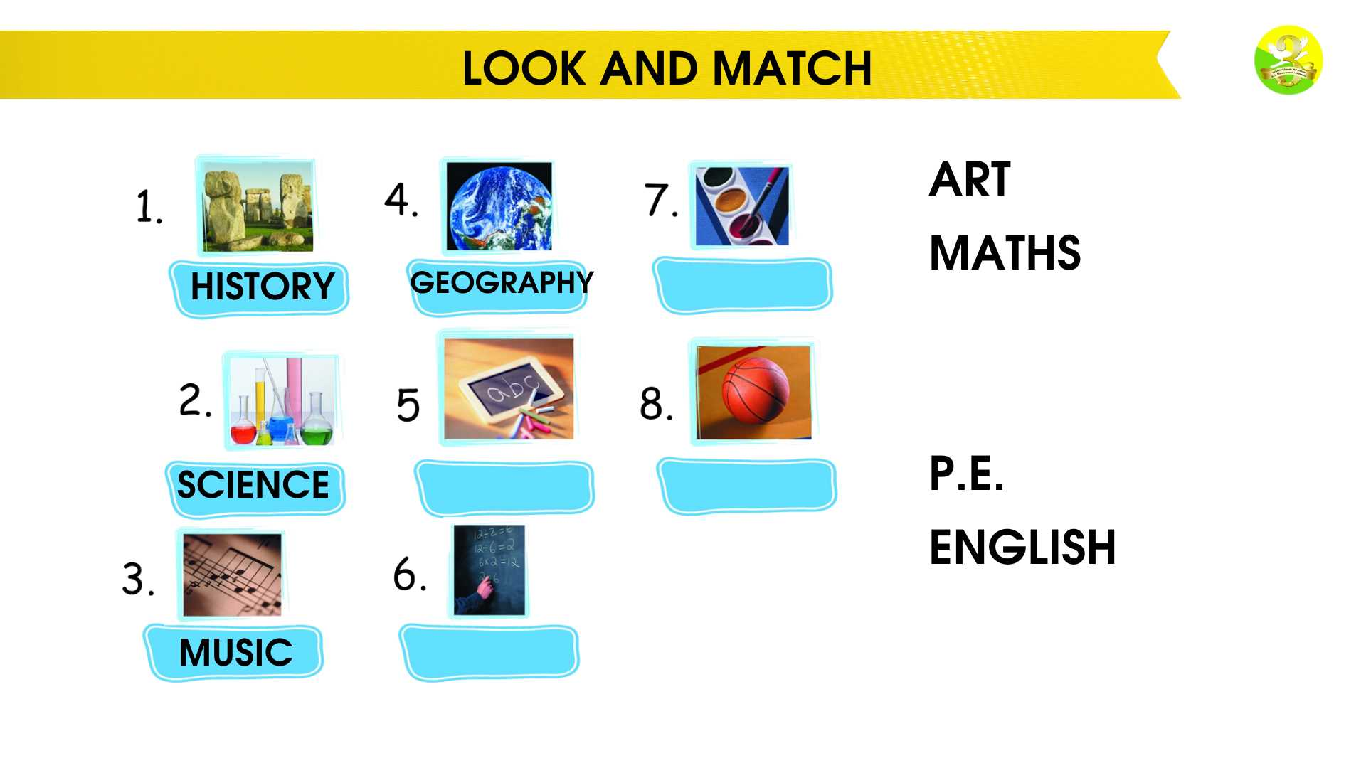
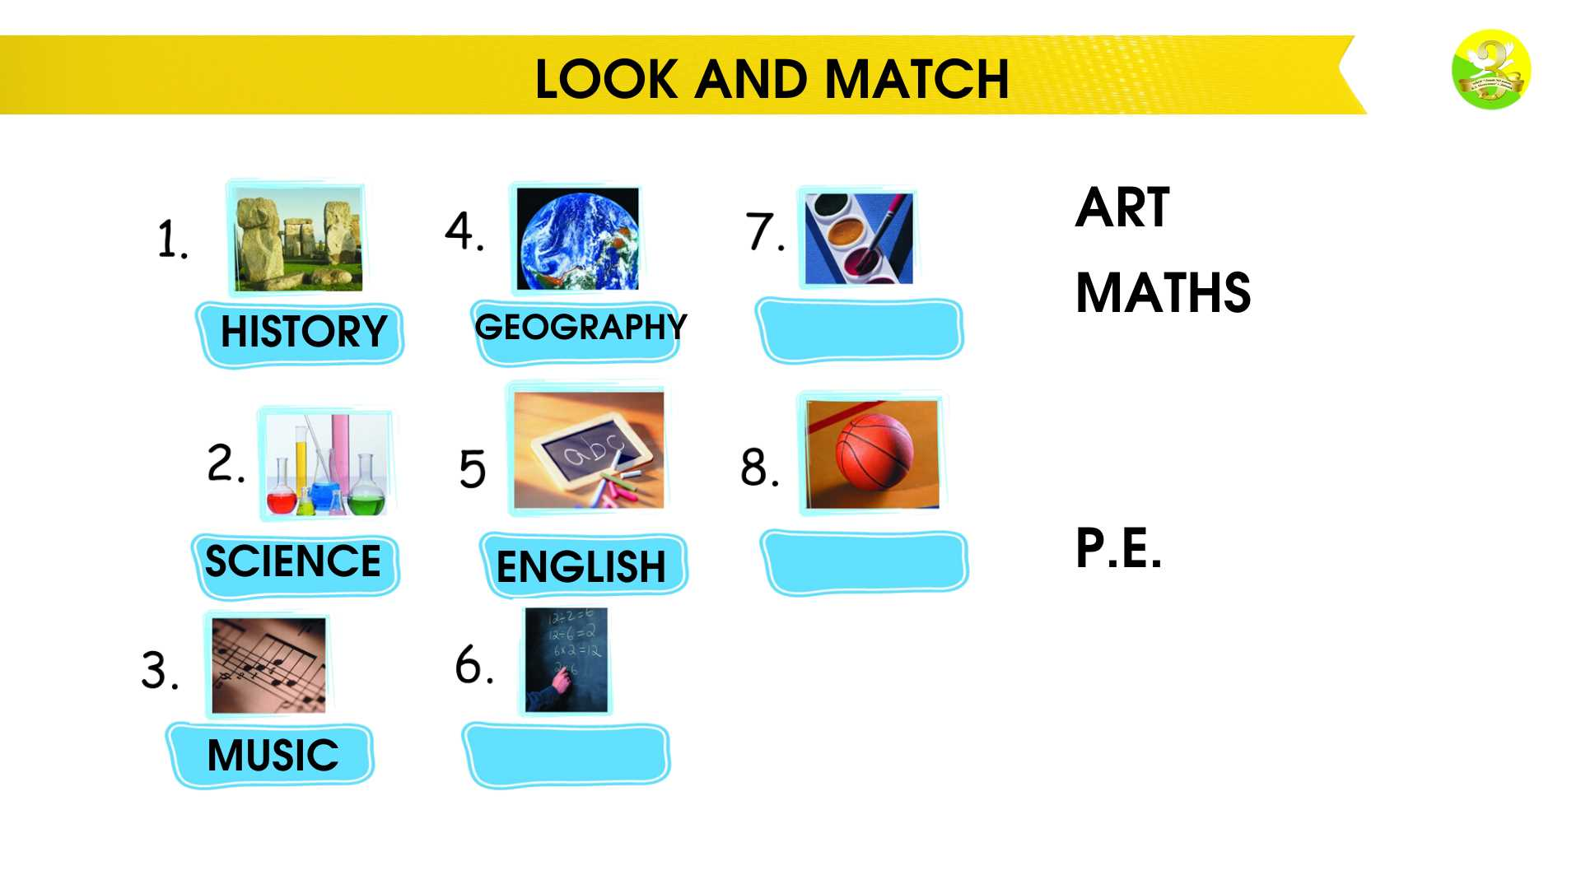
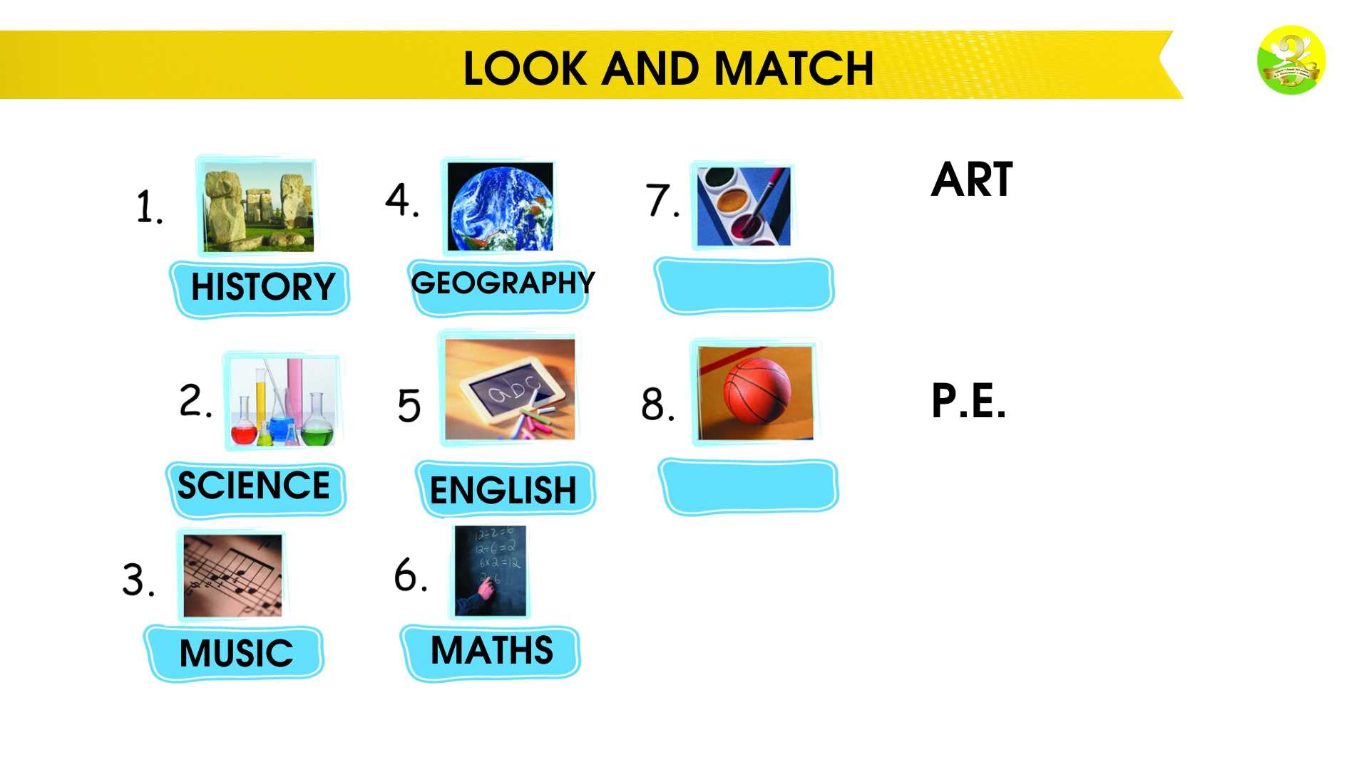
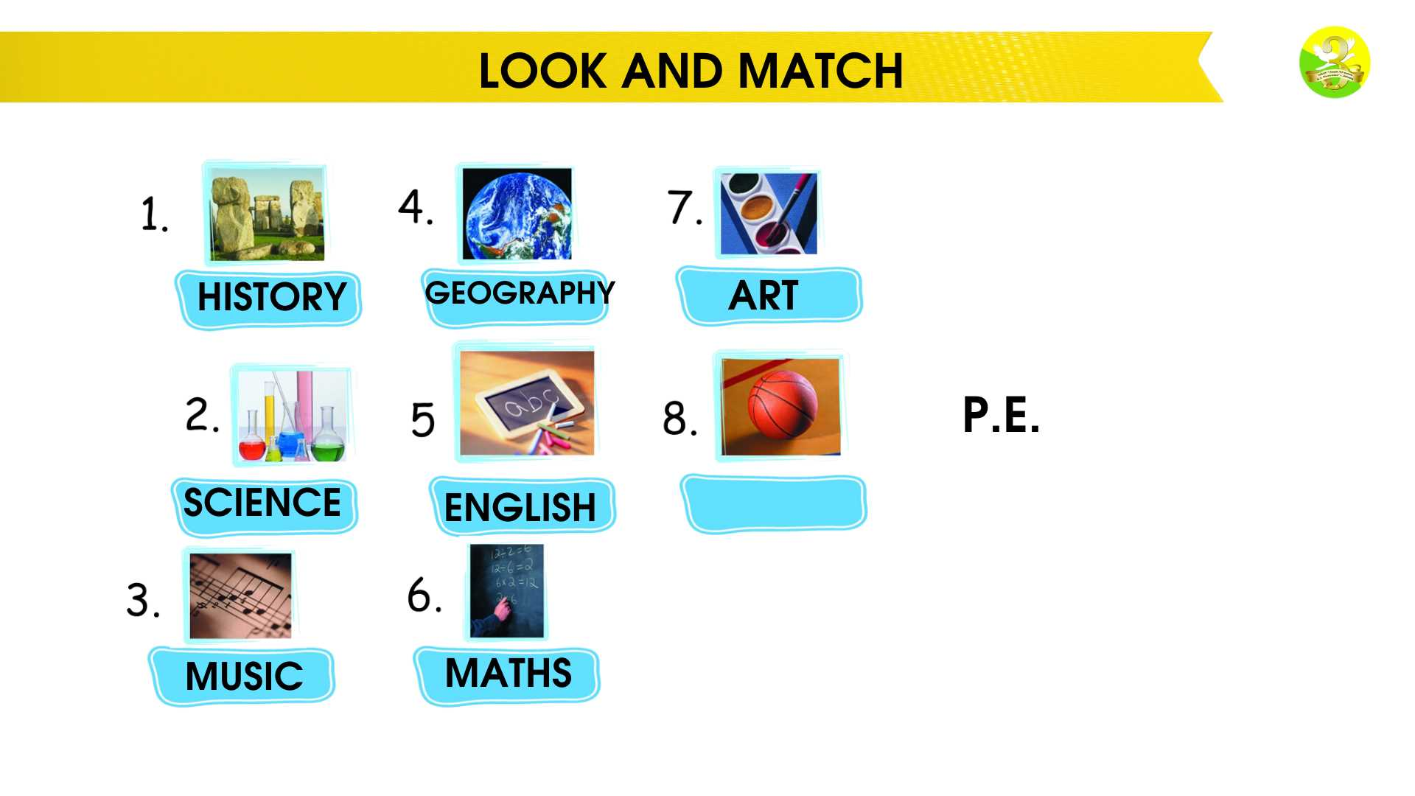
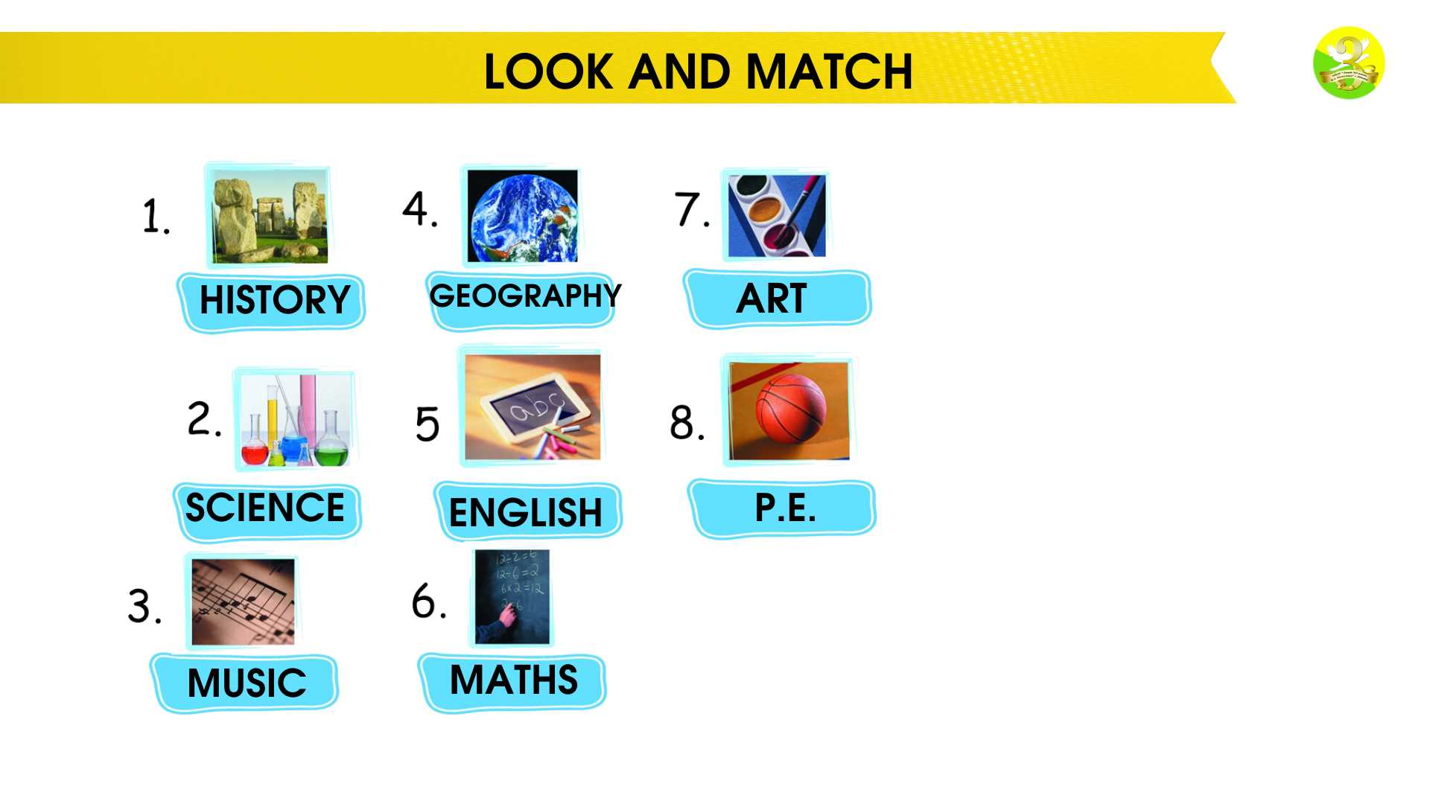
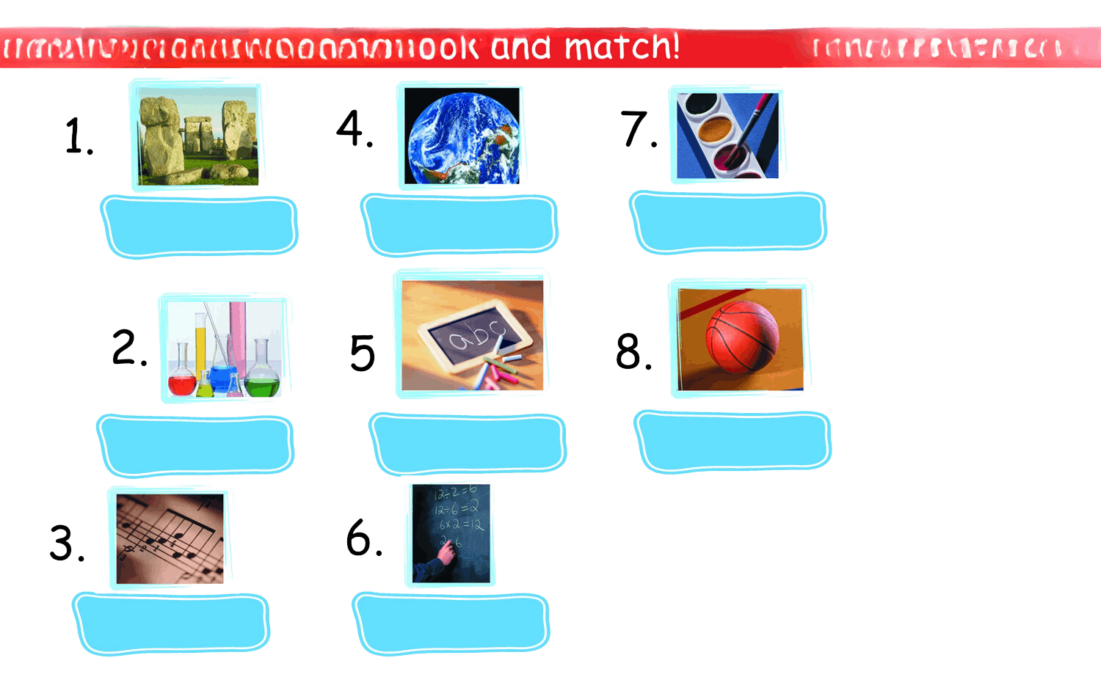
LOOK AND MATCH
Art
Maths
Science
Music
P.E.
English
Geography
History

Slide 9
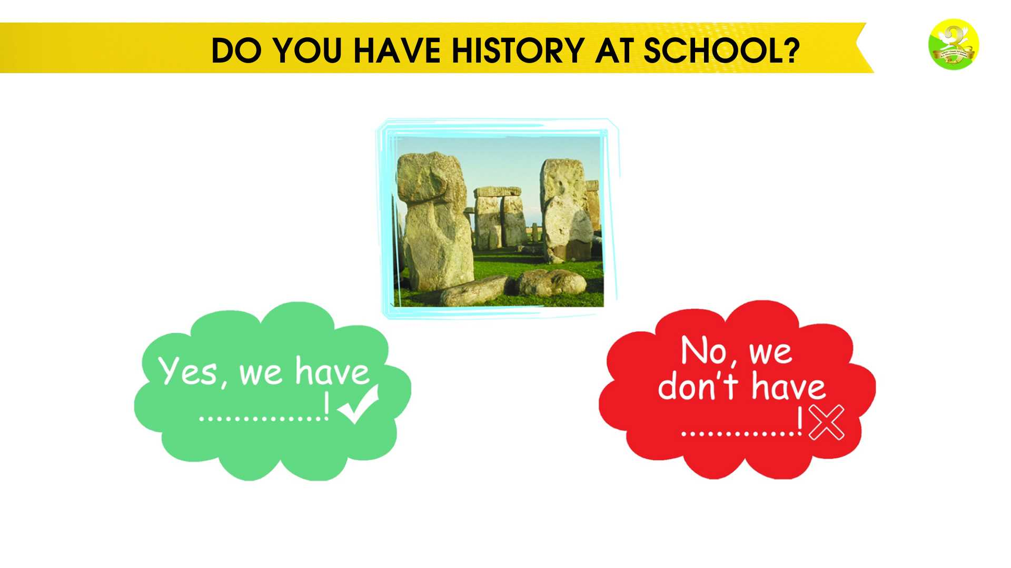
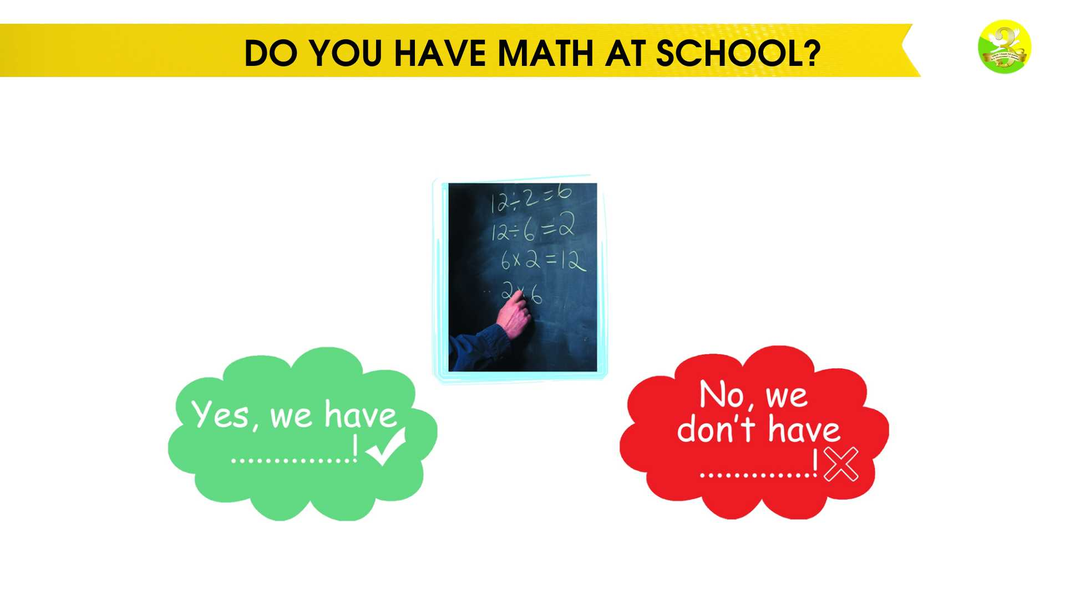
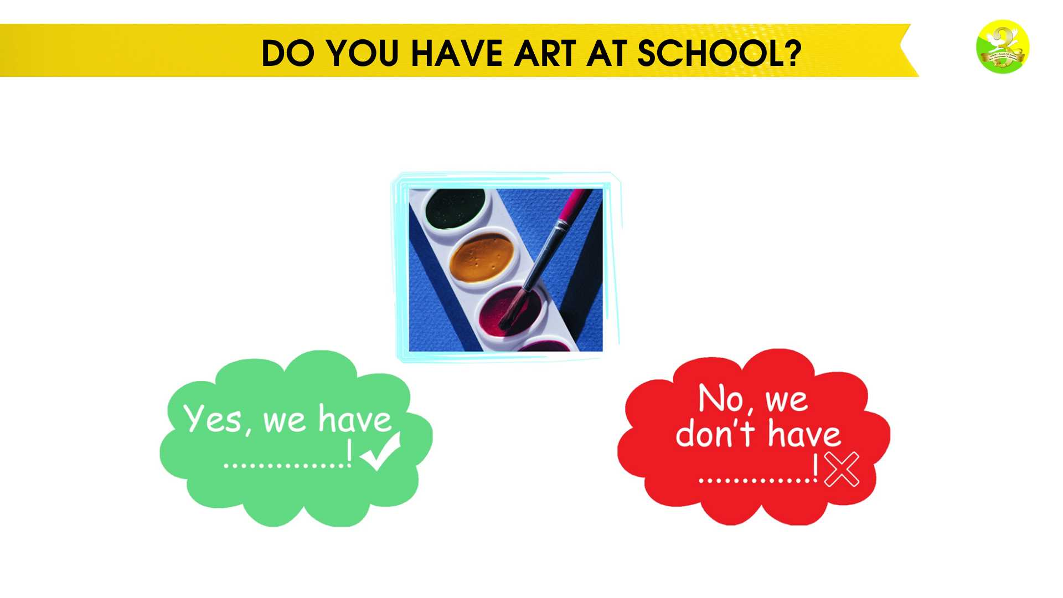
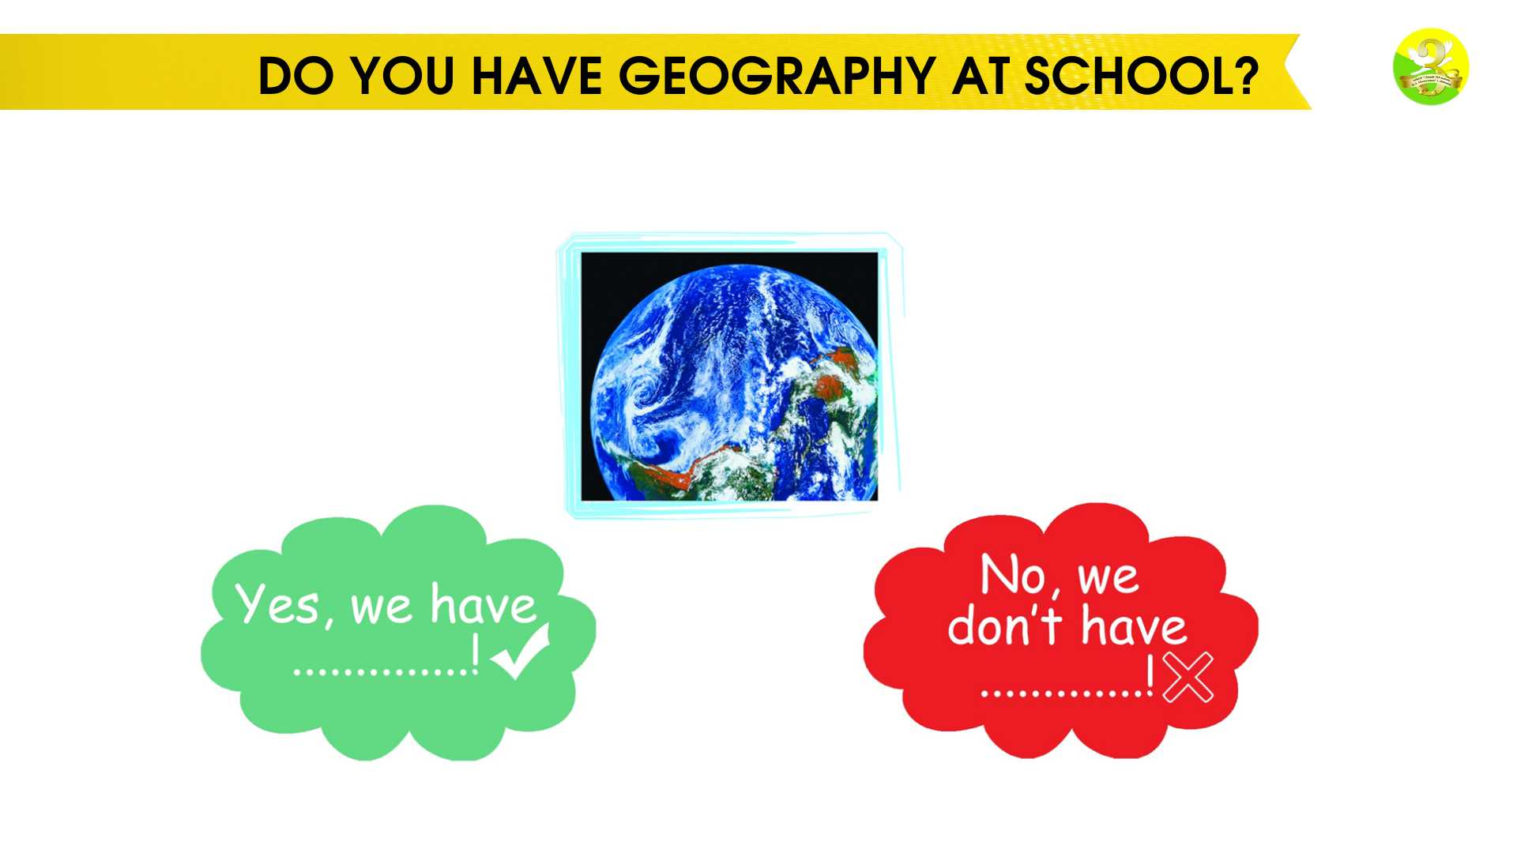
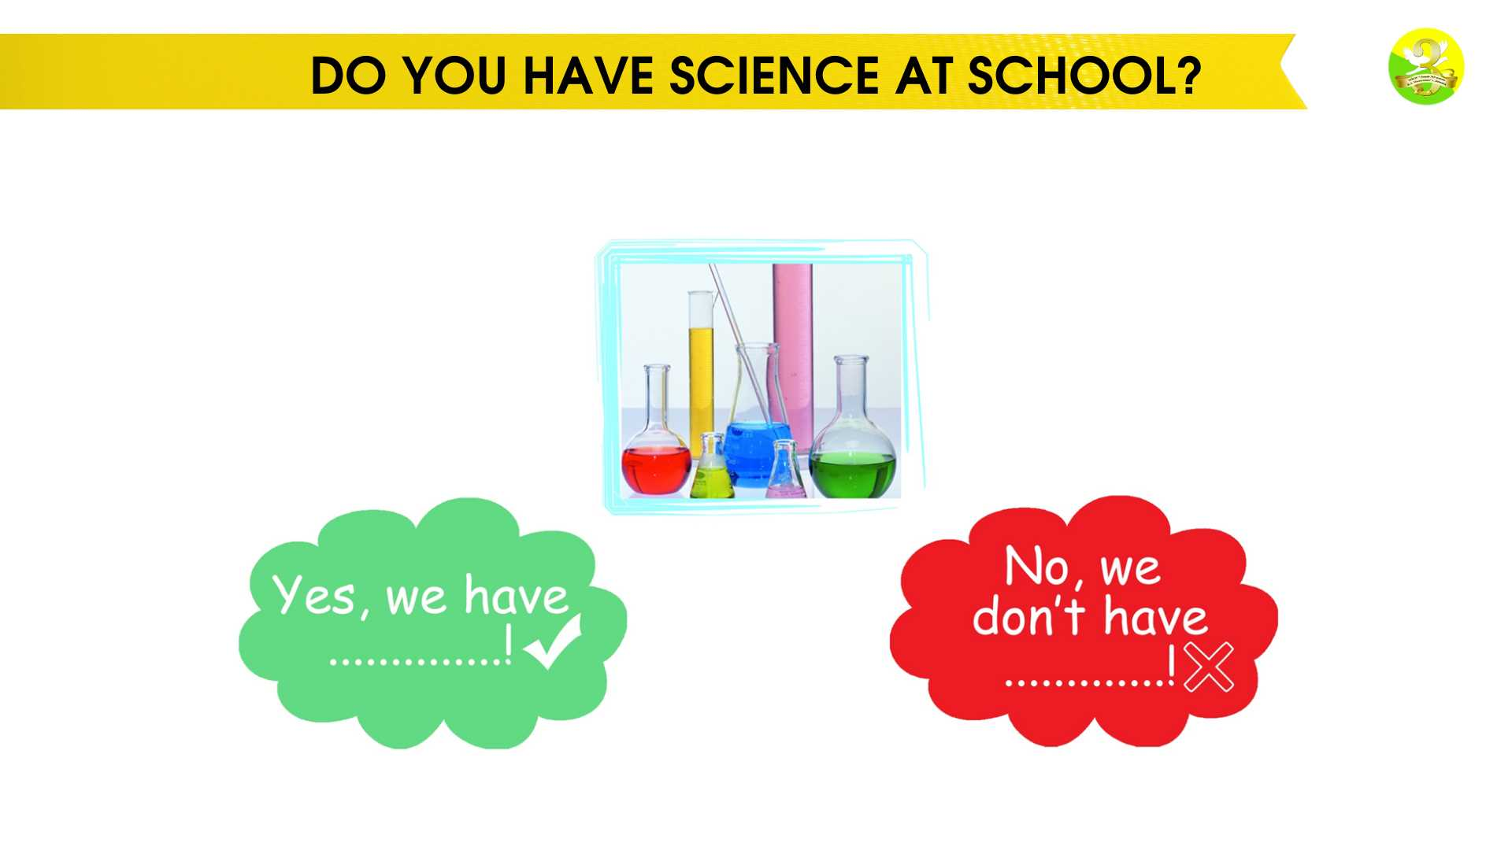
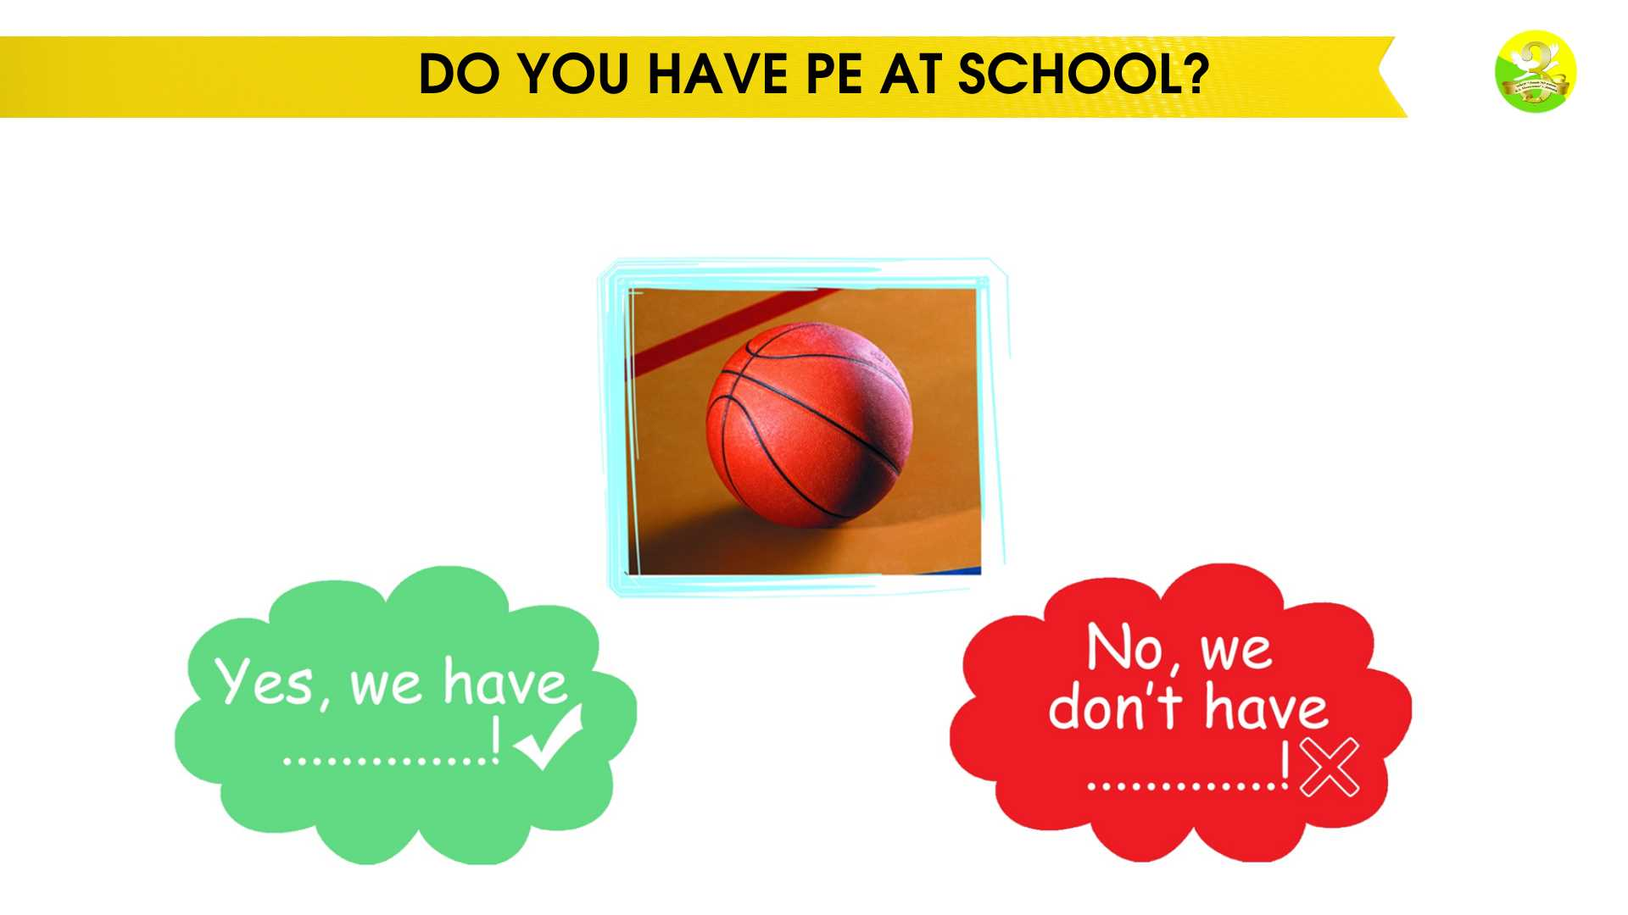
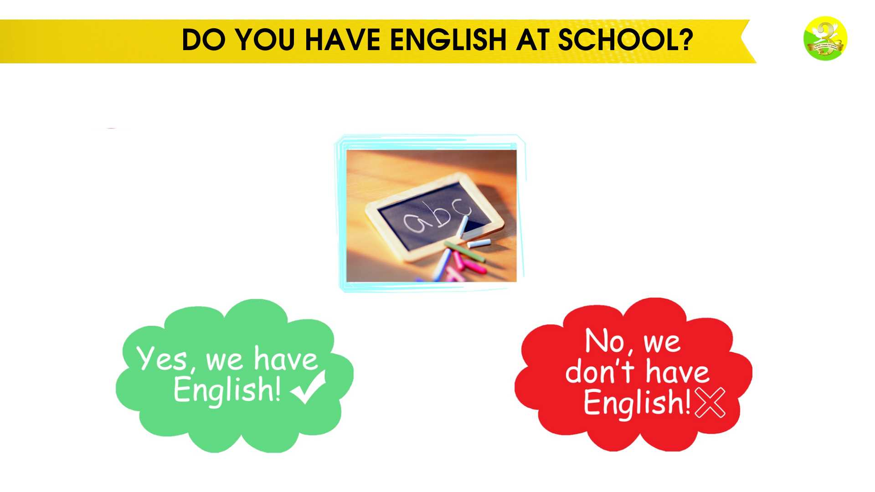
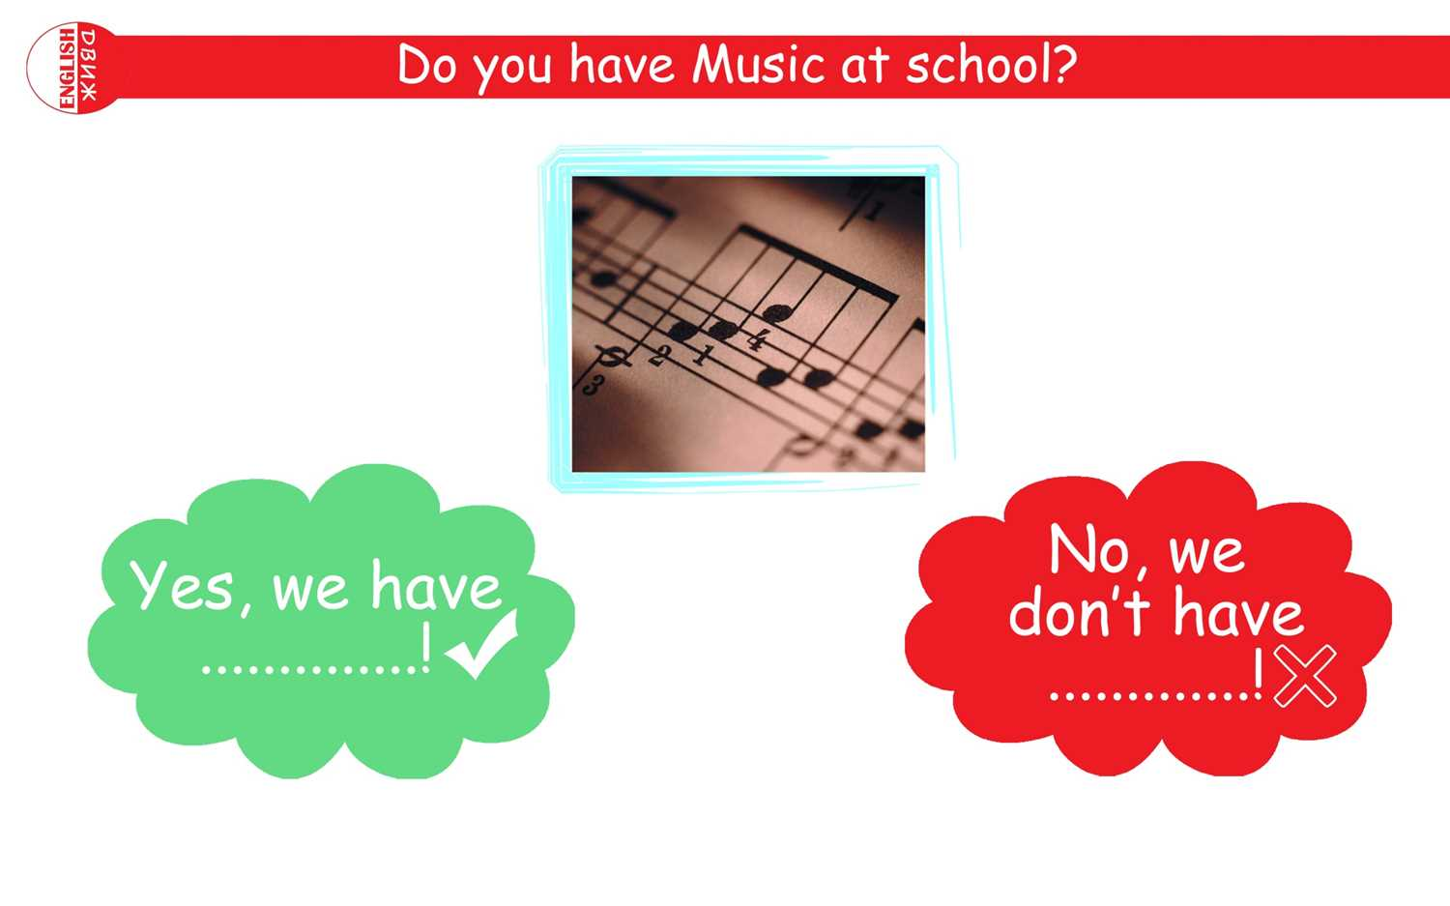
DO YOU HAVE MUSIC AT SCHOOL?

Slide 10
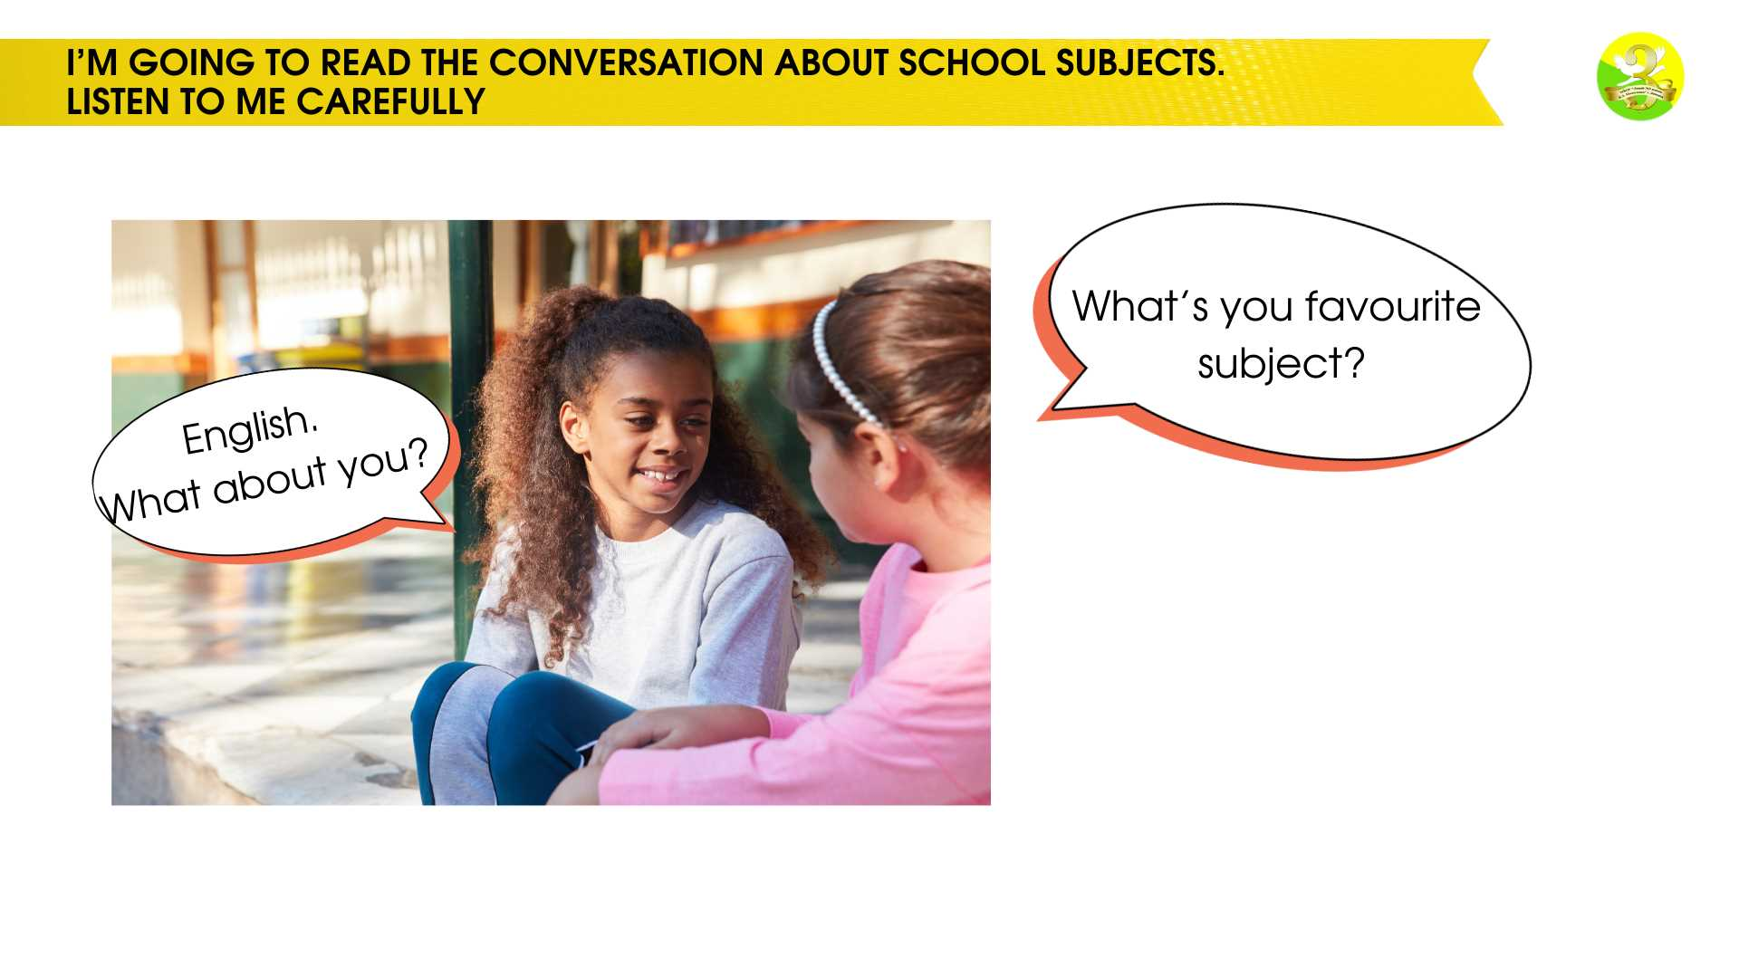
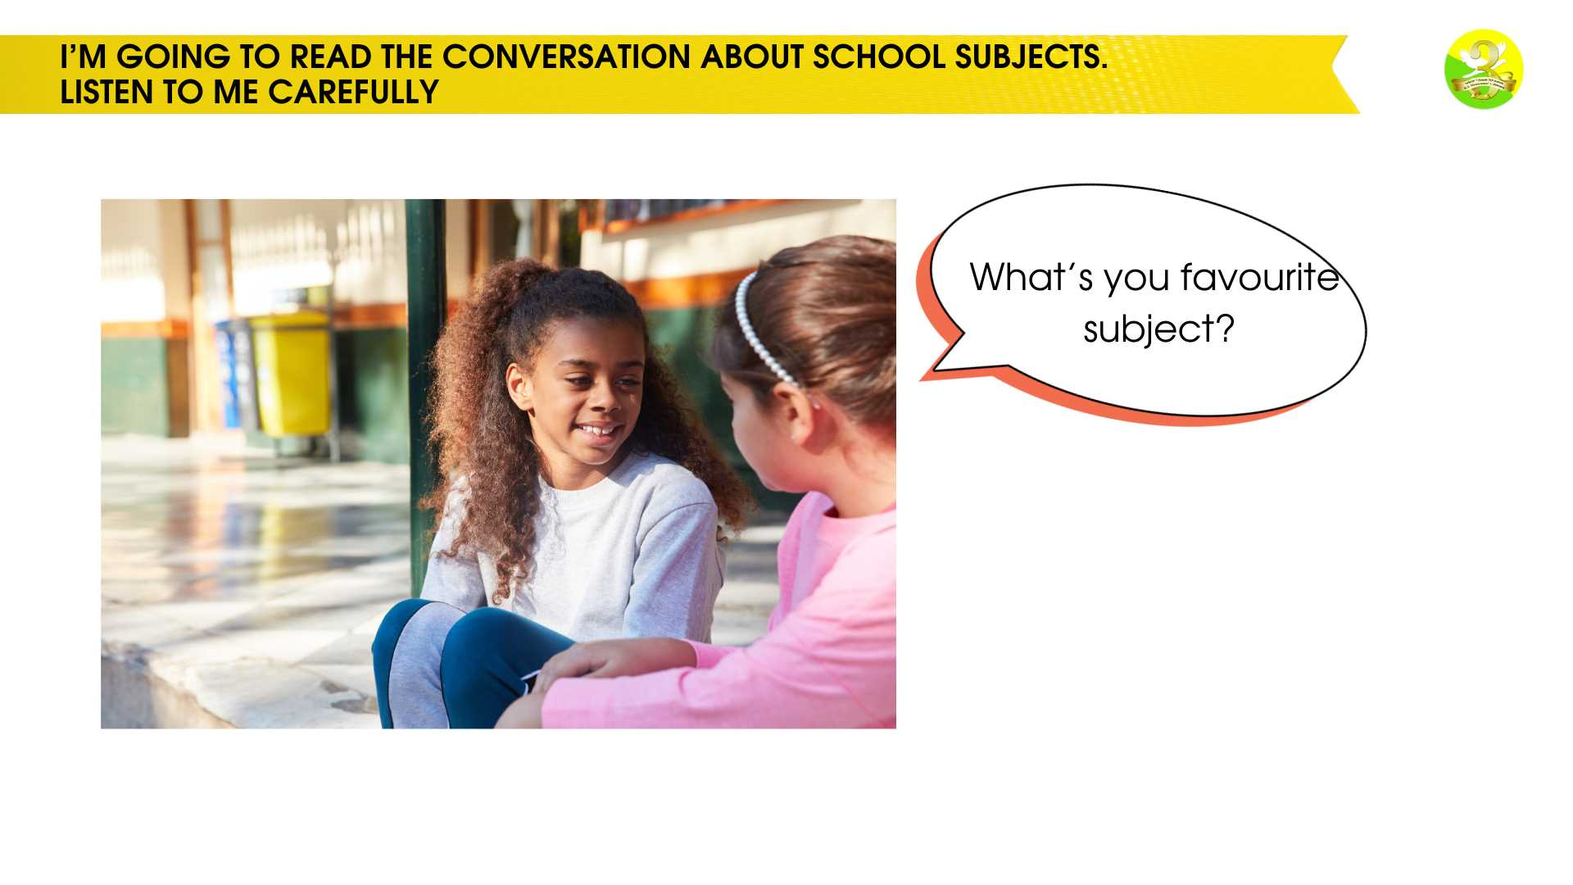
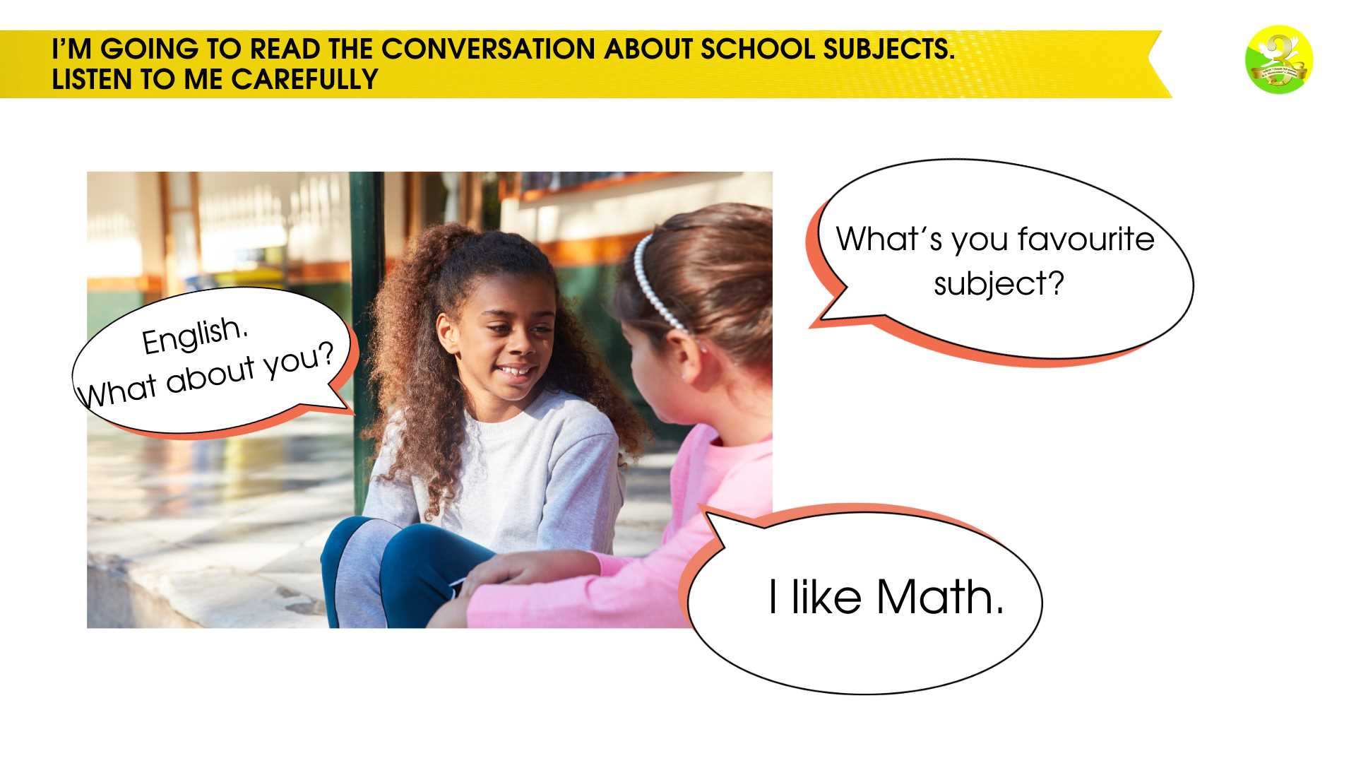
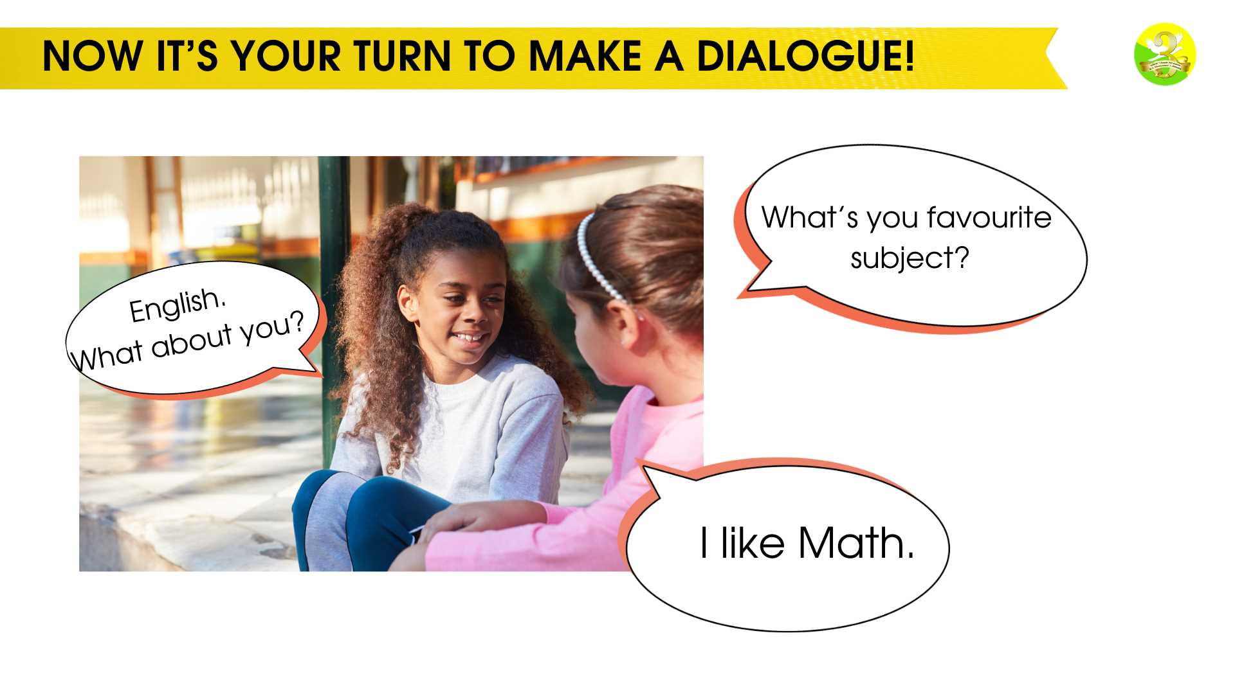
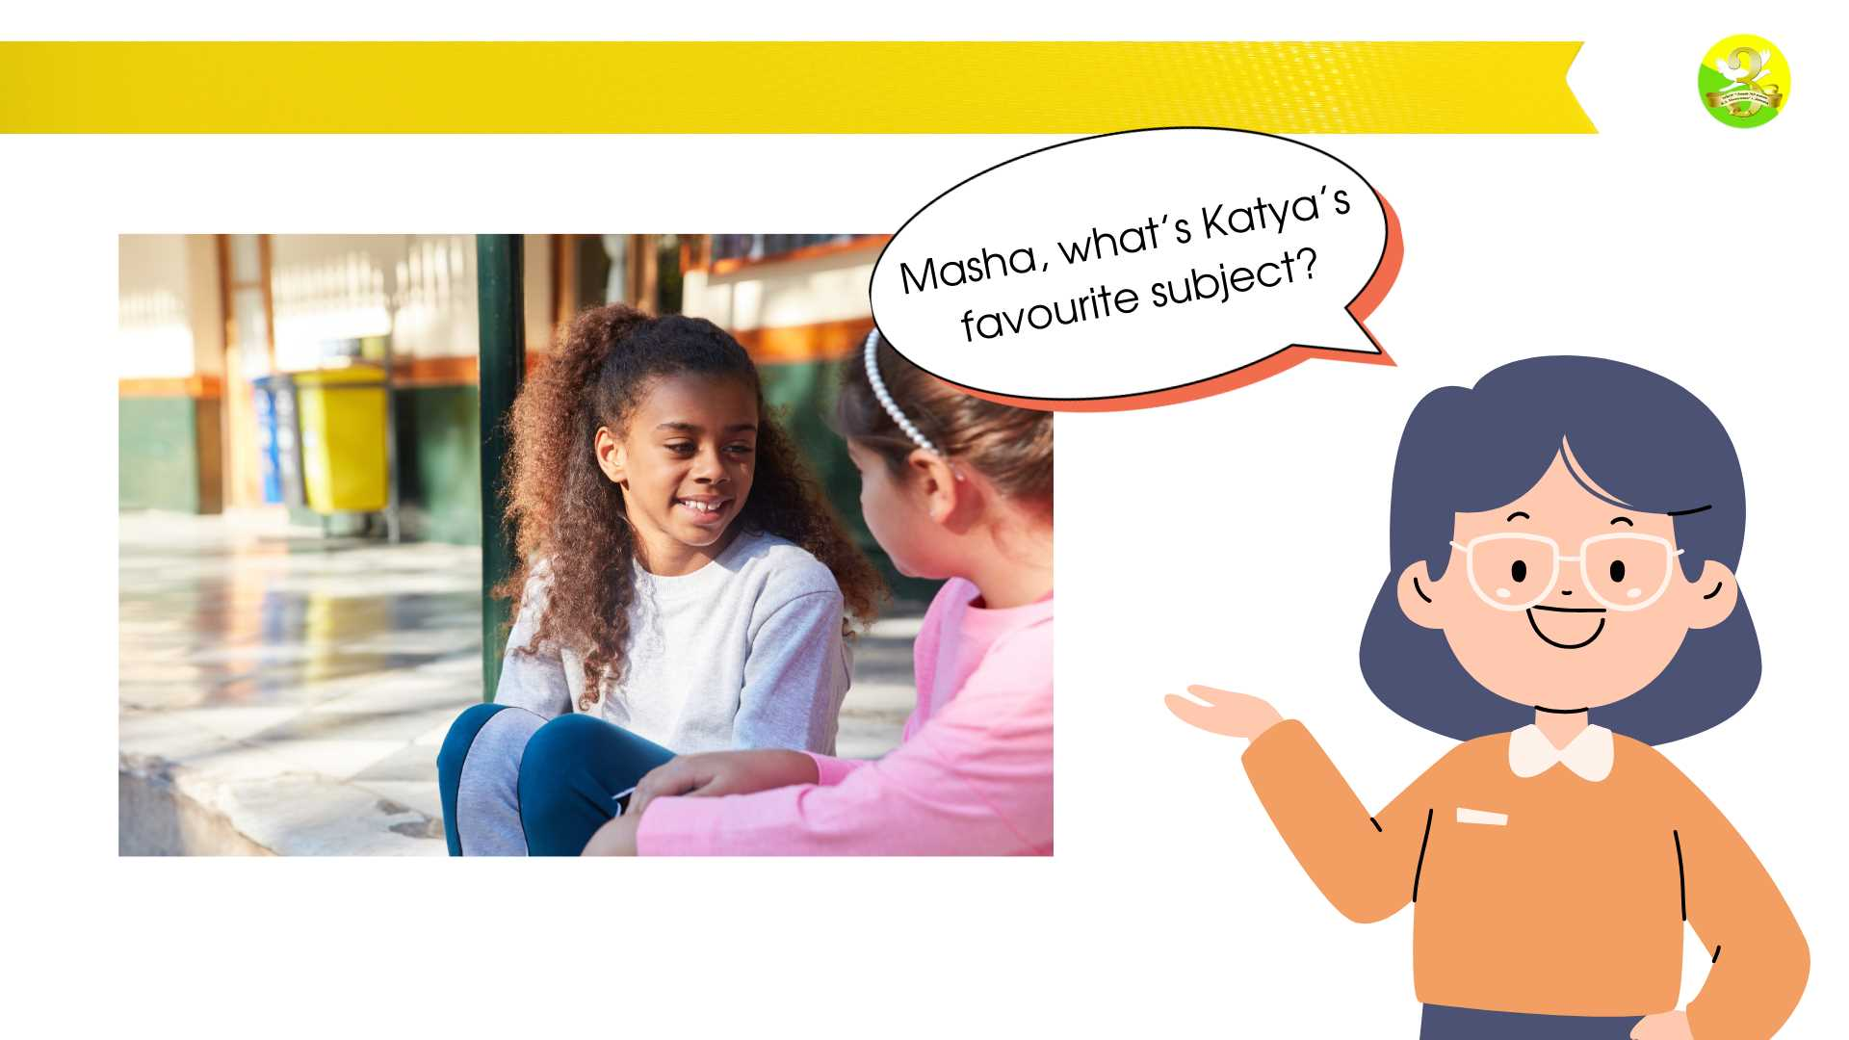
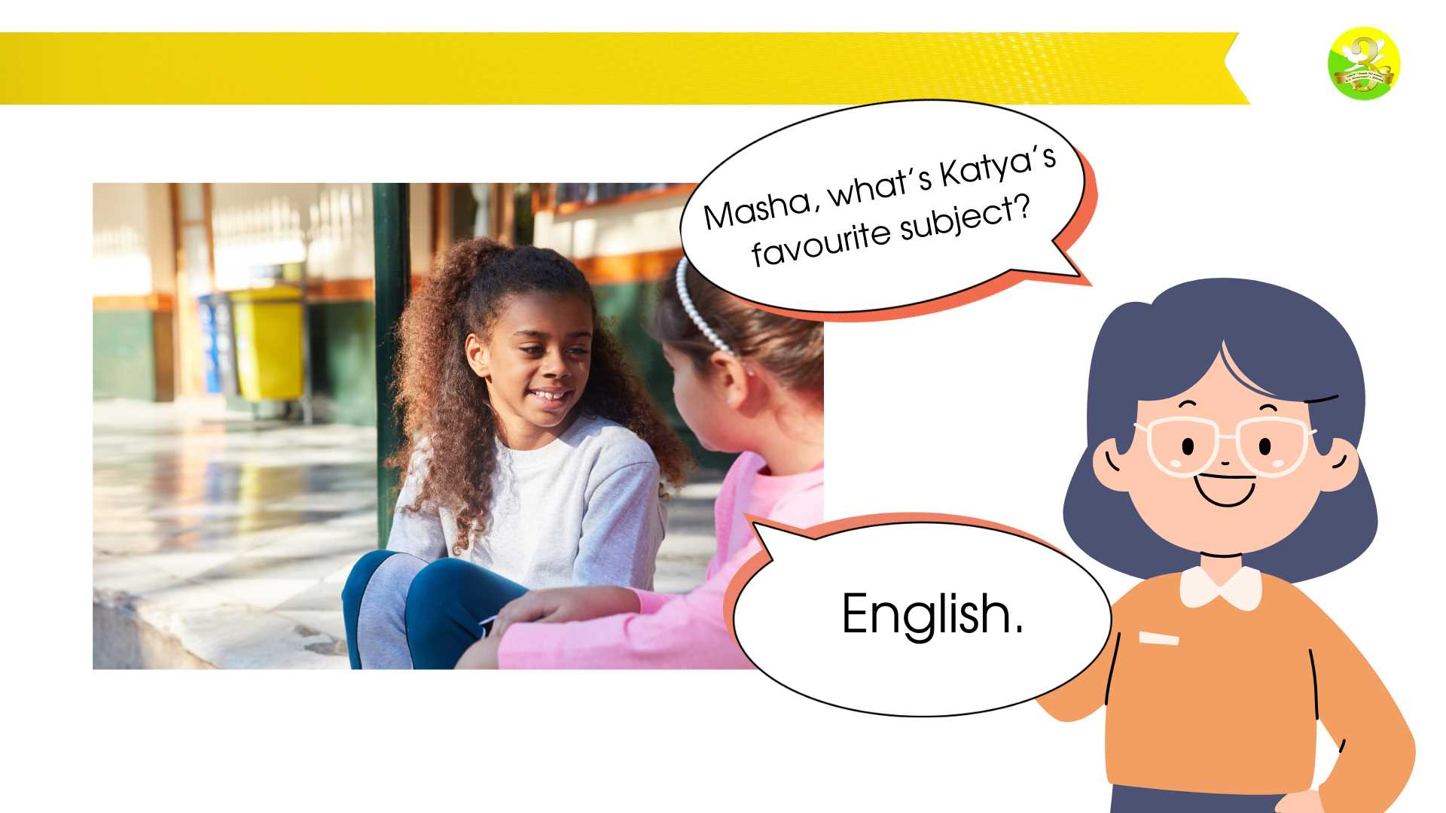

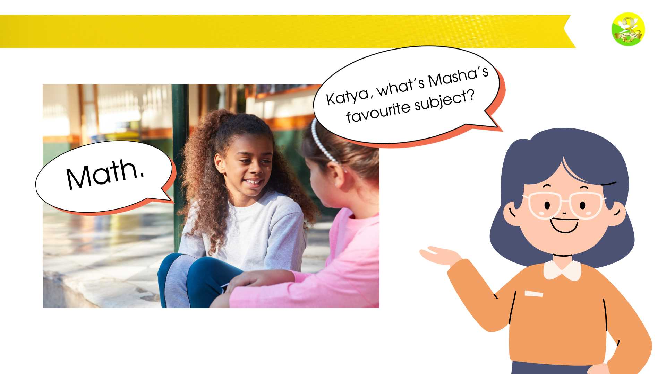
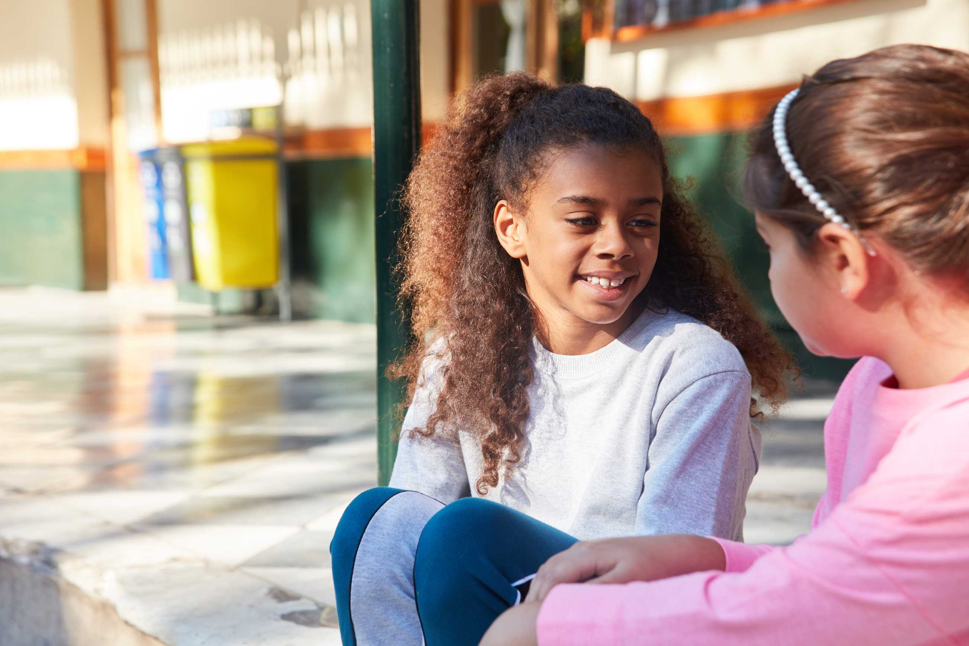

I’M GOING TO READ THE CONVERSATION ABOUT SCHOOL SUBJECTS.
LISTEN TO ME CAREFULLY
What’s you favourite
subject?
English.
What about you?

Slide 11


Slide 12
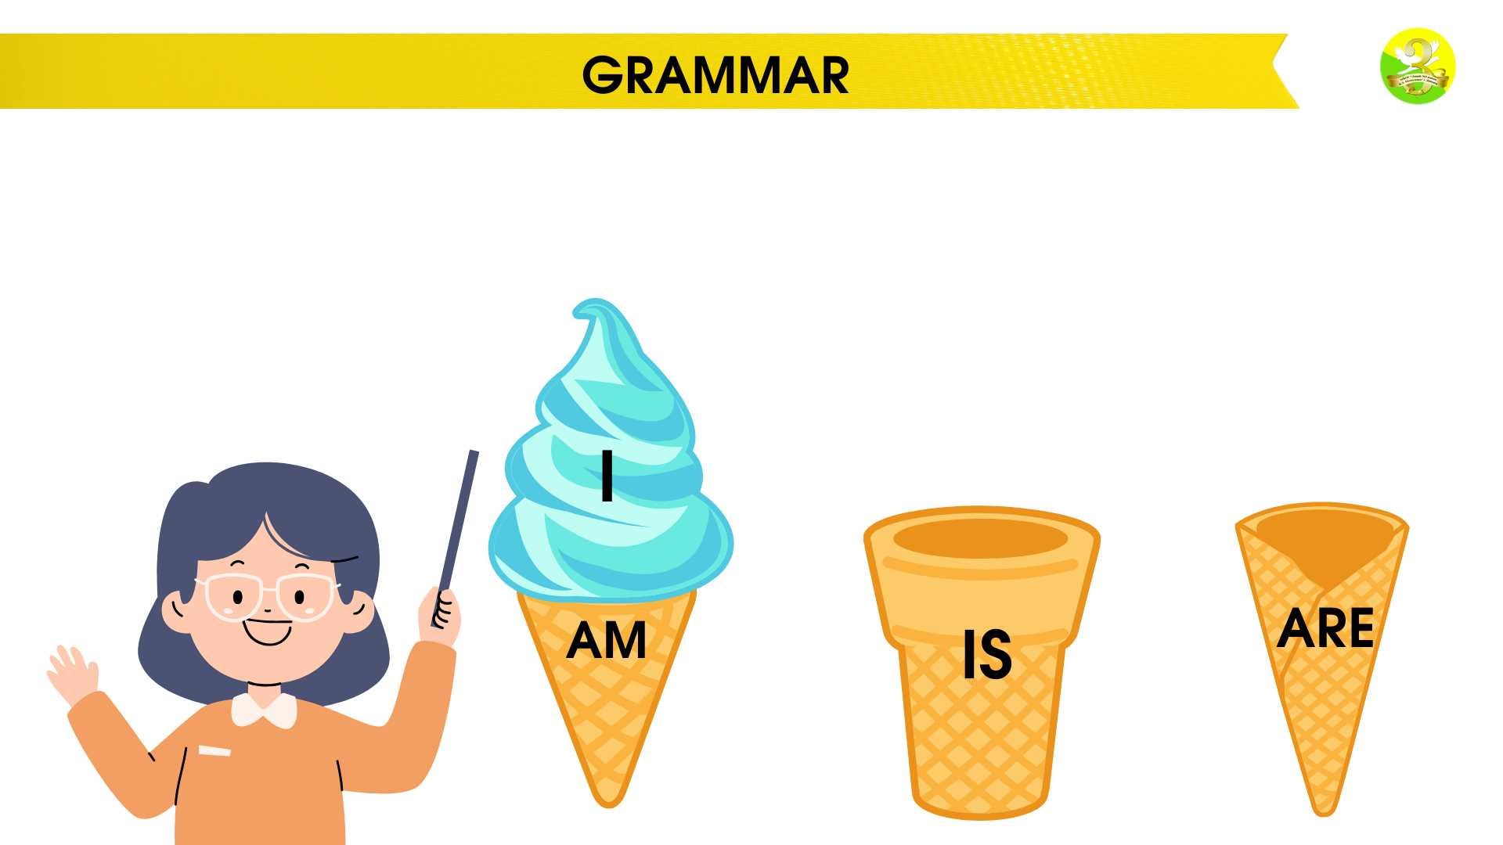
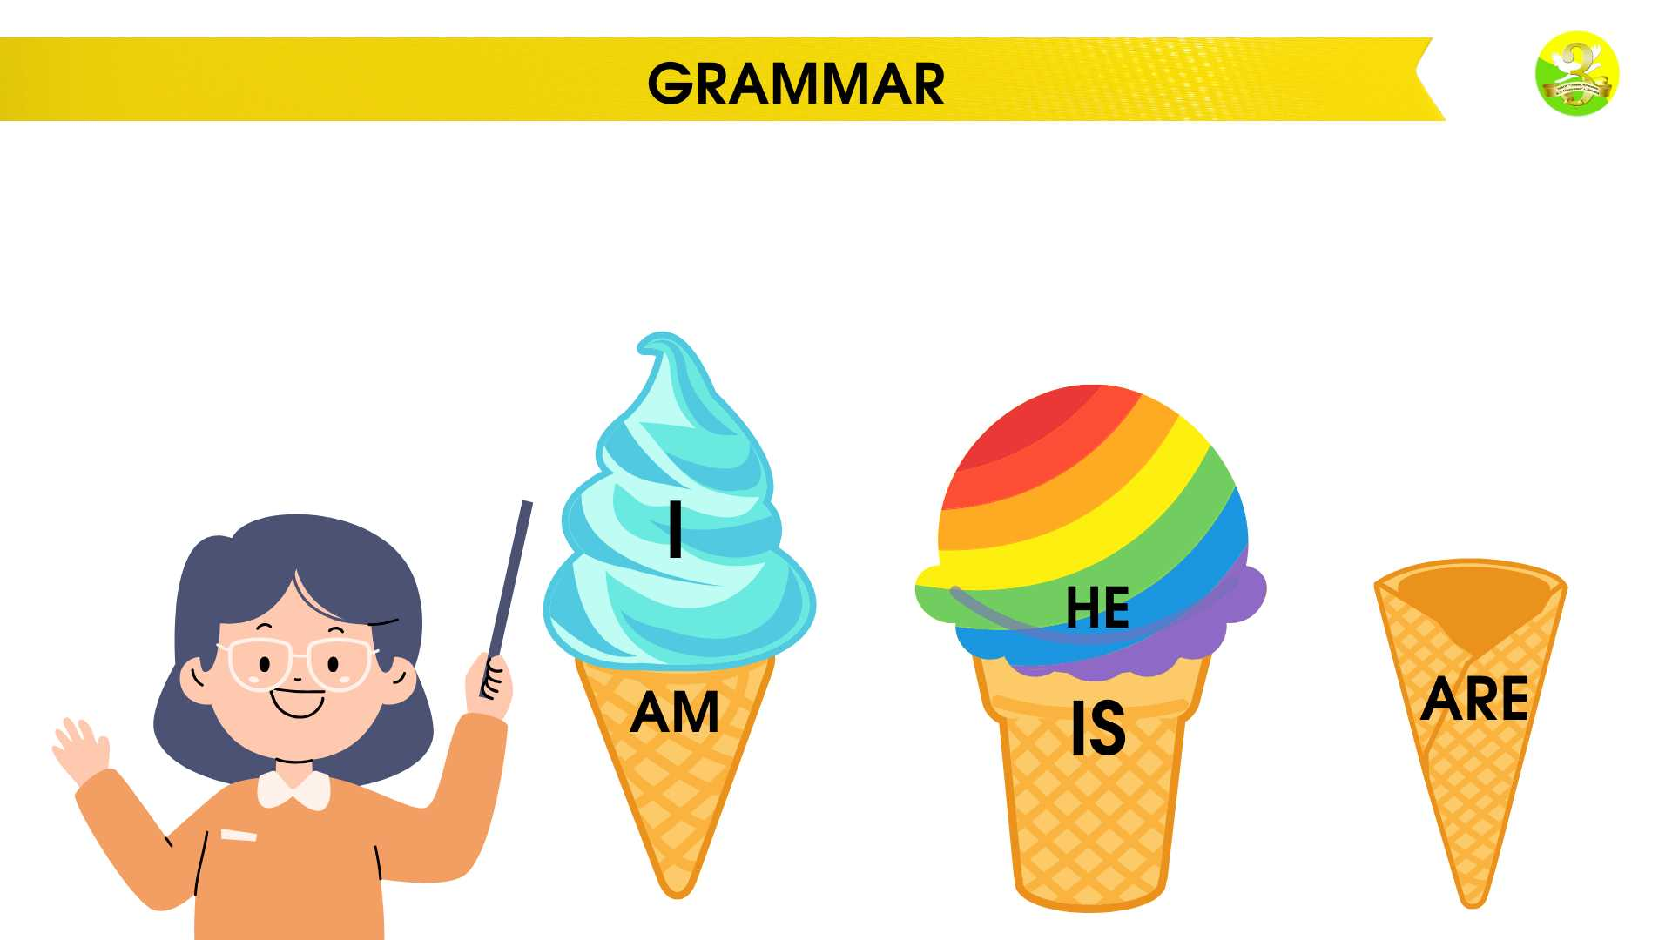
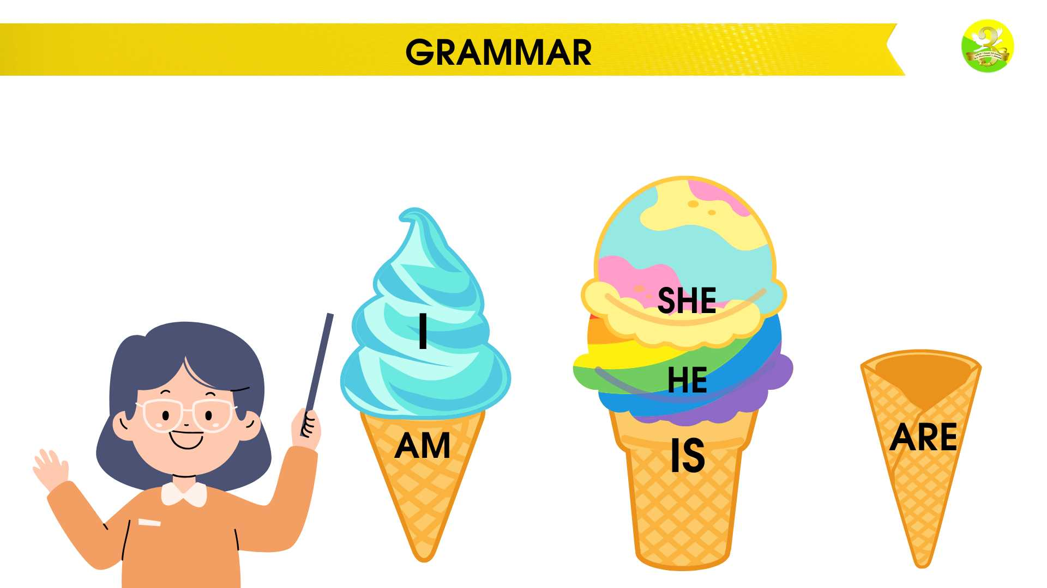
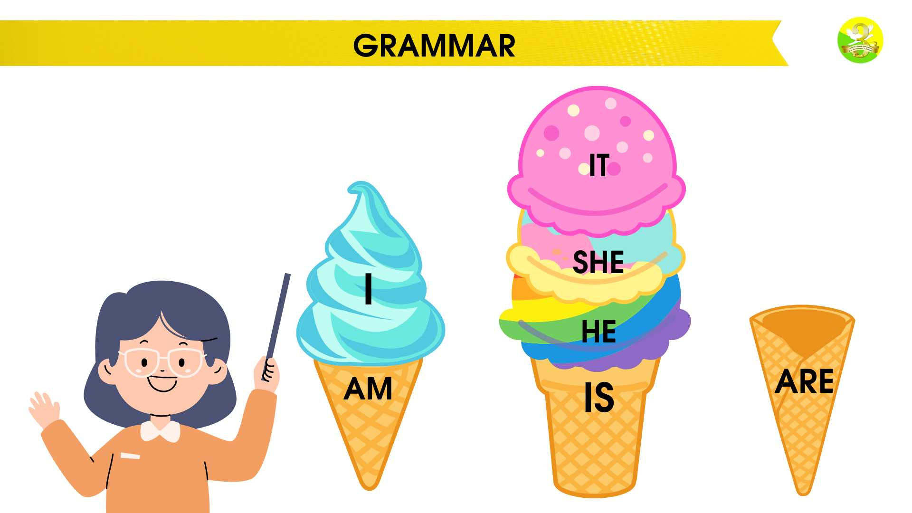
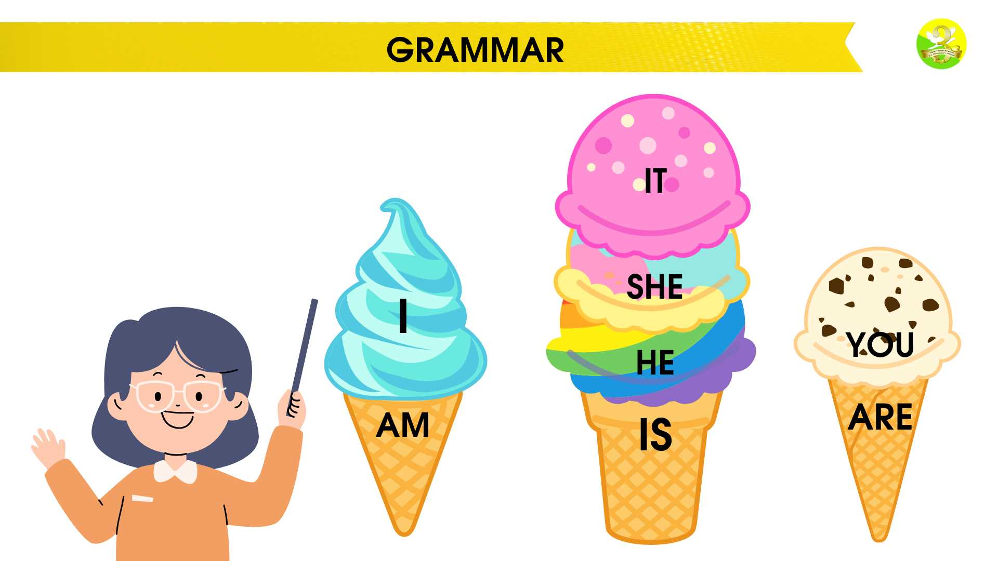
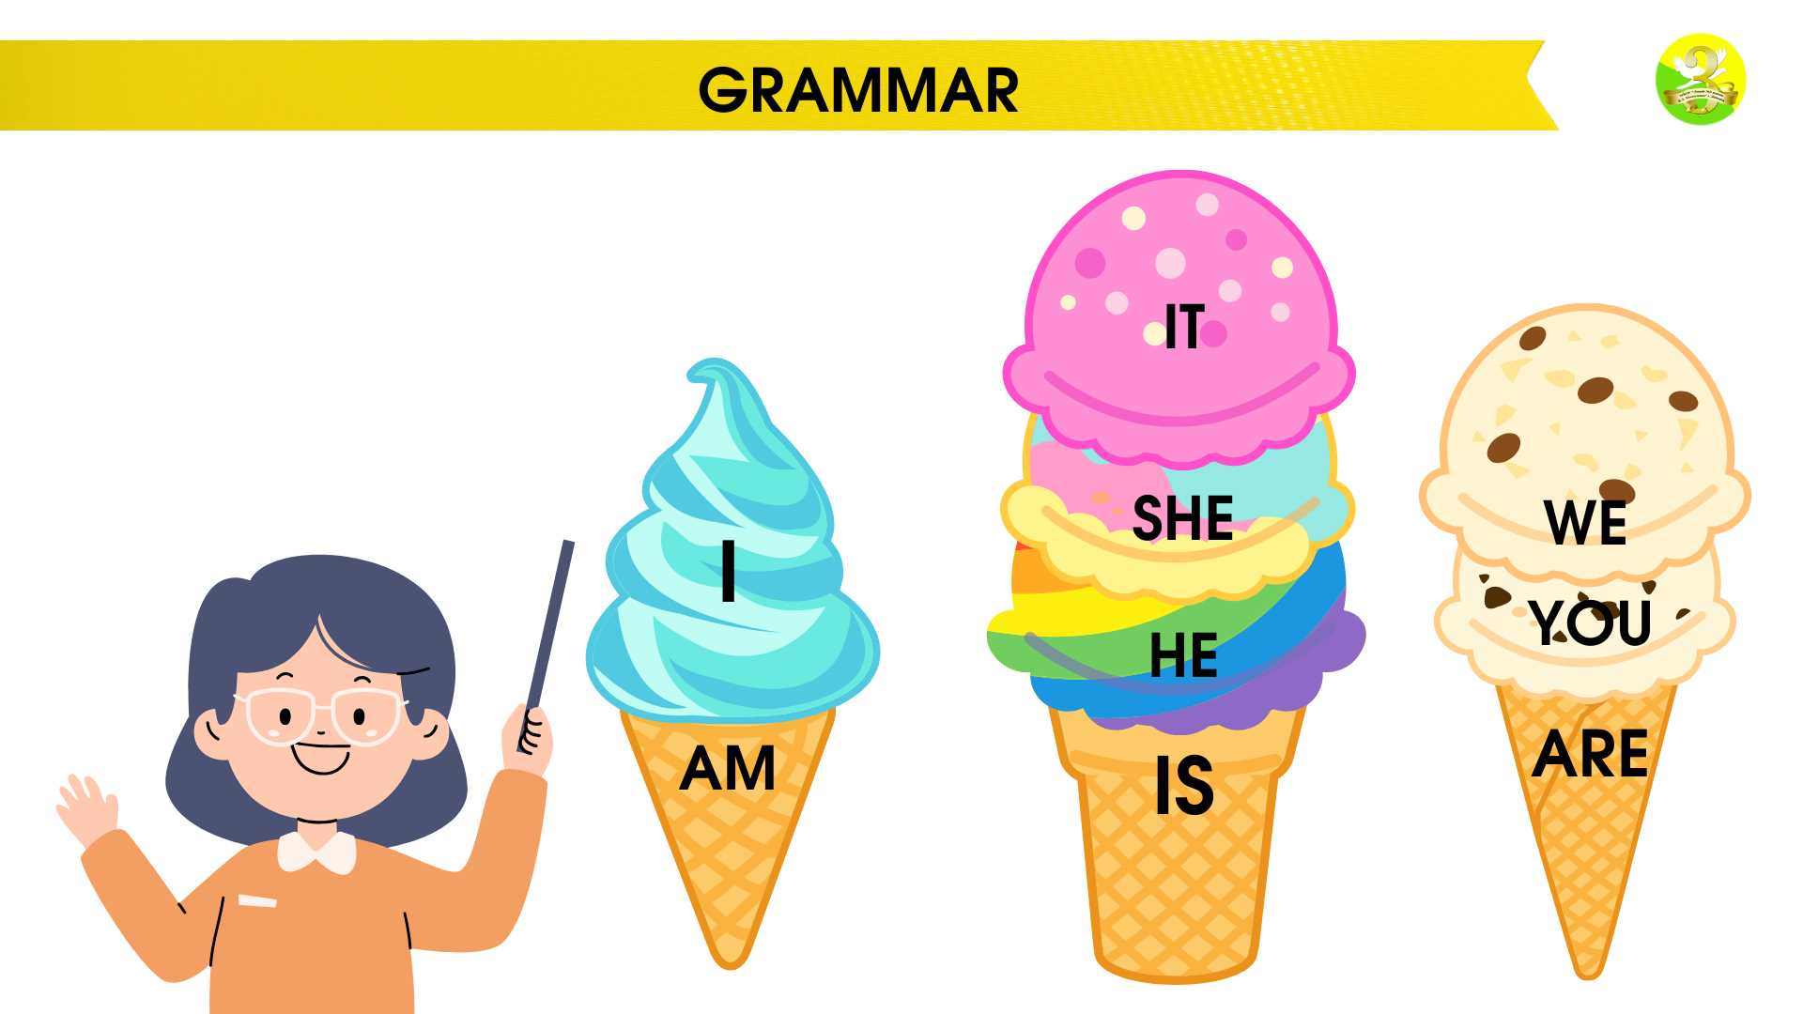
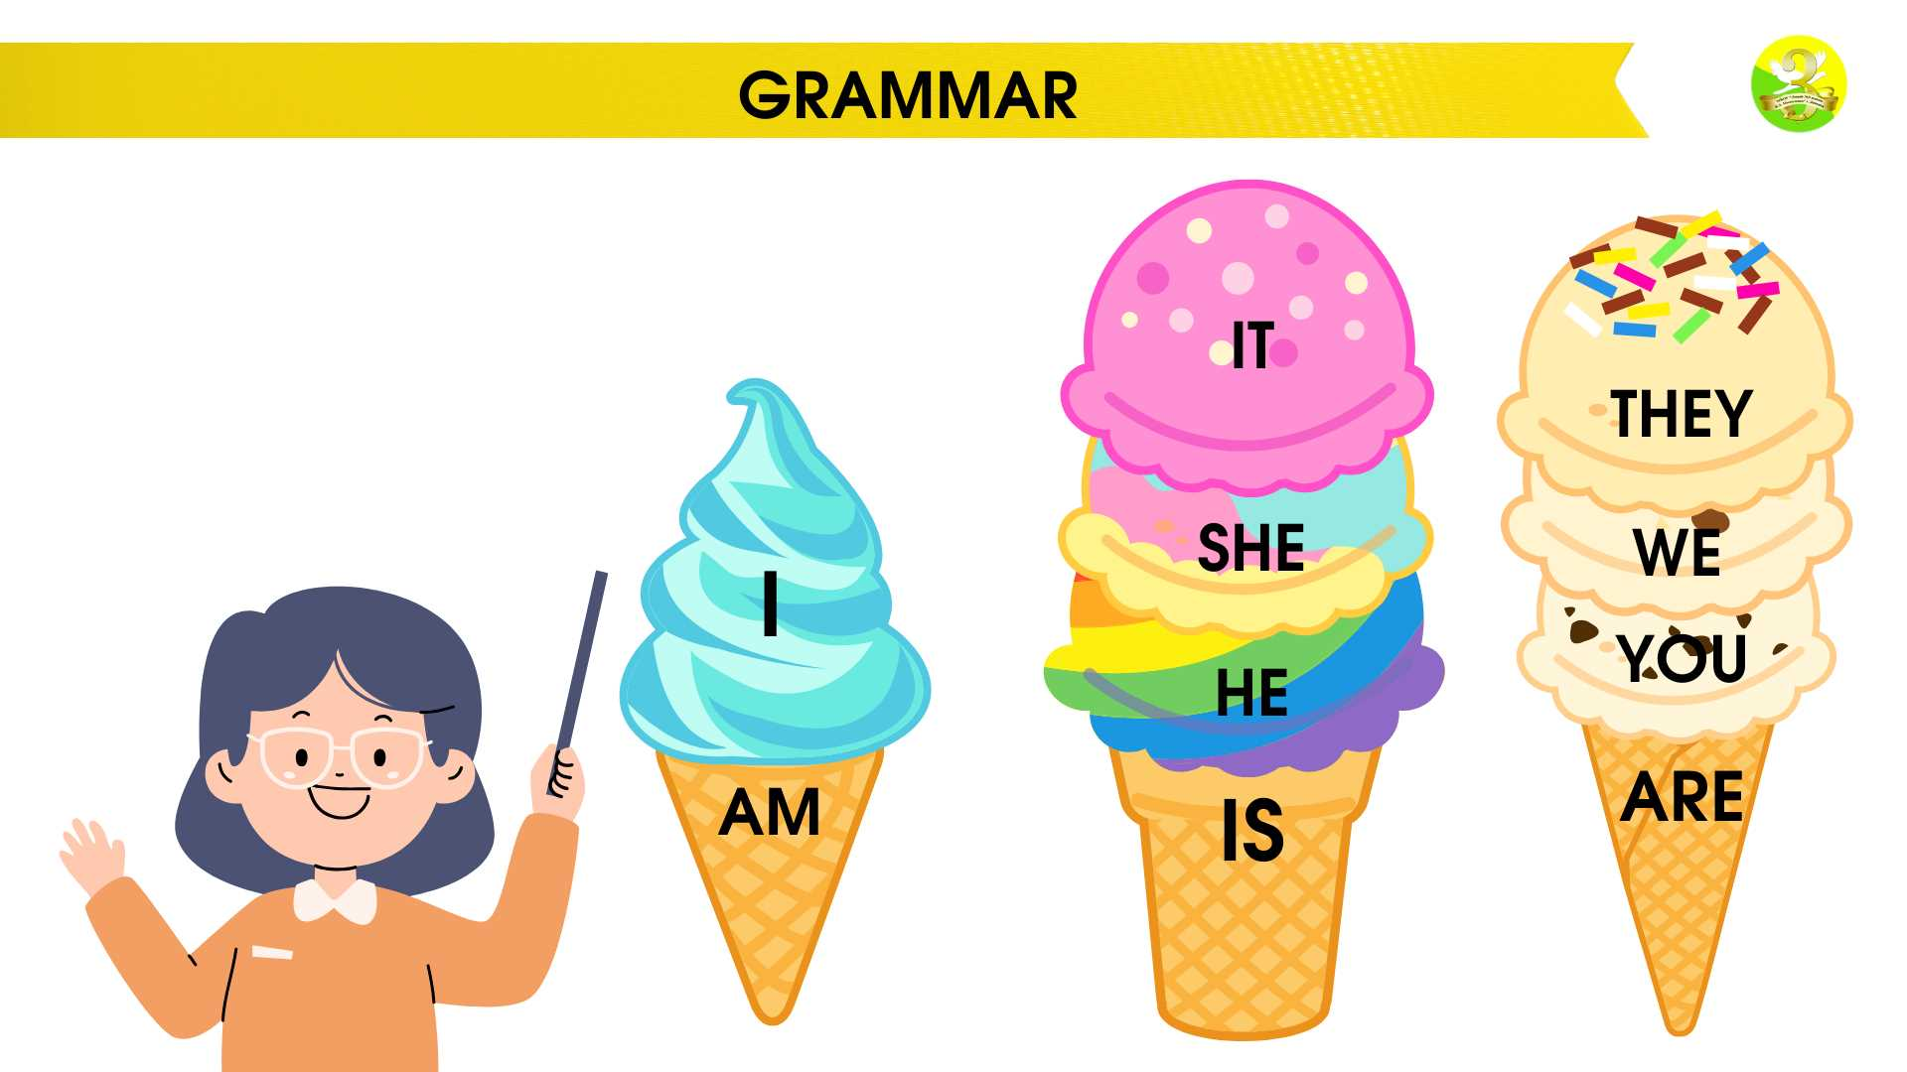



GRAMMAR
AM
ARE
IS

Slide 13
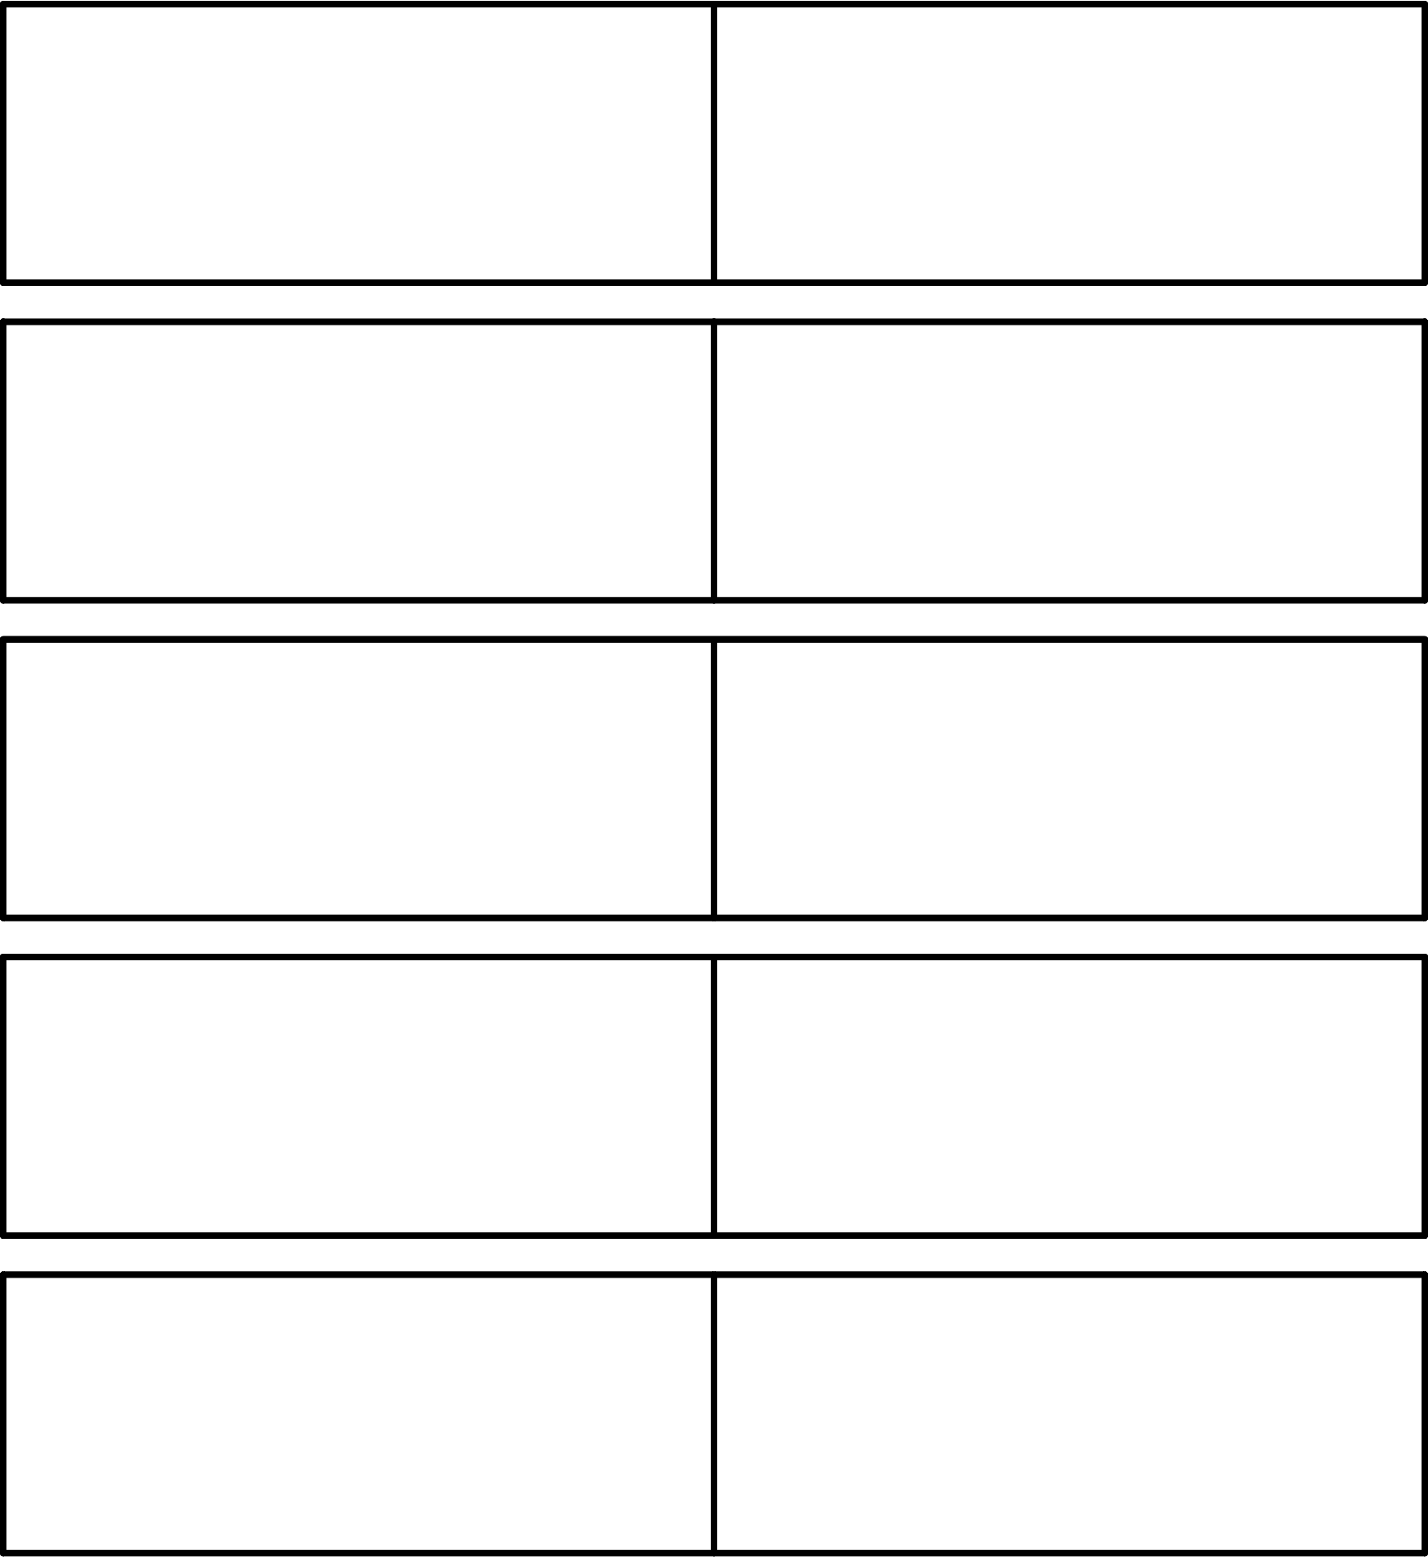
GRAMMAR
I AM
I’M
HE IS
HE’S
SHE IS
SHE’S
IT IS
IT’S
YOU ARE
YOU’RE
WE ARE
WE’RE
THEY ARE
THEY’RE

Slide 14
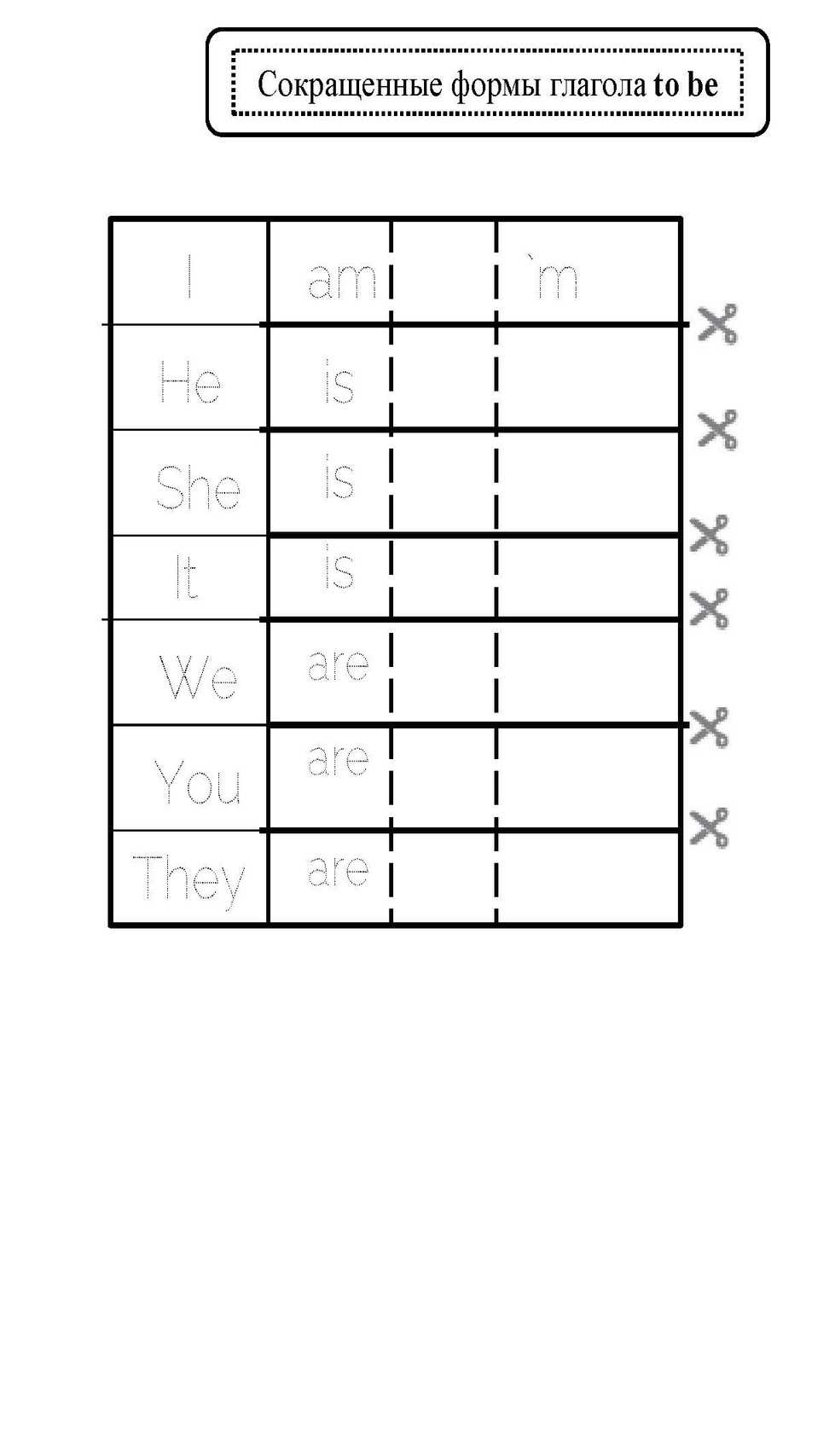



CUT OUT AND PASTE. COMPLETE.

Slide 15
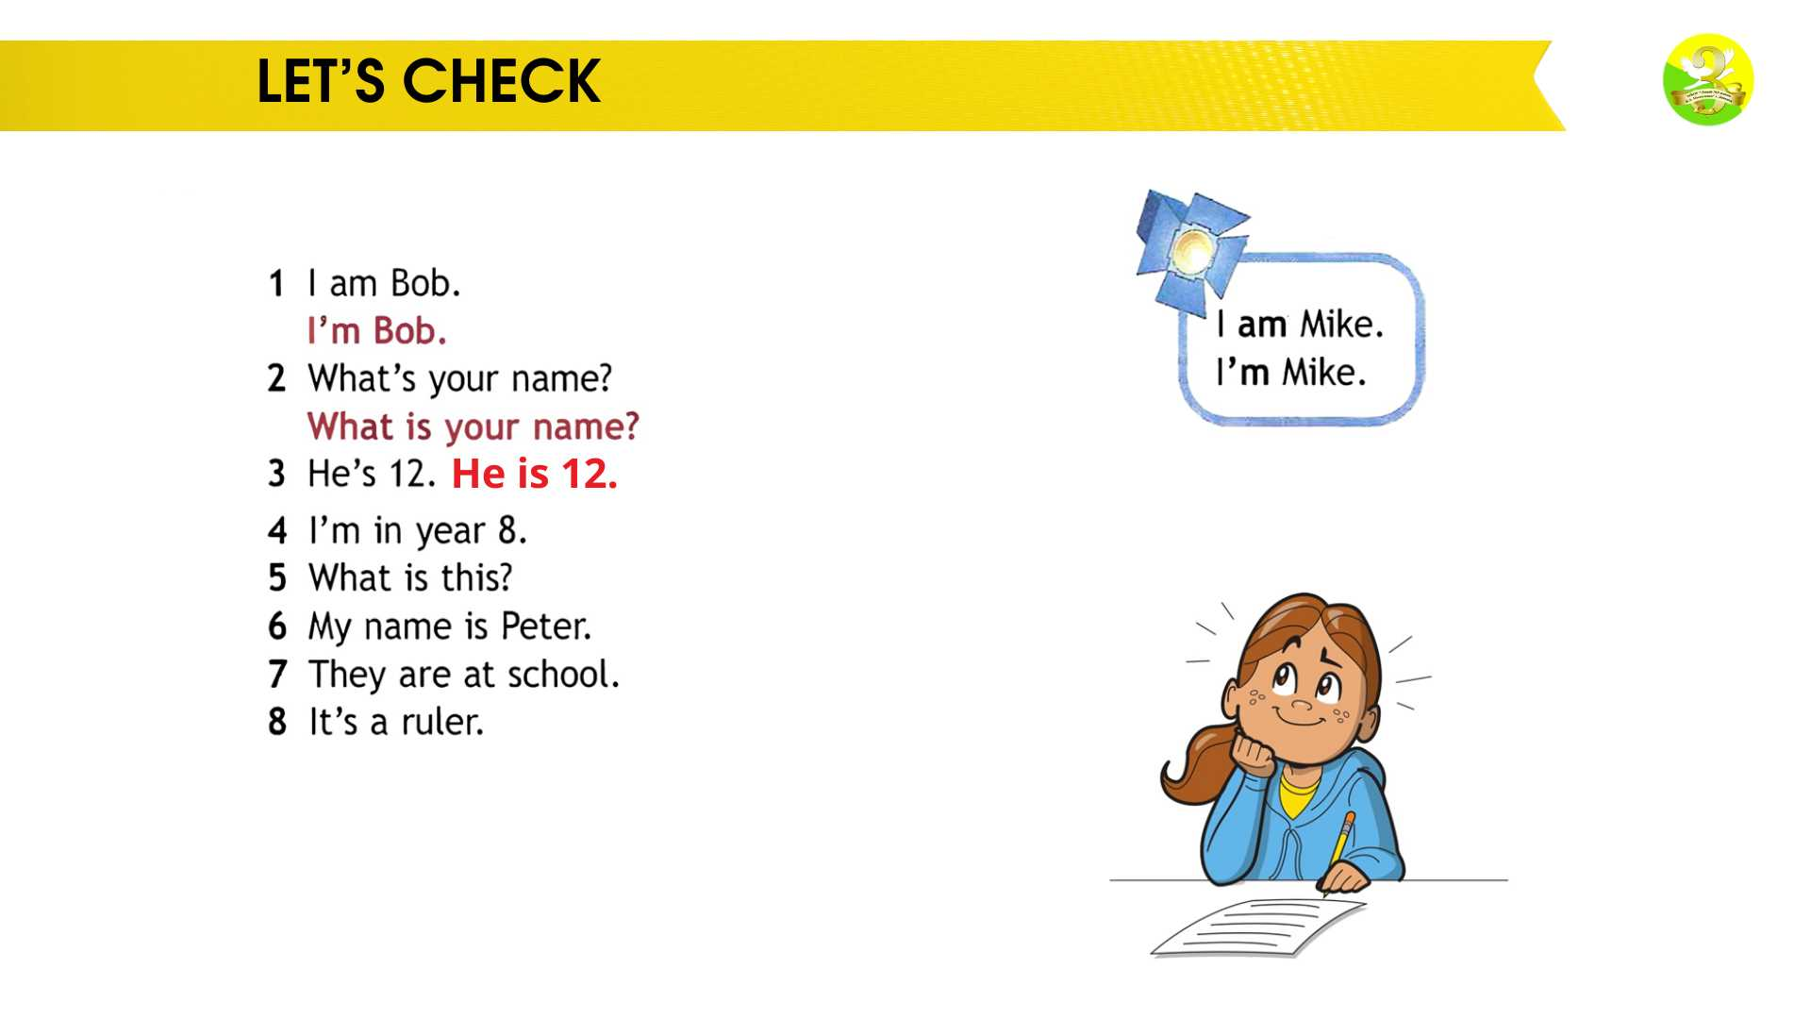
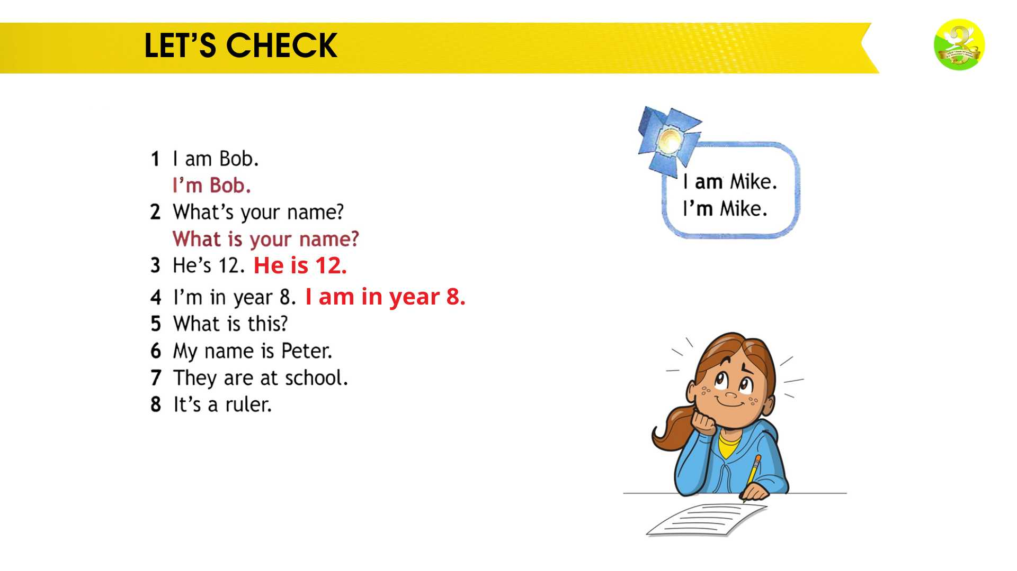
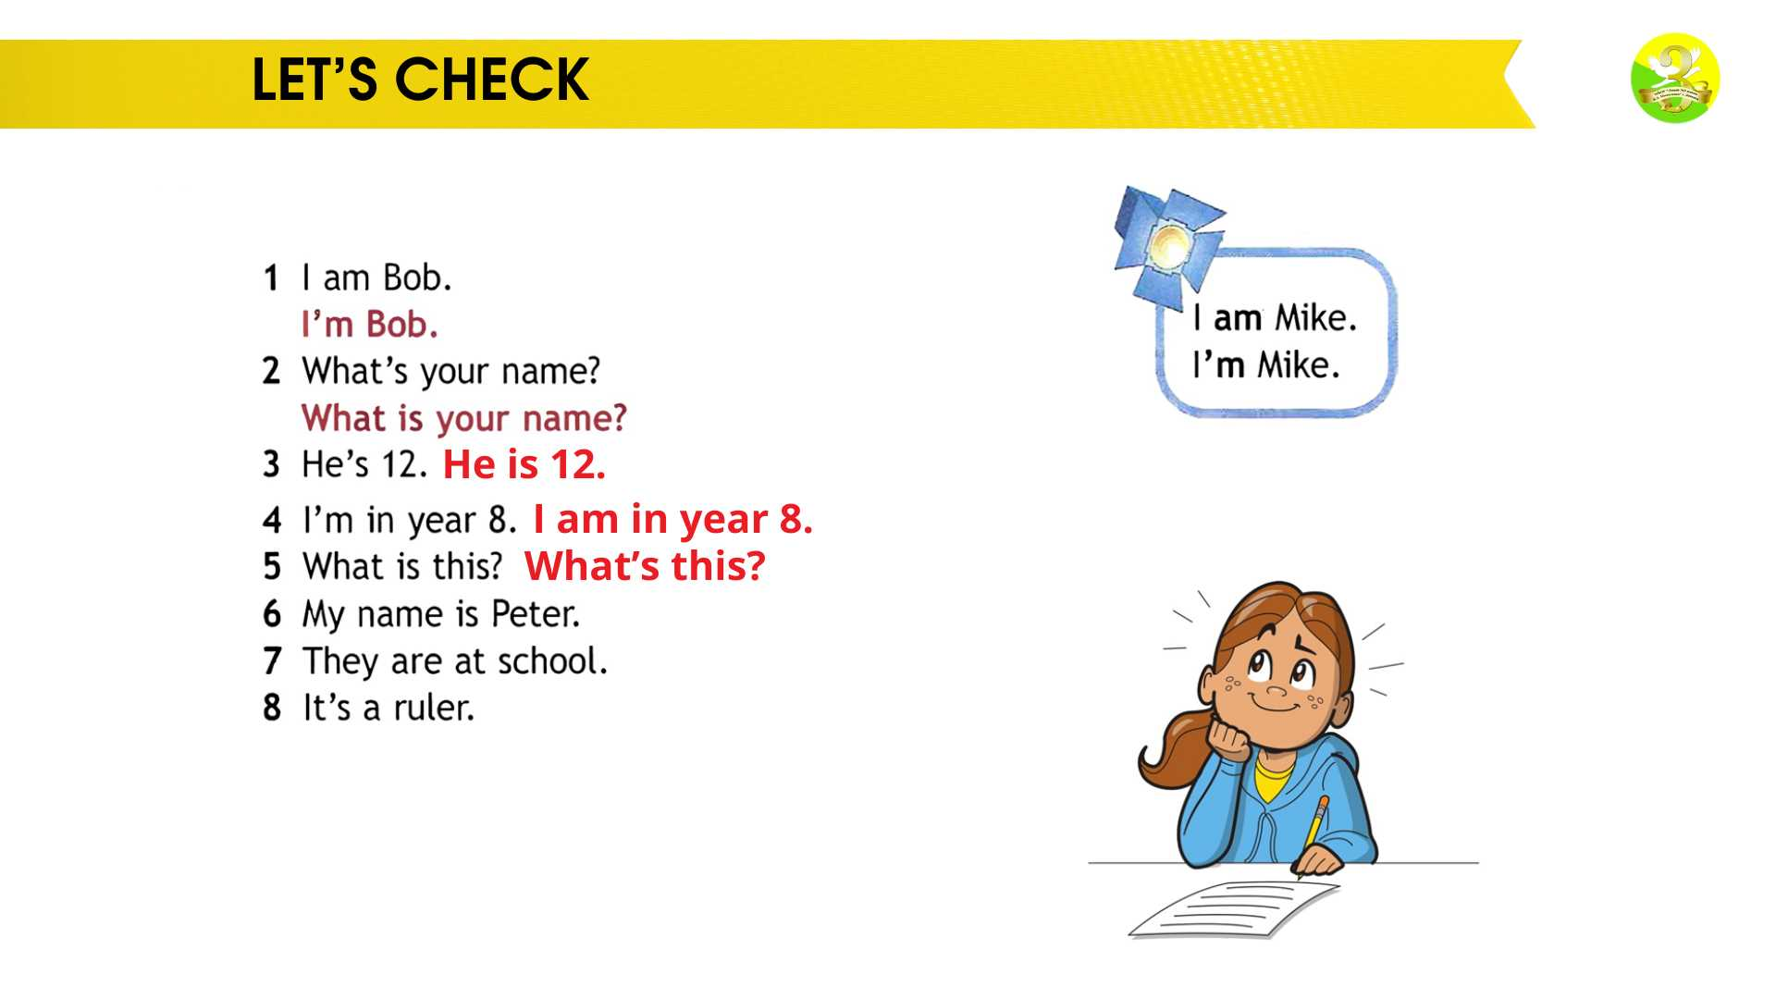
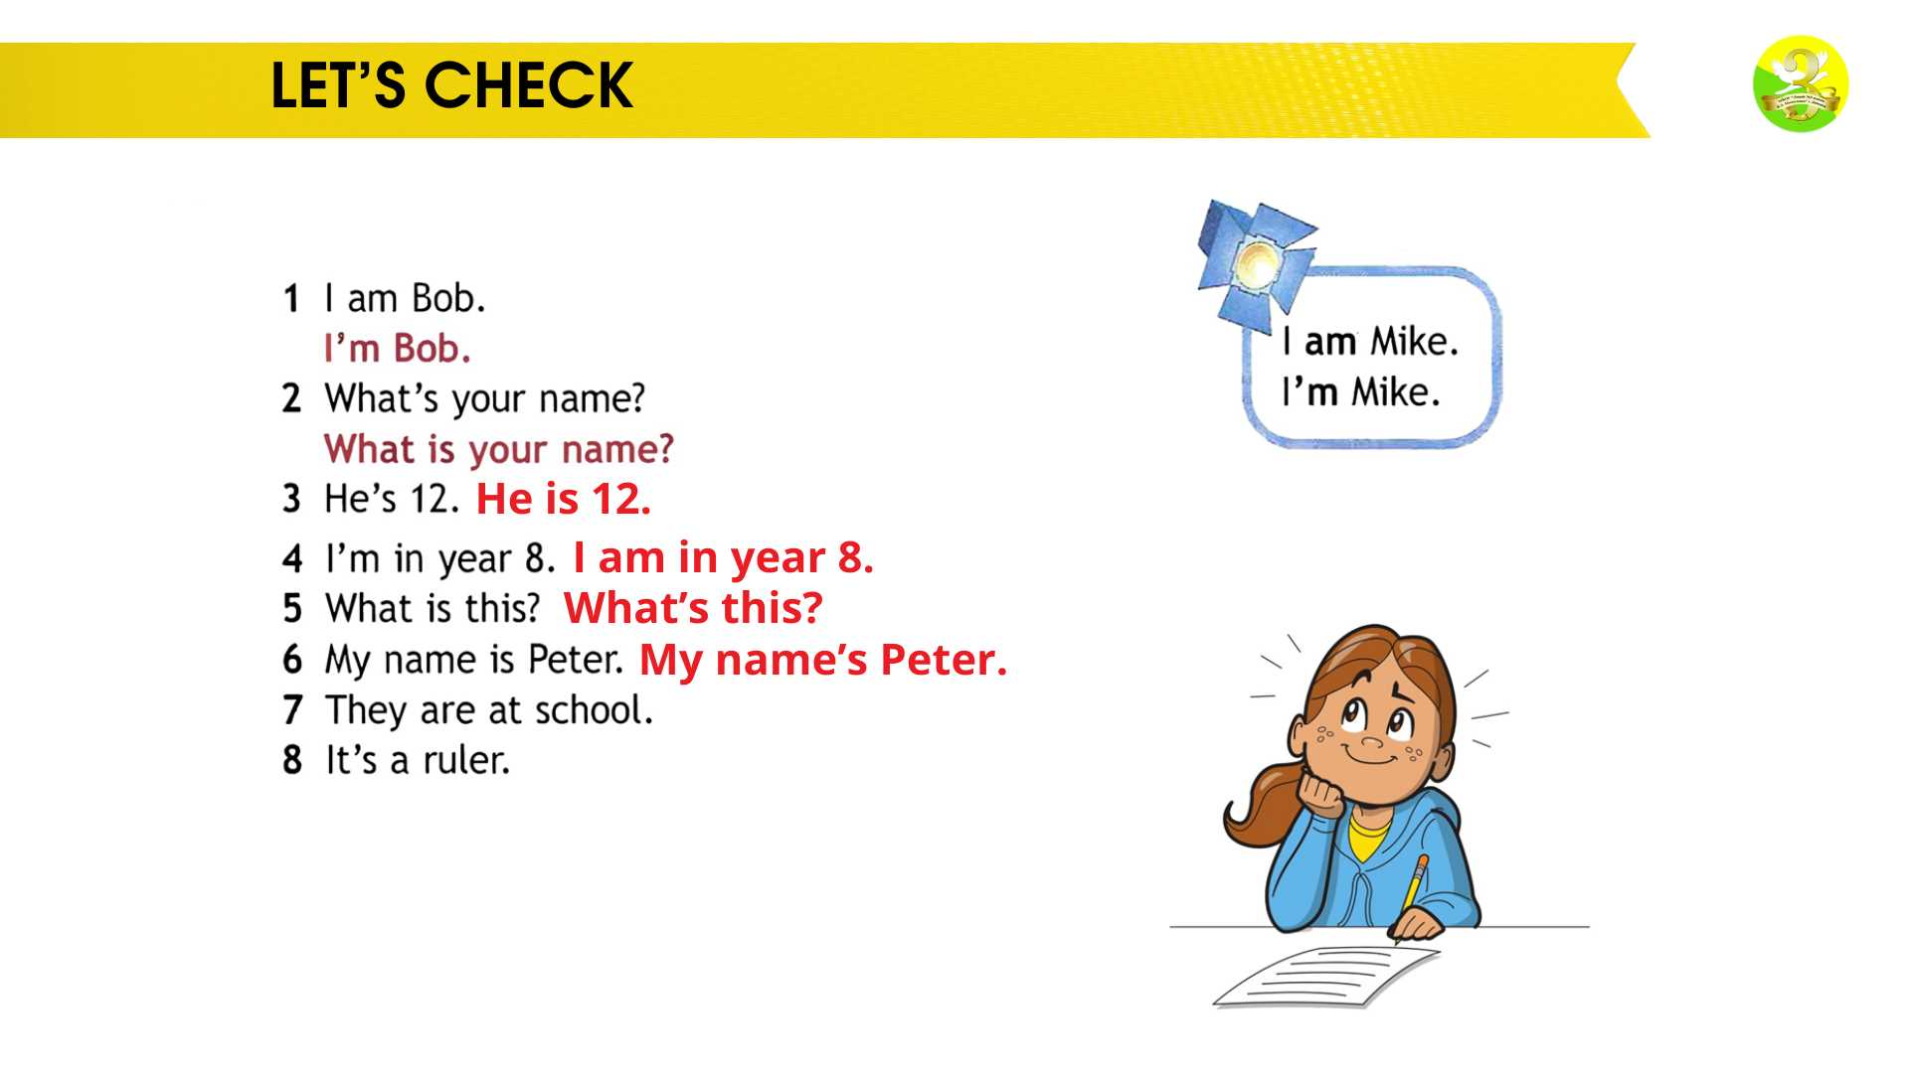
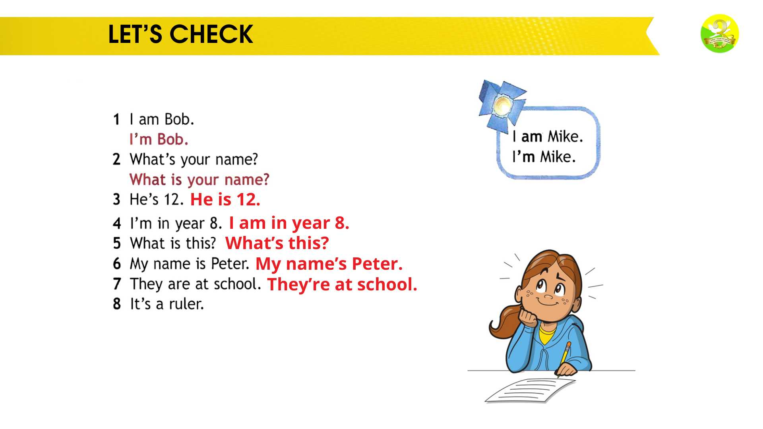


LET’S DO THE EXERCISE 4. READ THE EXAMPLES, PLEASE

Slide 16












WRITE THE SHORT FORMS AS IN THE EXAMPLE

Slide 17








WORKBOOK P. 8. LOOK, READ AND WRITE

Slide 18


WRITE THE SHORT FORM

Slide 19





LET’S CHECK

Slide 20





Let’s check what we’ve learnt today:
“I can” (я могу)

Slide 21
That’s all for now.
Goodbye!

