Slide 1
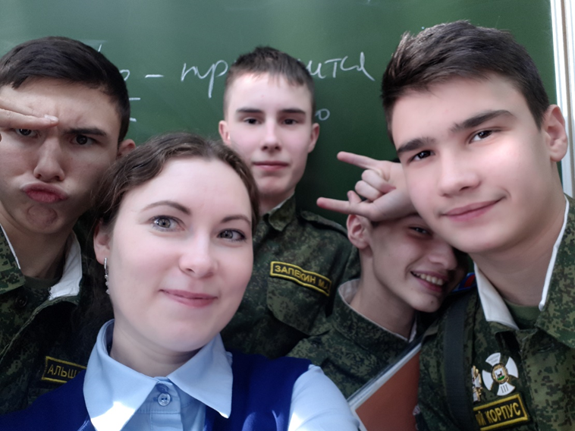
«Презентация к уроку по учебному предмету «Английский язык» в 9-ом классе на тему «Интернет»
Автор: Дренаева Анна Александровна, учитель английского языка 1 квалификационной категории
место работы: ГОБУ "Иркутский кадетский корпус им. П.А. Скороходова"

Slide 2







Этапы урока

Slide 3


Slide 4


Can you choose the correct word?
Can we delete or wipe a file by mistake?

Slide 5
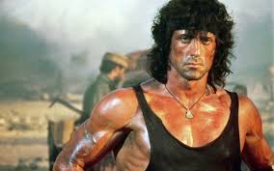
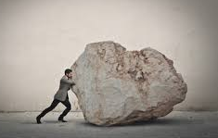
How is the disc that records and stores information called?

Slide 6

What do we say in this case?
Have we spilt or poured something on the keyboard?

Slide 7

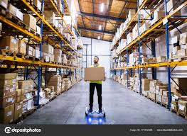
Do we save or store the documents?

Slide 8
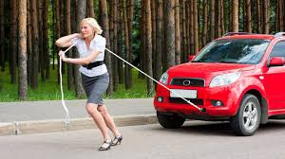

When we get a problem with a disc drive we say that DVD doesn’t …

Slide 9

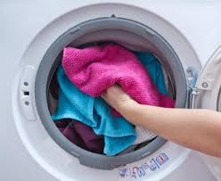
Do we transfer or download music on the computer?

Slide 10
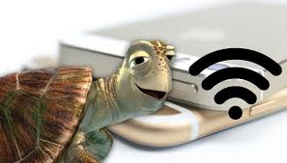
What can be slow: link or connection?

Slide 11

What do we mean when we say that that the printer has run out of ink?
We have to run to buy some ink
There is no ink in the printer

Slide 12
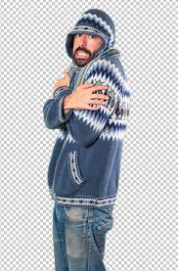
Computer problems
When the screen stays the same and does not change no matter what buttons you press we say that …..

Slide 13

When our computer is very slow it can mean that it has a …

Slide 14
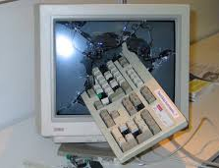
When a computer programme such as a software application or an operating system stops functioning properly and exits we say that computer….

Slide 15


Do we join or connect to the Internet?

Slide 16
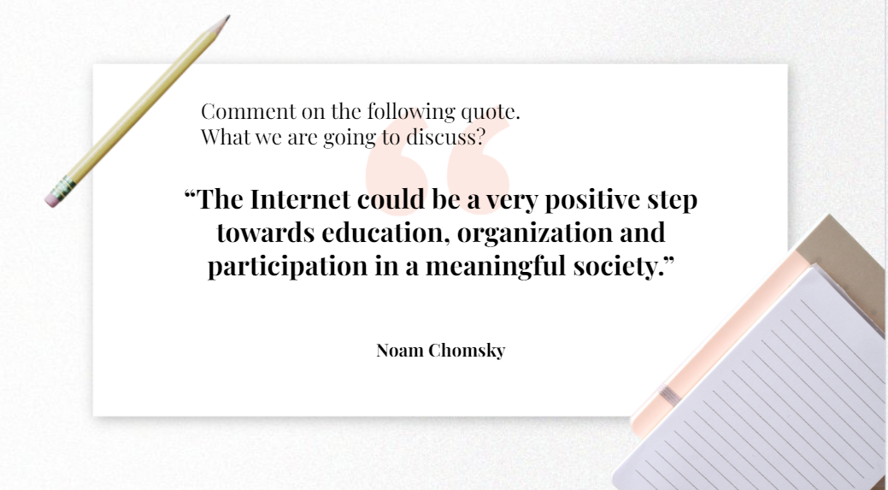

Slide 17
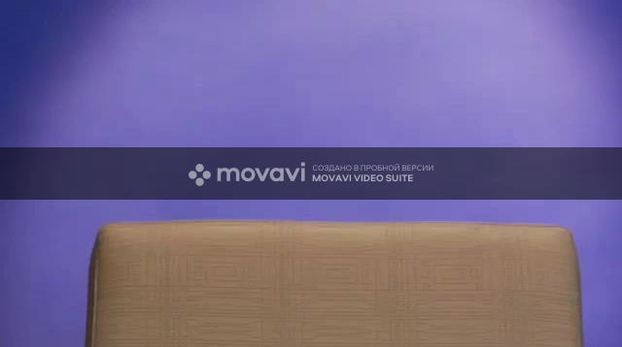
Watch the video and answer the questions

Slide 18



What is the Internet?
How does it work?
What can you do with the Internet?

Slide 19
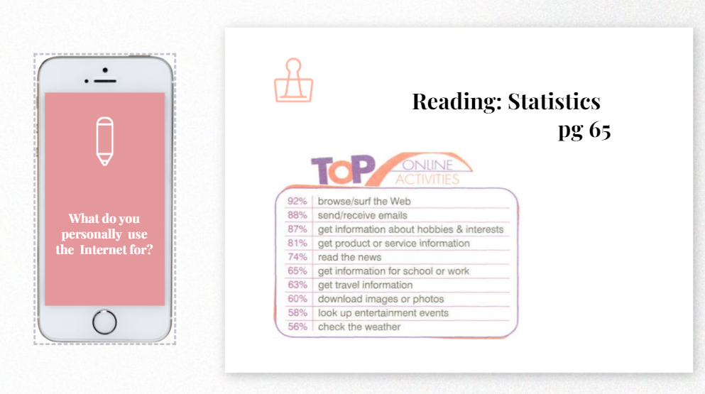

Slide 20
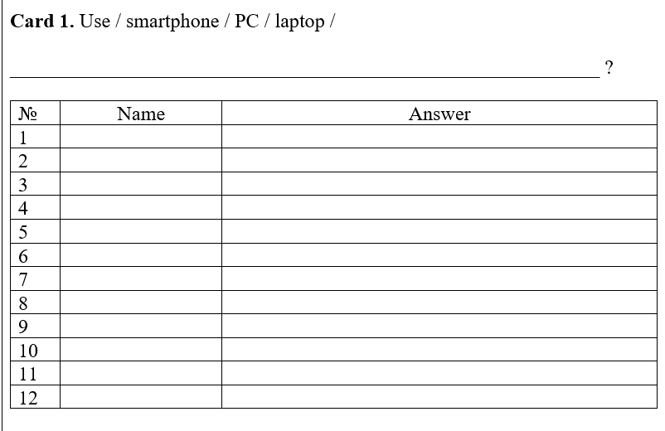
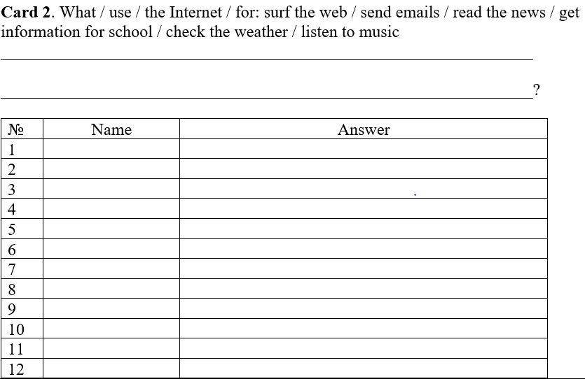
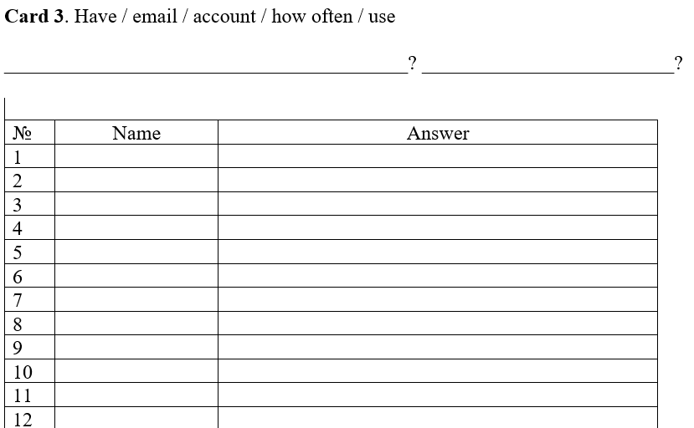
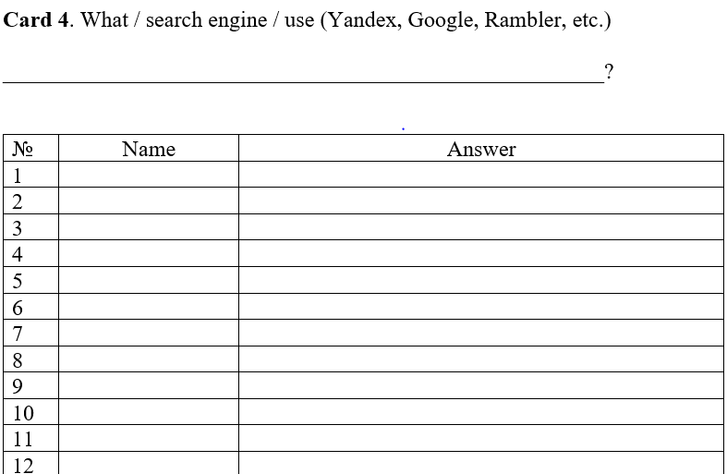
Project/Communication
Make up a question. Ask 5 classmates and fill out your card.

Slide 21
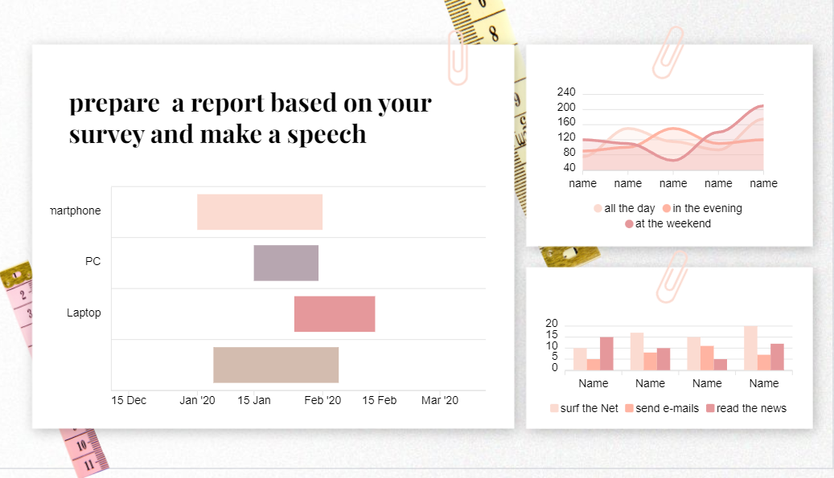

Slide 22

Home assignment: ex. 4, 5, pg 65

Slide 23
