Slide 1
Урок английского языка на основе обучающего мультфильма для 6 класса школ с углублённым изучением английского языка
Учитель английского языка
МОУ СОШ №1 г. Волжского
Волгоградской области
Малюгина Светлана Семеновна

Slide 2
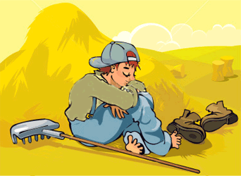
Lazy Jack
http://www.umniki21.ru/mults/mults.php?id=eng_lazyjack_01

Slide 3
Answer the questions:
Who is this story about?
Why was he lazy?
Is the end of this story happy or sad?

Slide 4
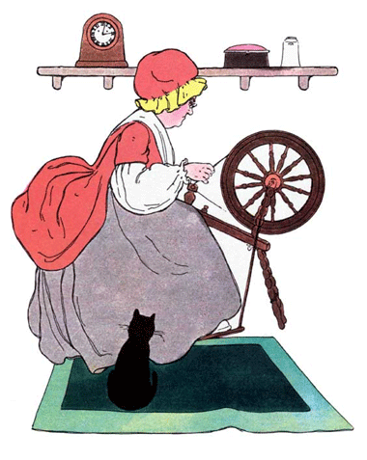
You will meet some new words.
Guess what they mean!
to spin- to produce thread (нить)
The old woman earned her living by spinning .

Slide 5
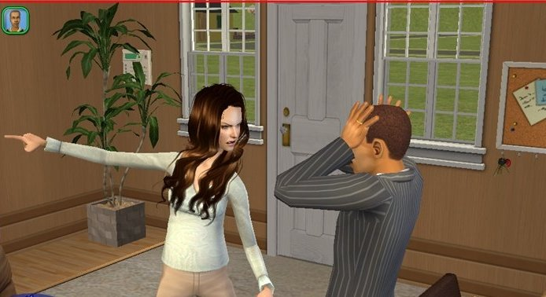
Guess what it means:
to take smb out- to make smb go out of the house
“Go out of the room! I want to take you out !” said the woman.

Slide 6
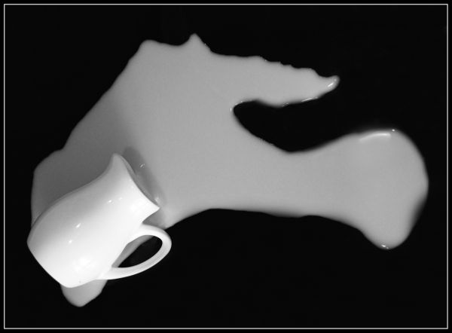
Guess what it means:
to spill (spilt-spilt) milk- to flow over the edge (край) of a glass or any other container.
The milk is spilt .

Slide 7

Guess what it means:
a jar of milk- a jar and what it contains.
There was a jar of milk on the table.

Slide 8
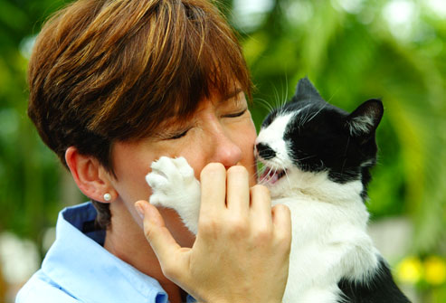
Guess what it means:
to scratch- to damage the skin
The cat scratched
her.

Slide 9
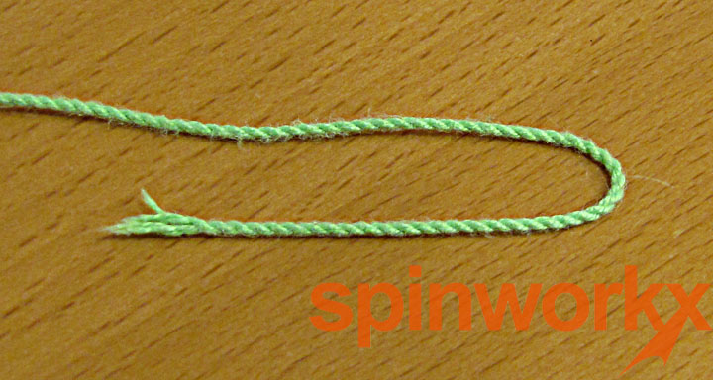
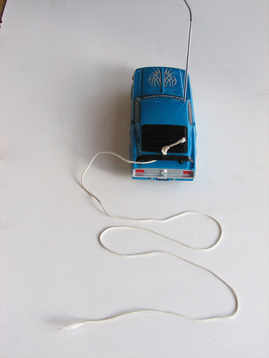
Guess what it means:
a string
to tie a toy car to the string
He tied the car to the string.

Slide 10
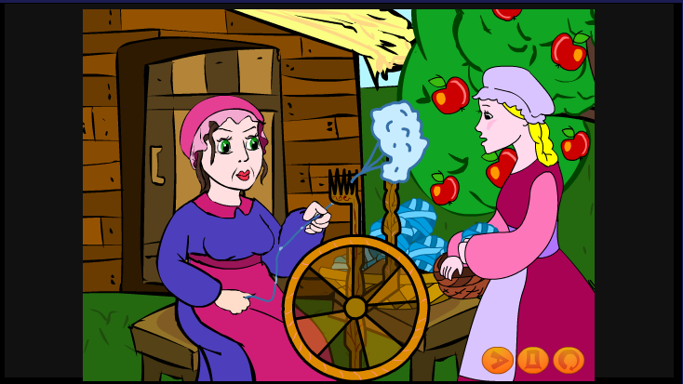
The old woman earned money by spinning.

Slide 11
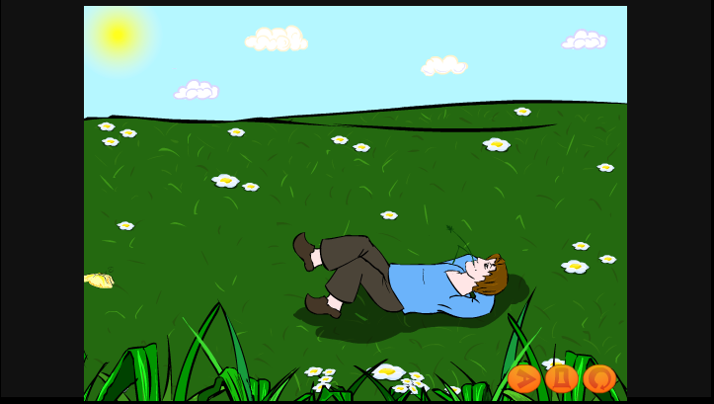
Jack was so lazy that he did nothing but lie in the sun.

Slide 12
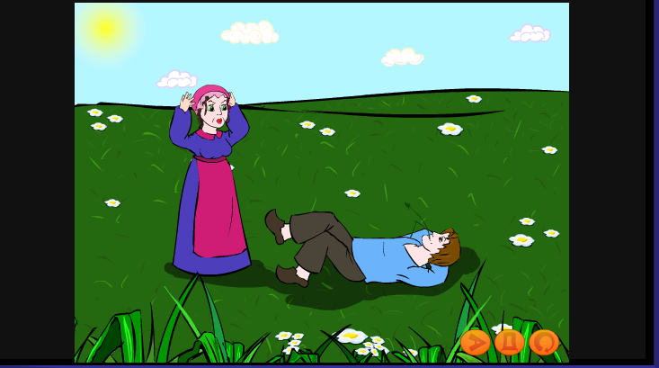
One day his mother grew very angry with Jack and said:”I will turn you out if you do not start working”.

Slide 13
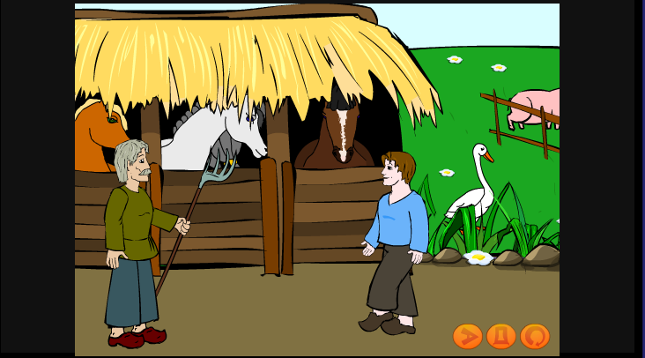
And the next morning he went to the neighbouring farmer to ask for a job”.

Slide 14
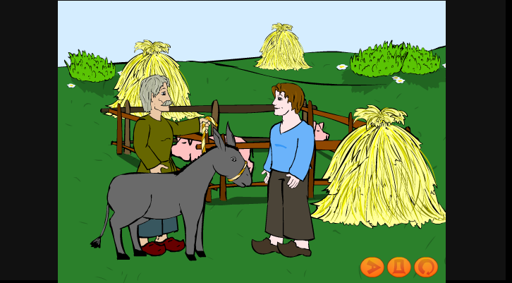
The next day Jack got a donkey for his day’s work.

Slide 15
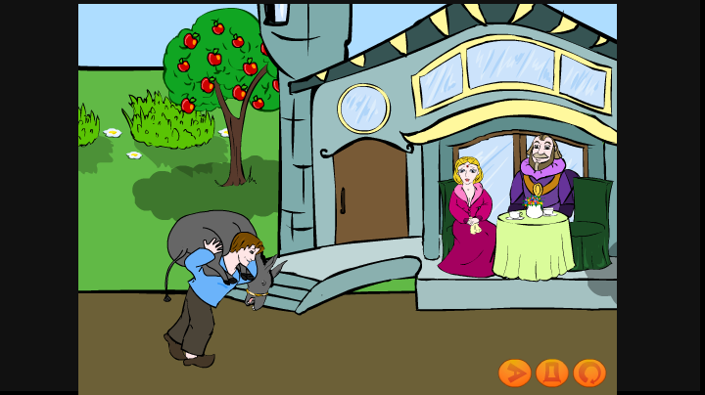
To take a short cut he decided to cross the land belonging to a rich man and his daughter.

Slide 16
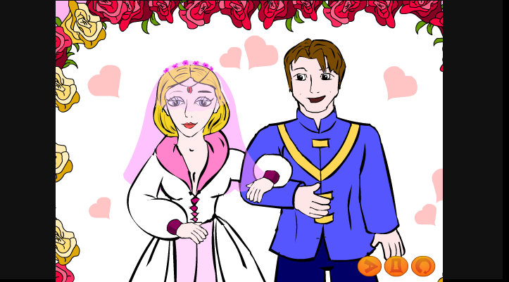
So, when the lord saw his daughter laughing he straight away said Jack could marry her.

Slide 17
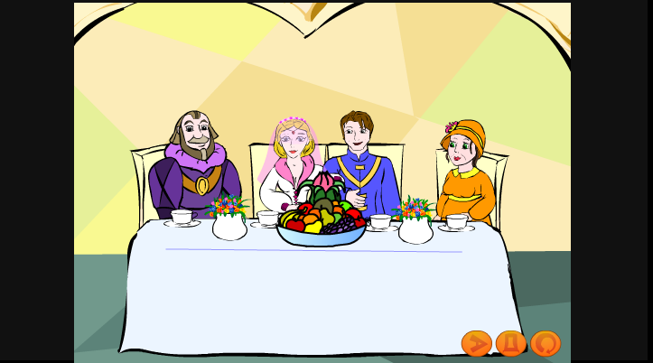
Thus, Jack became a rich man and they lived in a large house and Jack’s mother lived with him in a great happiness.

Slide 18
Work in small groups
Picture I
lazy
boy
spinning
nothing
mother
angry
work
Picture II
stupid
job
angry
shoulders
donkey
farmer
things
Picture III
to marry
laugh
rich
sad
lord
daughter
life

Slide 19
What is the moral of the tale?
We must always work.
We should always listen to our parents.
It is difficult to earn money.
We never know when we will be happy.

Slide 20
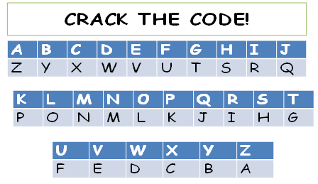
Crack the code to find out if you were right.

Slide 21
You
should
never
lose
hope

Slide 22
Finish the sentence:
I think our lesson was…
interesting
exciting
great
boring
difficult
wonderful
sad

Slide 23
What did you like most of all?
the tongue twister
I liked… most of all.
the cartoon
the work with the slides
the exercises
the fairy tale
the main character

Slide 24

Your home task :
Learn the tongue twister.
Put the sentences in the correct order and use them to retell the fairy tale.

Slide 25
Список использованных источников:
Изображение медальона http://www.pendantall.com/album/locket-pendant/images/locket-pendant07.jpg
Изображение иллюстрации сказки о Ленивом Джеке http://www.kidsgen.com/fables_and_fairytales/images/lazy-jack.gif
Изображение женщины, прядущей пряжу http://chestofbooks.com/crafts/needlework/Clothing-And-Health/images/Fig-111-The-flax-wheel.jpg
Изображение ссорящейся пары http://s39.radikal.ru/i084/1107/7a/e83944aedb3e.jpg
Изображение пролитого молока http://photoside.ru/uploads/users/135/2009-09-15/1562_thumbs.JPG
Изображение кувшина с молоком http://ai-cdr.ucoz.ru/kartinki_7/kuvshin_moloka.gif
Изображение кошки с когтями http://img.webmd.com/dtmcms/live/webmd/consumer_assets/site_images/articles/health_tools/behavior_problems_in_cats_slideshow/photolibrary_rm_photo_of_cat_scratching_womans_face.jpg
Изображение машинки на верёвочке http://farm5.static.flickr.com/4012/4489202094_5b30696525.jpg

