Slide 1
Барболина Светлана Алексеевна учитель английского языка Муниципальное автономное общеобразовательное учреждение «Средняя общеобразовательная школа №9 с углубленным изучением отдельных предметов» г. Череповца Красильникова Лариса Олеговна учитель английского языка Муниципальное автономное общеобразовательное учреждение «Средняя общеобразовательная школа №34» г. Череповца «Презентация к уроку по учебному предмету «Английский язык» в 6-ом классе на тему «Past Simple».

Slide 2
Present Simple Past Simple

Slide 3
Present Simple
Usually, often, always, sometimes
____V/V(s).
Do/Does _____ V ?
_____ do/does not(don’t/doesn’t) V.

Slide 4
Present Simple
They often play football after school. Не often plays football after school.
Do they often play football after school? Does he play football after school?
They don’t play football after school. He doesn’t play football after school.

Slide 5
Present Simple
Complete the sentences. Use present simple.
1. Tom always gets to school early. (get)
2. I ______________TV very often. (watch)
3. Lisa ____________her hair every morning. (wash)
4. My parents _____________ in a big company. (work)
5. Helen ______________ not far from the zoo. (live)
6. They _____________to the gym every day. (go)
7. Julia ______________her homework every evening. (do)

Slide 6
PAST Simple
Yesterday, last summer, 2 days ago, in 1936.
____V(ed)/V2.
Did _____ V ?
_____ did not (didn’t) V.

Slide 7
Past Simple
They played football after school yesterday. Не went home after school yesterday.
Did they play football after school yesterday? Did he go home after school yesterday?
They didn’t play football after school yesterday. He didn’t go home after school yesterday .

Slide 8
PAST Simple
Complete the sentences. Use past simple.
1. Paul ................... (find) a wallet on the bus yesterday.
2. My brother ................... (spend) €120 on CDs last weekend.
3. We ................... (decide) to stay in and watch a film last night.
4. I ................... (knock) at the door but no one was in.
5. He ................... (say) hello to me but I don’t know who he is.
6. We ................... (meet) on holiday last summer.
7. I ................... (hear) a lot about you.

Slide 9
Read the text «Mineral Park – The Ghost Town». (Spotlight 6, р.66 ex.3) Find the verbs in past simple.

Slide 10
PAST Simple
Answer the questions:
1. How many people lived in Mineral park in 1871?
2. Were there any schools, shops, restaurants, post offices and saloons in the town?
3. Where did the people of the town work?
4. What did they do after work?
5. When did the town start to change?
6. Why did many families move to other towns?

Slide 11
PAST Simple
Work in pairs. Imagine you are interviewing a person who lived in Mineral Park. Use the prompts to ask and answer questions.
Work/mines
Travel/by cars
Study/schools
Spend free time/saloons
Move/other towns
Live/blocks of flats
Close/shops
Use the example:
Did people work in the mines? - Yes, they did.

Slide 12
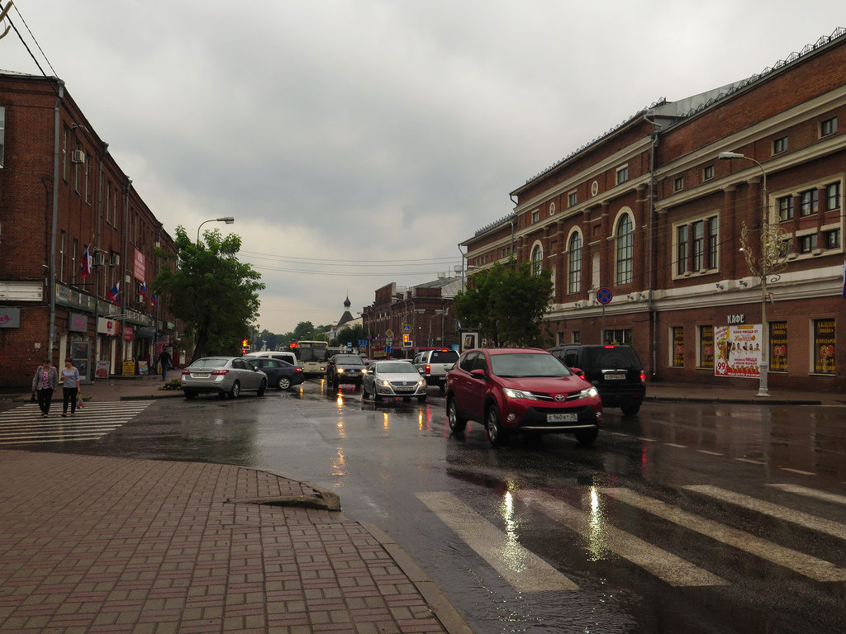
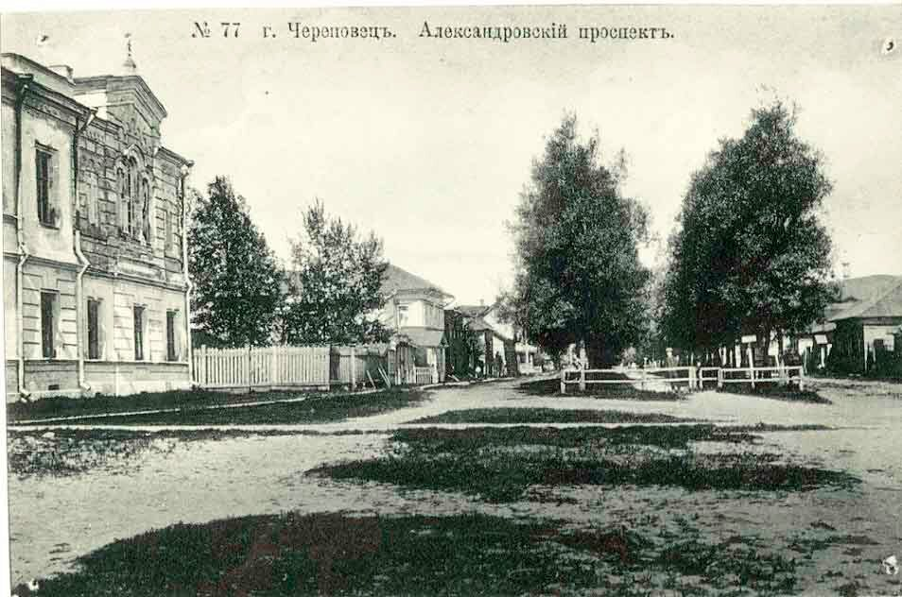
Cherepovets now and then.

Slide 13
Work in groups. Compare our town Cherepovets in 1919 and in 2019. Use the prompts:
10 thousand people/live
5 factories/work
2 schools/study
1 library/go
1 museum/visit
1 bank, 1 hospital/be
316 thousand people/live
20 factories and plants/work
43 schools/study
9 libraries/go
16 museums/visit
many banks, 10 hospitals/be

Slide 14
Self-evaluation
Evaluation criteria | Mark
1. I did exercises | 1
2. I asked and answered the questions using Present Simple and Past Simple | 1
3.I took part in the discussion about the past and the present of our town | 1
4.I spoke fluently and correctly | 2

