Slide 1
Презентация к уроку по учебному предмету «Английский язык» в 3 классе на тему «Умные животные»
Выполнила: учитель английского языка
Соколова Наталья Валерьевна
МБОУ «СОШ № 20» п. Усолье-7

Slide 2
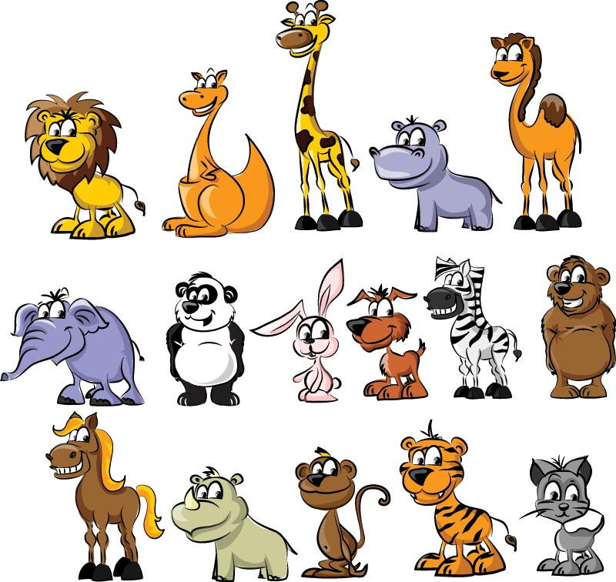
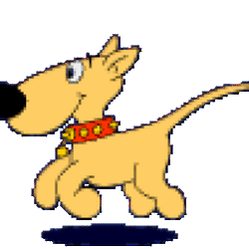
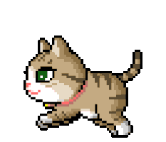
Clever animals

Slide 3
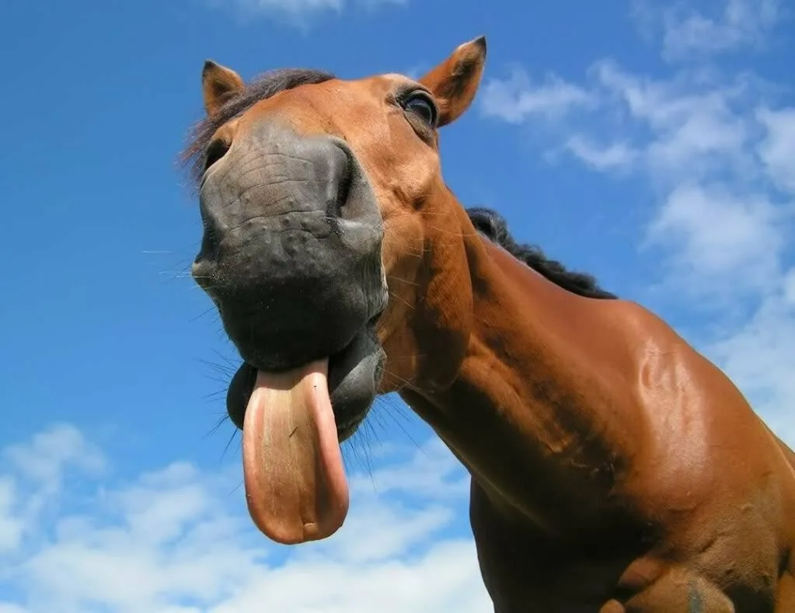
Let’s train our tongues!
A big pink sheep
bit a little funny chick
But the little funny chick
bit the big pink sheep.

Slide 4
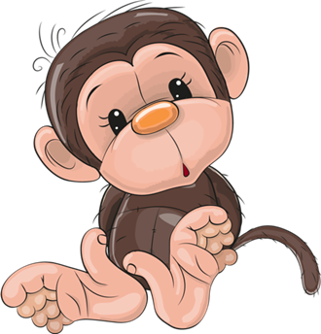
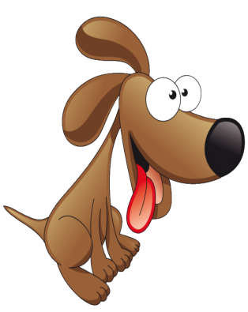
Распредели животных по группам
Wild
animals
Domestic animals
Farm
animals
dogs
horses
hamsters
tigers
dolphins
cats
parrots
sheep
cows
chimps

Slide 5
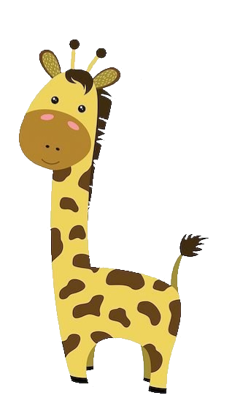
Parts of animal’s body
ears
eyes
a head
a nose
a mouth
a neck
a tail
a body
legs

Slide 6
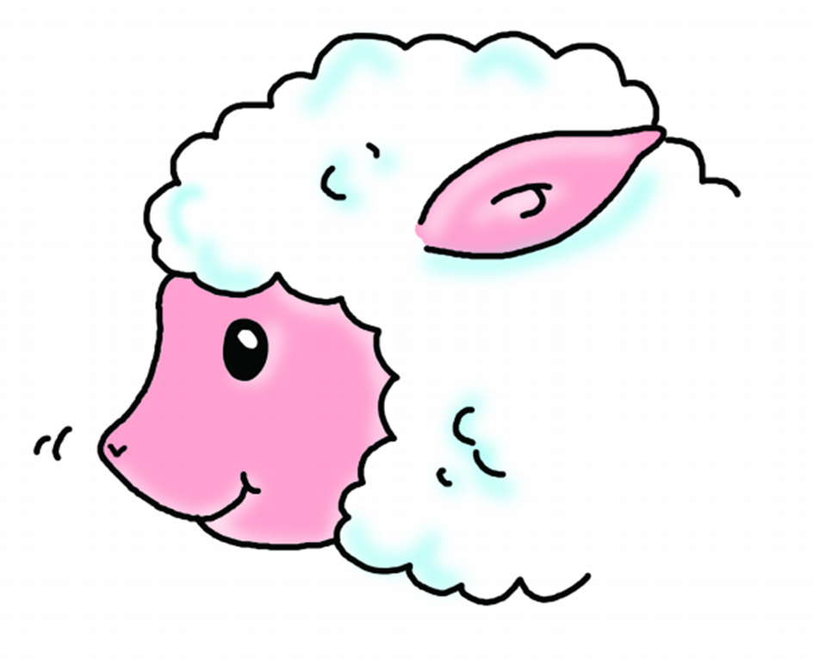
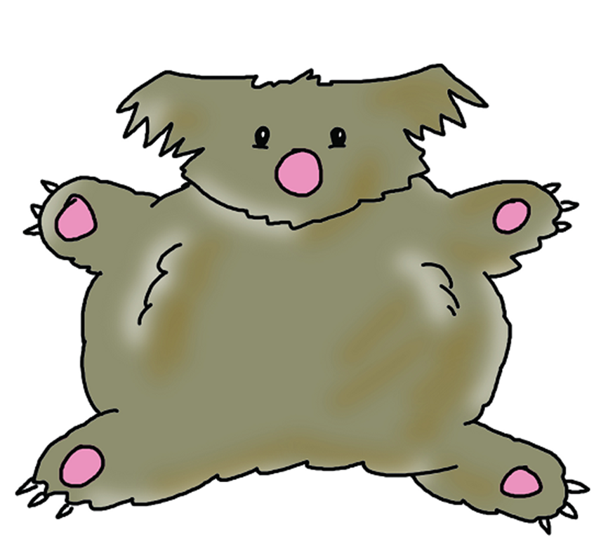
Remember!
small eyes
a small nose

Slide 7
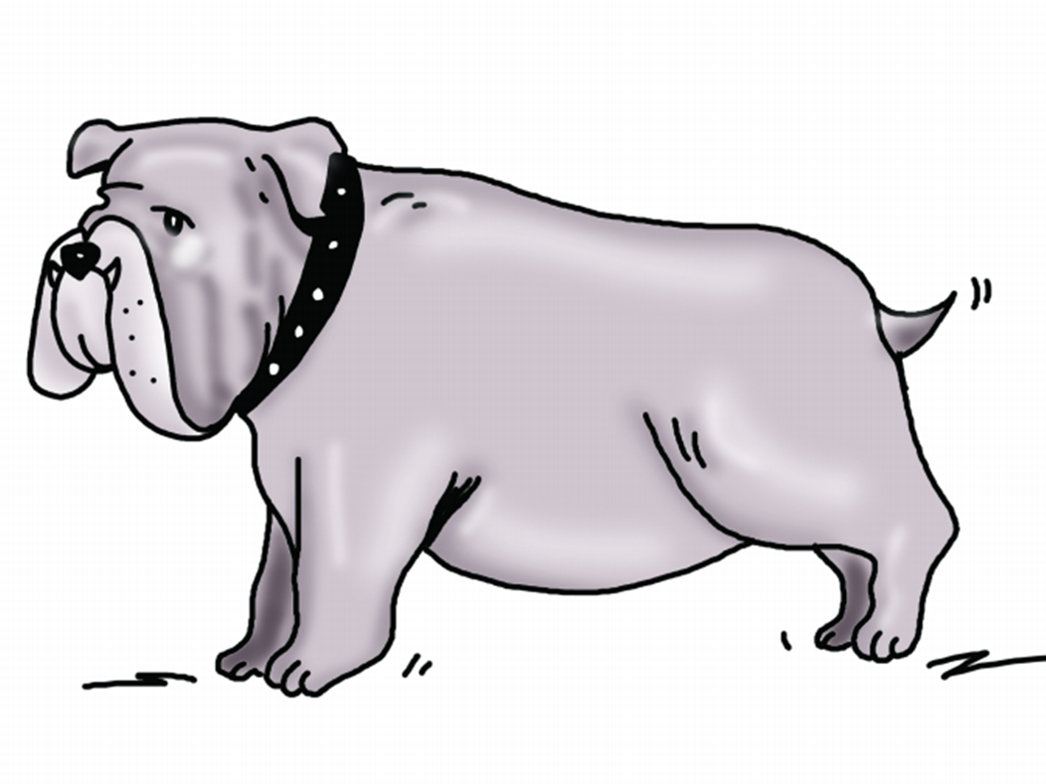
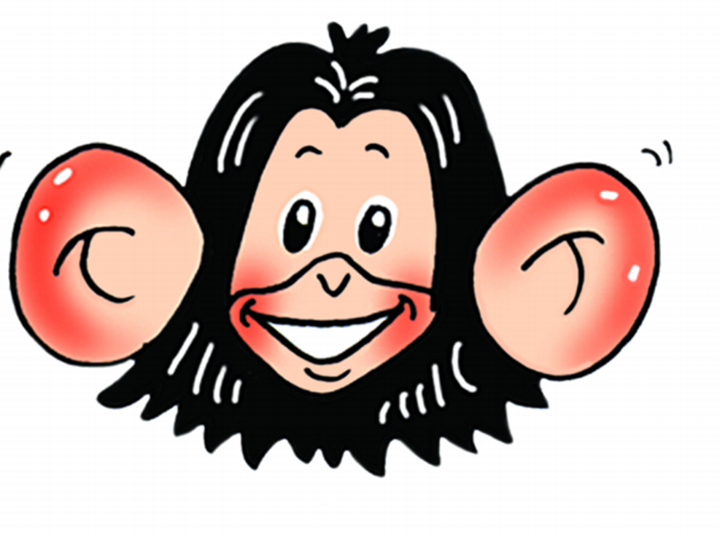
big ears
a short tail

Slide 8
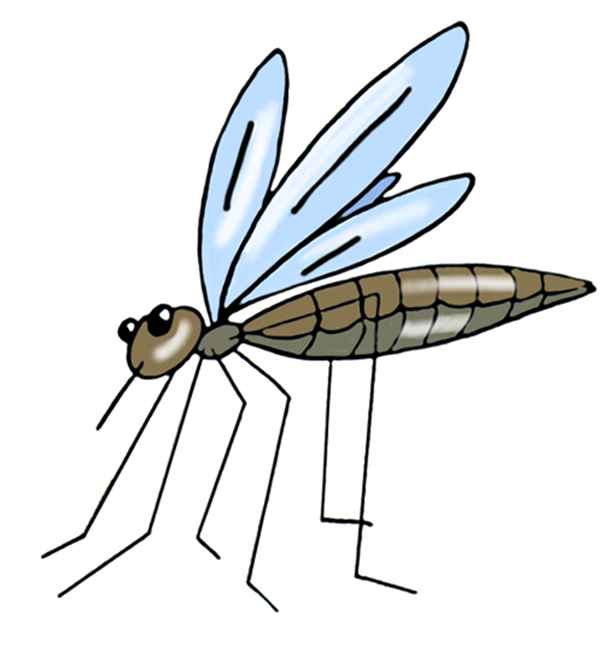
thin legs
a fat body

Slide 9
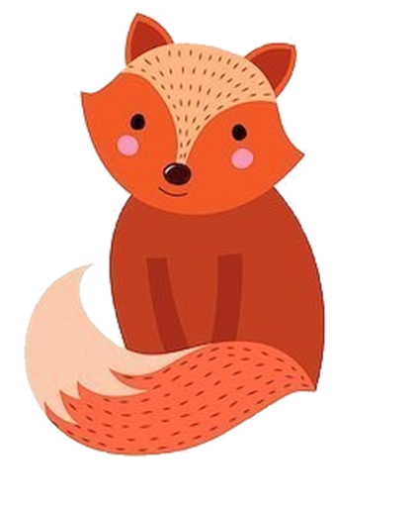
What do animals look like?
It is a giraffe.
It is big and tall.
It is brown and orange.
It has got a long neck, four legs and small eyes.
It is a fox.
It is small and fluffy.
It is orange.
It has got a long tail, four thin legs and small ears.

Slide 10
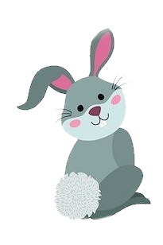
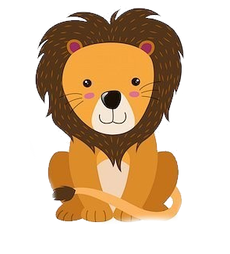

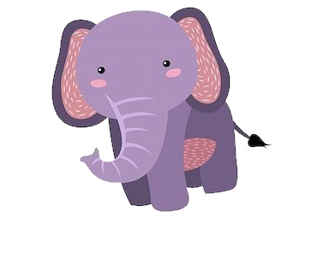
Describe the animal!
It is …
It is …
It is …
It has got …

Slide 11
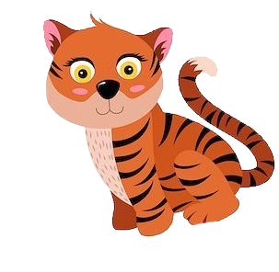
Tigers have got short tails.
No! Tigers haven’t got short tails.
They’ve got long tails.
Elephants have got thin legs.
No! Elephants …
…

Slide 12
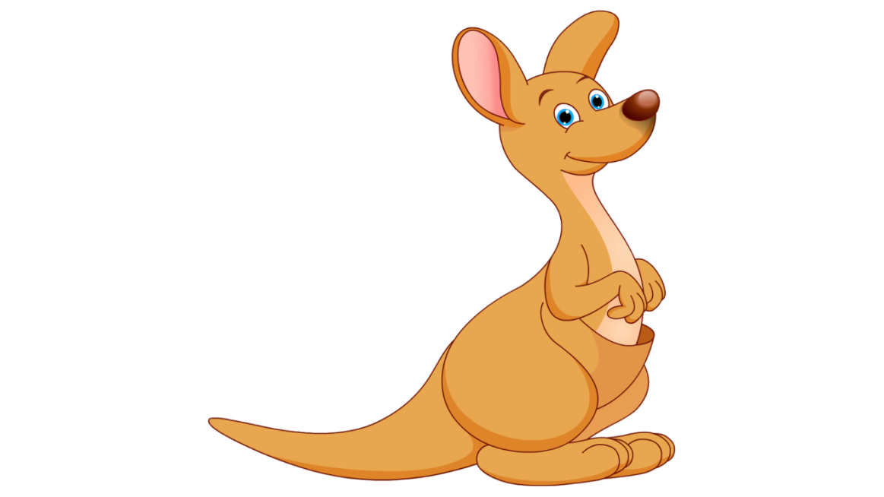
Kangaroos have got short tails.
No! ….
They’ve got ….
Monkeys have got big ears.
No! ….
…

Slide 13


What can animals do?
can’t = can not
Can a dog run?
Can a dog jump?
Can a dog fly?
Yes, it can.
No, it can’t.
A dog can run and jump, but it can’t fly.

Slide 14
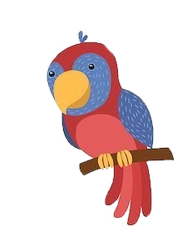
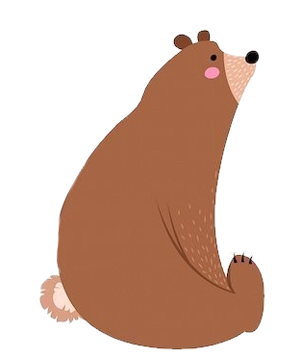
What can a parrot do?
A parrot can …, but it can’t …
What can a bear do?
What can a fox do?

Slide 15
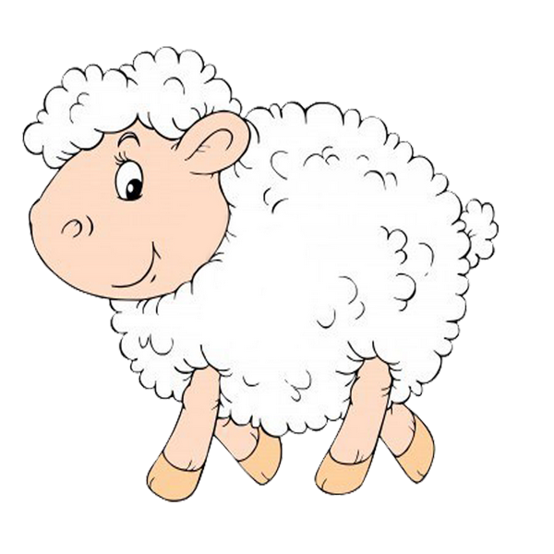
Read and guess the animal!
It is white and fluffy. It has got a small black nose and small eyes. It’s got four legs, a fat body and a short tail. It can run and jump. It can’t fly and swim. It likes eating grass.
a sheep

Slide 16
It is red, blue and green. It has got small eyes and a small head. It’s got two thin legs, a small body and a long tail. It can fly and jump. It can’t swim.
a parrot

Slide 17
It is orange and black. It’s got four legs, a big body and a long tail. It can run, jump and swim. It can’t fly. It’s dangerous.
a tiger

Slide 18


Slide 19

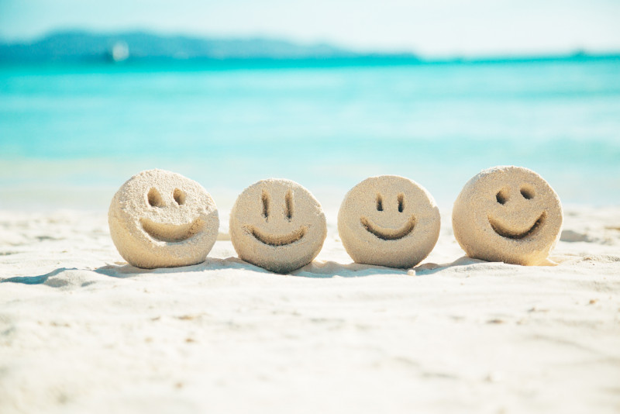
I feel…
sad
happy

Slide 20

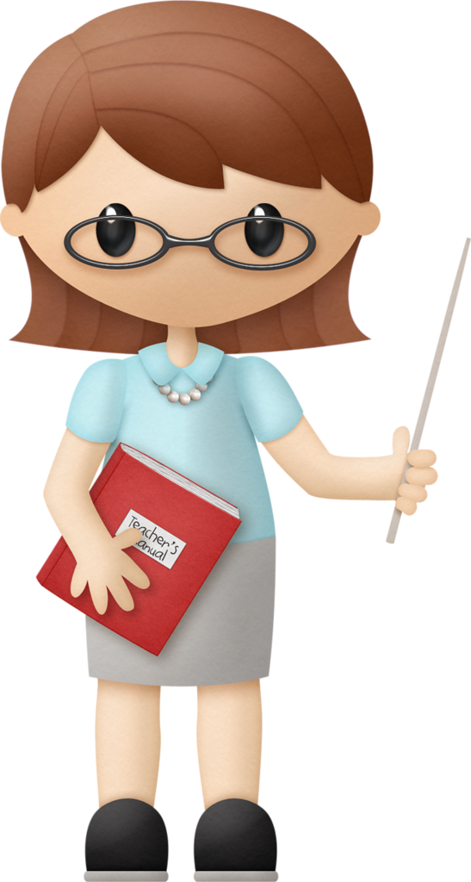
Can you describe animals?
Can you talk about what animals can do?
Our lesson is over! Good-bye!

