Slide 1
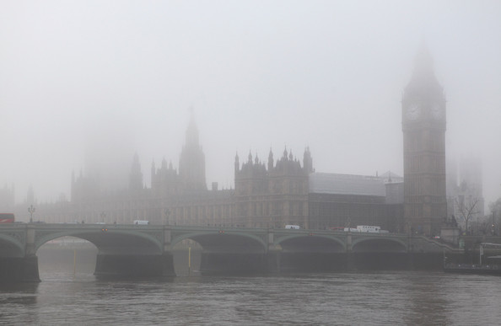
Презентация к уроку по учебному предмету
«Английский язык», 6 класс
«Соединенное королевство Великобритании и Северной Ирландии»
(обобщение и систематизация)
авторы-разработчики:
Щербакова Людмила Валентиновна, учитель англ. яз, МБОУ СОШ №1, г.Тулун
Батыль Ольга Степановна, учитель англ. яз. МБОУ СОШ № 1, г. Тулун

Slide 2
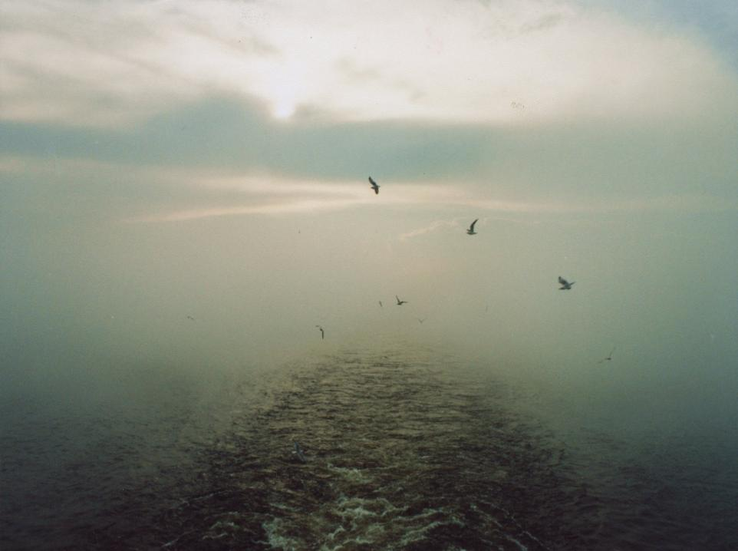

«Я мыслью улечу к брегам туманным Альбиона…»
К. Батюшкин
Read this quotation of the Russian poet and translator K.Batyushkin.
Think and say what it means «туманный Альбион»? Do you know anything about it from your History lessons?
Predict what we are going to speak about?

Slide 3

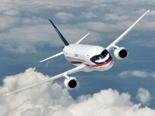
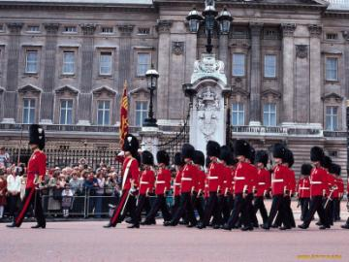

Have you ever been to the UK?
  Would you like to visit the UK?
What a strange sound! Can you hear?
Maybe it is the sound of a train, ship, car, bicycle or a plane?
Do you like travelling? Imagine we are on aboard of this plane. Fasten the belts please.

Slide 4


Slide 5
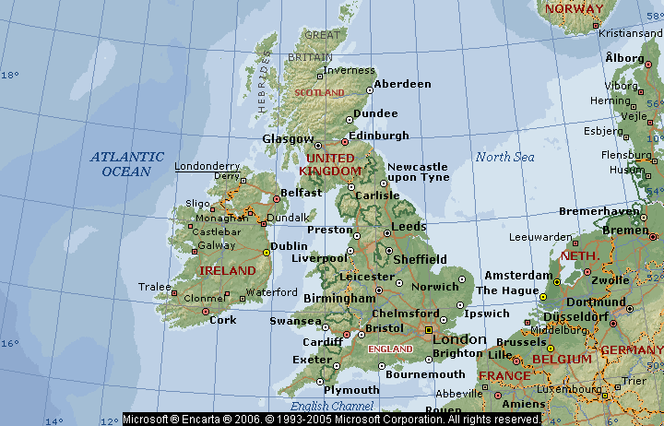

Travelling to the UK
What is the aim of our travelling? Learn more interesting facts about the UK and speak as much as possible about this country. During our flight we should revise some material in English. At the end of our trip you should make up your own story about the United Kingdom.

Slide 6
Phonetic drill
[‘iŋglənd]
[‘skotlənd]
[weilz]
[,no:ðn ‘aiələnd]
[‘edinbərə]
[‘ka:dif]
[,bel’fa:st]

Slide 7
How well do you know the UK?
1.What is the official name of the country?
2. How many parts are there in the UK?
3.Is the UK a large or a small country ?
4.What is the capital of Wales?
5.What is the capital of Scotland?
6.What is the symbol of Northern Ireland?
7.What is the symbol of Wales?

Slide 8
How well do you know the UK?
8.What is the longest river in Britain?
9.What is the capital of England?
10.What is the symbol of Scotland
11.What is the name for the flag of the UK?
12. What is the other name of London buses?
13. What was the most terrible prison in Great Britain?
14. What is Big Ben?
15. Who is the National Hero of Britain, the defender of the poor people?

Slide 9
Who knows grammar better
Fill in the definite article “the” where necessary
1. __UK is situated on ____ British Isles.
2. __ English Channel separates ___ Britain from the continent.
3. __ Irish Republic is an independent country.
4. __ North Sea is to ___ east of ___Scotland.
5. The capital of __ Wales is ___Cardiff.
6. __ Thames is the most famous river in ___ United Kingdom.
7. __ UK is washed by __ Atlantic Ocean in the east.

Slide 10
Let’s check
1. The UK is situated on the British Isles.
2. The English Channel separates ____ Britain from the continent.
3. The Irish Republic is an independent country.
4. The North Sea is to the east of Scotland.
5. The capital of ____ Wales is ____ Cardiff.
6. The Thames is the most famous river in the United Kingdom.
7. The UK is washed by the Atlantic Ocean in the east.

Slide 11
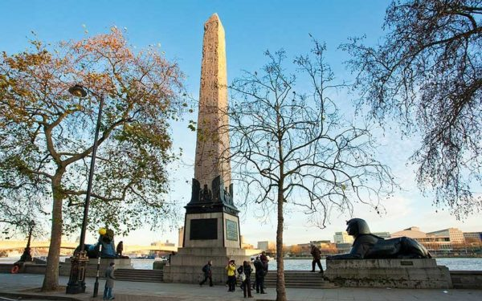
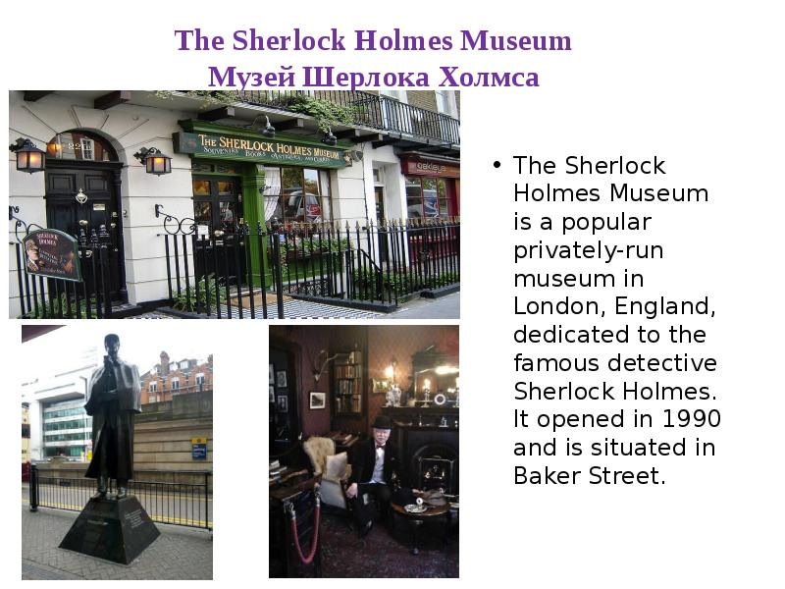
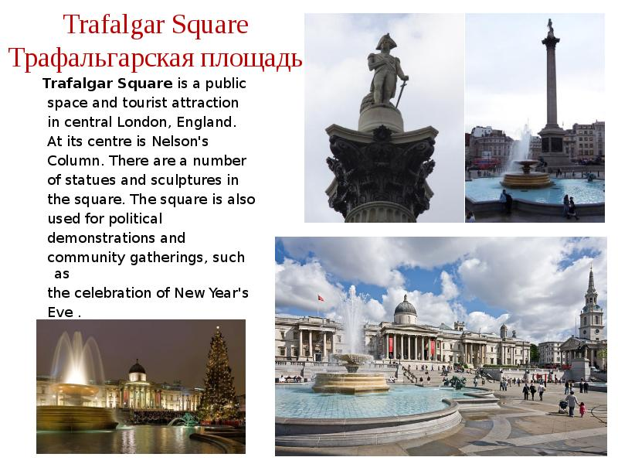
Match the Sights of London
It is a popular privately – run museum, dedicated to the famous detective Sherlock Holmes. It was opened in 1990 and is situated in Baker Street.
A
1
(The Sherlock Holmes museum)
It is the geographical center of London - It is also a historical place. In the middle of it there is the famous Nelson Column, which was built in memory of Admiral Nelson’s victory at Trafalgar.
B
2
(Trafalgar Square)
This obelisk is known as the Needle. It was brought to London from Alexandria. Two large bronze Sphinxes lie on either side of the Needle.
C
3
(Cleopatra’s Needle)

Slide 12
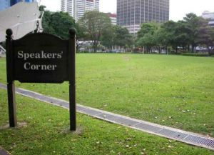
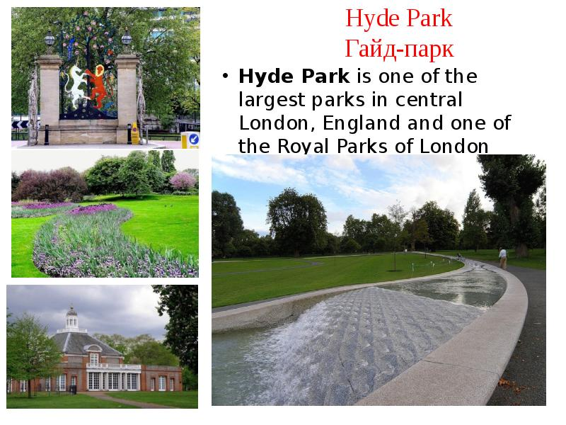
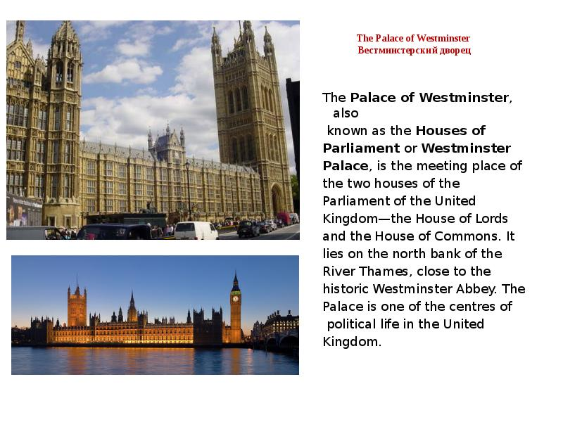
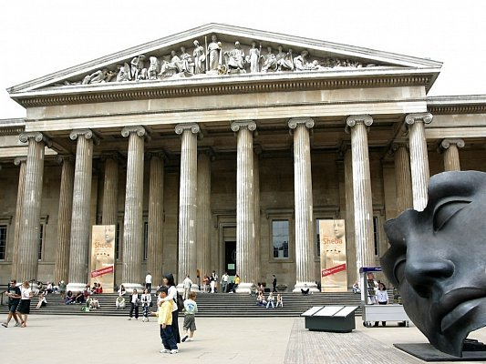
It ’s the national museum of Britain, founded in 1753. It has one of the world’s best collections of decorative art and houses many of the world’s greatest treasures.
D
4
(The British Museum)
It is the group of buildings, where the House of Lords and the House of Commons sit. It has two towers: The Clock Tower with Big Ben and the Victoria Tower with the national flag over it.
5
E
(The Houses of Parliament)
It is one of the largest Royal parks of London and it is famous for its Speakers’ Corner which attracts a lot of tourists.
6
F
(Hyde Park)

Slide 13
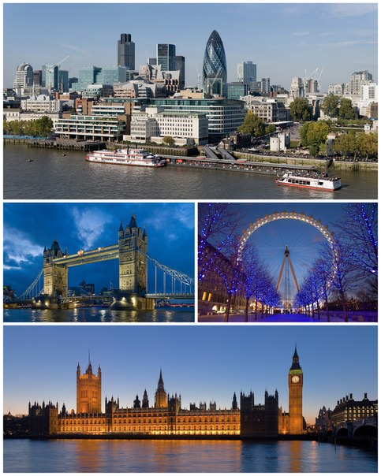
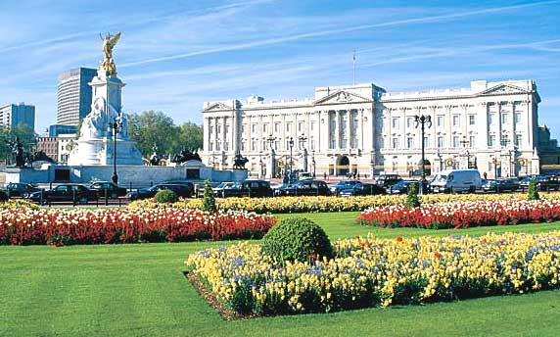
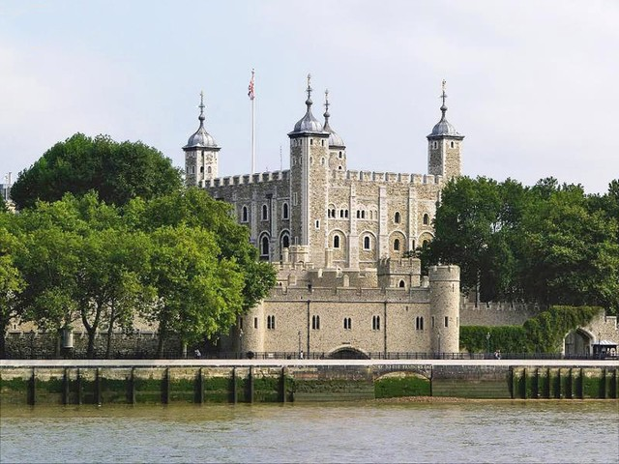
Welcome to the United Kingdom
Guess what country it is

Slide 14
Welcome to the United Kingdom
Guess what country it is
Don’t forget to say:
I think/ believe/ guess….
in the picture I can see…
sights of
on the right/ on the left
also….
That’s why it is….

Slide 15
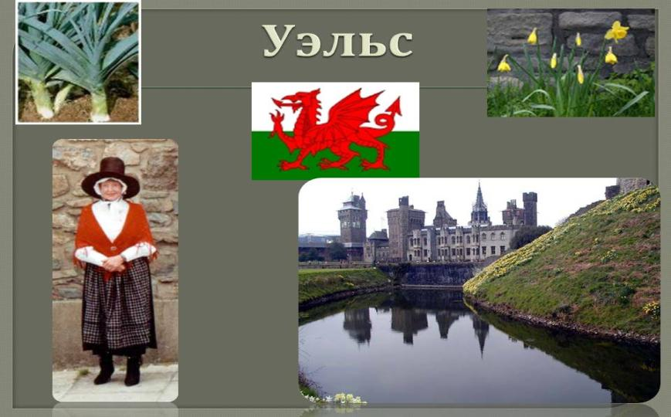

Guess what country it is

Slide 16
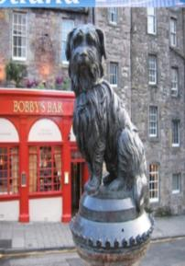
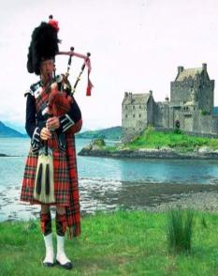
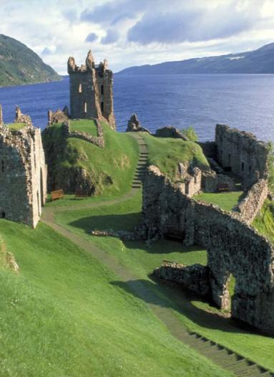
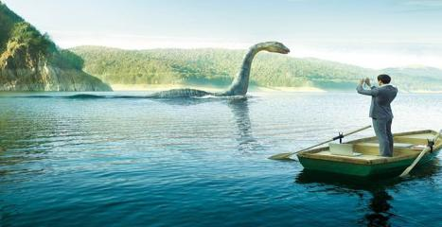
Guess what country it is

Slide 17
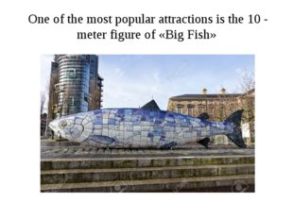
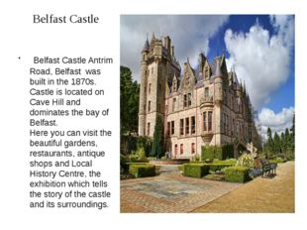
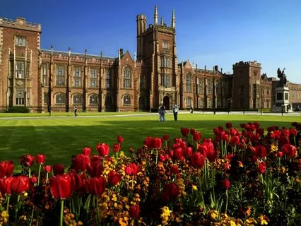
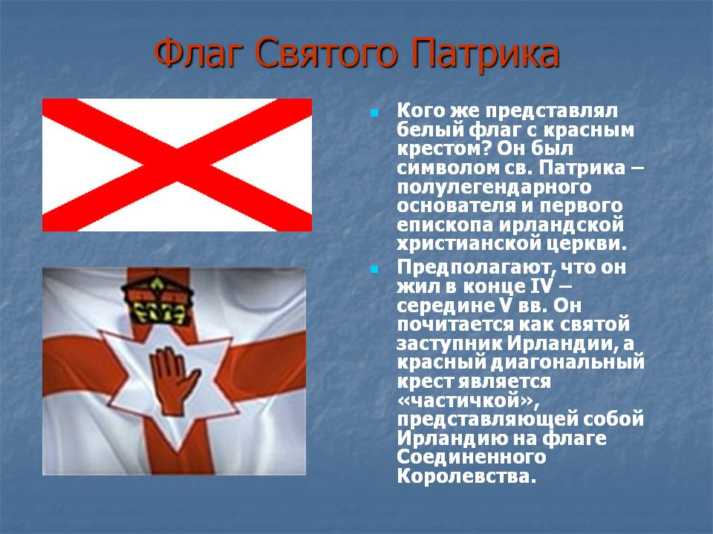
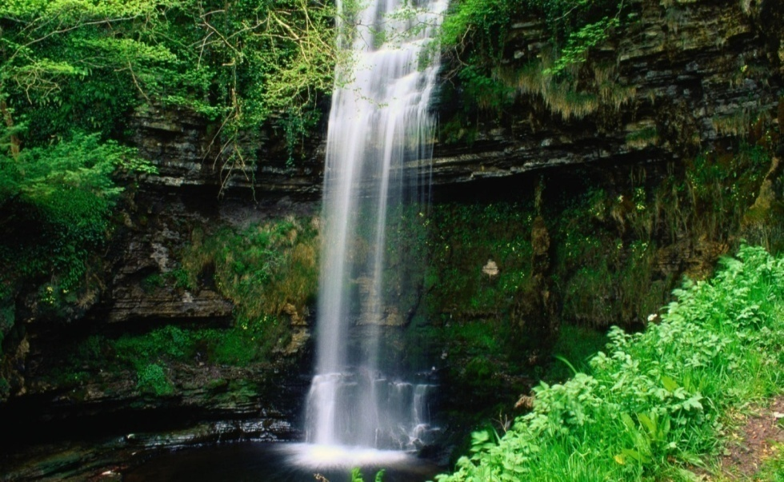
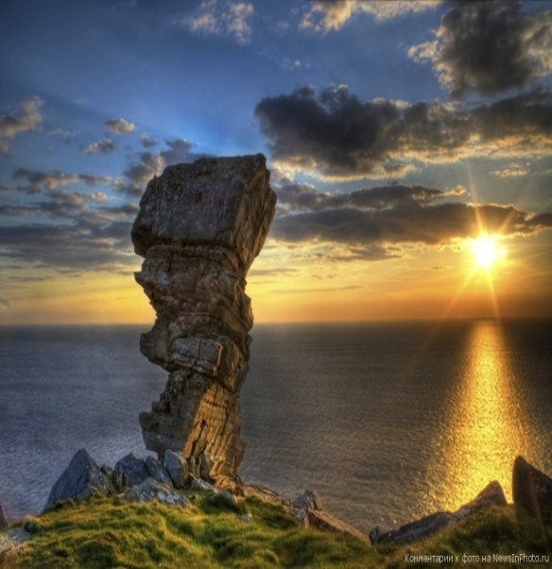

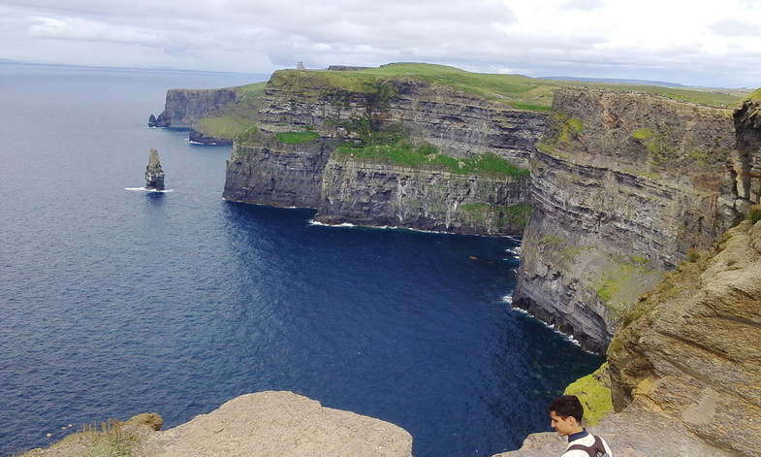
Guess what country it is

Slide 18
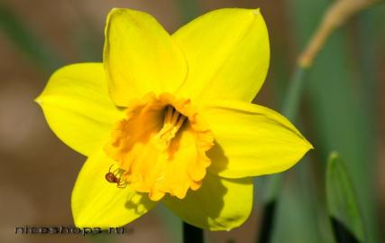
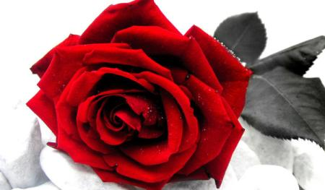
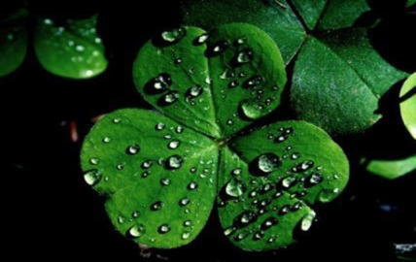
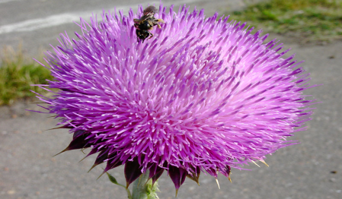
Name the symbol and the country
1
2
red rose
daffodil
4
3
thistle
clover

Slide 19
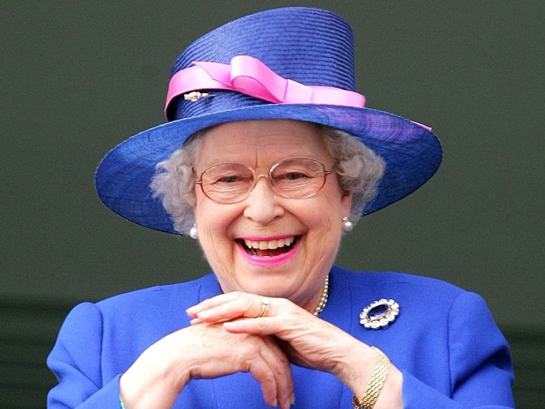
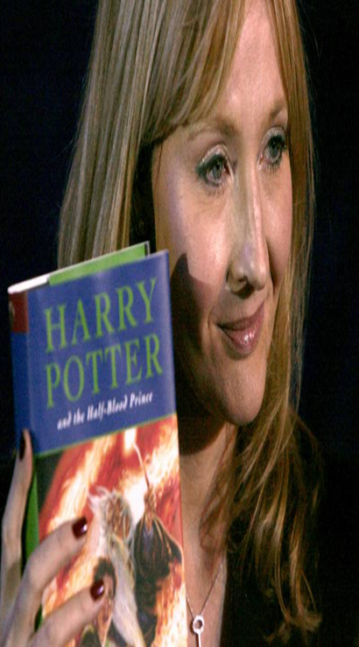
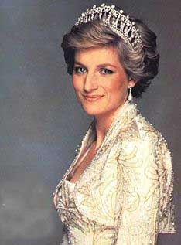
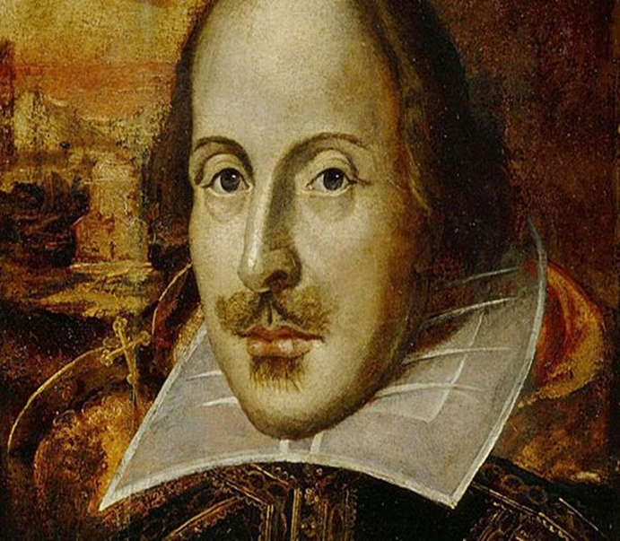
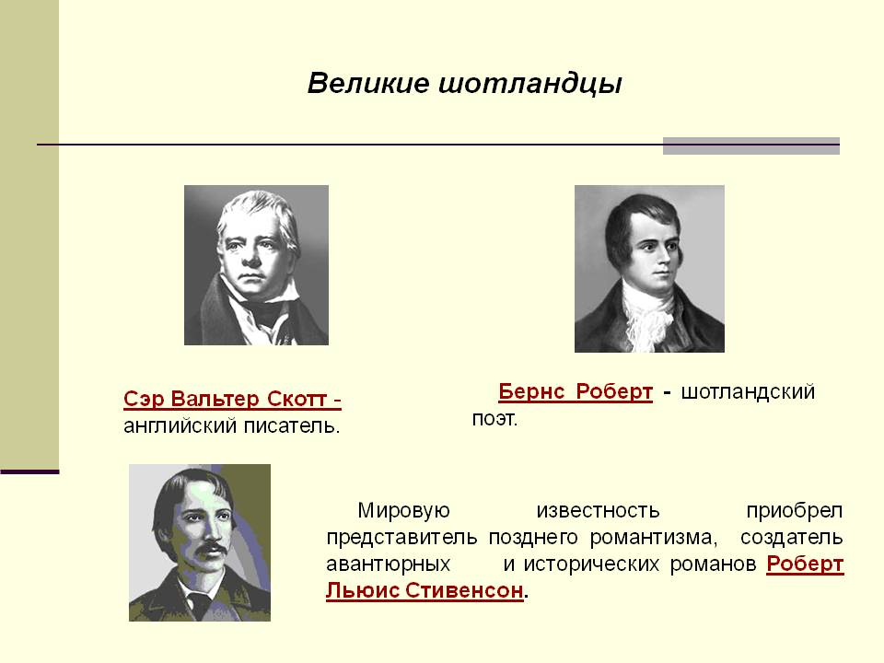
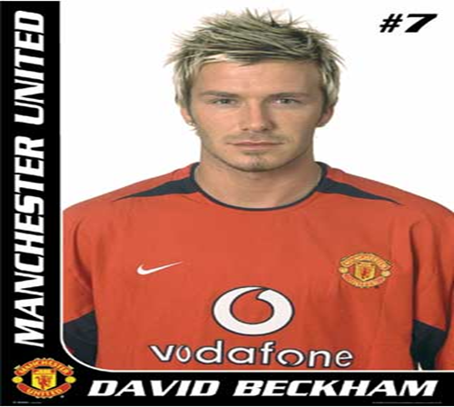
Do you know them?
1
2
3
Elizabeth II, the Queen
Diana, Princess of Wales
Joanne K. Rowling
4
5
6
William Shakespeare
Robert Burns
David Beckham

Slide 20
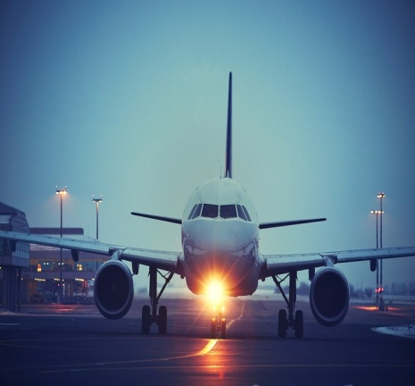
Let’s summarize the info. about the UK
1. Make up the proverb:
is, home, West, best, or, East.
2. Now we are in Russia. You’ve just visited 4 parts of the UK. Share your impressions with your friends. But first of all, fill in the table. Work in groups .
Country | Capital | People | Language | Patron Saint | Symbol | Interesting information

Slide 21
Let’s summarize the info. about the UK
3.Make up the story about the country (England, Wales, Scotland or Northern Ireland). Work in groups of four. You can use your cards/tables.
The name of the country
Where it is situated
The official language
Flower symbol
What it is famous for
……..

Slide 22
Home assignment
Write a short article about the most famous English square. Answer the questions.
1. What square is the symbol of London?
2. What is it famous for?
3. Do many tourists visit it?
4. What is there in winter?
5. What events take place in the square?

Slide 23


Let`s evaluate our work
Complete the sentences
Today I have known …
It was difficult for me to …
new words
tell about
information
read and understand
Now I can…
It was interesting…
do grammar exercises
ask
say my opinion on
make up sentences
I would praise myself for…
Now I’ve learnt how…
I would like to …..
well
I was good at
perfectly

Slide 24
Thank you!
Good-bye!
Английское «good bye» – сокращенная версия фразы «God be with you», что значит «Да прибудет с вами Господь»

