Slide 1
The ecological problems in
the world literature based on
the poem «Three Palms» written by
M. Y. Lermontov
Student Sertakova Katya
Teacher Shplatova M. E.

Slide 2
Earth, air, fire and water are the elements of life on our planet. They have always occupied a prominent place in the artistic knowledge of Man by himself. From The Tale of Igor’s Campaign to The Twelve by Alexander Blok, from the Russian epic about the plowman to the modern Village Prose our literature has been linking the life and fate of the Russian people with the life and destiny of nature.

Slide 3
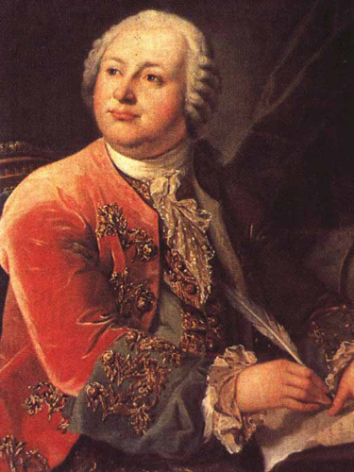
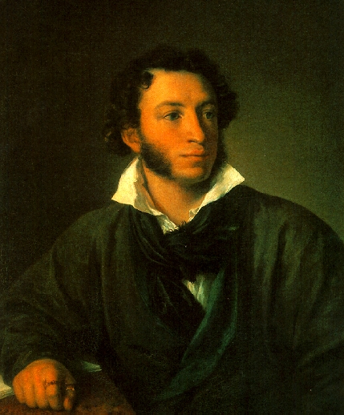
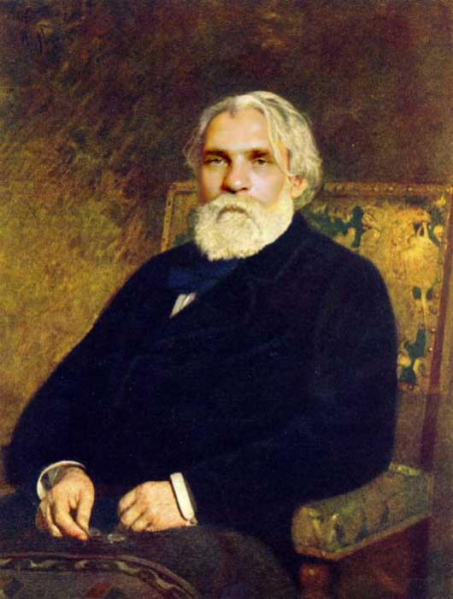
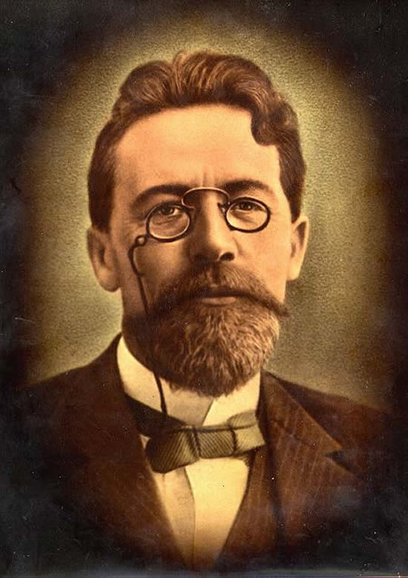
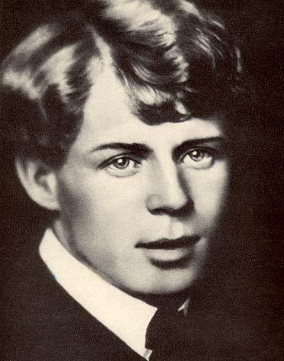
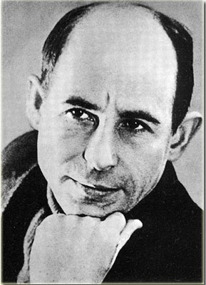

Slide 4
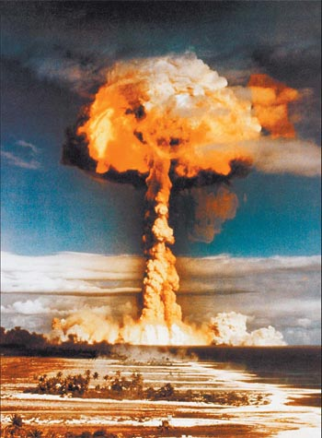
Man
and Nature

Slide 5
Knowing the world, Mankind has accumulated practical knowledge of communication with Nature. Little by little, there was a clear idea about the kinds of plants and animals, their habitats and conditions of life. These were the first steps of the creation and development of Ecology as a science.

Slide 6
We are the children of nature. So we must know and respect its laws. There is no other way; not today, in this interdependent, ever globalizing world. And interacting with Nature we must always remember Four laws of ecology written by an American ecologist Barry Commoner:
Everything is connected to everything else
Everything must go somewhere
Nature knows best
There is no such thing as a free lunch

Slide 7
Всё связано со всем — в законе отражён экологический принцип холизма (целостности), он основан на законе больших чисел
Всё должно куда-то деваться — закон говорит о необходимости замкнутого круговорота веществ и обеспечения стабильного существования биосферы.
Природа знает лучше — закон имеет двойной смысл — одновременно призыв сблизиться с природой и призыв крайне осторожно обращаться с природными системами.
Ничто не даётся даром — закон говорит о том, что каждое новое достижение неизбежно сопровождается утратой чего-то прежнего

Slide 8
M. Lermontov, one of the greatest Russian poets of the 19th century, wrote about the protection of the environment in the poem Three Palms. The poem was created in 1839. It is a short simple story that teachers us a moral lesson. His poetry is characterized by proud aloofness from existence, contempt for social being, gravitation to eternity and God. The feelings of joyful happiness and moral harmony with nature visited the poet in his wish to reach eternity.

Slide 9
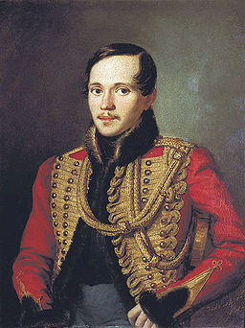
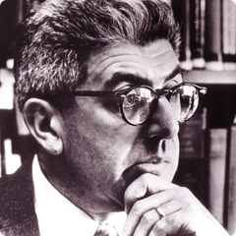

Slide 10
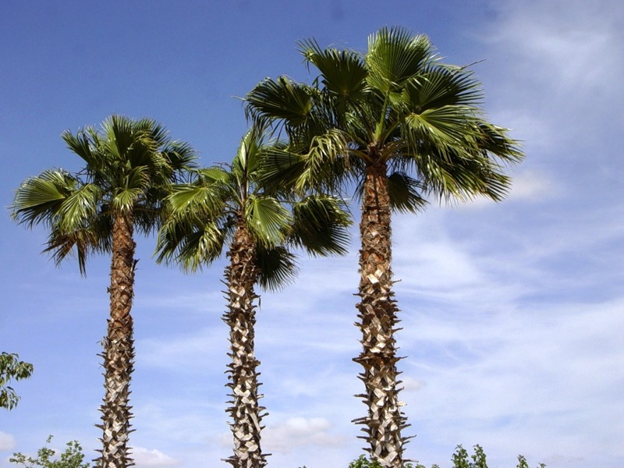
«Three Palms»

Slide 11
The main characters of the story are three palms that grow in the Arabian Desert. A cold stream flowing through the sands turned the lifeless world into a magical oasis, «хранимый, под сенью зелёных листов, от знойных лучей и песков» (sheltered under the shadow of green leaves from the burning sun and the sand dunes).

Slide 12
The action of the poem takes place in the beautiful eastern nature. «В песчаных степях аравийской земли три гордые пальмы высоко росли» (In the sandy steppes of the Arabian land three proud palm trees grew high). Unfortunately, the idyllic picture has got one defect. This perfect place isn’t available to people.

Slide 13
That’s why the proud palms ask the Creator to help them to carry out their mission: to give shelter to a lonely stranger in the gloomy desert, «И стали три пальмы на бога роптать: «На то ль мы родились, чтоб здесь увядать?» (And started three palms to ask God, «Were we born to fade here?»)

Slide 14
And the Creator gives them a chance sending a caravan of merchants who don’t like nature. They don’t care about the hopes and dreams of proud palms. Soon they will cut down the palms to light fires. «По корням упругим топор застучал, и пали без жизни питомцы столетий!» (The ax hit the elastic roots and the age-old creatures fell lifeless!) As a result, the blossoming oasis will turn into a pile of grey ash, the cold stream will dry up without the green leaves and the Arabian Desert will become a lifeless place where any man can die without fresh water and trees.

Slide 15
In the poem M. Y. Lermontov touches on the problem of the relationship between Man and Nature. He writes that people are cruel by nature and they rarely appreciate the world around them. Moreover, they want to destroy this fragile planet for the sake of their own benefit. People don’t’ even think that Nature knows how to defend itself from abusers. And this revenge is no less cruel and ruthless than the action of people who believe that the world belongs only to them.

Slide 16
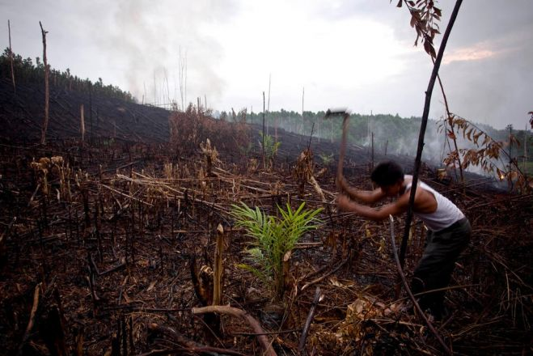
And the poem ends with an apocalyptic picture: «И ныне всё дико и пусто кругом….» (And today everything is wild and empty around…)

Slide 17
For Russian people and for Russian literature nature has always been a landscape forming an aesthetic taste, bringing up the idea of the beautiful. It has always talked about the naturalness of human existence and the origins of the universe.

Slide 18
Literature
https://en.wikipedia.org/wiki/Three_Palms
http://pishi-stihi.ru/tri-palmy-lermontov.html
https://en.wikipedia.org/wiki/Barry_Commoner

