Slide 1
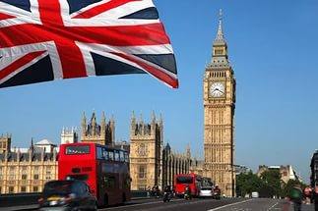
Автор: Альбас Анджелина Александровна, учитель английского языка
МБОУ СОШ №1 г.о. Подольск мк-н Климовск
Презентация к уроку по учебному предмету «Английский язык» в 5-ом классе на тему «Достопримечательности Лондона».

Slide 2
The Sights of London

Slide 3
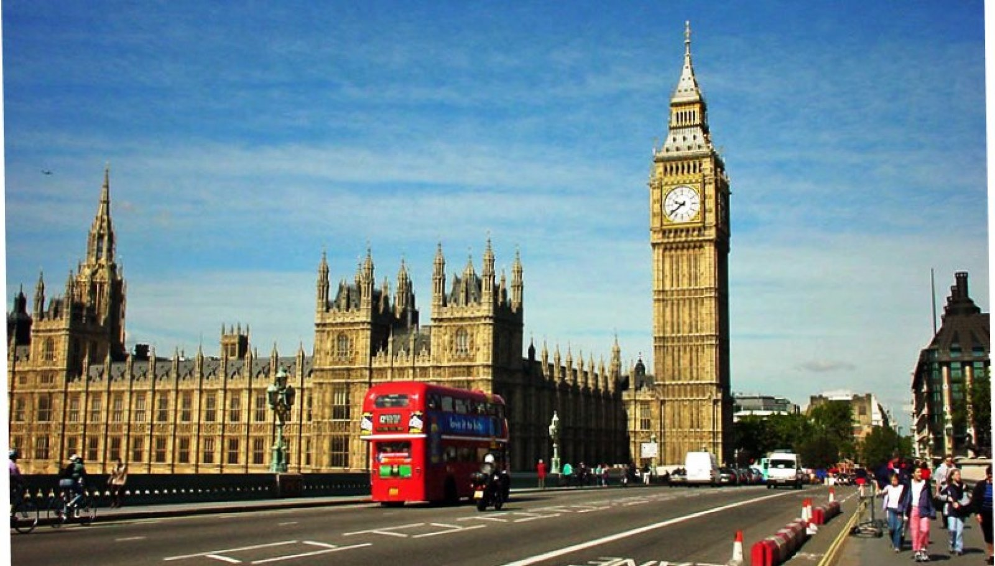
London draws people from all over the world. Some come on business, some come to study, to work or on holiday. London is one of the most beautiful and interesting cities in the world.

Slide 4
London stands on the river Thames. Crossing the river by the Tower Bridge you can see the Tower of London. It is one of the oldest buildings of the city.

Slide 5
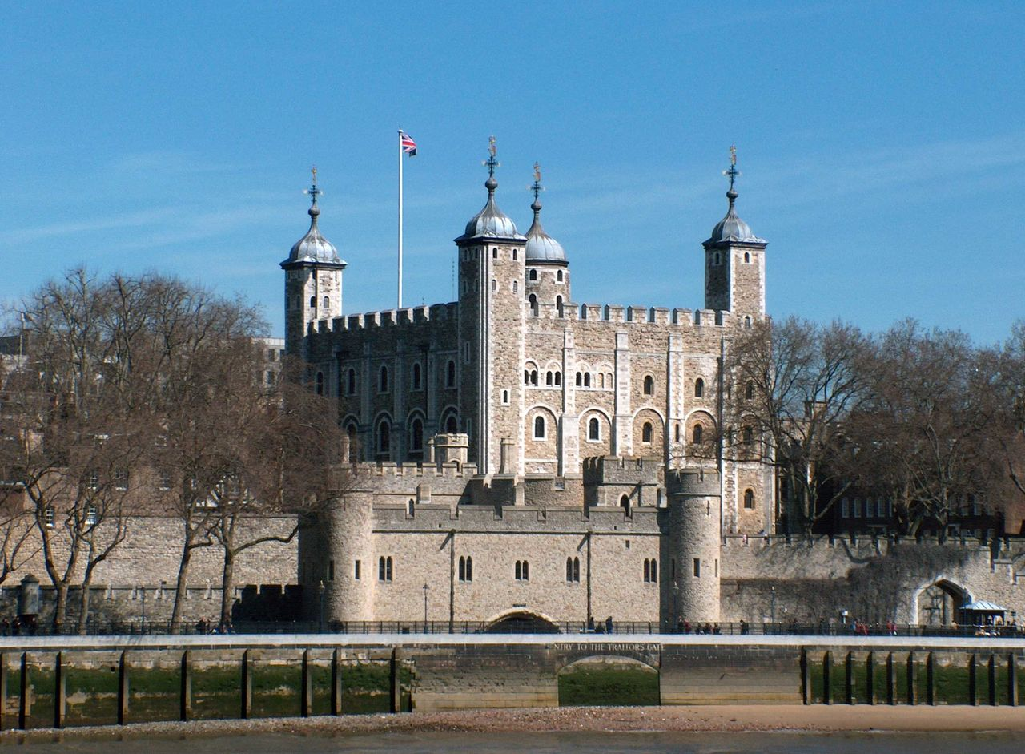
The Tower of London

Slide 6
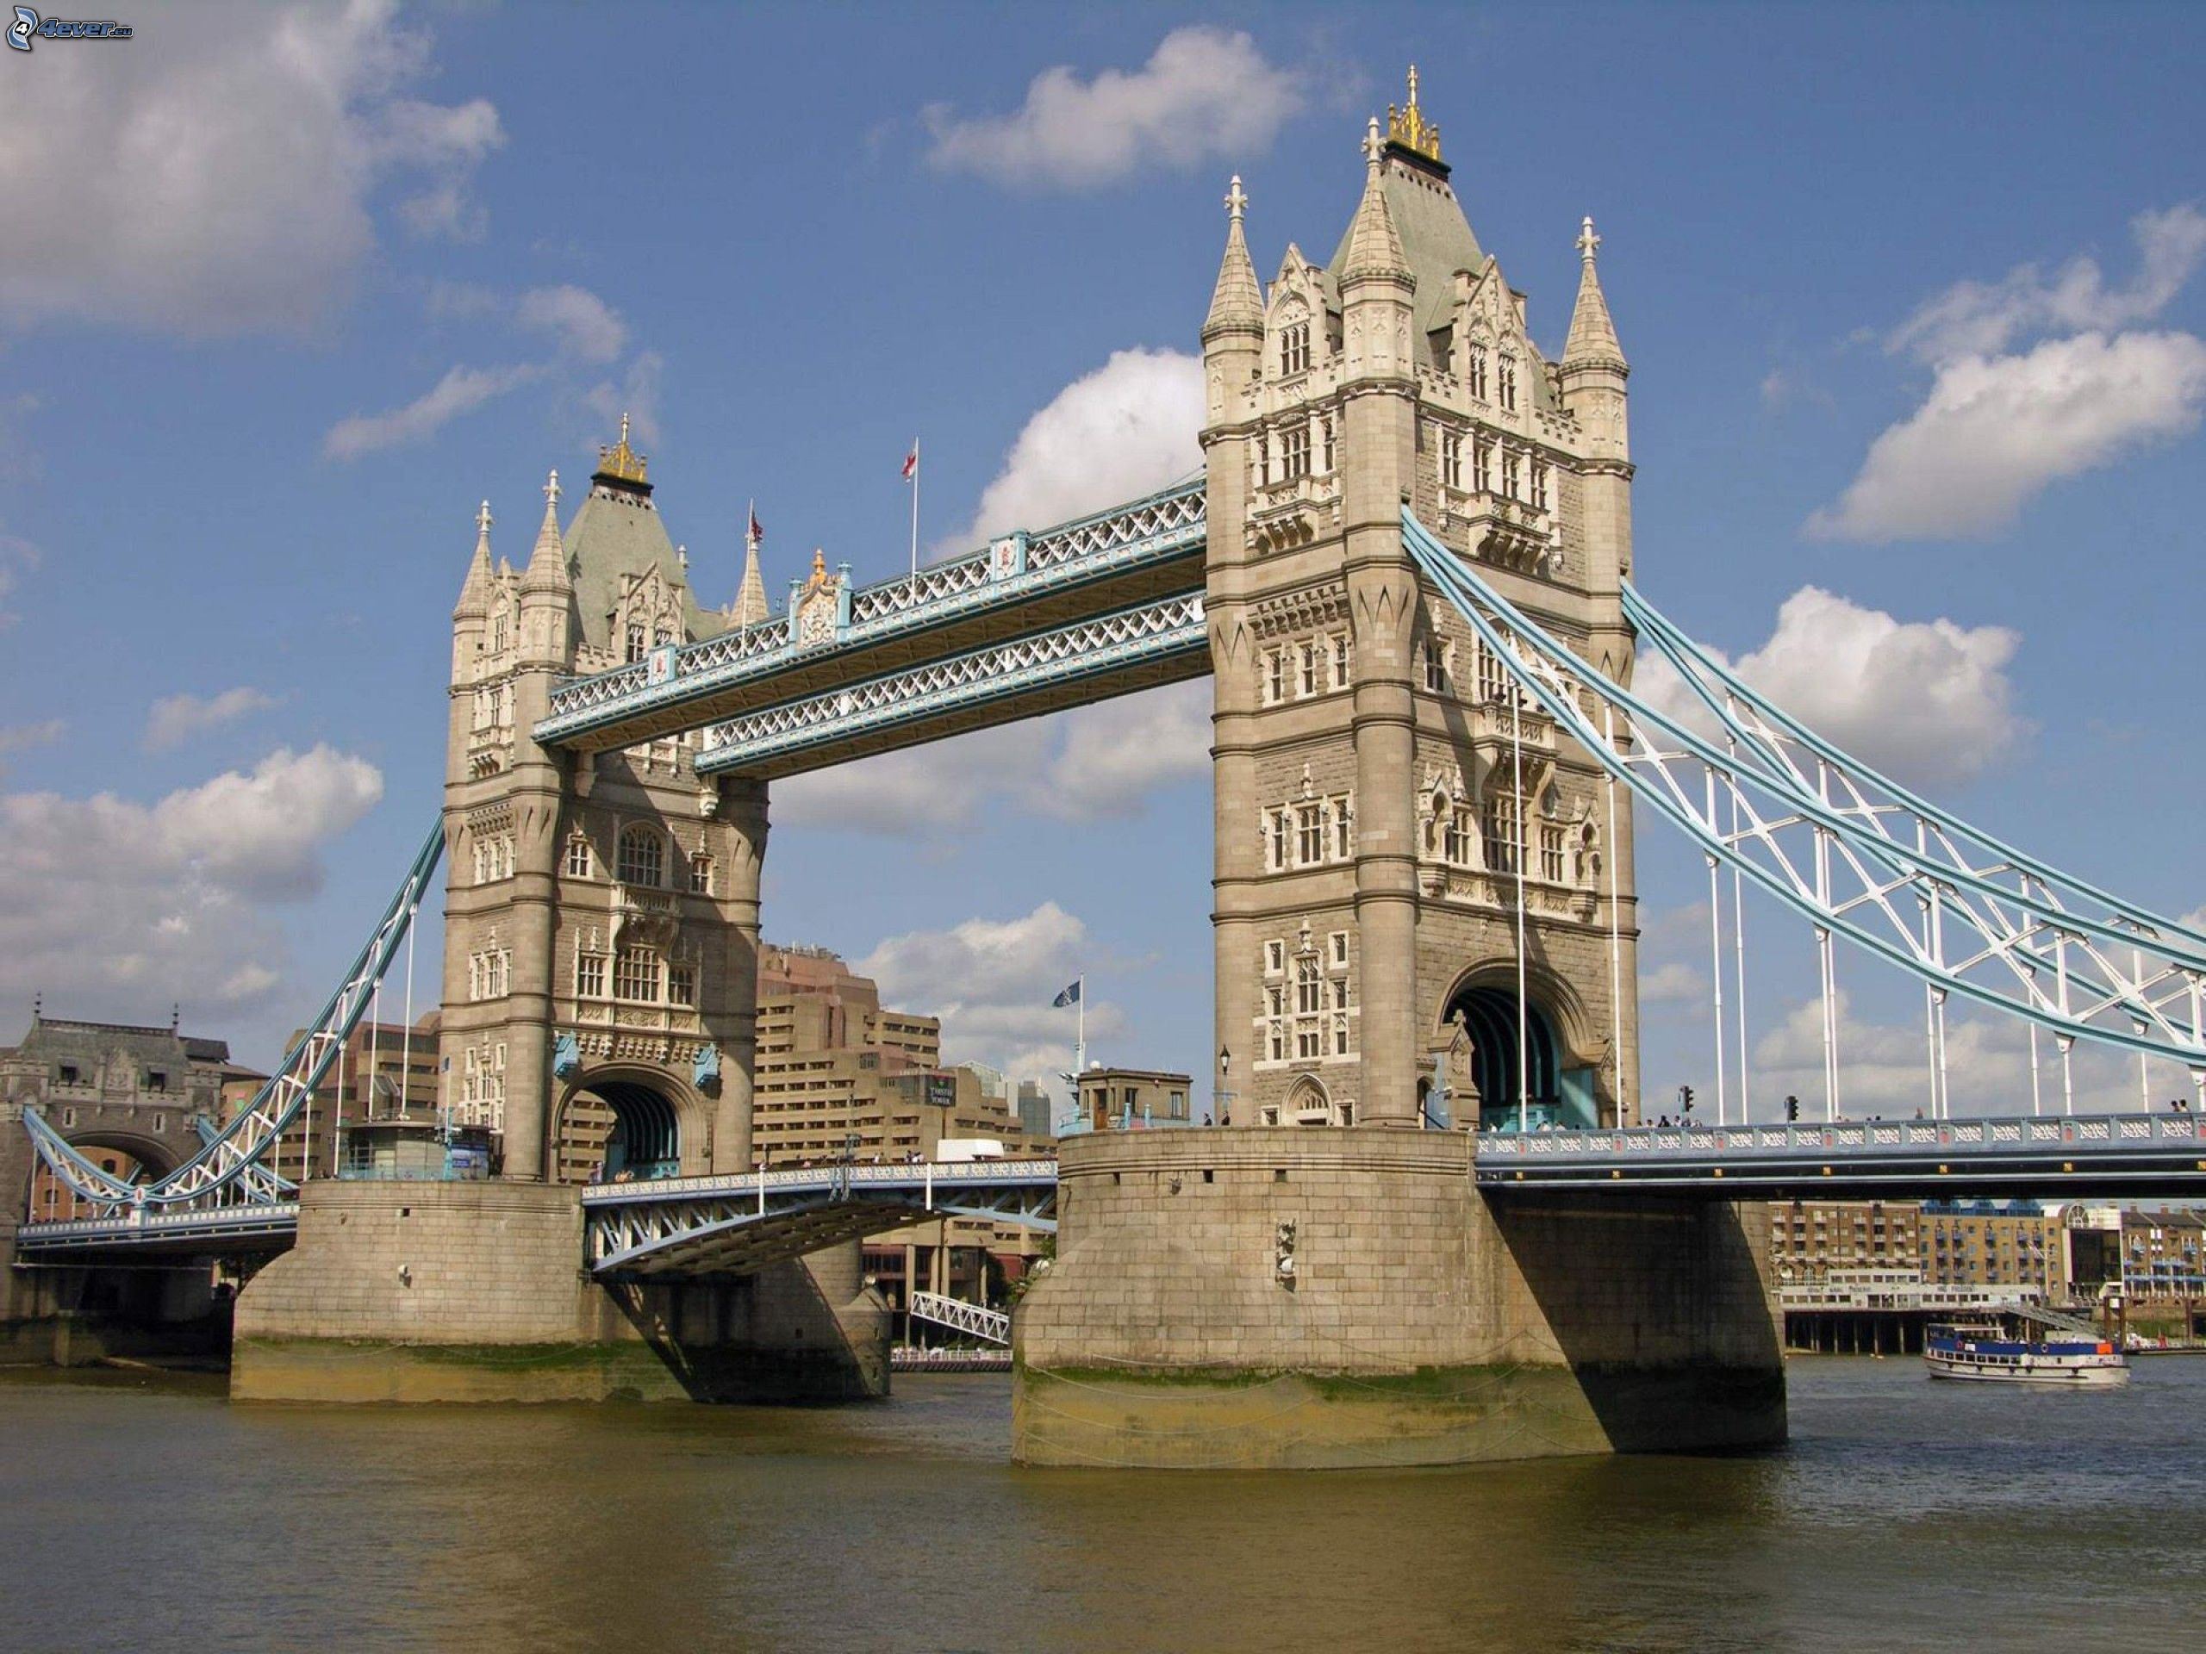
The Tower of Bridge

Slide 7
On the bank of the Thames, not far from the Tower of London, you can see Westminster Palace, or the Houses of Parliament [ˈpɑːləmənt]. It is one of the most beautiful buildings in London.

Slide 8
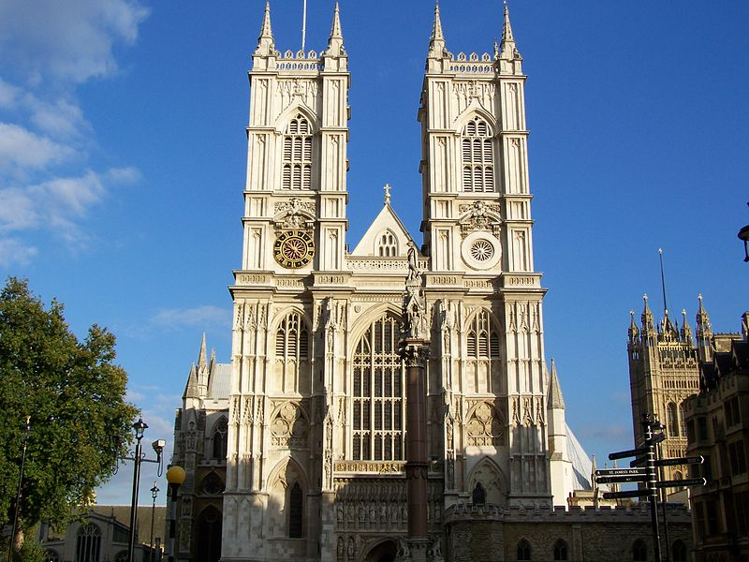
Westminster Palace

Slide 9
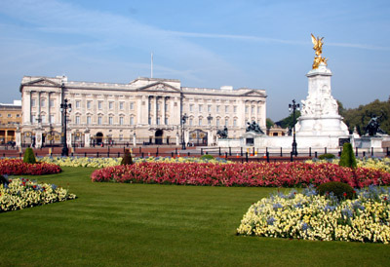
Buckingham Palace [ ͵bʌkıŋəmʹpælıs ] is the Queen’s official London residence. [əˈfɪʃəl] [ˈrezɪdəns]

Slide 10
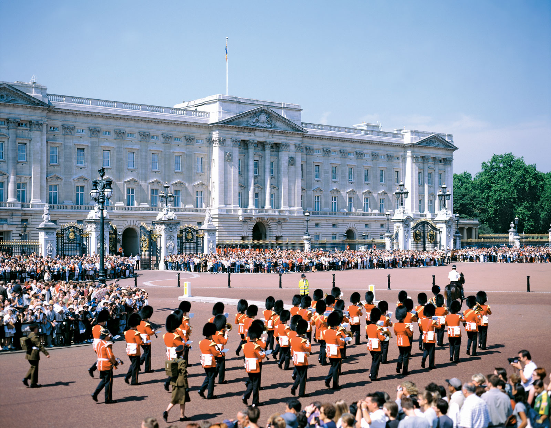
Buckingham Palace

Slide 11
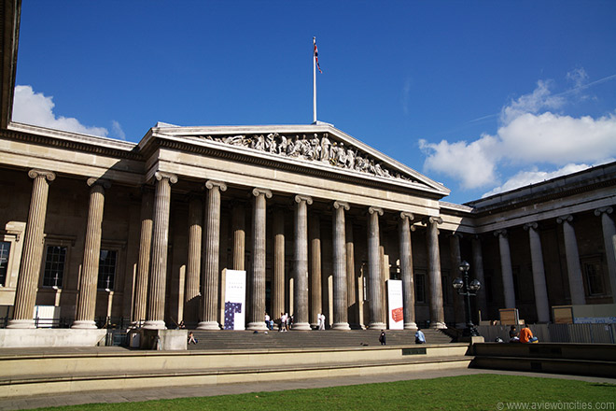
The British Museum
The British Museum is one of the most famous museums in the world with the richest collections.

Slide 12
The London Eye is the major feature [ˈfiːʧə] of London’s skyline. It consists of thirty-two capsules [ˈkæpsjuːl] each holding up twenty-five people.
capsules [ˈkæpsjuːl] –капсулы feature [ˈfiːʧə]- характеристика

Slide 13
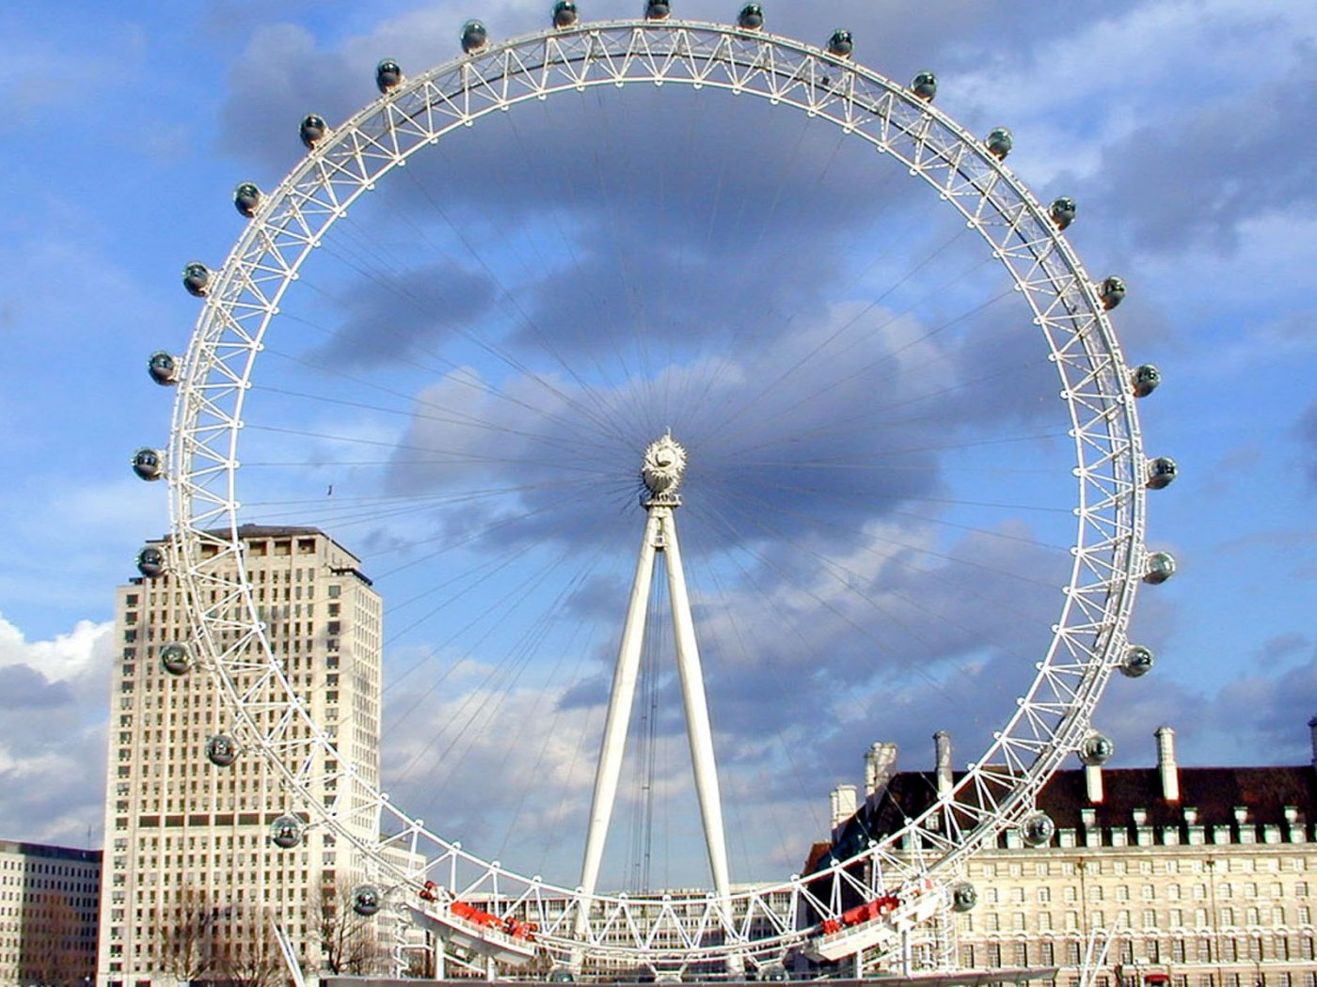
The London Eye

Slide 14
The present St. Paul's Cathedral was built between 1675 and 1710. The cathedral's immediate predecessor was destroyed in the Great Fire of London in 1666.

Slide 15
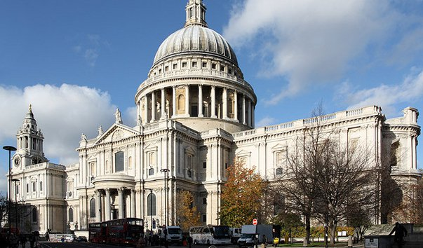
The present St. Paul's Cathedral

Slide 16
Trafalgar Square, the largest square in London, is often considered the heart [hɑːt] of the city. In the middle of the square stands a tall column [ˈkɔləm] honoring [ˈɔnə] admiral Nelson [nelsn].

Slide 17
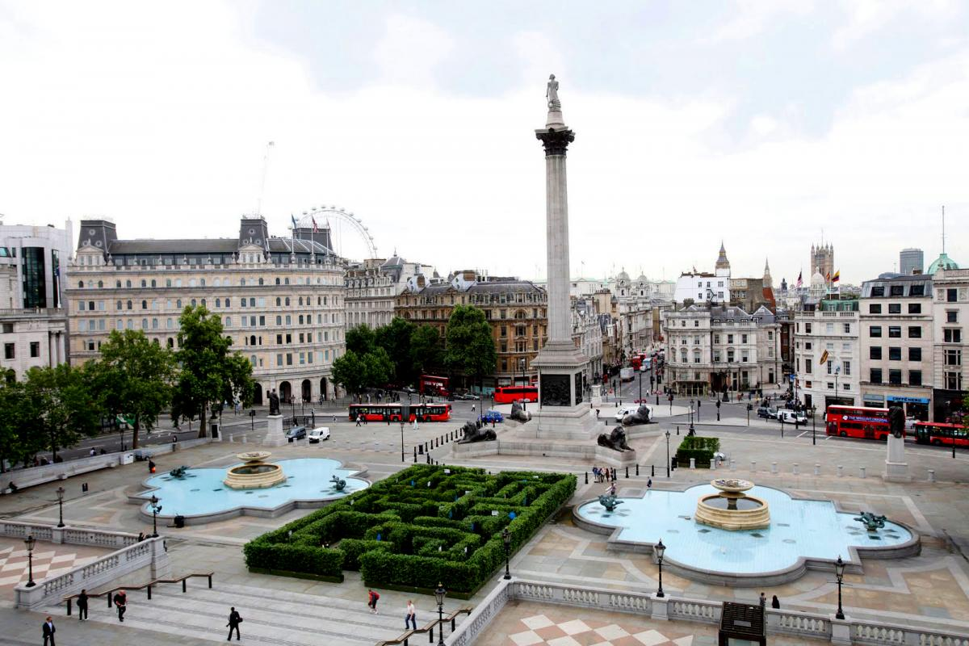
Trafalgar Square

Slide 18
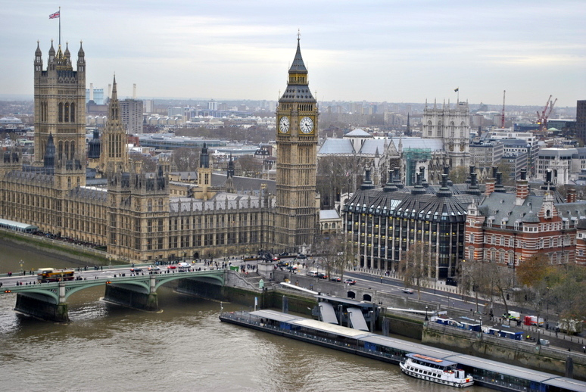
Big Ben

Slide 19
Лексический тест Match:
1) The Tower of London | a) Колонна Адмиралу Нельсону
2) Westminster Abbey | b) Лондонский мост
3) London Bridge | c) Замок Тауэр
4) Big Ben | d) Вестминстерское Аббатство
5) Nelson’s column | e) Башня Биг Бен
6) The Trafalgar Square | f) Трафальгарская площадь

Slide 20
Choose the right variant:
The Tower of London is: a) a prison b) a museum c) a shop
2) Big Ben is the name of: a) the clock tower b) the palace c) the church
3) Which bridge is in London? a) Brooklyn Bridge b) Tower Bridge c) Boston Bridge
4) The Queen lives in: a) the Tower of London b) the Houses of Parliament c) Buckingham Palace

Slide 21
Thanks for your attention!!!!!

Slide 22
https://ru.wikipedia.org/wiki/Лондон http://englishfull.ru/interesno/london.html https://yandex.ru/images/search http://www.ayda.ru/england/london/places/ http://www.russianlondon.com/aboutlondon/londonattractions.html
Используемые источники

