Slide 1

«Презентация к уроку по учебному предмету
«Английский язык» во 2-ом классе на тему
«Я ЛЮБЛЮ ПИЦЦУ».
Котлубовская Ольга Константиновна,
Учитель МАОУ «Средняя общеобразовательная школа № 36»
г. Кемерово

Slide 2


Slide 3
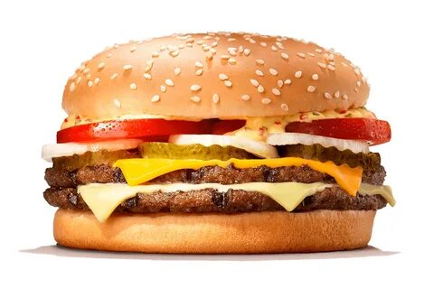
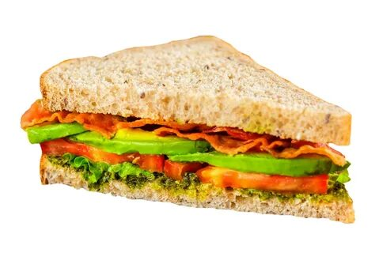
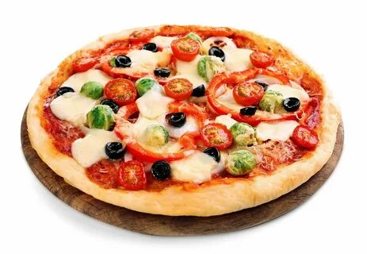
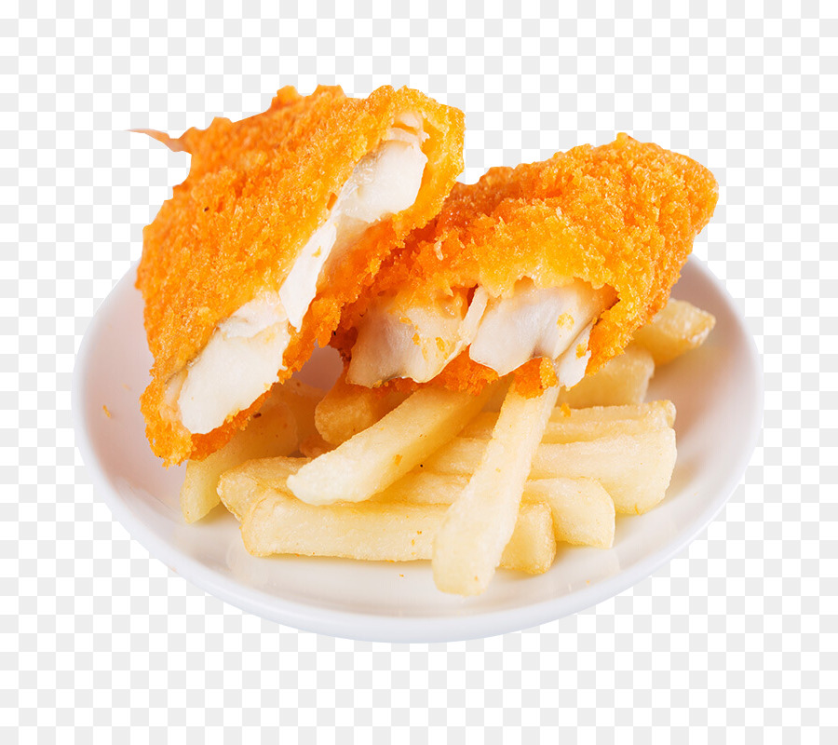
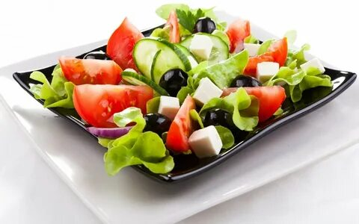
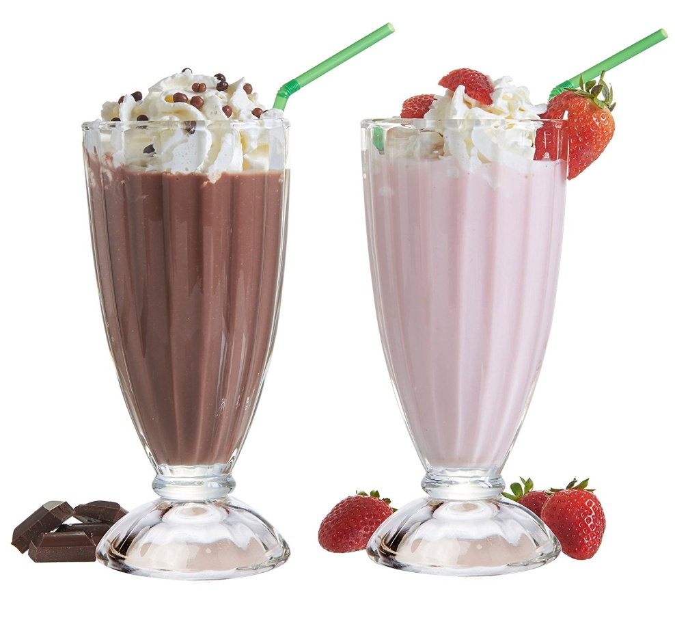
New words (новые слова)
fish and chips
milk shake
pizza
salad
sandwich
burger

Slide 4
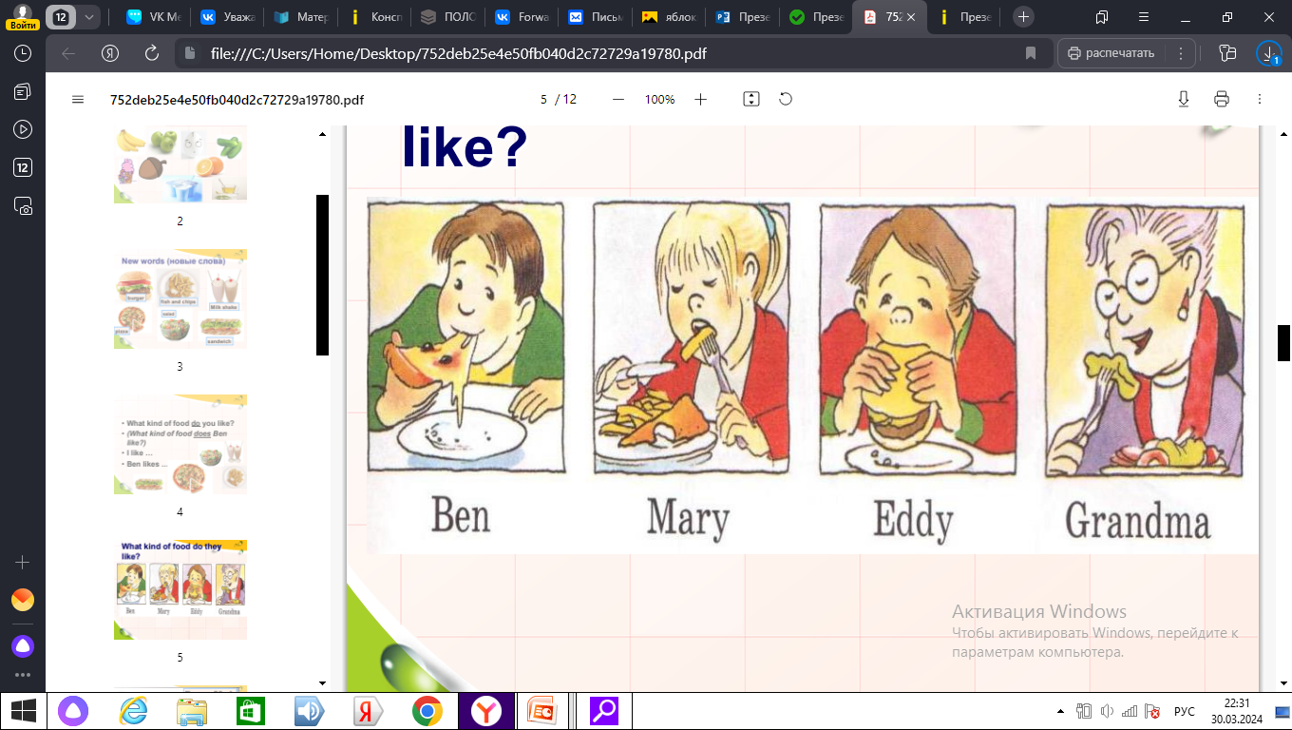
What do they like?
likes …
likes …
likes …
likes …

Slide 5
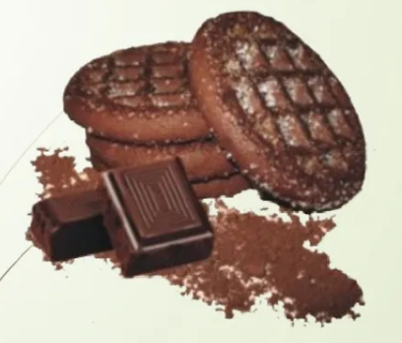

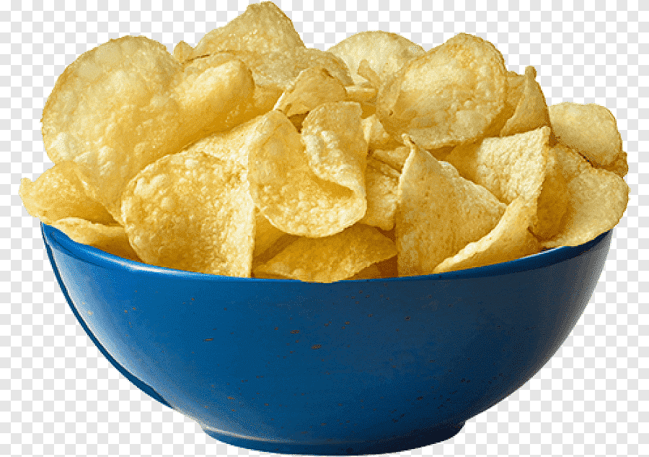

sausages
New words (новые слова)
chocolate
biscuits
cheese
chips

Slide 6
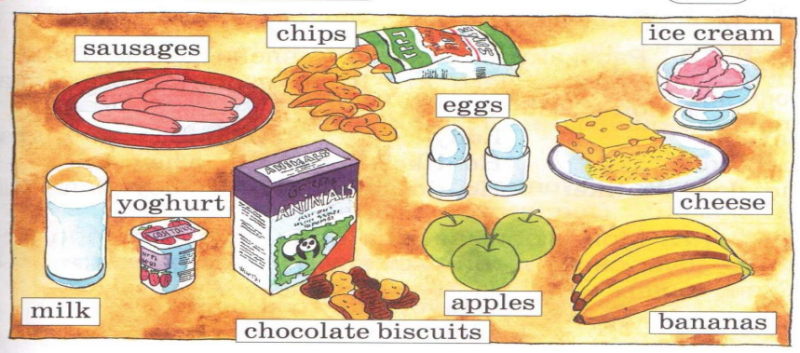
What do you like?

Slide 7

ГОВОРИ ПРАВИЛЬНО:
I like
She likes
He likes
They like
I don’t like
She doesn’t like
He doesn’t like
They don’t like

Slide 8

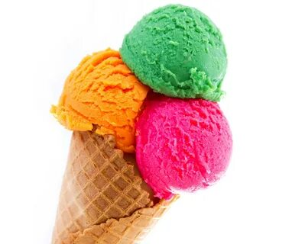
like
don’t like

Slide 9

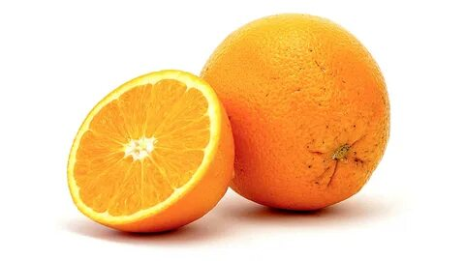

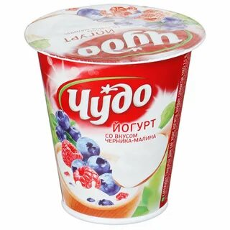
He doesn’t like
He likes
Tom

Slide 10


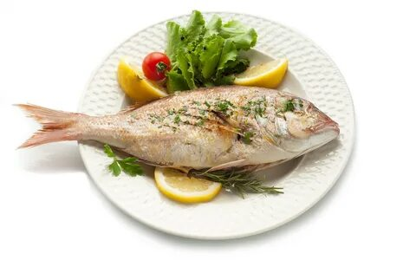
She doesn’t like
She likes
Vera

Slide 11

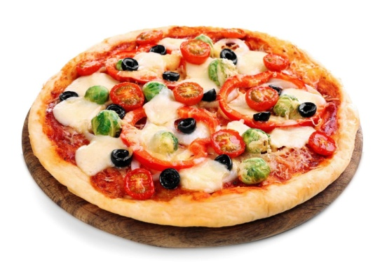
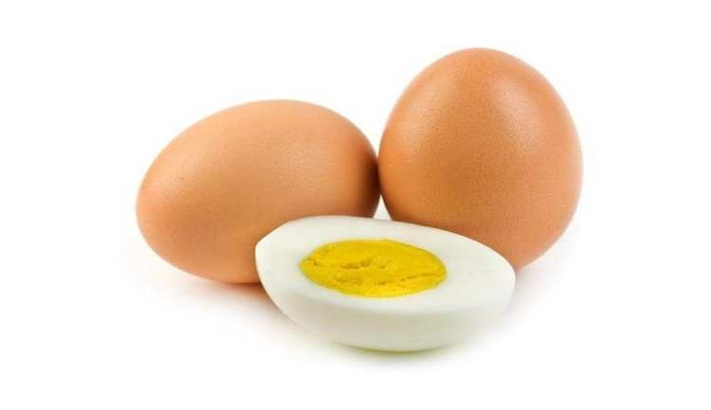
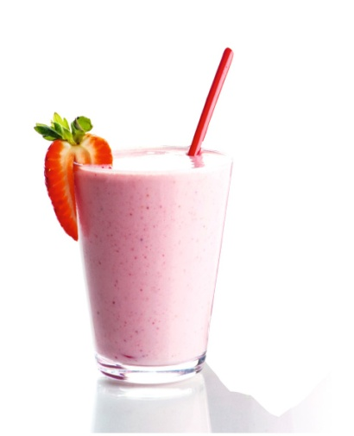
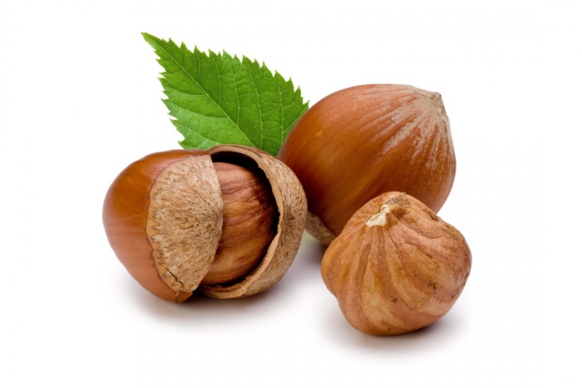
They like
They don’t like
Ann and Eddy

Slide 12



-
+
Mary

Slide 13
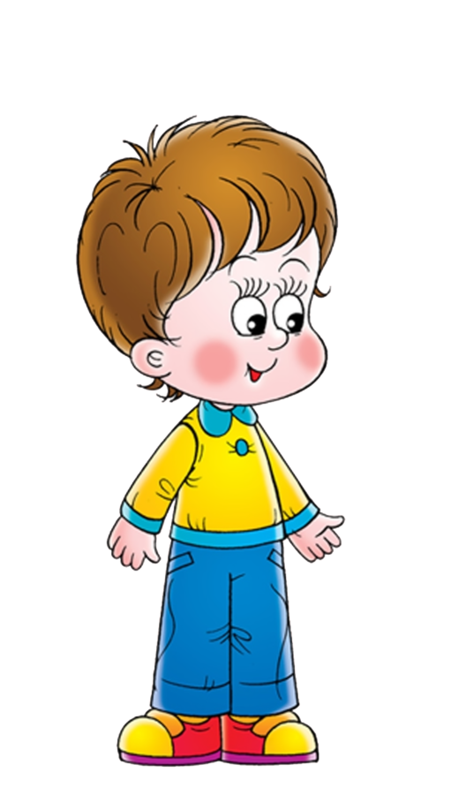

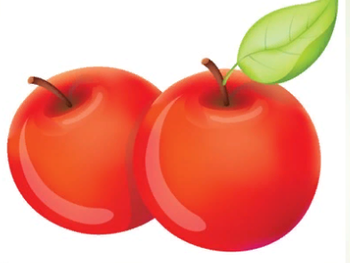
-
+
Ben

Slide 14


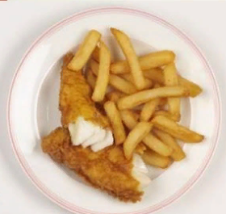
-
+
They

Slide 15

fish and chips
My favourite food is…
salad
sausages
milk shake
chocolate
biscuits
pizza
cheese
burger
sandwiches
chips

Slide 16

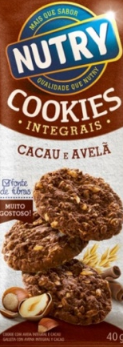
Thank you

Slide 17
Источник:
https://images.squarespace-cdn.com/content/59c126ac7131a5c1d568e4c4/1506166510699-6X1M9J2NYV9CW2NQVD9W/image-asset.jpeg?format=1500w&content-type=image%2Fjpeg
https://gas-kvas.com/grafic/uploads/posts/2023-09/1695925236_gas-kvas-com-p-kartinki-burger-3.png
https://catherineasquithgallery.com/uploads/posts/2021-03/1614587703_43-p-malchik-na-belom-fone-kartinka-54.png
https://catherineasquithgallery.com/uploads/posts/2021-03/1614565645_62-p-kartinka-devochki-na-belom-fone-70.png
https://e7.pngegg.com/pngimages/978/519/png-clipart-potato-chips-potato-chips.png
https://gas-kvas.com/grafic/uploads/posts/2024-01/gas-kvas-com-p-sir-multyashnii-na-prozrachnom-fone-2.png
https://kartinki.pics/uploads/posts/2022-02/1644902342_66-kartinkin-net-p-kartinki-devochki-77.png
https://flomaster.top/uploads/posts/2022-12/1672252693_flomaster-club-p-malchik-risunok-dlya-detei-vkontakte-3.png
https://avatars.mds.yandex.net/i?id=ef4a162061b1408a3f360a2fb3149f50-4118910-images-thumbs&n=13
https://img.freepik.com/premium-vector/cute-girl-and-boy-standing_1308-31300.jpg?w=2000
https://gas-kvas.com/uploads/posts/2023-02/1676722906_gas-kvas-com-p-smekh-detskii-risunok-33.png
https://svetoforbel.by/image/catalog/belarus_oblast/Tovary_Svetofor_rb.png

