Slide 1

Презентация к уроку по учебному предмету «Английский язык» в 4-ом классе на тему «Настоящее продолженное время»
Батенева Елена Сергеевна
учитель английского языка
МБОУ ЭКЛ

Slide 2
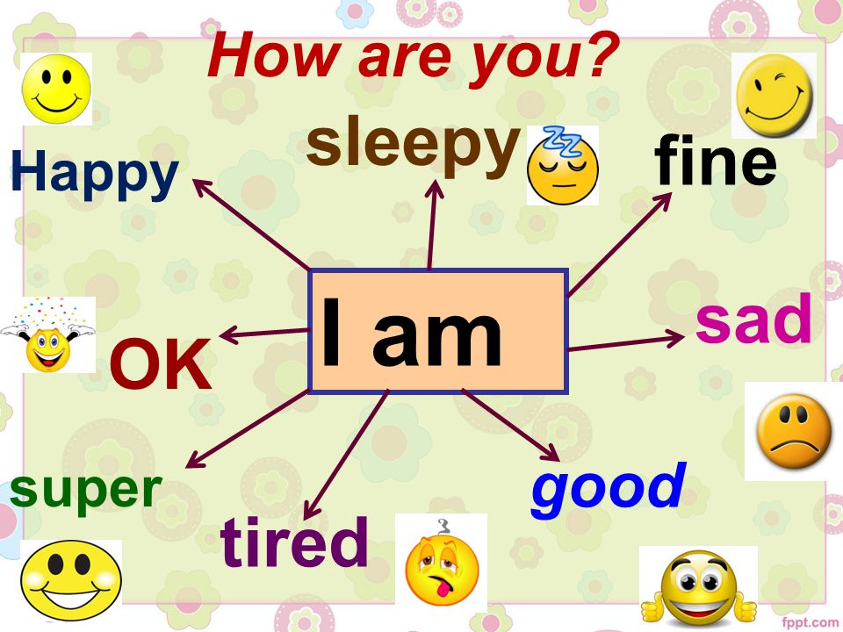

Slide 3
Фонетическая зарядка
I am counting to ten,
You are giving them a pen,
She is looking at the door,
He is sitting on the floor,
All of us are working well,
Waiting, waiting for the bell.

Slide 4
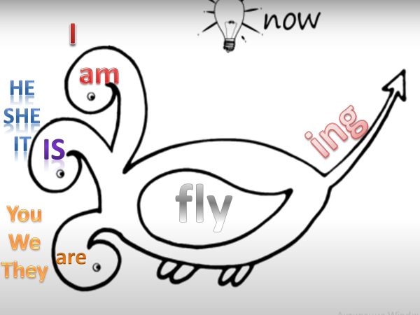
Present Continuous

Slide 5

Present Continuous
1. We use the present continuous tense to describe an action that is happening now.
You are listening to me now.
2. We form the present continuous tense by adding –ing to the main verb after appropriate form of verb to be
He is playing football at the moment.

Slide 6
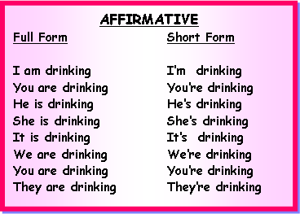
Утвердительные предложения

Slide 7
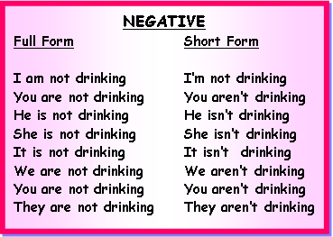

Отрицательные предложения

Slide 8
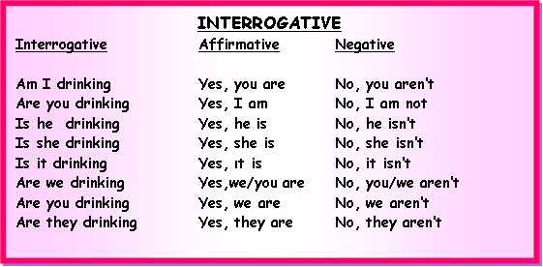

Вопросительные предложения

Slide 9
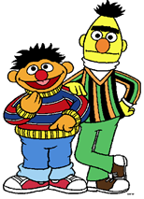
Present Continuous (Spelling)
1. We usually add –ing to the verb.
do - doing read - reading fly – flying eat - eating
2. If the verb ends with an -e we take away the -e and adding –ing
have - having ride - riding write - writing
3. If the verb has a short vowel and one consonant, we double the consonant and add -ing
sit - sitting run – running swim - swimming

Slide 10
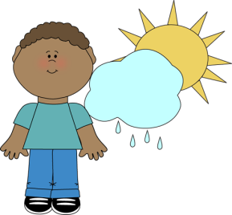
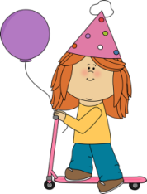
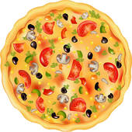


am is are
1) I …. speaking English now.
2) She … riding her scooter.
3) They … eating now.
4) My brother… listening to music.
5) The boys … running in the park.

Slide 11


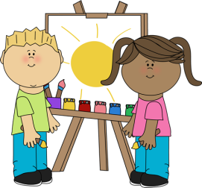
What’s happening? am/am not , is/isn’t, are/aren’t
I ____ watering the plant. I___ sleeping.
The girl ___talking on the phone, she ___ drinking milk.
They ___ playing a game, they ___
painting a picture.

Slide 12


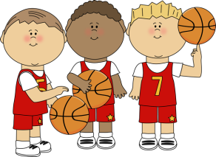
Make up questions
1. now / Mary / tea / is / drinking?
2. swimming / now / the / boy / is?
3. the / playing / basketball / boys/ are?

Slide 13
Boardgame
Rules:
Throw the dice, look at the picture and make a sentence using the present continuous.
Continue until someone reaches the finish.

Slide 14

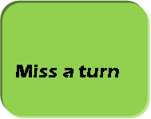






















1
Start
Finish

