Slide 1

The 26 th of April, 2021
What are you going to be?

Slide 2
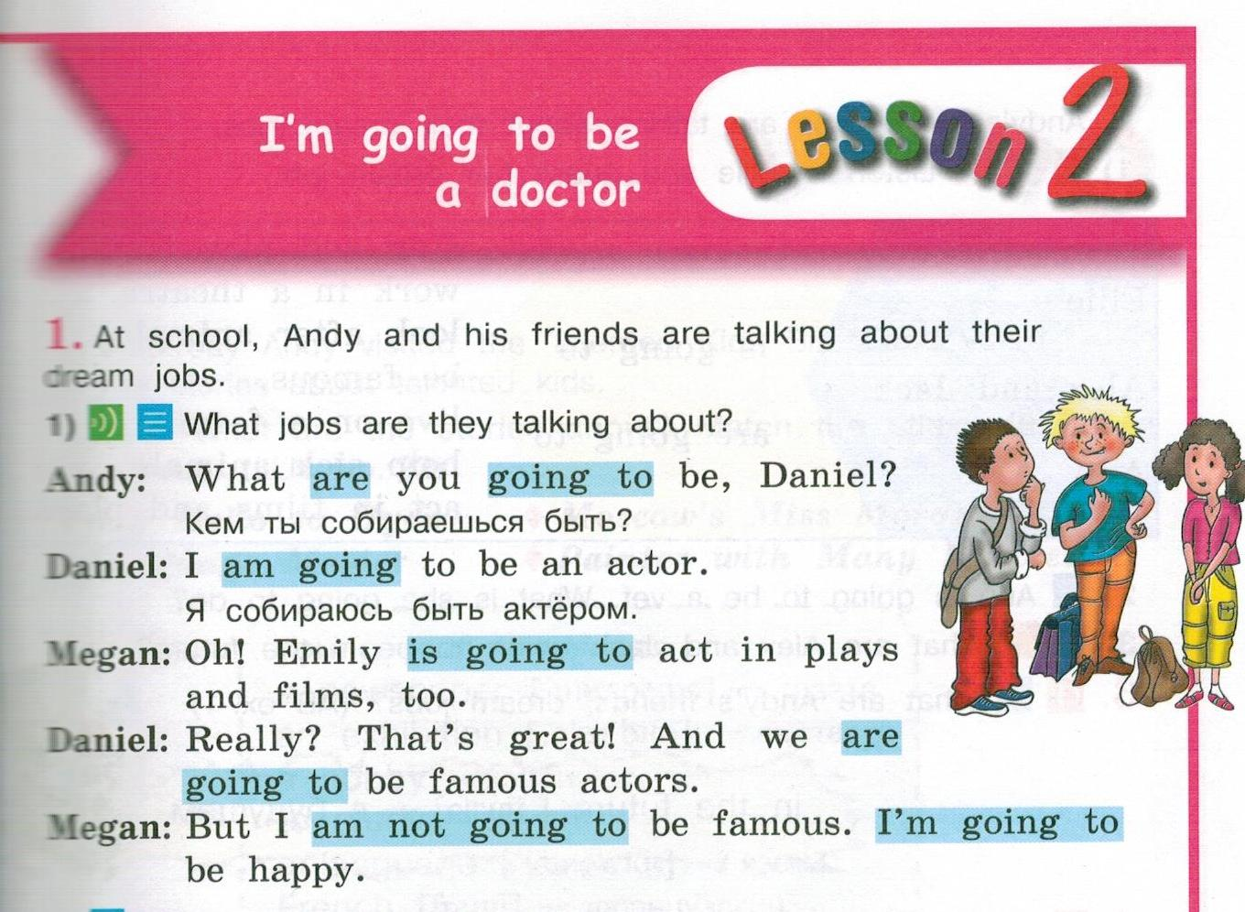

Slide 3
Как рассказать о намерениях?
to be going to – собираться что-либо сделать
I a teacher.
teach English?
Yes, I No, I
I’ going to teach English.
What teach?
am going to be
Are you going to
am.
am not.
m not
are you going to

Slide 4
Составьте предложения
My sister We My friend I My brother They Ivan and Olga She He | am going to be is going to be are going to be | a model. famous actors. a pilot. a vet. a writer. reporters. doctors. a teacher. a police officer.

Slide 5
Заполните пропуски правильной формой оборота «to be going to»
1) He … help sick people.
2) I … make reports.
3) Mike and Helen … act in plays and films.
4) My friends … teach English.
5) We … be doctors.
6) Mary … look after animals.
7) Peter … work in a hospital.
8) They … write books.
9) Andy … fly a plane.
10) She … wear a uniform.

Slide 6


ЗАГАДКА
1. Какой ты?
2. Где ты собираешься работать?
3. Что ты собираешься делать?
4. «Кем я собираюсь быть?»
1. I am kind and helpful.
2. I am going to work in a hospital.
3. I am going to help sick people.
4. What am I going to be?
(A doctor)

