Slide 1
Презентация к уроку
по учебному предмету «Английский язык»
в 3 – ом классе
по теме «Театр Дурова».
Автор Тонни Марина Александровна
Учитель английского языка
ГБОУ лицей №144 Калининского района
Санкт-Петербурга

Slide 2
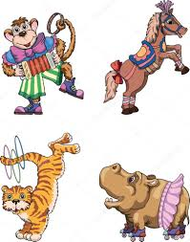
What can the animals do?

Slide 3
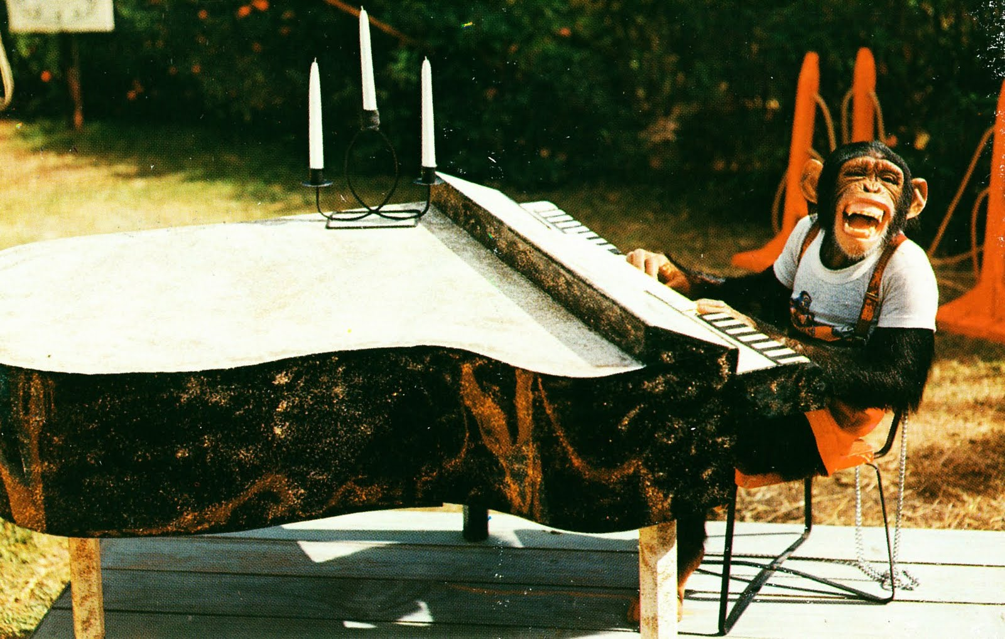
chimp/play the piano

Slide 4
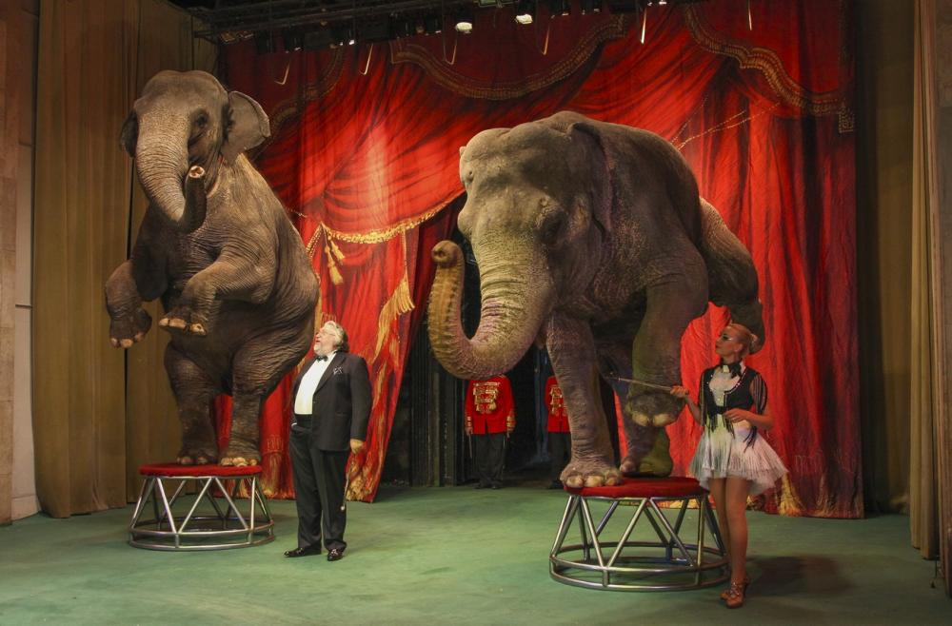
elephants/ stand on two legs

Slide 5
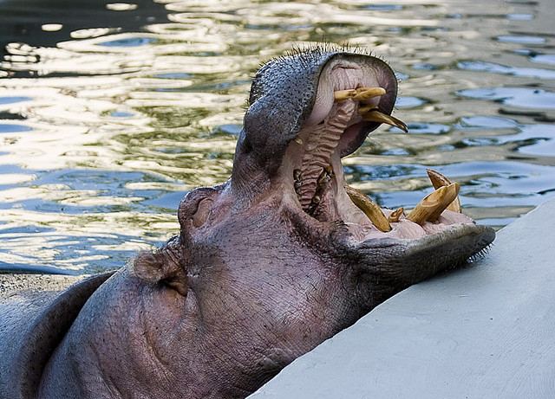
hippo/sing

Slide 6
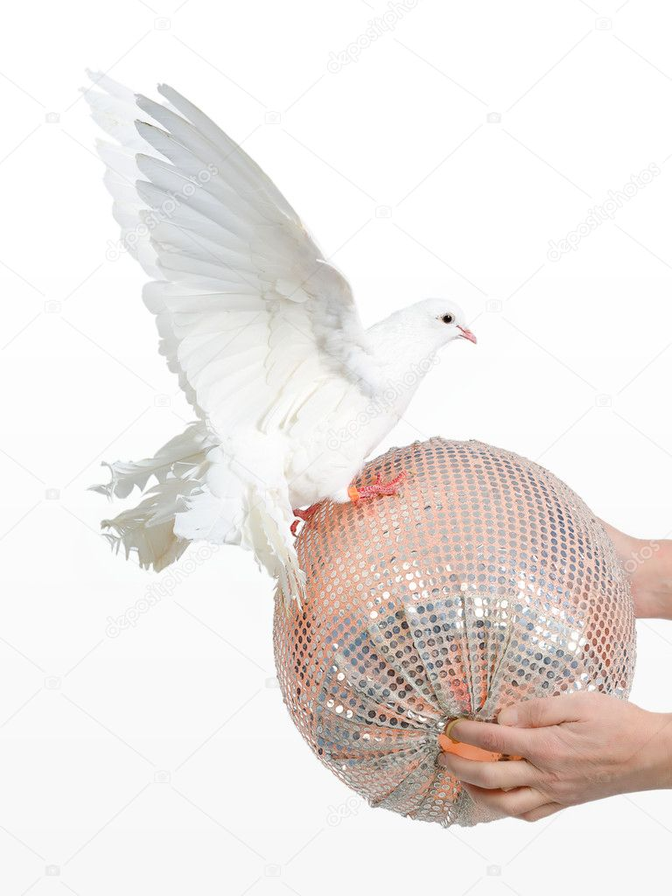
pigeon/walk on the ball

Slide 7
Where can they do these tricks?
zoo/circus/animal theatre

Slide 8
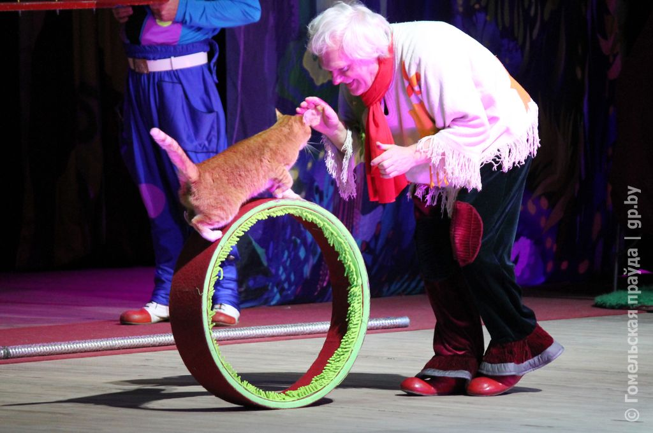
Kuklachev`s Theatre

Slide 9
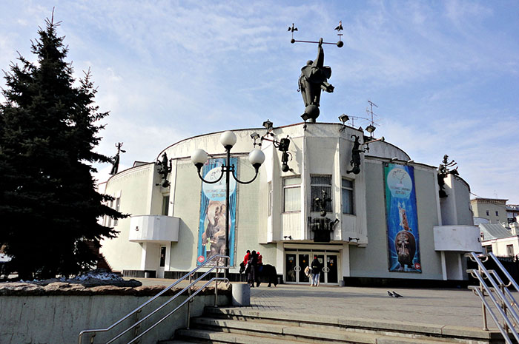
Durov`s Theatre

Slide 10
True or False.
1.Durov`s Theatre is in Moscow. 2.Animals are the actors here.
3.People can do different tricks.
4.Birds, bears, elephants and chimps can do different tricks.
5.Children don`t like visiting this theatre.

Slide 11
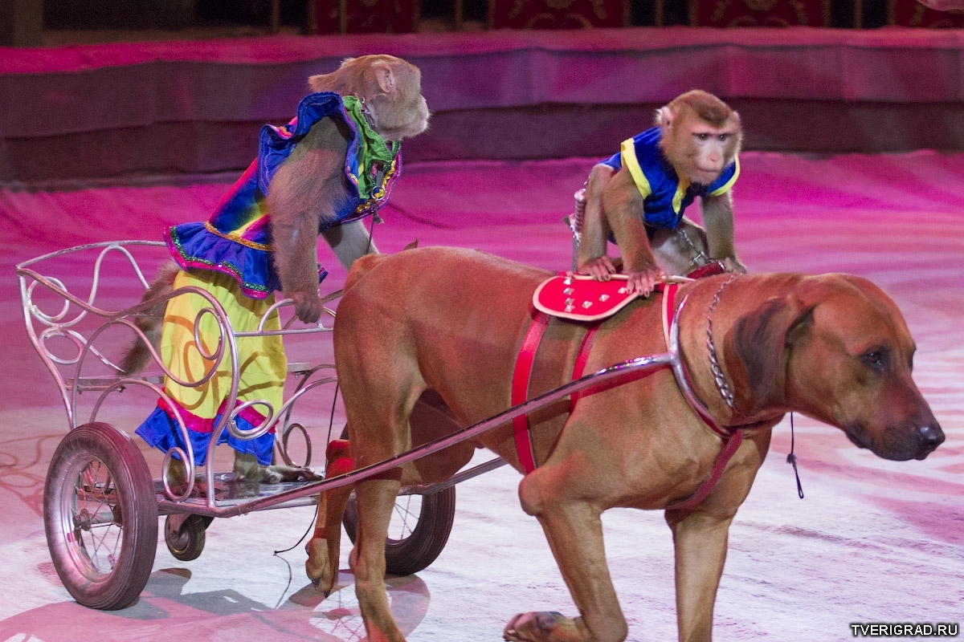

Slide 12
Home task.
St.b.p.146-
read and translate.
Ex.2-answer the questions
in your notebooks.

Slide 13

I`m happy / sad.
I`m happy / sad.

Slide 14

Thank you!

