Slide 1



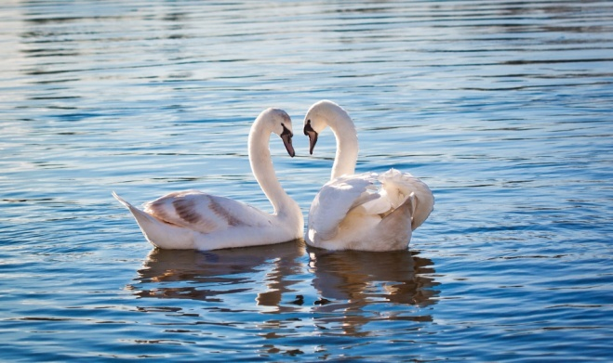
What idea combines these pictures?

Slide 2


Slide 3
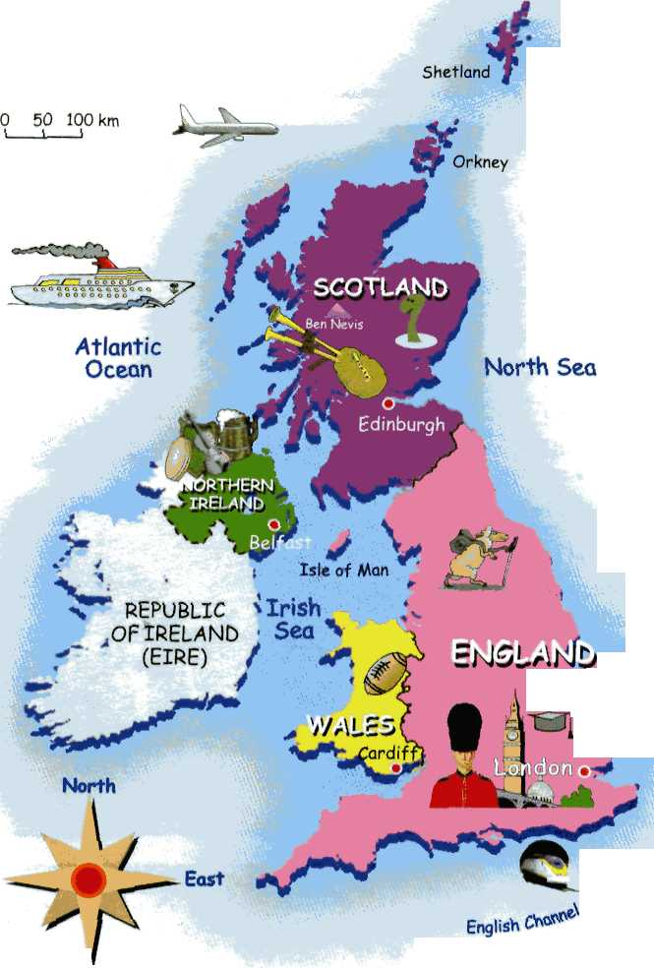
In the UK people celebrate the day of Love on 14th , February.

Slide 4
St. Valentine’s Day

Slide 5
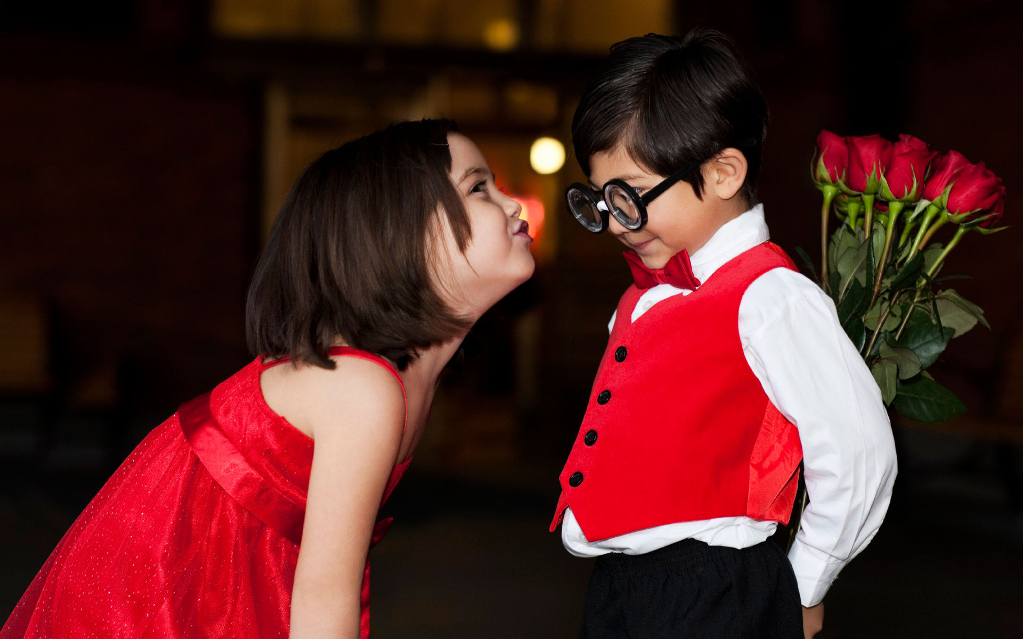
St Valentine's Day is celebrated on February 14th

Slide 6

Valentine’s Day it`s time when people in love express their feelings to those whom they love or adore

Slide 7

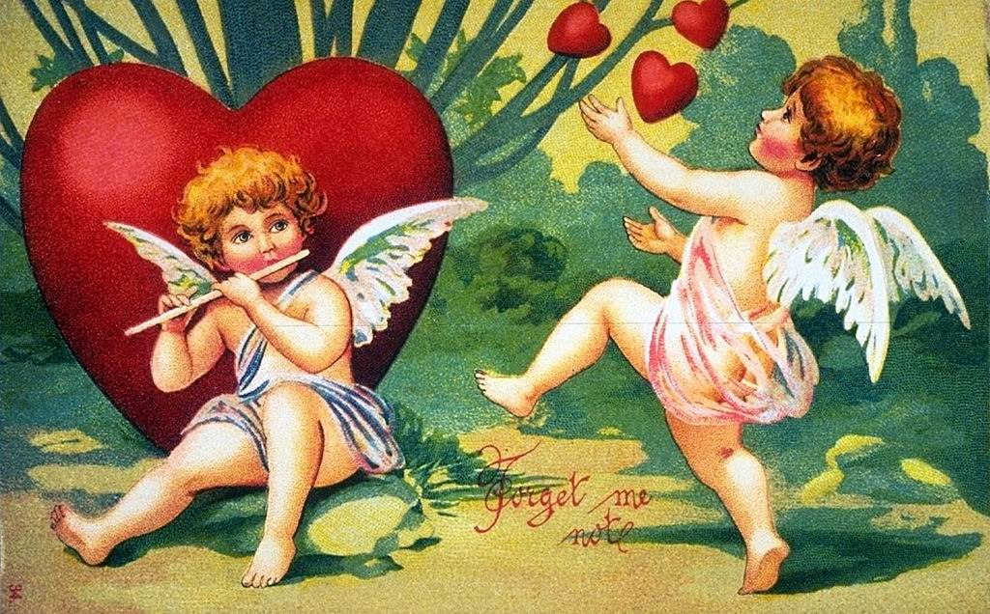
The origin of this day is not clear!

Slide 8
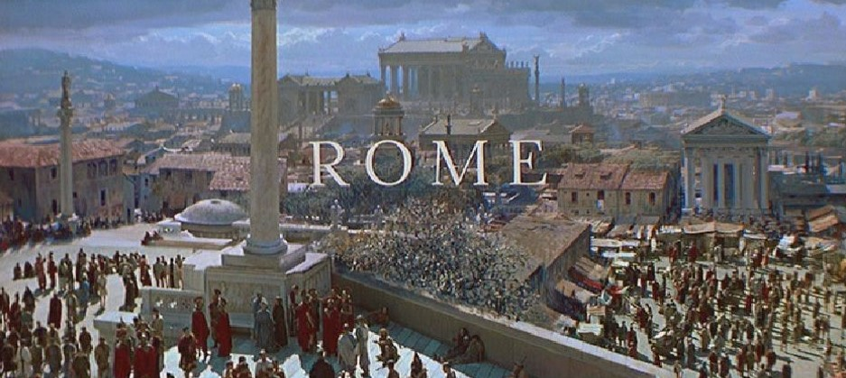
Some people believe that it stems from the story of St. Valentine, a Roman priest

Slide 9
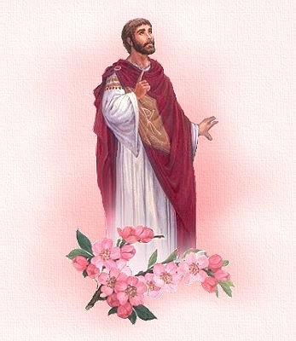
According to one legend, Valentine served as a priest during the third century in Rome.

Slide 10

When Emperor Claudius II decided that single men made better soldiers than those with wives and families.

Slide 11
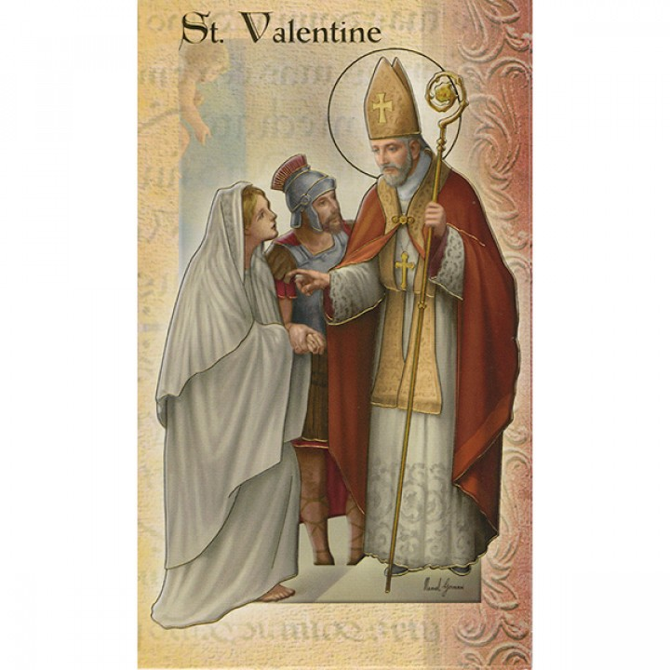
Valentine broke the order of Emperor Claudius II and secretly married young couples

Slide 12
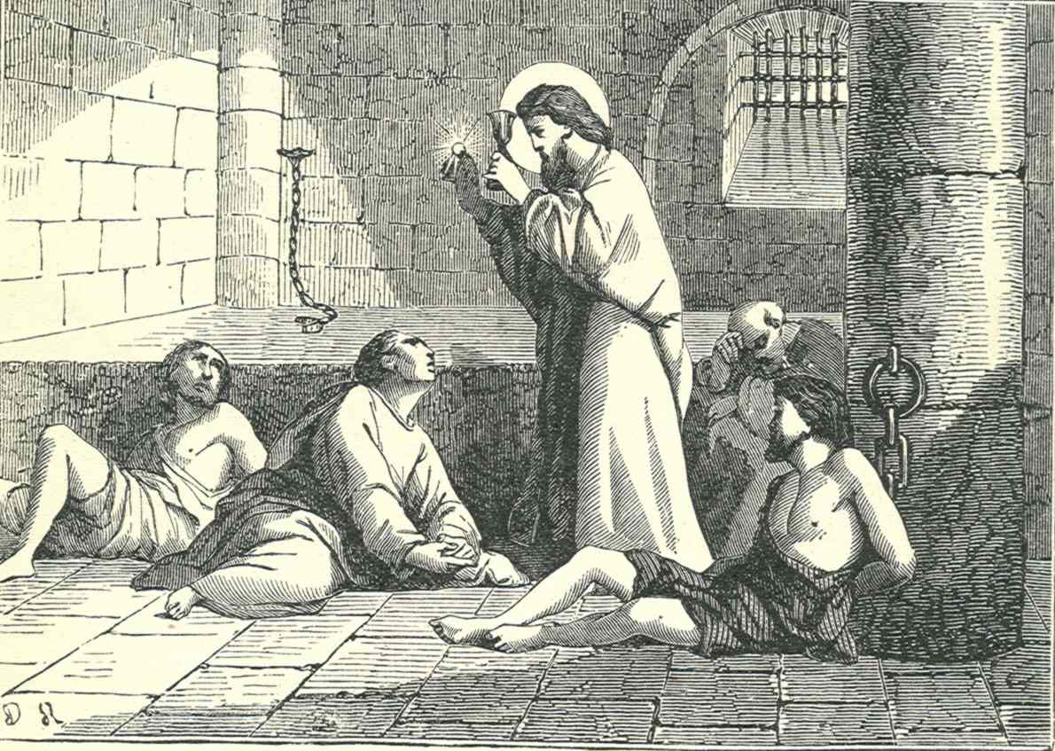
When Valentine’s actions were discovered, he was sentenced to death.

Slide 13
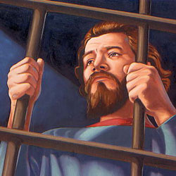
In prison he fell in love with his jailer’s daughter who visited him secretly

Slide 14

Just before his death, he wrote her a letter, which he signed “From Your Valentine”.

Slide 15
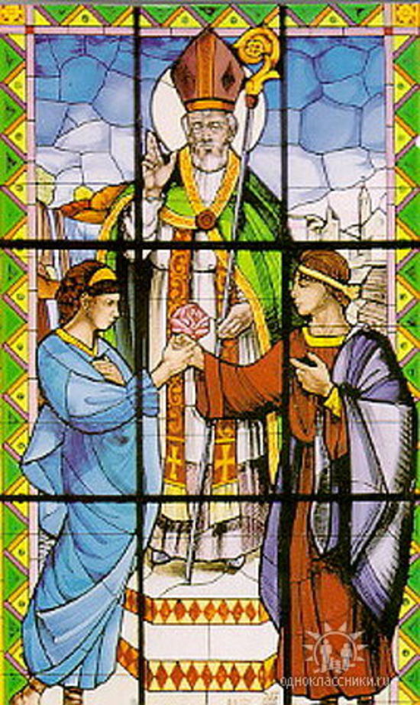
Today, St. Valentine is the Patron Saint of love, young people, happy marriages and the holiday was named after him.

Slide 16
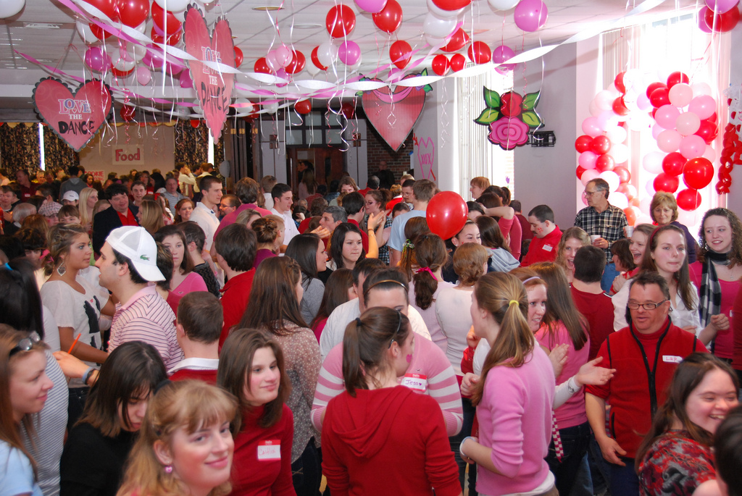
St. Valentine’s Day is a good day for parties.

Slide 17
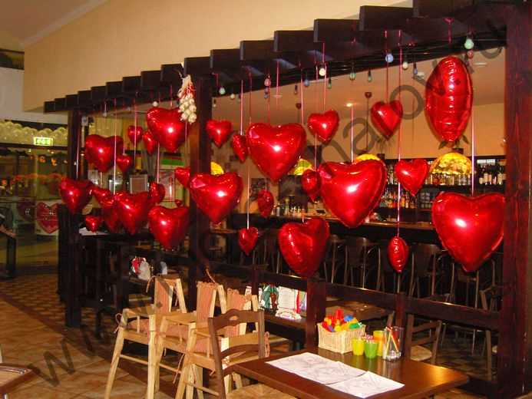
The restaurants and clubs are decorated with red and pink paper hearts

Slide 18
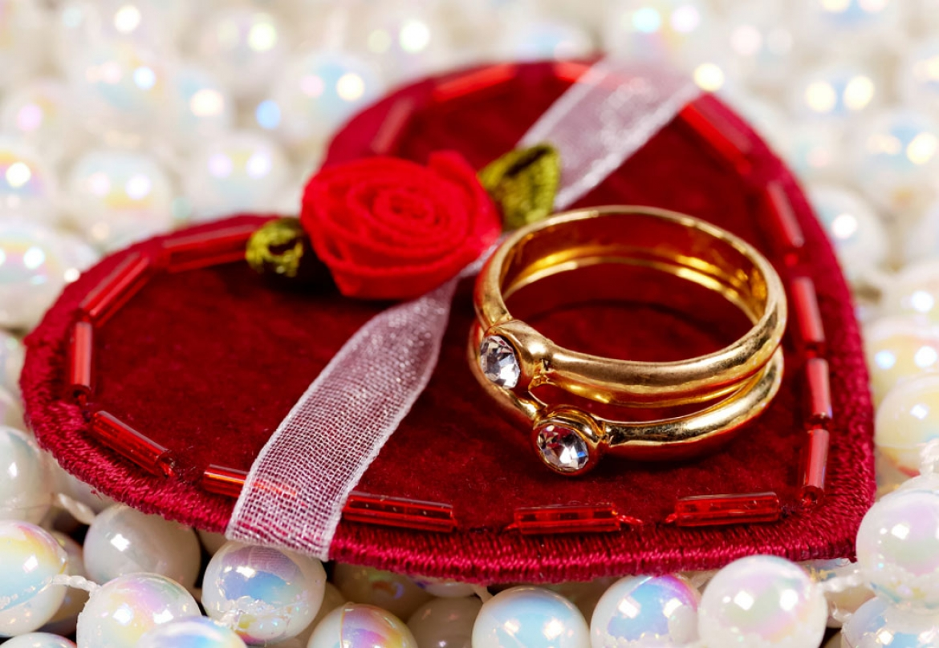
Some people give greeting cards, flowers, chocolates or even propose to get married.

Slide 19

Valentine’s Day cards are the most popular gifts

Slide 20


They can be ready-made or hand-made

Slide 21

Also Valentine’s cards can be pink or red-coloured and some of them can be heart-shaped.

Slide 22
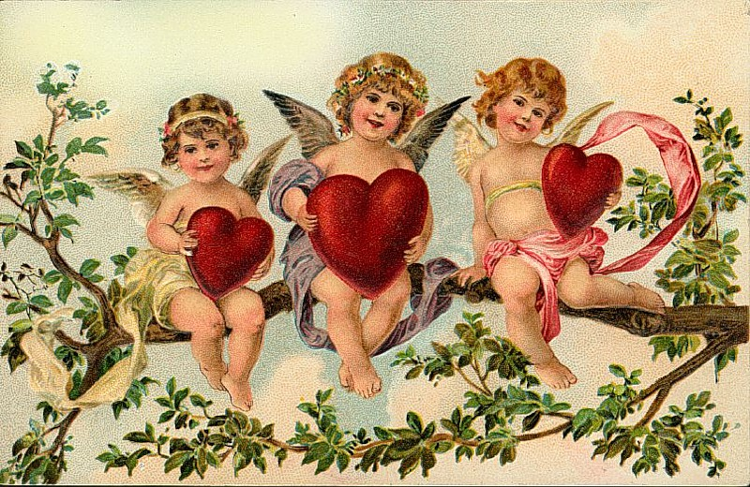
Some valentines are very fancy; they are decorated with ribbons, paper lace and images of cupids.

Slide 23

You can write in such cards:

Slide 24
St.Valentain’s Day’s vocabulary
St. Valentine’s Day – День Святого Валентина
to express feeling – выражать чувство
to adore – обожать, покланяться
to get married – выйти замуж, венчаться, жениться
Valentine’s Day card – валентинка
ready-made – готовый, стандартный
hand-made – сделанный своими руками
ribbon – лента
paper lace – кружево из бумаги
cupid – амур, купидон
priest – священник

Slide 25
What can we wish?
I’m sending this valentine today
With the message “I love you,”
Hoping that you love me, too.
Be My Valentine Love! Будь моей Валентинкой!
You Are In My Thoughts... Постоянно думаю о тебе...
Will U Be My Valentine? Будешь моей Валентинкой?
Take A Chance On Me, Valentine! Дай мне шанс!
It's 14th Feb... Be My Valentine!
Сегодня 14 февраля... Будь моей Валентинкой!
Wishing You To Be My Valentine! Хочу, чтобы ты была моей Валентинкой!
A Sweetheart Like You! Дарю сердце, такое же нежное, как ты!

Slide 26
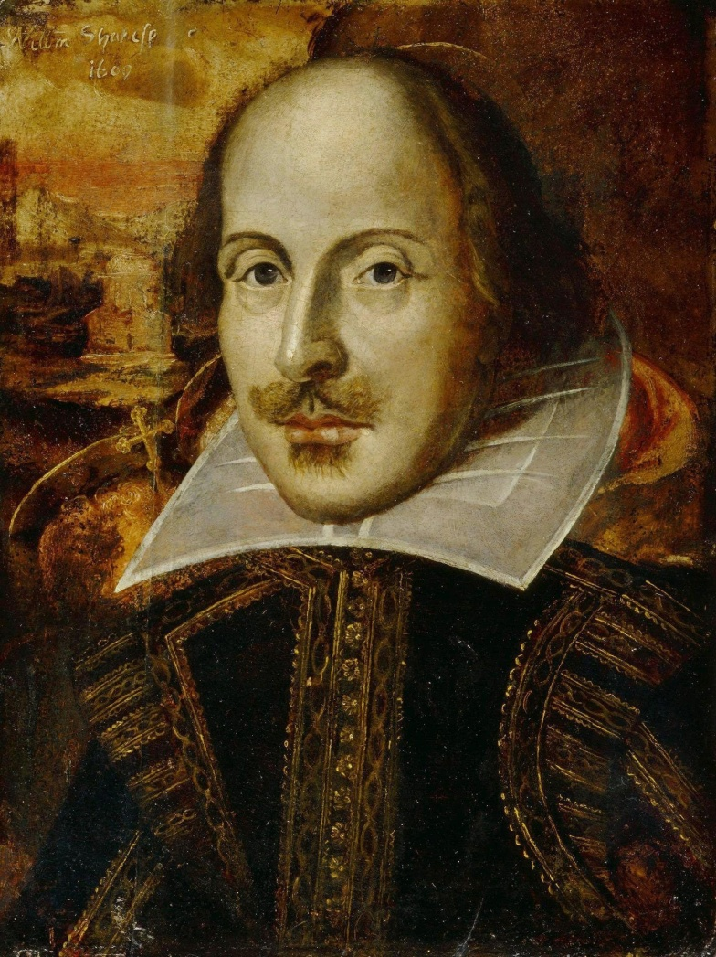
Who is this man?

Slide 27
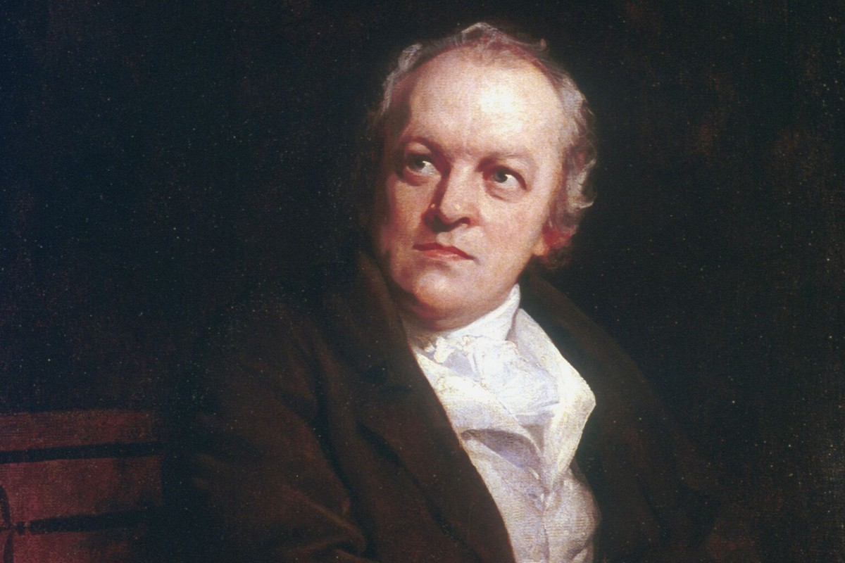

William Blake

Slide 28
Love's Secret Never seek to tell thy love, Love that never told can be; For the gentle wind doth move Silently, invisibly. I told my love, I told my love, I told her all my heart, Trembling, cold, in ghastly fears. Ah! she did depart! Soon after she was gone from me, A traveller came by, Silently, invisibly: He took her with a sigh. | Тайна любви Избегай в любви признанья, Смысл её неизъясним. Нежно ветерка дыханье — Он беззвучен и незрим. Я в любви, в любви признался, Сердце ей открыл Весь в волненьи, в страхе жутком — И покинут был. Шел чуть позже путник мимо, И была она И беззвучно, и незримо Им соблазнена.

Slide 29
Are these statements TRUE or FALSE?
1. Valentine`s Day celebrated in March.
2. One of the symbols is Cupid.
3. On Valentine`s Day people usually say: Merry Christmas
4. People send Valentine`s Day card.
5. People present books.
6. Tradition colours are pink and red.
7. People congratulate who they love.

Slide 30

What is this?
Do not watch, and ticks
Heart

Slide 31

It is brown and sweet. What is it?

Slide 32

On the bushes growing in the garden,
The smell sweet like honey
Roses

Slide 33
He has married many but has never been married. Who is he?
A priest

Slide 34

Thank you for attention!

