Slide 1
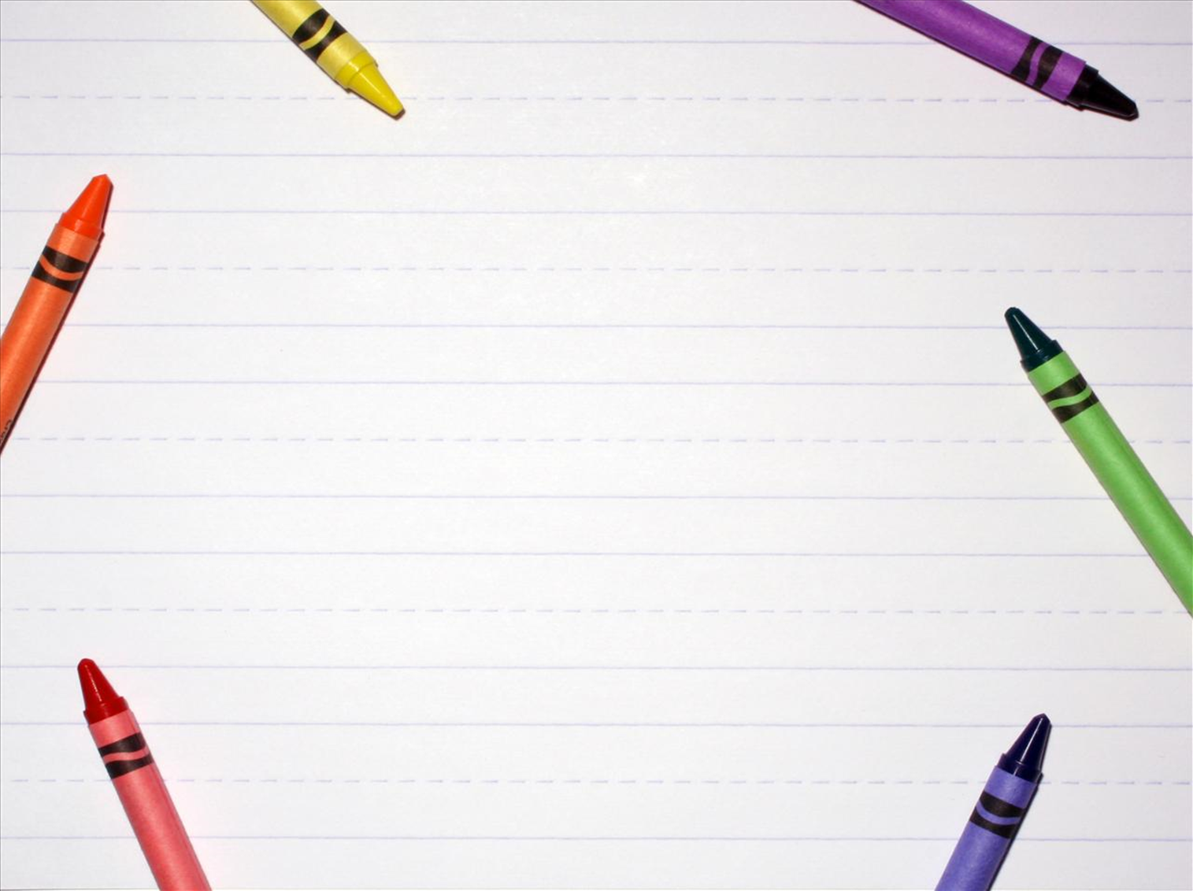
Урок-соревнование
Презентация по учебному предмету «Английский язык»
2 класс на тему «Животные»
Подготовила учитель английского языка
МБОУ «Солнечная СОШ №1»
Данильченко Ольга Павловна

Slide 2
Fill in the missing letters
6-7 correct words – 5 points 4-5 correct words – 4 points 2-3 correct words – 3 points 1 correct word – 1 point
r _ n
c h _ _ p
c l _ w _
s w _ m
s l _ _ p
s _ i _ g
h _ r _ e
r u n
c h i m p
c l o w n
s w i m
s l e e p
s w i n g
h o r s e

Slide 3
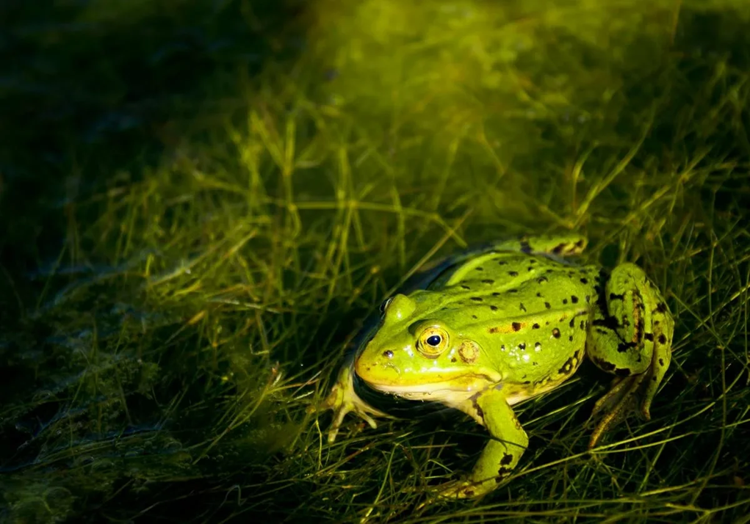
What’s this?
A frog can…

Slide 4
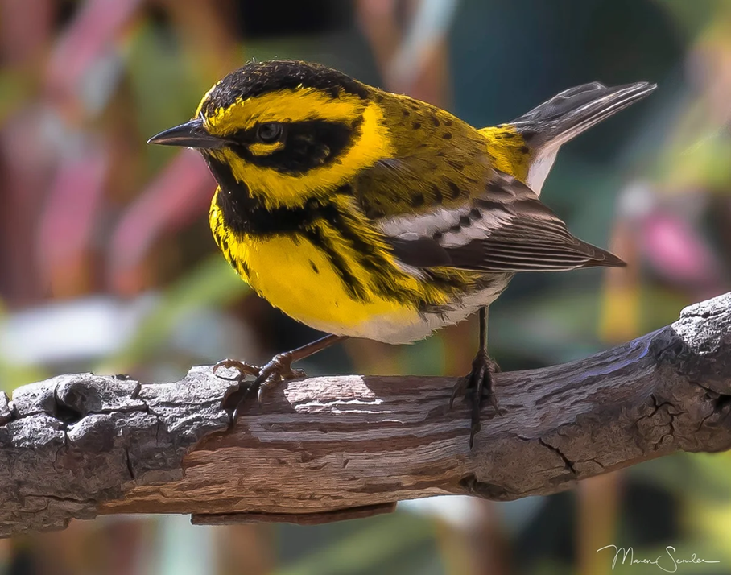
What’s this?
A bird can…

Slide 5
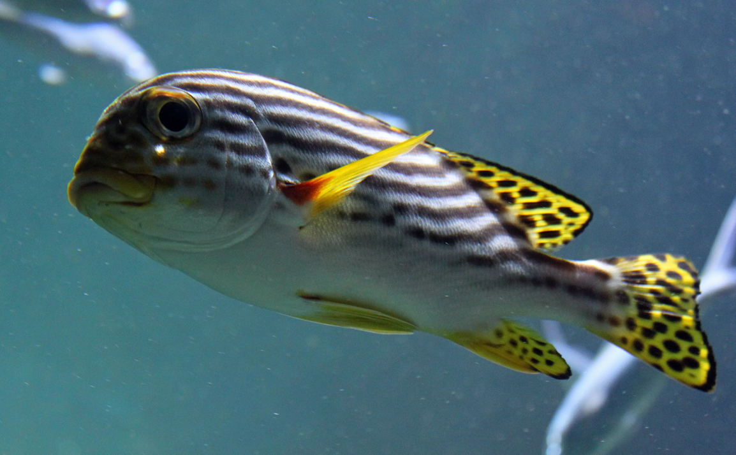
What’s this?
A fish can…

Slide 6
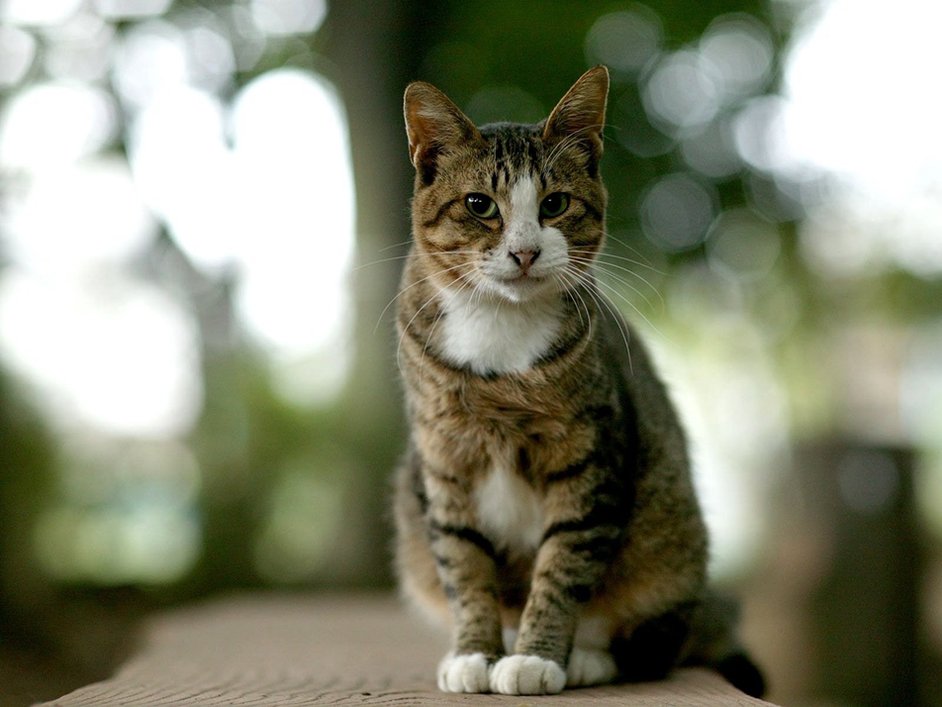
What’s this?
A cat can…

Slide 7
Put the words in the alphabetical order
6 correct words – 5 points 5 correct words – 4points 4 correct words – 3 points 3 correct words – 2 points 1-2 correct words – 1 point
chimp
elephant
rabbit
kangaroo
dolphin
cat
cat
chimp
dolphin
kangaroo
rabbit

Slide 8
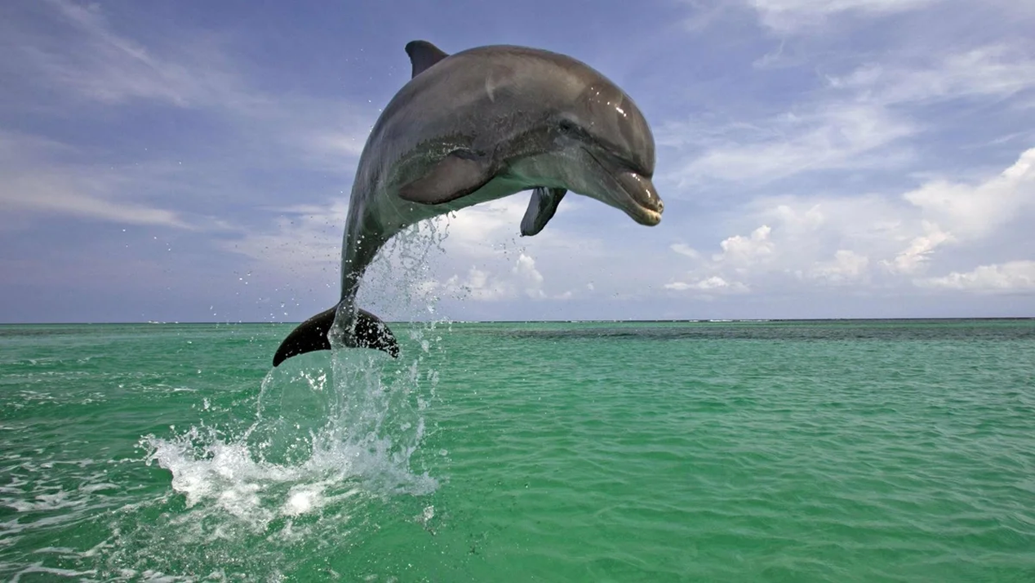
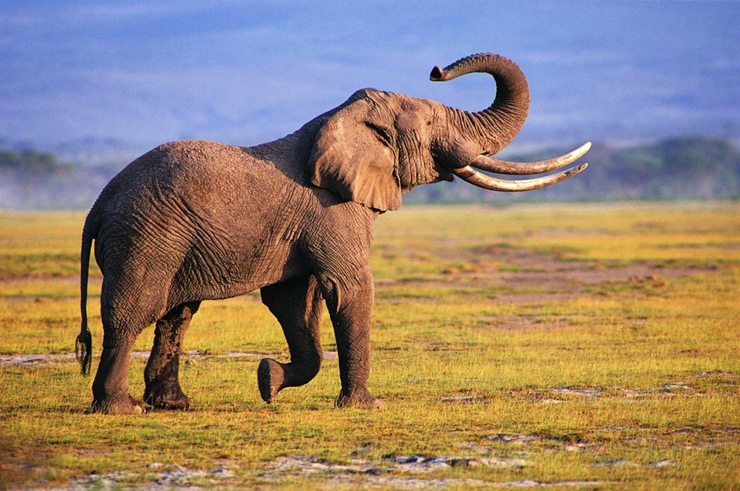
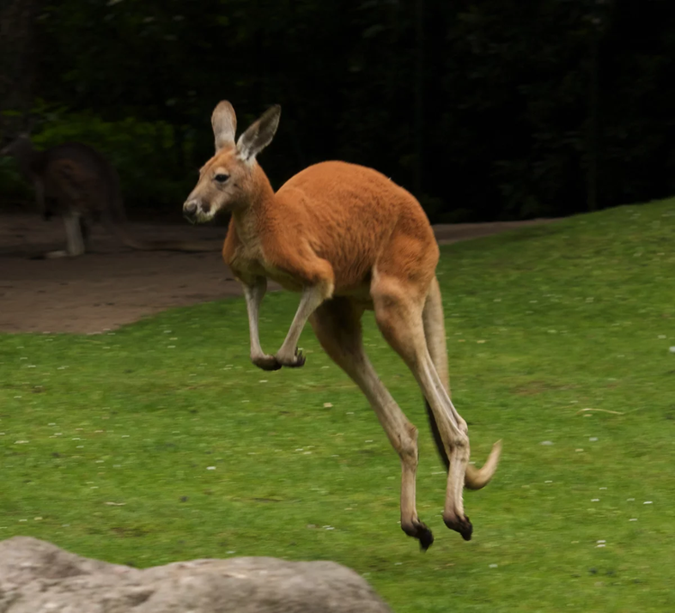
Choose the animal and write 5 sentences
5 correct sentences – 5 points 4 correct sentences – 4 points 3 correct sentences – 3 points 1-2 correct sentences – 2 points

Slide 9
Marks for the lesson!
14-15 points – “5”
10-12 points – “4”
7-9 points – “3”
6 points and less – “2”
Let’s count the points and learn your marks for the lesson.

Slide 10
Thank you for the lesson!

