Slide 1
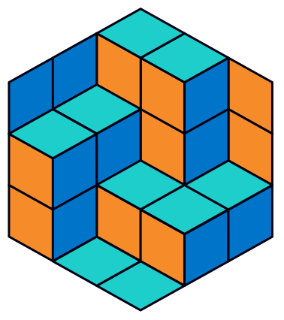
How do multi-robot systems in the automated warehouses work?
Konstantin Yakovlev
FRC CSC RAS, AIRI, SPbU, MIPT, HSE

Slide 2
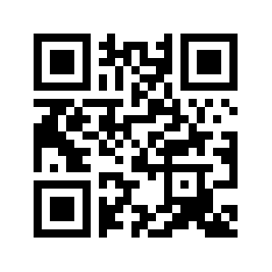
About The Speaker
Konstantin Yakovlev, PhD
Principal Investigator, Federal Research Center “Computer Science and Control” of the Russian Academy of Sciences (www.frccsc.ru)
Principal Investigator, AIRI (www.airi.net)
Associate Professor, Moscow Institute of Physics and Technology (www.mipt.ru)
Associate Professor, HSE University (www.hse.ru)
Associate Professor, SPbU (www.math-cs.spbu.ru)
Research Interests: AI, intelligent robotics, automated planning, path and motion planning, heuristic search, multiagent systems, integration of planning and learning
In lay terms: www.kyakovlev.me -> Media Some videos: www.kyakovlev.me -> Research

Slide 3
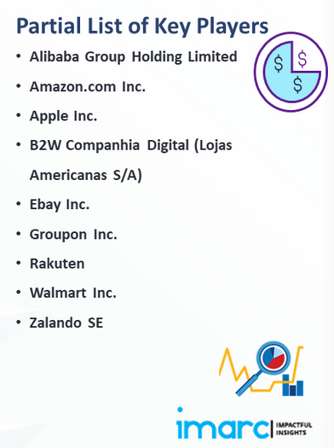
Motivation
https://www.imarcgroup.com/e-commerce-market

Slide 4
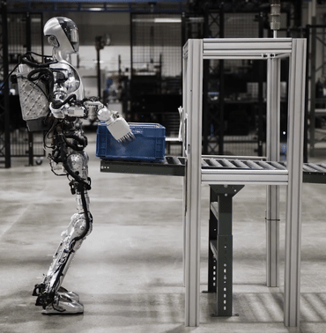
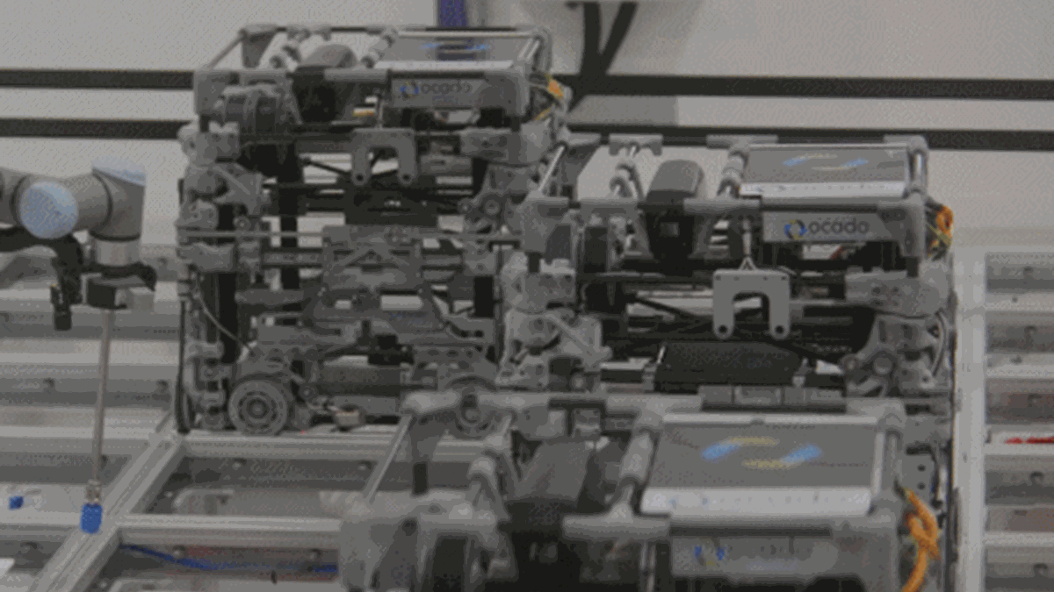
Robots In The Warehouses
Manipulators (robotic arms)
Pick’n’place (packing parcels)
Mobile robots
Transporting goods
General Purpose Robots (humanoids)
Do everything

Slide 5
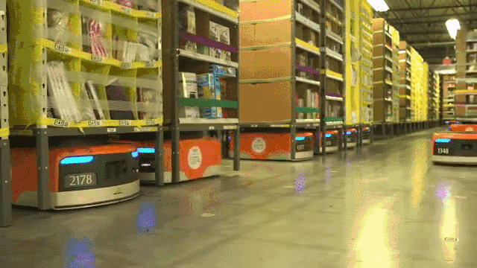
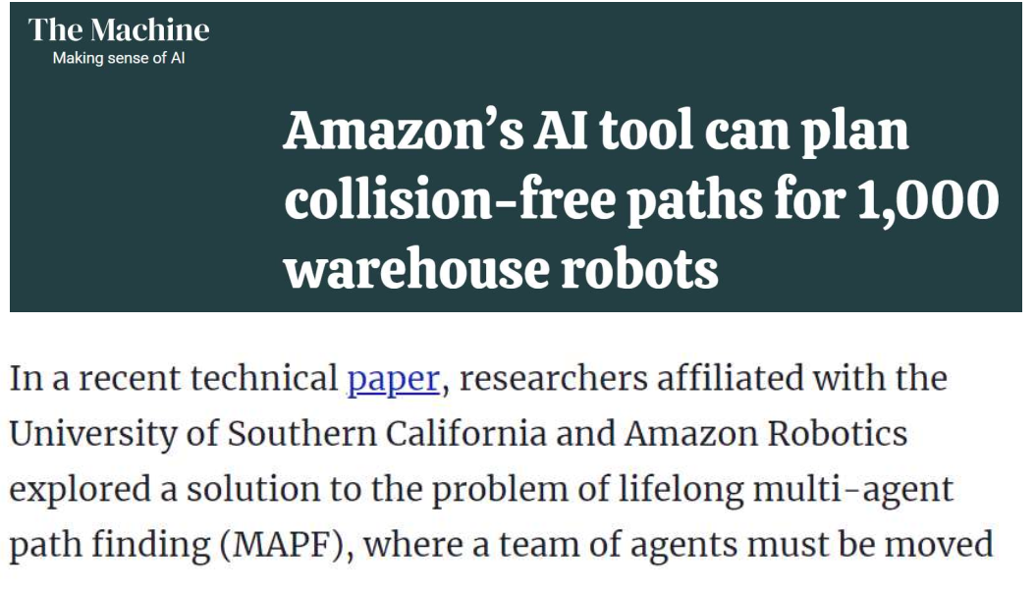
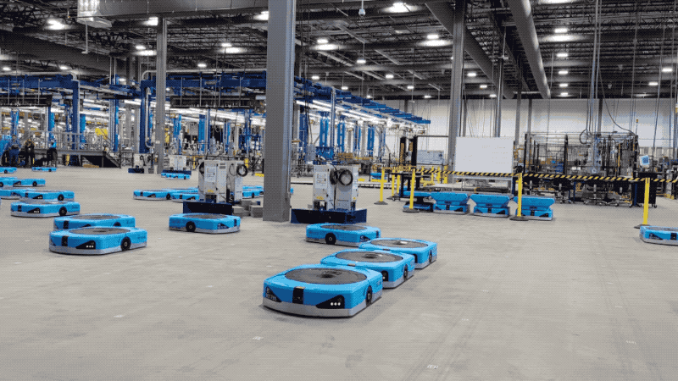
Robots In The Warehouses
Manipulators (robotic arms)
Pick’n’place (packing parcels)
Mobile robots
Transporting goods
General Purpose Robots (humanoids)
Do everything
https://venturebeat.com/ai/amazons-ai-tool-can-plan-collision-free-paths-for-1000-warehouse-robots/

Slide 6
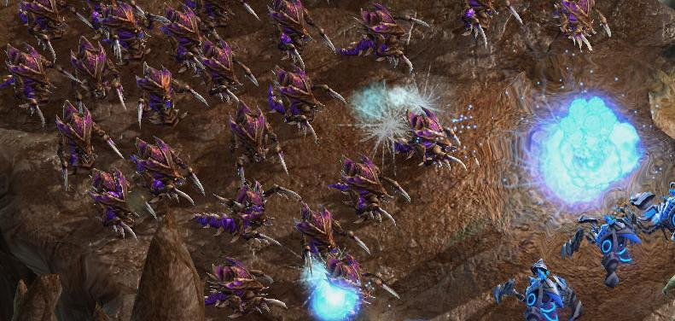
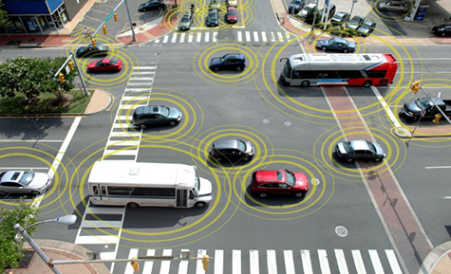
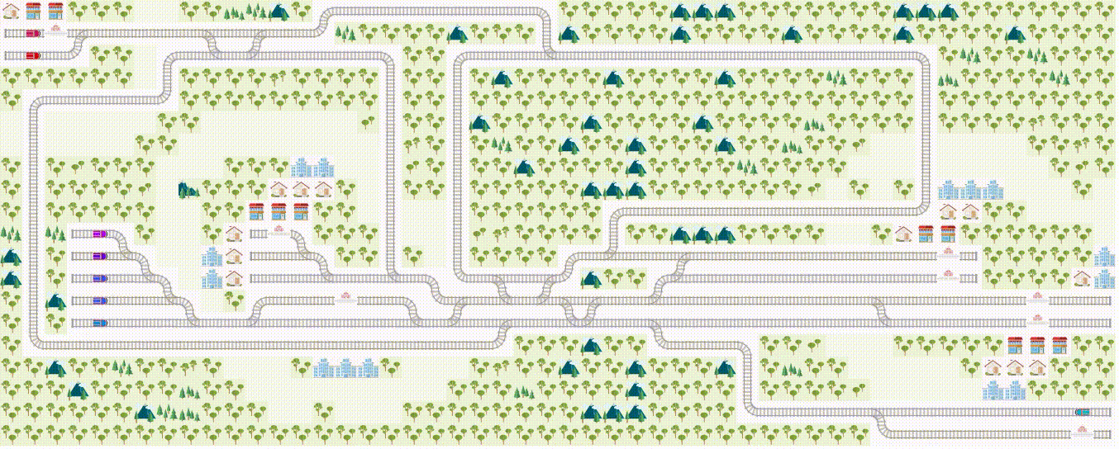
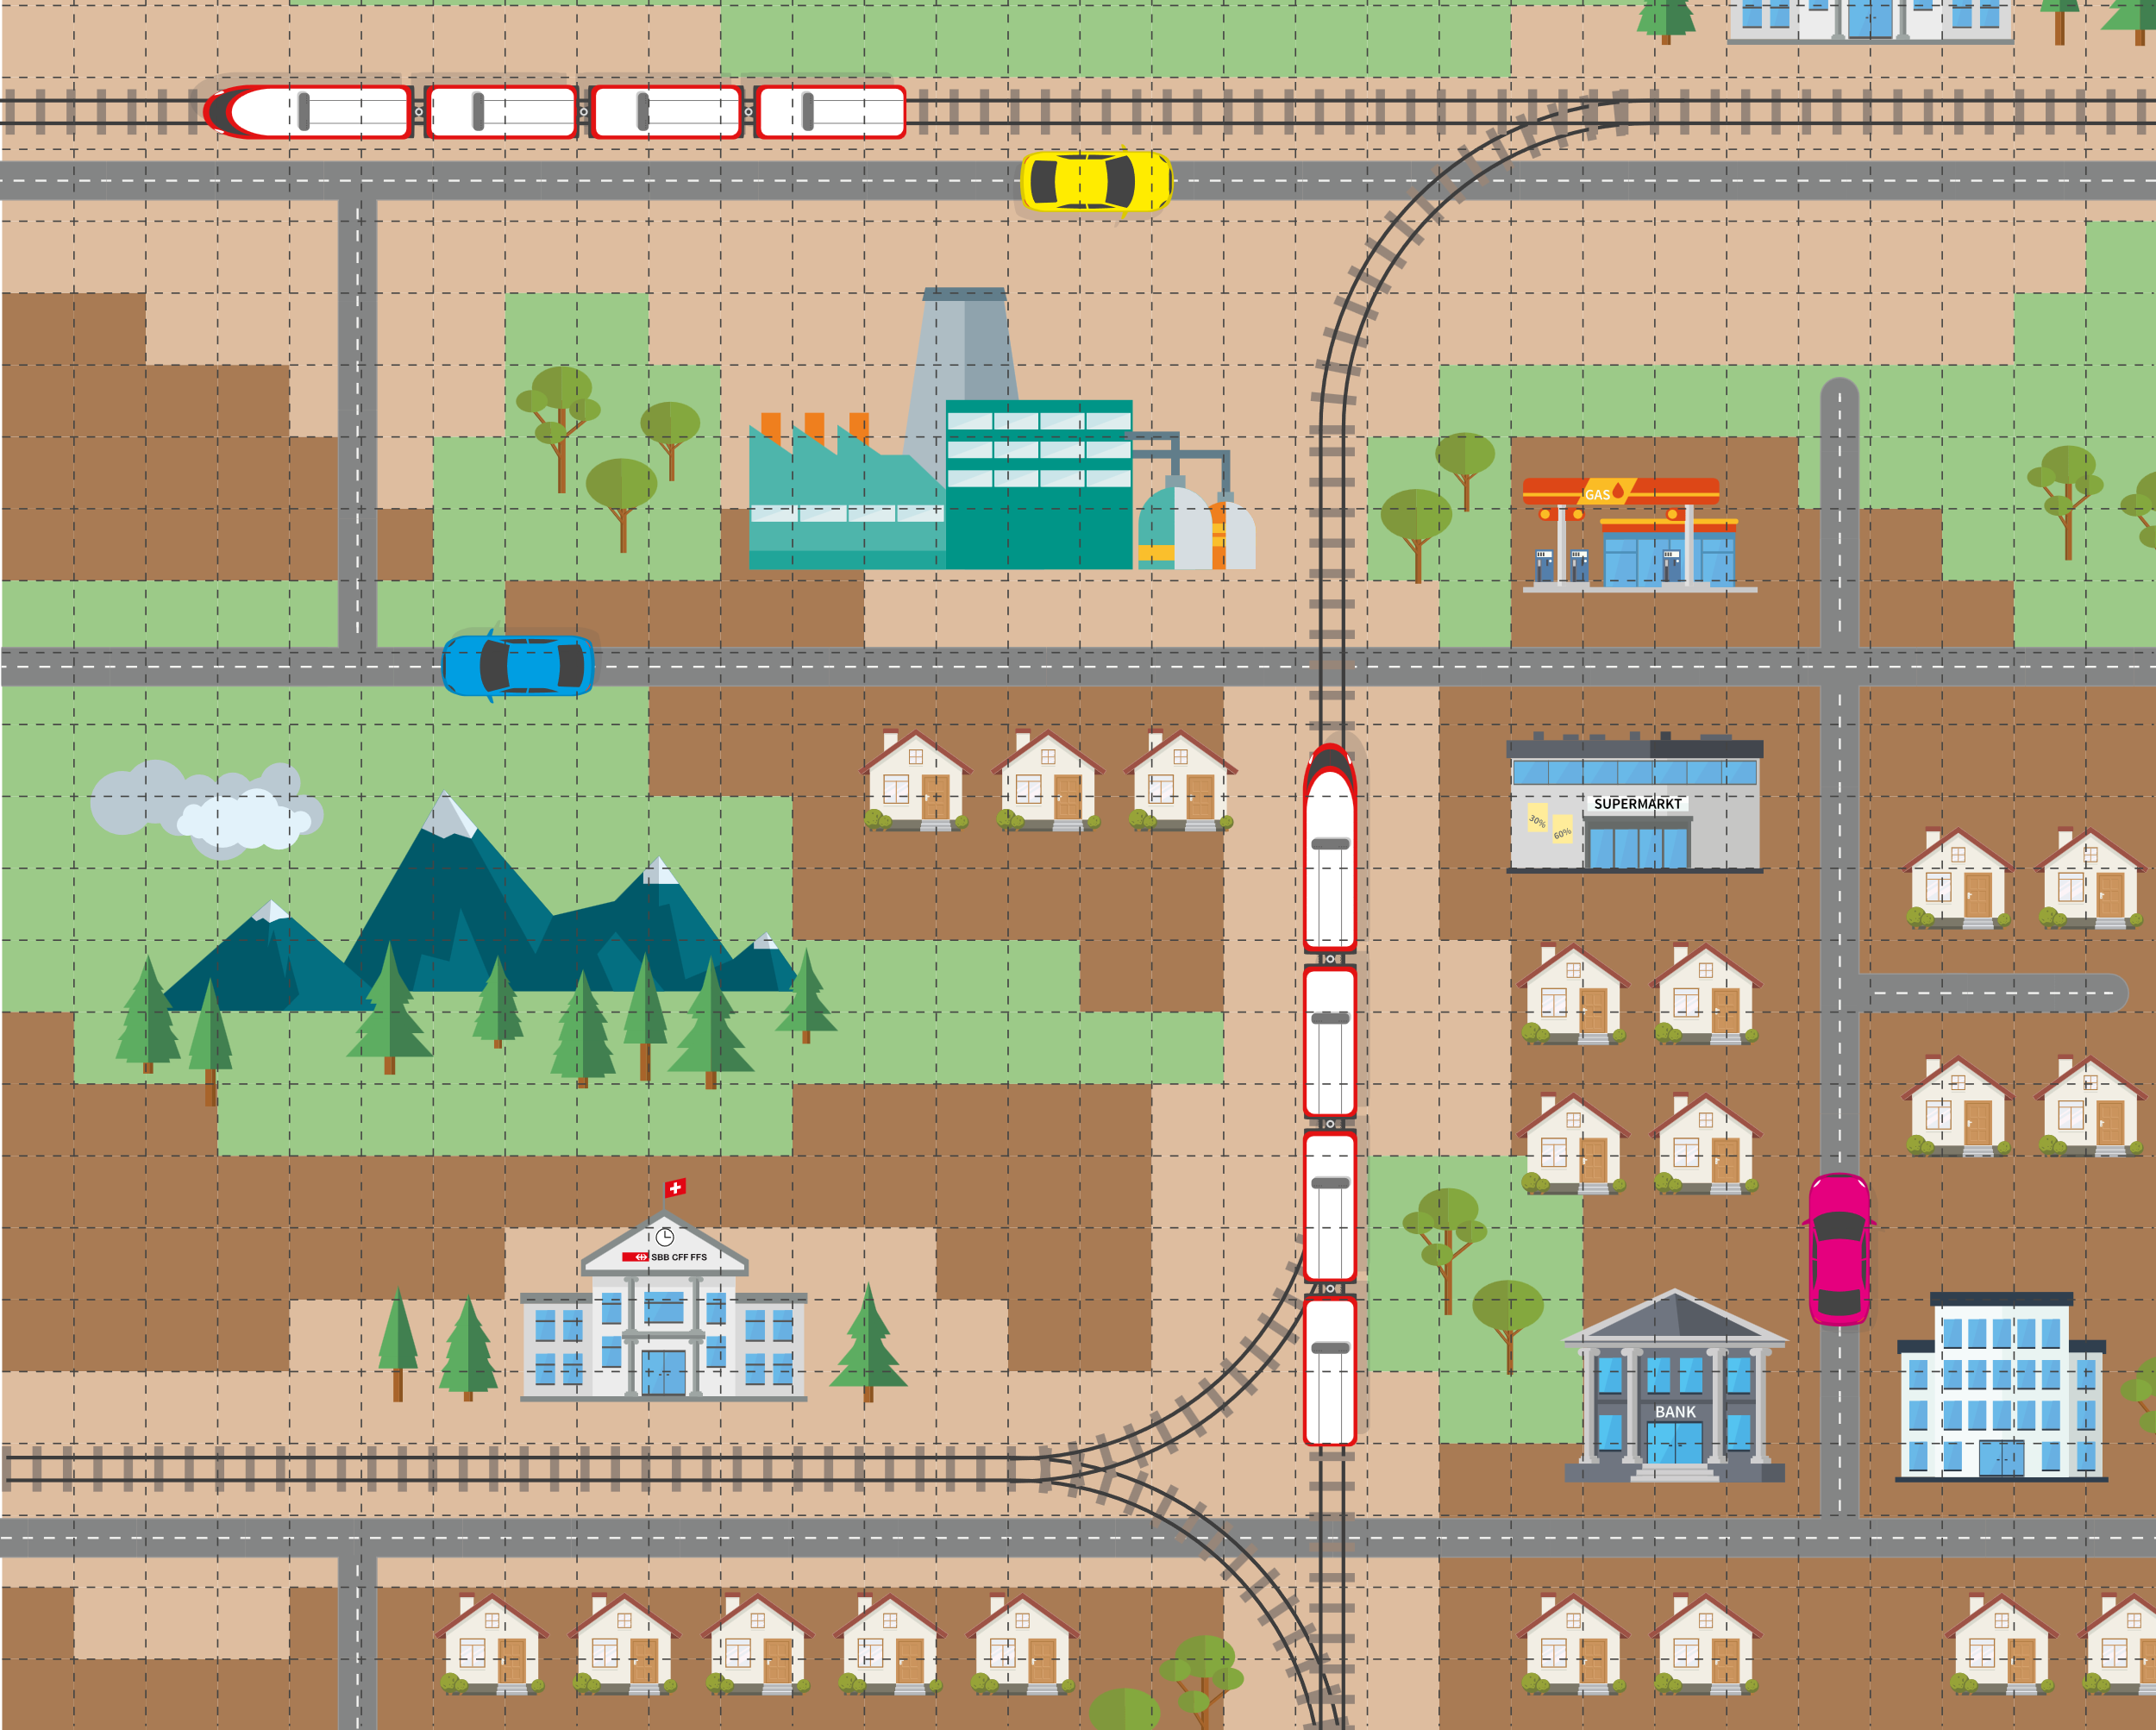
Problem’s Name

Slide 7
Problem’s Name
Multi-agent
Pathfinidng

Slide 8
Centralized vs. Decentralized MAPF
Centralized
single planner
full observability
information sharing
Idea
[Central planner] Plans a set of collision-free paths
Each agent follows its path
Pros
Strong theoretical guarantees
High-quality (optimal) solutions
Contras
Computationally intensive
The scalability is limited
Decentralized
each agent decides
partial observability
limited information sharing
Idea
[Each agent] Observes local surrounding
Each agent decides the next action
Pros
Fast
Highly scalable
Contras
No (limited) theoretical guarantees
Sub-optimal solutions

Slide 9
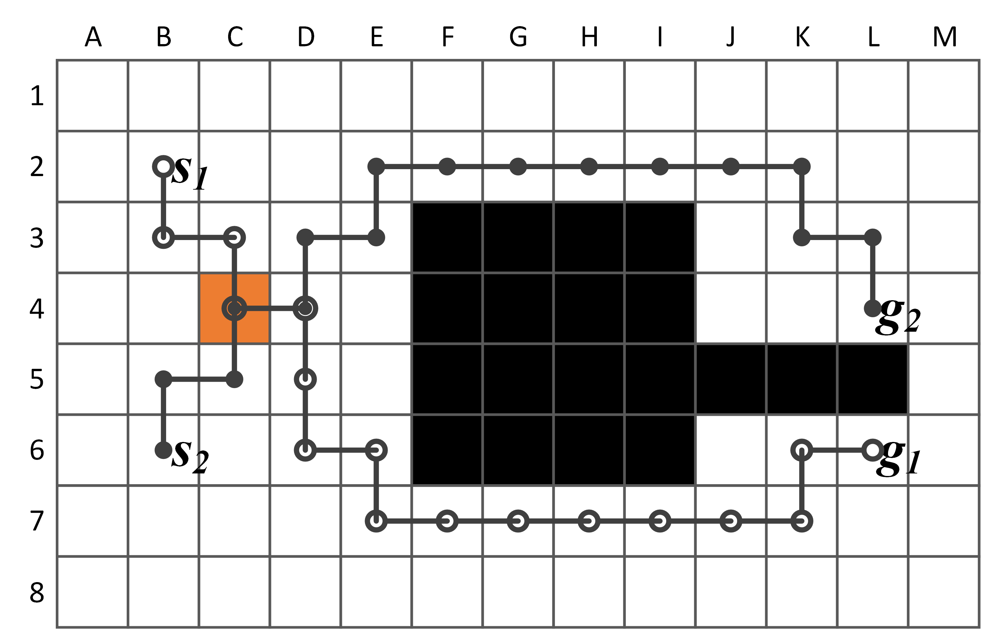
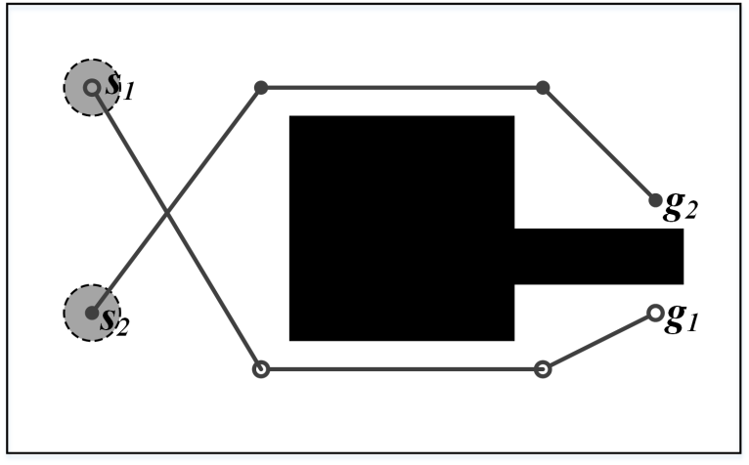
Workspace and Actions Representation
Time
T = {0, 1, 2, 3, 4, …} /timesteps/
Workspace
G = (V, E) /graph/
V — locations
E — transitions between locations (collision-free w.r.t. static obstacles)
Actions
wait (at graph vertex)
move (to another graph vertex)
Plan
Sequence of actions that leads agent from the start vertex to the goal one

Slide 10
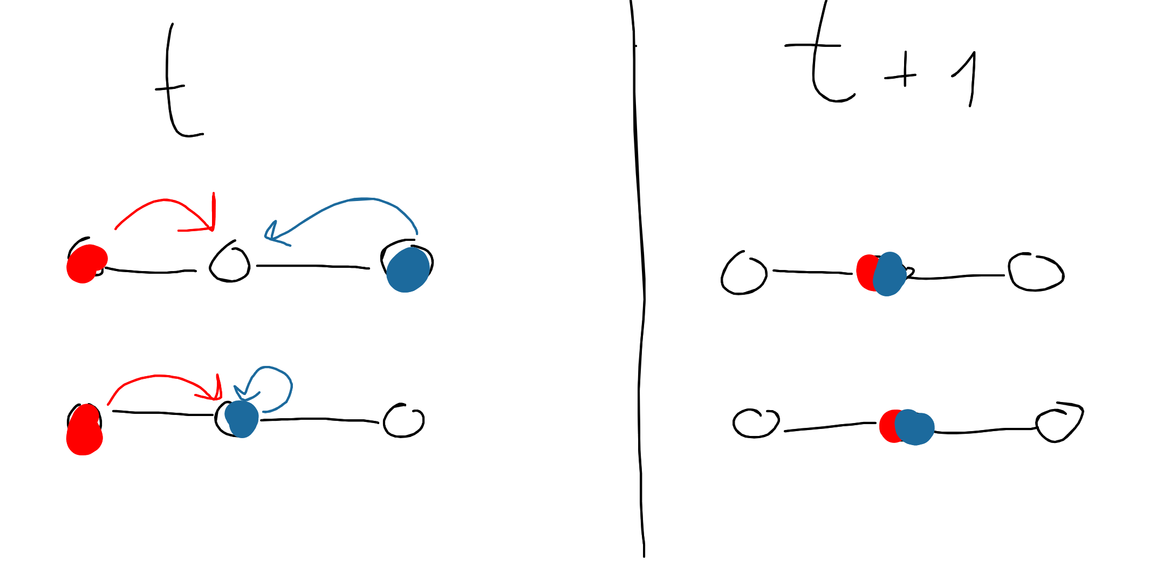
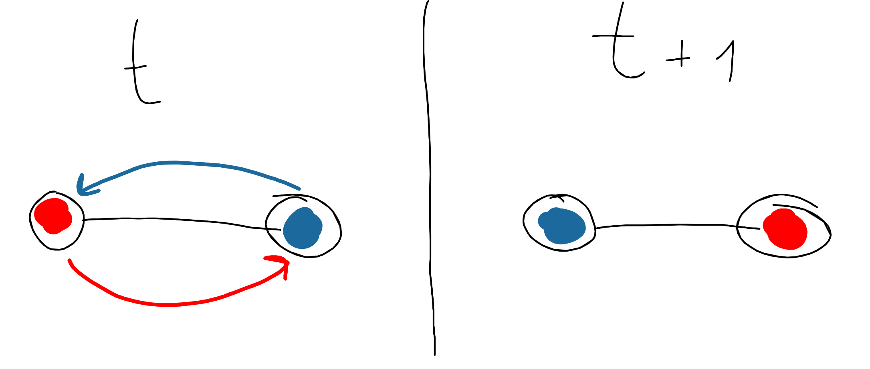
Problem Formulation : MAPF
Input: Graph, Actions, Starts, Goals
Output: Set of conflict-free plans
Objective (↓):
Sum-of-Costs $\sum_{i=1}^{n}{cost(π_{i}}$)
Makespan $\max_{i=1..n}(cost(π_{i}))$
Vertex conflict
Edge (swap) conflict

Slide 11
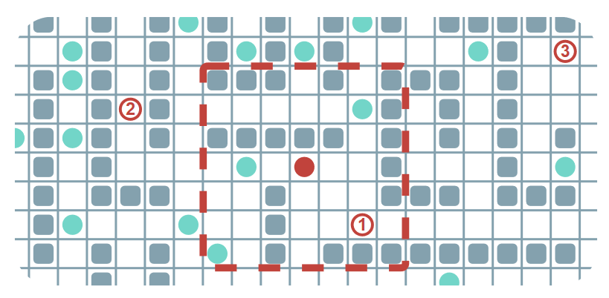
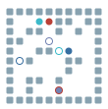
Problem Formulation : Lifelong MAPF (LMAPF)
MAPF
+
every time the agent achieves a goal it is assigned to a new one
Objective (↑)
Throughput(T)
$$\sum_{i=1}^{T}{\frac{\#(T)}{T} }$$
#(T) – number of the achieved goals up to the timestep T

Slide 12
Problem Formulation : Anonymous MAPF (MAPF)
MAPF
+
Task Assignment

Slide 13
Quiz
MAPF vs. AMAPF
(centralized)
Which problem is harder to solve optimally?

Slide 14
Quiz
MAPF vs. AMAPF
(centralized)
Which problem is harder to solve optimally?
 | MAPF | AMAPF
Makespan | NP-Hard | Polynomial alg. exists
Sum-Of-Costs | NP-Hard | ???

Slide 15
Solving Centralized MAPF fast. Prioritized Planning
02

Slide 16
Prioritized Planning
Choose priorities
Plan blue agent then plan green agent
Notes:
To eliminate it we need to constrain one of the agents NOT to occupy this node at timestep two.
It can be either green agent.

Slide 17
Prioritized Planning
Choose priorities
Plan blue agent then plan green agent
Phase 1
Plan blue agent
Notes:
To eliminate it we need to constrain one of the agents NOT to occupy this node at timestep two.
It can be either green agent.

Slide 18
Prioritized Planning
Choose priorities
Plan blue agent then plan green agent
Phase 1
Plan blue agent
0
Notes:
To eliminate it we need to constrain one of the agents NOT to occupy this node at timestep two.
It can be either green agent.

Slide 19
Prioritized Planning
Choose priorities
Plan blue agent then plan green agent
Phase 1
Plan blue agent
1
0
Notes:
To eliminate it we need to constrain one of the agents NOT to occupy this node at timestep two.
It can be either green agent.

Slide 20
Prioritized Planning
Choose priorities
Plan blue agent then plan green agent
Phase 1
Plan blue agent
2
1
0
Notes:
To eliminate it we need to constrain one of the agents NOT to occupy this node at timestep two.
It can be either green agent.

Slide 21
Prioritized Planning
Choose priorities
Plan blue agent then plan green agent
Phase 1
Plan blue agent
3
2
1
0
Notes:
To eliminate it we need to constrain one of the agents NOT to occupy this node at timestep two.
It can be either green agent.

Slide 22
Prioritized Planning
Choose priorities
Plan blue agent then plan green agent
Phase 1
Plan blue agent
done
3
2
1
0
Notes:
To eliminate it we need to constrain one of the agents NOT to occupy this node at timestep two.
It can be either green agent.

Slide 23
Prioritized Planning
Choose priorities
Plan blue agent then plan green agent
Phase 1
Plan blue agent
done
Phase 2
Plan green agent
3
2
1
0
Notes:
To eliminate it we need to constrain one of the agents NOT to occupy this node at timestep two.
It can be either green agent.

Slide 24
Prioritized Planning
Choose priorities
Plan blue agent then plan green agent
Phase 1
Plan blue agent
done
Phase 2
Plan green agent
3
2
1
0
0
Notes:
To eliminate it we need to constrain one of the agents NOT to occupy this node at timestep two.
It can be either green agent.

Slide 25
Prioritized Planning
Choose priorities
Plan blue agent then plan green agent
Phase 1
Plan blue agent
done
Phase 2
Plan green agent
1
3
2
1
0
0
Notes:
To eliminate it we need to constrain one of the agents NOT to occupy this node at timestep two.
It can be either green agent.

Slide 26
Prioritized Planning
Choose priorities
Plan blue agent then plan green agent
Phase 1
Plan blue agent
done
Phase 2
Plan green agent
1
3
2
1
0
0
Notes:
To eliminate it we need to constrain one of the agents NOT to occupy this node at timestep two.
It can be either green agent.

Slide 27
Prioritized Planning
Choose priorities
Plan blue agent then plan green agent
Phase 1
Plan blue agent
done
Phase 2
Plan green agent
3
2
1
0
WAIT
Notes:
To eliminate it we need to constrain one of the agents NOT to occupy this node at timestep two.
It can be either green agent.

Slide 28
Prioritized Planning
Choose priorities
Plan blue agent then plan green agent
Phase 1
Plan blue agent
done
Phase 2
Plan green agent
3
2
1
0
WAIT
WAIT
Notes:
To eliminate it we need to constrain one of the agents NOT to occupy this node at timestep two.
It can be either green agent.

Slide 29
Prioritized Planning
Choose priorities
Plan blue agent then plan green agent
Phase 1
Plan blue agent
done
Phase 2
Plan green agent
3
2
1
0
WAIT
WAIT
WAIT
Notes:
To eliminate it we need to constrain one of the agents NOT to occupy this node at timestep two.
It can be either green agent.

Slide 30
Prioritized Planning
Choose priorities
Plan blue agent then plan green agent
Phase 1
Plan blue agent
done
Phase 2
Plan green agent
3
2
1
2
3
0
0
1
Notes:
To eliminate it we need to constrain one of the agents NOT to occupy this node at timestep two.
It can be either green agent.

Slide 31
Prioritized Planning
Choose priorities
Plan blue agent then plan green agent
Phase 1
Plan blue agent
done
Phase 2
Plan green agent
3
2
1
4
2
3
0
0
1
Notes:
To eliminate it we need to constrain one of the agents NOT to occupy this node at timestep two.
It can be either green agent.

Slide 32
Prioritized Planning
Choose priorities
Plan blue agent then plan green agent
Phase 1
Plan blue agent
done
Phase 2
Plan green agent
3
2
1
4
5
2
3
0
0
1
Notes:
To eliminate it we need to constrain one of the agents NOT to occupy this node at timestep two.
It can be either green agent.

Slide 33
Prioritized Planning
Choose priorities
Plan blue agent then plan green agent
Phase 1
Plan blue agent
done
Phase 2
Plan green agent
done
3
2
1
4
5
6
2
3
0
0
1
Notes:
To eliminate it we need to constrain one of the agents NOT to occupy this node at timestep two.
It can be either green agent.

Slide 34
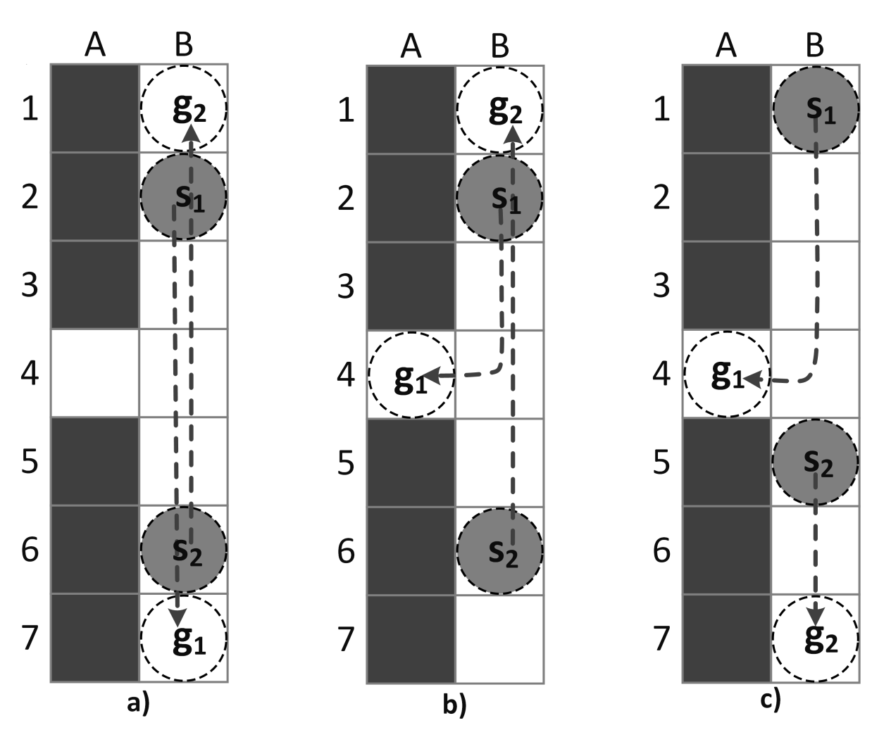
Prioritized Planning
Fast
Scalable
Not complete in general
Always fail
It depends
Always success
Notes:
To eliminate it we need to constrain one of the agents NOT to occupy this node at timestep two.
It can be either green agent.

Slide 35
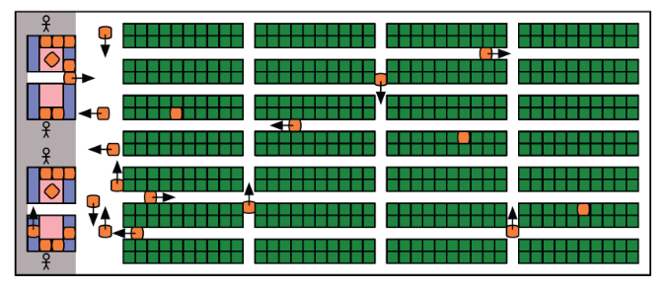
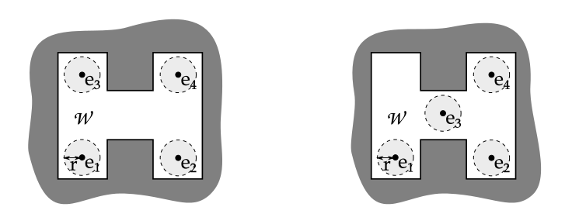
Prioritized Planning
Fast
Scalable
Not complete in general
PP scales well to large number of agents and is frequently used in practical applications
Complete for well-formed infrastructures
Čáp, M., Novák, P., Kleiner, A., and Selecký, M. 2015. Prioritized planning algorithms for trajectory coordination of multiple mobile robots. IEEE Transactions on Automation Science and Engineering, 12(3):835-849.
Wurman, P. R.; D’Andrea, R.; and Mountz, M. 2007. Coordinating Hundreds of Cooperative, Autonomous Vehicles in Warehouses. In Proceedings of the AAAI Conference on Artificial Intelligence (AAAI 2007), 1752–1760.
Notes:
To eliminate it we need to constrain one of the agents NOT to occupy this node at timestep two.
It can be either green agent.

Slide 36
Optimally Solving (Centralized) MAPF with Conflict-Based Search
03

Slide 37
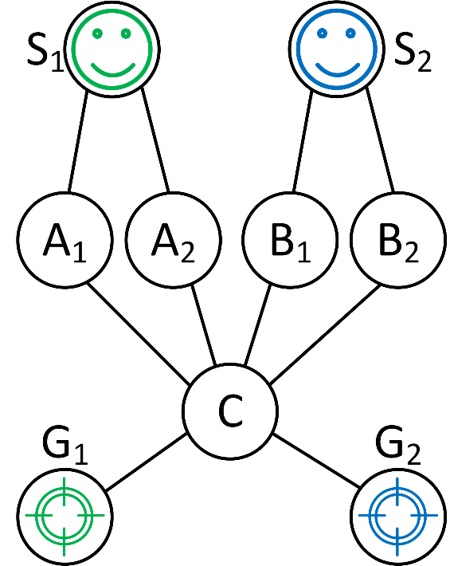
Conflict Based Search (CBS)
Plan each path individually with optimal planner, e.g. A*:
[Sharon et al., 2015] Sharon, G., Stern, R., Felner, A., & Sturtevant, N. R. (2015). Conflict-based search for optimal multi-agent pathfinding. Artificial Intelligence, 219, 40-66.
Notes:
To eliminate it we need to constrain one of the agents NOT to occupy this node at timestep two.
It can be either green agent.

Slide 38
Conflict Based Search (CBS)
Plan each path individually with optimal planner, e.g. A*: {S₁, A₂, C, G₁}; {S₂, B₂, C, G₂}
[Sharon et al., 2015] Sharon, G., Stern, R., Felner, A., & Sturtevant, N. R. (2015). Conflict-based search for optimal multi-agent pathfinding. Artificial Intelligence, 219, 40-66.
Notes:
To eliminate it we need to constrain one of the agents NOT to occupy this node at timestep two.
It can be either green agent.

Slide 39
Conflict Based Search (CBS)
Plan each path individually with optimal planner, e.g. A*: {S₁, A₂, C, G₁}; {S₂, B₂, C, G₂}
Find a conflict between the agents/paths:
[Sharon et al., 2015] Sharon, G., Stern, R., Felner, A., & Sturtevant, N. R. (2015). Conflict-based search for optimal multi-agent pathfinding. Artificial Intelligence, 219, 40-66.
Notes:
To eliminate it we need to constrain one of the agents NOT to occupy this node at timestep two.
It can be either green agent.

Slide 40
Conflict Based Search (CBS)
Plan each path individually with optimal planner, e.g. A*: {S₁, A₂, C, G₁}; {S₂, B₂, C, G₂}
Find a conflict between the agents/paths: {Green, Blue, C, 2}
[Sharon et al., 2015] Sharon, G., Stern, R., Felner, A., & Sturtevant, N. R. (2015). Conflict-based search for optimal multi-agent pathfinding. Artificial Intelligence, 219, 40-66.
Notes:
To eliminate it we need to constrain one of the agents NOT to occupy this node at timestep two.
It can be either green agent.

Slide 41
Conflict Based Search (CBS)
Plan each path individually with optimal planner, e.g. A*: {S₁, A₂, C, G₁}; {S₂, B₂, C, G₂}
Find a conflict between the agents/paths: {Green, Blue, C, 2}
If the conflict is found – impose constraint to avoid it:
[Sharon et al., 2015] Sharon, G., Stern, R., Felner, A., & Sturtevant, N. R. (2015). Conflict-based search for optimal multi-agent pathfinding. Artificial Intelligence, 219, 40-66.
Notes:
To eliminate it we need to constrain one of the agents NOT to occupy this node at timestep two.
It can be either green agent.

Slide 42
Conflict Based Search (CBS)
Plan each path individually with optimal planner, e.g. A*: {S₁, A₂, C, G₁}; {S₂, B₂, C, G₂}
Find a conflict between the agents/paths: {Green, Blue, C, 2}
If the conflict is found – impose constraint to avoid it: Constrain green agent to avoid C at timestep 2: {Green, C, 2}
2
[Sharon et al., 2015] Sharon, G., Stern, R., Felner, A., & Sturtevant, N. R. (2015). Conflict-based search for optimal multi-agent pathfinding. Artificial Intelligence, 219, 40-66.
Notes:
To eliminate it we need to constrain one of the agents NOT to occupy this node at timestep two.
It can be either green agent.

Slide 43
Conflict Based Search (CBS)
Plan each path individually with optimal planner, e.g. A*: {S₁, A₂, C, G₁}; {S₂, B₂, C, G₂}
Find a conflict between the agents/paths: {Green, Blue, C, 2}
If the conflict is found – impose constraint to avoid it: Constrain green agent to avoid C at timestep 2: {Green, C, 2} Constrain blue agent to avoid C at timestep 2: {Blue, C, 2}
2
[Sharon et al., 2015] Sharon, G., Stern, R., Felner, A., & Sturtevant, N. R. (2015). Conflict-based search for optimal multi-agent pathfinding. Artificial Intelligence, 219, 40-66.
Notes:
To eliminate it we need to constrain one of the agents NOT to occupy this node at timestep two.
It can be either green agent.

Slide 44
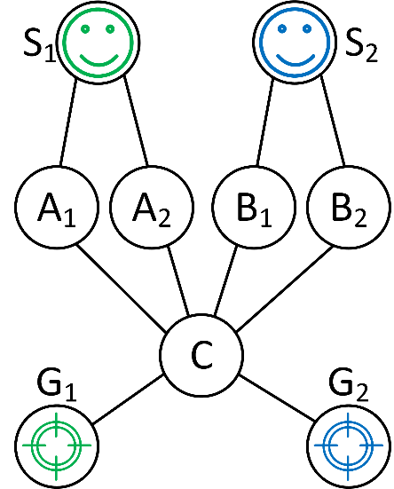
Conflict Based Search (CBS)
4) Split the solution into two alternative solutions, re-planning the paths of colliding agents with respect to the given constraints:
Conflict {Green, Blue, C, 2}
Constraint
{Green, C, 2}
Constraint
{Blue, C, 2}
[Sharon et al., 2015] Sharon, G., Stern, R., Felner, A., & Sturtevant, N. R. (2015). Conflict-based search for optimal multi-agent pathfinding. Artificial Intelligence, 219, 40-66.
Notes:
To eliminate it we need to constrain one of the agents NOT to occupy this node at timestep two.
It can be either green agent.

Slide 45
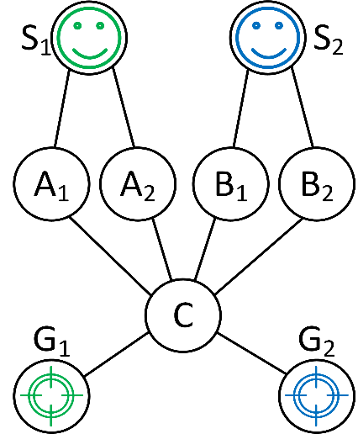
Conflict Based Search (CBS)
4) Split the solution into two alternative solutions, re-planning the paths of colliding agents with respect to the given constraints:
Conflict {Green, Blue, C, 2}
Constraint
{Green, C, 2}
Constraint
{Blue, C, 2}
{
}
{
}
{S₁, A₁, A₁, C, G₁}
{S₁, A₁, C, G₁}
{S₂, B₂, C, G₂}
{S₂, B₂, B_{2,} C, G₂}
Notes:
To eliminate it we need to constrain one of the agents NOT to occupy this node at timestep two.
It can be either green agent.

Slide 46
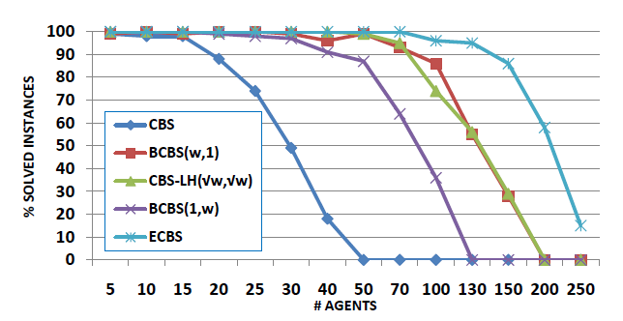
Conflict Based Search (CBS)
Nice theoretical properties
If the solution exists, then CBS will find a solution and the latter will be provably optimal.
Numerous extensions
Meta-agents (joining certain agents to groups)
Cardinal, semi-cardinal conflicts (choosing the conflict to “expand” smartly)
Bounded-suboptimal search at the high/low level
Makes CBS work much faster
Disjoint conflicts
Adding heuristics to high level
[Barer et al, 2014] Barer, M., Sharon, G., Stern, R. and Felner, A., 2014. Suboptimal variants of the conflict-based search algorithm for the multi-agent pathfinding problem. In SoCS 2014 (pp. 19-27).
CBS is a powerful algorithmic framework
for obtaining provably optimal solutions
Notes:
To eliminate it we need to constrain one of the agents NOT to occupy this node at timestep two.
It can be either green agent.

Slide 47
Andreychuk A., Yakovlev K., Atzmon D., Stern R. Multi-Agent Pathfinding with Continuous Time // In Proceedings of the 28th International Joint Conference on Artificial Intelligence, IJCAI 2019. pp. 39-45.
Notes:
To eliminate it we need to constrain one of the agents NOT to occupy this node at timestep two.
It can be either green agent.

Slide 48
Solving Decentralized (Lifelong) MAPF With Combination of Planning and Learning
04

Slide 49
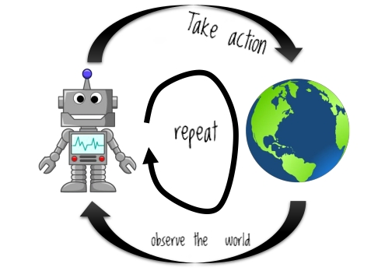
Decentralized (Lifelong) MAPF
[decentralized] No central planner
[decentralized] Each agent at each time step decides its next action
limited observability
limited communication
[lifelong] After a goal is reached a new one is assigned
Sequential decision making
Observe
Decide
Act
Repeat
Notes:
To eliminate it we need to constrain one of the agents NOT to occupy this node at timestep two.
It can be either green agent.

Slide 50
Why not simply plan individually with A*?
(each agent)
1. plans the shortest path to the goal
ignoring the other agents
2. picks the first action of that plan

Slide 51
Why not simply plan individually with A*?
It does not work =(
Planning only
# goals achieved by the red agent = 0
# goals achieved by all agents = 36
Throughput (512 steps, 32 agents) = 0.07

Slide 52
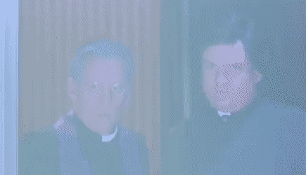
How about ‘pure’ reinforcement learning (RL)?
Non-stationary environment
Sparse reward
Hard combinatorial structure of the solution space
Slow, unstable learning (costly?)
Low generalization

Slide 53
Planning and Learning …
… is all you need
(to solve decentralized MAPF efficiently)

Slide 54
Quiz
What is the origin of the word ‘ROBOT’
?

Slide 55
Quiz
What is the origin of the word ‘ROBOT’
Czech Republic, 1920
Rossumovi univerzální roboti

Slide 56
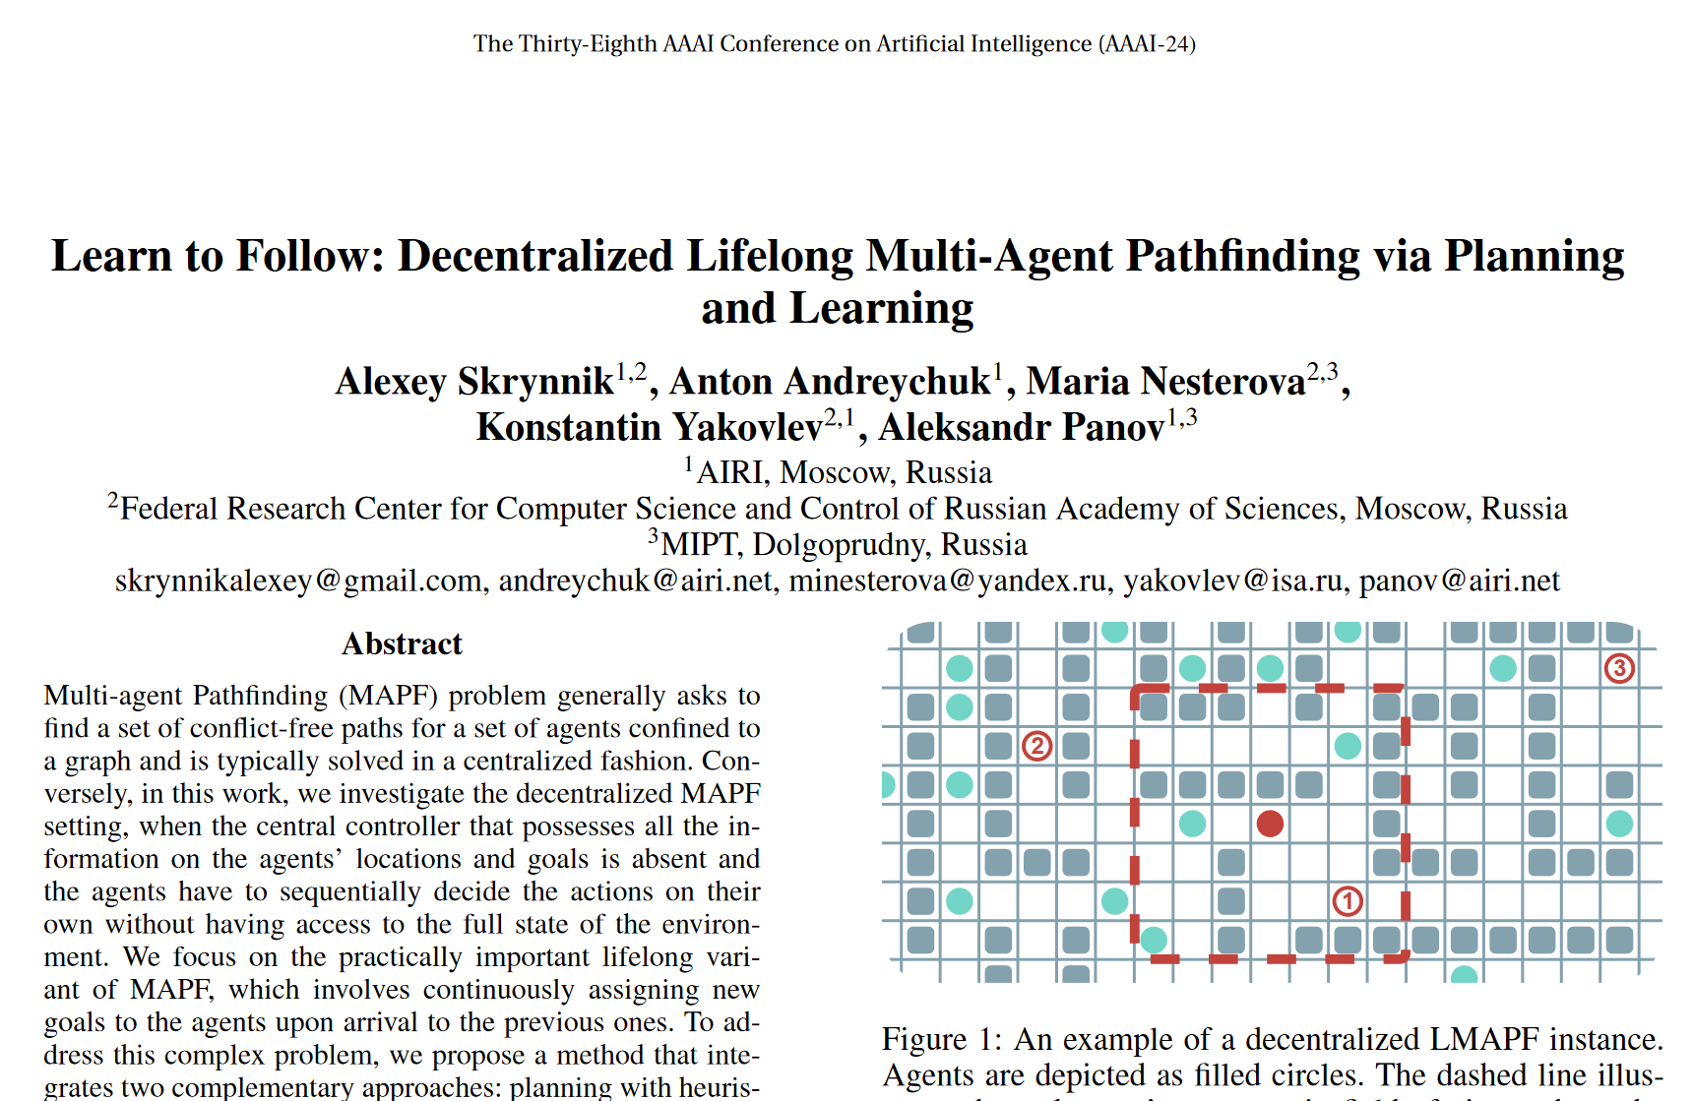
FOLLOWER
https://ojs.aaai.org/index.php/AAAI/article/view/29704/31207
Notes:
To eliminate it we need to constrain one of the agents NOT to occupy this node at timestep two.
It can be either green agent.

Slide 57
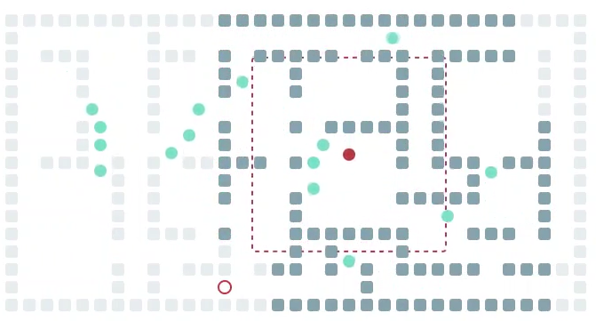
Learn to Follow: Decentralized Lifelong Multi-Agent Pathfinding via Planning and Learning
Two types of behavior:
Moving towards the goal (long-range planning)
Avoiding the other agents and/or yielding to them (short term decision making)
A* (heuristic search)
PPO (reinforcement learning)
Notes:
To eliminate it we need to constrain one of the agents NOT to occupy this node at timestep two.
It can be either green agent.

Slide 58
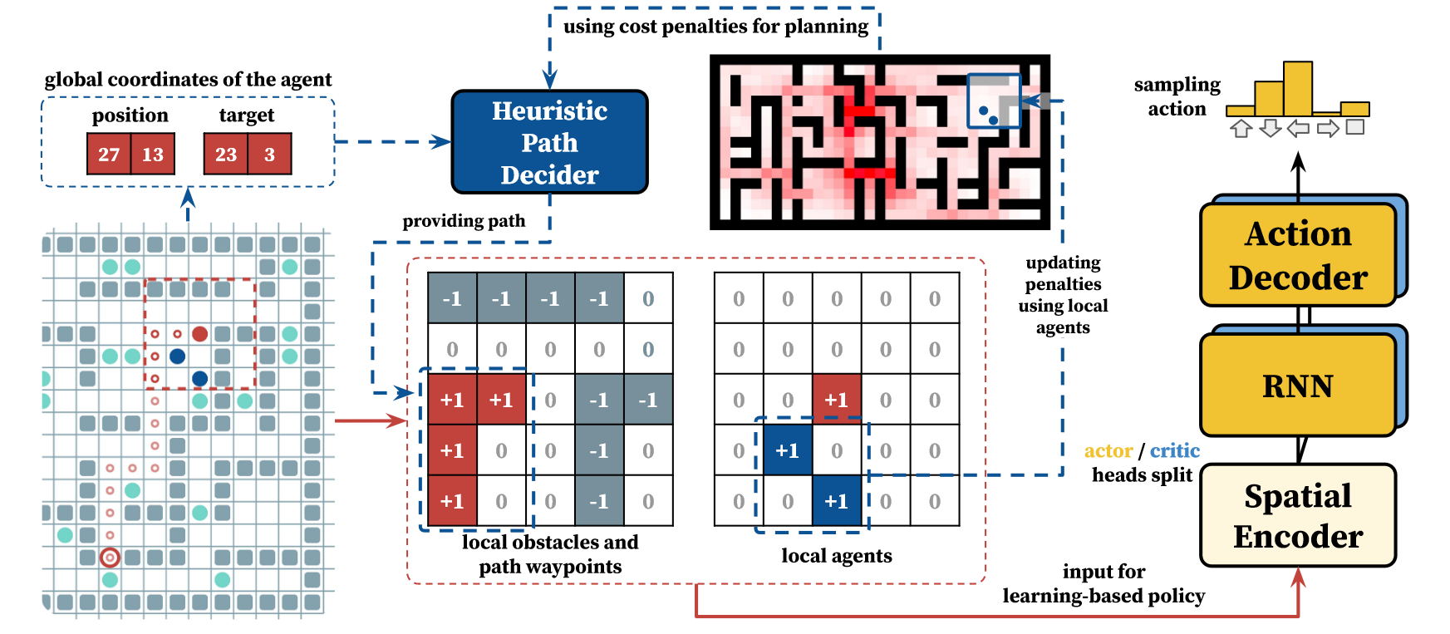
Learn to Follow: Decentralized Lifelong Multi-Agent Pathfinding via Planning and Learning
Planning
A*
Other agents are not taken into account
Penalizing frequently used cells
(Reinforcement) Learning
PPO
Local observation (path segment, other agents, obstacles)
Decentralized (fast) learning
Simplistic reward (achieve a waypoint = reward)
Notes:
To eliminate it we need to constrain one of the agents NOT to occupy this node at timestep two.
It can be either green agent.

Slide 59
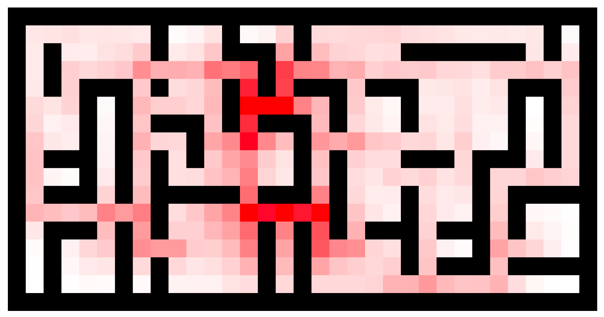
Learn to Follow: Decentralized Lifelong Multi-Agent Pathfinding via Planning and Learning
Planning
A*
Other agents are not taken into account
Penalizing frequently used cells
Notes:
To eliminate it we need to constrain one of the agents NOT to occupy this node at timestep two.
It can be either green agent.

Slide 60
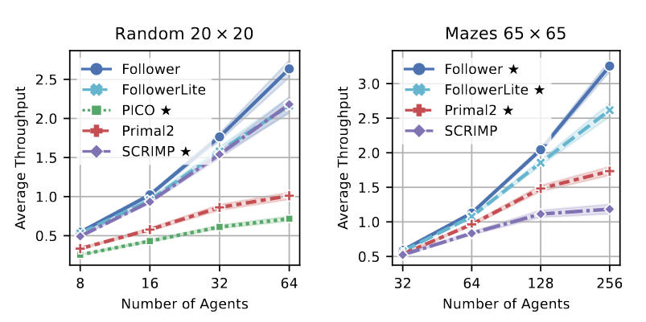
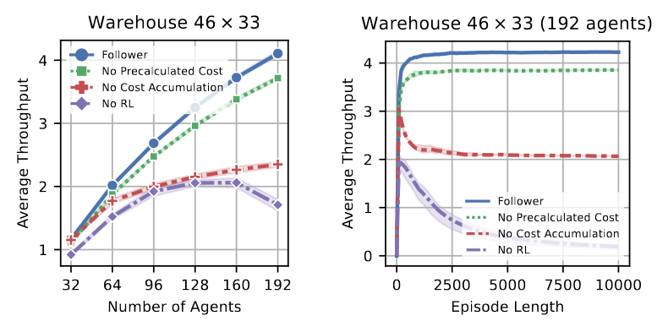
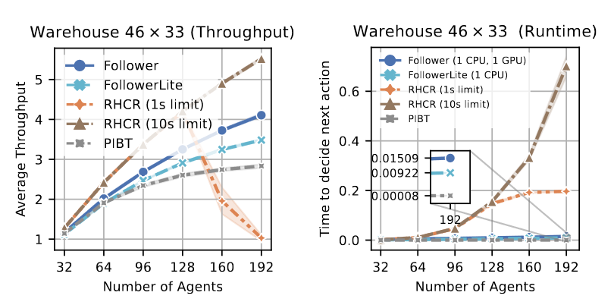
Learn to Follow: Decentralized Lifelong Multi-Agent Pathfinding via Planning and Learning
Empirical Results
Outperform (learnable) competitors in terms of solution quality and ability to generalize
Better scalability compared to centralized planners
Both components — planning and learning — are crucial
Notes:
To eliminate it we need to constrain one of the agents NOT to occupy this node at timestep two.
It can be either green agent.

Slide 61
Learn to Follow: Decentralized Lifelong Multi-Agent Pathfinding via Planning and Learning
Planning only
Planning + Learning
# goals achieved by the red agent = 0
# goals achieved by all agents = 36
Throughput (512 steps, 32 agents) = 0.07
# goals achieved by the red agent = 10
# goals achieved by all agents = 330
Throughput (512 steps, 32 agents) = 0.64
Notes:
To eliminate it we need to constrain one of the agents NOT to occupy this node at timestep two.
It can be either green agent.

Slide 62
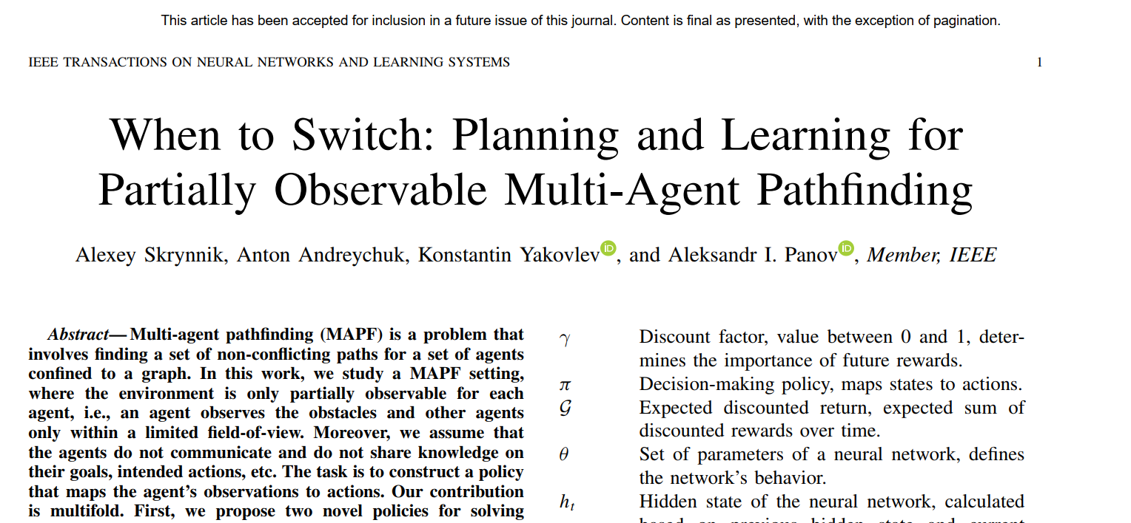
SWITCHER
https://ieeexplore.ieee.org/document/10236574
Notes:
To eliminate it we need to constrain one of the agents NOT to occupy this node at timestep two.
It can be either green agent.

Slide 63
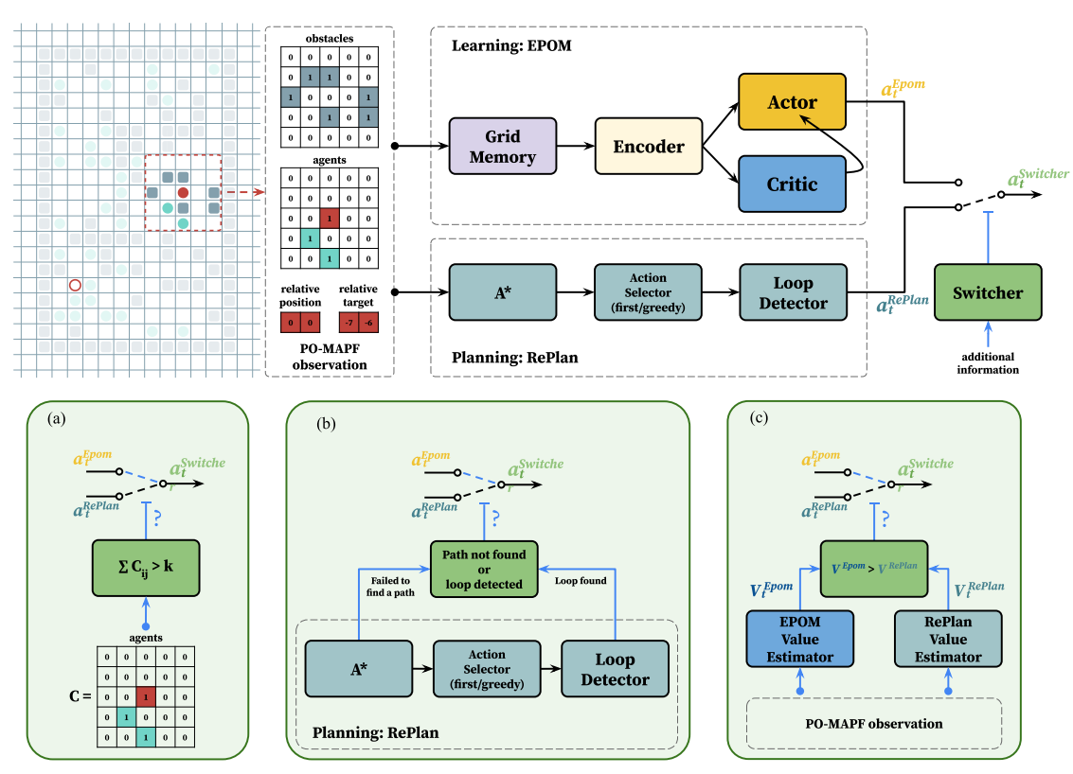
When to Switch: Planning and Learning for Partially Observable Multi-Agent Pathfinding
Notes:
To eliminate it we need to constrain one of the agents NOT to occupy this node at timestep two.
It can be either green agent.

Slide 64
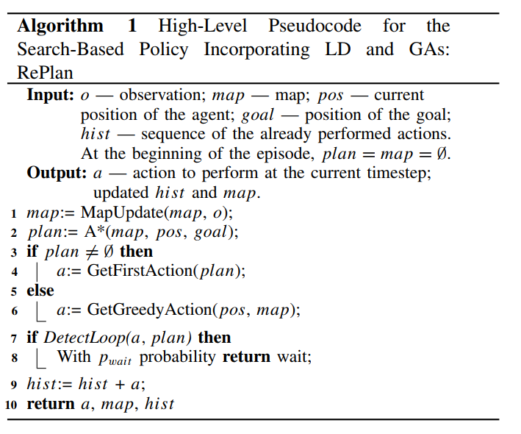
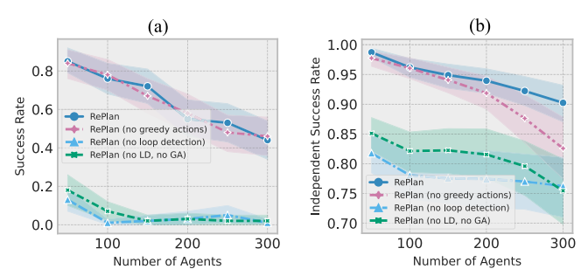
When to Switch: Planning and Learning for Partially Observable Multi-Agent Pathfinding
Notes:
To eliminate it we need to constrain one of the agents NOT to occupy this node at timestep two.
It can be either green agent.

Slide 65
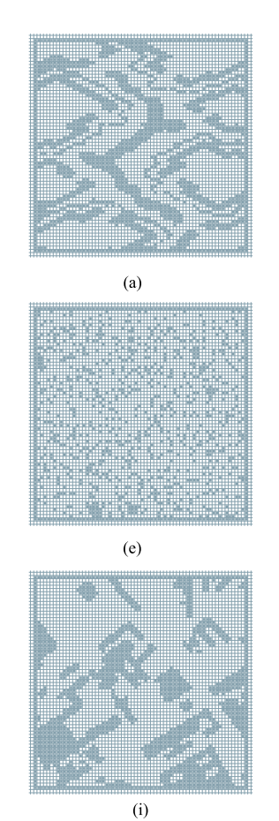
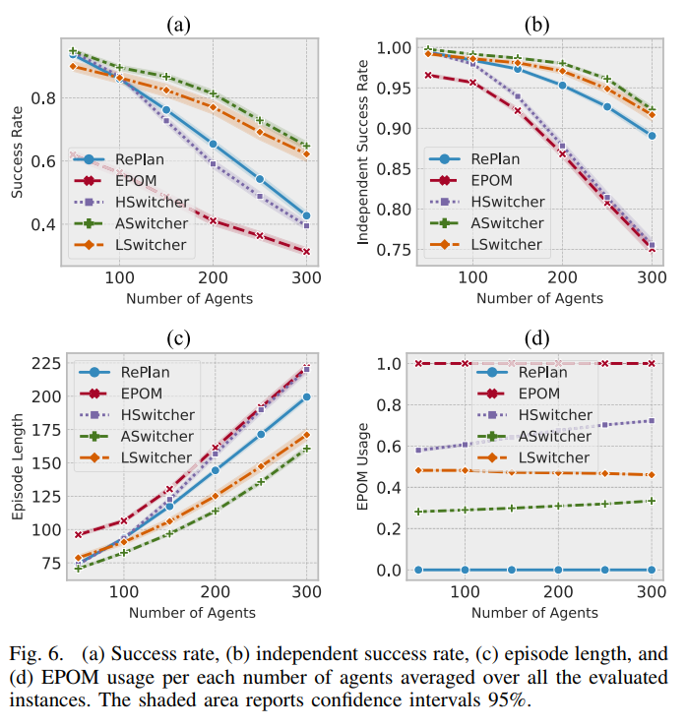
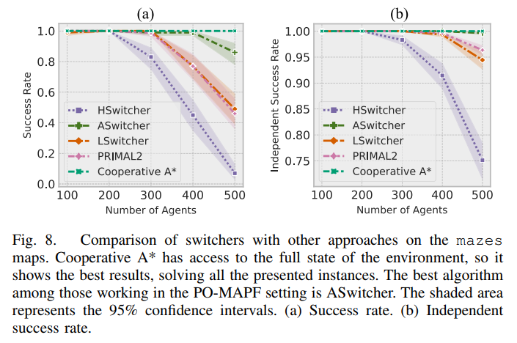
When to Switch: Planning and Learning for Partially Observable Multi-Agent Pathfinding
Notes:
To eliminate it we need to constrain one of the agents NOT to occupy this node at timestep two.
It can be either green agent.

Slide 66
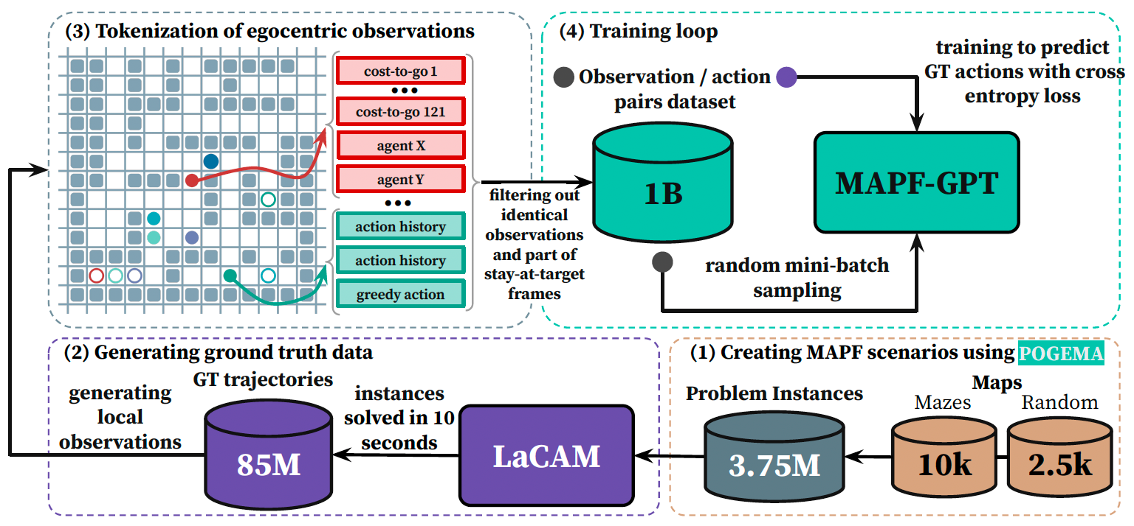
MAPF-GPT: Imitation Learning for Multi-Agent Pathfinding at Scale
Andreychuk, A., Yakovlev, K., Panov, A. and Skrynnik, A., 2024. MAPF-GPT: Imitation Learning for Multi-Agent Pathfinding at Scale. Preprint under review, arXiv:2409.00134.
Notes:
To eliminate it we need to constrain one of the agents NOT to occupy this node at timestep two.
It can be either green agent.

Slide 67
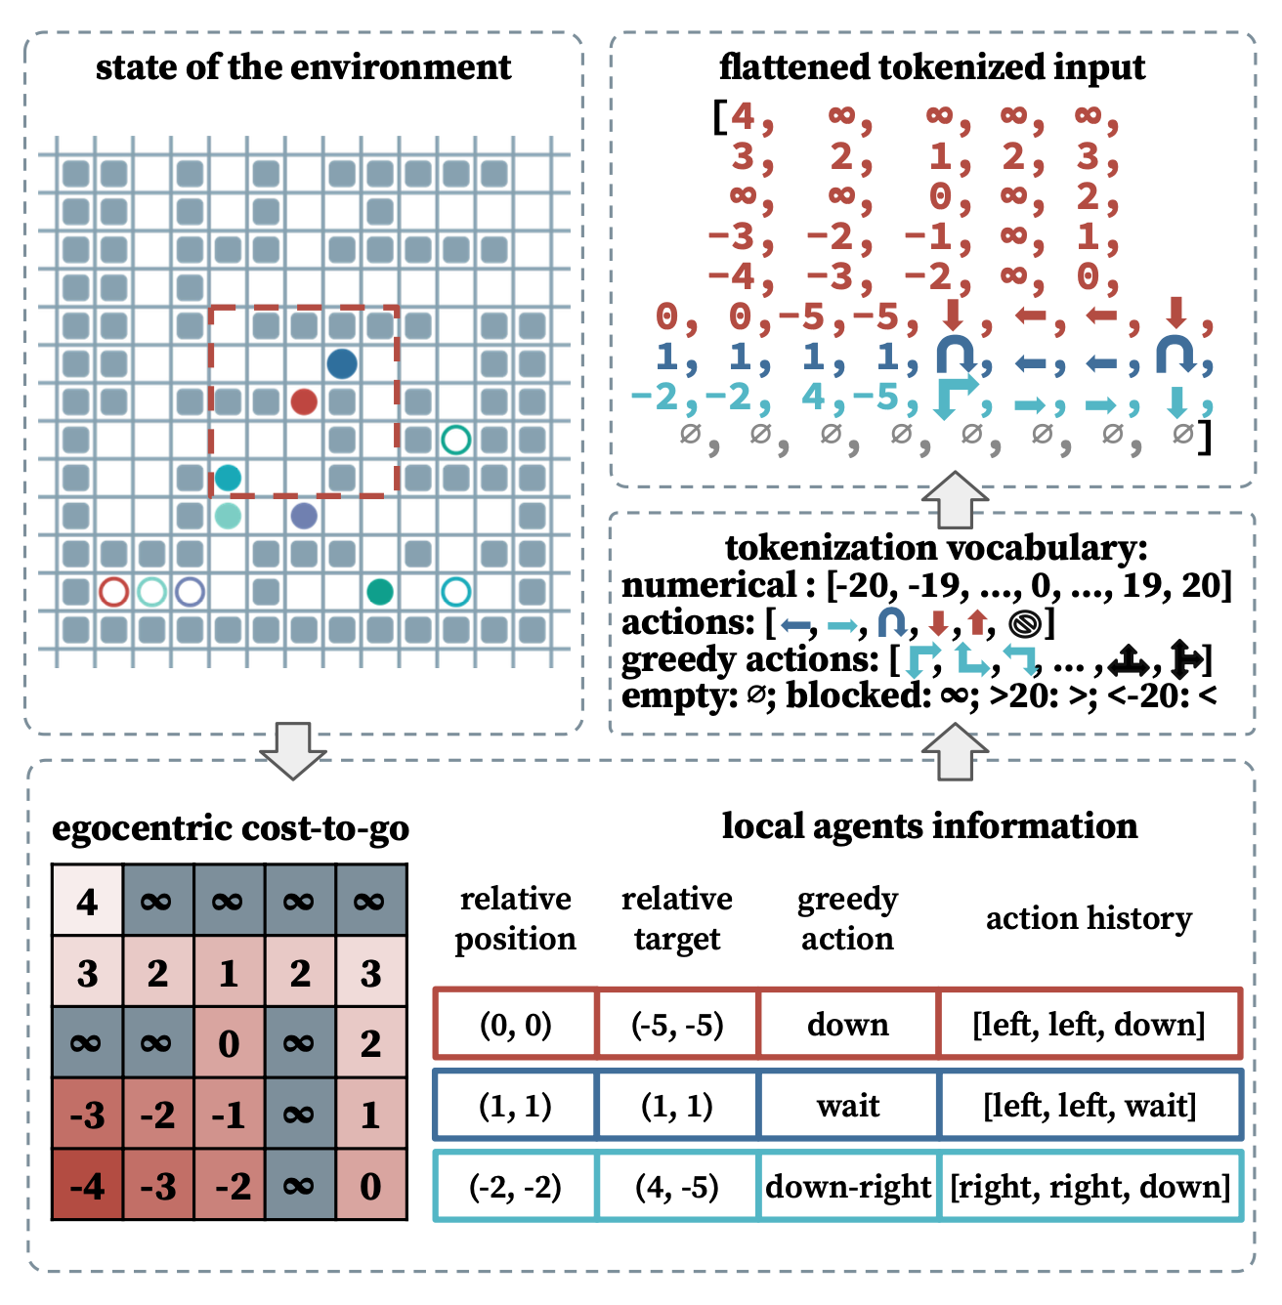
Tokenization
MAPF-GPT: Imitation Learning for Multi-Agent Pathfinding at Scale
The input consists of 256 tokens, but the example shown uses fewer tokens for clarity and visibility.
The local observation of an agent at a certain time step while following its (expert) path is composed of two parts: egocentric cost-to-go in local 11×11 field of view and data about the agent itself and the nearby ones.
The information about each agent is encoded via 10 tokens: 2 for the current position, 2 for goal location, 5 for action history, and 1 for the next greedy action.
Notes:
To eliminate it we need to constrain one of the agents NOT to occupy this node at timestep two.
It can be either green agent.

Slide 68
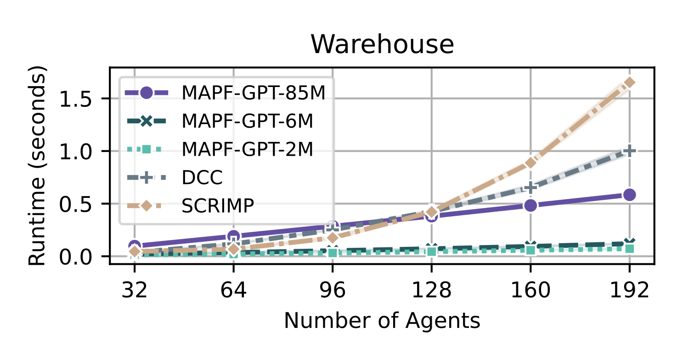
MAPF-GPT: Imitation Learning for Multi-Agent Pathfinding at Scale
SOTA performance with pure imitation learning
Notes:
To eliminate it we need to constrain one of the agents NOT to occupy this node at timestep two.
It can be either green agent.

Slide 69
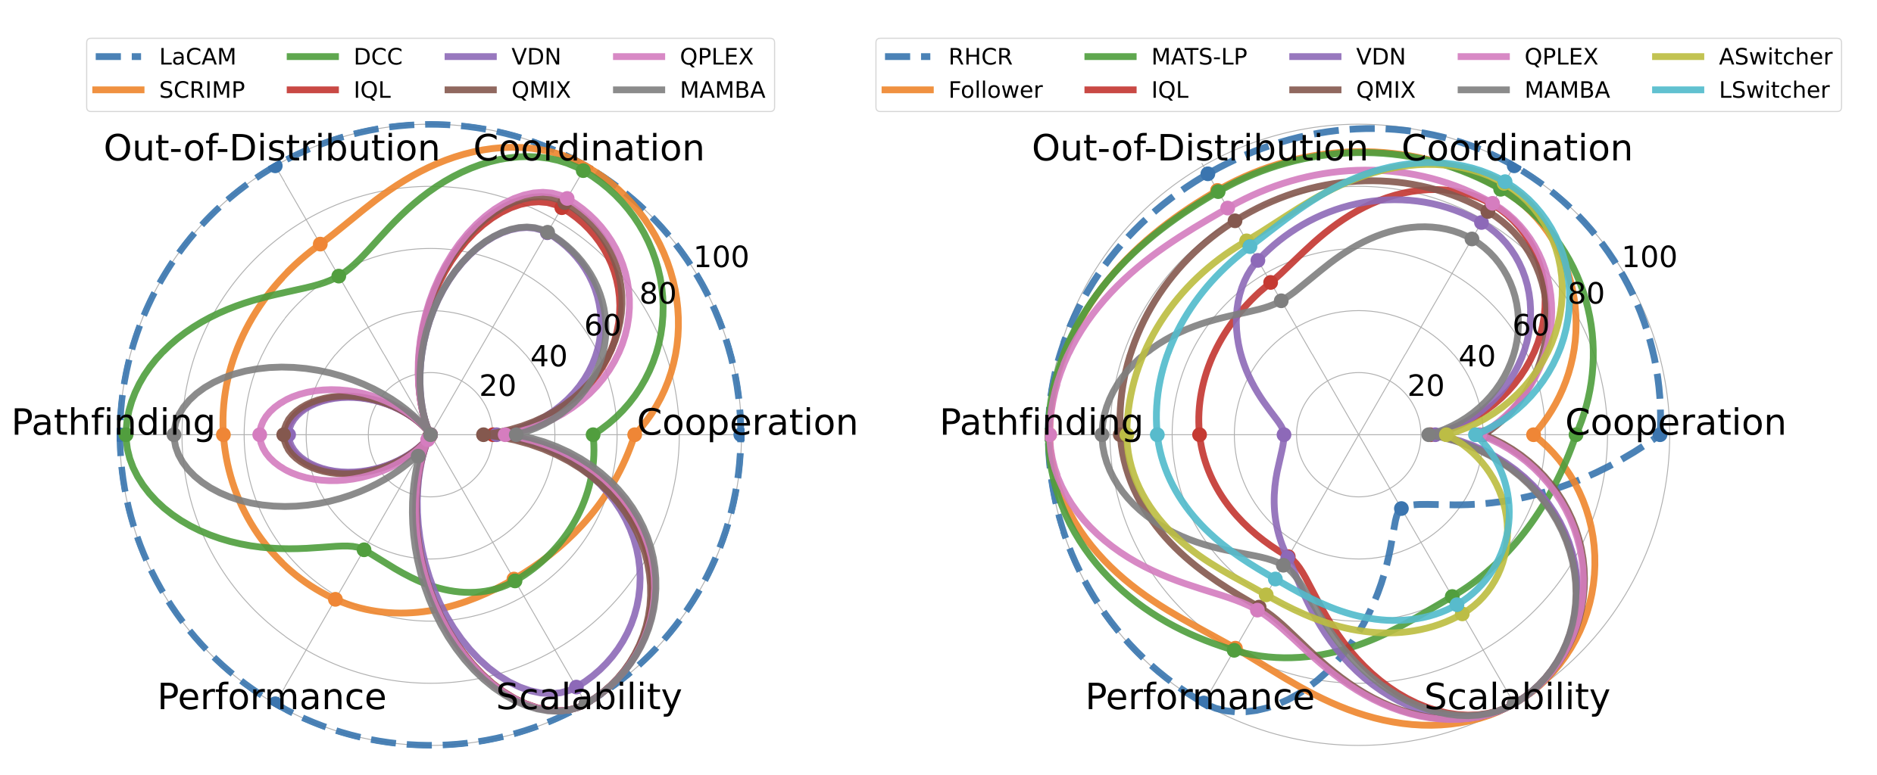
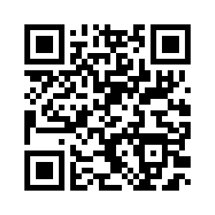
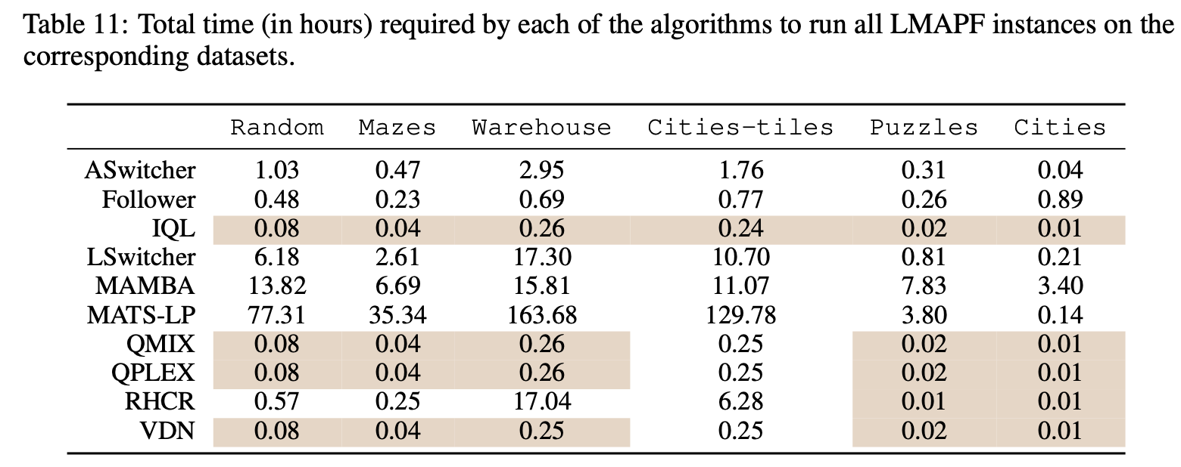
POGEMA: A Benchmark Platform for Cooperative Multi-Agent Pathfinding
Fast environment
POGEMA
https://github.com/Cognitive-AI-Systems/pogema
+ Benchmark (maps, tasks)
+ Metrics (cooperation, coordination, pathfinding etc.)
+ Automated evaluation
+ Baselines
+ Visualization tools
https://openreview.net/forum?id=6VgwE2tCRm
Notes:
To eliminate it we need to constrain one of the agents NOT to occupy this node at timestep two.
It can be either green agent.

Slide 70
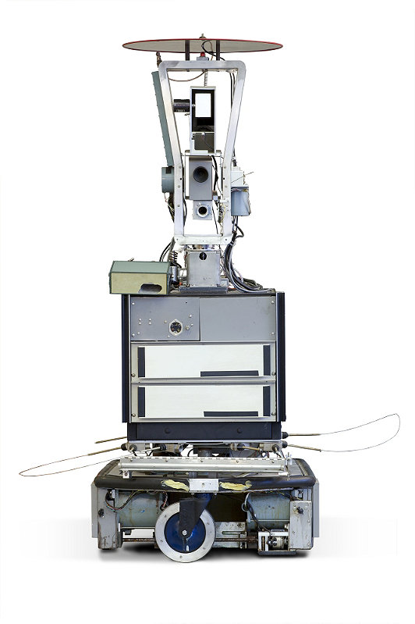
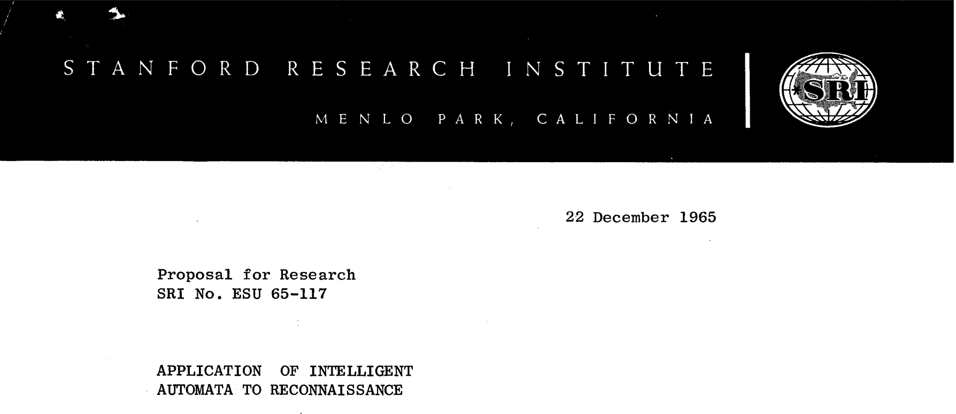
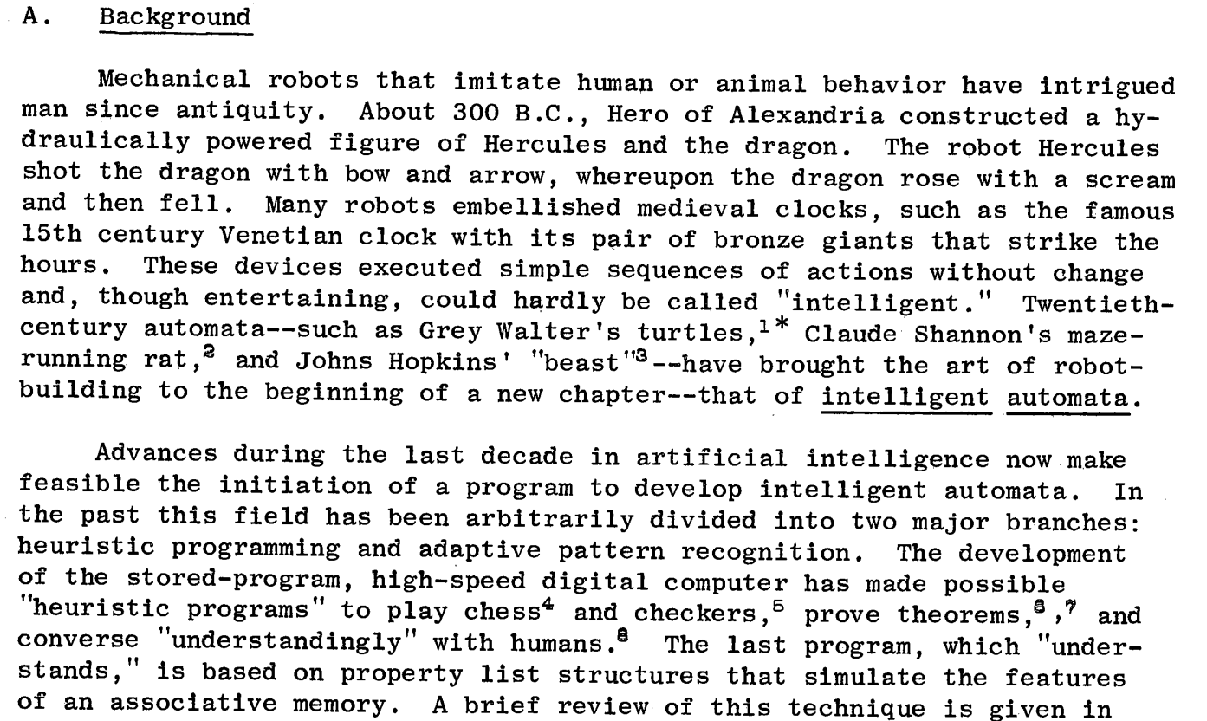
A minute of history in the end
Robot Shakey (1967))
https://www.youtube.com/watch?v=7bsEN8mwUB8
Notes:
To eliminate it we need to constrain one of the agents NOT to occupy this node at timestep two.
It can be either green agent.

