Slide 1

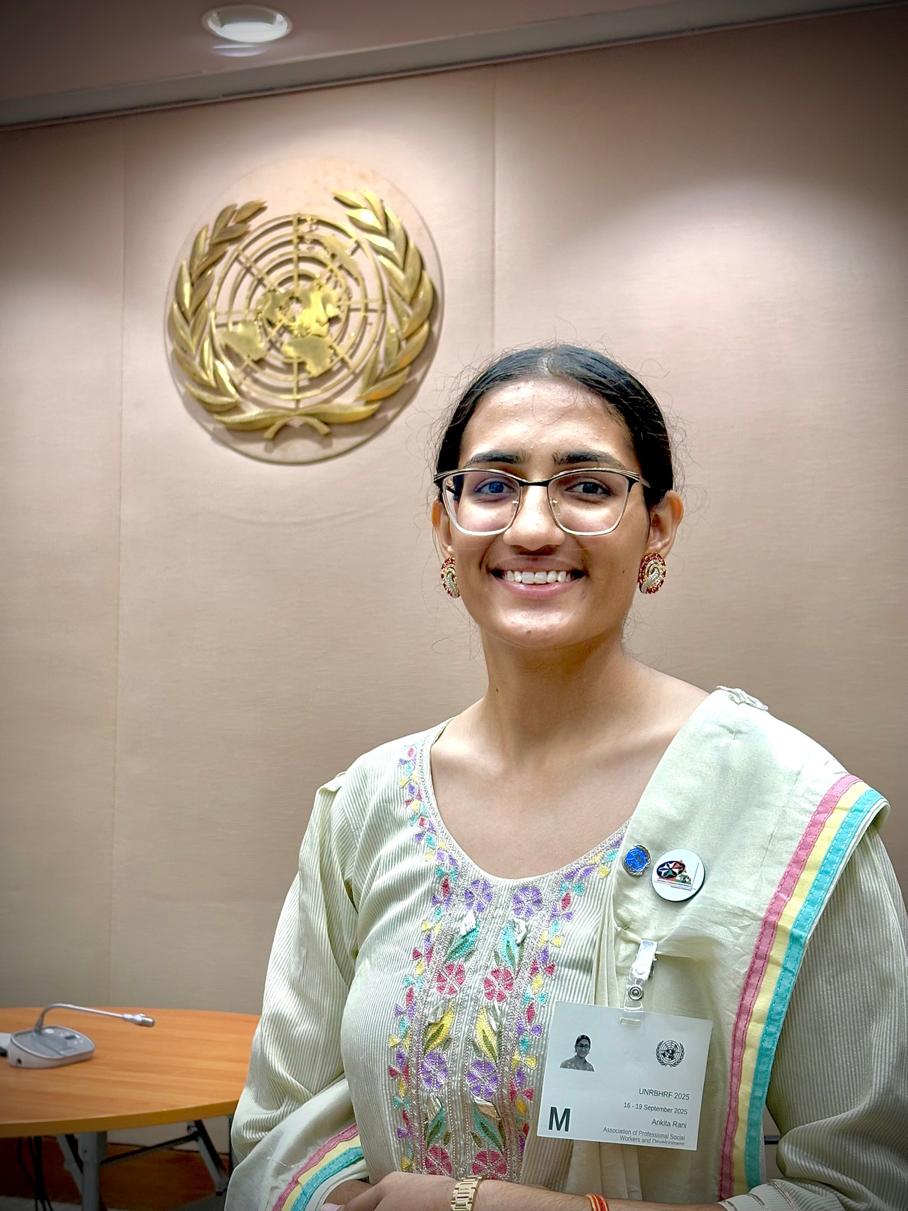
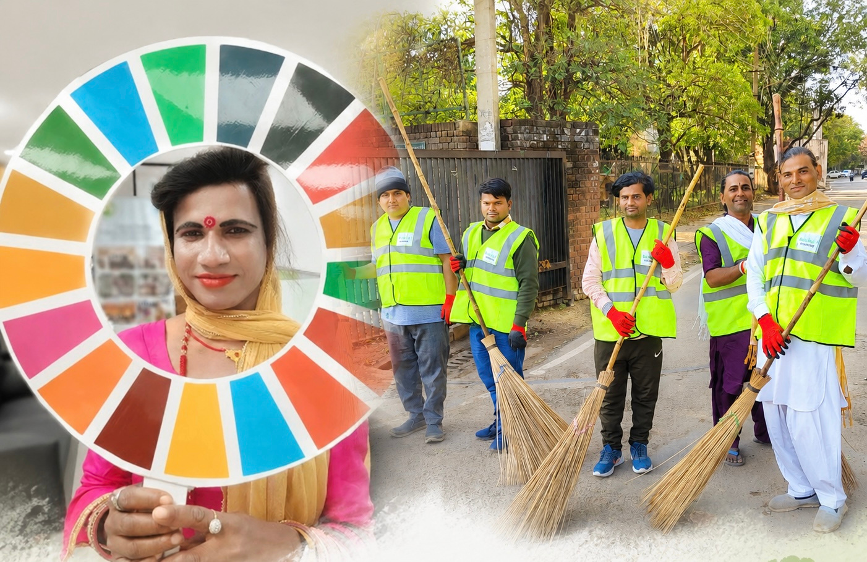
SAMTA
NYAY KENDRA
Drop In Centre for LGBTQ+ Community
ANKITA RANI
NOMINATION: HUMAN ASSISTANCE
REGION: CHANDIGARH
COUNTRY: INDIA

Slide 2



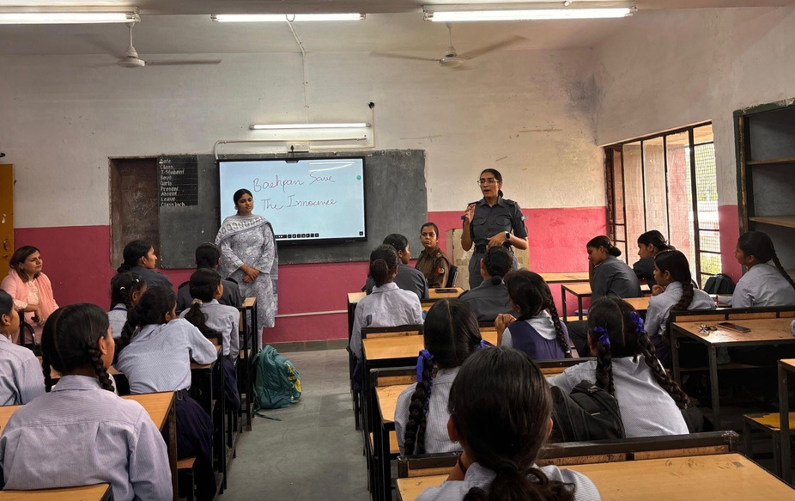
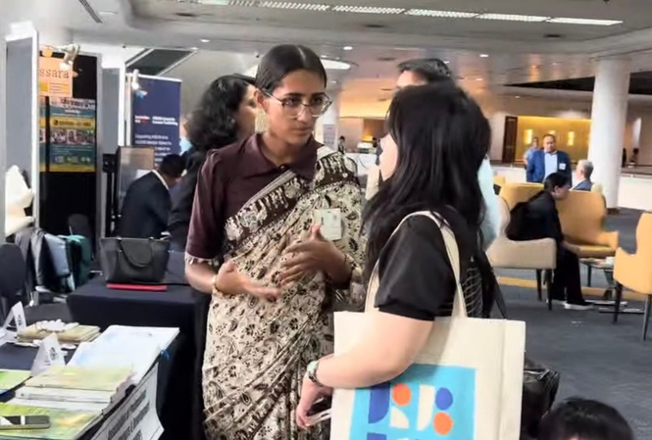
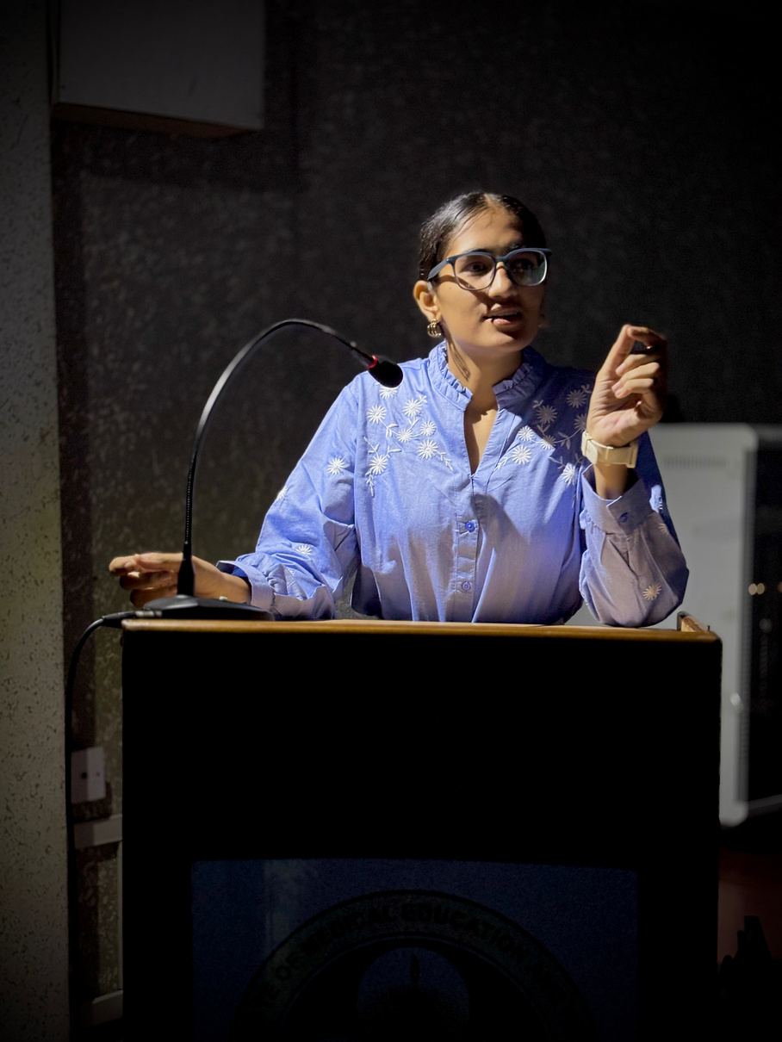
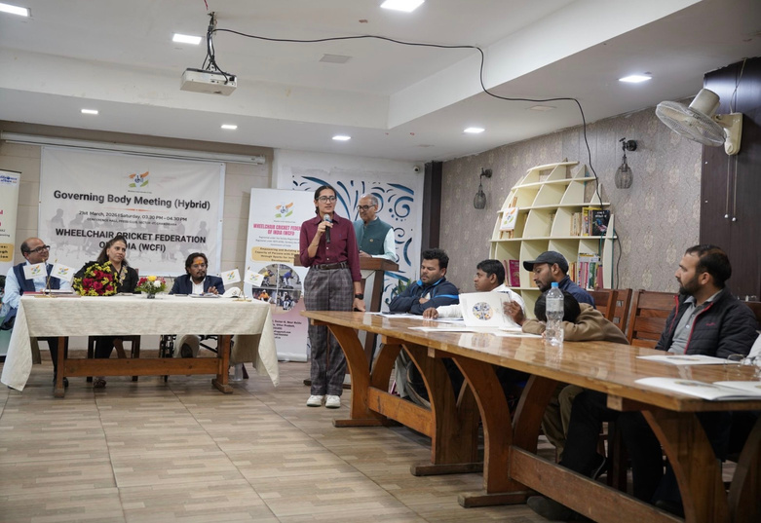
My roles & Contribution
“Youth Face of the Project”
  Social Development Officer (Hon.) – Supporting planning, implementation, outreach and coordination.
  Community Mobilisation – Connecting volunteers, beneficiaries and local stakeholders.
  Partnership Development – Building collaborations with NGOs, institutions and government stakeholders.
  Resource Mobilisation – Exploring CSR partnerships, grants and funding opportunities.
  Scale-up Strategy – Currently working to engage larger organisations and CSR partners to expand the project’s reach, resources and long-term sustainability.

Slide 3










Context
TARGET AUDIENCE
PROBLEM
GOALS
OBJECTIVES
VOLUNTEERS
RESULTS AND IMPACTS
PARTNERS & RESOURCES
RECOGNITION, MEDIA COVERAGE, GALLERY
LINK TO ACTIVITY REPORTS
FUTURE ROADMAP

Slide 4


Target audience
  TRANSGENDERS (Major)
  LGBTQ+ COMMUNITY

Slide 5






Problem
FAMILY & SOCIAL REJECTION
EDUCATION
INTERRUPTED
LIVELIHOOD
WITHOUT CHOICE
HEALTHCARE &
WELFARE BARRIERS
JUSTICE & COMMUNITY CHALLENGES
  Family rejection can force transgender persons out of their homes and support systems.
  Social stigma, harassment and discrimination restrict participation in everyday community life.
  Lack of family support, bullying and discrimination can force young transgender persons to discontinue education.
  Limited education reduces access to dignified employment and economic independence.
  Exclusion from formal employment can push some transgender persons towards begging and other informal livelihoods.
  Workplace harassment and discrimination can make it difficult to retain employment.
  Transgender persons may face stigma and discrimination while accessing healthcare and other essential services.
  Gaps in identity documents, welfare access and legal support can increase vulnerability.
  Lack of awareness and access to legal services can prevent people from effectively addressing discrimination and violence.
  Internal community disputes and misrepresentation by non-transgender persons engaged in begging can reinforce negative stereotypes.

Slide 6





EVIDENCE THAT THE PROBLEM EXISTS
GOVERNMENT OF INDIA
SUPREME COURT OF INDIA
NATIONAL HUMAN
RIGHTS COMMISSION
UNDP INDIA/ UNITED NATIONS
APSWDP
Transgender Persons (Protection of Rights)
Act, 2019
Legal framework that prohibits discrimination and ensures equal access to education, employment, healthcare, housing and services.
NALSA v. Union of India
(2014)
Landmark judgment recognizing transgender persons as a third gender and affirming their constitutional rights, dignity, equality and self-identification.
Studies document discrimination, social exclusion, unemployment, violence and barriers in healthcare and education faced by transgender communities in India.
Reports highlight stigma, livelihood insecurity, socio-economic exclusion and healthcare discrimination experienced by transgender communities in India.
Grassroots documentation through Virtual Conclave reports the community challenges related to legal exclusion, lack of identity documents, livelihood barriers and mental health concerns.

Slide 7


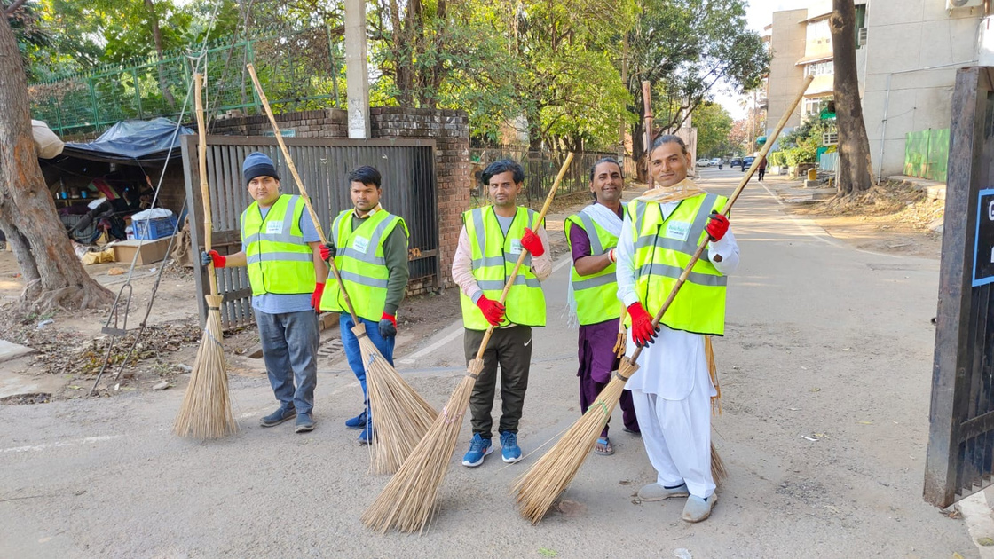



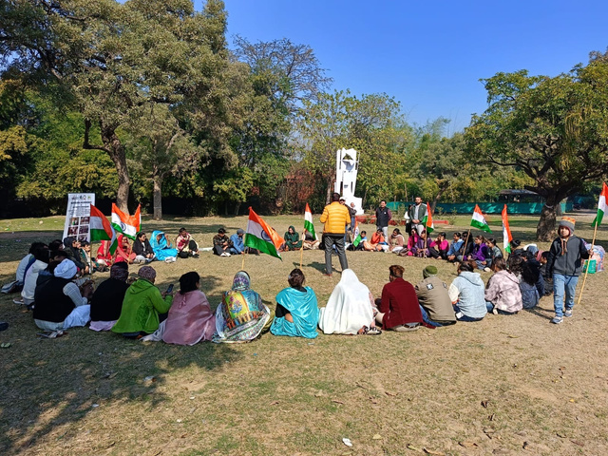
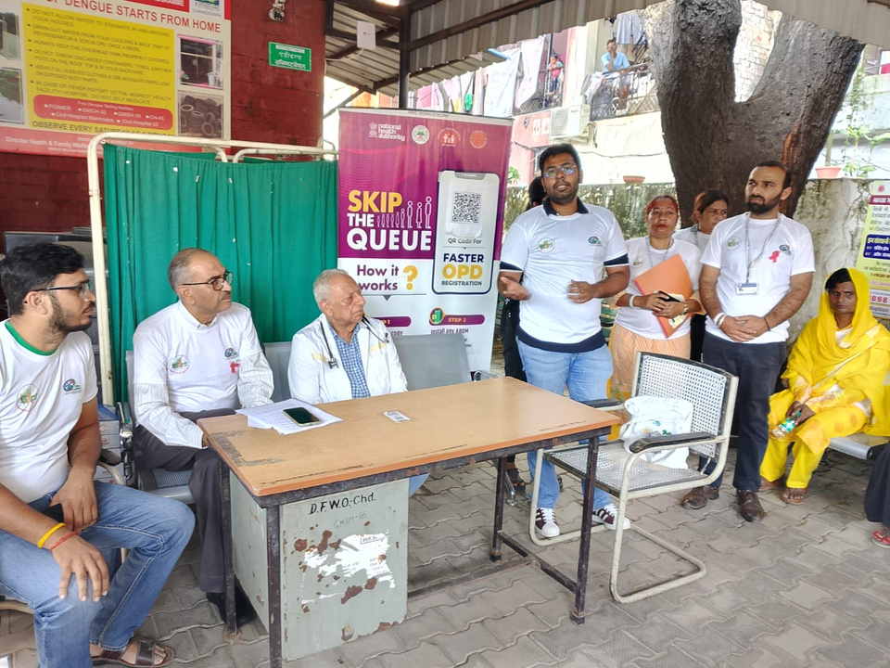
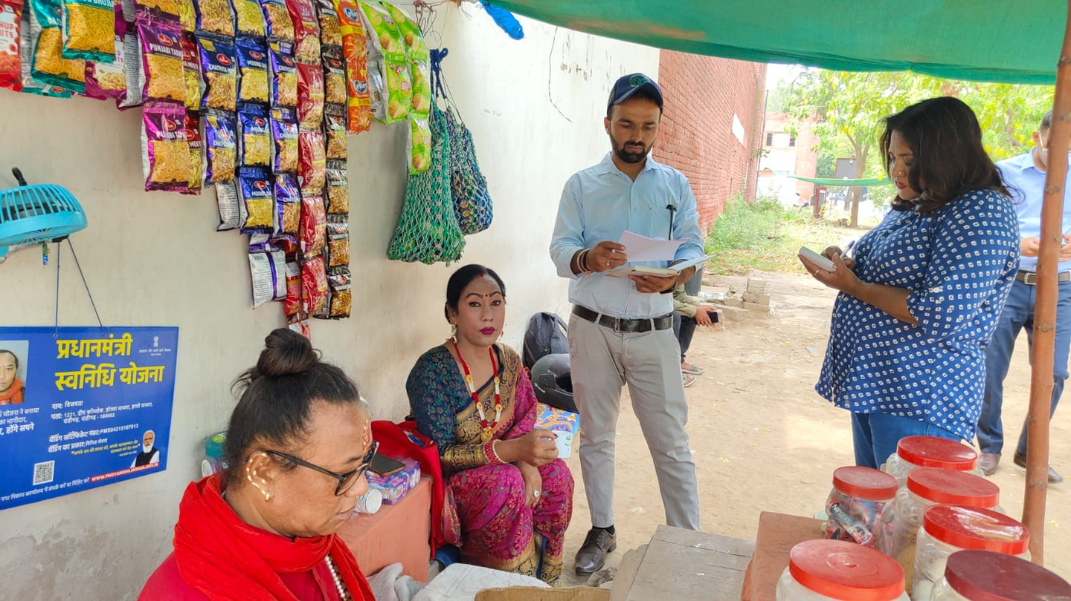


Goals
Dignity, Equality & Social Inclusion
A society where transgender persons live with dignity, equality, acceptance and freedom from discrimination.
Rights, Justice & Protection
An environment where transgender persons can exercise their legal and constitutional rights and seek justice without fear or exclusion.
Economic Independence
Sustainable economic self-reliance through dignified livelihoods, employment and entrepreneurship.
Equitable Access to Essential Services
Equal and barrier-free access to healthcare, education, welfare schemes, identity documentation and other public services.
Empowered Community Leadership
A strong transgender community capable of representing its interests, participating in decision-making and leading change.
Sustainable Community Empowerment
A long-term, community-led ecosystem that enables transgender persons to move from vulnerability and dependence toward inclusion, resilience and self-reliance.

Slide 8
Legal Aid & Grievance Support
Facilitate free legal aid, legal counselling, grievance redressal and case support through DLSA/SLSA and other institutional linkages.
Livelihood & Financial Inclusion
Connect community members with skill development, employment, entrepreneurship, SHGs, government schemes and other livelihood opportunities.
Identity & Entitlement Facilitation
Assist transgender persons in obtaining identity documents and accessing eligible government welfare schemes, services and entitlements.
Awareness & Sensitisation
Conduct legal-literacy programmes, sensitisation workshops, advocacy initiatives and community events to address stigma and discrimination.
Objectives
Community Mobilisation & Leadership Development
Build community leadership, encourage participation in decision-making and strengthen community-led mechanisms for sustained empowerment.
Health & Psychosocial Support
Provide counselling, emotional support, healthcare referrals and linkages to appropriate health and social-support services.

Slide 9
Involvement of volunteers
STUDENTS
Events, awareness programmes & capacity-building workshops
WORKING
PROPESSIONALS
Planning, coordination, process support & improvement
Volunteers
TRANSGENDER & LGBTQ+ VOLUNTEERS
Community outreach, trust-building & beneficiary mobilisation
ADVOCATES
Legal advice, representation & case support
PARA-LEGAL VOLUNTEERS
Legal awareness, documentation & DLSA/SLSA linkage

Slide 10





Results and Impact
LEGAL EMPOWERMENT
200+ IDENTITY CARDS
90 TRANSGENDER INVOLVED IN SHGS
Improved access to free legal aid, counselling and grievance redressal through DLSA/SLSA linkages.
Linked with public service contracts, self-employment, main stream education and small-business loans to create dignified and sustainable livelihood opportunities.
Supported transgender persons in obtaining legal identity and accessing government services and entitlements.
BETTER SERVICE ACCESS
1,000+ PEOPLE REACHED
GREATER INCLUSION & SELF-RELIANCE
Directly and indirectly engaged through legal awareness, sensitisation, outreach and community activities.
  Increased rights awareness and confidence
  Greater social participation and acceptance
  Pathways toward economic empowerment and independence
  Healthcare
  Welfare schemes
  Documentation support
  Psychosocial counselling and emotional support

Slide 11
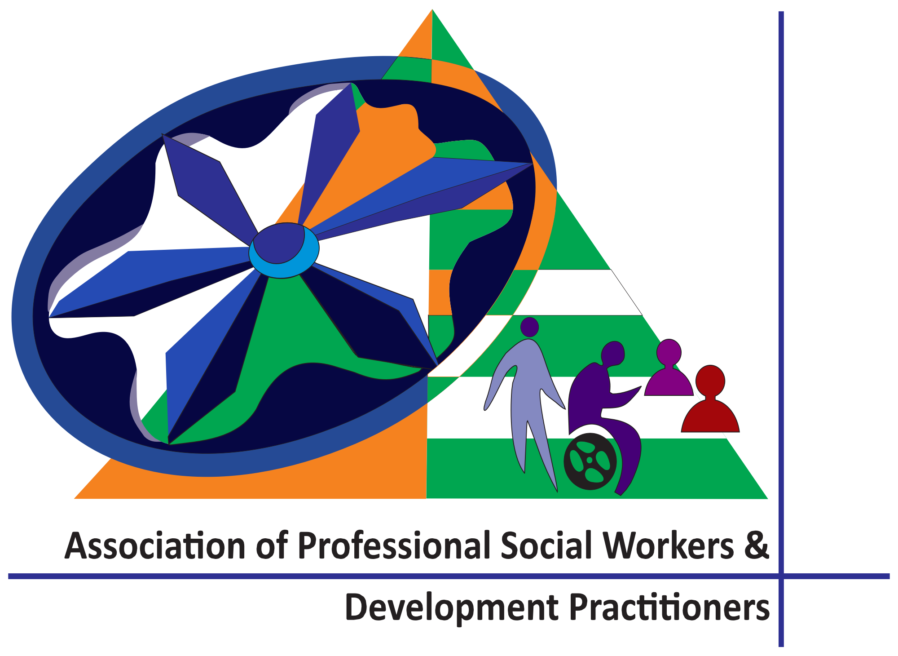





Partners and resources
  Crime Control & Social Development Organisation (CCSDO)
  Youth for Voluntary Action in Himachal (YOUVAH)
  Global Youth Federation
  Police Department
  Government Schools
  Municipal Corporation Chandigarh
  Association of Professional Social Workers and Development Practitioners (APSWDP)– CTI Project
  Public Health Department
Together, these partner organisations support SAMTA NYAY KENDRA in:
Resource Mobilisation • Planning • Coordination • Community Outreach • Community Event Execution • Institutional Linkages • Crisis Management

Slide 12
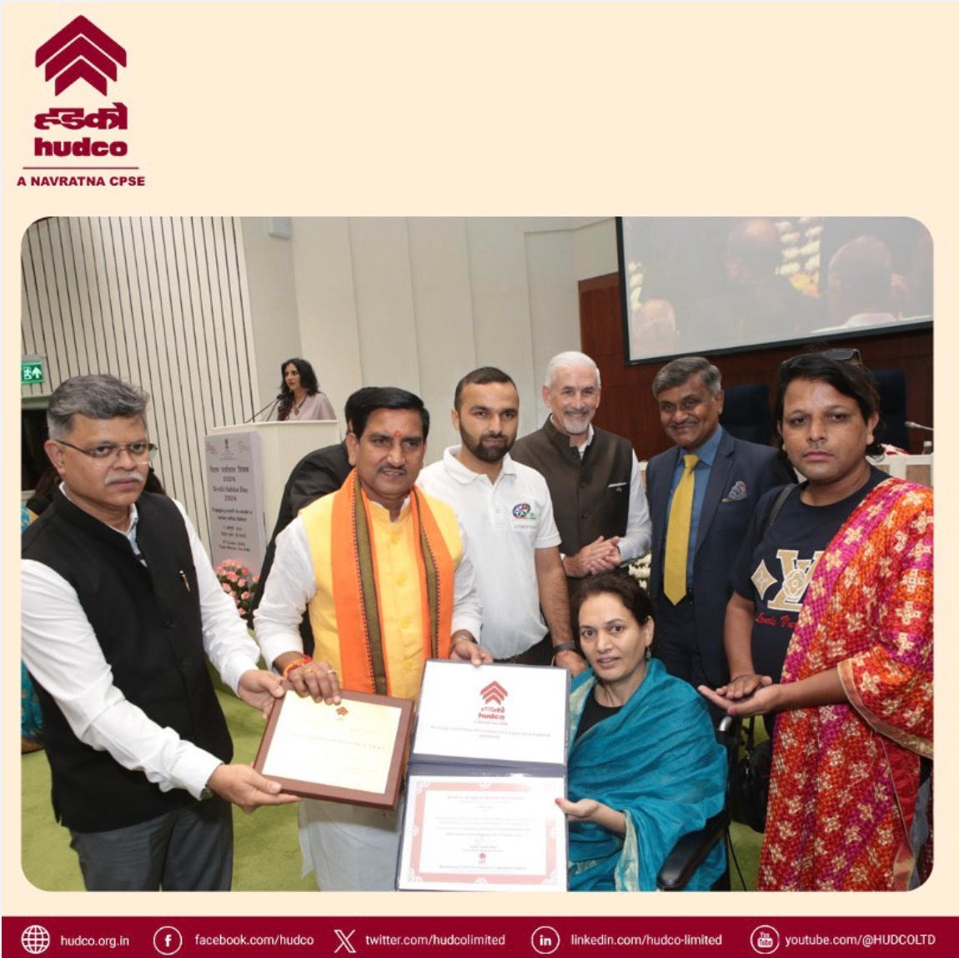
RECOGNITION
  Recognised SAMTA NYAY KENDRA as a Best Practice under Housing, Urban Poverty & Infrastructure.
  For work on mainstreaming transgender and High-Risk Communities.
HUDCO BEST PRACTICE AWARD 2024

Slide 13
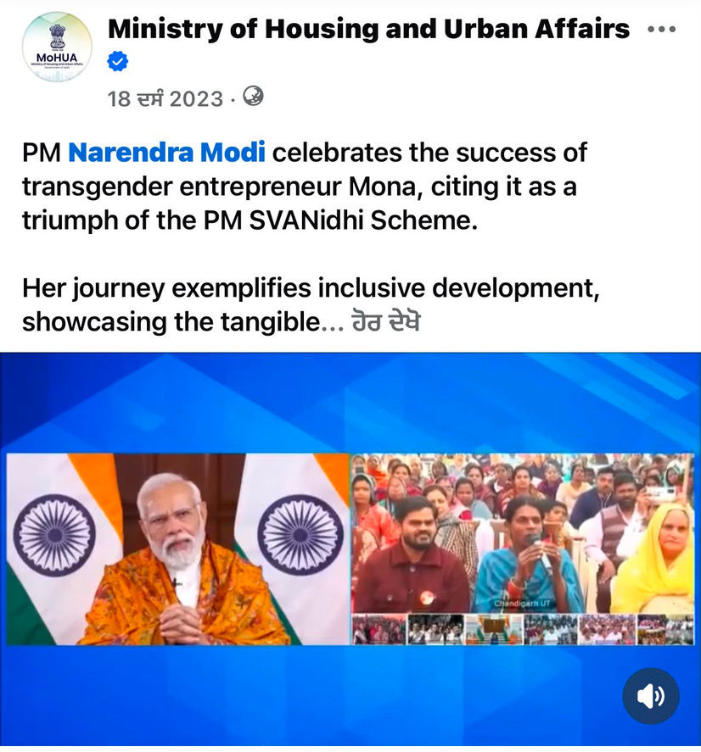
RECOGNITION
Featured in Mann Ki Baat | Interaction with Hon’ble PM Narendra Modi
  Mona, one of our beneficiaries, interacted with Hon’ble Prime Minister Shri Narendra Modi during Mann Ki Baat.
  The Prime Minister appreciated her work and contribution.
PM Narendra Modi’s Words
Hindi: “आपका काम देखकर लग रहा है कि सरकार सही दिशा में चल रही है।”
English: “Looking at your work, it seems that the government is moving in the right direction.”
A proud moment reflecting the impact of grassroots community work.
https://www.facebook.com/mohua.india/posts/pm-narendra-modi-celebrates-the-success-of-transgender-entrepreneur-mona-citing-/765938932228837/
PM Narendra Modi Appreciates Mona’s Work

Slide 14
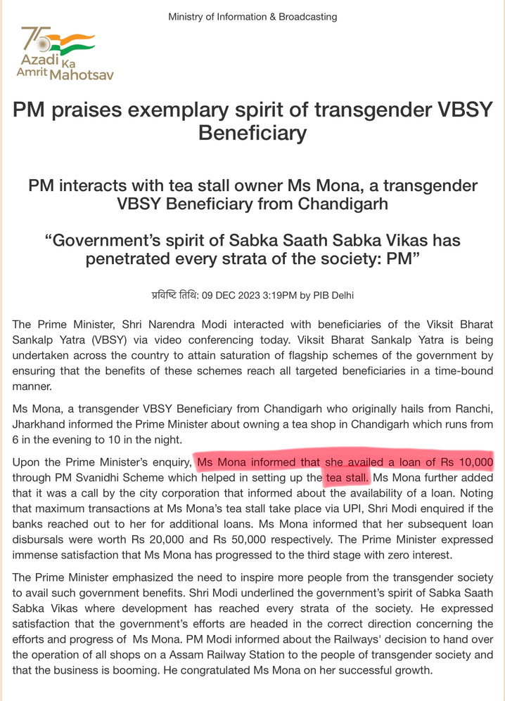
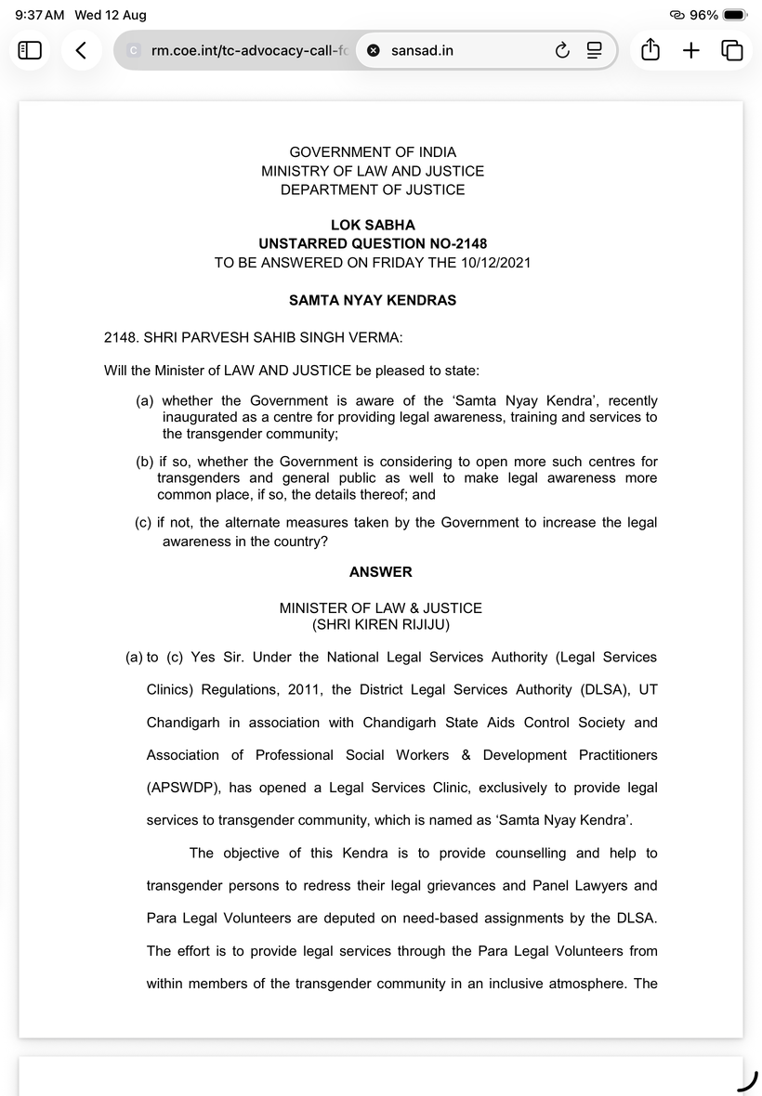
RECOGNITION
  Featured by the Ministry of Law & Justice / PIB as an exclusive legal services clinic for transgender persons.
  Government data recorded 265 beneficiaries in Chandigarh during June 2021-June 2022.
GOVERNMENT OF INDIA RECOGNITION

Slide 15
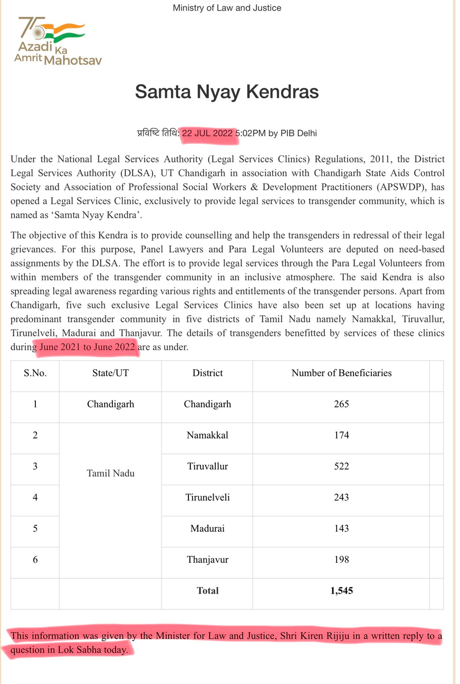
RECOGNITION
  Lok Sabha Recognition: Samta Nyay Kendra was discussed in the Lok Sabha as an inclusive legal-services model for transgender persons.
  Government-Recognised Impact: Featured by the Ministry of Law & Justice, Government of India, with 265 beneficiaries supported in Chandigarh during June 2021–June 2022.
https://www.pib.gov.in/PressReleaseIframePage.aspx?PRID=1843908®=48&lang=2
https://sansad.in/getFile/loksabhaquestions/annex/177/AU2148.pdf?source=pqals
REPRESENTED IN LOK SABHA

Slide 16
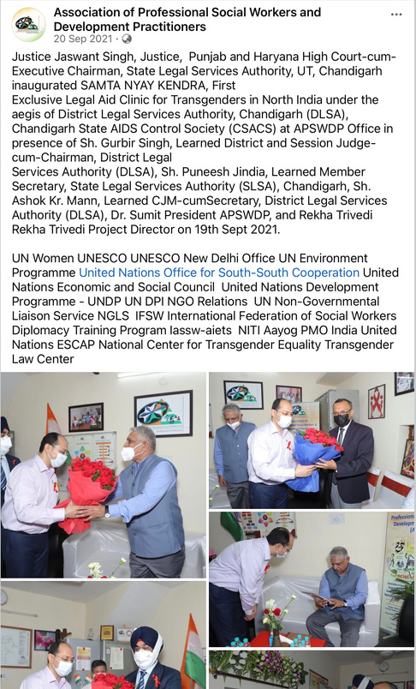
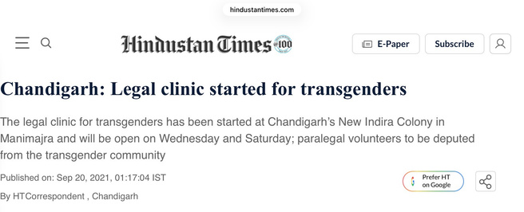
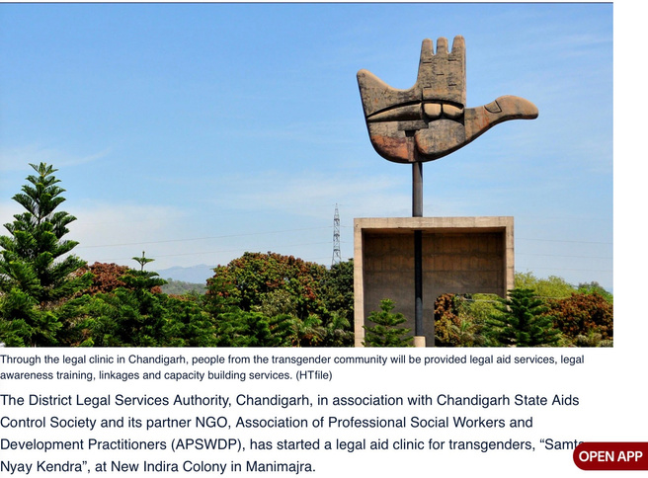
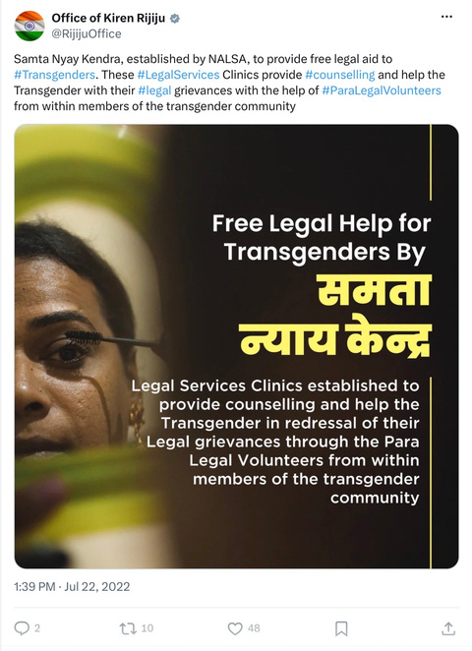
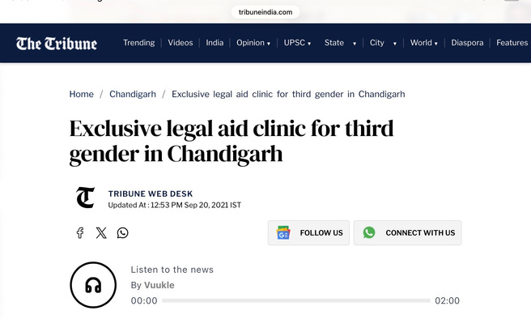
MEDIA COVERAGE
  Hindustan Times covered the launch of Samta Nyay Kendra as a dedicated legal aid clinic for transgender persons in Chandigarh.
  The Tribune highlighted it as a first-of-its-kind initiative for the third gender in Chandigarh.
  Punjab News Express covered its inauguration by Justice Jaswant Singh, Punjab & Haryana High Court.
NATIONAL MEDIA COVERAGE

Slide 17
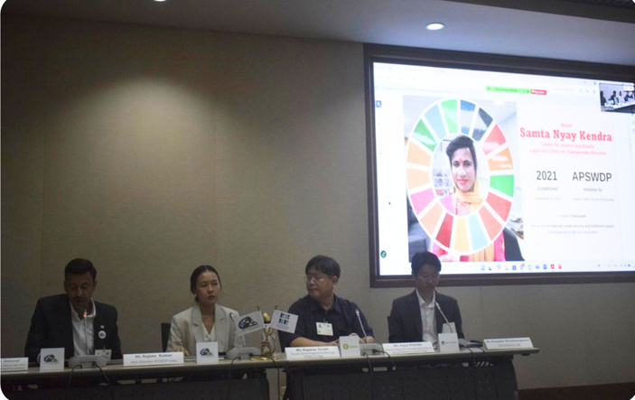
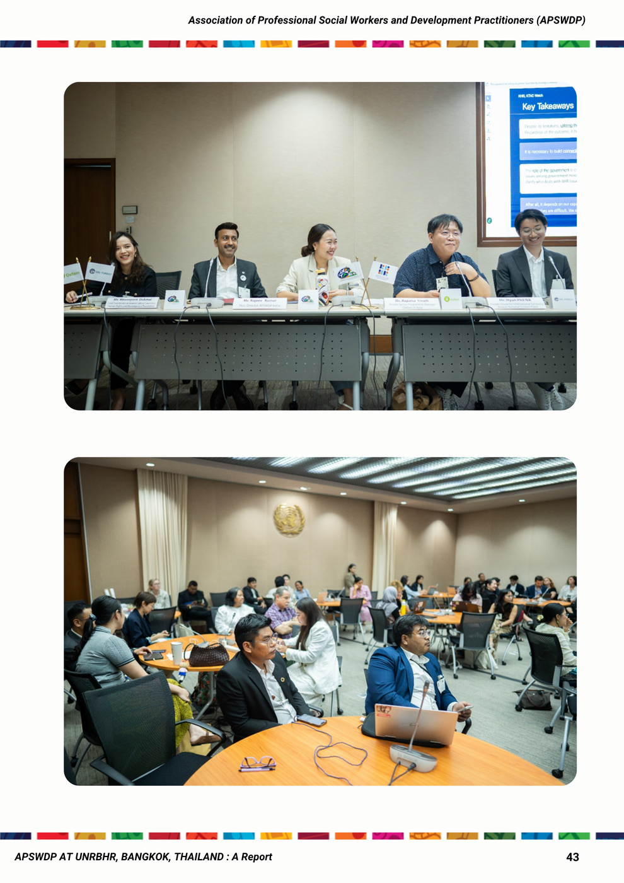
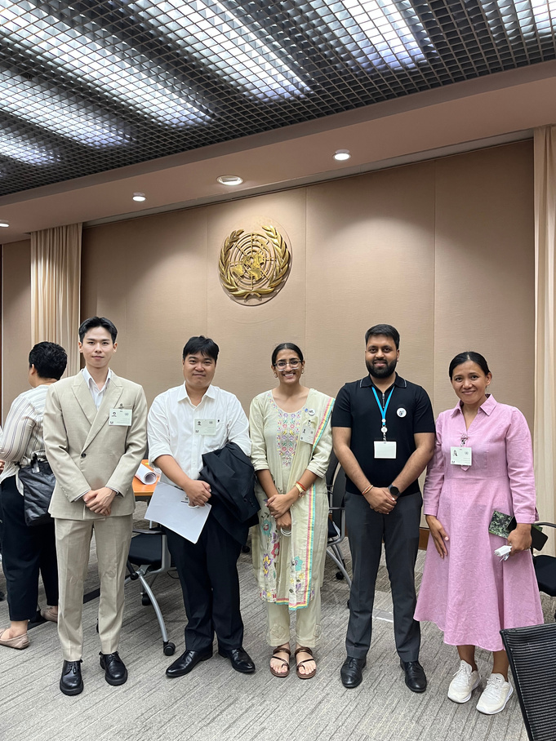
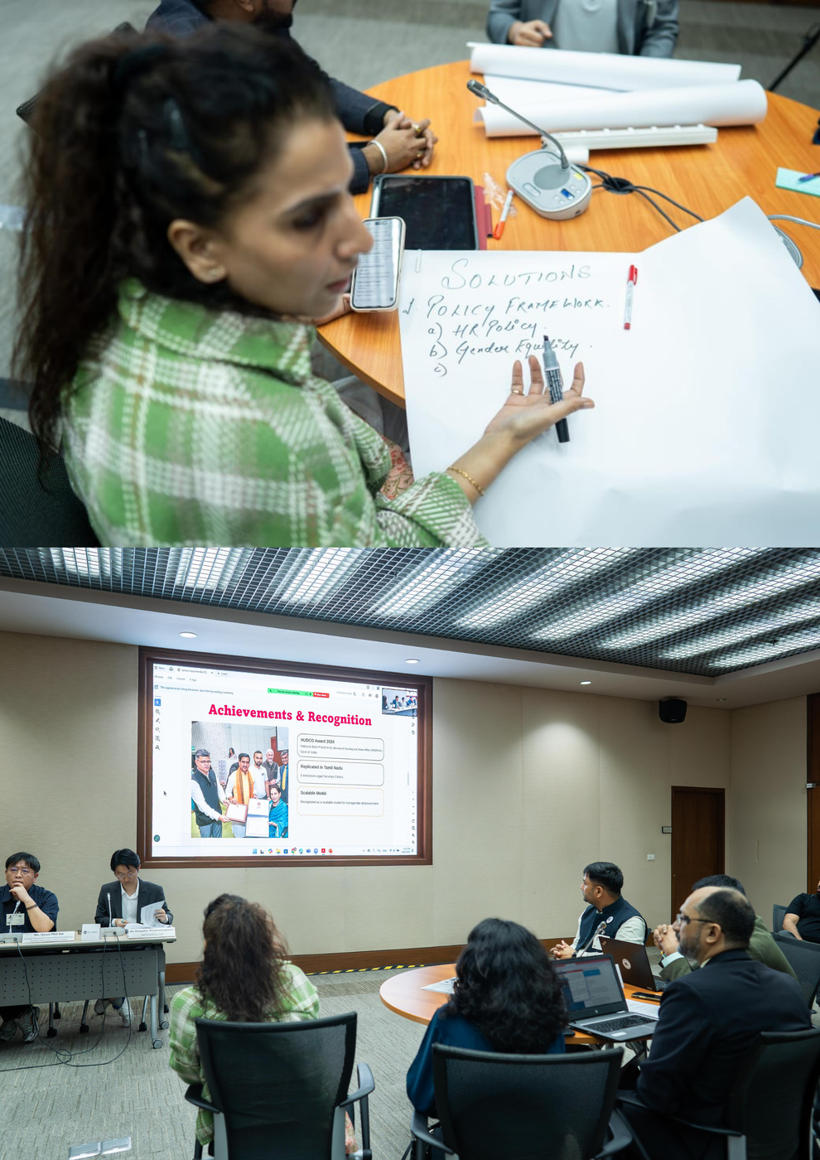
MEDIA COVERAGE
Presented as a community-led legal aid model at the UN Responsible Business and Human Rights Forum, Bangkok, 2025, in a session which was in collaboration with SAL FOREST and OXFAM ASIA highlighting its approach to transgender rights, livelihood and inclusion.
INTERNATIONAL VISIBILITY

Slide 18
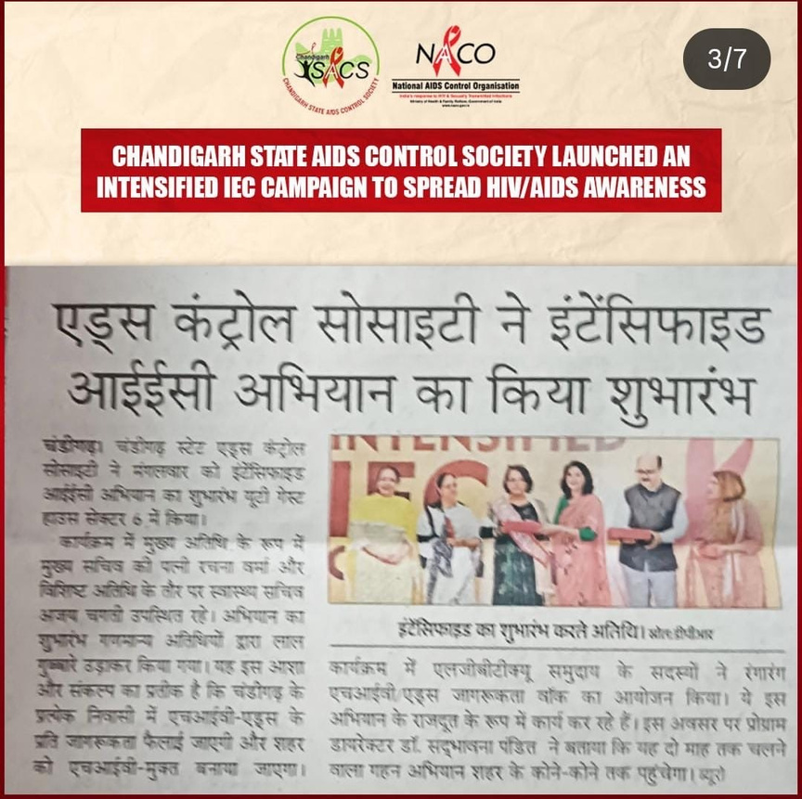
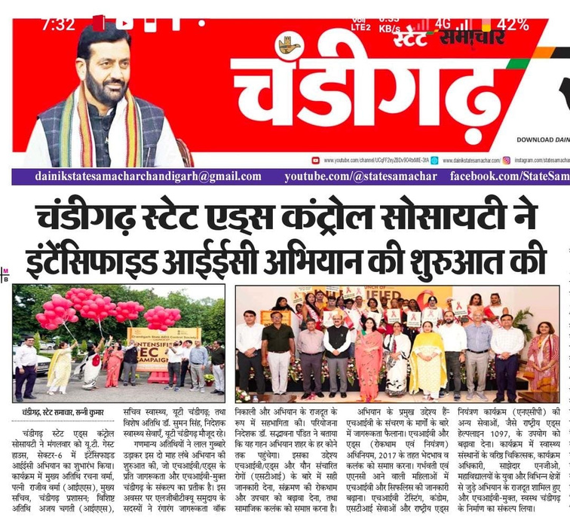
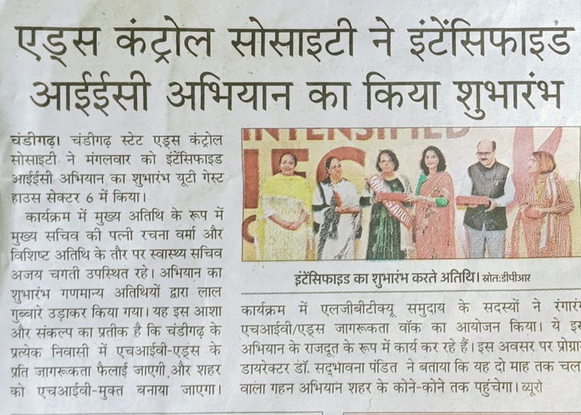
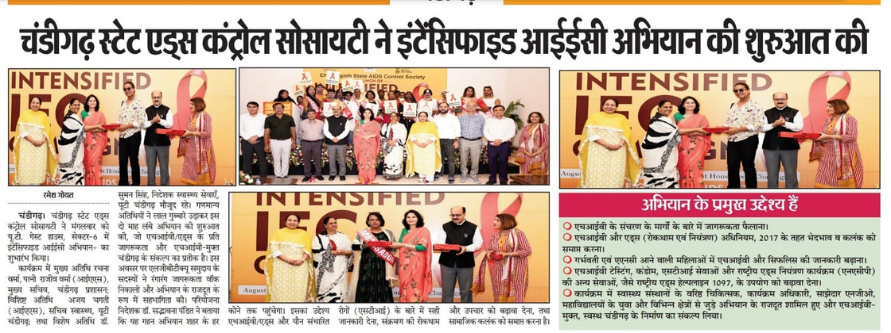
MEDIA COVERAGE
NEWS CUTTINGS

Slide 19
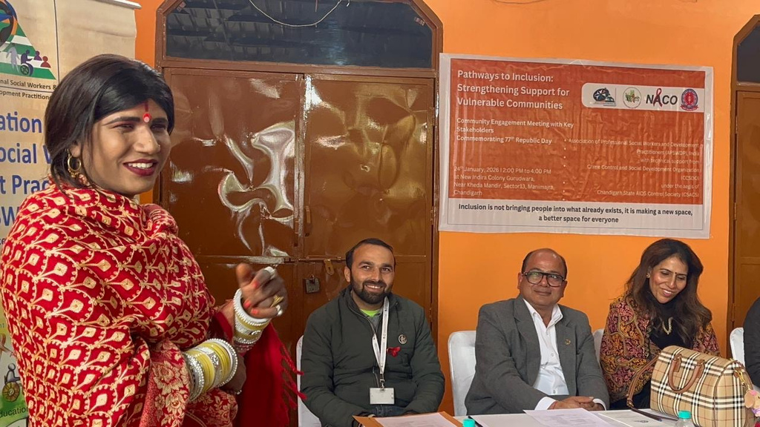
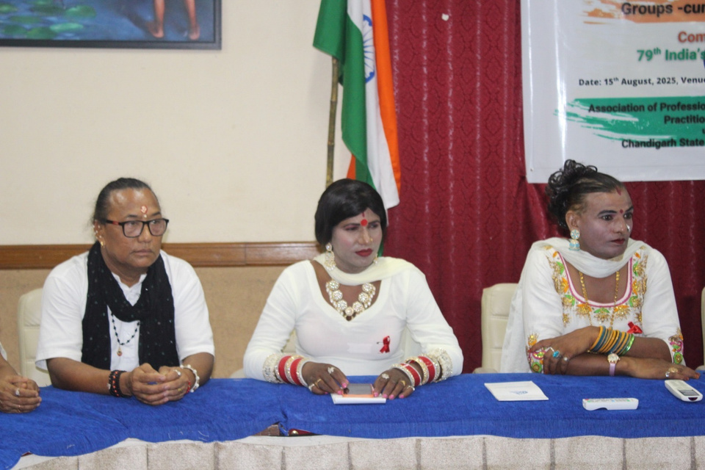
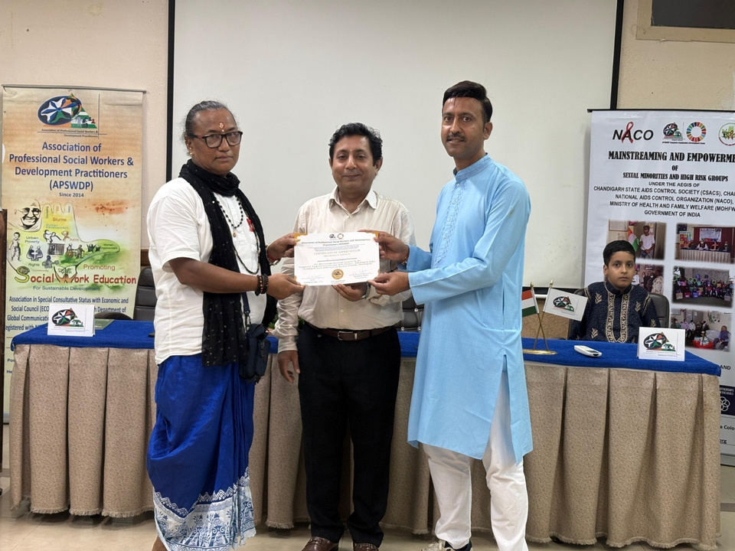
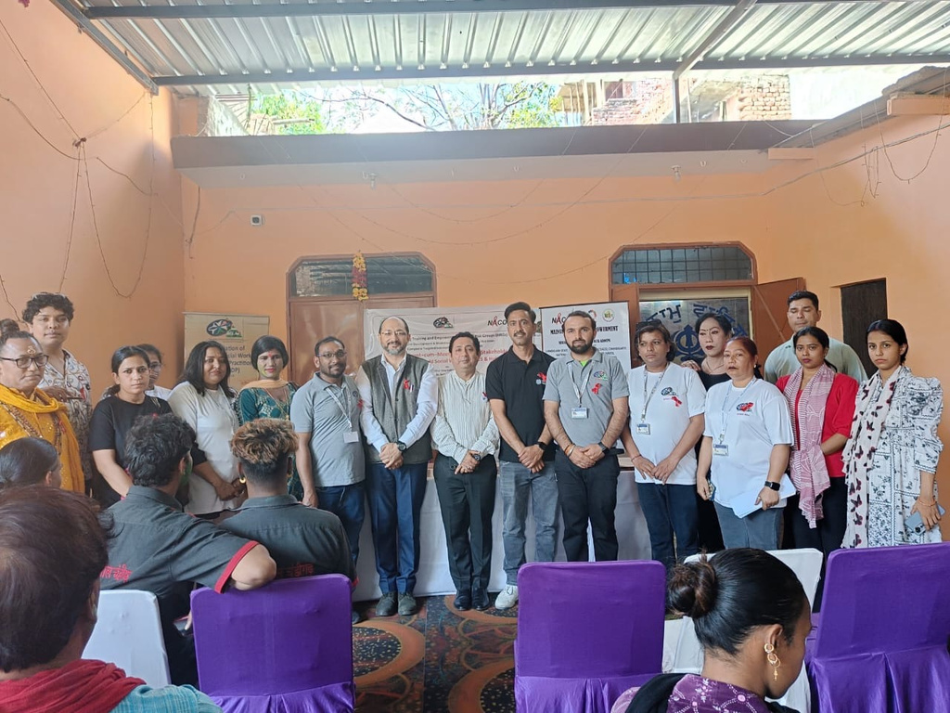
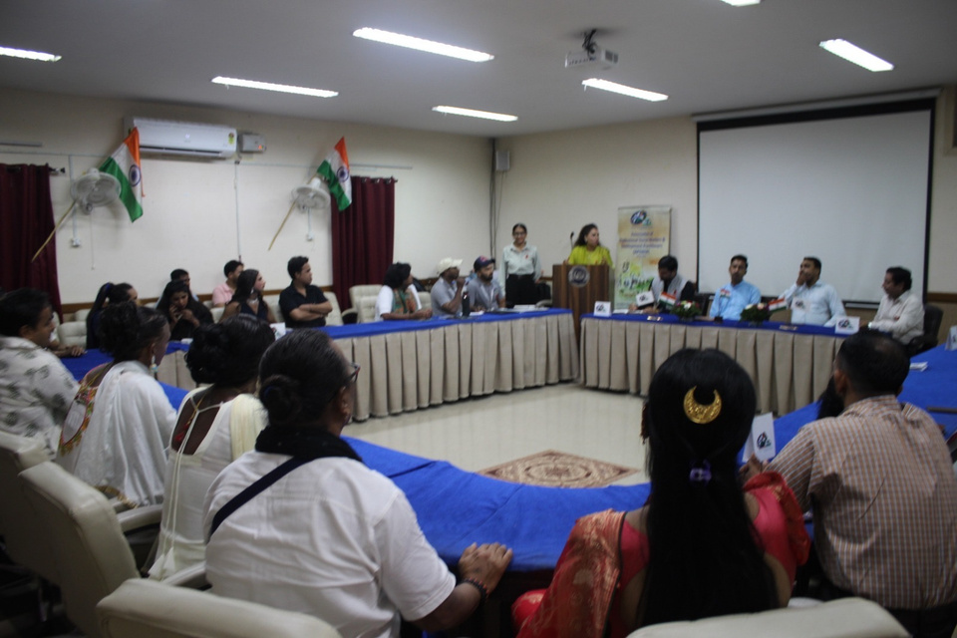
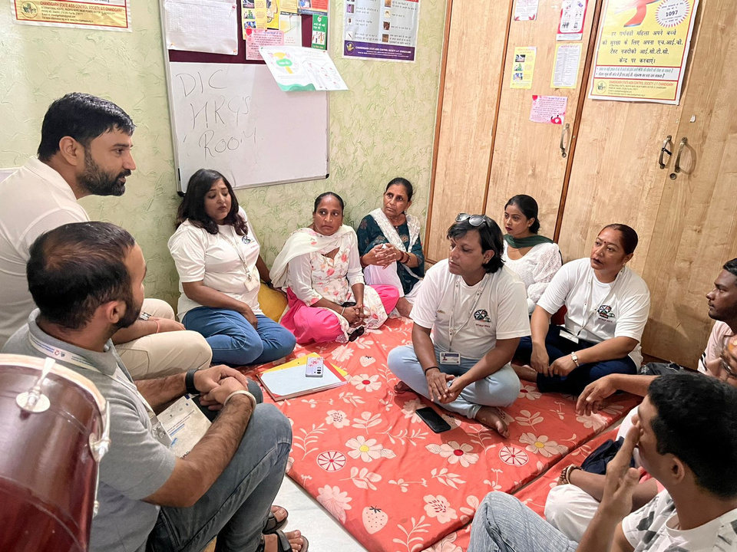
COUNSELLING & CAPACITY BUILDING WORKHSOPS

Slide 20
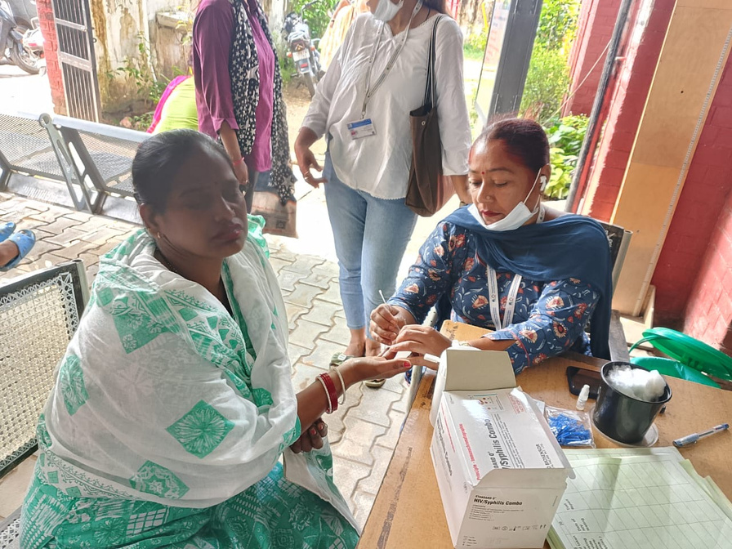
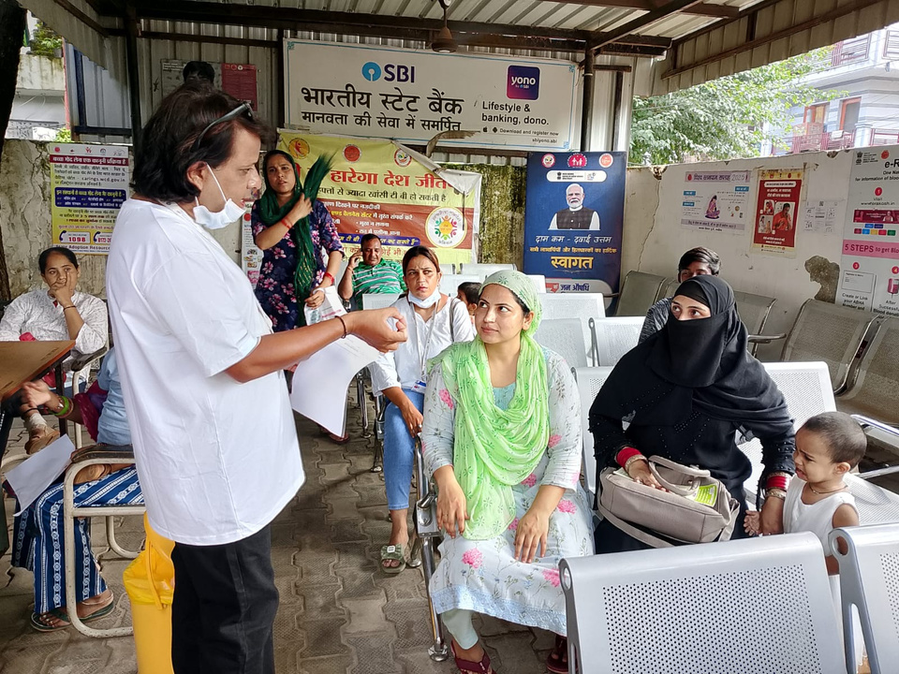
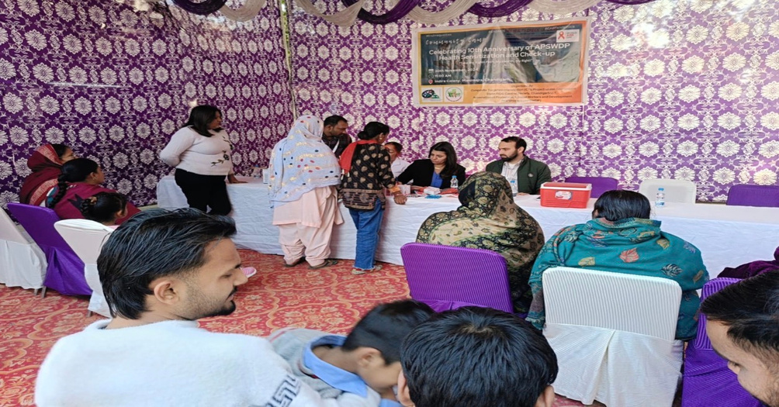
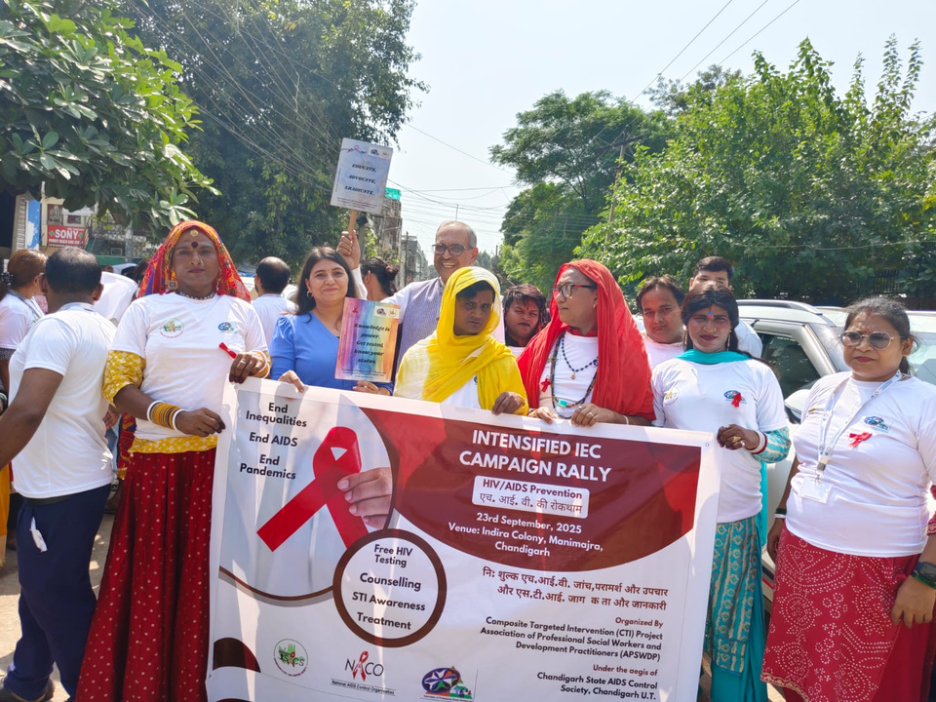
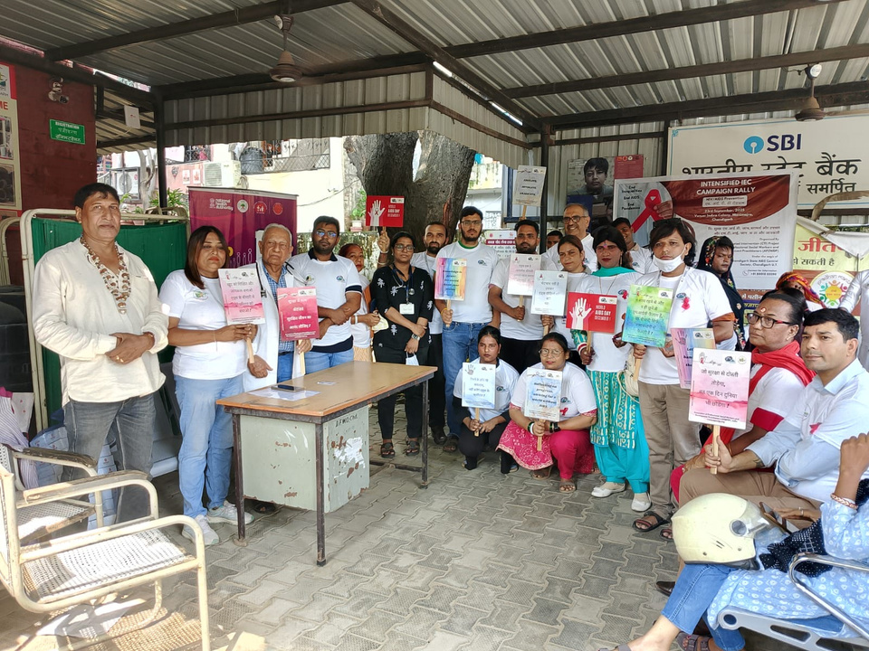
HEALTH CAMPS & RALLIES

Slide 21
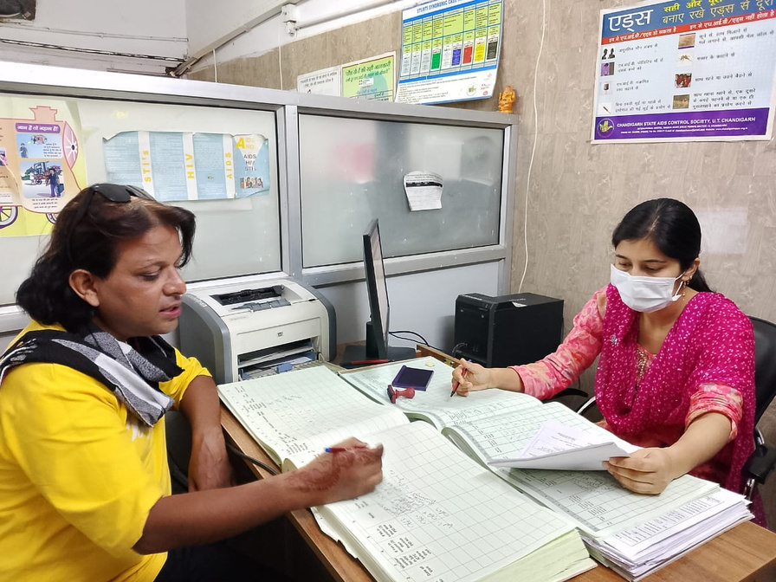
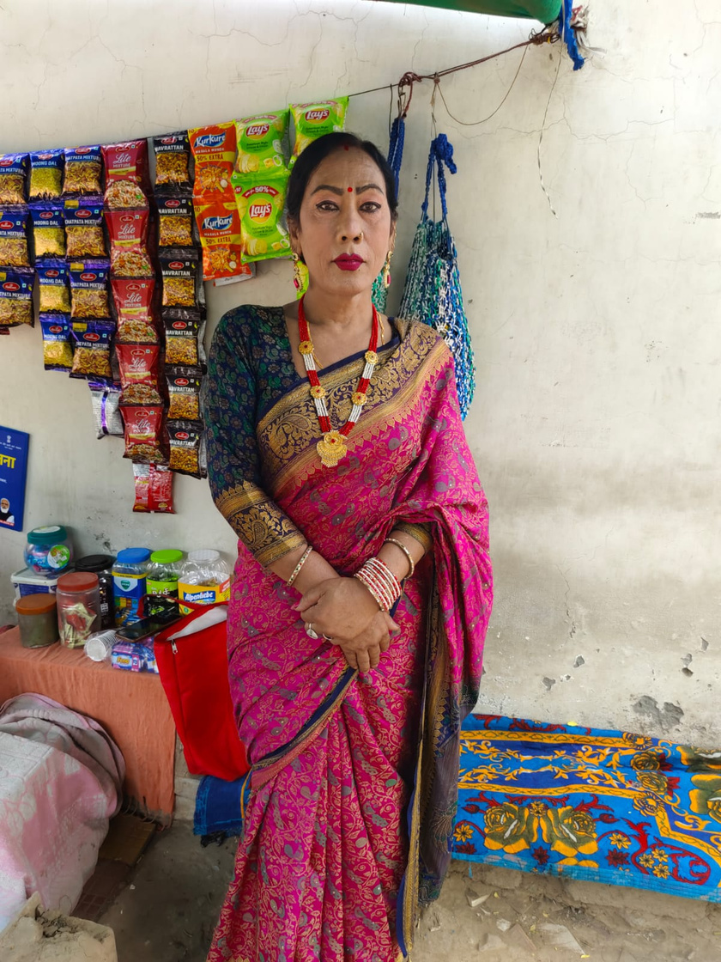
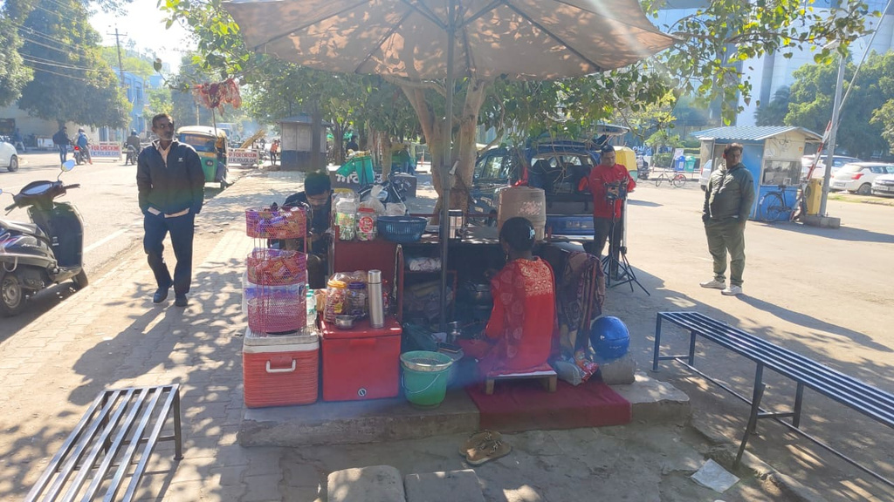
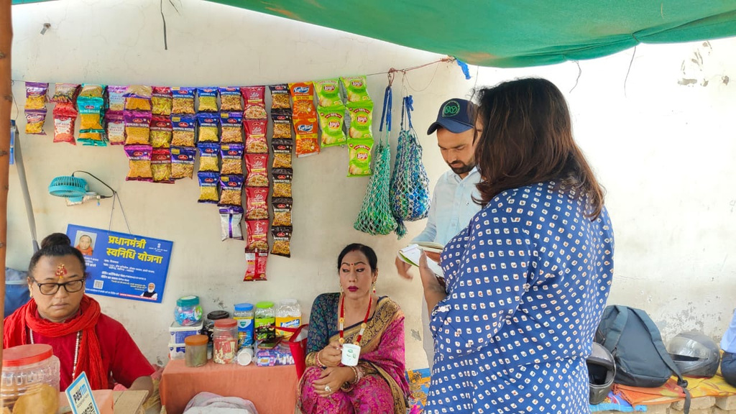
LIVELIHOOD LINKAGES

Slide 22
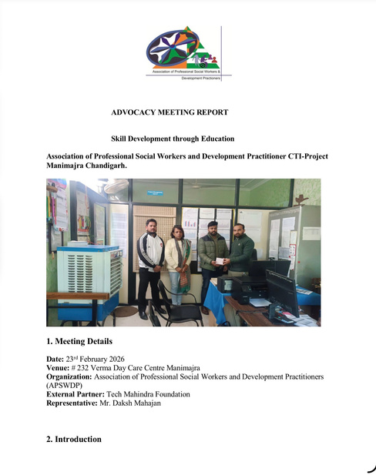
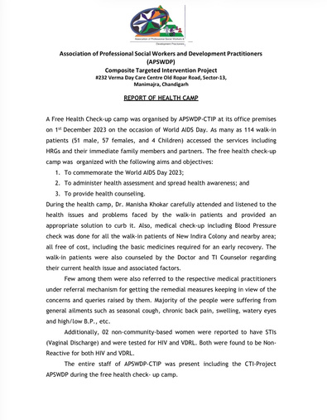
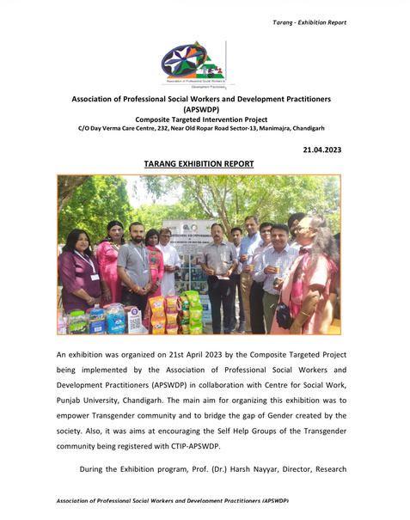
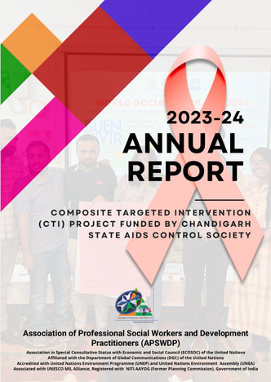
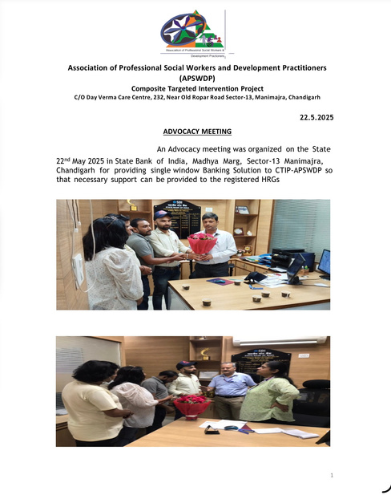
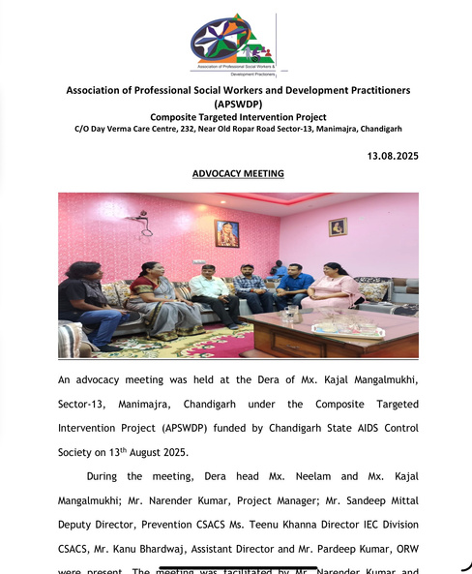




LINK TO ALL THE REPORTS OF ACTIVITIES
GOOGLE DRIVE:
https://drive.google.com/drive/folders/1QkEI662dy4MTBWZxw9tTG9BGkWu8lXPx
WEBSITE:
https://apswdp.org

Slide 23

FUTURE ROADMAP
Reach 1,000+ Community Members
Expand outreach and services to 1,000+ LGBTQ+ community members through a sustainable volunteer-led model.
Community Daycare & Support Centre
A one-stop centre for legal services, psychological support, counselling, awareness and skill development for the LGBTQ+ community.
Scale & Strengthen
Build CSR, NGO & institutional partnerships and mobilise funding.
Ultimate Goal: “To promote the meaningful social inclusion of the LGBTQ+ community by fostering equality, acceptance, and recognition, enabling individuals to live with dignity, equal rights, and full participation in mainstream society.”

Slide 24
THANK YOU

