Slide 1



SIWAR
Technology for a
Sustainable Generation
REGION:
Middle East and North Africa (MENA)
YOUR NAME:
Faisal Alqarni
COUNTRY:
Kingdom of Saudi Arabia
NOMINATION:
Sustainability
PROJECT: SIWAR
Notes:
1

Slide 2
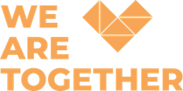
Problem
Bridging the Gap Between Environmental Awareness and Action
Low Awareness
Limited practical environmental knowledge.
Despite the growing global focus on sustainability and climate action, a significant gap remains between environmental awareness and real-life sustainable behavior, particularly among youth. Young people are highly connected to technology and digital platforms, yet environmental information is often technical, fragmented, or disconnected from their daily lives. In Saudi Arabia, empowering this generation is essential to transform knowledge into participation, responsible behavior, volunteering, and long-term environmental impact.
Awareness–Action Gap
Knowledge does not always translate into behavior.
Limited Youth Engagement
Few accessible pathways for youth participation.
Traditional Communication
Environmental topics can feel technical and distant.
The challenge is not only to increase environmental knowledge — it is to convert it into action.
Untapped Technology
Digital tools are not fully utilized for environmental action.
02
Notes:
2

Slide 3


Goal
From Awareness to Sustainable Action
To build a digitally empowered generation of young people who understand environmental challenges, adopt sustainable practices, and actively contribute to climate action through technology, volunteering, and community participation.
By the end of 2027, Siwar aims to empower 20,000+ young people through environmental education, digital engagement, community initiatives, and sustainability-focused programs across Saudi Arabia.
A generation that does not only understand sustainability — but practices, leads, and advances it.
03
Notes:
3

Slide 4
Objectives
01
02
03
04
05
01
02
03
04
05
EDUCATE
ACTIVATE
EMPOWER
CONNECT
COLLABORATE
Make environmental knowledge accessible and engaging through youth-focused digital content.
Transform awareness into sustainable behaviors through challenges, campaigns, and community initiatives.
Equip young people and volunteers to become sustainability advocates.
Build a digital community connecting youth, technology, innovation, and sustainability.
Develop partnerships to scale environmental impact.
Awareness → Engagement → Action → Measurable Impact
04
Notes:
4

Slide 5
Target Audience
Young People as Drivers of Sustainable Change
Who are they?
Students, graduates, young professionals, volunteers, entrepreneurs, innovators, and environmentally conscious youth across Saudi Arabia.
Their Problem
They are exposed to sustainability issues, but often lack practical and relatable guidance.
16–35
years old
Their Need
Accessible environmental knowledge, practical tools, communities, and opportunities to participate.
Their Motivation
To contribute to meaningful causes, develop skills, volunteer, and join Saudi Arabia's sustainable transformation.
Siwar turns young people from passive recipients of environmental information into informed, engaged, and active contributors to sustainability.
05
Notes:
5

Slide 6
Relevance
Why Siwar Matters
Accessible Knowledge
Technology for Sustainability
01
Makes sustainability easier to understand and apply.
02
Shows youth how technology can become a tool for positive environmental impact.
GOAL
Community & Participation
Sustainable Ecosystem
03
Moves youth from awareness toward participation and action.
04
Creates opportunities for collaboration and long-term impact.
Siwar addresses not only an information gap, but an engagement and action gap.
06
Notes:
6

Slide 7

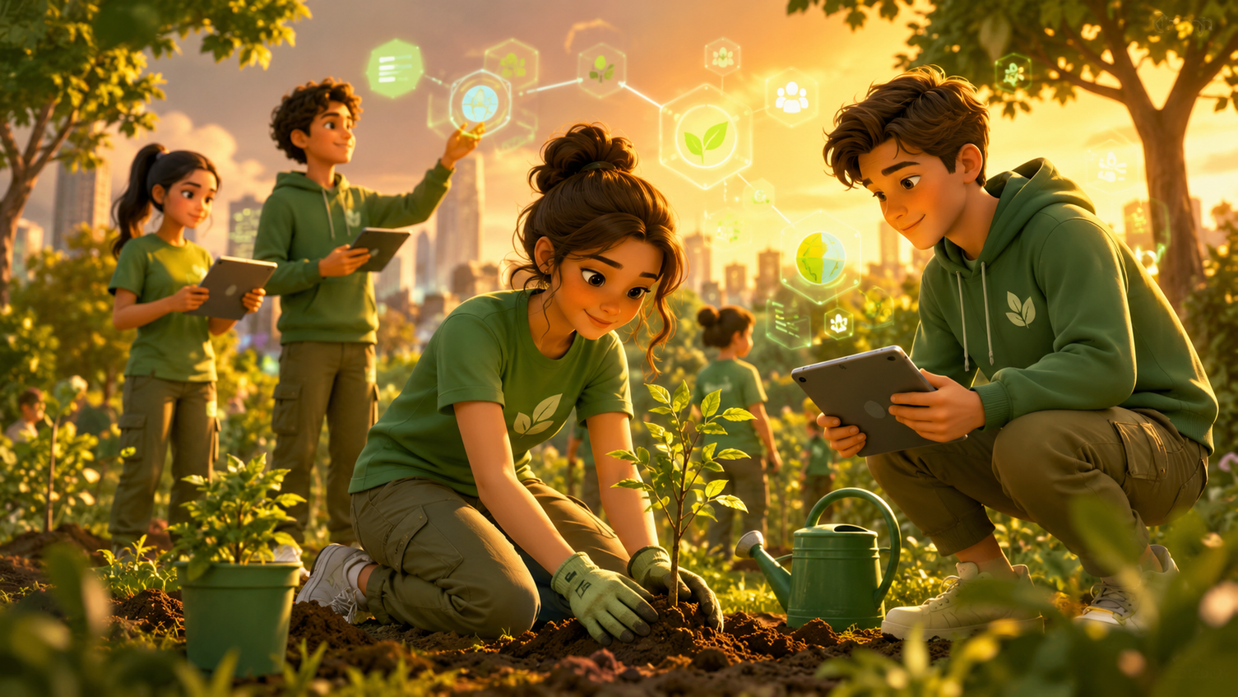
Involvement of Volunteers
Youth Volunteering at the Heart of Siwar
Siwar is built on a youth-led and volunteer-driven model. Volunteers contribute professional skills, creativity, and time to make environmental knowledge more accessible and engaging for young people.
Content & Research
Researching environmental topics and transforming them into accessible educational content.
Design & Creativity
Developing visual materials and campaigns that communicate sustainability effectively.
Technology
Supporting Siwar's website, digital tools, and online presence.
Community Engagement
Managing communities, campaigns, beneficiaries, and participation.
Initiatives & Events
Supporting planning and implementation of challenges and awareness activities.
Named contributors: Abdullah Abu Muala — Mechanical Engineer | Ahmed Mohammed — Web Development
07
Notes:
7

Slide 8
Results and Impact
4,450+
100,000+
55+
5+
Beneficiaries
Views
Educational Posts
Community Initiatives
A growing youth community reached through social media platforms and digital communities.
Digital content views achieved across platforms within one month, demonstrating growing public engagement.
Scientific, cultural, environmental, and sustainability-focused content created for youth.
Digital community initiatives designed to encourage participation, awareness, dialogue, and sustainable thinking.
Beyond reach: Siwar is building a community where sustainability becomes part of youth conversations, interests, and everyday decisions.
08
Notes:
8

Slide 9
Partners and Resources
Community Partners & Collaborators
01
02
03
04
King Khalid University Student Clubs
ADD-THON
Mohandis Community
Youth & Volunteer Communities
Access to student communities; youth engagement and knowledge sharing.
Innovation community engagement; knowledge exchange and outreach.
Access to engineering and professional youth; technical and community engagement.
Volunteer expertise; digital outreach and community participation.
Siwar connects universities, youth communities, volunteers, innovators, and organizations around one shared objective: empowering young people to create sustainable environmental impact.
09
Notes:
9

Slide 10
How Siwar Works
From Awareness to Environmental Action
01
EDUCATE
02
ENGAGE
03
EMPOWER
We simplify environmental and sustainability knowledge through accessible, science-based digital content designed for youth.
We activate young people through digital communities, interactive challenges, awareness campaigns, and volunteer-led initiatives.
We encourage youth to transform knowledge into sustainable behaviors, environmental initiatives, and positive community impact.
Knowledge → Engagement → Action → Sustainable Impact
10
Notes:
10

Slide 11
Our Growth Journey
Siwar's Journey: From an Idea to a Growing Youth Community
01
02
03
JANUARY 2026 | LAUNCH
COMMUNITY BUILDING
SCALING IMPACT
Siwar was launched as a youth-led initiative connecting technology, environmental awareness, and sustainability.
Built a growing digital community, launched 5+ initiatives, and published 55+ educational and awareness-focused posts.
Reached 4,450+ beneficiaries and generated 100,000+ views within one month, while expanding collaborations.
Future direction: workshops, environmental challenges, partnerships, volunteer programs, and technology-driven sustainability initiatives.
11
Notes:
11

Slide 12

Why Technology?
Technology as a Catalyst for Sustainability
For a generation that lives digitally, environmental awareness must also evolve digitally. Siwar believes technology can do more than communicate environmental problems — it can educate, connect, mobilize, and empower people to solve them. By combining digital platforms, youth communities, accessible knowledge, and volunteer participation, Siwar creates a scalable model where environmental awareness can reach thousands of people regardless of geographical boundaries.
We do not only use technology to talk about sustainability.
We use technology to make sustainability accessible, engaging, and actionable.
12
Notes:
12

Slide 13
Contribution to the SDGs
SDG 4
SDG 12
SDG 13
SDG 17
Quality Education
Responsible Consumption
Climate Action
Partnerships for the Goals
Providing accessible environmental and sustainability education for young people.
Promoting responsible behaviors, sustainable choices, and environmental consciousness.
Raising climate awareness and empowering youth to participate in environmental action.
Building collaboration between youth, universities, volunteer communities, and organizations.
One Initiative. Four SDGs. One Generation Driving Sustainable Change.
13
Notes:
13

Slide 14
Sustainability & Scalability
A model designed to keep growing without losing its youth-led identity.
Reusable Digital Content
Volunteer Engine
01
02
Educational posts and campaigns can be reused, updated, and scaled across platforms.
A structured volunteer model lets experts and youth contribute according to their skills.
Partner Network
Impact Measurement
03
04
Universities, communities, and institutions expand reach and credibility.
Views, beneficiaries, posts, campaigns, and partner growth are tracked as Siwar scales.
Scalable impact begins with simple knowledge, organized participation, and clear measurement.
14
Notes:
14

Slide 15
Future Roadmap
What makes Siwar different: it connects knowledge, technology, community, volunteering, and measurable impact in one youth-led model.
2026 H2
Launch interactive campaigns and expand volunteer-led digital content.
2027 Q1
Run youth workshops and environmental challenges with university communities.
2027 Q2
Build stronger partner programs and structured volunteer pathways.
2027 H2
Reach 20,000+ young people and publish a measurable impact report.
Siwar is not only an awareness initiative. It is a digital movement that helps a new generation practice sustainability, lead action, and create visible environmental change.
15
Notes:
15

