Slide 1


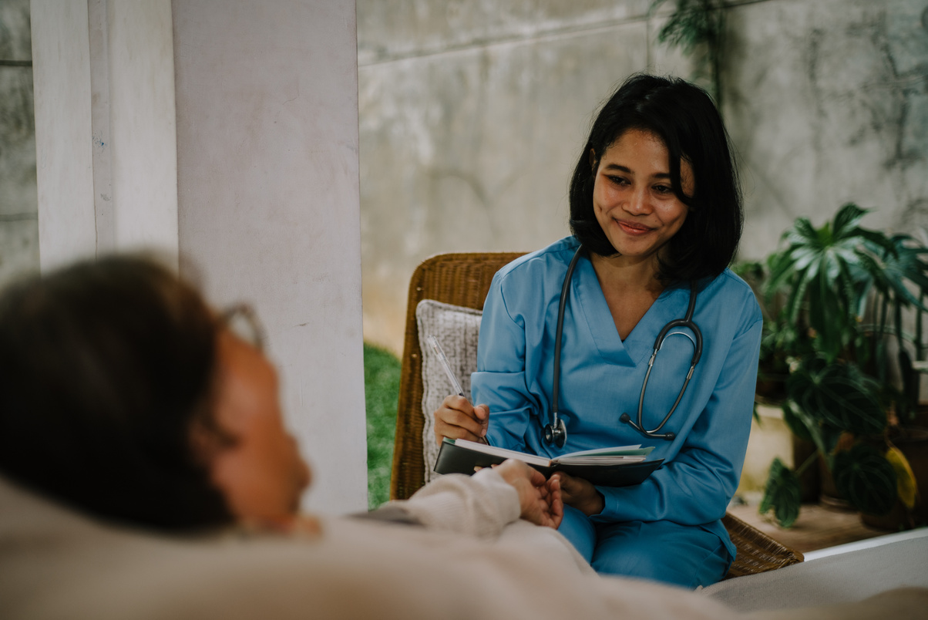

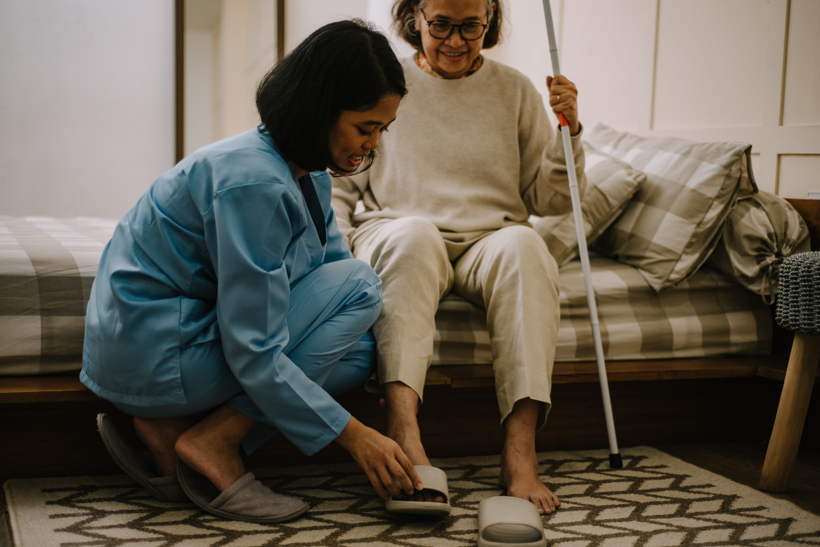






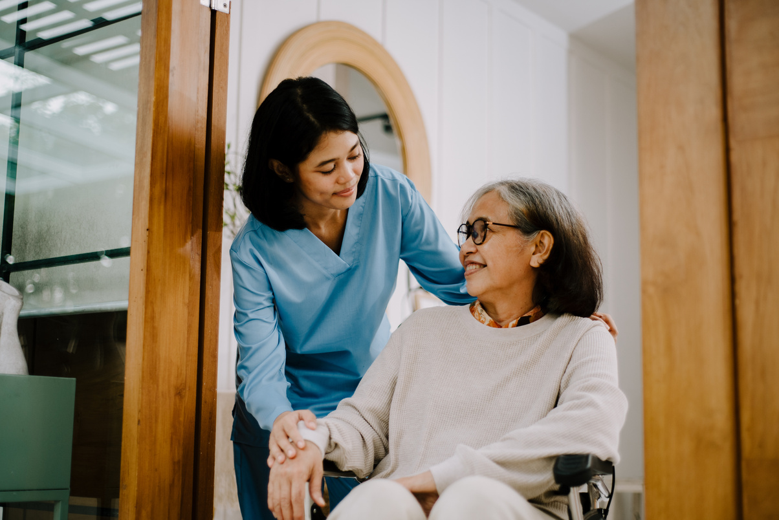

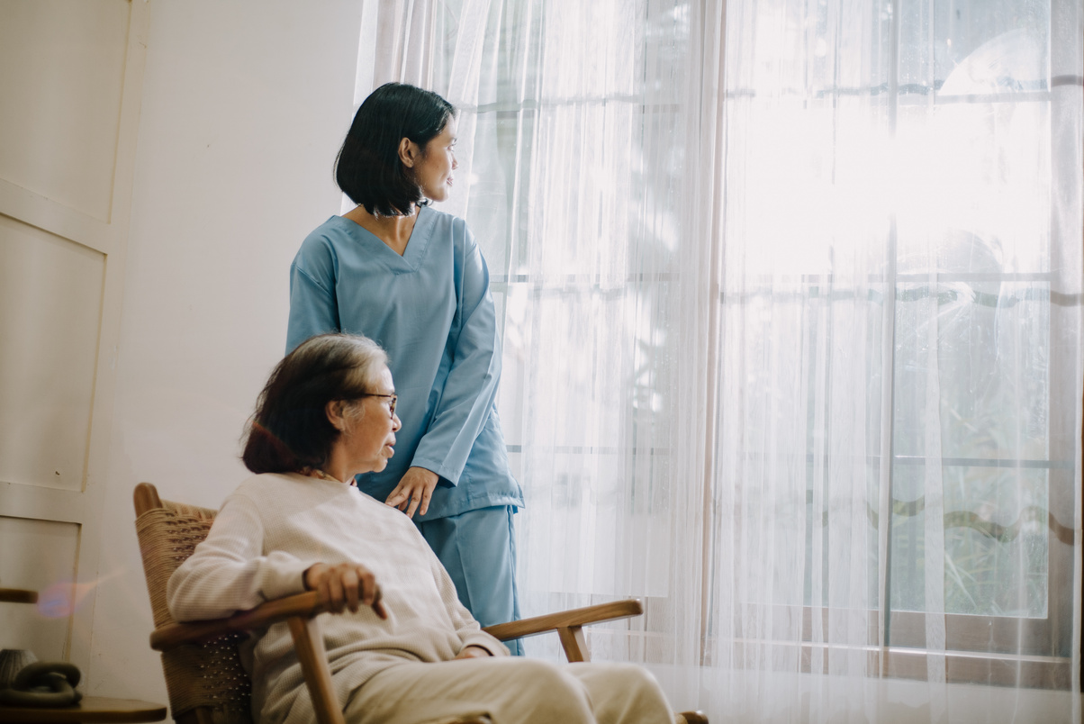

By Maggie Wilson

Slide 2

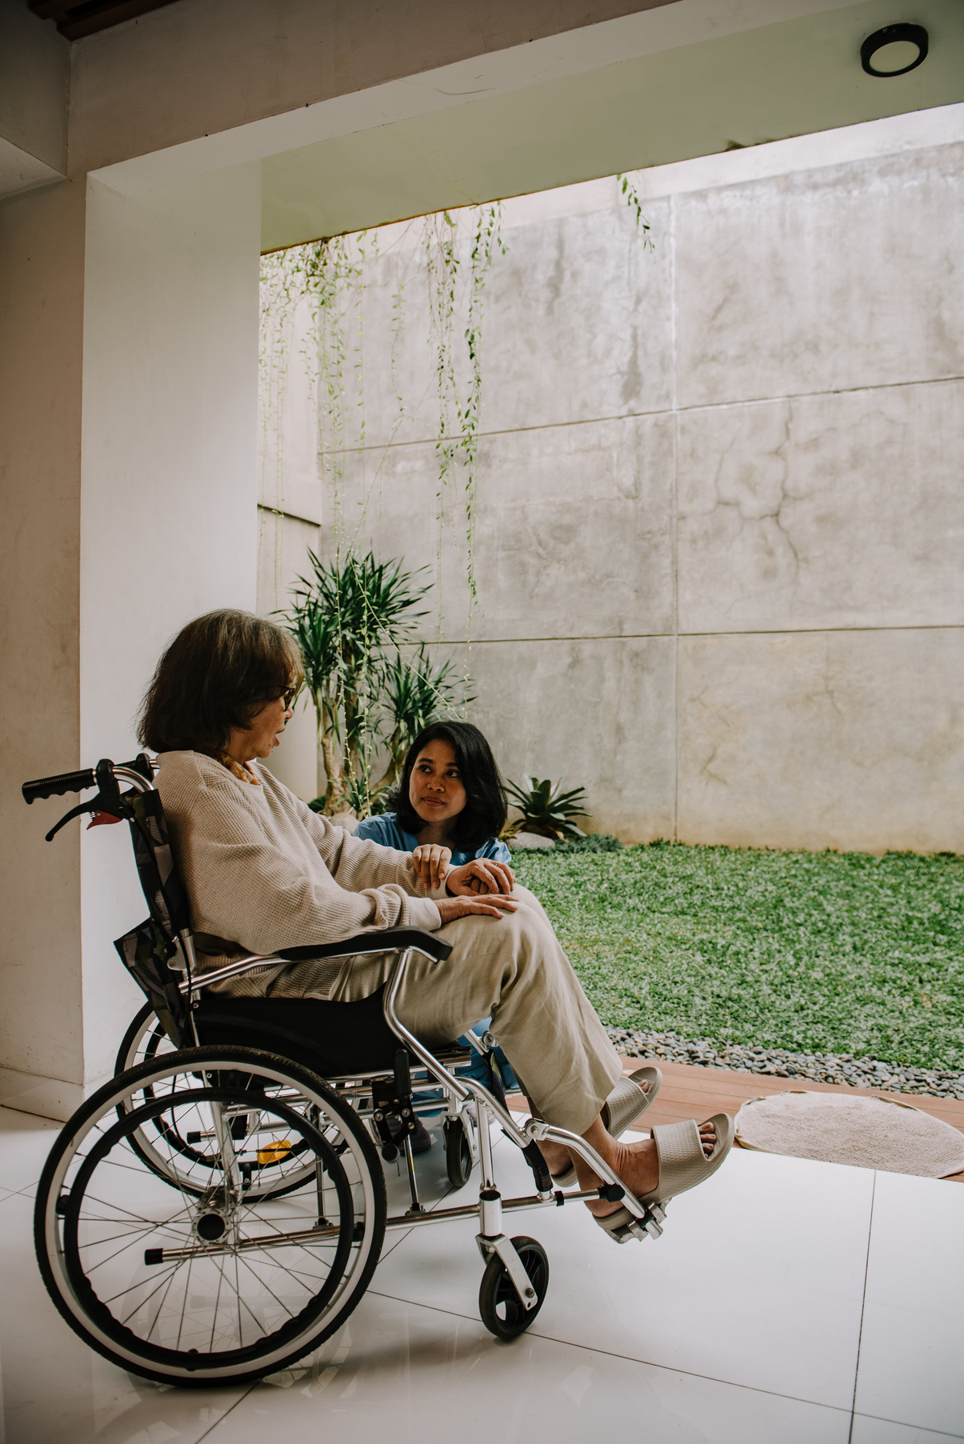
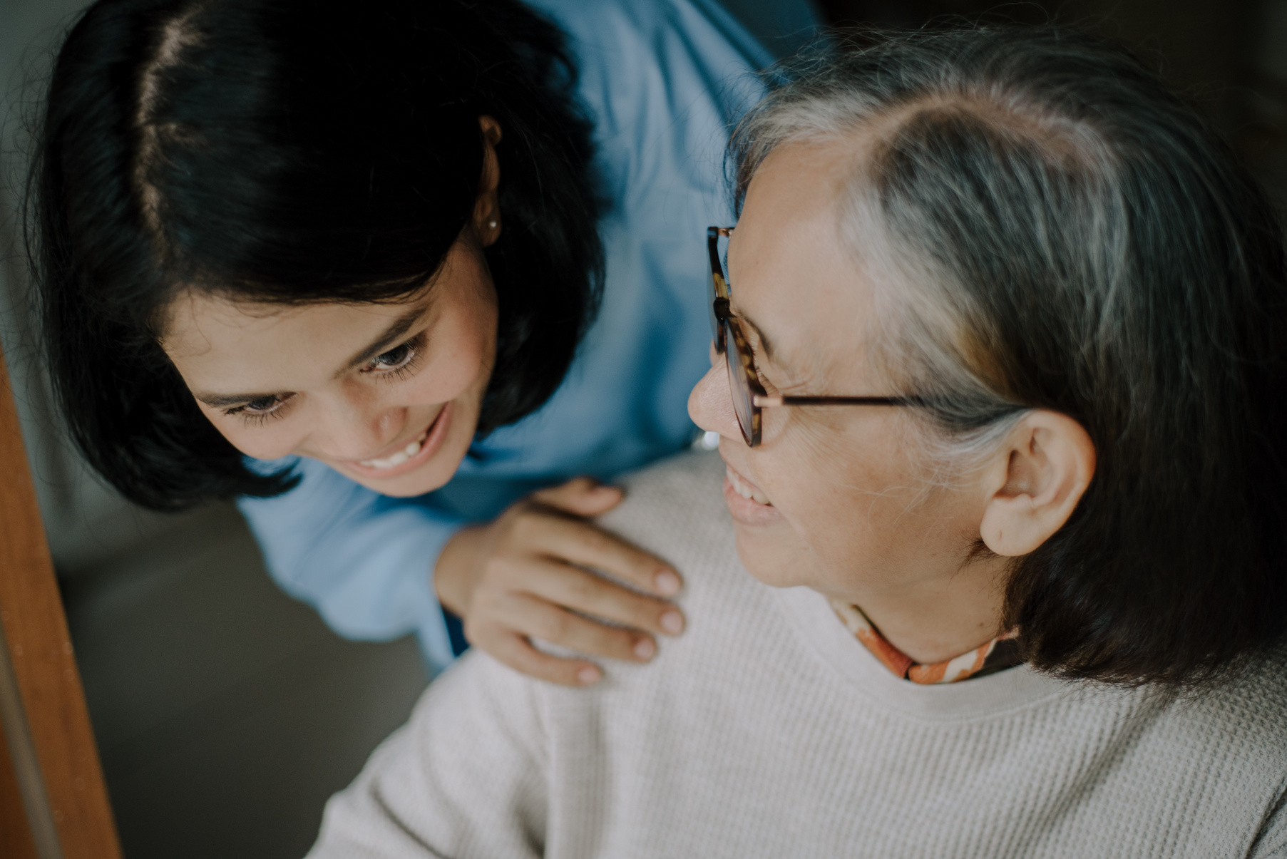
Nursing is more than a career, it’s a calling.
Compassion and care are at the heart of every action.

Slide 3




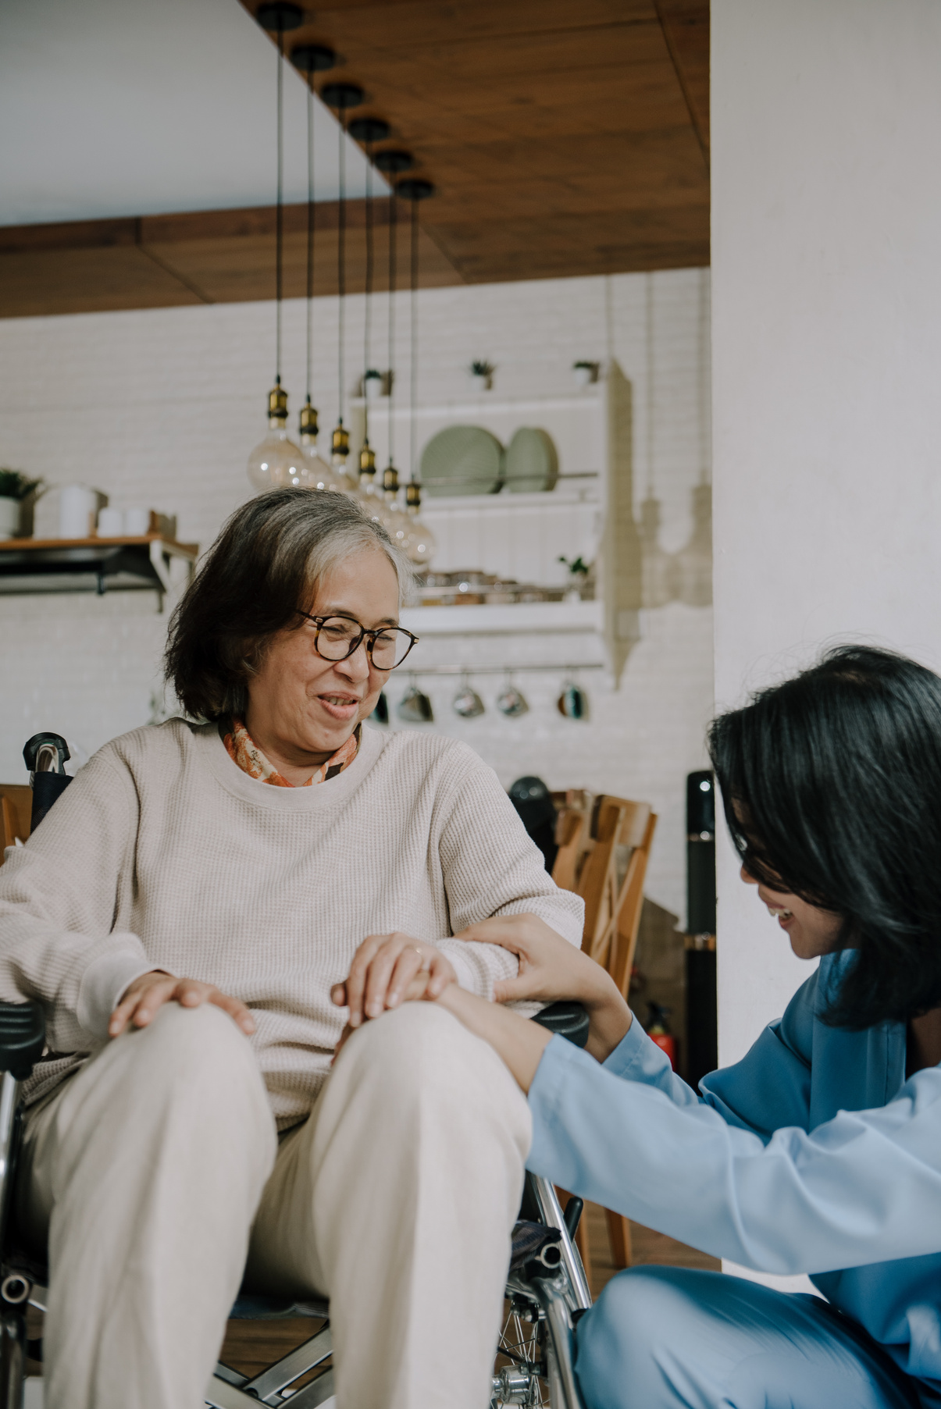

A nurse’s touch brings comfort and hope.
Kindness is the foundation of healing.

Slide 4

Nurses face challenges with courage and grace.
@powerpointrus

Slide 5
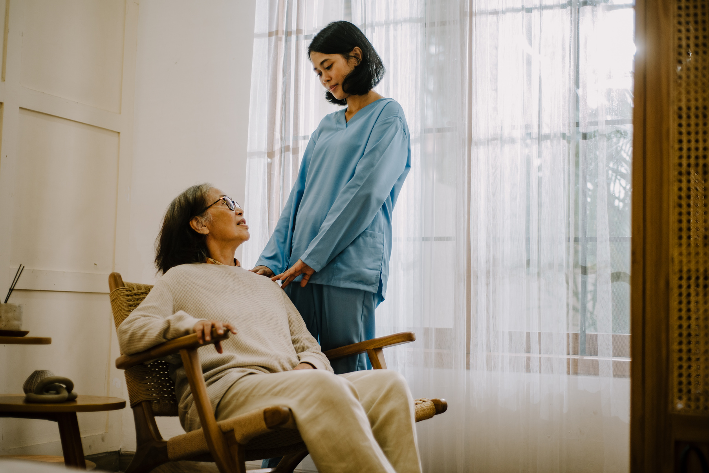
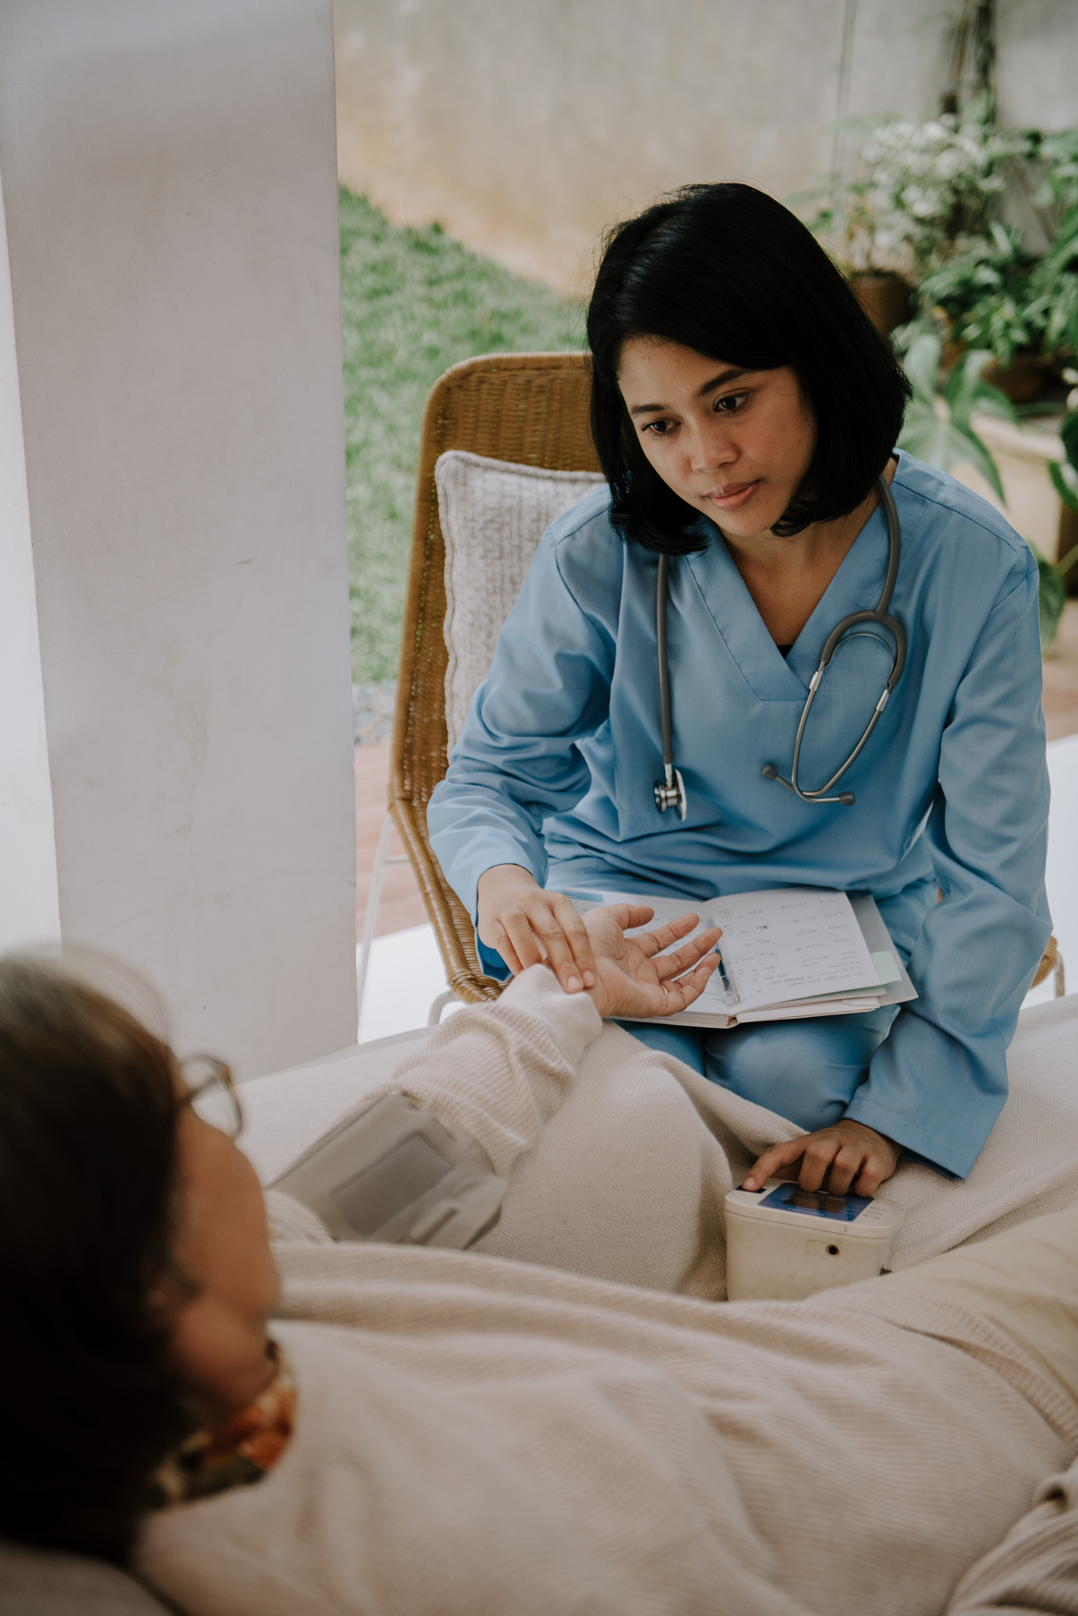
Nursing is a journey of constant growth.
Every day brings new lessons and experiences.

Slide 6

Nurses work together to save lives.
Support and trust make the team stronger.

Slide 7

A nurse’s greatest reward is a patient’s smile.
Small victories make a big difference.

Slide 8

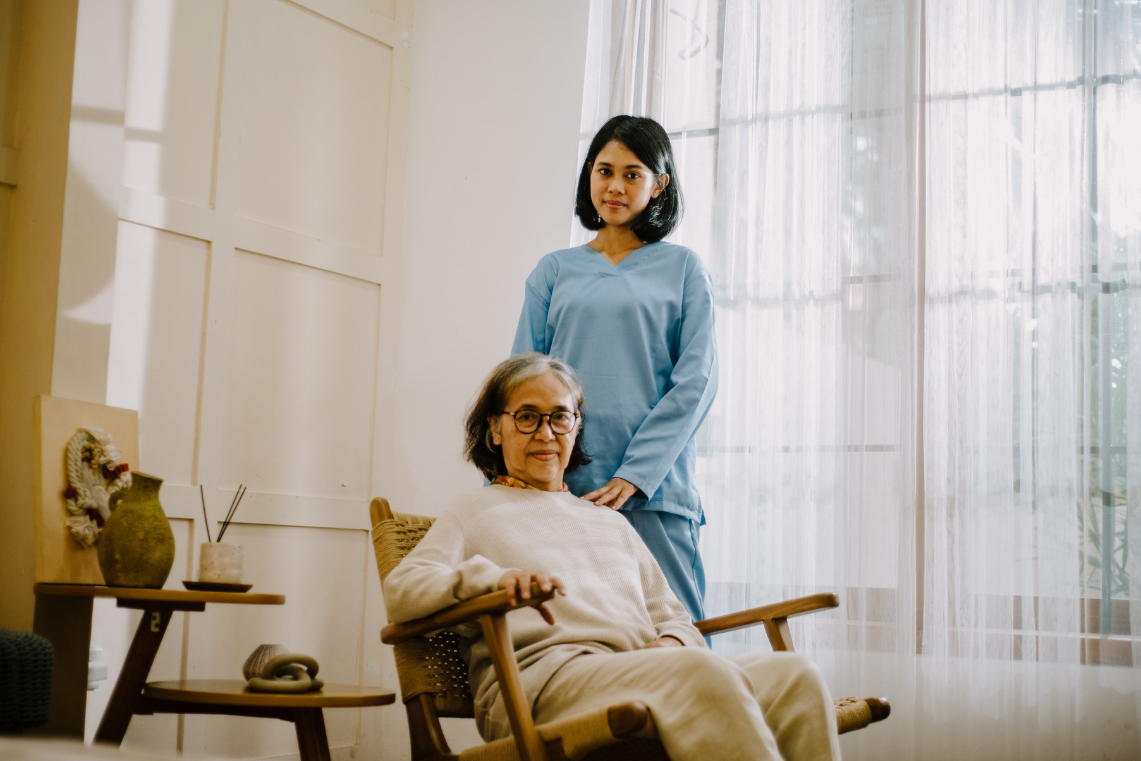
Caring for others requires strength and heart.
Self-care is essential for sustaining compassion.

Slide 9

Nurses give a voice to the vulnerable.
Advocating for patients means empowering them.

Slide 10
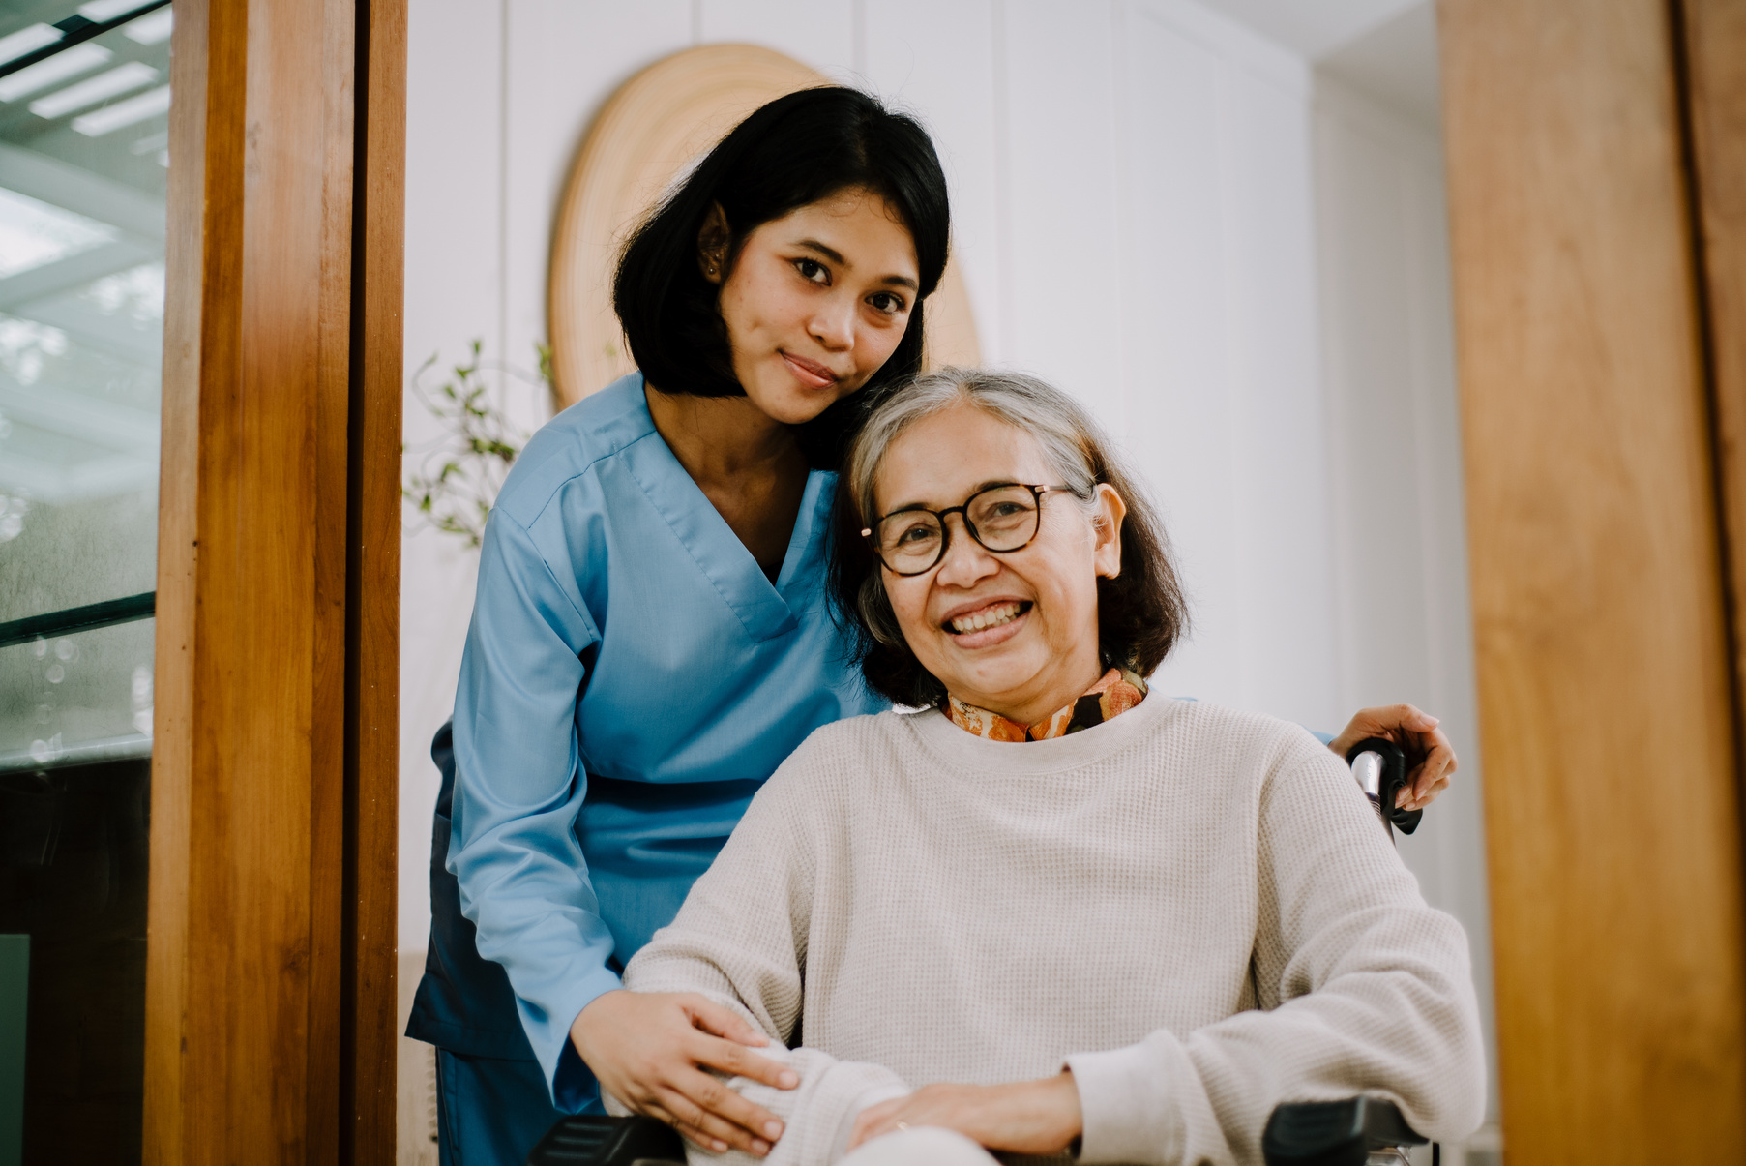
To be a nurse is to touch lives every day.
Thank you to all the nurses making a difference!

Slide 11
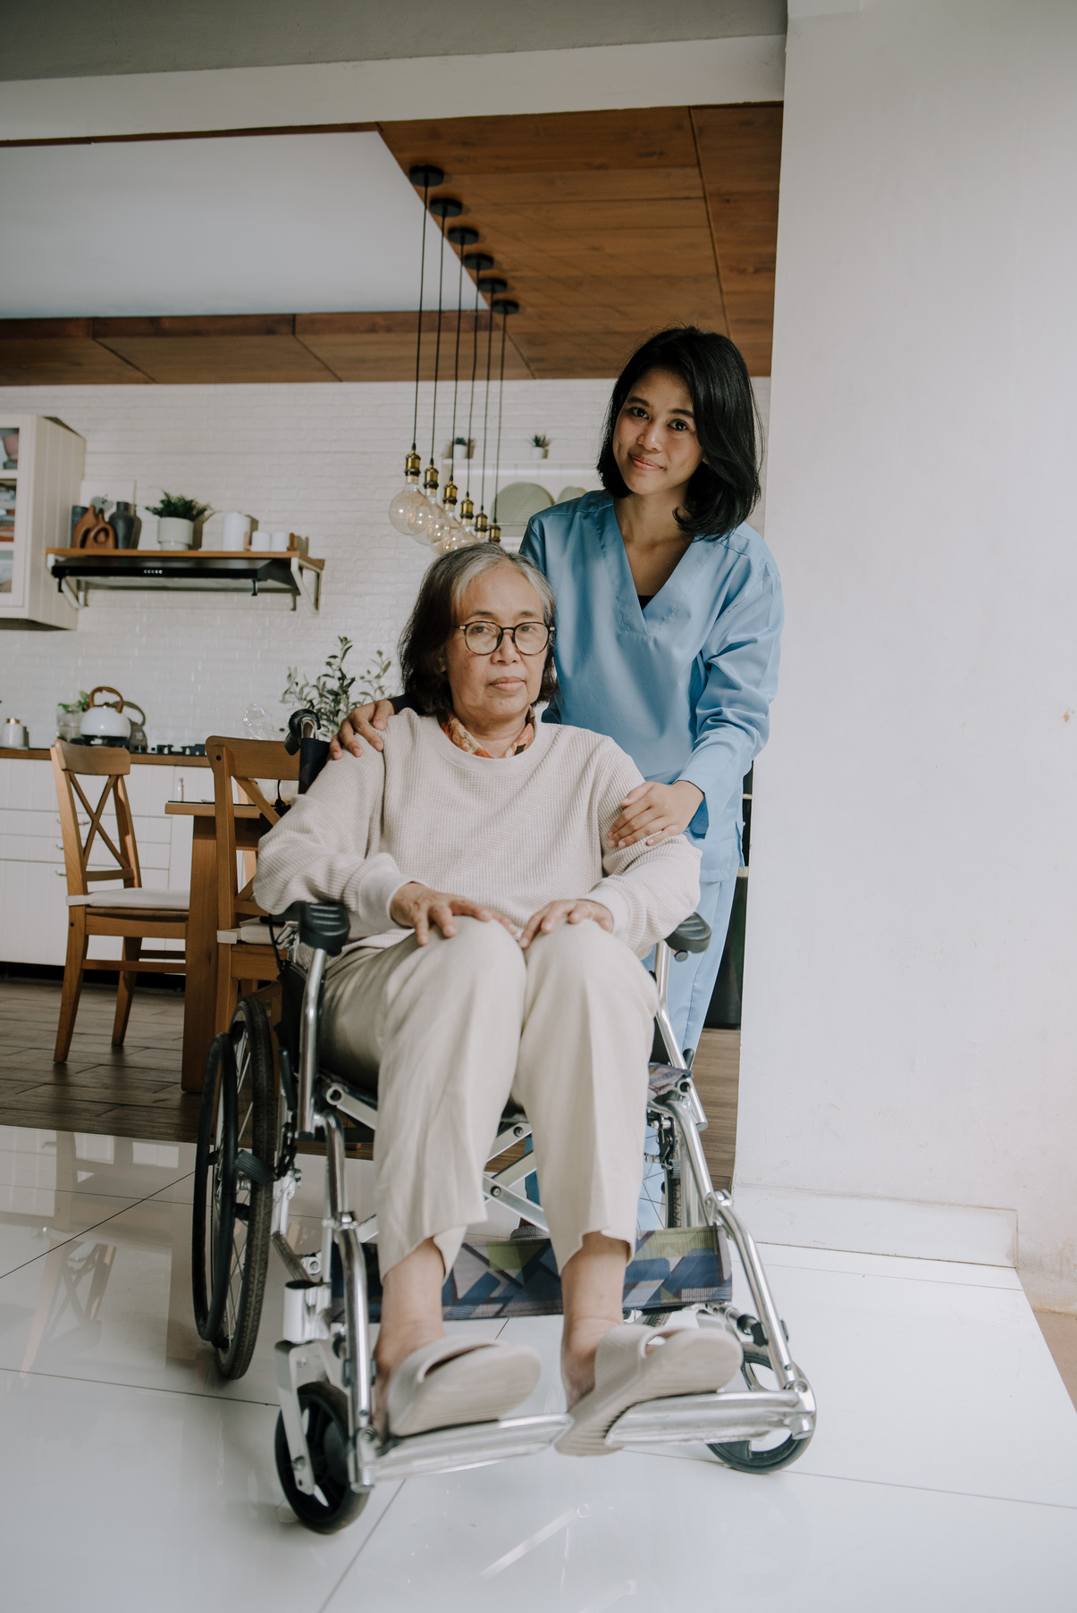
Thank you for listening!
Salute to all the healthcare workers!

