Slide 1


Решение логарифмических неравенств с переменной в основании
$$1 способ:$$
$$\log_{f(x)}{g(x)}>0↔\log_{f(x)}{g(x)}>\log_{f(x)}{1}↔$$
$$1) \left\{\begin{aligned}f\left(x\right)>1 \\ g\left(x\right)>1\end{aligned}\right. 2) \left\{\begin{aligned}0<f\left(x\right)<1 \\ 0<g\left(x\right)<1\end{aligned}\right.$$
2 способ:
$$\log_{f(x)}{g(x)}>0↔\left\{\begin{aligned}\left(f\left(x\right)−1\right)\left(g\left(x\right)−1\right)>0 \\ f\left(x\right)>0 \\ f(x)≠1 \\ g\left(x\right)>0\end{aligned}\right.$$

Slide 2
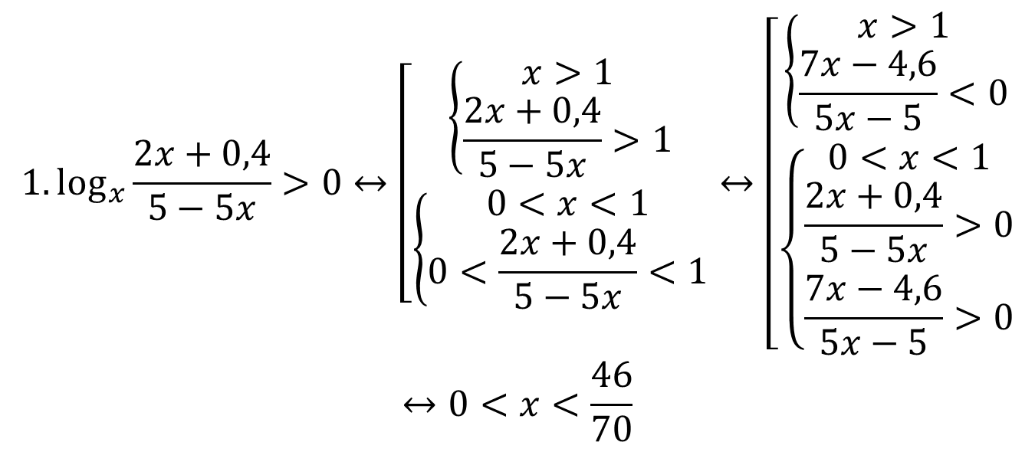
$$1. \log_{x}{\frac{2x+0,4}{5−5x}}>0↔\left[\begin{aligned}\left\{\begin{aligned}x>1 \\ \frac{2x+0,4}{5−5x}>1\end{aligned}\right. \\ \left\{\begin{aligned}0<x<1 \\ 0<\frac{2x+0,4}{5−5x}<1\end{aligned}\right.\end{aligned}\right.↔\left[\begin{aligned}\left\{\begin{aligned}x>1 \\ \frac{7x−4,6}{5x−5}<0\end{aligned}\right. \\ \left\{\begin{aligned}0<x<1 \\ \frac{2x+0,4}{5−5x}>0 \\ \frac{7x−4,6}{5x−5}>0\end{aligned}\right.\end{aligned}\right.$$
$$↔0<x<\frac{46}{70}$$

Slide 3
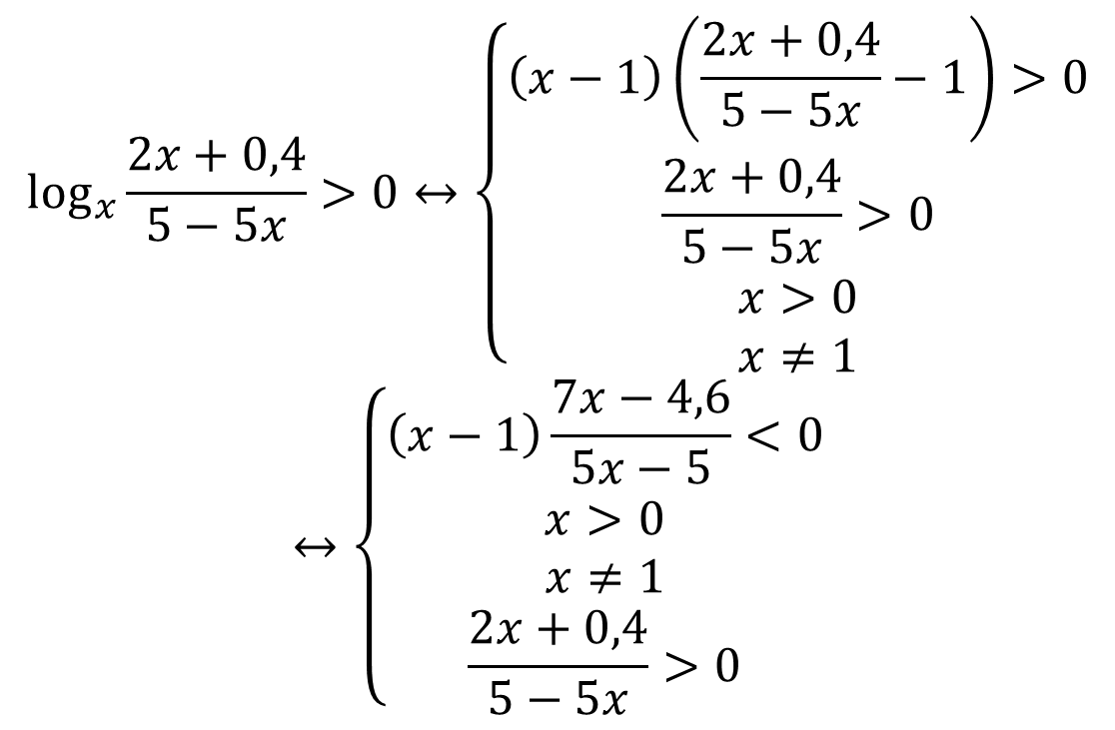
$$\log_{x}{\frac{2x+0,4}{5−5x}}>0↔\left\{\begin{aligned}\left(x−1\right)\left(\frac{2x+0,4}{5−5x}−1\right)>0 \\ \frac{2x+0,4}{5−5x}>0 \\ x>0 \\ x≠1\end{aligned}\right.$$
$$↔\left\{\begin{aligned}\left(x−1\right)\frac{7x−4,6}{5x−5}<0 \\ x>0 \\ x≠1 \\ \frac{2x+0,4}{5−5x}>0\end{aligned}\right.$$

Slide 4
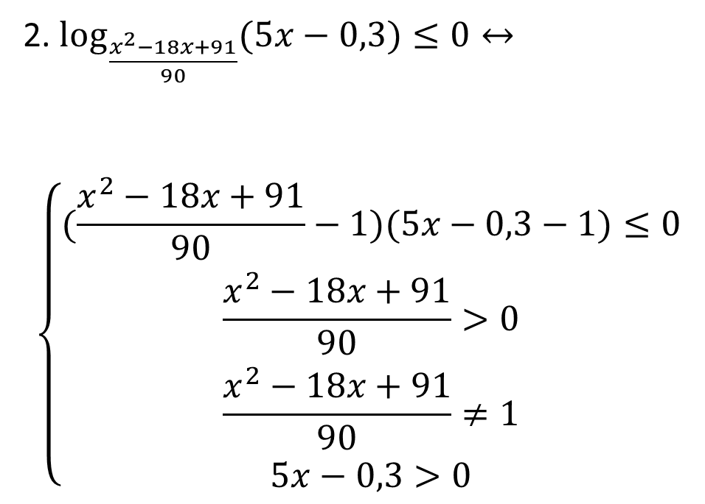
2. $\log_{\frac{x^{2}−18x+91}{90}}{(5x−0,3)}≤0↔$
$$\left\{\begin{aligned}(\frac{x^{2}−18x+91}{90}−1)(5x−0,3−1)≤0 \\ \frac{x^{2}−18x+91}{90}>0 \\ \frac{x^{2}−18x+91}{90}≠1 \\ 5x−0,3>0\end{aligned}\right.$$

Slide 5
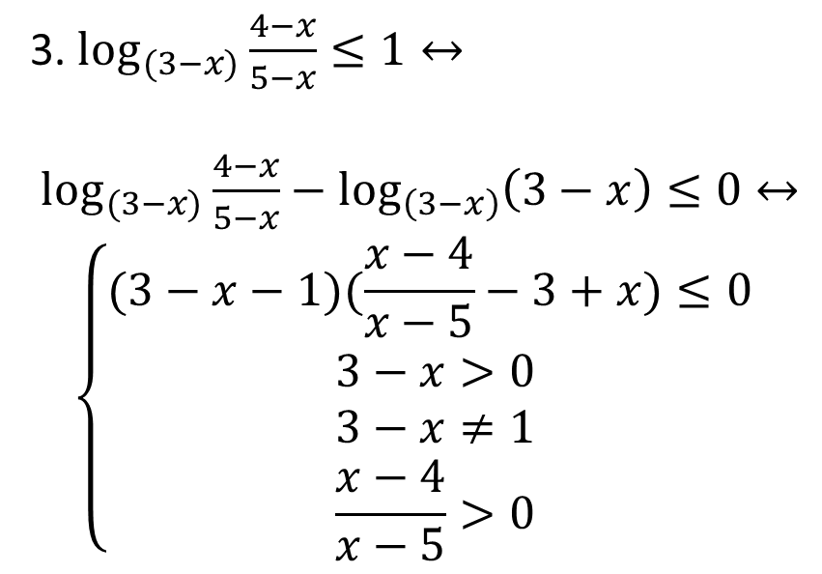
3. $\log_{(3−x)}{\frac{4−x}{5−x}}≤1↔$
$\log_{(3−x)}{\frac{4−x}{5−x}}−\log_{\left(3−x\right)}\left(3−x\right)≤0↔$
$$\left\{\begin{aligned}(3−x−1)(\frac{x−4}{x−5}−3+x)≤0 \\ 3−x>0 \\ 3−x≠1 \\ \frac{x−4}{x−5}>0\end{aligned}\right.$$

Slide 6
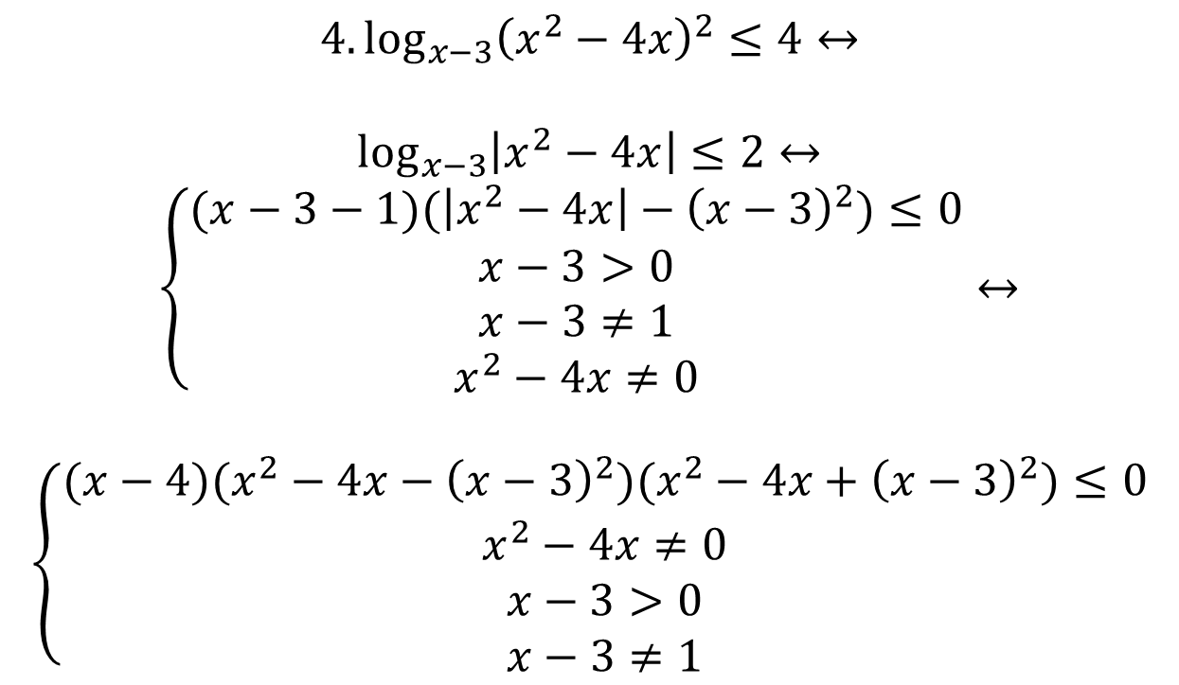
$$4. \log_{x−3}{{\left(x^{2}−4x\right)}^{2}}≤4↔$$
$$\log_{x−3}\left|x^{2}−4x\right|≤2↔$$
$$\left\{\begin{aligned}(x−3−1)(\left|x^{2}−4x\right|−{\left(x−3\right)}^{2})≤0 \\ x−3>0 \\ x−3≠1 \\ x^{2}−4x≠0\end{aligned}\right.↔$$
$$\left\{\begin{aligned}(x−4)(x^{2}−4x−{\left(x−3\right)}^{2})(x^{2}−4x+{\left(x−3\right)}^{2})≤0 \\ x^{2}−4x≠0 \\ x−3>0 \\ x−3≠1\end{aligned}\right.$$

Slide 7
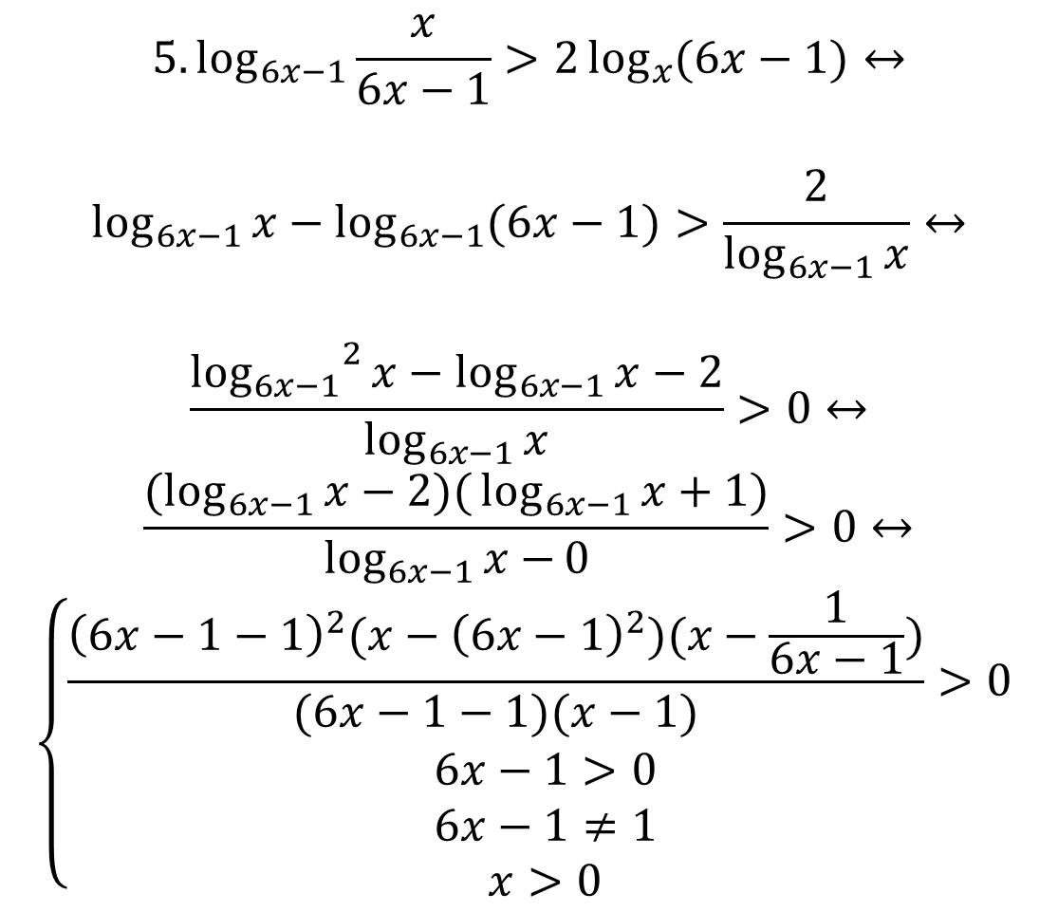
$$5. \log_{6x−1}{\frac{x}{6x−1}}>2\log_{x}{(6x−1)}↔$$
$$\log_{6x−1}{x}−\log_{6x−1}{(6x−1)}>\frac{2}{\log_{6x−1}{x}}↔$$
$$\frac{{\log_{6x−1}}^{2}{x}−\log_{6x−1}{x−2}}{\log_{6x−1}{x}}>0↔$$
$$\frac{(\log_{6x−1}{x−2)(}\log_{6x−1}{x+1)}}{\log_{6x−1}{x−}0}>0↔$$
$$\left\{\begin{aligned}\frac{{\left(6x−1−1\right)}^{2}(x−{\left(6x−1\right)}^{2})(x−\frac{1}{6x−1})}{(6x−1−1)(x−1)}>0 \\ 6x−1>0 \\ 6x−1≠1 \\ x>0\end{aligned}\right.$$

Slide 8
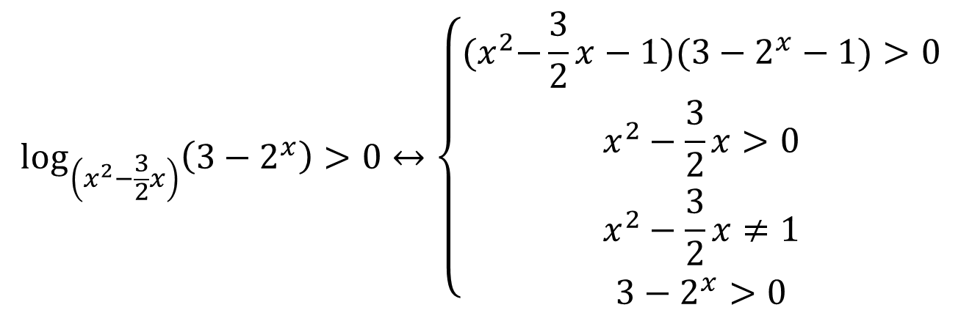
$$\log_{\left(x^{2}−\frac{3}{2}x\right)}\left(3−2^{x}\right)>0↔\left\{\begin{aligned}{(x}^{2}−\frac{3}{2}x−1)(3−2^{x}−1)>0 \\ x^{2}−\frac{3}{2}x>0 \\ x^{2}−\frac{3}{2}x≠1 \\ 3−2^{x}>0\end{aligned}\right.$$

