Slide 1
Grammar
The typical grammar and lexical tasks аs the preparation for the final exam.

Slide 2
Plan
1
Tenses of the Present
2
Tenses of the Future
3
Tenses of the Past
4
Sequence of tenses
5
Insertion

Slide 3
Present Simple регулярные, привычные действия, повторяющиеся действия, расписания – для будущего времени
Сигнификанты:
Always, often, usually, sometimes, rarely, regular, seldom, never(если не в значении совершённого действия, иначе Perfect), every day/week/month/year, on Mondays и др. дни недели.
Структура
+:___ + V_{o}(если мн.ч.)/V-s(если ед.ч.)
Окончание –es прибавляется если слово заканчивается -s, - ss, -sh, -ch, -x, -o (bus-busses)
-:___+ do(если мн.ч.)/does(если ед.ч.) + not + V_{o}
?: Do(если мн.ч.)/does(если ед.ч.) +___+ V_{o}
+:___+ TO BE (то есть am(I)/is(he, she, it, ед.ч) /are(you, we, they, мн.ч) + сущ/прилаг
-:___+ TO BE (то есть am(I)/is(he, she, it, ед.ч) /are(you, we, they, мн.ч) + not + сущ/прилаг
?: TO BE (то есть am(I)/is(he, she, it, ед.ч) /are(you, we, they, мн.ч) +___+ сущ/прилаг

Slide 4
Present Cont(длительное действие в настоящем, планы на ближайшее будущее, большой процент уверенности)
Сигнификанты:
now, at the moment, right now, still, currently, today, tonight
Структура
+:___ + am(I /is (he, she, it, ед.ч)/ are (you, we, they, мн.ч) + V-ing
-:___ + am(I /is (he, she, it, ед.ч)/ are (you, we, they, мн.ч) +not + V-ing
?: am(I /is (he, she, it, ед.ч)/ are (you, we, they, мн.ч) +___ + V-ing

Slide 5
Правила прибавления окончания -ing
окончание прибавляется глаголам при образовании формы present Participle(Ving) и герундия(Ving):
gо— коing ореn - ореning
непроизносимая буква е на конце оторасызается:
write - writing live - living
НО agree-agreeing dye - dyeing
если глагол оканчивается на одну согласную, перед которой стоит одна ударная гласная, то согласная удваивается:
run - running refer - referring
при прибавлении окончания -ing буквы -ie на конце глагола меняются на -y и прибавляется окончание -ing :
lie - lying die - dying tie - tying
ЕСЛИ глагол СТАТИЧНЫЙ, то Pr. Cont меняем на Pr. Simple!!!!

Slide 6
Present Perf.(что сделал?, действие прошло, но есть результат. НЕ продолжительное )
Сигнификанты:
ever, never, just, already, yet, since, recently, before, lately, so far, by now
Структура:
+:___+ have(мн.ч)/has(ед.ч) + V-3 форма (неправ гл) или ок
онч –ed
-:___+ have(мн.ч)/has(ед.ч) + not + V-3 форма (неправ гл) или оконч -ed
?:have(мн.ч)/has(ед.ч) +___+ V-3 форма (неправ гл) или оконч -ed

Slide 7
Present Perf Cont(что делали?, действие, которое началось в прошлом, длилось и имеет результат в настоящем или до сих пор длится)
Сигнификанты:
for, since, all day/month/week/night, lately, recently
Структура:
+:___+ have(мн.ч)/has(ед.ч) + been + V-ing
-:___+ have(мн.ч)/has(ед.ч) + not + been + V-ing
?:have(мн.ч)/has(ед.ч) +___+ been + V-ing
ПОМНИТЬ ПРО СТАТИЧНЫЕ ГЛАГОЛЫ! Если глагол статичный, то используем Present Perfect

Slide 8
Статичные глаголы
глаголы чувств (love, like, hate, dislike, enjoy)
глаголы предпочтения (want, need, prefer, fit, require, wish, hope, keep)
«умственные» глаголы (think, soppose, expect, belive, understand, realize, remember, forget, notice, recognize, mean, know, repeat, discuss, describe, explain, express, see)
глаголы восприятия (look, smell, seem, hear, taste, feel, sound, touch, see)
глаголы обладания (have(=possess), own, belong)
глаголыпревращения(be, seem, appear, look, turn, become)
глаголы измерения(contain, include, weight)
ИСКЛЮЧЕНИЯ!!! Статичные, которые можно испальзовать в Соntinucus в следующих значениях: think (обдумывать, размышлеть), tаste (пробовать на вкус), see (встречаться), look (когда фраз.глаг, наприм, look forwаrd, loок аfter, look for и тд), smell (нюхать), fеel (тpогать), have (принимать пищу: завтракать и тд, проводть встречу, вечеринку и тд), weigh (взвешиватгь)

Slide 9
Future Simple(действия в будущем, в которых вы не уверены, 50/50,предсказания, опасения, неуверенность, решение принятое в момент речи)
Сигнификанты:
now, at the moment, right now, still, currently, today, tonight
Структура:
+:___+ will + V_{o}
-:___+ will + not + V_{o}
?: Will +___+ V_{o}

Slide 10
Past Simple(одиночное ил повторяющеесся действие в прошлом, нет связи с настоящим, последовательные действия в прошлом)
Сигнификанты:
yesterday, ago, last year/month/week/Moday/November, in 1999, when he/she/I и тд wa 5
Структура:
+:___+ V-ed или 2 форма (неправ гл)
-:___+ did+ not + V_{o}
?: Did +___+ V_{o}
+:___+ TO BE (то есть was(ед.ч) /were(мн.ч) + сущ/прилаг
-:___+ TO BE (то есть was(ед.ч) /were(мн.ч) + not + сущ/прилаг
?: TO BE (то есть was(ед.ч) /were(мн.ч) +___+ сущ/прилаг

Slide 11
Правило согласования времён
Если в главном предложении глагол стоит в прошедшем времени, то в придаточном предложении глагол должен стоять в одном из прошедших времён (Past или Future-in-the-Past). При согласовании времён в косвенной речи необходимо осуществить сдвиг времён по следующим правилам:
Времена группы Present изменяются на соответствующие им времена Past
Времена группы Future изменяются на Future-in-the-Past (shall, will меняется на would)
Past Simple меняется на Past Perfect
Past Continuous меняется на Past Perfect Continuous
Past Perfect, Past Perfect Continuous – не изменяются
Can на Could, may на might, must на had to, should/would – не изменяются
Сдвиг времен не совершается, если не указана дата событий!

Slide 12
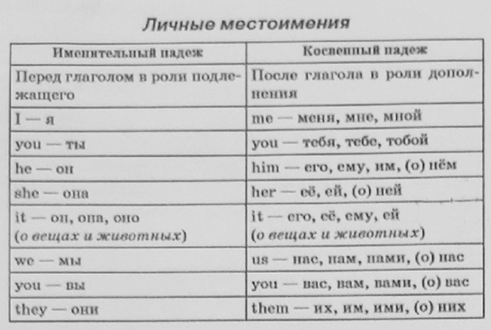
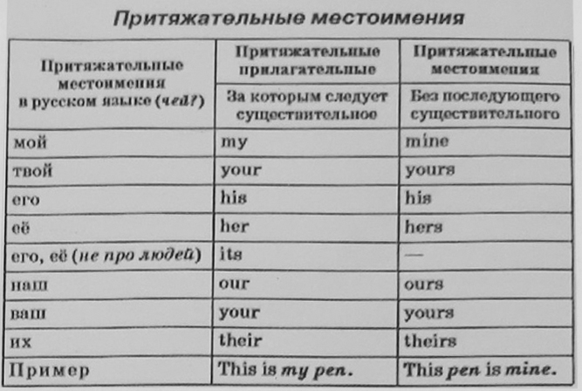
Если во вставке местоимение
Остается местоимение, просто другого типа.

Slide 13
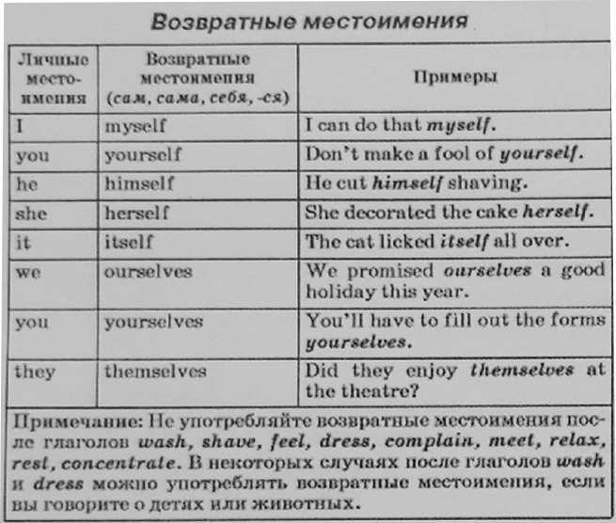
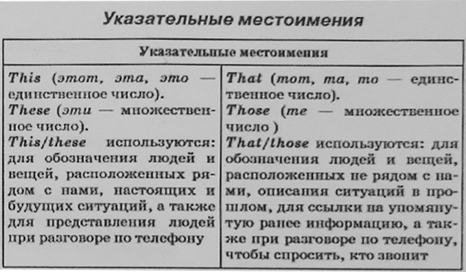

Slide 14
WORDLIST
Word Formation
analysis/analyse/analyst
artificial intelligence
automatic
backup copy
CD-ROM drive
computer program
crash
data/database
decrease/increase
development/develop/(under)developed
device/gadget
digital
discovery/discover/discoverer
download a file/aprogram/data
estimation/estimate
effect/(in)effective/affect
equip/equipment
findings
genetically modified food
germs
headphones
immune system
invention/invent/inventor/
inventive
24. investigation/investigate/
investigator
25. IT (Information Technology)
26. launch a rocket/a spacecraft
27. machine/machinery
28. mathematical formula
29. method/methodical
30. multiply/multiplication
31. nuclear power
32. research/research/rescarcher
33. satellite
34. science/scientist/scientific
35. Space exploration/flight
36. statistics/statistical data
37. survey
38. theory/theoretical

Slide 15
WORDLIST
Adjectives
сomplicated
out of order
wireless/wire
Useful Phrases
carry out/conduct/do research/an experiment
field of research/science
find evidence
keep a record of…
make a discovery
observe/make observations
patent an invention
predict/make predictions
specialize in a particular area of
research/science
surf/browse the Internet
undertake research to draw a conclusion

Slide 16
Thomas Alva Edison
27. Thomas Edison was an American inventor and ___.(BUSINESS)
28 . He developed many devices that ＿ influenced life around the world (GREAT) , including the phonograph, the motion picture camera, and the electric light bulb. Edison was the seventh child in his family. He went to school only for
29. three months but didn't ___ . His mother, who was his (SUCCESS)
30. closest friend, took him for home ___. For him his (educate)
mother was always the person who he couldn't disappoint. Edison
got his first patent at the age of 22 for the Yes/No vote recorder in the Washington Congress. Edison holds 1,093 US patents in his name, as well as many patents in the UK, France, and Germany.
31. Edison's ＿ inventions changed the world to the better (REMARK)
and did a lot for mass communication and, in particular,
telecommunications. These included a battery for an electric car,
32. electrical power, ___music and motion pictures. (RECORD)
Historians characterize Edison as a 'free thinker' who is still an icon in popular culture.
Check your answers
31- BUSINESSMAN
32- GREATLY
33 – SUCCEED
34 – EDUCATION
35 – REMARKABLE
36 - RECORDED

Slide 17
Задание 2. Прочитайте текст и напишите соответствующую форму каждого слова, данного под номерами В4-В11, в отведенное для этого место.
Check your answers
B4 – have enjoyed
B5 – seems
B6 – them
B7 – best
B8 – are
B9 – don`t have
B10 – has made/ makes
PLAYING
B4 Children ___ playing since the first humans walked on the Earth thousands of years ago. (ENJOY)
B5 Playing ___ to be an important way for children to learn how to work together. (SEEM)
B6 It also helps ___ find out how the world works. (THEY)
B7 Indeed, many scientists think that one of the ___ ways for children to learn a foreign language, for example, is to learn while playing games. (GOOD)
B8 Children play games and play with toys, but what ___ the differences between games and toys? (BE)
B9 Firstly, toys ___ rules or winners and losers. (NOT HAVE)
Most games do.
B10 Secondly, a toy is always a physical thing that someone ___ .(MAKE)
Some games, like Monopoly or football, need physical equipment but others, like word games, do not.

Slide 18
Задание 3. Преобразуйте слова, напечатанные заглавными буквами после номеров В12-В18 так, чтобы они грамматически и лексически соответствовали содержанию текста.
Have you heard of Ivan III Vasilevich?
B11 Ivan III Vasilevich, who is also known as Ivan the Great, is an ___ figure in Russian history. (INTEREST)
B12 Ivan had great ___ skills and became a popular leader, uniting many princes in the surrounding area. (POLITICS)
B13 Ivan the Great's greatest ___ was to free Russia from Mongol control. (ACHIEVE)
B14 In 1480, Ivan made an important ___ , telling the Mongols that he would no longer pay them the money they wanted. (ANNOUNCE)
B15 Both sides came together to fight, and it was unclear which side was more ___. (POWER)
B16 However, before the battle, the Mongols retreated because
of the ___ of Ivan's army and the battle never happened. (STRONG)
B17 The Mongols had, in effect ___ and from then on, Russia was a free country. (LOSE)
Check your answers
B11 – interesting
B12 – political
B13 – achievement
B14 – announcement
B15 – powerful
B16 – strength

Slide 19
Задание 4. Прочитайте текст и напишите соответствующую форму каждого слова, данного под номерами В4-811, в отведенное для этого место.
MUSIC
B4 Since civilisation began, music ___ an important part in people's lives. (PLAY)
B5 Even before musical instruments, people ___ and clapped their hands. (SING)
B6 Music brings ___ together. (WE)
B7 It is also very relaxing, although some music, such as pop music, can be a lot ___ than other kinds. (NOISY)
B8 There are probably hundreds of millions of people around the world ___ to music at this moment. (LISTEN)
B9 Being able to make music also ___ a lot of pleasure. (BRING)
B10 In the past, it ___ years and years of practice to learn how to play a musical instrument. (TAKE)
B11 Today, it's very easy for anyone who ___ a computer to make music. (HAVE)
Check your answers
B4 – has played
B5 – sang
B6 – us
B7 – noisier
B8 – listening
B9 – brings
B10 – took
B11 - has

Slide 20
B12 Travelling by air used to be quite ___ . (EXPENSE)
B13 In the past, going abroad on holiday cost a lot of money and it was something that only ___ people could afford. (WEALTH)
B14 However, many airlines are now offering tickets on their planes at ___ low prices. (SURPRISE)
B15 This means that many more people are able to travel to ___ destinations. (SUN)
B16 The airlines are able to make the tickets cheaper by not offering free food and drink or ___. (ENTERTAIN)
They also save money by not producing paper tickets.
B17 Low prices attract a lot of customers and the airlines have been very ___. (SUCCESS)
B18 As a result, holidays in exotic locations have increased in ___. (POPULAR)
Check your answers
B12 – expensive
B13 – weathy
B14 – surprisingly
B15 – sunny
B16 – entertainment
B17 - successful

Slide 21
Задание 6. Прочитайте текст и напишите соответствующую форму каждого слова, данного под номерами В4-В11, в отведенное для этого место.
JEANS
B4 These days, it seems that people all over the world __ jeans, but where did they come from? (WEAR)
B5 In the 1870s, an American tailor called Jacob Davis __ many customers who were farmers. (HAVE)
B6 Their clothes often needed repairs and Davis had the idea of __ strong trousers for them. (MAKE)
B7 He didn't have any money, so he __ to speak to a local merchant, Levi Strauss. (GO)
B8 Davis asked Levi Strauss to join __ in business, and blue jeans were born. (HE)
B9 They used denim for their jeans, which is __ than most other materials. (STRONG)
B10 The farmers __ such good trousers to work in before and jeans were an instant success. (NOT HAVE)
B11 Since then, jeans __ popular all over the world, particularly with young people. (BECOME)
Check your answers
B4 — wear/are wearing
B5 - had
B6 - making
B7 - went
B8 - him
B9 - stronger
B10 - had not had/hadn't had
B11 — have become

Slide 22
Задание 7. Прочитайте приведенный ниже текст. Преобразуйте слова, напечатанные заглавными буквами после номеров В12-В18 так, чтобы они грамматически и лексически соответствовали содержанию текста.
B12 Finland has many __ places to visit, including Saimaa, an area full of lakes and islands. (ATTRACT)
B13 Saimaa is an area of amazing __ beauty and around 350,000 people visit the area each summer. (NATURE)
B14 Many people spend their holiday canoeing along the __ (POLLUTE)
B15 lakes, enjoying the water, the forests, and the wide __ of local animal and plant life. (VARY)
B16 There are six towns around Saimaa, and the local people are very __. (FRIEND)
B17 However, you can spend days on the water without meeting a single person, so a good map is very __. (USE)
B18 The wonderful, unspoilt area of Saima __ does give you the chance to get away from it all. (REAL)
Check your answers
B12 - attractive
B13 - natural
B14 - unpolluted
B15 - variety
B16 - friendly
B17 - useful
B18 - really

Slide 23
Задание 8. Прочитайте текст и напишите соответствующую форму каждого слова, данного под номерами В4-В11, в отведенное для этого место.
Space Travel
People who travel into space are called 'astronauts' in English.
B4 If they come from Russian-speaking countries, they are also ___ as'cosmonauts! (KNOW)
B5 Many astronauts and cosmonauts ___ into space since space travel began, over forty years ago. (FLY)
B6 People have been to the Moon, and might ___ the planet Mars quite soon. (VISIT)
B7 However, before Yuri Gagarin made his historic flight in 1961, no human ___ outside the Earth's atmosphere. (TRAVEL)
B8 His flight was one of the ___ moments in the history of the world. (GREAT)
B9 Two years later, on 16th June 1963, Valentina Tereshkova, also from Russia, became the ___ woman to go into space. (ONE)
B10 She took just over 70 hours to go round the Earth 48 times, before ___ successfully back in Russia. (LAND)
B11 Valentina Tereshkova never ___ into space again, but she later received the United Nations Gold Medal of Peace. (GO)
Check your answers
B4– are also known
B5 – have flown
B6 - visit
B7 – had travelled
B8 - greatest
B9 - furst
B10 – landing
B11 - went

Slide 24
B12 If you want to try something ___ this summer, maybe you should consider camping. (DIFFER)
B13 A camping holiday can be an extremely ___ and educational experience, whether you're camping on. (ENJOY)
B14 your own, or with friends or ___. (RELATE)
B15 You don't have to go a long way from home as there are often good places to camp within a short ___ of most towns and cities. (DISTANT)
B16 Do make sure you have the right ___, though. (EQUIP)
B17 If there's a chance it might rain, be ___ to choose a tent that's waterproof. (CARE)
B18 Sleeping in a tent that's wet inside can be very ___ ! (COMFORT)
Check your answers
B12 – different
B13 - enjoyable
B14 – relatives/ relations
B15 – distance
B16 – equipment
B17 – careful
B18 - uncomfortable

