Slide 1
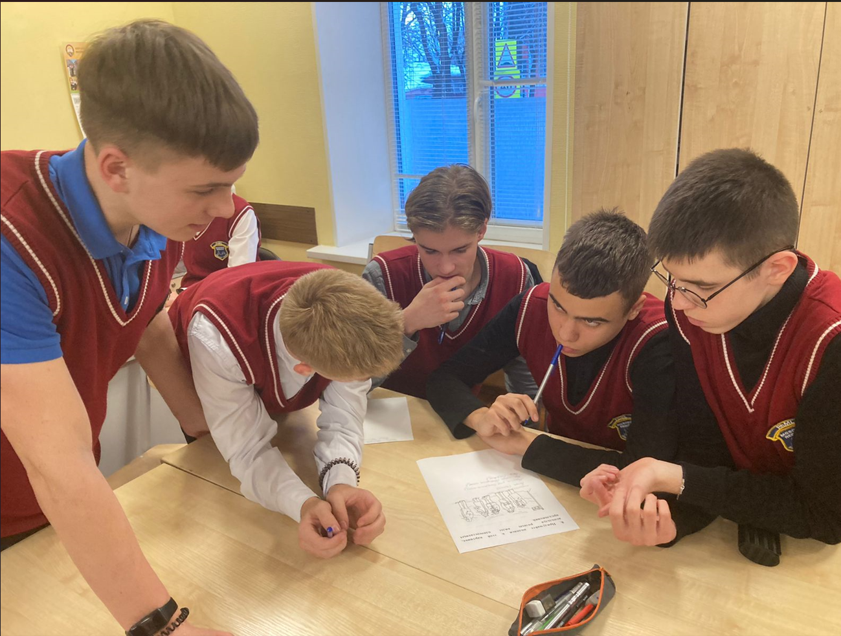
государственное бюджетное общеобразовательное учреждение Московской области
«Сергиево-Посадский физико-математический лицей»
«Коммуникативная методика преподавания Английского языка в рамках курса внеурочной деятельности «Полиглот».Лексико-грамматический практикум»
учитель английского языка высшей квалификационной категории
Маковская Ирина Валерьевна
учитель английского языка
Поликарпова Наталья Алексеевна

Slide 2




КОММУНИКАТИВНЫЙ ПОДХОД/Communicative Approach — это метод обучения, который подчеркивает важность реального общения во время изучения языка.
ЦЕЛЬ МЕТОДА - развитие коммуникативных компетенций
(обучение общению на языке) и развитие всех четырех языковых навыков в связке
(чтение, письмо, аудирование и говорение)

Slide 3

ЦЕЛИ, КОТОРЫЕ СТОЯТ ПЕРЕД ВСЕМИ УЧАСТНИКАМИ УЧЕБНОГО ПРОЦЕССА ГБОУ МО СП ФМЛ
,1. УЧАСТИЕ В ОЛИМПИАДНОМ ДВИЖЕНИИ
В 2022-2023 учебном году среди учеников Лицея было _____ призеров и победителей ВСоШ муниципального этапа и _____ призеров и победителей ВСоШ регионального этапа).
2. УЧАСТИЕ В ПРОЕКТНОЙ ДЕЯТЕЛЬНОСТИ, не только с лингвистическими темами , но и проектами в межпредметной области).
3. УСПЕШНАЯ СДАЧА ОГЭ и ЕГЭ (средний балл учеников нашего ицея составляет___)
4. СОЗДАНИЕ У УЧАЩИХСЯ ЛИЦЕЯ БАЗЫ ЗНАНИЙ, которая позволит им в дальнейшем комфортно получать образование в ведущих ВУЗах страны .

Slide 4
МАТЕРИАЛЫ, ИСПОЛЬЗУЕМЫЕ В РАБОТЕ
1. Учебные пособия Forward М.В.Вербицкая, Вентан Гранд)
2. Дополнительные материалы иностранных издательств Pearson, McMillan, Oxford и др.
3. Собственные авторские разработки, в том числе с использованием аутентичных материалов.

Slide 5
При выборе материалов мы учитываем:
1. Требования программы
2. Возрастные особенности наших учащихся
3. Интересы и учащихся и учителя (все участники процесса должны испытывать интерес к изучаемому материалу)
4. Уровень знаний учащихся

Slide 6
ПРАКТИКУМ на основе собственных разработок

Slide 7
Задание 1
Преобразуйте слова в скобках так, чтобы они грамматически и лексически соответствовали смыслу предложения
Thomas Edison was an American inventor and ___.(BUSINESS)
He developed many devices that ＿ influenced life around the world (GREAT), including the phonograph, the motion picture camera, and the electric light bulb. Edison was the seventh child in his family. He went to school only for
three months but didn't ___ . His mother, who was his (SUCCESS)
closest friend, took him for home ___. For him his (educate) mother was always the person who he couldn't disappoint. Edison got his first patent at the age of 22 for the Yes/No vote recorder in the Washington Congress. Edison holds 1,093 US patents in
his name, as well as many patents in the UK, France, and Germany.
Edison's ＿ inventions changed the world to the better (REMARK) and did a lot for mass communication and, in particular, telecommunications. These included a battery for an electric car,
electrical power, ___music and motion pictures. (RECORD)
Historians characterize Edison as a 'free thinker' who is still an icon in popular culture.

Slide 8
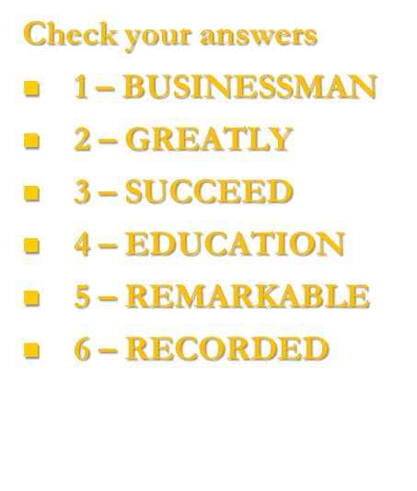
Задание 1
Thomas Edison was an American inventor and ___.(BUSINESS)
He developed many devices that ＿ influenced life around the world (GREAT), including the phonograph, the motion picture camera, and the electric light bulb. Edison was the seventh child in his family. He went to school only for
three months but didn't ___ . His mother, who was his (SUCCESS)
closest friend, took him for home ___. For him his (educate) mother was always the person who he couldn't disappoint. Edison got his first patent at the age of 22 for the Yes/No vote recorder in the Washington Congress. Edison holds 1,093 US patents in
his name, as well as many patents in the UK, France, and Germany.
Edison's ＿ inventions changed the world to the better (REMARK) and did a lot for mass communication and, in particular, telecommunications. These included a battery for an electric car,
electrical power, ___music and motion pictures. (RECORD)
Historians characterize Edison as a 'free thinker' who is still an icon in popular culture.

Slide 9
Задание 2. Прочитайте текст и напишите соответствующую форму каждого слова, в отведенное для этого место.
Children ___ playing since the first humans walked on the Earth thousands of years ago. (ENJOY)
Playing ___ to be an important way for children to learn how to work together. (SEEM)
It also helps ___ find out how the world works. (THEY)
Indeed, many scientists think that one of the ___ ways for children to learn a foreign language, for example, is to learn while playing games. (GOOD)
Children play games and play with toys, but what ___ the differences between games and toys? (BE)
Firstly, toys ___ rules or winners and losers. (NOT HAVE) Most games do.
Secondly, a toy is always a physical thing that someone ___ .(MAKE) Some games, like Monopoly or football, need physical equipment but others, like word games, do not.

Slide 10
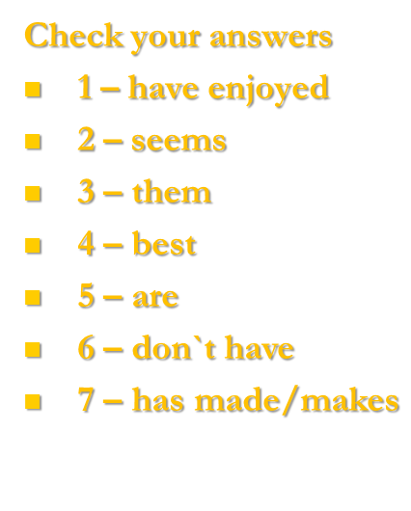
Задание 2. Прочитайте текст и напишите соответствующую форму каждого слова, в отведенное для этого место.
Children ___ playing since the first humans walked on the Earth thousands of years ago. (ENJOY)
Playing ___ to be an important way for children to learn how to work together. (SEEM)
It also helps ___ find out how the world works. (THEY)
Indeed, many scientists think that one of the ___ ways for children to learn a foreign language, for example, is to learn while playing games. (GOOD)
Children play games and play with toys, but what ___ the differences between games and toys? (BE)
Firstly, toys ___ rules or winners and losers. (NOT HAVE) Most games do.
Secondly, a toy is always a physical thing that someone ___ .(MAKE) Some games, like Monopoly or football, need physical equipment but others, like word games, do not.

Slide 11
Задание 3. Преобразуйте слова, чтобы они грамматически и лексически соответствовали содержанию текста.
Have you heard of Ivan III Vasilevich?
Ivan III Vasilevich, who is also known as Ivan the Great, is an
___ figure in Russian history. (INTEREST)
Ivan had great ___ skills and became a popular leader, uniting many princes in the surrounding area. (POLITICS)
Ivan the Great's greatest ___ was to free Russia from Mongol control. (ACHIEVE)
In 1480, Ivan made an important ___ , telling the Mongols that he would no longer pay them the money they wanted.
(ANNOUNCE)
Both sides came together to fight, and it was unclear which side was more ___. (POWER)
However, before the battle, the Mongols retreated because of the ___ of Ivan's army and the battle never happened.
(STRONG)
The Mongols had, in effect ___ and from then on, Russia was a free country. (LOSE)

Slide 12
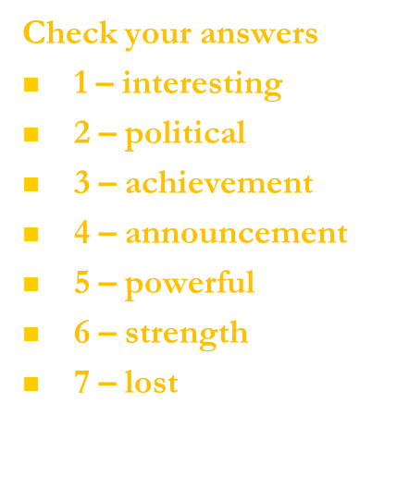
Задание 3. Преобразуйте слова, чтобы они грамматически и лексически соответствовали содержанию текста.
Have you heard of Ivan III Vasilevich?
Ivan III Vasilevich, who is also known as Ivan the Great, is an
___ figure in Russian history. (INTEREST)
Ivan had great ___ skills and became a popular leader, uniting many princes in the surrounding area. (POLITICS)
Ivan the Great's greatest ___ was to free Russia from Mongol control. (ACHIEVE)
In 1480, Ivan made an important ___ , telling the Mongols that he would no longer pay them the money they wanted.
(ANNOUNCE)
Both sides came together to fight, and it was unclear which side was more ___. (POWER)
However, before the battle, the Mongols retreated because of the ___ of Ivan's army and the battle never happened.
(STRONG)
The Mongols had, in effect ___ and from then on, Russia was a free country. (LOSE)

Slide 13
Задание 4. Прочитайте текст и напишите соответствующую форму каждого слова, в отведенное для этого место.
Since civilisation began, music ___ an important part in people's lives. (PLAY)
Even before musical instruments, people ___ and clapped their hands. (SING)
Music brings ___ together. (WE)
It is also very relaxing, although some music, such as pop music, can be a lot ___ than other kinds. (NOISY)
There are probably hundreds of millions of people around the world ___ to music at this moment. (LISTEN)
Being able to make music also ___ a lot of pleasure. (BRING)
In the past, it ___ years and years of practice to learn how to play a musical instrument. (TAKE)
Today, it's very easy for anyone who ___ a computer to make music. (HAVE)

Slide 14
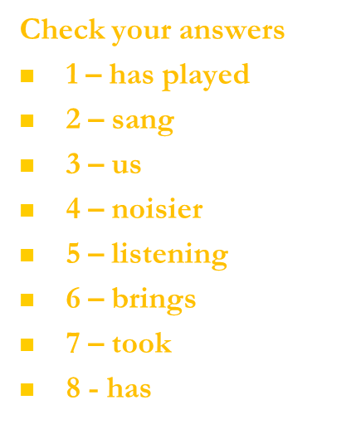
Задание 4. Прочитайте текст и напишите соответствующую форму каждого слова, в отведенное для этого место.
Since civilisation began, music ___ an important part in people's lives. (PLAY)
Even before musical instruments, people ___ and clapped their hands. (SING)
Music brings ___ together. (WE)
It is also very relaxing, although some music, such as pop music, can be a lot ___ than other kinds. (NOISY)
There are probably hundreds of millions of people around the world ___ to music at this moment. (LISTEN)
Being able to make music also ___ a lot of pleasure. (BRING)
In the past, it ___ years and years of practice to learn how to play a musical instrument. (TAKE)
Today, it's very easy for anyone who ___ a computer to make music. (HAVE)

Slide 15
Задание 5. Прочитайте текст и напишите соответствующую форму каждого слова, в отведенное для этого место.
Travelling by air used to be quite ___ . (EXPENSE)
In the past, going abroad on holiday cost a lot of money and it was something that only ___ people could afford. (WEALTH)
However, many airlines are now offering tickets on their planes at ___ low prices. (SURPRISE)
This means that many more people are able to travel to ___ destinations. (SUN)
The airlines are able to make the tickets cheaper by not offering free food and drink or ___. (ENTERTAIN) They also save money by not producing paper tickets.
Low prices attract a lot of customers and the airlines have been very ___. (SUCCESS)
As a result, holidays in exotic locations have increased in ___. (POPULAR)

Slide 16
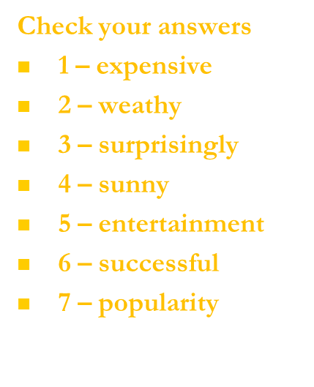
Задание 5. Прочитайте текст и напишите соответствующую форму каждого слова, в отведенное для этого место.
Travelling by air used to be quite ___ . (EXPENSE)
In the past, going abroad on holiday cost a lot of money and it was something that only ___ people could afford. (WEALTH)
However, many airlines are now offering tickets on their planes at ___ low prices. (SURPRISE)
This means that many more people are able to travel to ___ destinations. (SUN)
The airlines are able to make the tickets cheaper by not offering free food and drink or ___. (ENTERTAIN) They also save money by not producing paper tickets.
Low prices attract a lot of customers and the airlines have been very ___. (SUCCESS)
As a result, holidays in exotic locations have increased in ___. (POPULAR)

Slide 17
Задание 6. Прочитайте текст и напишите соответствующую форму каждого слова, в отведенное для этого место.
These days, it seems that people all over the world __ jeans, but where did they come from? (WEAR)
In the 1870s, an American tailor called Jacob Davis __ many customers who were farmers. (HAVE)
Their clothes often needed repairs and Davis had the idea of
__ strong trousers for them. (MAKE)
He didn't have any money, so he __ to speak to a local merchant, Levi Strauss. (GO)
Davis asked Levi Strauss to join __ in business, and blue jeans were born. (HE)
They used denim for their jeans, which is __ than most other materials. (STRONG)
The farmers __ such good trousers to work in before and jeans were an instant success. (NOT HAVE)
Since then, jeans __ popular all over the world, particularly with young people. (BECOME)

Slide 18
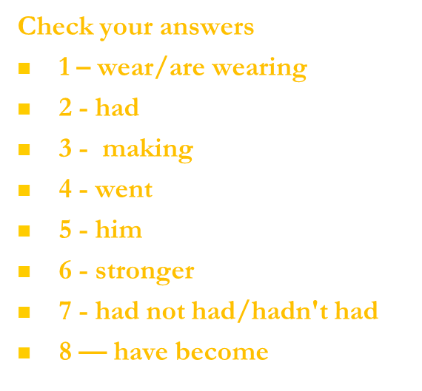
Задание 6. Прочитайте текст и напишите соответствующую форму каждого слова, в отведенное для этого место.
These days, it seems that people all over the world __ jeans, but where did they come from? (WEAR)
In the 1870s, an American tailor called Jacob Davis __ many customers who were farmers. (HAVE)
Their clothes often needed repairs and Davis had the idea of
__ strong trousers for them. (MAKE)
He didn't have any money, so he __ to speak to a local merchant, Levi Strauss. (GO)
Davis asked Levi Strauss to join __ in business, and blue jeans were born. (HE)
They used denim for their jeans, which is __ than most other materials. (STRONG)
The farmers __ such good trousers to work in before and jeans were an instant success. (NOT HAVE)
Since then, jeans __ popular all over the world, particularly with young people. (BECOME)

Slide 19
Задание 7. Прочитайте приведенный ниже текст. Преобразуйте слова, чтобы они грамматически и лексически соответствовали содержанию текста.
Finland has many __ places to visit, including Saimaa, an area full of lakes and islands. (ATTRACT)
Saimaa is an area of amazing __ beauty and around 350,000 people visit the area each summer. (NATURE)
Many people spend their holiday canoeing along the __ (POLLUTE)
lakes, enjoying the water, the forests, and the wide __ of local animal and plant life. (VARY)
There are six towns around Saimaa, and the local people are very __. (FRIEND)
However, you can spend days on the water without meeting a single person, so a good map is very __. (USE)
The wonderful, unspoilt area of Saima __ does give you the chance to get away from it all. (REAL)

Slide 20
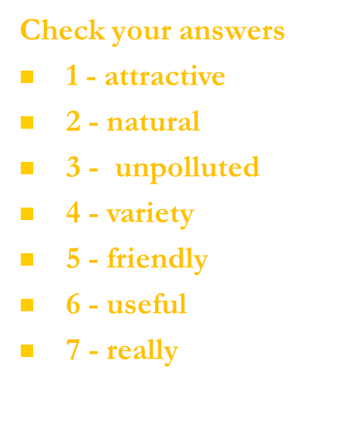
Задание 7. Прочитайте приведенный ниже текст. Преобразуйте слова, чтобы они грамматически и лексически соответствовали содержанию текста.
Finland has many __ places to visit, including Saimaa, an area full of lakes and islands. (ATTRACT)
Saimaa is an area of amazing __ beauty and around 350,000 people visit the area each summer. (NATURE)
Many people spend their holiday canoeing along the __ (POLLUTE)
lakes, enjoying the water, the forests, and the wide __ of local animal and plant life. (VARY)
There are six towns around Saimaa, and the local people are very __. (FRIEND)
However, you can spend days on the water without meeting a single person, so a good map is very __. (USE)
The wonderful, unspoilt area of Saima __ does give you the chance to get away from it all. (REAL)

Slide 21
Задание 8. Прочитайте текст и напишите соответствующую форму каждого слова, в отведенное для этого место.
People who travel into space are called 'astronauts' in English.
If they come from Russian-speaking countries, they are also ___ as'cosmonauts! (KNOW)
Many astronauts and cosmonauts ___ into space since space travel began, over forty years ago. (FLY)
People have been to the Moon, and might ___ the planet Mars quite soon. (VISIT)
However, before Yuri Gagarin made his historic flight in 1961, no human ___ outside the Earth's atmosphere. (TRAVEL)
His flight was one of the ___ moments in the history of the world. (GREAT)
Two years later, on 16th June 1963, Valentina Tereshkova, also from Russia, became the ___ woman to go into space. (ONE)
She took just over 70 hours to go round the Earth 48 times, before
___ successfully back in Russia. (LAND)
Valentina Tereshkova never ___ into space again, but she later received the United Nations Gold Medal of Peace. (GO)

Slide 22
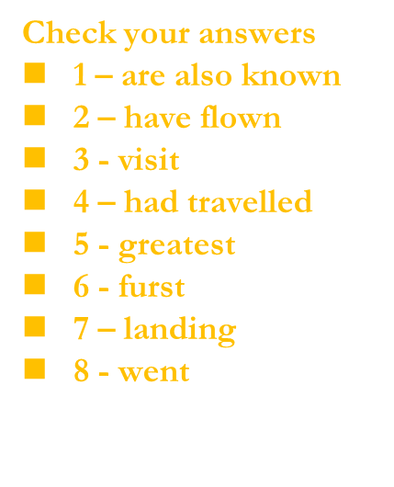
Задание 8. Прочитайте текст и напишите соответствующую форму каждого слова, в отведенное для этого место.
People who travel into space are called 'astronauts' in English.
If they come from Russian-speaking countries, they are also ___ as'cosmonauts! (KNOW)
Many astronauts and cosmonauts ___ into space since space travel began, over forty years ago. (FLY)
People have been to the Moon, and might ___ the planet Mars quite soon. (VISIT)
However, before Yuri Gagarin made his historic flight in 1961, no human ___ outside the Earth's atmosphere. (TRAVEL)
His flight was one of the ___ moments in the history of the world. (GREAT)
Two years later, on 16th June 1963, Valentina Tereshkova, also from Russia, became the ___ woman to go into space. (ONE)
She took just over 70 hours to go round the Earth 48 times, before
___ successfully back in Russia. (LAND)
Valentina Tereshkova never ___ into space again, but she later received the United Nations Gold Medal of Peace. (GO)

Slide 23
Задание 9.
If you want to try something ___ this summer, maybe you should consider camping. (DIFFER)
A camping holiday can be an extremely ___ and educational experience, whether you're camping on. (ENJOY)
your own, or with friends or ___. (RELATE)
You don't have to go a long way from home as there are often good places to camp within a short ___ of most towns and cities. (DISTANT)
Do make sure you have the right ___, though. (EQUIP)
If there's a chance it might rain, be ___ to choose a tent that's waterproof. (CARE)
Sleeping in a tent that's wet inside can be very ___ ! (COMFORT)

Slide 24
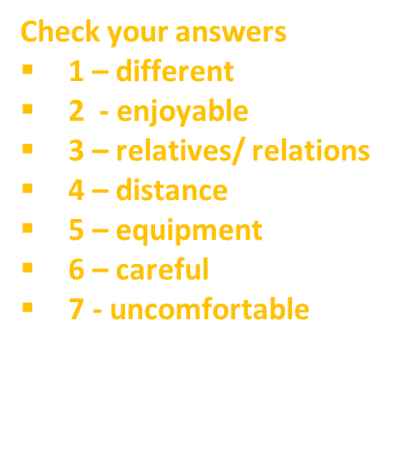
Задание 9.
If you want to try something ___ this summer, maybe you should consider camping. (DIFFER)
A camping holiday can be an extremely ___ and educational experience, whether you're camping on. (ENJOY)
your own, or with friends or ___. (RELATE)
You don't have to go a long way from home as there are often good places to camp within a short ___ of most towns and cities. (DISTANT)
Do make sure you have the right ___, though. (EQUIP)
If there's a chance it might rain, be ___ to choose a tent that's waterproof. (CARE)
Sleeping in a tent that's wet inside can be very ___ ! (COMFORT)

Slide 25
Задание 10.
If you want to try something ___ this summer, maybe you should consider camping. (DIFFER)
A camping holiday can be an extremely ___ and educational experience, whether you're camping on. (ENJOY)
your own, or with friends or ___. (RELATE)
You don't have to go a long way from home as there are often good places to camp within a short ___ of most towns and cities. (DISTANT)
Do make sure you have the right ___, though. (EQUIP)
If there's a chance it might rain, be ___ to choose a tent that's waterproof. (CARE)
Sleeping in a tent that's wet inside can be very ___ ! (COMFORT)

Slide 26
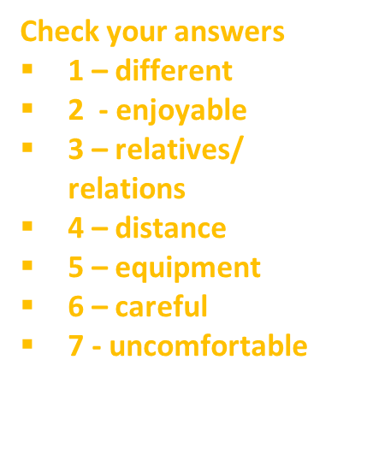
Задание 10.
If you want to try something ___ this summer, maybe you should consider camping. (DIFFER)
A camping holiday can be an extremely ___ and educational experience, whether you're camping on. (ENJOY)
your own, or with friends or ___. (RELATE)
You don't have to go a long way from home as there are often good places to camp within a short ___ of most towns and cities. (DISTANT)
Do make sure you have the right ___, though. (EQUIP)
If there's a chance it might rain, be ___ to choose a tent that's waterproof. (CARE)
Sleeping in a tent that's wet inside can be very ___ ! (COMFORT)

Slide 27
ПРАКТИКУМ
с использованием аутентичных материалов

Slide 28
Задание на закрепление грамматического материала – 2е условное наклонение
Послушайте песню и заполните пропуски
My name's 'Blurryface' and I
Care what you think.
My name's 'Blurryface' and I
Care what you think.
Wish we ______ back time,
To the good ol’ days,
When our mama sang us to sleep.
But now we’re stressed out.
Wish we _________ back time,
To the good ol’ days,
When our mama sang us to sleep.
But now we’re stressed out.

Slide 29
My name's 'Blurryface' and I
Care what you think.
My name's 'Blurryface' and I
Care what you think.
Wish we could turn back time,
To the good ol’ days,
When our mama sang us to sleep.
But now we’re stressed out.
Wish we could turn back time,
To the good ol’ days,
When our mama sang us to sleep.
But now we’re stressed out.
I wish I found some better sounds
No one’s ever heard,
I wish I had a better voice
That sang some better words,
I wish I found some chords
In an order that is new,
I wish I didn't have to rhyme
Every time I sang.
I was told when I get older
All my fears would shrink,
But now I’m insecure
And I care what people think.

Slide 30
Задание на практику лексики на тему ЕДА.
Посмотрите видео и заполните пропуски.

Slide 32
НАШИ УЧЕНИКИ – НАША ГОРДОСТЬ

Slide 33
УЧАСТНИКИ РЕГИОНАЛЬНОГО ЭТАПА ВсОШ
ПО АНГЛИЙСКОМУ ЯЗЫКУ
ЕГОР МАЙОРОВ
И
ГЕОРГИЙ АГЗАМОВ

Slide 34
УЧАСТНИКИ ПРОГРАММЫ «ВЗЛЕТ»
ПО АНГЛИЙСКОМУ ЯЗЫКУ
ЕГОР МАЙОРОВ
И
ВЕРОНИКА ДАВЫДКИНА

Slide 35
УЧАСТНИКИ ПРОГРАММЫ «ВЗЛЕТ»
ПО АНГЛИЙСКОМУ ЯЗЫКУ
ЕГОР МАЙОРОВ
И
ВЕРОНИКА ДАВЫДКИНА

Slide 36
АВТОРЫ МЕЖПРЕДМЕТНОГО ИССЛЕДОВАТЕЛЬСКОГО ПРОЕКТА
«ЯЗЫК ПРОГРАММИРОВАНИЯ АДА В СОВРЕМЕННОМ МИРЕ»
(ИНФОРМАТИКА + АНГЛИЙСКИЙ ЯЗЫК)
ЕЛЕНА СИМАЧКОВА
И
АЛИНА НОВИЦКАЯ

Slide 37
АВТОРЫ МЕЖПРЕДМЕТНОГО ИССЛЕДОВАТЕЛЬСКОГО ПРОЕКТА
«ЭКСПЕРИМЕНТЫ ПО ИЗМЕРЕНИЮ ПЛОТНОСТИ ЗЕМЛИ ГЕНРИ КАВЕНДИША»
(ФИЗИКА+АНГЛИЙСКИЙ ЯЗЫК)
ВИОЛЕТТА КОНДРАЦОВА
И
ЕКАТЕРИНА НИКОЛАЕВА

Slide 38
УЧАСТНИКИ МЕЖДУНАРОДНОГО ПРОЕКТА
Students Experience Exchange programme
ВАРВАРА ГЛОЗМАН
И
АЛЕКСЕЙ ПАЛАМАРЧУК

Slide 39

Заключение
Коммуникативная методика, вобрала в себя множество полезных элементов от других подходов.
В настоящее время коммуникативная методика - одна из самых эффективных и современных методик изучения языка.

